Slide 1
CSIP for Limited Generation Profiles Resolution E-5230 Requirements
Gordon Lum

Slide 2
E-5230 – CSIP & IEEE 2030.5 Support
Do CSIP-Certified devices already support E-5230 requirements?
Short Answer: YES
Longer Answer: Review the contents of this slide-deck to verify this assertion.
What are the basic requirements of E-5230 as it relates to IEEE 2030.5?
Support for Phase 3 Function 3 – Limit Maximum Active Power Mode
Map to IEEE 2030.5 DER Control: opModMaxLimW
Support for Phase 3 Function 8 – Scheduling Power Values and Mode
288-hour format: 12 months with 24 events per month
Use inherent Event scheduling mechanism of IEEE 2030.5

Slide 3
CSIP Requirements and Testing
What are the relevant CSIP requirements related to E-5230
DER must support the opModMaxLimW function
opModMaxLimW specifies real power output limit as a percentage of the Nameplate value. 100% = No curtailment.
DER must be able to store at least 24 Events
DER must comply with all IEEE 2030.5 Event rules
What is tested during CSIP certification testing?
Confirmation that DER can process opModMaxLimW event
Communications verification using QualityLogic testing and SunSpec review
Verification of DER storage of 7 Events (not 24)
Verification of IEEE 2030.5 basic event processing (scheduling)
Functional testing using UL1741SA -SA18

Slide 4
CSIP Testing
Is the existing CSIP certification testing sufficient for E-5230?
Short Answer: YES. CSIP testing already verified communications, basic scheduling, and functionality. The remaining question is whether the 288-hour format is supported.
Can CSIP certified DERs comply with the 288-hour requirement of E-5230?
CSIP requires the storage of at least 24 events, but CSIP testing only verifies storage of at least 7.
The amount of event storage does not directly impact support for the 288-hour requirement.
A DER with no storage capabilities can meet the 288-hour requirement by periodically polling the event schedule on the Server.
CSIP uses a default polling rate of every 10 minutes, so it should be able to execute the 288-hour schedule if it maintains communications with the Server
Stored events allow the DER to continue operating when there is a loss of communications with the server – the DER has local copies of upcoming events and can act accordingly.
Assuming a storage number of 7, and assuming the scheduled value changes every day, a CSIP certified device can ride through a communications outage of 1 week.

Slide 5
Scheduling – Overview of IEEE 2030.5 Events
How is scheduling done in IEEE 2030.5
The basic building block of a DER scheduling is a DER Control Event
DER Control Event contains the following:
DER function (e.g., opModMaxLimW)
DER function value (e.g., 75%)
Start time in UTC (seconds since 1/1/1970)
Duration in seconds
UTC (seconds since 1/1/1970) is used. There is no concept of a calendar.
Advantages: No need to worry about Time Zones, Daylight Savings Time, Leap Year, Leap Seconds, etc.
Disadvantages: Not human friendly. No concept of daily, weekly, monthly, yearly.
A schedule is a list of DER Control Events stored in a DER Program as a DER Control List
DER’s obtain the schedule by downloading (HTTP GET) a DER Program’s DER Control List
At most 1 event for the DER Control is active at any given time.
Overlapping controls cause the superseding event rules to come into play
If no event is currently active, the Default DER Control value is applied if it is defined.
If no event is active and no Default DER Control was defined, the behavior of the DER is undefined.
Once an event is created, it can not be modified – only cancelled.

Slide 6
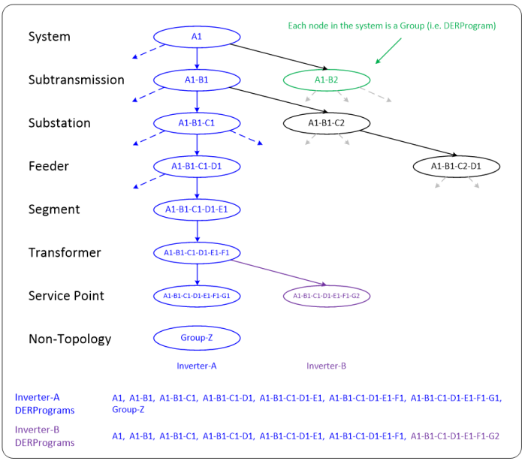
Scheduling – Overview of IEEE 2030.5 DER Programs
How is a DER Program used in CSIP
CSIP uses DER Programs to represent different nodes in the electrical topology.
The System node (DER Program) represents the entire topology.
A Transformer node represents all DERs on that transformer.
A Service Point node represents all DERs on that service point.
Utility servers will insert a DER Control Event into the appropriate node (DER Program) depending on which set of DERs they want the event to apply to.
Note: A server can also create a DER Program that represents an arbitrary group, not just a topological group.

Slide 7
Scheduling – Basic Operations
How Does Scheduling Work
The Utility Server periodically creates a series of DER Control Events
The Server adds these Events to the appropriate DER Program’s DER Control List
When each Event completes, the Server removes it from the DER Control List
The DER Client periodically (every 10 minutes) polls the Server
The DER checks the DER Control List of all the DER Programs it belongs to
If a new event is found, the DER schedules it for activation and sends the appropriate responses (Received, Started, Completed, Cancelled, Superseded).
When the event completes, the DER removes it from its internal event list.

Slide 8
Scheduling – Options
How should E-5230 schedules be implemented?
Scheduling is under the total control of the Utility server.
There are many (maybe too many) ways to do this.
Factors that influence how scheduling is done include:
Scheduling complexity – simple scheduling algorithms is generally better
Resource efficiency – using less is generally better
Handling changes – the simpler the better
Operational convenience – some scheduling methods may be more conducive to existing operations

Slide 9
Scheduling – Option 1
Option 1 – Schedule a large number of future Events
Example, in December, create all 288 Events for the next year.
Advantages:
Simple to do
Need to do scheduling once per year
Disadvantages:
Uses a lot of resources to process all 288 Events
Physical storage costs
Transmission costs
If changes need to be made mid-year, many pre-scheduled events need to be cancelled or supersede causing an even greater number of resources to be consumed.

Slide 10
Scheduling – Option 2
Option 2 – Schedule a smaller number of future events
Example:
Schedule 1 month ahead
Schedule 1 week ahead
Schedule 1 day ahead
Advantages:
Uses fewer resources
Easier to modify as the number of events to cancel or supersede is less
Disadvantages:
Must perform scheduling more often

Slide 11
Scheduling – Option 3
Option 2 – Schedule on Change with Indefinite Events
Example
Create a single Event with infinite duration. This event will continue until cancelled or superseded.
When it’s time to change the value
Create a new (future) Event with the new value and infinite duration. This Event will supersede the current Event. Suggest the new Event be created 1 day before it is scheduled to be active.
After the new Event has started, the Server can cancel the old event and remove it.
Create a new event with new value and infinite duration
Advantages:
Minimal use of resources. Only need to create new events if you want to change the value.
Simple ad hoc scheduling.
Disadvantages:
Creating a new event that overlaps the current event triggers the IEEE 2030.5 superseding event rules that are sometimes non-intuitive. You need to verify that edge-case behavior is acceptable.

Slide 12
Scheduling – Option 4
Option 2 – Use Default DER Control instead of DER Control Events
Example
Similar to Option 3, but using the Default DER Control instead of an infinite duration Event
Server creates a Default DER Control with the current value of opModMaxLimW
When the Server wants to change the value, update the Default DER Control with the new value.
Advantages:
Only need to modify the Default DER Control when a change is needed.
IEEE 2030.5 Event rules do not apply, so it’s simpler.
Disadvantages:
The CSIP polling rate is every 10 minutes, so it may take 10 minutes for the DER to realize the change in the Default DER Control.
Requires reliable connection to the Server. If there is a communications outage, the DER will not be able to detect the change in the Default DER Control.
Unlike DER Control Events, the Server does not get any Responses from the DER for changes to the Default DER Control status.

Slide 13
Additional Scheduling Notes
Scheduling Notes and Recommendations
Try not to cancel events without cause
Once an event is created, the contents cannot be modified – it can only be cancelled.
For a period of time, both the cancelled event and the new event exists in the DER Control List, so this causes an increased use of resources for both the Server and the Client.
Try not to overlap events
When events overlap, the IEEE 2030.5 superseding rules come into play. Some of the rules are non-intuitive, so make sure you understand all the consequences of creating an overlapping event.
Try not to have gaps between events
Define a Default DER Control to be activated when there is no active Event.
If there is no active DER Control Event and no defined Default DER Control Event, the DER behavior is undefined. The DER may disable the control. It may use an internally defined default value. It may remember an earlier state and try to restore that state. You probably don’t want to depend on undefined behavior.

