Slide 1
DER LGP Profiles
Standard Schedule File Format
Brian Seal, EPRI
January 30, 2023

Slide 2
Standard DER Schedule Motivation
“Customer submits a Limited Generation Profile with their application, which may include generation up to the 80 percent Integration Capacity Analysis-SG value published by the utility and submitted in a standard 288-hour format;…”
-CPUC D.20-09-03
ICA
90% of ICA
Integration Capacity
Time/Date

Slide 3

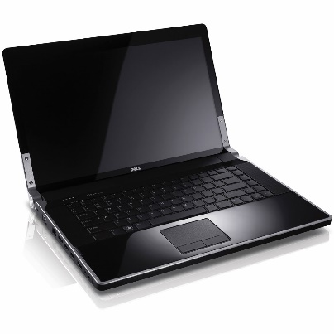
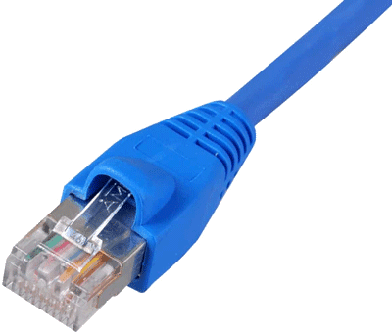


Potential Uses of the Standard File Format
Developer-Provided
ICA – Capacity Schedule
During Interconnection
Submit Schedule with Application
PCS in Inverter
Developer Install Tool
or
Approval
Standalone PCS / Plant Controller
Utility
Proof/Evidence
Local PCS or DER Interface (out of scope in PCS testing)
Vendor-Provided
At the NRTL
Provide Test Schedules
PCS in Inverter
Verified Schedule Execution
Vendor Test Tool
or
Standalone PCS / Plant Controller
NRTL Test System
Vendor Protocols

Slide 4
Schedule File Format
Initiated by the UL PCS CRD working group
Guided by requirements from CA, HI, MA, and the PCS WG
Technical approach: keep with a CSV file format for consistency with the IEEE 1547-2018 standard results reporting and settings files
  Human or machine readable, no special software needed
Keep it simple
High value in a uniform national format (saving time/cost, reducing error)… but with regional specifications on usage

Slide 5
Overview of the Standard Schedule File Format
Metadata (optional)
Comments (optional)
Schedule (mandatory)

Slide 6
12-Entry Monthly Schedule Example

Slide 7
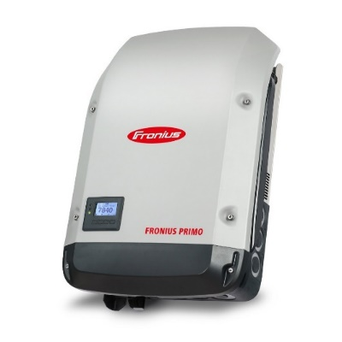
Verifying DER Schedules
ICA Available Information
IEEE 1547-2018 Standard Interface
Proposed Schedule
Approved Schedule
Developer Tools
Other Utility Enterprise Applications
Vendor Protocols
Schedule Applied in DER
Approved Schedule
Schedule “Compare” Tool

