Slide 1
Smart Inverter Working Group (SIWG)
Pronounced “SIWoG” not “SWIG”
October 27, 2022
1:00-2:30 PM PST
Please keep yourself muted when not speaking and do NOT put the call on hold. If muted by the leader, press *6 to unmute.

Slide 2
Agenda
Topic | Time | Presenter
Intro and Agenda | 1:00 – 5 minutes | CPUC
Limited Generation Profiles per Resolution E-5211 Workshop 1 | 1:05 – 10 minutes | CPUC
Integration Capacity Analysis: Transparency into Modeling | 1:15 – 45 minutes | PG&E, SCE, SDG&E
Q&A | 2:00 – 20 minutes | All
Wrap Up and Next Steps | 2:20 – 10 minutes | CPUC
Please keep yourself muted when not speaking and do NOT put the call on hold. If muted by the leader, press *6 to unmute.

Slide 3
Announcements: Workshops per Resolution E-5211 (Issued 10/10/22)
Discussions to resolve Limited Generation Profiles (LGP) (per OP 16 and 15 of D.20-09-035)
  Workshop 1: Date: November 7, 2022; Time: 9:00 a.m. – 5:00 p.m. Forum: WebEx
    Workshop will be announced to SIWG and R.17-07-007;
    Invites and materials will be sent to LGP Workshop Distribution List (see 10/8/22 SIWG solicitation e-mail for forms to be added to the LGP Distribution List); thereafter materials will be available on the CPUC Rule 21 Web Page
  Workshop 2: Tentative November 29, 2022; Details TBD
  Workshop 3: TBD (if needed)
  Tier 3 Advice Letters: Due within 90 days, after issuance of the Resolution – January 8, 2023
SIWG Preparation Meetings:
  Oct. 27, 2022— (1) LGP Workshop #1 Agenda, (2) Integration Capacity Analysis Presentation (ICA): Transparency into ICA Modeling to understand the workings and limitations of ICA, and how smart inverter functions can help the ICA value to avoid lowering export power; Discussion may be carried into November 7th Workshop or November 10th SIWG.
  Nov. 10, 2022— (1) Continuation of 10/27 SIWG (tentative); (2) Mapping/Comparison of ICA to Rule 21 Study Screens
  Dec. 8, 2022— TBD
  Dec. 22, 2022 —TBD

Slide 4
Announcements: LGP Workshop1
Main Agenda Items:
  Whether/How Reductions to A Customer’s LGP Are Determined Needed
    This will cover the circumstances that under which reduction of export power will occur. The goal is to outline elements of the circumstances that will prompt a reduction of export power and specific reasons for doing so; and establish criteria to establish a new Limited Generation Profile.
  How Reductions to A Customer’s LGP Are Processed
    This will cover the process to determine an updated LGP. The goal is to establish a process to implement the new LPG once criteria is established including a scheduling format.
Please keep yourself muted when not speaking and do NOT put the call on hold. If muted by the leader, press *6 to unmute.

Slide 5
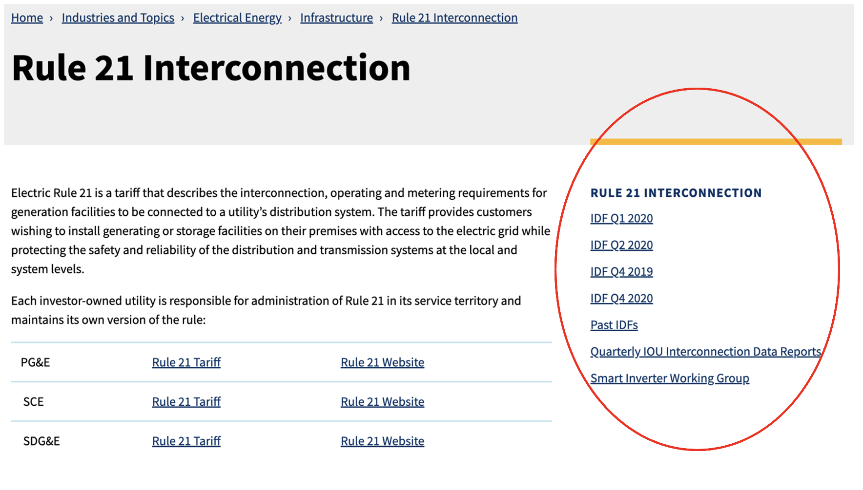
Rule 21 Web Page
NEW LINK FOR LIMITED GENERATION PROFILES TO BE INCLUDED IN THIS SECTION. SECTION TO BE RENAMED: “CURRENT ACTIVITIES”
Please keep yourself muted when not speaking and do NOT put the call on hold. If muted by the leader, press *6 to unmute.

Slide 6
Background: OP 16 and 15 Requirements of D.20-09-035
OP 16 required the IOUs to provide “the specifics of whether and how reductions to a customer’s Limited Generation Profile are determined. The Advice Letter shall include a description of how the Utilities will implement Ordering Paragraph 15.”
OP 15 adopted the IOUs’ counter proposal for Issue 9 (Limited Generation Profile) with modifications and stated “Retroactive alterations to generation profiles shall not reduce generation to below a pre-defined static level, i.e., the lowest Integrated Capacity Analysis – Static Grid typical profile value identified at the time of the Interconnection Application. As part of the proposal, Utilities shall: i) allow customers to utilize a smart inverter’s ability to increase its output on a monthly basis; and ii) use a10 percent buffer, which shall be revisited.”
Please keep yourself muted when not speaking and do NOT put the call on hold. If muted by the leader, press *6 to unmute.

Slide 7
Questions?

Slide 8

For additional information on the SIWG contact:
Jose.Aliaga-Caro@cpuc.ca.gov

