Slide 1
Limited Generation Profiles Workshop #1 per Resolution E-5211
November 7, 2022
9:00 AM -- 3:30 PM PST
Please keep yourself muted when not speaking and do NOT put the call on hold. If muted by the leader, press *6 to unmute.

Slide 2
Workshop Logistics
Safety reminder. Make a note of your surroundings and exit routes. Reach out if you need help, either during the call or to an attendee
This meeting is being recorded
Workshop recording and materials will be posted in the CPUC Rule 21 Limited Generation Profiles Web Page shown on slide 5 of this presentation.
If you were forwarded the invite and did not receive it directly from Energy Division, and would like to be added to the workshop distribution list, please email Mary Rottman at Mary.Rottman@cpuc.ca.gov
Workshop participants are encouraged to ask questions during the presentation; a dedicated Q&A time slot has also been scheduled after each presentation
Please keep yourself muted when not speaking and do NOT put the call on hold. To speak, unmute yourself from the button at the lower part of your screen
If calling in by phone, use the mute button on your handset and unmute yourself to speak. If muted by the host, press *6 to unmute. To raise your hand press *3
Questions?
Please keep yourself muted when not speaking and do NOT put the call on hold. If muted by the leader, press *6 to unmute.

Slide 3
Agenda
Please keep yourself muted when not speaking and do NOT put the call on hold. If muted by the leader, press *6 to unmute.

Slide 4
Workshop Goals
Arrive at a consensus proposal on “the specifics of whether and how reductions to a customer’s Limited Generation Profile are determined," the process to implement a reduction of export power (OP 15), and address that “Retroactive alterations to generation profiles shall not reduce generation to below a pre-defined static level, i.e., the lowest Integrated Capacity Analysis – Static Grid typical profile value identified at the time of the Interconnection Application.” (OP 16)
Agenda topics have been drafted so as to lead to a meaningful discussion to understand current practices and how they would apply to Limited Generation Profiles (LGP) customers or if modifications are needed for the LGP option
The IOU presentation contain the IOUs' proposals but should not be taken as final solutions
Stakeholders are welcome to, based on the information gathered, propose a different process
Rule 21 is an end user of the ICA and changes to the ICA are out of scope--Discussions on the ICA should not center on changes to the ICA
Please keep yourself muted when not speaking and do NOT put the call on hold. If muted by the leader, press *6 to unmute. ​

Slide 5
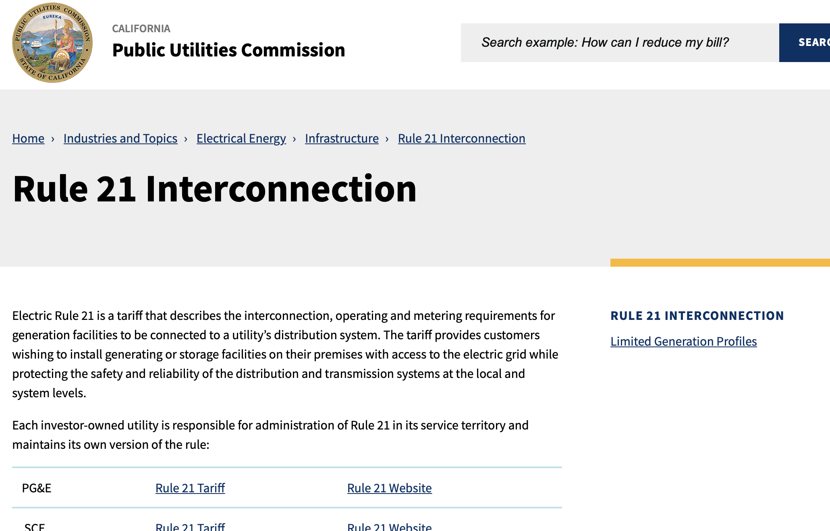
Rule 21 Web Page: Limited Generation Profiles
Main Page: https://www.cpuc.ca.gov/rule21/
Workshop recording and materials will be posted in the Rule 21 Limited Generation Profiles Web Page
Please keep yourself muted when not speaking and do NOT put the call on hold. If muted by the leader, press *6 to unmute.

Slide 6
Announcements
Draft Resolution E-5230 was mailed out for comments on Oct. 28, 2022.
  Comments are due Nov. 17, 2022; Scheduled for December 1, 2022 Commission Meeting
  Concerns PG&E AL 6141-E, SCE AL 4455-E, SDG&E AL 3721-E (submitted on March 30, 2021) per OP 15 of D.20-09-035
  If adopted by the Commission, it would approve in part, modify, and seek clarity on protested topics and topics identified by Energy Division and order the IOUs to participate in a minimum of two half-day workshops to confer with stakeholders on topics identified in this Resolution as needing discussion which include:
    To discuss the Quarterly Reporting proposal in greater detail and ensure the proposal does not impose undue burden to the customer or ratepayers.
    To justify the use of gross nameplate rating (instead of limited export value) for the Rule 21 screens.
    Clarification on the IOUs’ proposals for the Limited Generation Profile process: Customer Preparation Phase, Interconnection Request Phase, Technical Evaluation Phase, Interconnection Agreement/Permission to Operate Phase, and Operation Performance Phase.
    Implementation of Limited Generation Profiles (LGP) Using Current Smart Inverter Functions—The Large IOUs are directed to discuss the possibility of and challenges with implementing the LGP-option before standards are approved.
Please keep yourself muted when not speaking and do NOT put the call on hold. If muted by the leader, press *6 to unmute.

Slide 7
Background: OP 16 and 15 Requirements of D.20-09-035
OP 16 required the IOUs to provide “the specifics of whether and how reductions to a customer’s Limited Generation Profile are determined. The Advice Letter shall include a description of how the Utilities will implement Ordering Paragraph 15.”
OP 15 adopted the IOUs’ counter proposal for Issue 9 (Limited Generation Profile) with modifications and stated “Retroactive alterations to generation profiles shall not reduce generation to below a pre-defined static level, i.e., the lowest Integrated Capacity Analysis – Static Grid typical profile value identified at the time of the Interconnection Application. As part of the proposal, Utilities shall: i) allow customers to utilize a smart inverter’s ability to increase its output on a monthly basis; and ii) use a10 percent buffer, which shall be revisited.”
Please keep yourself muted when not speaking and do NOT put the call on hold. If muted by the leader, press *6 to unmute.

Slide 8
Next Steps
Discuss:
  Requirements for Workshop #2, scheduled for Nov. 29, 2022
    AL language
    Outstanding Topics or Clarifications
    Non-IOU Party Proposals
    Other?

Slide 9
Questions?

Slide 10


