Slide 1
Integration Capacity Analysis Limited Generation Profile October 27, 2022

Slide 2
Agenda
Generation ICA Overview
Generation ICA Modeling Methodology
LGP and ICA Buffer
Q&A

Slide 3
Regulatory Background – DRP (High DER)
CPUC Decision (D.) 17-09-023:
Integration Capacity Analysis (ICA) to address the primary interconnection use case of aiding Distributed Energy Resource (DER) developers in identifying interconnection locations where projects are less likely to trigger distribution upgrades and providing ICA data that can be relied upon to streamline Rule 21 interconnection.
The Distribution Resources Plan (DRP) proceeding was responsible for the methodological development of ICA and the publication of ICA data and maps.
Currently, ICA is ruled under High DER Proceeding.
IOUs update their ICA portals and data on a monthly basis.

Slide 4
ICA Criteria & Methodology
Steady State Voltage
Amount of generation which can be installed without causing primary voltage to result in a deviation from Rule 2 limits at the customer premise. Rule 2 customer service voltage limits are 5% of the nominal voltage (i.e. 114-126 V on a 120 V base).
No additional buffer values are built into the ICA prior to publication.
Thermal
Cable, conductor, and equipment ratings establish the thermal limits. In cases where the ICA results exceed circuit or substation transformer bank ratings, the ICA results will be reduced to the circuit or substation transformer bank rating.
Voltage Variation
Amount of generation which can be installed without causing unacceptable variation in voltage levels.
Protection
Checks for minimum fault level
Reverse Power Flow
Checks for reverse power flow through substation transformer and operational flexibility
Uniform Generation ICA
The uniform Gen ICA results represent the maximum uniform generation at the point of interconnection without violating the thermal, voltage variation, protection, steady state voltage criteria, and reverse power flow.

Slide 5
ICA Iterative Methodology

Slide 6
Rule 21 Use Cases with Gen ICA
Rule 21 Screen M Use Case
All Interconnecting DERs to be evaluated against the ICA values as a part of Screen M
Rule 21 Limited Generation Profile Use Case
Allow Interconnecting DER to Be Evaluated and Operate Under Limited Generation Profile. This proposal would Modify interconnection procedures to allow a DER customer to submit a “Limited Generation Profile” as part of their Interconnection Application, require that customer to enable generation profile limiting functionality, and allow utility limited future opportunity to alter that profile if circumstances warrant
Limited Generation Profile (LGP) would be applied when requested by the interconnecting DER customer

Slide 7
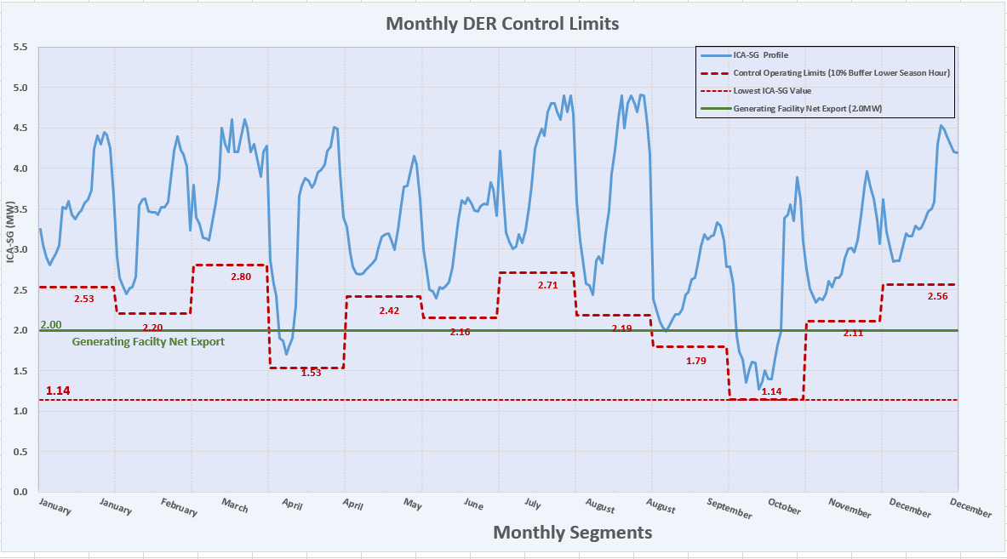
Limited Generation Profile
As shown on the graph, the GF Net export is 2.0 MW which is higher than 1.14MW (lowest ICA-SG value in the ICA-SG profile). Customer can choose to request using LGP to operate within the lower limits of April, September and October.
Month | Limits
Jan | 2.00
Feb | 2.00
Mar | 2.00
Apr | 1.53
May | 2.00
Jun | 2.00
Jul | 2.00
Aug | 2.00
Sept | 1.79
Oct | 1.14
Nov | 2.00
Dec | 2.00
January February March April May June July August September October November December
Monthly Schedule

Slide 8
 | PGE | SCE | SDGE
Loading Conditions | 90th and 10th percentile loading based on circuit-level shapes and AMI load | Circuit-level: Generate 576 profile from one year of 8,760 historical data AMI-level: 90th and 10th percentile loading | 90th and 10th percentile loading based on circuit-level shapes and SCADA/AMI load
Voltage Conditions | Bank-level loading is used to develop settings that output 122 V at minimum loading and 126 V at maximum loading. At each hour, the base-case loading level is used to specify what the output voltage is for that hour for circuit-level analysis. | Circuit Voltage Profiles are developed by obtaining the maximum voltage reading at the substation transformer bank coincident with the 576 circuit load profile. The voltage profiles are then capped to 0.96 to 1.04 of the nominal voltage to clear any preexisting conditions which may prevent the ICA from being performed. | A flat 120V voltage profile is assumed. Substation voltage regulators are allowed to float based on local settings
Existing Distributed Generation Assumptions | Interconnected distributed generation is modeled as it materializes in metered net load. Queued generation is modeled in Gen ICA | Existing PV assumed to be generating based on typical PV profiles Other technologies assumed to be generating at 100% of nameplate Queued generation is modeled in Gen ICA | Existing PV assumed to be generating based on typical PV profiles Other technologies assume 100% of nameplate.
Equipment Assumptions | Regulators and switched capacitors allowed to float based on local settings in base case, locked in ICA | Regulators and switched capacitors allowed to float based on settings | Regulators and switched capacitors allowed to float based on local settings
Thermal Limitations | Limits are consistent with planning process, and cap at circuit and bank capability limits post-process Accounts for other limitations such as underground cable temperature and protective devices in the field (83% of the phase overcurrent value) | Limits are consistent with planning process, and cap at circuit capability limits post-process, where applicable Does not currently account for underground cable temperature limitations. | Analysis incorporates both equipment limitations and planning limits for circuits and banks Does not account for other limitations such as underground cable temperature and protective devices in the field
Voltage Variation Limitations | 3 V (2.5%) limit on 120 V base | 3.6 V (3%) limit on 120 V base | 3.6 V (3%) limit on 120 V base
Steady-state Primary Voltage Limitations | Acceptable voltage: 118.0-126.5 V | Acceptable voltage: 114-126 V Considering increasing lower bound to 118 V to account for secondary voltage drop | Acceptable voltage: 116-126 V

Slide 9
Q&A and Discussions

