Slide 1

Overview of Rules 2, 15, 16 and 21

Slide 2
Meeting Objectives
Provide education as precursor to discussing the scope item in OIR
Capture key policy questions that may be considered in the OIR (not discuss solutions, but gain understanding of current gaps and challenges)
Others?

Slide 3
Learning Objectives
Understand when Rule 2, Rule 15/16, come into play in Rule 21 interconnection
Understand the allocation of mitigation costs between the different Rules
Understand if and how the different allocation affects the interconnection timeline to PTO and final cost calculation for OTCC and ITCC
Understand the non-tariff policies of each utility to communicate timeline and cost expectations and manage to those expectations
Others?

Slide 4

Basic Definition: Line Extension (Rule 15)
Property Line
Existing permanent distribution line
Service
panel
Distribution Line Extension
Service
panel
DISTRIBUTION LINE EXTENSION: (Rule 15)
New distribution facilities of PG&E that is a continuation of, or branch from, the nearest available existing permanent Distribution Line (including any facility rearrangements and relocations necessary to accommodate the extension) to the point of connection of the last service. PG&E’s Line Extension includes transmission underbuilds and converting an existing single phase line to three-phase in order to furnish three-phase service to an Applicant, but excludes transformers, meters and services..

Slide 5
Basic Definition: Service Extension (Rule 16)
overhead
Service Extension
Service Extension
Service
panel
Service
panel
underground
SERVICE EXTENSIONS: (from Rule 16)
The overhead and underground primary or secondary facilities (including but not limited to PG&E-owned Service Facilities and Applicant owned service facilities) extending from the point of connection at the Distribution Line to the Service Delivery Point. When an underground Service Extension is supplied from a PG&E-designated overhead pole, the beginning point of connection to PG&E's Distribution Line shall be where the Service Extension is connected to PG&E's overhead Distribution Line conductors.

Slide 6

Allowances for Rule 15/16
PG&E will complete a Distribution Line / Service Extension without charge provided:
PG&E’s total estimated installed costs do not exceed the allowances from permanent, bonafide loads to be served
Allowances are based on an average for Residential, but are calculated on a site-by-site basis for Non-residential customers.
Rule 15.C.3/Rule 16.E RESIDENTIAL ALLOWANCES
The allowance for Distribution Line Extensions, Service Extensions, or a combination thereof, for Permanent Residential Service is $2,154 per meter or residential dwelling unit.
Rule 15.C.4/Rule 16.E NON-RESIDENTIAL ALLOWANCES
The allowance for Distribution Line Extensions, Service Extensions, or a combination thereof, for Permanent Non-Residential Service is determined by PG&E using the formula in Section C.2.
D07-07-019 -The monthly COO charge applicable to special facilities would be equal to one twelfth of the COS factor if the special facilities are utility financed and the utility pays for replacement over the same period.. The Cost-of-Ownership comes from the November 6, 2017 Advice Letter 3905-G/5176-E - In compliance with provisions of Gas Rule 2 and Electric Rule 2, PG&E submits this advice letter to revise its gas and electric distribution cost of ownership rates which apply to non-standard Special Facilities installed to serve specific customers. The cost of ownership rates are also used in determining, the residential gas and electric line extension allowances in Gas Rule 15.H.2 and Electric Rule 15.I.2.

Slide 7
Special Facilities: Definition
Special Facility
I. SPECIAL FACILITIES
1. PG&E normally installs only those standard facilities which it deems are necessary to provide regular service in accordance with the tariff schedules. Where the applicant requests PG&E to install special facilities and PG&E agrees to make such an installation, the additional costs thereof shall be borne by the applicant, including such continuing ownership costs as may be applicable.
2. Special facilities are:
facilities requested by an applicant which are in addition to or in substitution for standard facilities which PG&E would normally provide for delivery of service at one point, through one meter, at one voltage class under its tariff schedules, or
a pro rata portion of the facilities requested by an applicant, allocated for the sole use of such applicant, which would not normally be allocated for such sole use. Unless otherwise provided by PG&E's filed tariff schedules, special facilities will be installed, owned and maintained or allocated by PG&E as an accommodation to the applicant only if acceptable for operation by PG&E and the reliability of service to PG&E's other customers is not impaired.

Slide 8
Special Facilities: Definition
Special Facilities (Rule 2)
Unless otherwise provided by PG&E's filed tariff schedules, special facilities will be installed, owned and maintained or allocated by PG&E as an accommodation to the applicant only if acceptable for operation by PG&E and the reliability of service to PG&E's other customers is not impaired.
Special Facilities can be assessed for:
Generation Requests
Demand Response
Electric Vehicles
Unique Customer Requests (i.e. dual service feeds)
Special Program (e.g. Storage)

Slide 9
Examples of Standard and Special Facilities for
Load Only (Non-Generation) Applications
Standard Facility | Special (or Added) Facility
Service from a shared distribution line | Dedicated, “express”, feeder from PG&E substation
Single Service to a Premises | Second Service to a Premises (above what is normally provided)
Primary Service from a Single Circuit | Back-up Primary Line from the same or a Separate Circuit

Slide 10
Examples of Special Facilities for
Generation Applications
Net Generator Output Meters (as required by applicable tariffs – e.g. NEMMT, NEMV, etc.)
Telemetry (may be required under Rule 21)
Direct Transfer Trip* (as determined by PG&E system protection)
Transformer Upgrade** (incremental cost above loading requirement due to generator)
* Two components of Direct Transfer Trip. Connection at PG&E’s substation at transmission voltage is a network upgrade
** Net Energy Metering 1 MW or less has different treatment

Slide 11
Special Facilities: Components
For PG&E, if customer requests, and PG&E agrees to the installation of non-standard or Special facilities, the customer pays the additional cost of these facilities.
The costs are based on the:
  Cost difference between standard and special/added facilities.
  And also includes:
  Cost of ownership to cover PG&E’s cost to own and maintain the special facilities.
  ITCC* per IRS Notices
*Income Tax Component of Contribution

Slide 12
Generation (Rule 21/WDAT) Related Upgrades and Facilities
Generation Projects can require upgrades and additional facilities to accommodate interconnection:
These are defined as:
  Interconnection Facilities:
  sole use facilities that are required for a single generation interconnection
    Examples include an Net Generation Output Meter, dedicated transformer, etc.
  Distribution Upgrades:
  modifications to the Distribution System (<60KV) required for a single or cluster of generator interconnections
    Examples include reconductoring, a new substation bank, shared transformer, etc.
  Network Upgrades:
  modifications to the Transmission System (>60KV) required for a single or cluster of generator interconnections
    Examples include transmission protection equipment, transmission substation modification
These upgrades are identified and included in the:
- Interconnection Study Report
- Generator Interconnection Agreement (GIA) or
- Special Facilities Agreement (SFA), typically for Interconnection Facilities

Slide 13
Engineering, Procurement, and Construction of Facilities/Upgrades
For PG&E, when projects require Interconnection Facilities or Distribution/Network Upgrades to interconnect, these projects follow a process to Engineer/Design, Procure, and Construct (EPC) the required work
The EPC process applies to various types of work:
  PG&E internally generated projects
  customer building and renovation projects (e.g. New Business)
  emergency projects
  electric grid interconnection projects
This EPC process has sometimes been referred to as the Service Planning or Rule 15/16 process. This is because historically, majority of customer driven work performed on PG&E’s distribution system was for projects under Rule 15/16
More recently, this work relates to upgrades for Distributed Energy Resources interconnections

Slide 14
Possible Scenarios
1. New Generation Only (“Greenfield”) with No Load
(e.g., NEMA, NEMV, NEMVMASH, RES-BCT, Wholesale)
– no Rule 15/16 contract
  Rule 21 Special Facility Contract
Existing permanent distribution line
Special Facility Interconnection Facilities

Slide 15
Possible Scenarios
2. New Load Service with New Generation
  Rule 15/16 contract and allowance eligibility reviewed for new load
  Rule 21 contracts cover facilities to accommodate generator interconnection (special facilities applies to all facilities required above Rule 16 service requirements)
Existing permanent distribution line

Slide 16
Possible Scenarios
3. Existing Load Service, Adding New Generation
  Service Panel Upgrade:
    Rule 15/16 contract and allowance eligibility review
    Rule 21 special facilities beyond what is required to serve Load
  No Service Panel Upgrade: Rule 21 only –upgrades/additional facilities for generator as a special facility.
Existing permanent distribution line
PV
AG Pumps

Slide 17
Possible Scenarios
4. Recent New Load Service, Adding New Generation Only
  Rule 21 contracts
  May be subject to deficiency bill per Rule 15/16 contract due to modified load demand

Slide 18
Questions
Questions?

Slide 19
Key policy questions
Should load and generation be considered together in how we calculate load
  Planning question – look at this proliferation of solar differently in secondary (lots of solar in neighborhood) and primary distribution (one shopping center)?
  Should we be reviewing interconnection at a larger system level rather than individual services
  (IOUs have obligation to serve load – in code)
  Cost responsibility assignment - ensure distribution allocation is accurate
  should there be an option for the customer to release the utility from the liability of obligation to serve. (note microgrid use case, large resource)
NEM paired storage does not have a charging restriction and therefore max charging load is considered in studies the load side; should NEM paired storage follow the same rules as Rule 21 non-export
Cost responsibility pertaining to design changes over time – special facilities vs. standard facilities for upgrades; Is the service conductor a special facility if it is undersized as compared to service panel – IOUs do not determine service panel size – rather size to the load evaluation and size economically – especially when undergrounding)
Should there be consideration for old, unsafe service panel upgrades next to gas meters while the National Electrical Code requires it.

Slide 20
Key policy questions (cont)
Should there be / what should the metric be for
  1) assigning a project to an estimator/service planning
  2) receiving an estimate
  3) comparing the SIS timelines and cost (does the cost envelop option already handle this?) to actual and for:
  what types of upgrades (interconnection facility level, distribution level, and network level)
  for different parts of the process (design, estimating, construction)
  should it also contain a customer timeframe (there are already some of these in place), other factors (environmental permits, outage coordination with ISO)
  4) How long voltage rise calculations should take?

Slide 21
Learning Objectives
Understand when Rule 2, Rule 15/16, come into play in Rule 21 interconnection
Understand the allocation of mitigation costs between the different Rules
Understand if and how the different allocation affects the interconnection timeline to PTO and final cost calculation for OTCC and ITCC
Understand the non-tariff policies of each utility to communicate timeline ad cost expectations and manage to those expectations
Others?

Slide 22
Appendix

Slide 23
Rule 15 Overview
Rule 15 covers the extension of Distribution Lines
(less than 60kV) necessary to furnish Permanent electric service to Applicants
Rule 15 covers the following:
General
Installation Responsibilities
Distribution Line Extension Allowances
Contributions or Advances By Applicants
Refunds
Applicant Design Option
Applicant Installation Options
Overhead Distribution Line Extensions for Subdivisions or Developments
Special Conditions
Definitions

Slide 24
Rule 16 Overview
Rule 16 covers both
PG&E Service Facilities that extend from PG&E's Distribution Line facilities to the Service Delivery Point, and
service related equipment required of Applicant on Applicant's Premises to receive electric service
Rule 16 covers the following:
General
Metering Facilities
Service Extensions
Responsibilities for New Service Extensions (Customer and PG&E responsibilities)
Allowances and Payments by Applicant
Existing Service Facilities
  Service Reinforcement
  Service Relocation or Rearrangement
  Impaired Access and Clearances
  Overhead to Underground Service Conversions – (Rule 20 connection)
  Damaged Facilities
  Subdivision of Premises
Exceptional Cases
Definitions

Slide 25
Major Rule 15 Tariff Provisions: Cost Allocations
Line Extension Cost Allocation
  Costs estimates are site specific
  Refundable portions of the line extension cost is reduced by Applicant’s Allowances (load portion)
  Applicant’s load (future revenues) and Refundable payments support the Line Extension
    Allowances
    Customer is granted a Customer/Meter Charge and Maximum Demand allowance
    Most all cases result in an allowance far less than the estimated cost to serve
    Allowances are not granted to off set any Special Facility

Slide 26
Major Rule 15 Tariff Provisions: Additional Info
Project-specific costs/charges covered in Rule 15.D.2
  Structured on cost causation principles
  Doesn’t fully account for customer distributed generation
  Nearby Distribution interferes with pricing for Transmission line costs
Special Facilities
  “Facilities in an addition to or in substitution for standard facilities which PG&E would normally provide for”
  Special Facilities are provided as an accommodation to the applicant only if acceptable for operation by PG&E and the reliability of service to PG&E’s other customers is not impaired
  Additional reliability feature such as redundant feeds, non-preferred service options where it is less economical to provide than PG&E identified least-cost option

Slide 27
Rule 2 Overview
Rule 2 is primarily on requirements for service connections with load. Rule 2 includes Special Facilities and ANSI requirements that relate to load and generation
Rule 2 covers the following:
General
Service Delivery Voltages - includes description of distribution & transmission, single to three phase, and primary vs. secondary)
Voltage and Frequency Control - American National Standard Institute (ANSI) requirements +/- 5% of nominal voltage
General Load Limitations - Max Demand Load Permitted for various service types
Protective Devices – Applicant to protect its facility
Interference with Service - Customer’s obligation to maintain its electrical service to avoid interruption e.g. motor start current limits
Power Factor - must provide equipment to not impact Power Factor
Connected Load Ratings - description of how load is calculated
Special Facilities (see next slide)
Welder Service – description of service for welding

Slide 28
Major Rule 15/16 Tariff Provisions:
Customer Payments
Payment Options for Rules 15, 16
Ten-year Agreement
  Refundable costs subject to refund for ten years
  Transmission customer may get refund each year for first three years based on demand increases or other Customers being served from same line extension in accordance with Rule 15.
  Cost of ownership charges deducted annually from un-refunded balance
  Customer may get deficiency bill if actual revenue doesn’t meet the initial allowance granted
50% Non-refundable Discount Option
  Customer pays ½ of the refundable costs above an allowance granted for Rule 15 extensions and Rule 16 Non-Residential extensions
  Customer not eligible for refunds
  Customer may get deficiency bill if actual revenue doesn’t meet the initial allowance granted

Slide 29
Electric Forms related to Generation & Rules 2/15/16
Approved Rates for Cost of Ownership & ITCC
Appendix A (Form 79-702), is utilizes specific Rates to determine costs. These are:
  Cost of Ownership (COO) Rate (from Rule 2, Section I):
  0.53% for Customer Financed and
  1.22% for Company Financed.
  PG&E Advice Filing 3905-G approved by the CPUC 1/29/17 made effective 1/1/2018. Advice Filing 3905-G
  2. Income Tax Component of Contribution (ITCC) Rate:
  The Current Rate is 24%.
  PG&E Advice Filing 3669-G/4766-E approved 2/11/16 and made effective 1/1/2015. Link
  3. Present Worth Factor (PWF) Rate:
  Current Rate is 14.2%.
  PG&E Advice Filing 3896-G/5162-E approved 12/22/17 and made effective 1/1/18. Link

Slide 30
Electric Forms related to Generation & Rule 2/15/16
When Special Facilities are required for Generation, a Special Facility Agreement and its accompanying Appendix are executed with the Generation Customer:
Form 79-280 - Agreement For Installation or Allocation of Special Facilities for Parallel Operation of NonUtility-Owned Generation And/Or Electrical Standby Service (Electric Rules 2 and 21) Link
Form 79-702 - Agreement For Installation or Allocation of Special Facilities for Parallel Operation of NonUtility-Owned Generation And/Or Electrical Standby Service – Appendix A – Detail of Special Facilities Charges Link

Slide 31
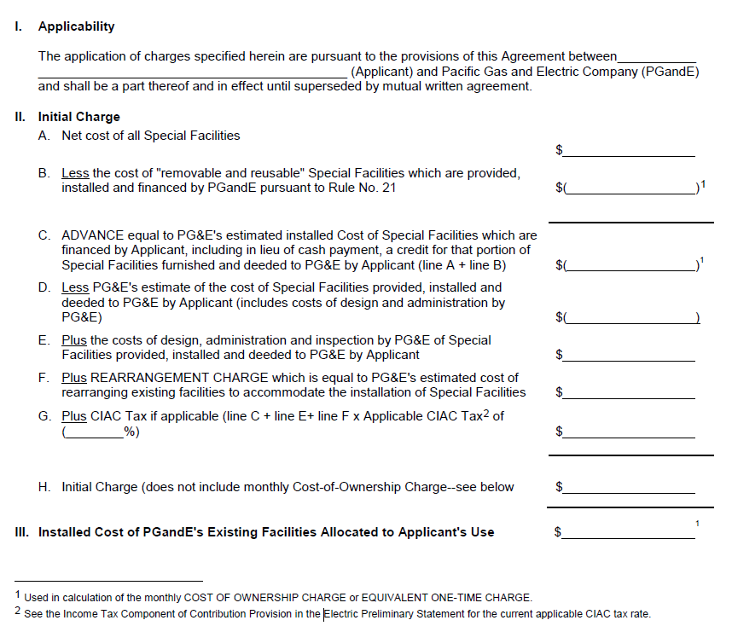
SFA Appendix A for Generation Project
24% ITCC
(CAIC)

Slide 32
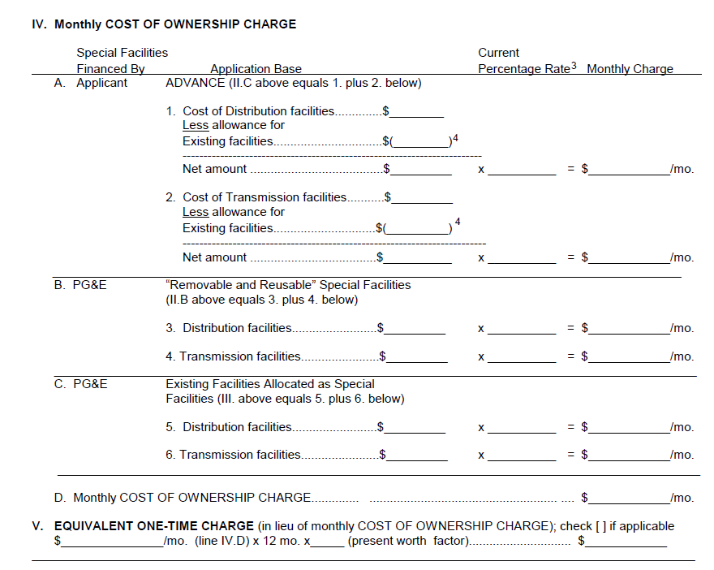
SFA Appendix A for Generation Project: Pg 2
Cost
Of
Owner-ship (COO)
Facilities required and costs based on Interconnection Study
Present Worth Factor (PWF)

Slide 33
Appendix
IDF – Timeline projects < 1 MW

Slide 34
INTERCONNECTION TIMELINE
Timeline Assumptions: Rule 21 ≤ 1MW
Timelines given are based on average installer experiences. These are not guaranteed timelines given by any of the IOU’s.
Differing Procedures Between IOU’s
Interconnection Process Stages:
Application Submittal Process
Engineering
Design and Construction (projects with mitigations)
Special Facilities Agreements and Mitigation Payments
Commissioning

Slide 35
ENGINEERING REVIEW
Engineering Timelines are all Rule 21 Tariff mandated and should be consistent between all IOU’s
Engineering Timeline
Initial Review: 15 Business days
Supplemental Review: 20 Business Days
Supplemental Results Meeting: 10 Business Days
Electrical Independence Test: 20 Business Days
*System Impact Study: 60 Business Days
SIS Results Meeting: 10 Business Days
*Assumes project passes Screen Q and R in the EIT

Slide 36
DESIGN AND CONSTRUCTION (projects with mitigations)
Timelines assume working CAD file and Spec Sheets at design initiation.
PG&E
SCE
SDG&E
Local Service planning design timelines differ depending upon the local offices queue.
Design timelines can range from 60-180 business days.
Construction typically ranges between 20-80 business days.
Design is typically 60 business days
SCE has stated that they have a 90 business day construction timeline. Most installers experience a 60 business day construction timeline.
SDG&E has stated that they have various timelines for their design process and construction process.
The impute average design timeline used is 100 business days.
The impute average construction timeline used is 60 business days.
Assumes no substation mitigations or Mini RTU’s.
Timeframes above indicate a range of some installer experiences.
The handout timeline indicates a more average experience.

Slide 37
SPECIAL FACILITY AGREEMENTS AND PAYMENT PROCESSING
PG&E
SCE
SDG&E
Utilizes a payment advance method where a portion of the non binding costs are paid prior to design.
Upon design completion SFA is drafted and remaining payment is collected.
SFA drafting process is typically done in 5-10 business days.
Prior to the start of design, the SFA is drafted. This process includes 15 BD for non-binding costs (unless DIS), 15 business days for a draft SFA and 15 business days for a final SFA.
SCE requires full payment prior to start of design.
Utilizes a payment advance method where a portion of the non binding costs are paid prior to design.
Upon design completion SFA is drafted and remaining payment is collected.
SFA drafting process is typically done in 5-10 business days.
Assumes Projects <1MW

Slide 38
COMMISSIONING AND PTO
PG&E
SCE
SDG&E
Commissioning requests take about 5 BD to schedule. However, during a time of backlog, this can sometimes take 15 BD to schedule.
Commissioning is typically scheduled for the following week.
PTO is issued between 1-5 BD after the project passes the final inspection.
Commissioning requests take about 5 BD to schedule.
Commissioning is typically scheduled for the following week.
It can sometimes take between 1-15 business days for PTO issuance as the project may be sent back to have a final review prior to PTO issuance.
SDG&E’s final inspections are initiated when the AHJ automatically uploads the final building permit (about 5BD).
PTO is issued on the same day as the inspection is cleared by the on-site inspector.

Slide 39
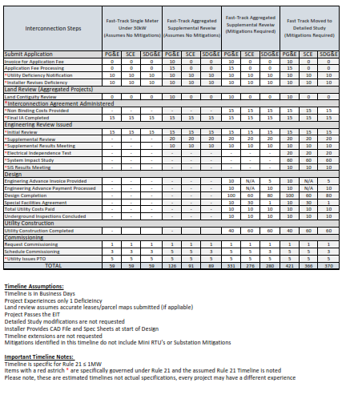

Slide 40
Appendix
IDF – Timeline projects > 1 MW

Slide 41
WHAT ARE SOME TYPES OF MITIGATIONS?
Key areas of concern
COMMUNICATIONS
Disconnect/Reconnect – request/timing is different depending on what your purpose is (service planning vs. EGI approval) need variance approval and then
Service Planning (Design & Estimating (NEM & NEMA)
TYPES OF UTILITY MITIGATIONS:
Facility Upgrades
Distribution Upgrades
Network Facility Upgrades
DISTRIBUTION AND NETWORK UPGRADES
  Telemetry Items always required for projects over 1MW
  Distribution Upgrades Typically Installed by Local Utility Estimating/Construction Group.
  Network Upgrades can be installed by local crews or specialized crews depending on the type of work required.
  Utility may use local crews or larger “GC” crews depending on the amount of work needed for the job. Larger crews may require more time for construction scheduling
  Timelines typically vary depending on the local office
  (PG&E: 4-10 months) (SCE: 5-8 months), (SDG&E: 6-8 months)
  Please refer to the utility unit cost guide for more cost clarification on upgrades costs.
  There are certain windows of time where upgrades can not be done – e.g. ISO doesn’t allow any facilities off line in the summer, bird season. CAN THESE WINDOWS BE PUBLISHED?

Slide 42
WHAT IS THE SUBSTATION UPGRADE PROCESS?
SUBSTATION UPGRADES
  Typically assigned to a specialized group – not the local office.
  Can be Distribution Upgrades or Network Upgrades
  Estimated Timeline: 12-24 Months
Why do these upgrades have extended timelines?
Complex Engineering and Designs: requires experienced specialized design and estimating.
Permitting Process: Obtaining permits for these types of upgrades can be time consuming and sometimes require complex environmental permits.
Procurement: challenging to procure the specialized equipment.
Limited Resources: small selection of Contractors and utility crews that are certified to perform this type of work.
Rule 21 Section: Unspecified

Slide 43
Out of Rule 21 estimating timeline is not consistent:
  For small NEM projects SCE includes total cost estimate and must pay prior to moving to construction
  PG&E requires small engineering advance up front and includes combined block of time for design and estimating (24-34 weeks) – then issued total cost – Invoiced for SFA & Rule 15-16 then get on construction schedule
For all IOUs, the system impact studies including non-binding cost estimate and timeline (SCE for non-NEM)

Slide 44
WHAT IS THE INTERCONNECTION FINANCIAL SECURITY PROCESS?
  Purpose: To ensure that the utility customer is capable of paying the interconnection costs.
Different Types of Interconnection Financial Security (IFS):
  Letter of Credit
  Irrevocable Guaranty
  Cash Deposit in an interest bearing Escrow Account
Fast Track Process
  Initial 30% Due 60 calendar days of IA Execution
  Remaining amount 20 calendar days prior to construction Start
  Detailed Study Process
  Network Upgrades Process
  Utilizes a three phase step approach as well.
60 CD after SIS
FS
120 CD after FS
On or before start of construction
Start
Construction
System Impact Study
20% or $20K per MW
30%
100%
Projects >1MW
Rule 21 Section: F. 3. b. iv.

Slide 45
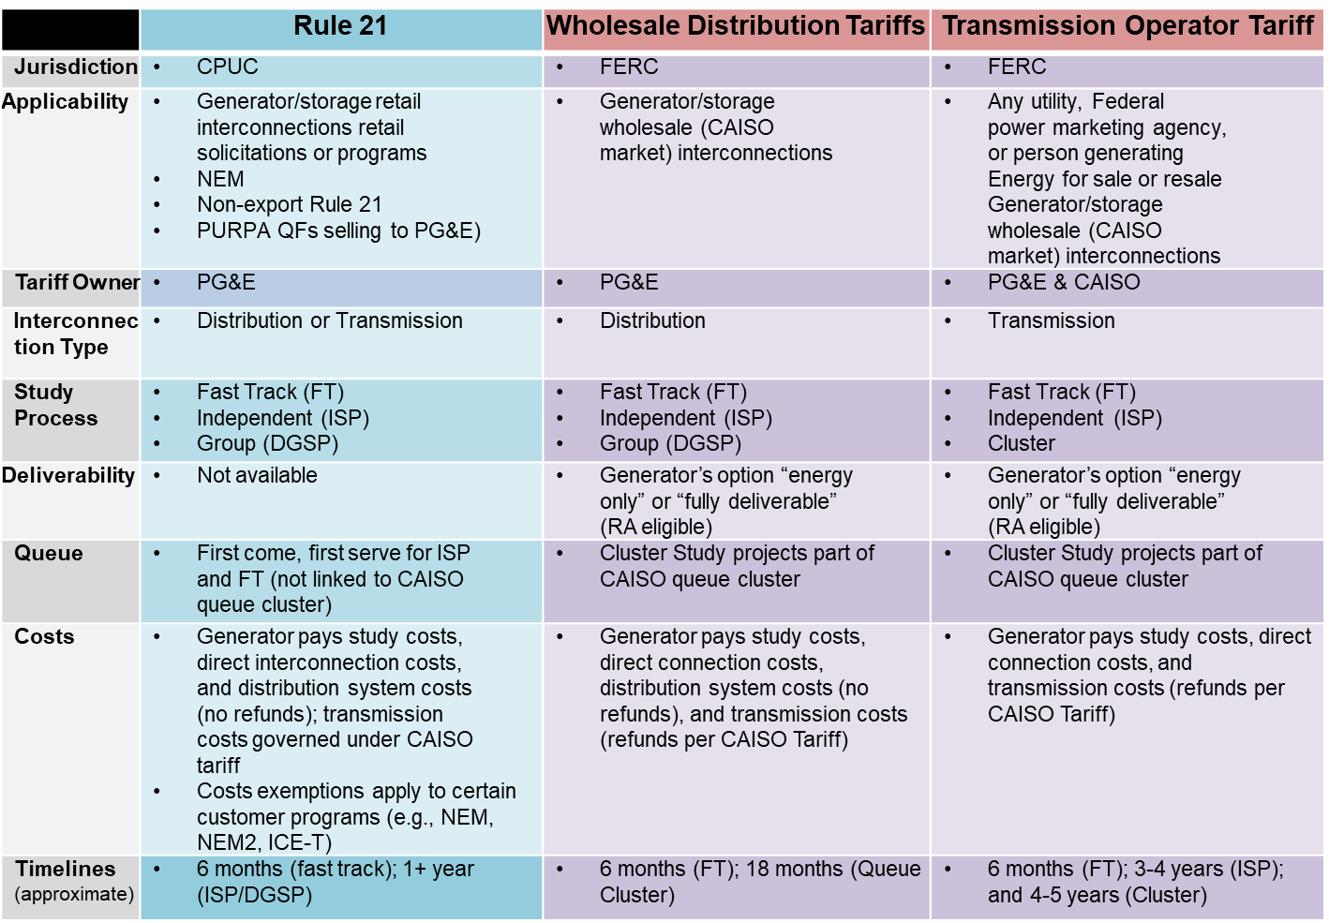
WHEN DOES RULE 21 APPLY?

Slide 46
Questions for
Interconnection Discussion Forum
What is the definition and scope for each rule? When does Rule 2, Rule 15/16 tariffs apply in interconnecting DER under Rule 21 tariff (show on case study diagram for illustration?
Projects have only Rule 21 Special Facilities Agreements issued when…
Projects have Rule 21 & Rule 15/16 when..
Projects have Rule 21 & Rule 15/16 & Rule 2 when…
When a project is triggered in Rule 21, what is the process to determine 1) the costs (estimating and design) and 2) the allocation between tariffs?
What is the timeline for determining the mitigation cost and allocation across tariffs? Does the cost allocation to a specific tariff impact the timing?
No specific timelines are articulated in Rule 2 or 15/16 tariffs
IOU policy and procedures manage expectations for cost and timely execution by….<<how is this done?>>
IOUs establish metrics for their service planning teams…(what metrics/how is this done)
Based on IOUs non-tariff policy what are the current timeline expectations for common mitigations?
How does the tariff allocation (Rule 2, 15/16, 21) affect the final OTCC and ITCC Calculation?

