Slide 1
PV + Storage
Interconnection Discussion Forum
September 20, 2018

Slide 2


Agenda
Topic
Application Process – NEM Paired Storage | 1:15
Desired Improvements
SDG&E’s Program
Questions? | 2:00
Utility | Presenter | Title
PG&E | Harold Hirsch | Sr. Interconnection Manager Electric Grid Interconnections
SCE | Markus Lotto | Senior Manager Grid Interconnections & Contract Development
SDG&E | Ken Parks | Customer Generation Manager Electric System Planning

Slide 3

Interconnection Application
NEM Paired Storage

Slide 4
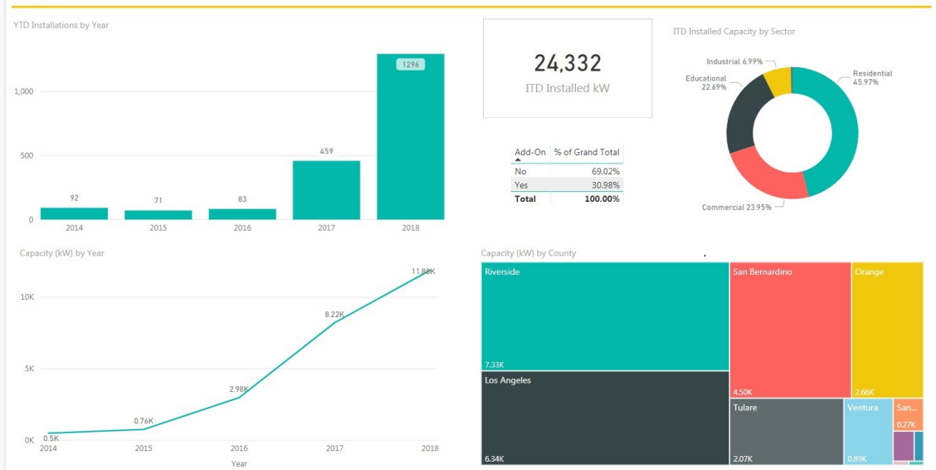
SCE NEM Paired Storage Volume

Slide 5
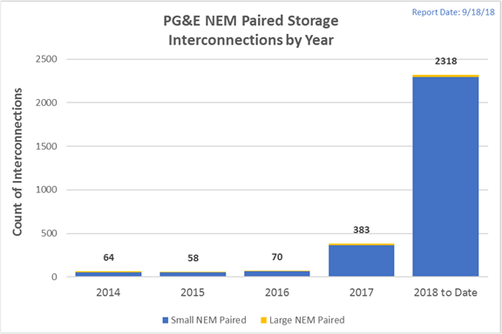
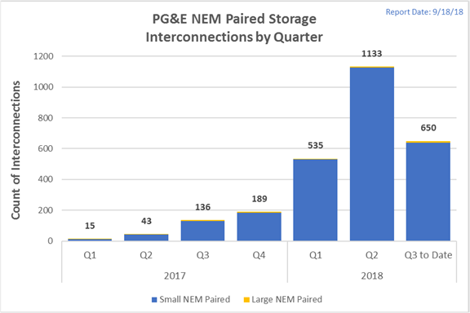
PG&E NEM Paired Storage
What to expect for Q4?

Slide 6
Interconnection Process - Overview
Interconnection Request Submit
Application
Intake
Review for Completeness and Validity
Fast Track Screening
Agreement Phase
Construction
Commissioning
Permission to Operate
Internal review & validation to ensure request meets acceptability
requirements
Review Per Rule 21 Section E.5
Screened per Rule 21 Section F.2
or
Studied per Rule 21 Section F.3, as applicable.
Agreement drafted, negotiated and executed, per Rule 21 Sections F2.e or F.3.e or N.3.b, as applicable
Agreement handed off to for payment schedule and construction activities
Project commissioned
This overview is not comprehensive and excludes Cost Envelope Option listed in Section 7 of Rule 21
Notes:
Additional Deficiency… SCE Application Issue: Discrepancies between Customer name across SCE’s Service Account record, California Secretary of State database, and Interconnection Application.
Solution/ Best Practice: - Ensure Customer understands the name must be in agreement across each record. SCE provided guidance on naming issues.
SCE

Slide 7
Application Phase
Application Intake
Application Phase
Commissioning
Interconnection Request Submit
Application
Intake
Review for Completeness and Validity
Fast Track Screening
Agreement Phase
Construction
Permission to Operate
Focus Area | Best Practice
Consider pre-application review
Application Make sure eligible for program Sized no more than annual load | Submit Early.
Single Line Diagram
NEM Application Fee
Online Portal
Notes:
Additional Deficiency… SCE Application Issue: Discrepancies between Customer name across SCE’s Service Account record, California Secretary of State database, and Interconnection Application. Solution/ Best Practice: - Ensure Customer understands the name must be in agreement across each record. SCE provided guidance on naming issues.
SCE

Slide 8
Fast Track Screening
Planning/Studies Phase
Application Phase
Interconnection Request Submit
Application
Intake
Review for Completeness and Validity
Fast Track Screening
Agreement Phase
Construction
Commissioning
Permission to Operate
Common Deficiency | Best Practice
Inverter voltage discrepancy with electric service | Verify inverter voltage
Missing data required to complete supplemental review | Provide SLD Impedance data per F2x ii and per the study
Incorrect impedance information provided | Verify impedance information for submittal

Slide 9
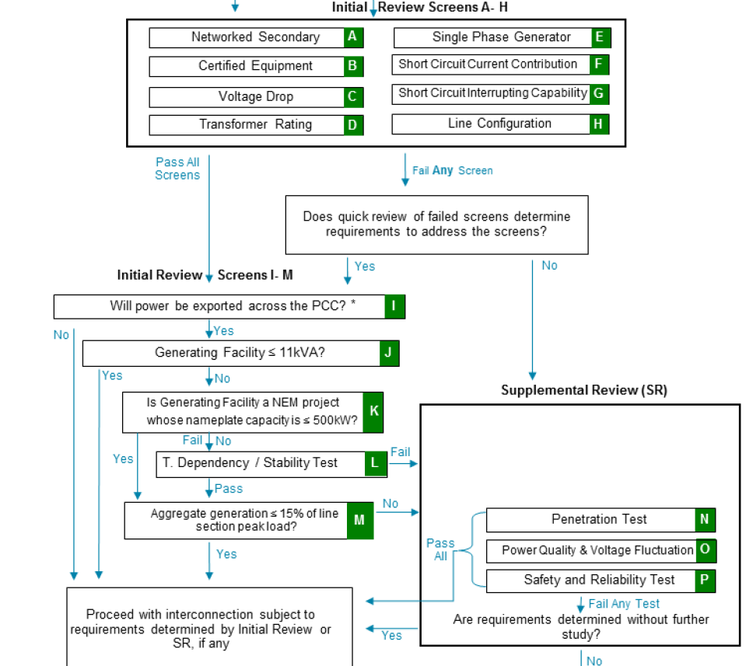
Fast Track Screening
Application Phase
Interconnection Request Submit
Application
Intake
Review for Completeness and Validity
Fast Track Screening
Agreement Phase
Construction
Commissioning
Permission to Operate
All NEM-Paired Storage Projects will be evaluated according to the Engineering screens above.

Slide 10
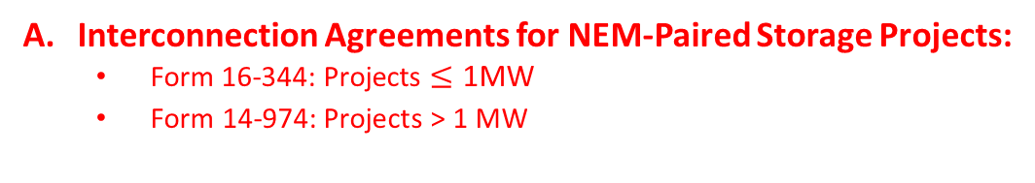
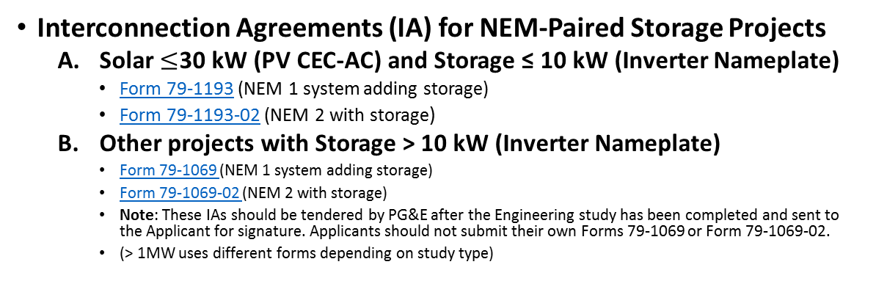
Agreement Phase
Interconnection Request Submit
Application
Intake
Review for Completeness and Validity
Fast Track Screening
Agreement Phase
Construction
Commissioning
Permission to Operate
PG&E
Interconnection Agreements (IA) for NEM-Paired Storage Projects
  Solar $≤$30 kW (PV CEC-AC) and Storage ≤ 10 kW (Inverter Nameplate)
    Form 79-1193 (NEM 1 system adding storage)
    Form 79-1193-02 (NEM 2 with storage)
  Other projects with Storage > 10 kW (Inverter Nameplate)
    Form 79-1069 (NEM 1 system adding storage)
    Form 79-1069-02 (NEM 2 with storage)
    Note: These IAs should be tendered by PG&E after the Engineering study has been completed and sent to the Applicant for signature. Applicants should not submit their own Forms 79-1069 or Form 79-1069-02.
    (> 1MW uses different forms depending on study type)
Interconnection Agreements for NEM-Paired Storage Projects:
  Form 16-344: Projects $≤\text{1}\text{MW}$
  $\text{F}\text{orm}\text{ 14−974: }\text{Projects}\text{ > 1 }\text{MW}$
SCE
SDG&E
SDGE has two forms for NEM-Paired Projects
  <30kW projects NEM Terms and Conditions
  >30kW projects Form 142-02760
  ** Paired battery projects that are less than 150% of the PV project are considered an enhancement and no additional / separate IA are done. They fall under the PV IA/Terms and conditions.

Slide 11
Construction
Implementation Phase
Application Phase
Interconnection Request Submit
Application
Intake
Review for Completeness and Validity
Fast Track Screening
Agreement Phase
Construction
Commissioning
Permission to Operate
Common Deficiency | Best Practice
Missing/incorrect information | Work with assigned the assigned representative on requested information: PG&E: Service Planning Representative SCE: Engineer and/ or Interconnection Advisor SDG&E: DIIS application system sends email notifications and customer/contractor can access at any time the status and any open issues on application.

Slide 12

Commissioning $≥\text{10}\text{kw}$
Application Phase
Interconnection Request Submit
Application
Intake
Review for Completeness and Validity
Fast Track Screening
Agreement Phase
Construction
Commissioning
Permission to Operate
Safety Reminders:
Do not perform your own Disconnect/Reconnects,
request the Disconnect/Reconnect from your Utility.
Ensure that your installation meets the utility’s requirements:
  PG&E: - Greenbook - Electric and Gas Service Requirements, including gas clearance requirements.
  SCE: NEM Handbook; Interconnection Handbook & Electric Service Requirements.
  SDG&E: Interconnection Handbook & Electric Service Requirements
Do not operate System while interconnected before receiving permission to operate from the Utility.
Check clearance requirements when installing electric equipment in the vicinity of gas meters

Slide 13
Desired
Functionality
Improvements

Slide 14
Desired Functionality Improvements
Online Payments
  PG&E: Integrate PayPal plug-in to ACE-IT portal
  SCE: Exploring solutions to accept online payment
  SDGE: has been using Paypal since 10/12/16
Updated Application
  PG&E: Simplify application questions
      Front-end Error Checking
      Display existing generator equipment
  SCE: Can’t promise changes to the forms. Plan on simplifying the application - Show only applicable information (data validation in the future online version).
  SDG&E: Ken will provide separate presentation on their application platform/process DIIS.
Notes:
PG&E: deployed an interim solution.
Further updates expected soon for $145
Exploring options for $800

Slide 15
Desired Functionality Improvements
Update document uploads
  PG&E Additional document type options for clarity
  SCE: This is under review at SCE
  Electronic Signature
  PG&E: Exploring electronic signature process similar to under 30 kw solar NEM Portal
  SCE: Under review, but SCE may use Docusign
  SDG&E: accepts electronic signatures and NEM terms and conditions are set up in DIIS for electronic acceptance

Slide 16
Desired Functionality Improvements
Developer/Installer Support
PG&E: Enterprise level accounts for installers (ACE-IT Login)
SCE: Reviewing a specialized user role for developers who submit on behalf of other account holders
SDG&E: DIIS using MyPartners Platform allows for developers to submit for the customers/account holders.
These improvements are desired, but not yet approved at this time and are subject to change

Slide 17
Desired Functionality Improvements
  Reporting
  PG&E: Status Reporting across enterprise user accounts in one place
  SCE: Analyzing future developer user role(s) and reporting capabilities.
  SDG&E: Both the developer/contractor and the customer/account holder are sent all notifications
Single Line Drawings
PG&E: Exploring options for Pre-Approved single line drawings and operating schemes
SCE: Pre-approved single lines not part of SCE’s current set of future enhancements. Liability concerns regarding not having “all” the engineering information required.
SDG&E: Pre-Approved SLD are only available for PV systems only, not for paired or stand alone.
These improvements are desired, but not yet approved at this time and are subject to change

Slide 18
SDG&E’s Program

Slide 19
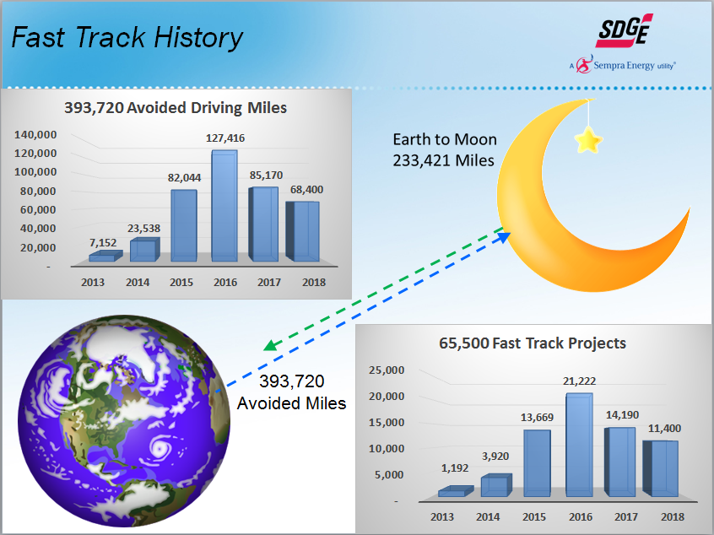
Desired Functionality Improvements

Slide 20
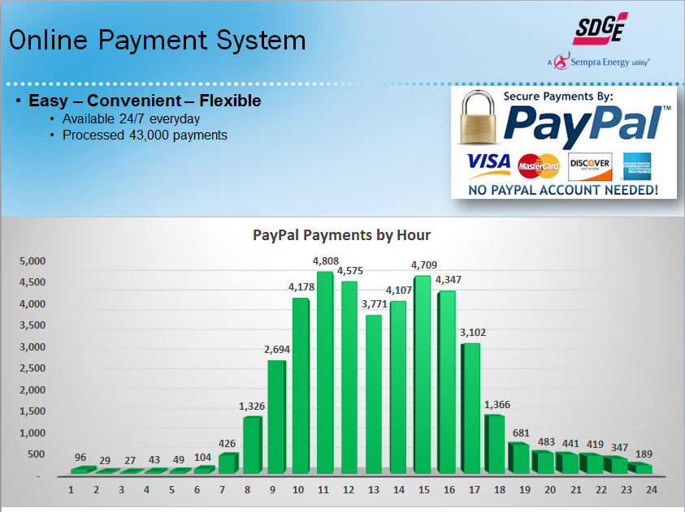
Desired Functionality Improvements

Slide 21
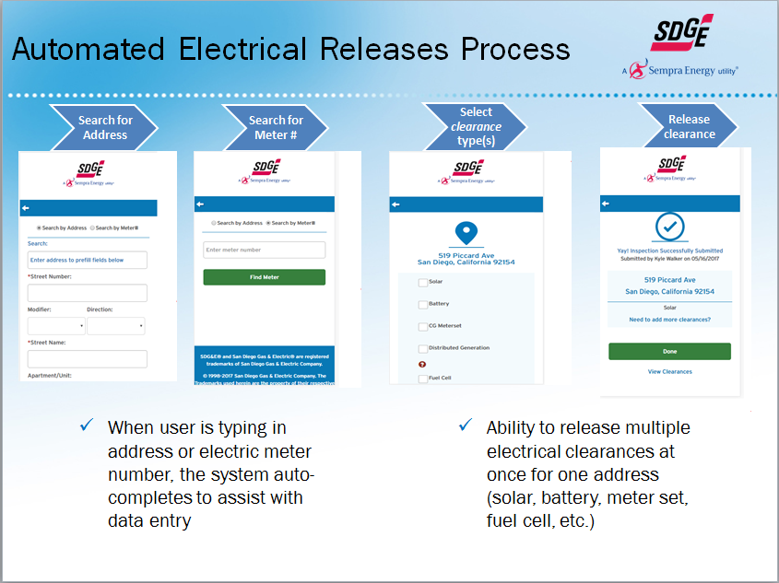
Desired Functionality Improvements

Slide 22
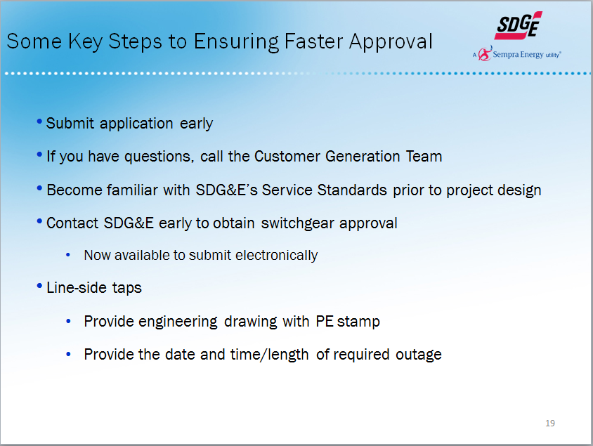
Desired Functionality Improvements

Slide 23
Appendix

Slide 24
Application Phase
Review Application for Completeness
Application Phase
Commissioning
Interconnection Request Submit
Application
Intake
Review for Completeness and Validity
Fast Track Screening
Agreement Phase
Construction
Permission to Operate
Focus Area | Common Deficiency | Best Practice
Application SDG&E: N/A DIIS – Application tied into billing system so wont accept if Acct & meter don’t match | Discrepancies with Customer information | Have customer provide most recent account information, Customer can obtain info by: Energy Statement Logging into their web account Call the Customer Service 800 no.
Application | Make, model, quantity of AC Disconnect, Inverter(s), and/or PV modules not listed on application | Ensure that application information includes make, model, and quantity of equipment *
Application | Existing system is not identified on application | Identify the make, model, and quantity of the existing system on the application
Smart Inverter | Inverter is not on CEC approved Smart Inverter List | Select a Smart Inverter from CEC Certified inverter List
Storage with Integrated Inverter | Storage with integrated Smart Inverters do not list the certification | Provide cut sheet that lists Smart Inverter certification Request manufacturer to list Smart Inverter certification
*PG&E Front-End Error Checking will resolve this for applicants with existing service
Notes:
Additional Deficiency… SCE Application Issue: Discrepancies between Customer name across SCE’s Service Account record, California Secretary of State database, and Interconnection Application. Solution/ Best Practice: - Ensure Customer understands the name must be in agreement across each record. SCE provided guidance on naming issues.
SCE

Slide 25
Review Application for Completeness
Application Phase
Interconnection Request Submit
Application
Intake
Review for Completeness and Validity
Fast Track Screening
Agreement Phase
Construction
Commissioning
Permission to Operate
Focus Area | Common Deficiency | Best Practice
Single Line Diagram | Point of interconnection selected not shown or incorrectly labeled on single-line diagram | Clearly identify point of interconnection in relation to main breaker
Single Line Diagram | Single Line Diagram depiction of Line Side Tap shown in utility section | Provide photos of customer panel with: Proposed Point of Interconnection (POI) Wire routing NOTE: POI and wires cannot be in utility sealed section
Single Line Diagram | Single Line Diagram missing meter number and service address SDG&E doesn’t require meter# on SLD | Include electric meter number and service address
Single Line Diagram | Net Generator Output Meter (NGOM) is not shown or labeled on single-line diagram | Clearly identify the location of the NGOM
Single Line Diagram | Make, model, quantity of AC Disconnect, Inverter(s), and/or PV modules not listed on single-line diagram | Ensure that single-line includes make, model, and quantity of equipment *
Single Line Diagram | Existing system is not identified on Single Line Diagram | Identify the make, model, and quantity of the existing system on the single-line diagram
Single Line Diagram / Application | Information on Single Line Diagram does not match that listed on Applications | Ensure equipment information on Single Line Diagram matches Applications

Slide 26
Agreement Phase
Interconnection Request Submit
Application
Intake
Review for Completeness and Validity
Fast Track Screening
Agreement Phase
Construction
Commissioning
Permission to Operate
 | Common Deficiency | Best Practice
PG&E | Discrepancies with Customer information on Interconnection Agreement | Have customer provide most recent PG&E account information, Customer can obtain info by: Energy Statement Logging into their PG&E web account Call 800-743-5000
PG&E | Selected ineligible rate schedule | Select applicable time-of-use rate Visit www.pge.com/rates To enroll in an Electric Vehicle (EV) rate, customer must apply for (EV) rate separately
PG&E | Interconnection Agreement (IA) signed by someone other than the PG&E Customer of Record | Ensure Interconnection Agreement is signed by Customer of Record
PG&E | New Customer signature and date missing when there are changes made to a previously signed Interconnection Agreement | Provide a new Customer signature and date to show that the Interconnection Customer has reviewed and agreed to the changes made
SDG&E | Application tied to CISCO (billing system) DRAFT IA to customer to complete generator information and confirm customer information. Then pdf version sent for final signatures.
SCE | Interconnection Agreement (IA) proposed to be signed by someone who is not an “owner of a proprietorship”, “officer of a corporation,” “director or general manager of an agency”. | Work with Customer to ensure proposed signatory meets the requirements or the Customer to provide documentation showing signatory has authority to sign on behalf of the Customer. SCE has templates for use by Customer to delegate signing authority.
SCE | requires that the entity enterinto the IA be: (1) registered with the CA Secretary of State; and (2) bes the customer of record/ Service Account holder | Ensure Customer understands the name must be in agreement across each record. SCE provided guidance on naming issues.

Slide 27
Commissioning
Interconnection Request Submit
Application
Intake
Review for Completeness and Validity
Fast Track Screening
Agreement Phase
Construction
Commissioning
Permission to Operate
Focus Area | Common Deficiency | Best Practice
Authority having Jurisdiction (AHJ) approval (e,g. Final Building Permit) See Note Section | Final Signed-Off Building Permit is missing information | Ensure that signing jurisdiction, project address, scope of work, final sign-off date and signature or initial of inspector is included
Inspection See Note Section | Site not ready for final inspection (i.e., site contact for did was not onsite for inspection, customer is still finalizing installation-related, etc.) | Ensure generating facility is ready for PG&E’s final inspection to minimize need for rescheduling.
Inspection See Note Section | Generating system has point of interconnection and/or wires in the utility’s sealed section | The Point of Interconnection and wires cannot be in the utility’s sealed section
Inspection | Installation does not meet the utility requirements | Reference utility requirements
Permission to Operate Change Request See Note Section | Equipment is different from what was originally indicated in the submitted application that was reviewed | Provide updated information if changes are made New application is required if inverter nameplate increases
After Permission to Operate Issuance | System is connected to meter not listed on application | Ensure application and point of interconnection references the same meter
Notes:
SDG&E: AHJ releases the permit/clearance directly to the utility. We do not allow the customer/contractor to submit them to us. In 2017 enhancement made to DIIS that allows the AHJ to release them electronically to us from any mobile device at any time.
Inspection: We do not schedule site inspections for final review. If there are any issues, they are inputted in DIIS and the customer/contractor is notified of the issue and how to correct it. They can email the inspector/ Interconnection team when ready for re-inspection or if minor can be cleared using photos.
Application / Equipment Changes: If prior to PTO, we can change the status of the application in DIIS and the customer/contractor can make any necessary changes and when finished can resubmit to us. If the changes are major, then we can cancel that application at our discretion and have them resubmit a new application. Unless the customer has applied under the wrong application type, we generally just incomplete the current application and let them make the changes as needed and resubmit to us.

Slide 28
Guidelines for NEM & Storage Paired System
Directly Connected
(storage device not exclusively charged by NEM generator)
NEMMT
NEM paired with Storage Devices sized larger than 150% of the NEM-eligible generator’s max output capacity.
Small NEM Paired Storage
Solar NEM (PV CEC-AC <= 30kW) Paired with Storage Devices Sized 10 KW or Smaller (based on storage inverter nameplate)
Option to either install metering (defined under “Large NEM Paired Storage”) or use the estimation methodology.
These projects are referred to as “SNEM-Paired Storage”.
Large NEM Paired Storage
All other NEM Paired except Small NEM-Paired Storage have the requirements that the storage be sized no larger than 150% of the NEM-eligible generator’s max output capacity and that it has one of the following metering conditions:
installed a non-export relay on the storage device(s);
installed an interval meter for the NEM-eligible generation, meter the load, and meter total energy flows at the point of common coupling; OR
installed a Net Generation Output Meter (NGOM) directly to the NEM-eligible generator(s)
NEM Paired Storage Interconnection Cost Responsibility
The storage will have the same interconnection cost responsibility as the NEM generator that it is paired with. In the event the storage is added at a later date after the permission to operate of the NEM generator it is subsequently paired with, the storage applicant will be required to pay the same interconnection fees and costs that the NEM generator would be required to pay, as provided for in Electric Rule 21 (Table E-1).
Example: Adding 10kW of storage to an existing solar-only NEM 2 system would qualify as “Small NEM Paired Storage” and would therefore have an application fee of only $145 as opposed to $800 that would be required for all Non-Net Energy Metering Generating Facility Types.
Rule 21 Interconnection Cost Responsibility
Notes
Please see Special Condition 10 (NEM Tariff) and Special Condition 11 (NEM2 Tariff) for clarification on what qualifies as “NEM Paired Storage”
Applying as NEM Paired Storage includes both adding storage to an existing NEM system (retrofit) and a first-time interconnection with both NEM and storage

Slide 29
Paired Storage Simplification Plan

Slide 30
NEM and Storage Paired System Configurations
Shared Inverter (DC-Coupled)
Separate Inverters (AC-Coupled)
Important Note: To be eligible for NEM-Paired Storage with shared inverters (as shown above), the gross inverter nameplate for shared inverters is 10 kW behind the same point of common coupling (PG&E meter). If the gross inverter nameplate for shared inverters behind the same PG&E meter exceeds 10kW, then it is must install a non-export relay on the storage device or it must interconnect under another Rule 21 interconnection agreement. Current work is underway to provide another interconnection path for large DC-coupled NEM Paired Storage systems only for customers with storage that is incapable of charging from the grid.

Slide 31
Storage
Interconnection
Problems

Slide 32
A. ELIGIBILITY ISSUES
Non-export certification
Non-import certification
Combined generating capacity
Meter totalization
Line side taps
Partial PTO

Slide 33
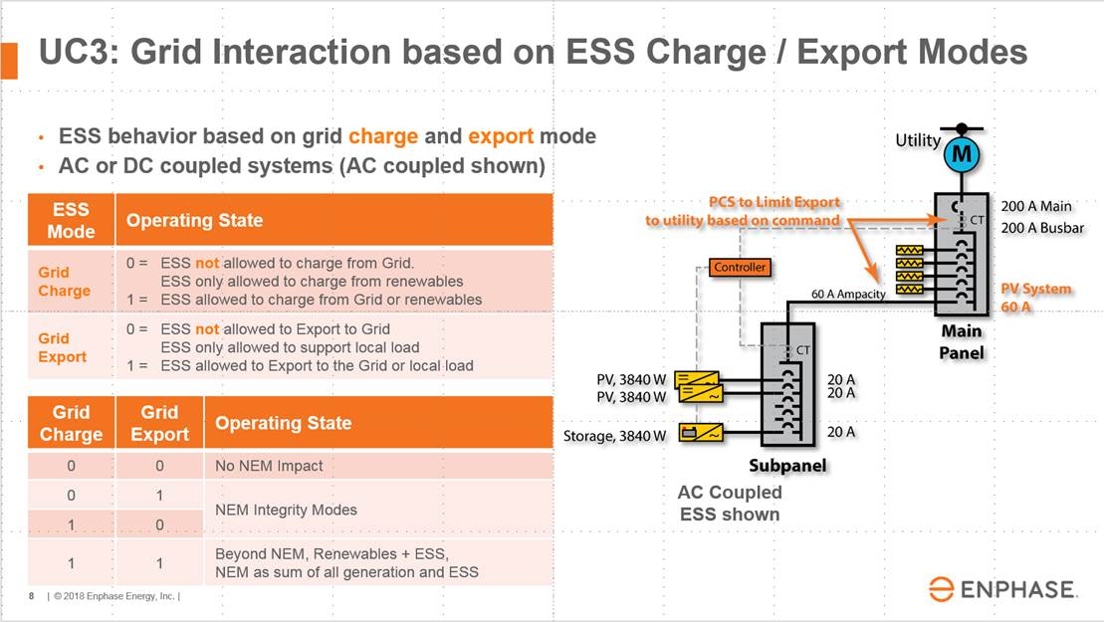
Non-Export/Non-Import Certification

Slide 34
Combined Generating Capacity
Current interconnection review treats solar plus storage projects based on their combined nameplate, as though the PV will be producing and the storage discharging simultaneously at full capacity for all daytime hours. In reality, storage paired with solar will decrease energy exported to the grid during hours of concern.
Utilities are changing to hourly ICA for solar generation. They should also consider the true hourly profile of storage.

Slide 35
Meter Totalization
If a building has more than one meter, customers are currently not allowed to aggregate the load for purposes of sizing storage.
Even if the amount of wire between two meters is a few inches it is considered the distribution system and energy transferred across that space makes a customer ineligible for rules governing inadvertent export.
Some buildings have multiple meters simply because the meters themselves are only designed to handle a certain amount of current.
This is also of interest to microgrid projects

Slide 36
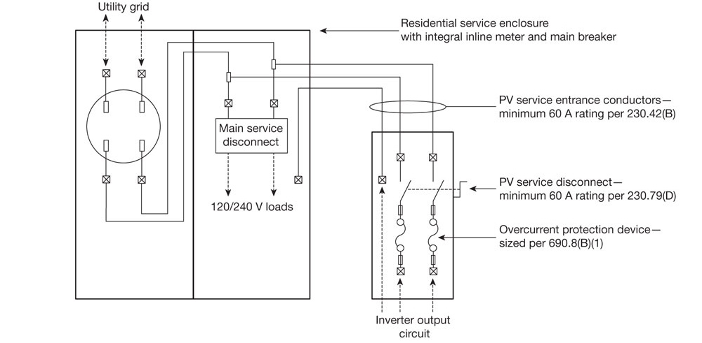
Line Side Tap Rules
Can an energy storage system be connected on the line side of a customer’s service disconnect if a control system can guarantee never to charge beyond the customer’s historical peak load?

Slide 37
Partial PTO for Paired Systems
Guidance on when PV or storage components will be allowed partial PTO, especially when there is a long lead time for PTO.

Slide 38
B. TIMELINE ISSUES
Meter installation
Application review

Slide 39
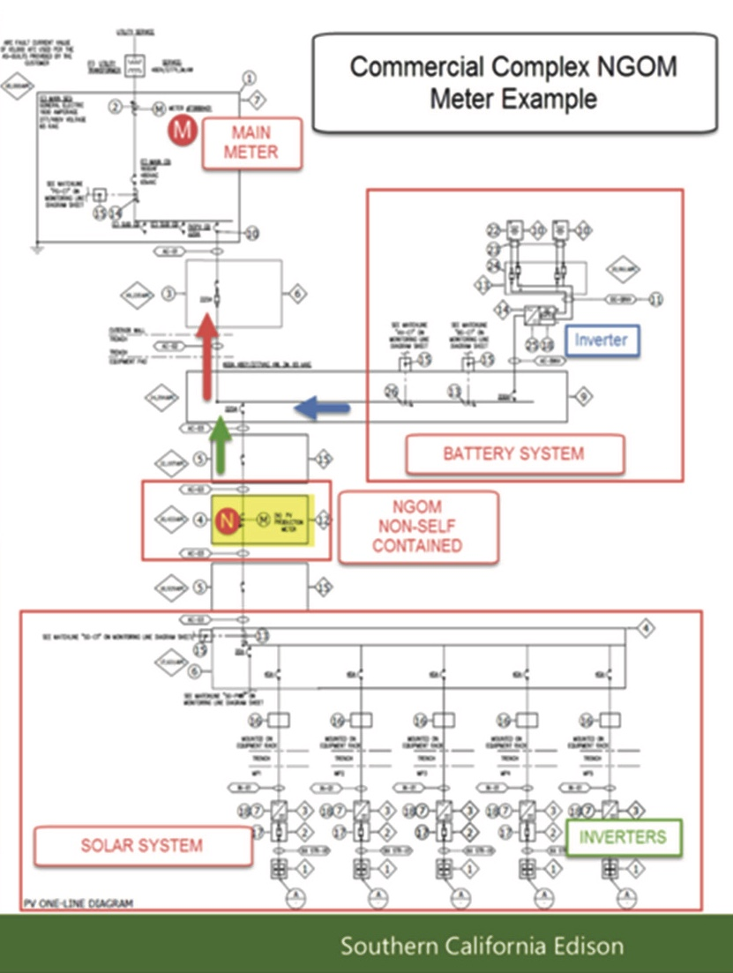
NGOM Timeline
Projects routinely wait 6-12 months for metering installation
Inconsistent process
Mistakes and no shows
CALSSA proposes a maximum timeline of 60 calendar days

Slide 40
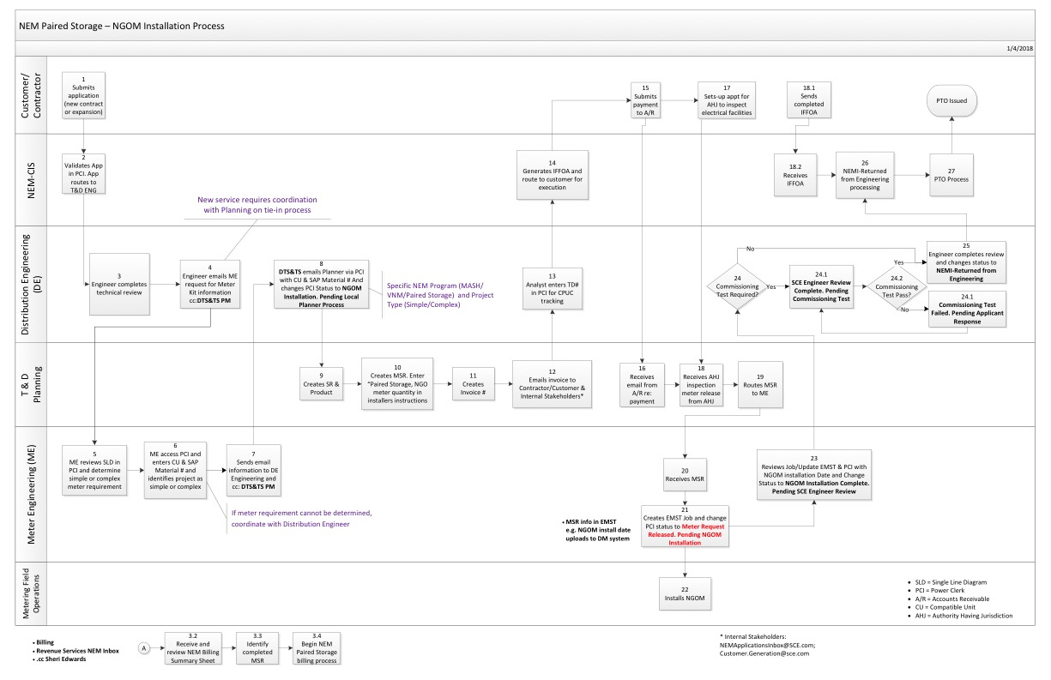
NGOM Installation Process

Slide 41
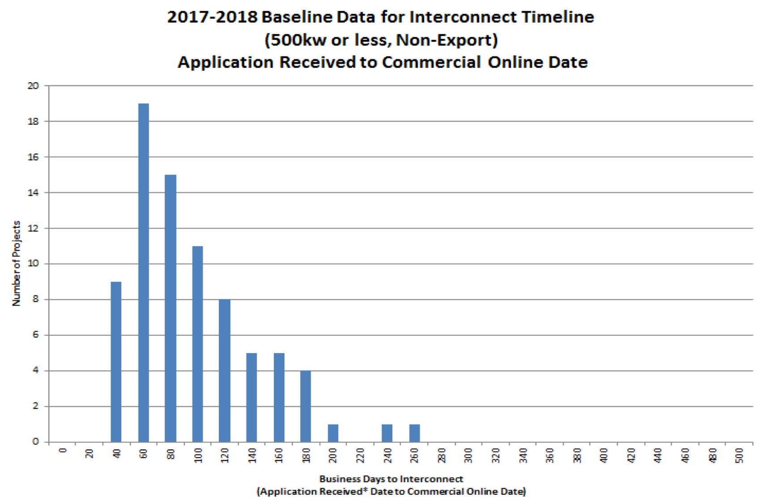
PG&E Expedited Review Timeline

Slide 42
C. BASIC APPLICATION ISSUES
List of approved storage devices
Standard NEM application
Specs for pre-existing solar
Customer service specific to application issues
Pre-filled data
Changing ID numbers
Multiple entries of the same info
Unclear terminology

Slide 43

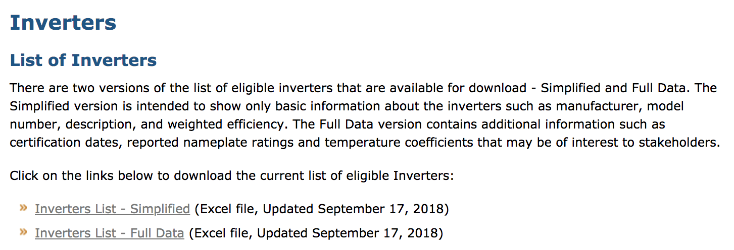
List of Approved Equipment
CEC is considering creating a new Approved Equipment List for energy storage
Until that happens, IOUs should share their lists

Slide 44
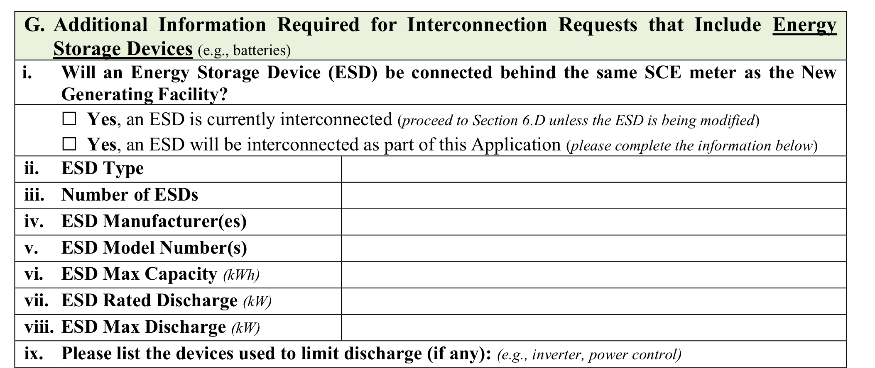
Standard NEM Application
Requiring a small residential solar plus storage system to use the NEM-MT application is a square peg in a round hole.
SOLUTION: For NEM paired storage smaller than 30 kW use the standard NEM application.
  SCE and SDG&E already do this. PG&E does not.

Slide 45
Specs for Pre-Existing Solar
If storage is added to an existing solar system, the application needs to list the exact existing equipment.
If the customer does not have the interconnection agreement, they should be able to request a copy from the utility.
Better yet, why does the customer need to ask the utility for the data to give back to the utility. The utility could use its own records to begin with.

Slide 46
Customer Service Specific to Applications
It is impossible to get someone on the phone who can clarify questions
It would save everyone time if an applicant could ask for clarity rather than submitting an application based on best guesses, then wait for a response from an application reviewer that may even add to the confusion.

Slide 47
Pre-Filled Data for Approved Equipment
It wastes everybody’s time if an application is rejected for inconsequential administrative issues
  (system recognizes Powerwall 2 but not Powerwall II or Powerwall-2)
Basic info should populate based on drop-down menu selection
  Performance specifications, model numbers, configurations
Inverters and batteries are already in the database in drop down menus
SOLUTION: use pre-filled data from drop down lists

Slide 48
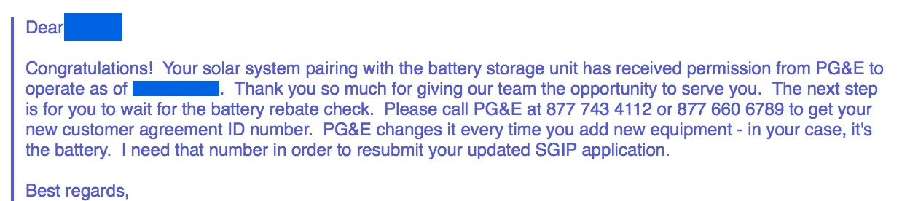
Changing ID Numbers
Electric Service Agreement Number CHANGES during the battery installation process
Contractor is not notified of this new number, and must ask customer to call PG&E
Contractor must then use this new number for Interconnection
Contractor must then UPDATE all SGIP paperwork, including Customer signature pages, with this new.
SOLUTION: do not change Service Agreement Number

Slide 49
Repeated Data Entry for Standard Contact Information
NEM Application requires repeated data entry for Customer Contact, Contractor and Authorized Contacts
Standard NEM projects are almost always completed by a contractor who is also the customer contact and authorized contact.
Software often crashes or freezes up, requiring multiple data entry efforts
SOLUTION: store customer contact, contractor, and authorized contact information for re-use
  SGIP and CSI programs both use this time and error-saving approach

Slide 50
Terminology Is Incorrect or Lacks Explanation
The application form contains language that is not clear.
  “discharge rate” = continuous or maximum?
  “generating system” = battery + solar?
  “Generator” = inverter (SolarEdge), battery (LG Chem), or inverter + battery (Tesla)
  ”Electrical Source Function Maximum Capacity”, “Rated Discharge”, “Charging Function Rated Charge Demand Load”, “Estimated Annual Net Energy Usage for Energy Storage Device”
Energy Storage Technologies
  Described as a “Generator”
  Requires data field entry as an “Inverter”
  Inverter Manufacturer is LG Chem and Model is RESU10H – which is a battery
  DC capacity is irrelevant
Incorrect information is required to complete applications, otherwise applications were rejected
  Export Information ”Generator Nameplate Export” requires a value of 11.6. That value is not correct for SolarEdge/LG Systems
  “Maximum Expected Facility Net Export” requires a value of 11.04
Inverter and Battery software version are required. These versions change often.
Some questions are not relevant to all types of systems.
SOLUTION: provide correct terminology and ”Help” or “Info” windows to explain

