Slide 1
Rule 21 Update with IEEE1547-2018/IEEE1547.1-2020
IEEE 1547-2018
Clause 4 continuation,10 and 11 Discussion
Smart Inverter Working Group
1/14/2021

Slide 2
Agenda
Welcome
Review of the schedule
Discussion of remaining Clause 4 Issues.
Discussion of Clauses 10 and 11.
Q&A

Slide 3
Proposed SIWG Schedule for 2020-2021

Slide 4
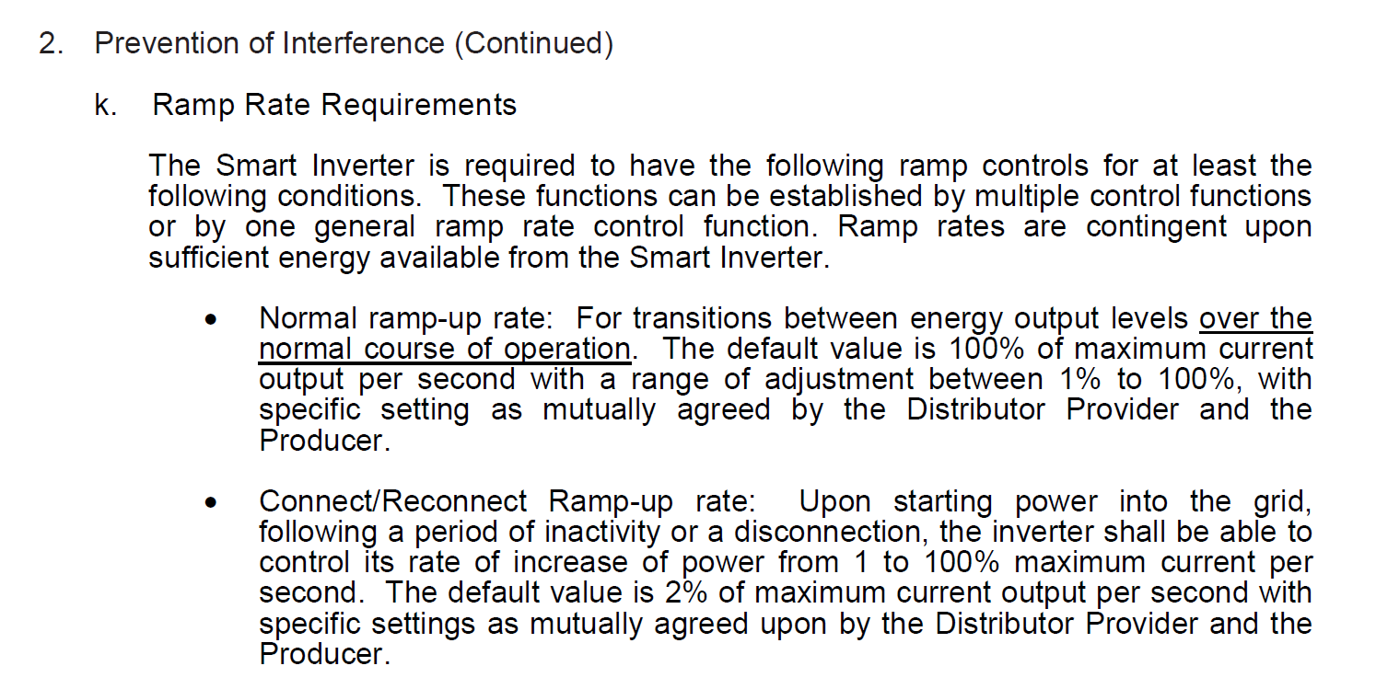
Rule 21 Proposed Modification For IEEE 1547 section 4.10
Enter Service
Section 4.10 Enter Service
Rule 21 section Hh.1.a.ii, Hh8.b, Hh.2.k
Current Rule 21 language
Rule 21 language Changes
k. Enter Service and normal operation Ramp Rate Requirements
The Smart Inverter is required to have the following ramp controls for at least the following conditions. These functions can be established by multiple control functions or by one general ramp rate control function. Ramp rates are contingent upon sufficient energy available from the Smart Inverter.
  Normal ramp-up rate: For transitions between energy output levels over the normal course of operation. The default value is 100% of maximum current output per second with a range of adjustment between 1% to 100%, with specific setting as mutually agreed by the Distributor Provider and the Producer.
  Connect/Reconnect Ramp-up rate: Upon starting power into the grid, following a period of inactivity or a disconnection, the inverter shall be able to control its rate of increase of power from 1 to 100% maximum current per second. The default value is 2% of maximum current output per second with specific settings as mutually agreed upon by the Distributor Provider and the Producer.
  Enter Service requirements as outlined in IEEE1547-2018 section 4.10.3 with following default settings
    Delay Enter Service per Hh.1.a.ii (15 seconds)
    Default Enter Service Duration of 300 seconds
SIWG comments
Separate Enter Service and Normal Operation into two sections
Need to discuss this the second ramp control in R21 but not in IEEE 1547 with emphasis on Storage charging/discharging which may be frequent and create grid issues
What do with do with this one?
01/07/2021 Update
Smart Inverters used for energy storage applications shall include ramp-up rate control. The default value shall be 100% of maximum current output per second or lower if required by applicant with specific settings, when required, as mutually agreed by the Distribution Provider and the Producer. Prioritization of ramp response should be in accordance to IEEE1547-2018 4.7
Comment: Input on the applicability of ranges of adjustement. IOUs agree to strike the requirement.

Slide 5
Rule 21 Proposed Modification For IEEE 1547 section 4.10
Enter Service
Section 4.10 Enter Service
Rule 21 section Hh.1.a.ii, Hh8.b, Hh.2.k
Current Rule 21 language
Proposed Rule 21 language Changes
k. Enter Service Ramp Rate Requirements
The Smart Inverter is required to have the following ramp controls for at least the following conditions. These functions can be established by multiple control functions or by one general ramp rate control function. Ramp rates are contingent upon sufficient energy available from the Smart Inverter.
  Normal ramp-up rate: For transitions between energy output levels over the normal course of operation. The default value is 100% of maximum current output per second with a range of adjustment between 1% to 100%, with specific setting as mutually agreed by the Distributor Provider and the Producer.
  Connect/Reconnect Ramp-up rate: Upon starting power into the grid, following a period of inactivity or a disconnection, the inverter shall be able to control its rate of increase of power from 1 to 100% maximum current per second. The default value is 2% of maximum current output per second with specific settings as mutually agreed upon by the Distributor Provider and the Producer.
  Enter Service requirements as outlined in IEEE1547-2018 section 4.10.3 with following default settings
    Delay Enter Service per Hh.1.a.ii (15 seconds)
    Default Enter Service Duration of 300 seconds

Slide 6
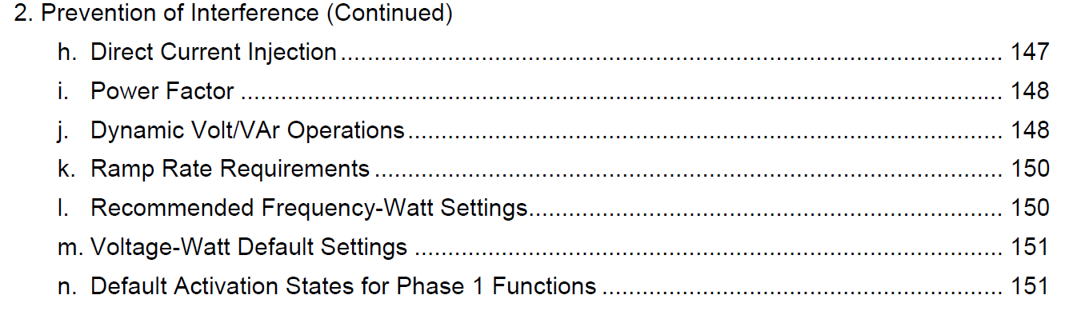
Rule 21 Storage Inverter Normal Operations Ramp Controls
Add Section to Section H.2 (Prevention of Interference)
?. Storage Inverter Normal Operation Ramp Control Requirements
Proposed Language Update
Smart Inverters used for energy storage applications shall include ramp-up rate control. The default value shall be 100% of maximum current output per second or slower if required by applicant. Other ramp-up control settings, when required, as mutually agreed by the Distribution Provider and the Producer.

Slide 7
Clauses 10 & 11

Slide 8
Rule 21 Proposed Modification For IEEE 1547 Section 10.0
Interoperability, Information Exchange, Information models, and Protocols
Rule 21 Sections Hh.2.p, Hh.5.a –b,Hh.6., and Hh.7 address communication, monitoring, telemetry and control requirements :
5.a The communication protocol requirements included in this section
Hh.5 shall become are mandatory for Generating Facilities utilizing
inverter-based technologies for which an Interconnection Request is
submitted February 22, 2019, nine (9) months following the approval
of the SunSpec Alliance Communication Protocol Certification Test
Standard. Until such date. This subsection may be used in all or in part
by inverter-based technologies by mutual agreement of the
Distribution Provider and the Applicant. The communications
requirements herein shall be between:
IEEE 1547-2018 language:

Slide 9
Rule 21 Proposed Modification For IEEE 1547 Section 10.0
Section 10.2 Monitoring Control and Information Exchange Requirements
IEEE 1547-2018 language:
Add to Ca Rule Hh.7.
Add to Ca Rule Hh.7 under “Namplate”.
Add points to Ca Rule Hh.7.a.
Include in Ca Rule Hh.6.a. and Hh.8.a

Slide 10
Rule 21 Proposed Modification For IEEE 1547 Section 10.0
Section 10.3 Nameplate Information
IEEE 1547-2018 language:
Add nameplate section and reference IEEE 1547-2018 reference to Ca Rule 21 Section Hh.7 (Monitoring and Telemetry Requirements).

Slide 11
Rule 21 Proposed Modification For IEEE 1547 Section 10.0
Section 10.4 Configuration Information.
IEEE 1547-2018 language:
Add to Ca Rule 21 Hh.7 under the added “Nameplate Information”.

Slide 12
Rule 21 Proposed Modification For IEEE 1547 Section 10.0
Section 10.5 Monitoring Information.
IEEE 1547-2018 language:
Recommend including these points in Rule 21 Section Hh.7.a, these points need to be available will be activated as required by the utility.

Slide 13
Rule 21 Proposed Modification For IEEE 1547 Section 10.0
Section 10.6 Management Information.
IEEE 1547-2018 language:
Each Mode and Function is summarized below.
Constant Power Factor - Included in Rule 21 as “fixed power factor function Hh.6.a.ii, add reference to IEEE 1547-2018 10.6.2. Interoperability requirements will be applicable 1/1/2022.
Voltage Reactive Power - Included in Rule 21 as “dynamic Volt/Var function”, Hh.6.a.i, add reference to IEEE 1547-2018 10.6.3. Interoperability requirements will be applicable 1/1/2022.
Active Power Reactive Power – Do not add.
Constant Reactive Power – Need to add in Rule 21 in Hh.6.a, with reference to IEEE 1547-2018 10.6.5. Interoperability requirements will be applicable 1/1/2022.
Voltage Active Power- Included in Rule 21 as “volt/watt function”, Hh.6.a.iii, add reference to IEEE 1547-2018 10.6.6. Interoperability requirements will be applicable 1/1/2022.
Voltage Trip and Momentary Cessation -Need to add in Rule 21 in Hh.7.a, add reference to IEEE 1547-2018 10.6.7.
Frequency Trip- Need to add in Rule 21 in Hh.6.a, with reference to IEEE 1547-2018 10.6.8. Interoperability requirements will be applicable 1/1/2022.
Frequency Droop- Need to add in Rule 21 in Hh.6.a, with reference to IEEE 1547-2018 10.6.9. Interoperability requirements will be applicable 1/1/2022.
Enter Service- Included in Rule 21 Hh.8.a.ii as “Return to service control”, add reference to IEEE 1547-2018 10.6.10.
Cease to Energize and Trip-Existing in Rule 21 Hh.8.a.i, add reference to IEEE 1547-2018 10.6.11.
Limit Maximum Active Power- Included in Rule 21 Hh.8.a.iii as “Limit Active Power Command”, add reference to IEEE 1547-2018 10.6.12. Interoperability requirements will be applicable 1/1/2022.

Slide 14
Rule 21 Proposed Modification For IEEE 1547 Section 10.0
Section 10.6 Management Information.
Rule 21 Section 6.b “Scheduling Capability Requirements”
This information is specific to utility application scheduling requirements. It’s not covered in IEEE 1547-2018. Recommending no change to Rule 21.
Notes:
Inserted this slide to bring attention to utility specific scheduling requirements.

Slide 15
Rule 21 Proposed Modification For IEEE 1547 Section 10.0
Section 10.6 Management Information.
IEEE 1547-2018 language:
This is covered in Rule 21 6.a.ii

Slide 16
Rule 21 Proposed Modification For IEEE 1547 Section 10.0
Section 10.6 Management Information.
IEEE 1547-2018 language:
This is covered in Rule 21 6.a.i

Slide 17
Rule 21 Proposed Modification For IEEE 1547 Section 10.0
Section 10.6 Management Information.
IEEE 1547-2018 language:
This function is not implemented in Rule 21, do not add.
This is covered in Rule 21 6.a.ii

Slide 18
Rule 21 Proposed Modification For IEEE 1547 Section 10.0
Section 10.6 Management Information.
IEEE 1547-2018 language:
This is covered in Rule 21 6.a.iii

Slide 19
Rule 21 Proposed Modification For IEEE 1547 Section 10.0
Section 10.6 Management Information.
IEEE 1547-2018 language:
Presently Rule 21 does not include this data, add to Rule 21 Section 7.a.

Slide 20
Rule 21 Proposed Modification For IEEE 1547 Section 10.0
Section 10.6 Management Information.
IEEE 1547-2018 language:
Presently Rule 21 does not include this data, add to 6.a.

Slide 21
Rule 21 Proposed Modification For IEEE 1547 Section 10.0
Section 10.6 Management Information.
IEEE 1547-2018 language:
Presently Rule 21 does not include this data, add to section 6.a.

Slide 22
Rule 21 Proposed Modification For IEEE 1547 Section 10.0
Section 10.6 Management Information.
IEEE 1547-2018 language:
Existing in Rule 21 Hh.8.a.ii

Slide 23
Rule 21 Proposed Modification For IEEE 1547 Section 10.0
Section 10.6 Management Information.
IEEE 1547-2018 language:
Existing in Rule 21 Hh.8.a.i
Recommend no change:
Existing in Rule 21 Hh.8.a.iii

Slide 24
New Hh.5.c (add or reference the below 1547 language)
Rule 21 Proposed Modification For IEEE 1547 Section 10.0
Section 10.7 Communication Protocol Requirements.
The DER shall support at least one of the protocols specified in Table 41. The protocol to be utilized may
be specified by the Area EPS operator. Additional protocols, including proprietary protocols, may be
allowed under mutual agreement between Area EPS operator and DER operator. Additional physical layers
may be supported along with those specified in the table.

Slide 25
Modify Hh.5 and Hh.5.a per below
Rule 21 Proposed Modification For IEEE 1547 Section 10.0
Section 10.7 Communication Protocol Requirements.
Moved this sentence up from previous Hh.5.a
5. Communication Requirements
The communication protocol requirements included in this Hh.5 shall become mandatory for Generating Facilities utilizing inverter-based technologies for which an Interconnection Request is submitted beginning June 22, 2020. The utilization of this function is under mutual agreement between Distribution Provider and the generating facility before the effective date. Generating Facilities utilizing inverter-based technologies must adhere to all of the following communication protocol requirements for communication between Distribution Provider and the communication option selected under section Hh.5. This Rule does not specify the communication between the selected communication option and Smart Inverter but performance will be enforced by this Rule
  a. The communications requirements herein shall be between (i) the Distribution Provider and the individual Generating Facility’s inverter control or energy management system; (ii) the Distribution Provider and communication to the Generating Facility through an aggregator not co-located or part of the Generating Facility; or (iii) other communication options as mutually agreed to by Applicant and Distribution Provider.
i. Shall be capable of communications;
ii. Software shall be updateable via communications remotely;
iii. The transport level protocol shall be TCP/IP; and,
  iv. The default application-level protocol shall be IEEE 2030.5 (i.e., Smart Energy Profile 2.0 (SEP 2)) as defined in the California IEEE 2030.5 Implementation Guide, but other application-level protocols may be used by mutual agreement of the parties including IEEE 1815/DNP3 for SCADA real-time monitoring and control and IEC 61850.
New Hh.5.a language
used to be under Hh.5
I, ii, and iii are covered in 1547
Keep existing Hh.5.b

Slide 26
Rule 21 Proposed Modification For IEEE 1547 Section 10.0
Section 10.8 Communication Performance Requirements.
IEEE 1547-2018 language:
Add to Rule 21 Hh.5.b. Create v. “Communication performance shall meet requirements of IEEE 1547-2018 10.8.”

Slide 27
Rule 21 Proposed Modification For IEEE 1547 Section 10.0
Section 10.9 Cyber Security Requirements.
IEEE 1547-2018 language:
Separate Cyber Group Should Address this requirement.

Slide 28
Rule 21 Proposed Modification For IEEE 1547 Section 11.0
Section 11.0 Testing and Verification Requirements
Rule 21 Section L. Certification and Testing Criteria
Keep the majority of the text with updates standard references (IEEE 1547.1, 1547-2018 and UL 1741 SB.
Notes:
Keep as much as possible to allow for legacy DER installations.

Slide 29
Rule 21 Proposed Modification For IEEE 1547 Section 11.0
Section 11.0 Testing and Verification Requirements
Rule 21 L.3.a
Modify to include new
sections of UL1741-SB
and update IEEE 1547.1. Add column
to Include 1547 2018 smart inverter, to
differentiate SWIG smart inverters.

Slide 30
Rule 21 Proposed Modification For IEEE 1547 Section 11.0
Section 11.4 Fault Current Characterization
Add this section to Rule 21 to Table L.2.
L.3.a

Slide 31
Discussion

