Slide 1
Smart Inverter Working Group (SIWG)
January 21, 2021 Meeting
1-2:30 PM PST
Please keep yourself muted when not speaking and do NOT put the call on hold. If muted by the leader, press *6 to unmute.

Slide 2
Agenda
Topic | Time | Presenter
Intro and Agenda | 1:00 – 5 minutes | Sophie Meyer
Continued IEEE 1547 Discussion | 1:05 – 45 minutes | Mike Jensen of PG&E
Continued D.20-09-035 Issue 9 and A-B #3 Discussion | 1:50 – 35 minutes | Roger Salas of SCE
Wrap Up and Next Steps | 2:25 – 5 minutes | Sophie Meyer

Slide 3
Rule 21 Update with IEEE1547-2018/IEEE1547.1-2020
IEEE 1547-2018
Clause 10 Continuation Discussion
Smart Inverter Working Group
1/21/2021

Slide 4
Agenda
Welcome
Review of the schedule
Discussion of Remaining Clause 7 and 10 issues.
Q&A

Slide 5
Proposed SIWG Schedule for 2020-2021

Slide 6
Clause 7 and 10

Slide 7
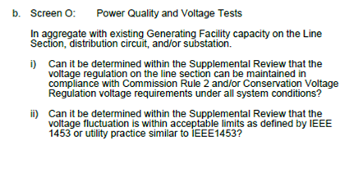
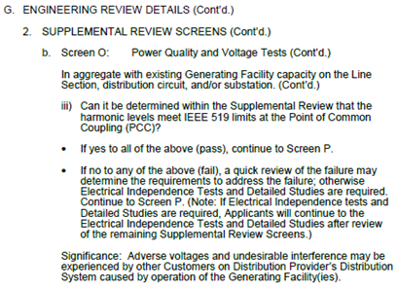
Rule 21 Proposed Modification For IEEE 1547 Section 7.0
Power Quality
Proposed Rule 21 Language:
Replace with IEEE 1547-2018 7.2
Replace with IEEE 1547-2018 7.3

Slide 8
Rule 21 Proposed Modification For IEEE 1547 Section 10.0
Section 10.4 Configuration Information.
IEEE 1547-2018 language:
Add to Ca Rule 21 Hh.7 under the added “Nameplate Information”.
Proposed addition based upon
1/14/21 discussion.
“Note: Configuration change may require a study depending on the change and mutual agreement”
Notes:
H7 Telemetry and control
OK to have mutual agreement. Need to have a study performed before configuration change.

Slide 9
Modify Hh.5 as follows
Rule 21 Proposed Modification For IEEE 1547 Section 10.0
Section 10.7 Communication Protocol Requirements.
5. Communication Requirements
The communication protocol requirements included in Hh.5 shall become mandatory for Generating Facilities utilizing inverter-based technologies for which an Interconnection Request is submitted beginning June 22, 2020. The utilization of this function is under mutual agreement between Distribution Provider and the generating facility before the effective date. Generating Facilities utilizing inverter-based technologies must adhere to the following communication protocol requirements for communications between Distribution Provider and the DER. This Rule does not specify the communication between the selected communication option and Smart Inverter but performance will be enforced by this Rule. The below diagram shows the interface requirements as Applicable for section Hh.5. The Distribution Provider Interface (solid red line) is described in Sections Hh.5.a and Hh.5.b. The Local DER Interface (dotted blue line) is described in Section Hh.5.c. The top row shows a direct connection between the Distribution Provider and the DER network adapter which may be separate or integrated into the DER. The lower row shows a connection between the Distribution Provider and an aggregator or local control system.

Slide 10
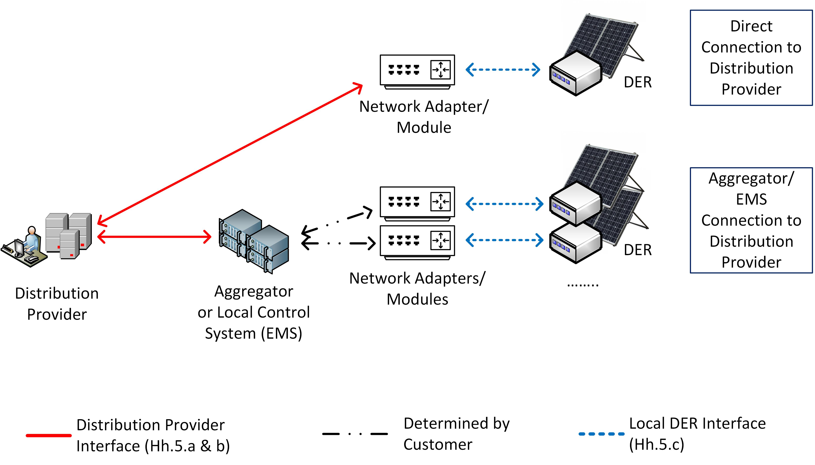
10.7 Continued
Add Diagram to Hh.5

Slide 11
10.7 Continued
Modify Hh.5a
  a. The communications requirements herein shall be between in Section Hh.5.a pertain to (i) the Distribution Provider and the individual Generating Facility’s inverter control or energy management system; (ii) the Distribution Provider and communication to the Generating Facility through an aggregator not co-located or part of the Generating Facility; or (iii) other communication options as mutually agreed to by Applicant and Distribution Provider. the Distribution Provider and the DER:
i. Shall be capable of communications;
ii. Software shall be updateable via communications remotely;
iii. The transport level protocol shall be TCP/IP; and,
  iv. The default application-level protocol shall be IEEE 2030.5 (i.e., Smart Energy Profile 2.0 (SEP 2)) as defined in the latest final version of the Common Smart Inverter Profile (CSIP), the Interconnection Handbook, Cybersecurity Requirements or Programs and Contracts. Other application-level protocols may be used by mutual agreement of the parties including IEEE 1815/DNP3 for SCADA real-time monitoring and control and IEC 61850.

Slide 12
New Hh.5.c (add or reference the below 1547 language)
10.7 Continued
The DER shall support at least one of the protocols specified in Table 41. The protocol to be utilized may
be specified by the Area EPS operator. Additional protocols, including proprietary protocols, may be
allowed under mutual agreement between Area EPS operator and DER operator. Additional physical layers
may be supported along with those specified in the table.
Notes:
Intent is to adopt 1547 requirements.
Modify this figure to include Rule 21 requirements.

Slide 13
Rule 21 Proposed Modification For IEEE 1547 Section 10.0
Section 10.8 Communication Performance Requirements.
IEEE 1547-2018 language:
Add to Rule 21 Hh.5.b. Create v. “Communication performance shall meet requirements of IEEE 1547-2018 10.8.”
Notes:
Contractual operation end- to-end performance terms.

Slide 14
Discussion
Notes:
Ensure screen O is covered in PQ update.

Slide 15
Smart Inverter Working Group Discussions
Supporting Ordering Paragraphs 15 (Issue 9 –Step 2) and 51
January 21, 2020

Slide 16
Meeting Agenda
Welcome
Adopted Order for Issue 9 (OP 15)
Adopted Order for Issue A-B #3 (OP 51)
Review and Discuss Process Block Diagram (Applicable for OP 15 and OP 51)
Next Steps

Slide 17
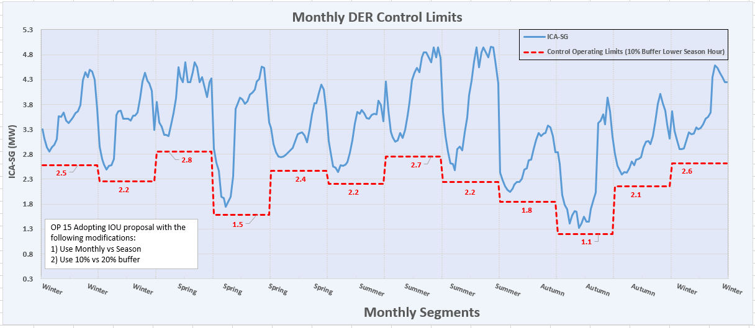
Overview -Issue 9 (OP 15)
Source: Final Decision (D.20-09-035) @Pg. 220
Adopts IOU proposal with modifications
Requires use of Monthly
Requires use of 10% buffer
Proposed the future reduction of generation profiles may be necessary
SWIG Consultation regarding implementation details

Slide 18
Issue A-B #3 - PUC Adopted (OP 51)
Source: Final Decision (D.20-09-035) @Pg. 224
OP 51 Timelines Nearly in alignment with OP 15
Within 90 of the Decision, IOUs should commence discussion with the SIWG on the implementation of the order. (consistent with OP 15)
Within 90 days after the standard approval, IOUs are to submit a Tier 2 AL to modify Rule 21 (OP 15 requires this at 90 days)
Within 6 months of issuance of the Commission’s Final Decision, IOUs shall submit a Tier 3 AL providing recommendations regarding standard review, certification, and interconnection process. This AL may be combined with Tier 3 AL required for OP 15 (Consistent with OP 15)
OP 51 Proposed Implementation approach
The order should not be implemented until 9 months after technical specification standards, and a certification scheme for Limited Generation Profile has been approved by the standards bodies.
  Currently, the UL PCS standard is the standard being viewed as being used to meet this requirement
Comparing OP 15 and OP 51
OP 51 parallels OP 15 except that OP 15 does not provide generation technology specifications while OP 51 requires that generation be certified inverter-based technology (relies on OP 49 and OP 50)
While OP 15 may not specify the technology, it assumed that approach needs to be implemented with certified inverter-based technology in order to have the intended benefits
Thus OP 15 and OP51 are essentially looking to similar needs and will be implemented in the same manner

Slide 19
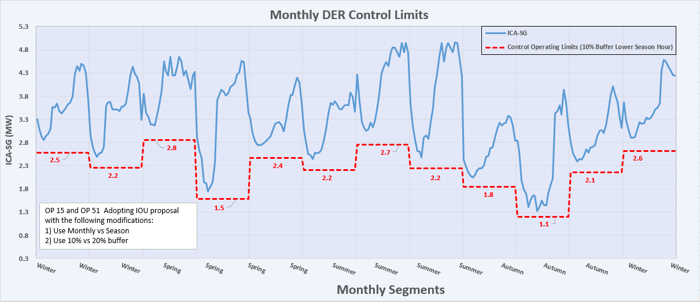
Overview Issue A-B #3 (OP 51)
The order requires that inverters approved for non-export and limited export be set using different maximum export values at different time of the year when meeting qualification for either Proposal for either A-B #1 (OP49) or A-B #2(OP50)
  A-B #1: Inverter Based Gen, Non-export, Limited-Export Open Loop Response=2 seconds
  A-B #2: Inverter Based Gen, Inadvertent-export, Open Loop Response=10 seconds
Order does not specify the frequency of allowed changes throughout the year.
  For consistency with OP 15 (issue 9). The frequency for OP 51 should be monthly.
  Should apply the same buffer as that of OP 15

Slide 20
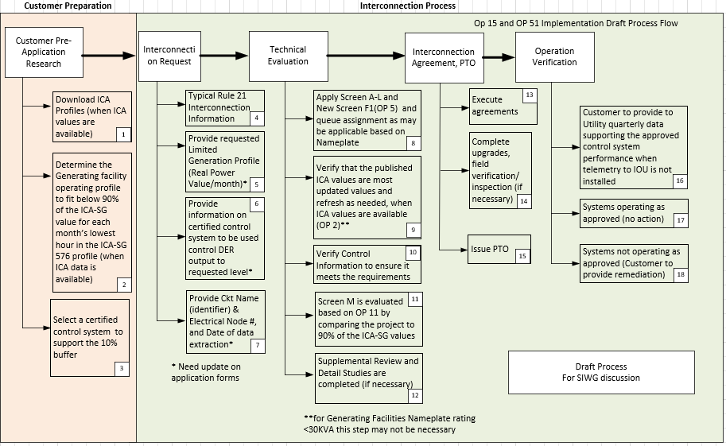
Review and Approval Process (For Discussion)

Slide 21
Ordering Paragraph 15
Issue 9 – Continue discussion
Step 2
January 7, 2020
Decision Issued: 9-24-2020
Target Completion of Step 2: End of February, 2021
Tier 3 AL to be filed: 3/24/2021

Slide 22
Meeting Agenda
Welcome
Review Step #2 in detail
Background on ICA development
Background on Issue 9
Review and Discuss Process Block Diagram
Next Steps

Slide 23
Breaking down OP 15 – Step 2
Step #2:
Within six months of issuance of this decision, Utilities shall submit a Tier 3 Advice Letter providing:
  Recommendations (as applicable) regarding the standard review
  Certification requirements
  Interconnection processes necessary for implementation of the proposal.
Decision Issued: 9/30/2020
Tier 3 AL due: 3/28/2021
Therefore, completion of Step 2 should be by 2/24/2021 as we need input from Step #2 for Tier 3 AL.

Slide 24
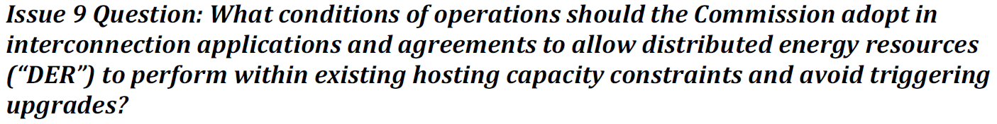
Issue 9

Slide 25
What is Hosting Capacity Values (ICA Values in CA)
ICA Methodology:
  Developed as part of the AB327 DRP
  ICAWG team discussed as part of Track I DRP proceeding
  October 2017, PUC Track 1 ruling provides requirement to develop ICA values for system wide by July 2018 (eventually moved to December 2018)
ICA Use Case: Interconnection Application of DERs
  Calculates ICA values for Thermal, Steady State Voltage, Power Quality, Protection, and safety (OF) independently from each other
  Calculates the available hosting capacity at each of the three phase nodes. For reference, for SCE each circuit has average of approximately 600 three phase electrical nodes
  Calculated for 576 hours of the year (12 months, each month’s high and low days- 24 days *12 = 576 hours)
  Calculates a technology agnostic value and translates the agnostic ICA value to a typical fixed PV ICA value
  Calculates three types of ICA values:
    ICA with no operation flexibility (now known as ICA-Static Grid – ICA-SG)
    ICA with operational flexibility (now known as ICA-Operational Flexibility- ICA-OF)
    Load ICA values (not related to this order)
  Must be published for customer to view and download the information. SCE published at: https://ltmdrpep.sce.com/drpep/

Slide 26
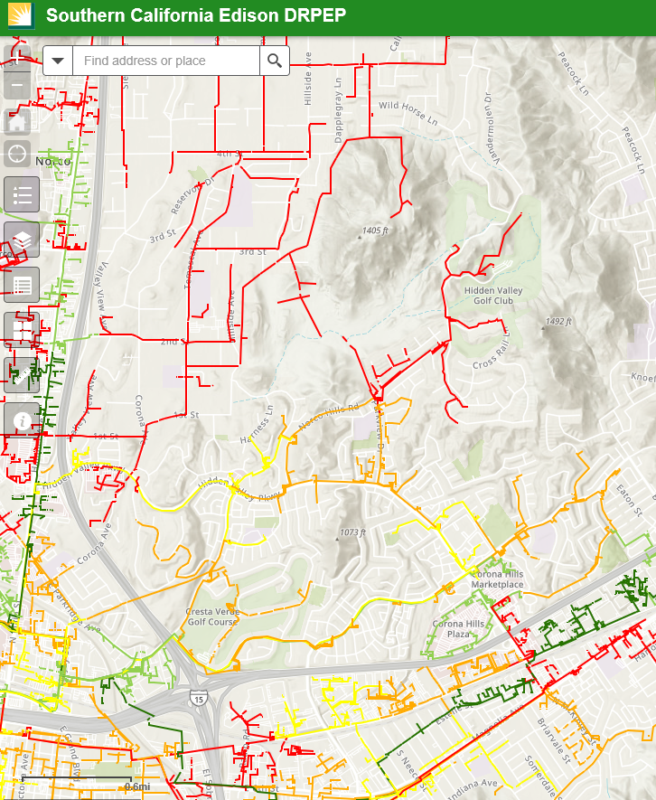
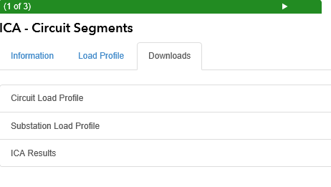
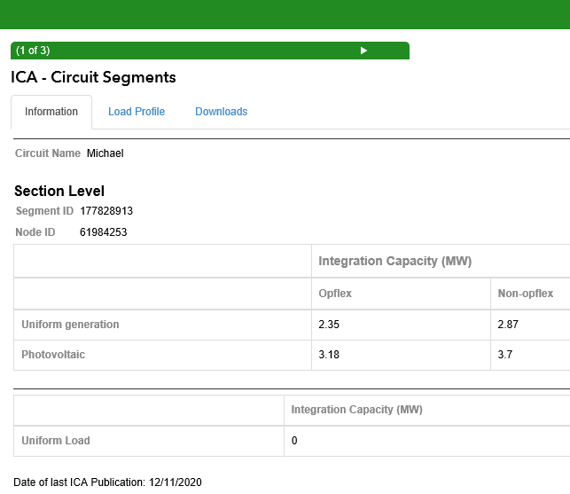
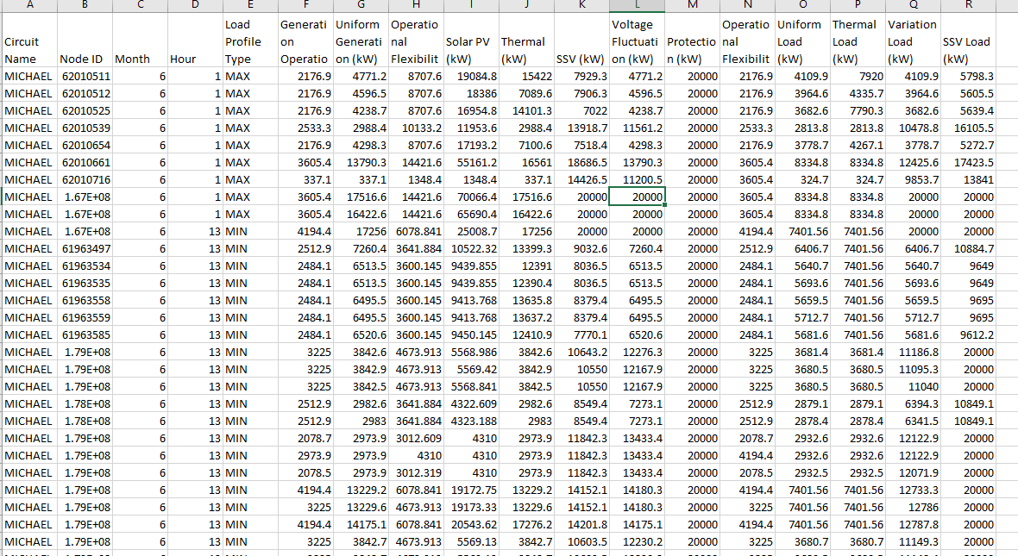
What is Hosting Capacity Values (Example- SCE DRPEP
  https://ltmdrpep.sce.com/drpep/
Download Access
3-phase Electrical Node
Data ready to be analyzed
Lowest ICA-SG Value in the ICA-SG profile
Lowest ICA-OF value in the ICA-OF profile

Slide 27
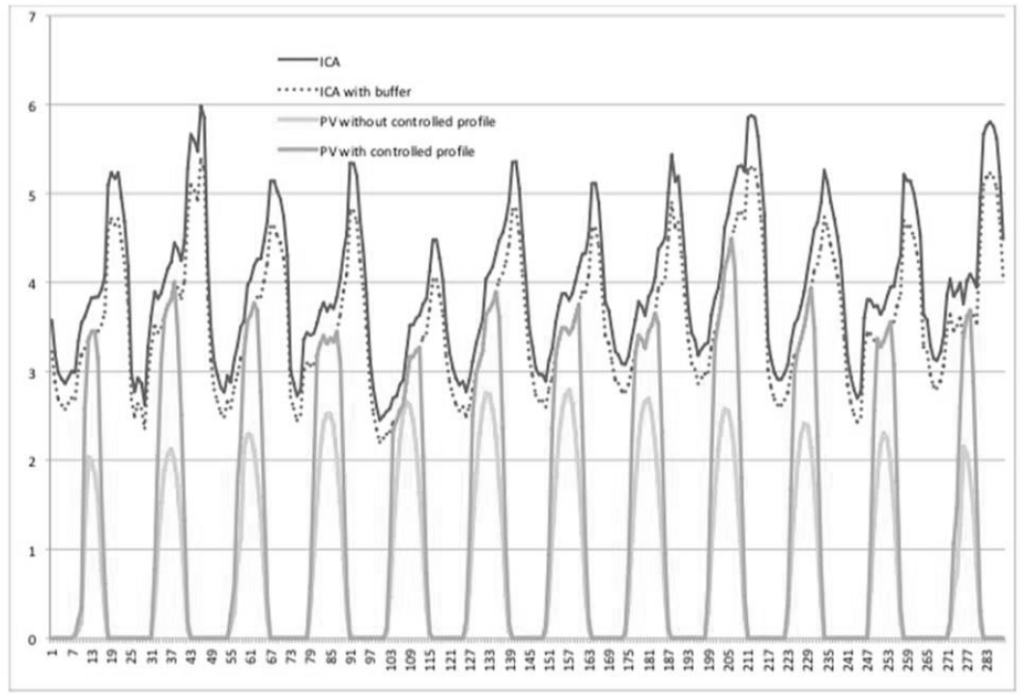
Issue 9 – Non-IOU Proposal
Source: Rule 21 WG 2 Report Pg. 120
Proposal acknowledge that a buffer between ICA-SG and Operating profile was needed but did not specify the buffer
Proposed that the technology was available but did not provide specific details
Proposed the future reduction of generation profiles may be necessary

Slide 28
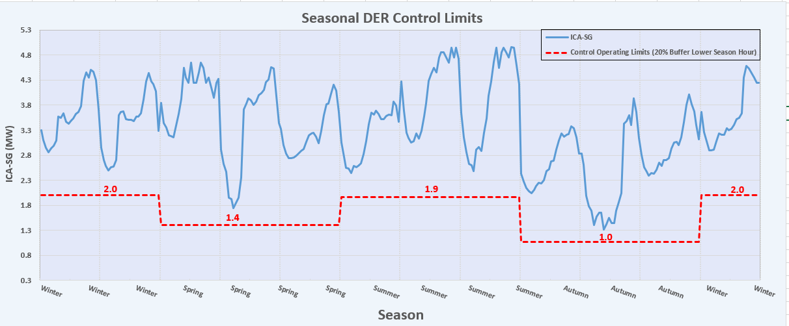
Issue 9- IOU Proposal
Source: Rule 21 WG 2 Report Pg. 125
Adopts several element from the non-IOU proposal but provides detail further details
Proposed to use season periods
Proposed to use of 20% buffer
Proposed the future reduction of generation profiles may be necessary

Slide 29
Issue 9- PUC Adopted (OP 15)
Source: Final PUC Order (D.20-09-035) @Pg. 220
Adopts IOU proposal with modifications
Requires use of Monthly
Requires use of 10% buffer
Proposed the future reduction of generation profiles may be necessary
Consult the SIWG for implementation details

Slide 30
Review and Approval Process (For Discussion)

Slide 31
Ordering Paragraph 15
Issue 9
As required by OP 15 – Utilities shall, within 90 days, commence discussion with SIWG on implementing the proposal
December 17, 2020
Decision Issued: 9-24-2020
Meetings must commence prior to: 12/24/2020
Today: 12/17/2020

Slide 32
Meeting Agenda
Welcome
Review OP 15
Breaking down OP 15
Discussion Draft Schedule
Next Steps

Slide 33
Ordering Paragraph 15 (Issue 9)
Adopted IOUs’ counter-proposal to resolve Issue 9, with modification.
Within 90 days of the decision, Utilities shall commence discussions with the SIWG focused on implementing the proposal.
Within six months the decision, Utilities shall submit a Tier 3 Advice Letter providing recommendations (as applicable) regarding the standard review, certification requirements, and interconnection processes necessary for implementation of the proposal.
Within 60 days of adoption of a certification scheme for the Limited Generation Profile, Utilities shall modify Rule 21 Interconnection Application Process to allow a DER customer to include a Limited Generation Profile with their application, require the customer to enable generation profile limiting functionality, and allow Utilities opportunity to alter the profile if safety and reliability concerns warrant it.
  Retroactive alterations to the ICA values within the interconnection process and addressing whether the Commission should continue use of the 10% buffer or adjust it, based on the data generation profiles shall not reduce generation to below a pre-defined static level, i.e., the lowest ICA – Static Grid typical profile value identified at the time of the Interconnection Application.
  As part of the proposal, Utilities shall:
  allow customers to utilize a smart inverter’s ability to increase its output on a monthly basis; and
  use a 10% buffer, which shall be revisited.
  No later than 18 months after the implementation of this proposal, Utilities shall submit a Tier 3 Advice Letter providing data obtained from Proposals 8b and 8c, adopted below, assessing the effectiveness of the use of the ICA values within the interconnection process and addressing whether the Commission should continue use of the 10 percent buffer or adjust it, based on the data.

Slide 34
Breaking down OP 15 – Step 1
Step #1:
Within 90 days of the issuance of this decision, Utilities shall commence discussions with the Smart Inverter Working Group focused on implementing the proposal.
Decision Issued: 9/24/2020
90 days from Decision: 12/24/2020
Today: 12/17/2020
Today’s meeting is to meet this requirement: Commence Discussion on implementation of the proposal

Slide 35
Breaking down OP 15 – Step 2
Step #2:
Within six months of issuance of this decision, Utilities shall submit a Tier 3 Advice Letter providing:
  Recommendations (as applicable) regarding the standard review
  Certification requirements
  Interconnection processes necessary for implementation of the proposal.
Decision Issued: 9/24/2020
Tier 3 AL due: 3/24/2021
Therefore, completion of Step 2 should be by 2/24/2021 as we need input from Step #2 for Tier 3 AL.

Slide 36
Breaking down OP 15 – Step 3
Step #3:
Within 60 days of adoption of a certification scheme for the Limited Generation Profile, Utilities shall modify the Rule 21 Interconnection Application Process to:
Allow a distributed energy resources customer to include a Limited Generation Profile with their application,
Require the customer to enable generation profile limiting functionality, and
Allow Utilities opportunity to alter the profile if safety and reliability concerns warrant it.
Anticipated adoption (approval) certification Scheme for Limited Generation Profile: 12/31/2020*
Relying on the approval of the revised UL PCS standard currently being updated via weekly working UL PCS working group meetings
If John Berdner or Tim Zgonena are in the call, they may provide an update
Rule 21 shall be modified by: 3/01/2021.
  Assuming that adoption of a certification scheme would be by 2/1/2020
  Assuming this would be done through an Advice Letter although the order does not specify that.
  Assuming approval of certification Scheme for Limited Generation Profile by 12/31/2020
There is some conflict between Step #2 and Step #3. Some clarification and support from the commission may be good here:
  Do we need an AL for this? If so, can this be done in the same AL as that of Step #2?

Slide 37
Breaking down OP 15 – Step 3
Step #3 Continued:
Retroactive alterations to the generation profiles shall not reduce generation to below a pre-defined static level, i.e., the lowest Integrated Capacity Analysis – Static Grid typical profile value identified at the time of the Interconnection Application.
As part of the proposal, Utilities shall:
i) allow customers to utilize a smart inverter’s ability to increase its output on a monthly basis; and
ii) use a 10% buffer, which shall be revisited.

Slide 38
Breaking down OP 15- Step 4
Step #4: Not part of SIWG discussion (Reporting)
No later than 18 months after the implementation of this proposal, Utilities shall submit a Tier 3 Advice Letter providing data obtained from Proposals 8b and 8c, assessing the effectiveness of the use of the ICA values within the interconnection process and addressing whether the Commission should continue use of the 10% buffer or adjust it, based on the data.

Slide 40
Next Steps
Next meeting will be focused on the elements of Step #2

Slide 41

Thank you!
For Additional Information visit:
http://www.cpuc.ca.gov/General.aspx?id=4154
or contact Sophie Meyer at:
sme@cpuc.ca.gov

