Slide 1

Solar on Multifamily Affordable Housing (SOMAH) Independent Evaluation
Public Webinar on Triennial Evaluation
June 16, 2023

Slide 2
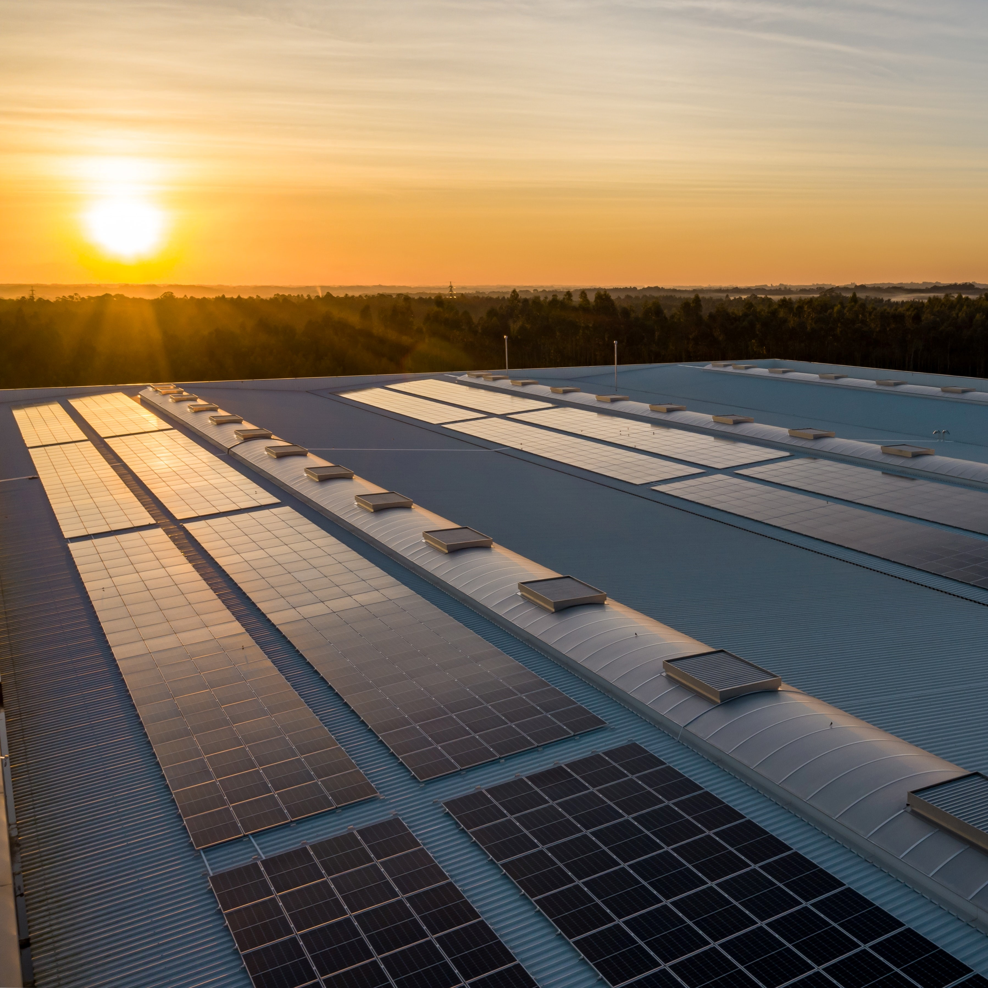

AGENDA
SOMAH Background
Evaluation Overview
Review of Key Evaluation Findings
Top Recommendations
Q&A

Slide 3
SOMAH Background
California State Assembly Bill (AB) 693 directed the CPUC to institute a new program intended to make qualifying solar energy systems more accessible to low-income and disadvantaged communities (DACs). In December 2017, the program’s budget and incentive structure were established.
Goal of 300 MW CEC-AC solar generating capacity installed in qualified multi-family affordable housing properties by December 31, 2030
The program provides solar incentives to qualifying affordable housing within the service territories of Pacific Gas and Electric Company (PG&E), Southern California Edison Company (SCE), San Diego Gas and Electric (SDG&E), Liberties Utilities Company (Liberty) and PacifiCorp

Slide 4
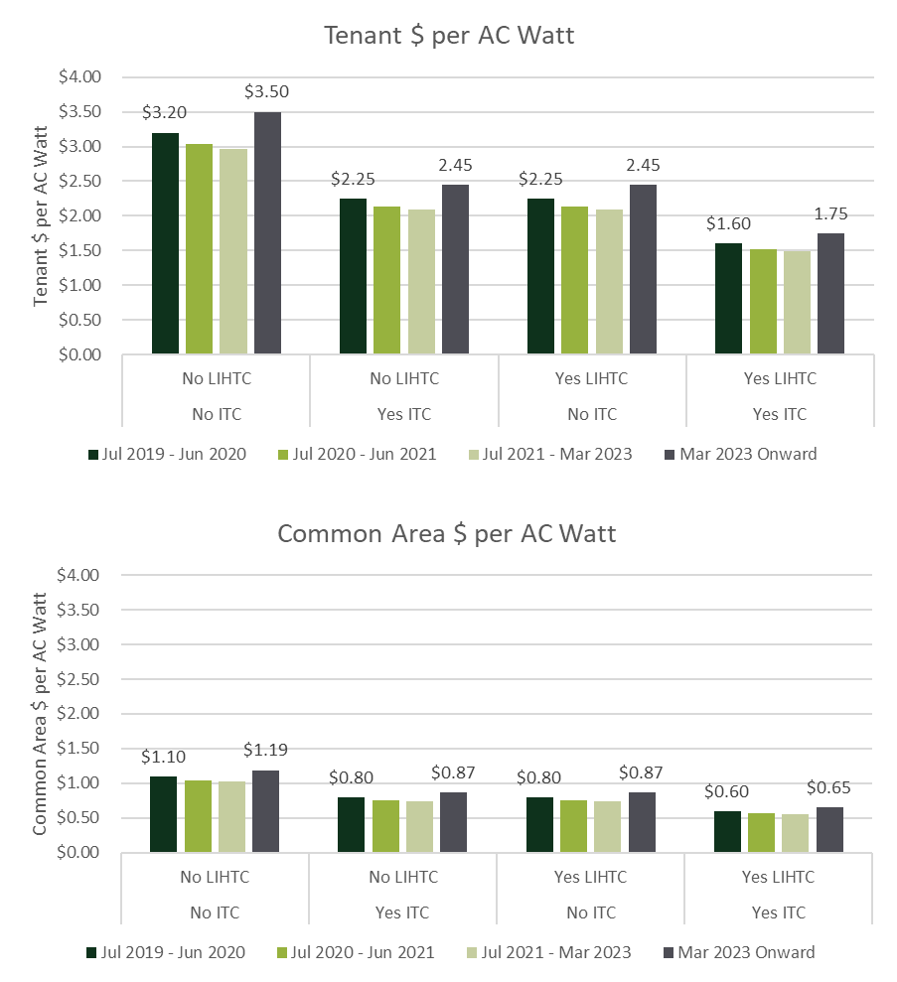
SOMAH Background - Incentives
D.23-03-007 increased SOMAH incentive levels above original level
Two incentive payment options:
  100% of incentive after install, Permission to Operate (PTO), and fulfilled all SOMAH requirements
  60% progress payment once the equipment is installed, but prior to receiving PTO (opt-in)

Slide 5
Evaluation Objectives
Primary objectives
Objective 1: Assess progress towards the program goals and metrics, determine cost-effectiveness, and meet legislative reporting requirements
Objective 2: Determine electrical system benefits, environmental benefits, workforce outcomes, and customer/participant outcomes
Objective 3: Progress meeting past evaluations’ recommendations and identify recommendations for improving the program to meet its goals

Slide 6
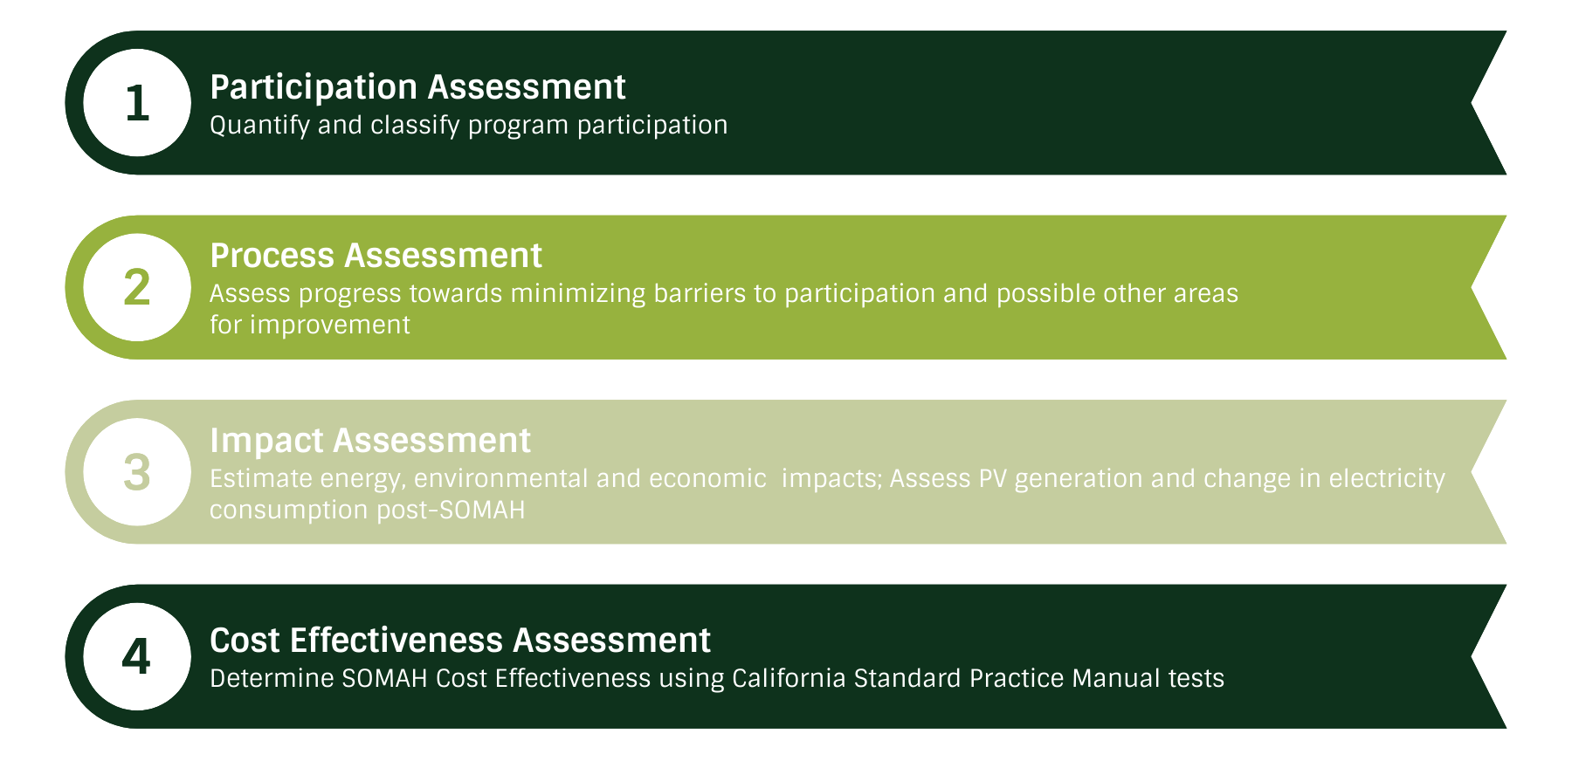
Research Areas

Slide 7
Participation Assessment

Slide 8
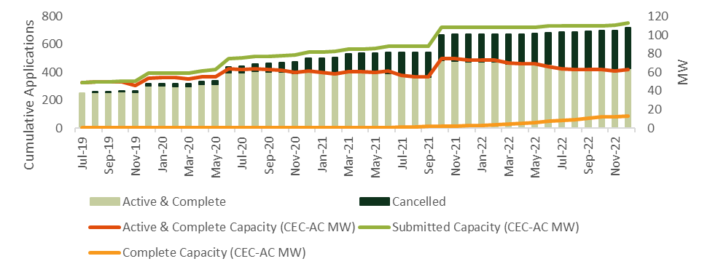
Application History
Cumulative SOMAH applications and capacity since program inception
63 MW Active & Completed Capacity
13 MW Completed Capacity

Slide 9
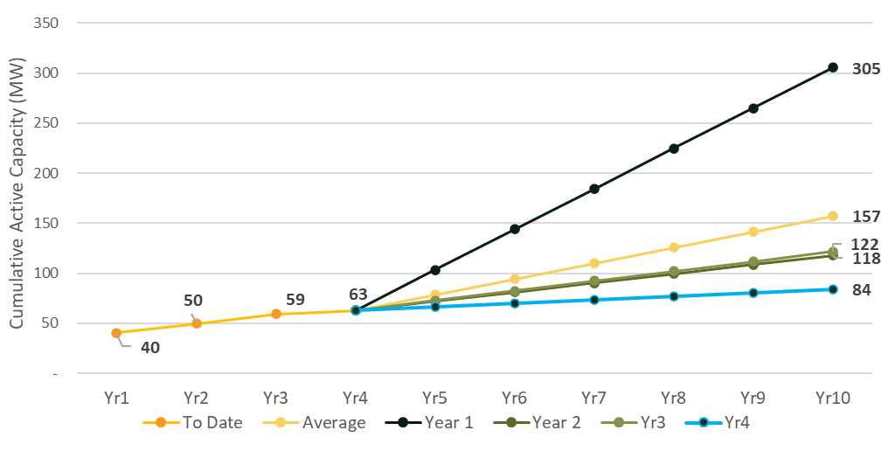
Active Capacity towards 300 MW Goal
300 MW Goal is only achieved if participation increases to first year level.

Slide 10
Participant Characteristics
Property Owner and Contractor Diversity
Property Owners
  Participation dominated by large property owners
    69% of applications submitted by 21 property owners (20% of all property owners)
  Cancellation rates lower for large property owners
    29% for property owners with 10+ applications
    63% for property owners with < 10 applications
Contractors
  3 contractors dominate participation (94% of applications)
  Subcontracting (54 active and complete projects) significantly increasing in diversity
    More than half of subcontracted applications with small (<=25 employees) or underrepresented owned businesses

Slide 11
System Ownership
Host Customer Owned (HCO) vs. Third Party Owned (TPO)
73% of applications chose Third-Party Ownership (vs HCO)
  Higher completion rates for TPO (13% vs 7%)
  Lower cancellation rates for TPO (30% vs 68%)
  Larger (183 kW vs 118 kW) and lower incentive ($1.54 vs $2.08/watt)
Tax Credits
  88% of TPO completed projects took advantage of ITC (no HCO projects used ITC)
  25% of HCO completed projects planned to use the LIHTC
  → Federal ITC increased to 30% by IRA & added mechanism for nonprofits & tax-exempt entities

Slide 12
Process Assessment

Slide 13
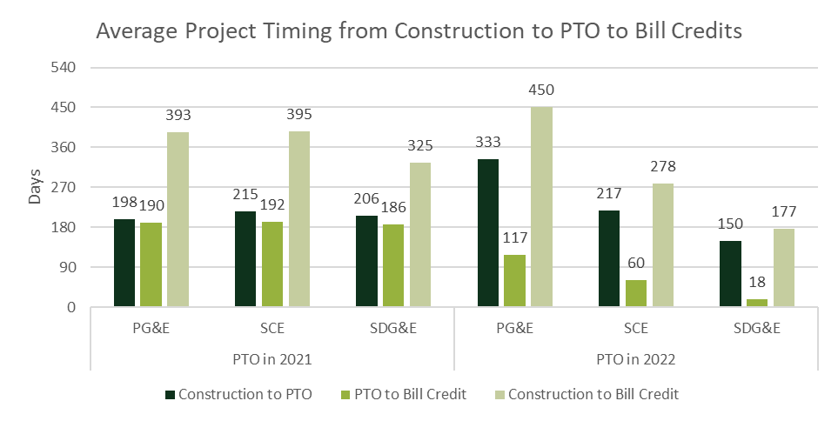
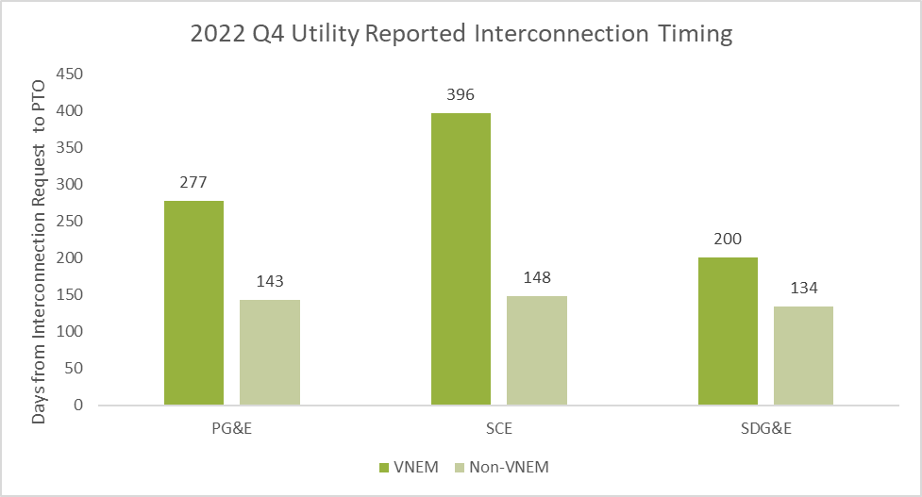
Project Processing Timeline
Getting Permission to Operate (PTO) and then setting up bill credits takes a long time (6 months to a year)
Time to setup bill credits has improved from 2021 to 2022
Longer PTO waits are a problem for all VNEM systems…
*As construction end data was not available, it was estimated using construction start date and an estimate of the average length of SOMAH PV system installation (8 weeks).

Slide 14
Marketing and Outreach
Program awareness among property owners is primarily driven by contractors or other trusted sources not affiliated with SOMAH program implementation. CBOs (30% of ME&O budget) have not yet had a significant impact on program participation.
Difficult to contact non-participating properties (over 25% of individuals contacts for interviews were no longer at organization). 54% of non-participating PO were aware of SOMAH.
Contractors report a disconnect between marketing messaging (highlighting social and environmental benefits) and property owner motivations (financial bottom line).

Slide 15
PROPERTY OWNER BARRIERS
Lack of property owner staff resources to participate in SOMAH (personnel to manage solar installation project)
Participation Burden
Project Financing
Physical Site Issues
Application Prioritization
Some smaller affordable housing organizations report difficulty finding contractors
Continues to be a large concern
Property owners frequently use TPO to eliminate upfront out of pocket costs
Many properties are older and would need maintenance (roof repairs) before adding solar

Slide 16
CONTRACTOR Barriers
Level of documentation required is too high
Administrative Burden
Elongated Timelines to Identify Issues
Financial Costs
Uneven Playing Fields
More consistent interaction with and feedback to PAs is required to solve issues in a timely manner
Significant presence of large subcontractors makes it difficult for smaller ones to “break into” the program
Small contractors can’t support upfront costs
Incentives are too low to engage property owners or make a profit

Slide 17
Process – Tenant Education
Tenants were often confused regarding the timing and accounting of bill credits, as tenant training can occur up to a year prior to PV installation, interconnection, and bill credit receipt
56% of tenants who completed the PA’s tenant survey did not recall seeing any materials in their building related to the SOMAH program
Of those who saw materials, 43% said the materials helped them feel very or somewhat prepared for their building’s solar installation.

Slide 18
Process – Workforce Development
Not all interviewed contractors were aware of the job training resources and reported they would be interested in using them
According to contractors, almost all trainees were prepared to perform the tasks assigned to them
11% of job trainees covered in contractor survey were still employed with their contractor 9 months post-installation. Contractors are very satisfied with these trainees. An additional 10% of job trainees were employed with a different contractor or subcontractor 9 months post-installation.

Slide 19
Impact Assessment

Slide 20
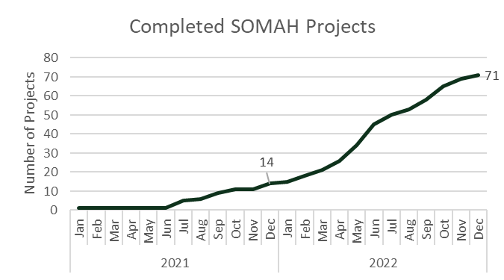
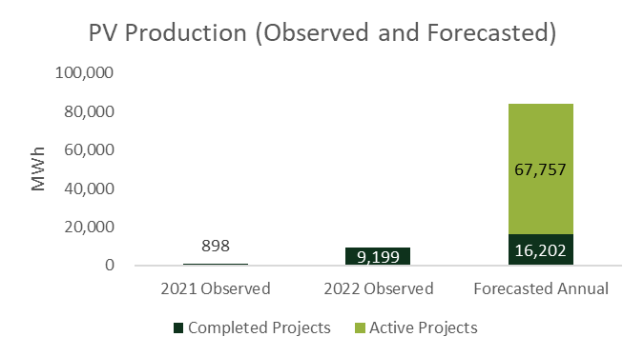
Energy and Demand Impacts
Forecasted energy production from completed and active projects is 83,959 MWh/year
Average Observed PV Generation Coincident with Top 200 Hours CAISO Gross Demand:
  2021: 44 kW
  2022: 36 kW

Slide 21
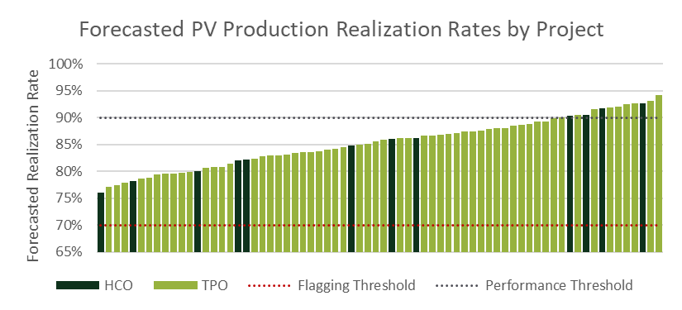
PV production Realization Rates
Poor system performance relative to expectations
Forecasted Realization Rate (71 completed projects): 85%
SOMAH PA monitoring threshold is 70% and certain performance guarantees exist at 90%

Slide 22
Customer Electricity Consumption
Estimated average change in tenant consumption was small relative to monthly consumption
Tenants may have reduced energy consumption due to timing of PV installations relative to the return to in-person activities related to the COVID-19 pandemic
Utility | Estimated Monthly Difference in Post Period | % of Avg weather normalized consumption in pre-period
PG&E | -18.10 kWh | -3.1%
SCE | 3.35 kWh | 0.96%
SDG&E | -4.81 kWh | -1.6%

Slide 23
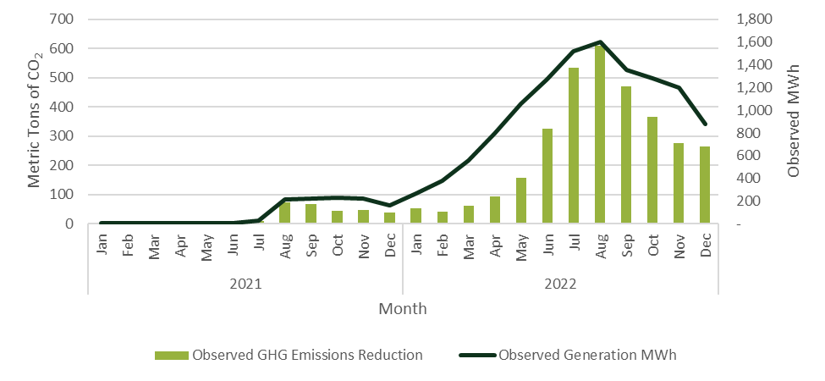
Environmental Impacts
As SOMAH systems are completed, emissions reductions are beginning to materialize
Observed Emissions Reductions
  229 metric tons of CO₂ in 2021
  2,351 metric tons of CO₂ in 2022
Forecasted Emissions Reductions
  3,838 metric tons of CO₂ /yr (completed projects)
  20,835 metric tons of CO₂ /yr (completed + active projects)
Forecasted Avoided GHG Costs
  $101K/yr (completed)
  $539K/yr (completed + active)
Observed Emissions Reductions

Slide 24
Bill Impacts
~60% average monthly bill reductions due to SOMAH systems
Estimated Bill Savings in 2022 due to SOMAH system
  Tenant - $39 saved per month due to SOMAH system (59%)
    CARE: $34 per month (60%)
    Non-CARE: $52 per month (57%)
  Common Area – $931 per month (58%)
YoY Bill Reductions
  Tenant year over year bill reductions were ~50% of SOMAH bill impact (above) in PG&E & SCE and ~70% in SDG&E
  Experienced YoY bill reductions were dampened by rate increases and changes in consumption due to weather

Slide 25
Cost-Effectiveness Assessment

Slide 26
Cost Effectiveness
Many of SOMAH’s equity benefits not captured by SPM cost-effectiveness tests and may not be easily quantifiable
Lower program administrative costs would improve TRC, sTRC, and RIM
Since SOMAH PV systems contribute to customer bill savings this leads to higher RIM costs and lower overall RIM benefit-to-cost ratios
Utility | TRC | sTRC | RIM
PG&E | 0.49 | 0.55 | 0.17
SCE | 0.60 | 0.63 | 0.22
SDG&E | 0.86 | 0.94 | 0.15
SOMAH Total | 0.61 | 0.65 | 0.19
25th-75th percentile range | $10,707,971 | $13,197,932 | $10,592,516
NPV Total Benefits | $17,688,059 | $20,349,663 | $54,976,416
NPV Total Costs | 0.49 | 0.55 | 0.17

Slide 27
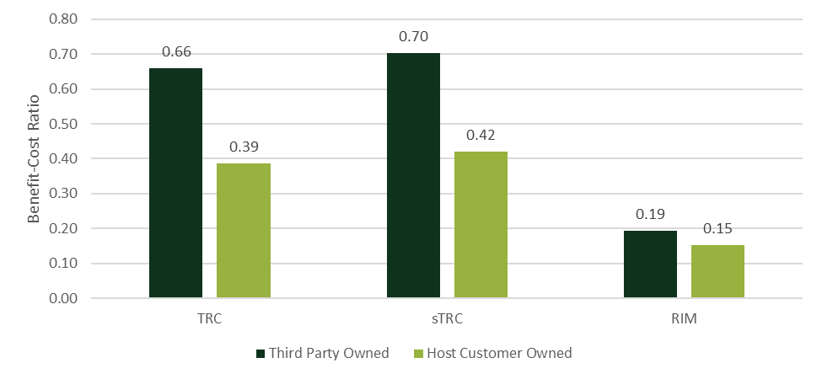
Cost Effectiveness by Ownership Type
Third Party Owned (TPO) vs Host Customer Owned (HCO)
TPO higher benefit-cost ratio likely driven by ability to take advantage of ITC
Administrative costs potentially lower for TPO (not captured in analysis), would lead to even higher benefit-cost ratios for TPO

Slide 28
Recommendations

Slide 29
Recommendations
Contractor Barriers:
Conduct greater outreach to contractors to ensure they are aware of all available SOMAH resources and to reduce administrative burden.
Establish a well-understood communication channel for program feedback to be shared with the PA and the CPUC.
Increase marketing of the progress payment pathway and/or set as the default
Property Owner Barriers:
Prioritize direct outreach to non-participating property owners to ensure they are aware of and knowledgeable about the program.
Increase engagement with property owners using HCO
Prioritize outreach to potentially “recoverable” cancelled applications
Impact:
Track and report SOMAH bill credits as a secondary measure of data quality and system performance
Increase SOMAH PA monitoring threshold that flags underperforming systems and consider additional system performance enforcement measures

Slide 30
Questions

Slide 31
Thank You

