Slide 1
Resource Tracking Data
Data current as of August 2024

Slide 2
Notes on Resource Tracking Data
Notes on Online MWs data
All data are derived from CAISO Master Generating Capability List, and CPUC NQC Lists with online dates between Jan 1, 2020 – August 31, 2024
Nameplate Capacity is shown as “Net Dependable Capacity” in the CAISO Master Generating List file.
Data shown excludes imports, except where specified.
NQC values are “Estimated September NQC” and subject to change based on counting rules or changes to resource configurations.
Data showing “Number of Projects” is derived by counting each unique CAISO resource ID as a project.
“Natural Gas” includes Alamitos Unit 7 (675 MW) and Huntington Beach (674 MW), online in Feb 2020.
Notes on Expected New MWs
All data are from LSE self-reported contracting for projects expected to come online between 2024 and 2026.
Data are subject to change as the CPUC gets updated information from LSEs, IOU interconnection departments, developers and others.
CPUC staff continue to refine the data included herein. Data in this presentation are current up until August 2024 and any subsequent postings will supersede prior postings.
Data included here are only the projects under contract to CPUC jurisdictional LSEs, and do not include all resources being developed in the state nor the CAISO footprint.
Notes on Differences between Resource Tracking Data and IRP Compliance
Due to numerous differences, such as varied baselines and resource eligibility for compliance, data on New MW Online plus New MW Expected do not exactly match progress towards IRP compliance orders. For information on compliance with IRP Procurement orders, see compliance updates at IRP Procurement Track (ca.gov).
Notes on Updates and Questions
For the most up-to-date data publicly available, please visit the CPUC's Summer Reliability page.
For any questions about the data, please contact irpdatarequest@cpuc.ca.gov

Slide 3
Part 1: New MW Online
New Resources Online from 1/1/2020 to 8/31/24
By Nameplate, NQC, and Number of Projects
New Resources Online by Year and Resource Type
By Nameplate and NQC
New IRP Procurement Resources Online by Year and Resource Type
By Nameplate and NQC

Slide 4
New MWs - Key Takeaways
Data includes projects online as of August 31, 2024
Total New MW Online between 1/1/2020 - 8/31/2024
 | Nameplate Capacity (MW) | Estimated Sept. Net Qualifying Capacity (NQC) MW | Number of Projects by Resource IDs
New SB100 Resources, IN-CAISO | 18,565 | 10,017 | 295
New Resources, IN-CAISO (includes Natural Gas) | 20,041 | 11,491 | 307
Total New Reliability Resources, including Imports | 21,792 | 12,418 | 321
Total Storage Online in CAISO (all time)
 | Nameplate Capacity (MW) | Estimated Sept. Net Qualifying Capacity (NQC) MW | Number of Projects by Resource IDs
Battery Energy Storage Systems (BESS) Projects (Including Standalone BESS & Hybrids) | 9,924 | 9,523 | 159 (incl. 23 hybrids)
Note: MW only include storage portion of hybrids

Slide 5
New Energy Resources Online
Data includes projects online as of August 31, 2024
New Resources Additions, Jan 1, 2020 – August 31, 2024, Cumulative
Technology Type | Nameplate Capacity MW | Estimated Sept. Net Qualifying Capacity (NQC) MW | Number of Projects
STORAGE | 8,881 | 8,554 | 126
SOLAR | 6,946 | 537 | 112
HYBRID (STORAGE/SOLAR) | 1,539 | 758 | 23
WIND | 1,118 | 138 | 22
GEOTHERMAL | 41 | 31 | 1
BIOGAS, BIOMAS, HYDRO | 39 | 0 | 11
Subtotal Total New SB100 Resources, IN-CAISO | 18,565 | 10,017 | 295
NATURAL GAS, incl. Alamitos & Huntington Beach | 1,477 | 1,474 | 12
Total New Resources, IN-CAISO | 20,041 | 11,491 | 307
New Imports, Pseudo-Tie or Dynamically Scheduled | 1,751 | 927 | 14
Total New Resources, including Imports | 21,792 | 12,418 | 321
Notes: All data shown derived from CAISO Master Generating Capability List, and CPUC NQC Lists.
Nameplate Capacity is shown as “Net Dependable Capacity” in the CAISO Master Generating List file. Data shown excludes imports, except where specified. All NQC values are “September NQC” and subject to change based on counting rules and additions to monthly CPUC NQC Lists. “Project” is defined as a unique CAISO resource ID. “Natural Gas” includes Alamitos Unit 7 (675 MW) and Huntington Beach (674 MW) added in Feb 2020.
Notes:
This slide shows the unprecedented quantity of new clean energy resources that have come online in under two years.
So, Let’s just take a quick look at this data together. We are showing both the nameplate and Sept. net qualifying capacity (NQC). The NQC reflects the amount a particular resource can count towards meeting the reliability requirements.
The first row shows the huge amount of new energy storage that has come online since January 2020. This is really the big story in the transformation of the energy fleet. While we have been expecting storage to provide reliability for most of the past decade – here we can see it has finally arrived – it is now here. So, Prior to 2020 we had just barely begun to see a few hundred MWs of energy storage online to serve the CAISO markets – and most of the storage was providing just ancillary services. But the storage that you see here now reflects a truly new reliability resource – and these storage MWs are providing energy and capacity on a daily basis. There is also some storage shown in the “Hybrid” line – so together, there is over 4,000 MW of new storage regularly serving the CAISO market at this time. (And growing monthly)
Of course these storage MWs need energy to charge – so the wind and solar MWs that were added in the past two years – can help provide that energy.
In addition to the Clean New Resources shown, our possibly last new gas plants came online in Feb 2020 so they are included here as part of the data set of new resources. Also, some of our new resources serving the CAISO do so as imports, so there are some new imports shown on this chart as well.
All of the new resources support reliability in different ways.

Slide 6
New MWs Online - Nameplate By Year and Resource Type
Data includes projects online as of August 31, 2024
Technology Type | 2020 | 2021 | 2022 | 2023 | 2024 to date | Total MW | # Projects
SOLAR | 1,300 | 1,048 | 913 | 2,482 | 1,204 | 6,946 | 112
STORAGE | 101 | 1,703 | 1,907 | 2,528 | 2,642 | 8,881 | 126
HYBRID (SOLAR + STORAGE) | 0 | 26 | 890 | 470 | 153 | 1,539 | 23
WIND | 16 | 304 | 367 | 171 | 260 | 1,118 | 22
GEOTHERMAL | 0 | 0 | 0 | 0 | 41 | 41 | 1
HYDRO | 26 | 0 | 0 | 0 | 0 | 26 | 4
BIOMASS | 0 | 2 | 3 | 3 | 0.5 | 8 | 3
BIOGAS | 1 | 0 | 2 | 3 | 0 | 6 | 3
Subtotal Total New SB100 Resources, IN-CAISO | 1,444 | 3,083 | 4,082 | 5,657 | 4,301 | 18,565 | 295
NATURAL GAS, incl. Alamitos & Huntington Beach | 1,448 | 17 | 12 | 0 | 0 | 1,477 | 12
Total New Resources, IN-CAISO | 2,892 | 3,100 | 4,094 | 5,657 | 4,301 | 20,041 | 307
New Imports, Pseudo-Tie or Dynamically Scheduled | 695 | 807 | 49 | 50 | 150 | 1,751 | 14
Total New Resources, including Imports | 3,587 | 3,907 | 4,143 | 5,707 | 4,451 | 21,792 | 321

Slide 7
New MWs Online – Sept NQC By Year and Resource Type
Data includes projects online as of August 31, 2024
Technology Type | 2020 | 2021 | 2022 | 2023 | 2024 to date* | Total MW | # Projects
SOLAR | 126 | 110 | 78 | 188 | 36 | 537 | 112
STORAGE | 100 | 1,616 | 1,906 | 2,448 | 2,485 | 8,554 | 126
HYBRID (SOLAR + STORAGE) | 0 | 8 | 440 | 214 | 95 | 758 | 23
WIND | 7 | 41 | 46 | 30 | 13 | 138 | 22
GEOTHERMAL | 0 | 0 | 0 | 0 | 31 | 31 | 1
HYDRO | 0 | 0 | 0 | 0 | 0 | 0 | 4
BIOMASS | 0 | 0 | 0 | 0 | 0 | 0 | 3
BIOGAS | 0 | 0 | 0 | 0 | 0 | 0 | 3
Subtotal Total New SB100 Resources, IN-CAISO | 233 | 1,775 | 2,470 | 2,879 | 2,660 | 10,017 | 295
NATURAL GAS, incl. Alamitos & Huntington Beach | 1,448 | 16 | 12 | 0 | 0 | 1,474 | 12
Total New Resources, IN-CAISO | 1,681 | 1,791 | 2,481 | 2,879 | 2,660 | 11,491 | 307
New Imports, Pseudo-Tie or Dynamically Scheduled | 380 | 317 | 30 | 50 | 150 | 927 | 14
Total New Resources, including Imports | 2,061 | 2,108 | 2,511 | 2,929 | 2,810 | 12,418 | 321
*Note: Some new projects have not yet made it onto the CPUC’s monthly NQC list and have not yet been assigned NQC. Future reports will include updated NQC amounts for these resources.

Slide 8
New MWs Online August 2024 Additions
Data includes projects online as of August 31, 2024
Technology Type | Nameplate Capacity MW | Estimated Sept. Net Qualifying Capacity (NQC) MW | # Projects
STORAGE | 790 | 715 | 7
Total New Resources, IN-CAISO | 790 | 715 | 7
New Imports, Pseudo-Tie or Dynamically Scheduled | 150 | 150 | 1
Total New Resources, including Imports | 940 | 865 | 8
IRP Procurement
Technology Type | Nameplate Capacity MW | Estimated Sept. Net Qualifying Capacity (NQC) MW | # Projects
STORAGE | 170 | 95 | 3
Total New IRP Procurement | 170 | 95 | 3
*Note: New projects have not yet made it onto the CPUC’s monthly NQC list and have not yet been assigned NQC. Future reports will include updated NQC amounts for these resources.

Slide 9
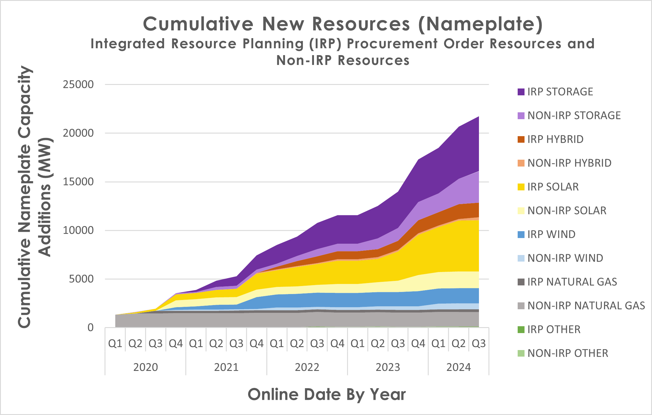
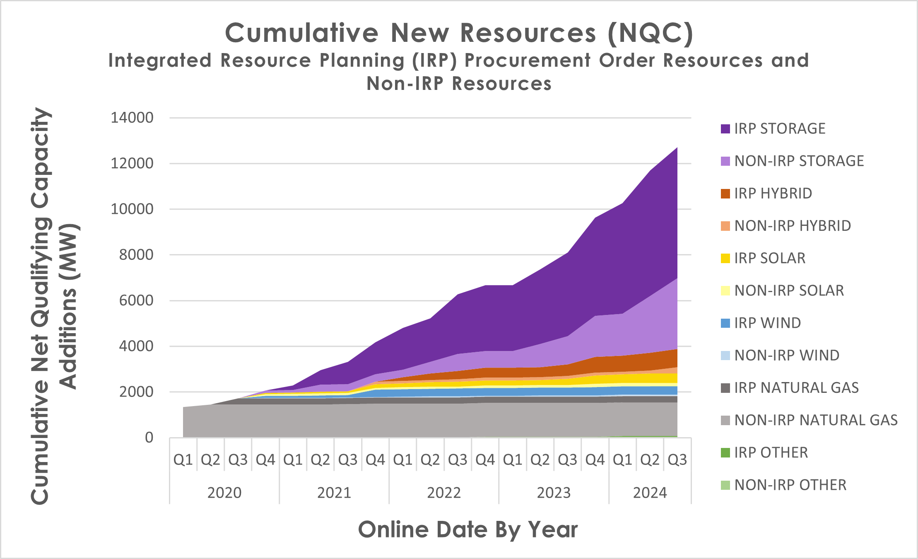
Total New Procurement By Year and Resource Type
Data includes projects online as of August 31, 2024
Note: Data shown here shows a snapshot of new resources added to the CAISO grid Q12020 – Q3 2024, including specified CAISO imports. "Other" resources include geothermal, biomass, biogas, and hydropower. Hybrids include some storage, and some other (usually solar) technology. "IRP Procurement Order Resources" refer to resources claimed for compliance with IRP Procurement Orders; "Non-IRP Resources" include resources that are not counting towards IRP Procurement order compliance, which occurs for a variety of reasons such as the resource was in development prior to IRP orders, the resource is energy-only, the resource is not under contract to a CPUC jurisdictional entity, etc.
NQC = Net qualifying capacity (NQC) and represents the amount the resource contributes to reliability; NQC can vary over time, and for each month of the year; the values shown are indicative of September NQC values for the resources.

Slide 10
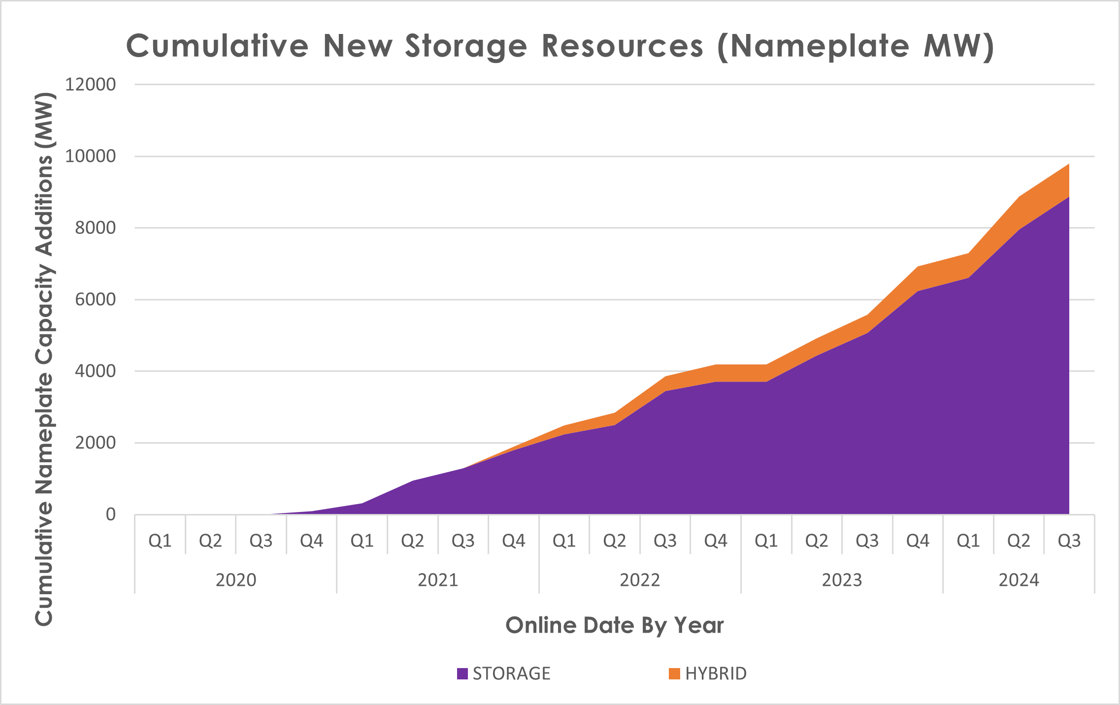
Total Storage Online By Year
Data includes projects online as of August 31, 2024
Installed to date: ~10,000 MW of storage nameplate capacity is online serving the grid as of August 2024, including imports
Includes ~150 MW of storage added prior to 2020
Includes standalone batteries storage and the storage component of hybrid resources
Expected future installs: ~12,600 MW nameplate of additional storage resources are in contract and expected to come online by 2026.
Note: Data shown here shows a snapshot of new resources added to the CAISO grid Q12020 – Q3 2024, including specified CAISO imports. Hybrids include some storage, and some other (usually solar) technology. MW shown here only include the storage portion of hybrids.

Slide 11
Part 2: Integrated Resource Planning Compliance
New IRP Procurement MW by Year and Resource Type- Nameplate
New IRP Procurement MW by Year and Resource Type – NQC

Slide 12
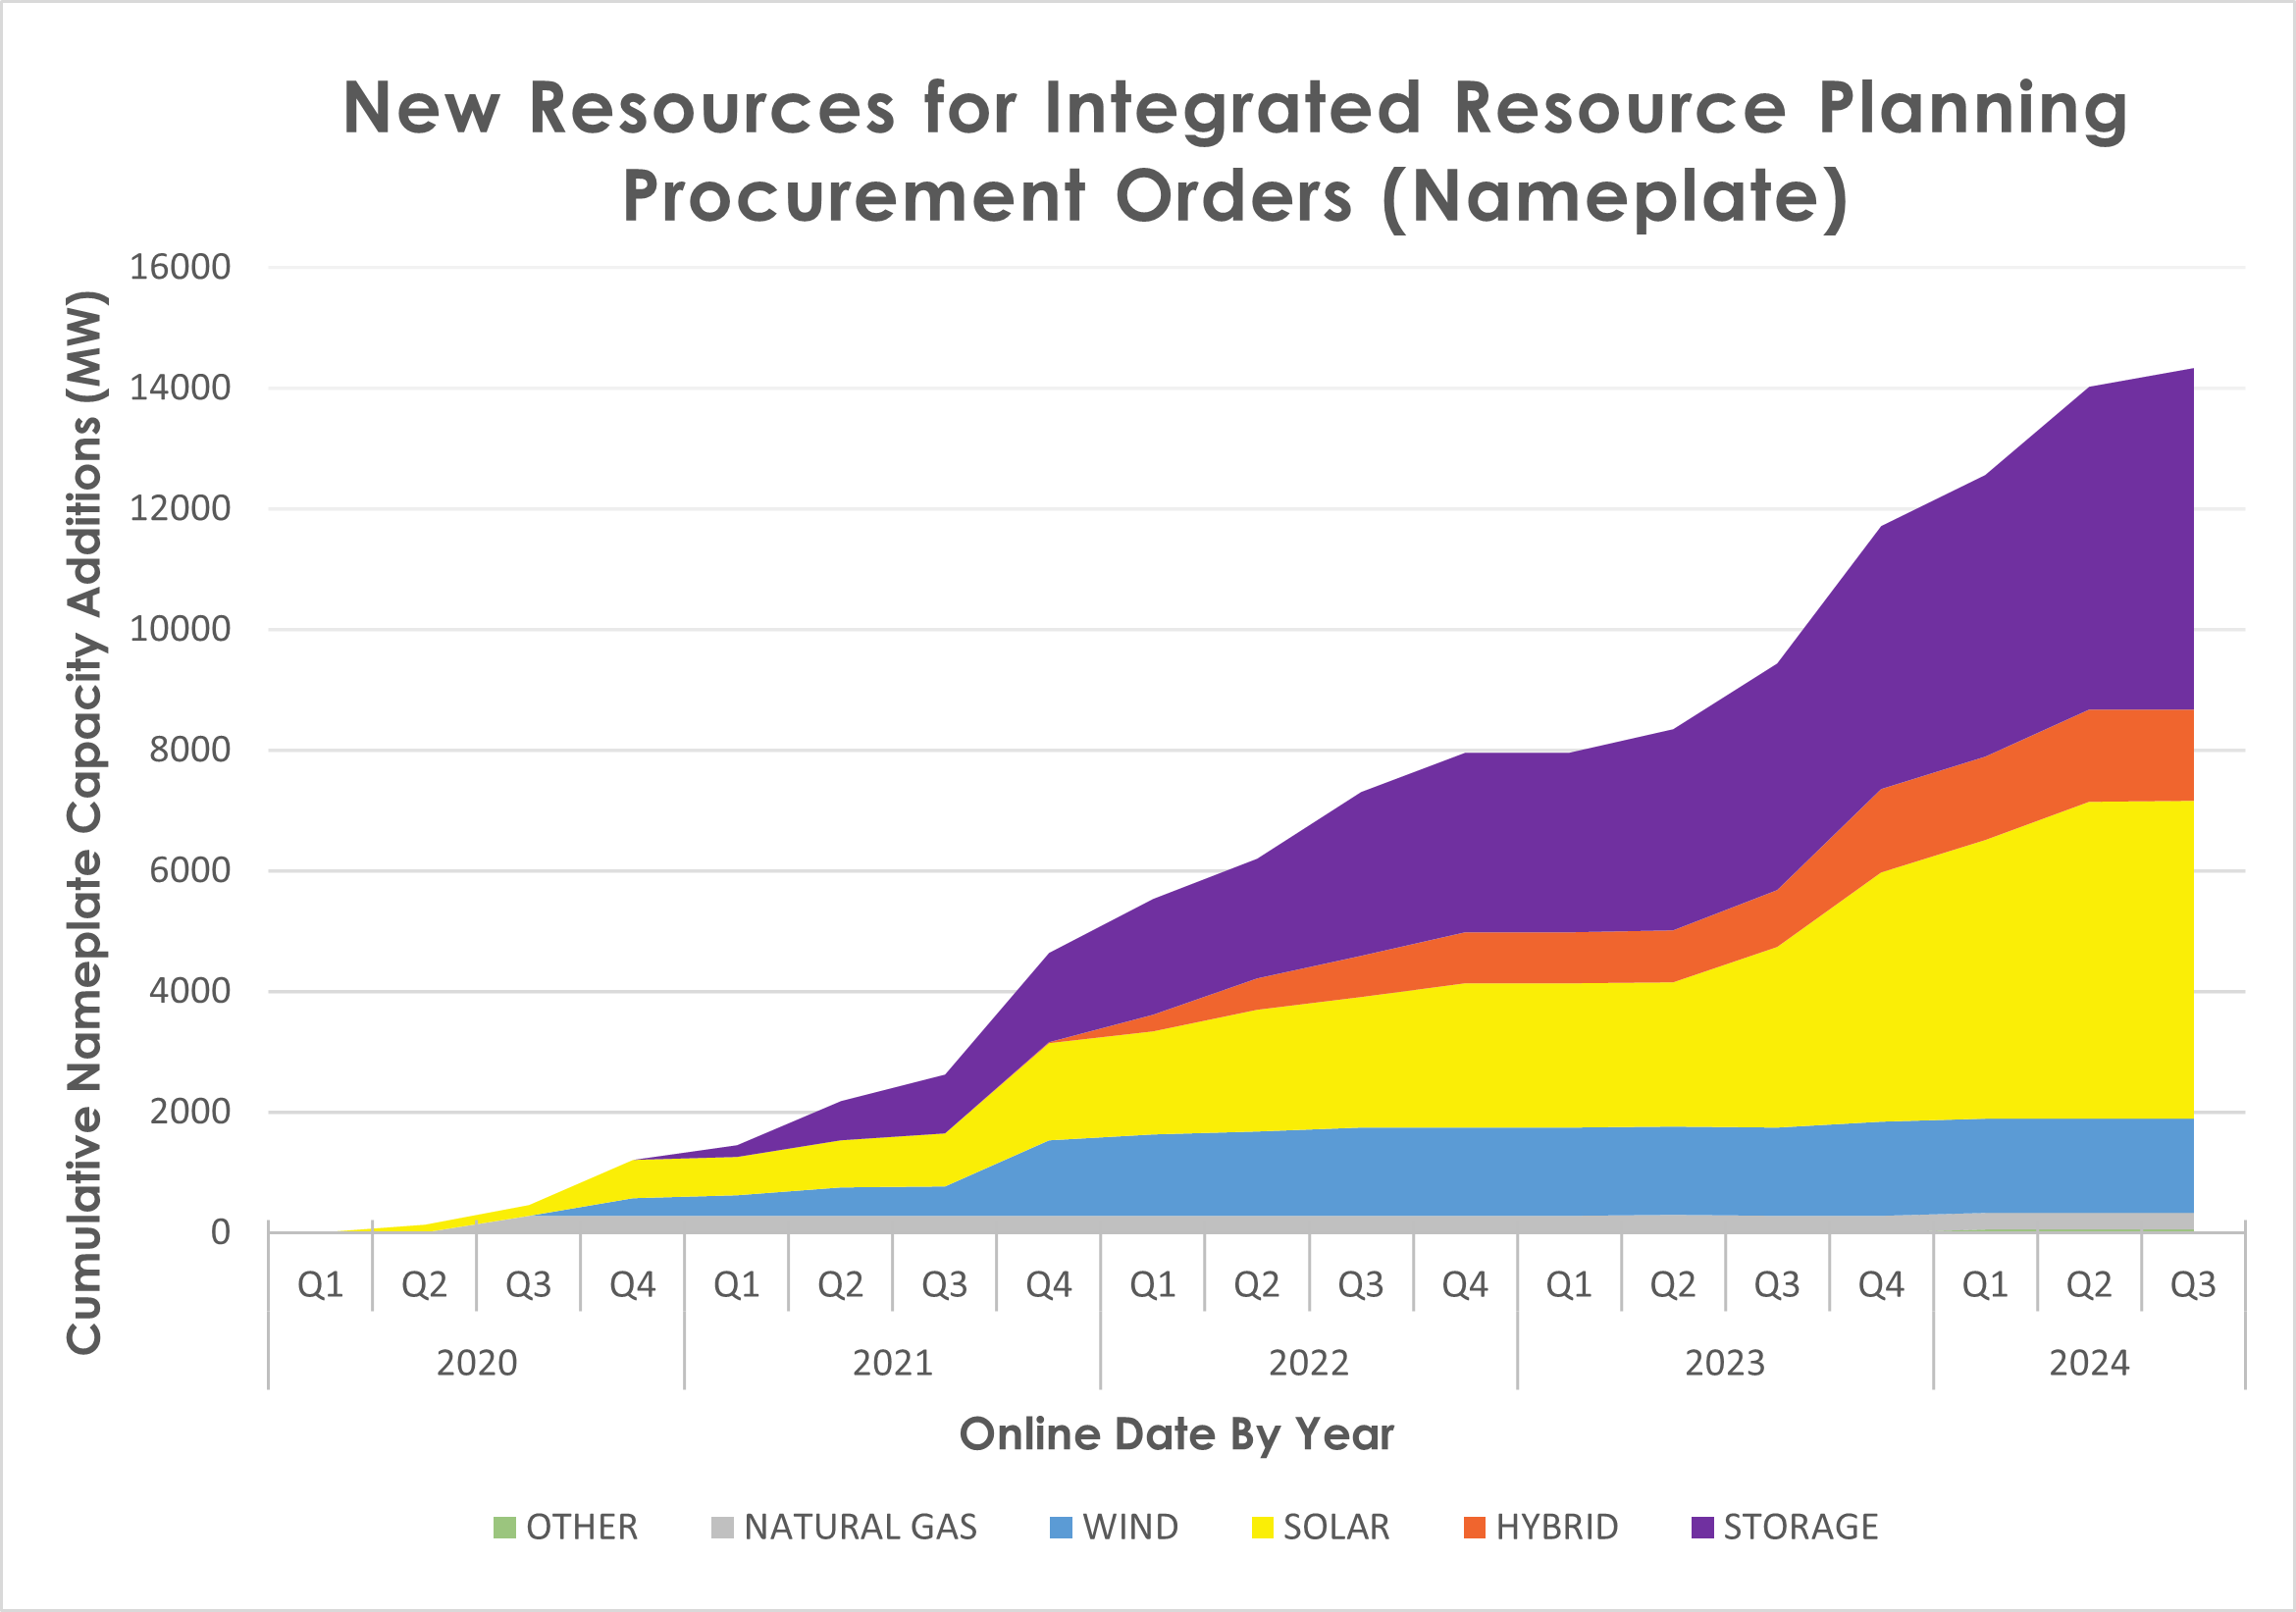
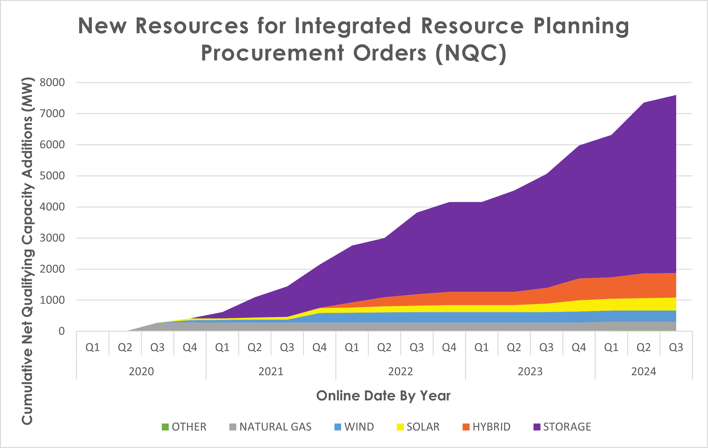
New IRP Procurement By Year and Resource Type
Data includes projects online as of August 31, 2024
Note: Data shown here shows a snapshot of new resources added to the CAISO grid Q12020 – Q3 2024 for compliance with Integrated Resource Planning (IRP) procurement orders, including specified CAISO imports. "Other" resources includes geothermal, biomass, biogas, and hydropower. Hybrids include some storage, and some other (usually solar). Additional resources have come online for other reasons in this time period but are not included in these figures.
See: IRP Procurement Track (ca.gov) for more information about IRP Procurement Order Compliance.

Slide 13
Part 3: Expected New MWs based on LSE Contracts to date
Expected New MW by Year and Resource Type- Nameplate
Expected New MW by Year and Resource Type – NQC
Total New Energy Resources Online and Under Contract - Nameplate

Slide 14
New MWs Expected - Nameplate By Year and Resource Type, including imports
Data includes projects expected/under contract
as of March 2024
Over 15,000 MW nameplate of future contracts are executed to meet CPUC’s procurement order obligations.
Majority of new resource MWs are expected to be battery storage and hybrid solar+storage.
Other types of resources are eligible to meet orders and may be contracted in the future.
2024 New Resource Projection ~6,600+ MW Nameplate
Resource Type | 2024 | 2025 | 2026 | Total
Solar | 637 | 144 | 527 | 1,308
Battery Storage | 4,134 | 2,665 | 2,233 | 9,032
Paired/Hybrid | 1,805 | 1,262 | 545 | 3,612
Wind | 0 | 226 | 1,433 | 1,659
Geothermal | 7 | 94 | 217 | 318
Biomass/Biogas | 32 | 6 | 0 | 38
Totals | 6,615 | 4,397 | 4,955 | 15,967

Slide 15
New MWs Expected - NQC By Year and Resource Type, including imports
Data includes projects expected/under contract
as of March 2024
Over 11,000 MW NQC of future contracts are executed to meet CPUC’s procurement order obligations.
Majority of new resource MWs are expected to be battery storage and hybrid solar+storage.
Other types of resources are eligible to meet orders and may be contracted in the future.
2024 New Resource Projection ~5,000 MW NQC
Resource Type | 2024 | 2025 | 2026 | Total
Solar | 172 | 38 | 2 | 212
Battery Storage | 3,603 | 2,578 | 2,151 | 8,332
Paired/Hybrid | 1,187 | 824 | 377 | 2,388
Wind | 0 | 17 | 379 | 396
Geothermal | 7 | 50 | 205 | 262
Biomass/Biogas | 28 | 6 | 0 | 34
Totals | 4,997 | 3,513 | 3,114 | 11,624

Slide 16
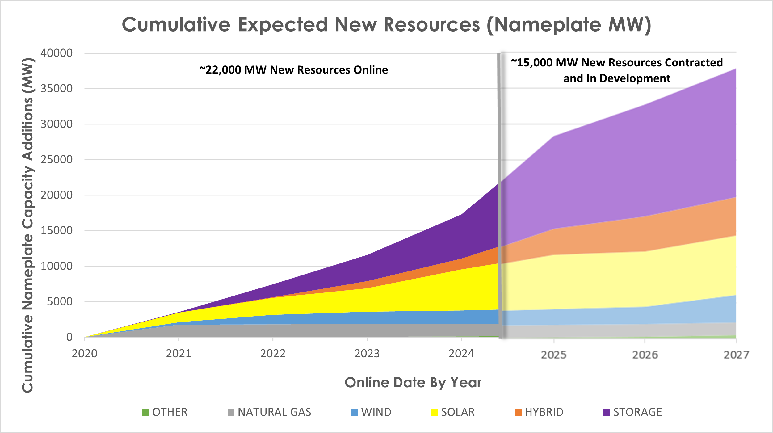
Total New Energy Resources Online and Under Contract
Note: Data shown here shows a snapshot of new resources added to CAISO grid Q12020 – Q3 2024, including specified CAISO imports. Also shown is a projection of future new resources based on contracts in place by March 2024. "Other" resources includes geothermal, biomass, biogas, and hydropower.

Slide 17
Links to Other Key References on New Resource Development

Slide 18
References to Related Information
Tracking Energy Development Task Force – Tracking Energy Development (ca.gov)
Joint Agency Reliability Planning Assessments – pursuant to SB 846
February 2023 Report
May 2023 Report
August 2023 Report
December 2023 Report
May 2024 Report
August 2024 Report
California Energy Commission’s Energy Almanac - Energy Almanac (ca.gov)
CAISO Key Energy Statistics: Media resources | California ISO (caiso.com)
Overview of CPUC IRP Procurement Orders – IRP Procurement Track (ca.gov)
Overview of CPUC Jurisdictional LSE Procurement in Compliance with IRP Procurement Orders
Procurement in Compliance with D.19-11-016 and Mid Term Reliability (D.21-06-035) per August 1, 2023, 4/22/2024
Procurement in Compliance with D.19-11-016 and Mid Term Reliability (D.21-06-035) per February 1, 2023, 11/2/2023
Procurement in Compliance with D.19-11-016 per August 1, 2022 Fillings, 2/13/2023
Procurement in Compliance with D.19-11-016 per February 1, 2022 Filings, 7/22/2022
Procurement in Compliance with D.19-11-016 per February 1, 2021 Filings, 8/23/2021
For any questions about the data, please contact irpdatarequest@cpuc.ca.gov

