Slide 1
10/22/25
Transportation Electrification Proactive Planning Webinar
Inputs & Assumptions and
Corridor Disaggregation Methodology

Slide 2
Agenda
Background and Objectives
10 min
Introductions
5 min
Inputs and Assumptions (I&A)
30 min
30 min
Corridor Disaggregation Methodology (CDM)
Open Q&A
35 min
Wrap Up and Next Steps
10 min
Topic name
07
Topic name
08

Slide 3
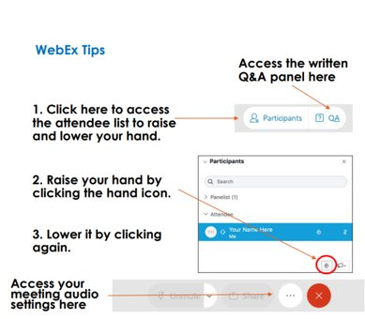
Webex Participation Logistics
Questions will be addressed during Q&A periods.
Please share your name and organization before providing comments to assist with notetaking.
Virtual Participants
All attendees are muted on entry by default.
Please write your questions in the chat.
Alternatively, comments or questions can be provided verbally using the “raise hand” function.
The host will unmute you to ask your question.
Please lower your hand after asking your question by clicking on “raise hand” again.

Slide 4

Background & Objectives

Slide 5
Background & Objectives
TEPP Background:
In May 2023, the CPUC released a Draft Staff proposal on Freight Infrastructure Planning (FIP) outlining an initial vision for enabling proactive planning of long lead time utility-side electrical infrastructure to support the acceleration of transportation electrification, focused on freight.
Released in April 2024, the Scoping Memo for R.23-12-008 includes a track for TE Proactive Planning (TEPP) to address the need for zero-emission vehicle planning related to corridor freight charging infrastructure and similar loads such as light-duty charging plazas due to the 1) significant load growth anticipated from this type of charging and 2) its likely impact on electric infrastructure.
Webinar Objectives:
1) Familiarize stakeholders with the TEPP Inputs and Assumptions (I&A) and Corridor Disaggregation Methodology (CDM) released via Ruling on 10/1/25
2) Provide opportunity for stakeholders to pose clarifying questions about I&A, CDM or Ruling Questions.

Slide 6






Guidehouse Team
Derek Jones
Karen Maoz
Tiina Aardemae
Director
Project Oversight
>15 years in California transportation and energy sectors
Associate Director
Project Manager
>20 years in California energy sector
Associate Director
Task Lead
>15 years in energy and 5 years in California transportation sectors
Vivek Nath
Will Sierzchula
Gavin Aiello
Associate Director
Technical Advisor
>15 years in transportation and energy modeling
Managing Consultant
I&A Lead
>20 years in transportation and energy modeling
Managing Consultant
CDM Lead
>10 years in transportation and energy modeling
Today’s presenters

Slide 7
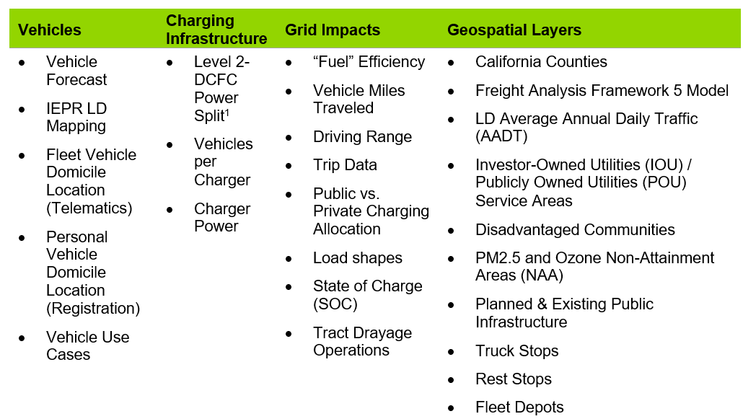
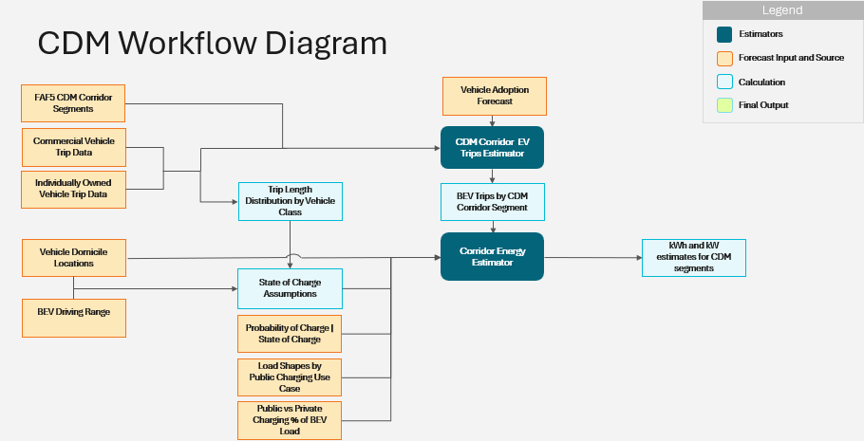
I&A feed the CDM to identify EV load along CA highways
Together, the I&A and CDM support a bottom-up approach to planning, with the I&A providing the key data elements, and CDM providing the methodology
Corridor Disaggregation Methodology (CDM):
Methodology by which public DC charging load for light-duty (LD) and medium- and heavy-duty (MDHD) EVs is allocated to specific corridor segments throughout major corridors in California.
Inputs and Assumptions (I&A):
Key data elements and sources of inputs and assumptions, IEPR aligned where feasible, to be publicly vetted.
Details in I&A section
Details in CDM section
© 2025 Guidehouse Inc.

Slide 8

Inputs and Assumptions
Overview

Slide 9
TEPP Modeling I&A Overview
Purpose of TEPP Modeling Inputs & Assumptions
Support bottom- up modeling of TE public charging loads (LD & MDHD) along highway corridors
Identify and vet the best available data relevant to modeling transportation patterns, charging/fueling patterns, and expected ZEV charging technology adoption timelines and locations
Support the identification of the timing/location/size of expected TE load growth on the electric system

Slide 10
TEPP Modeling I&A Overview
How I&A will be used
Identify TE load associated with public LD and MDHD battery electric vehicle (BEV) charging and MDHD BEV depot charging along major California highway corridors
Aligns with IEPR energy demand forecast, providing localized planning insight for use in existing planning and cost recovery processes

Slide 11
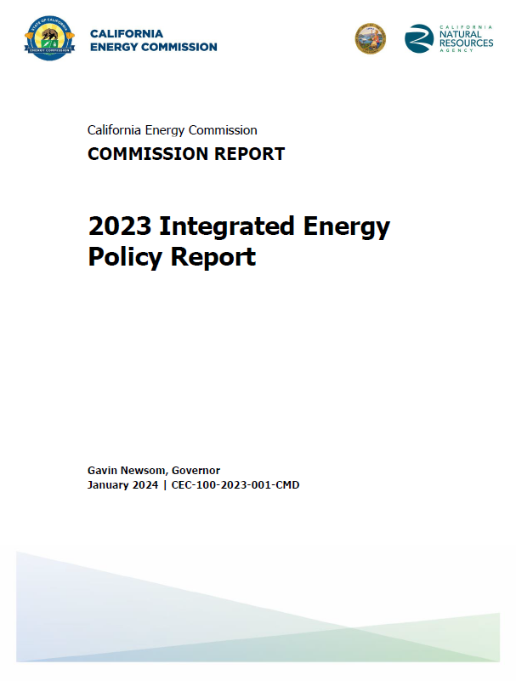
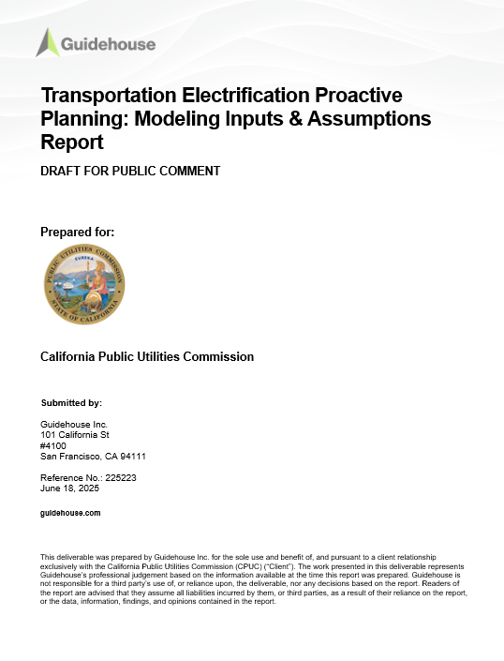
TEPP Modeling I&A Overview
What are the input sources
Real-world data
Vehicle domicile data from Geotab (third-party data vendor)
Trip data from Geotab provides public/private charging and route paths
Vehicle registration data sourced from DMV
Recent fleet electrification pilot projects
Studies
National labs and government agencies
Academic studies for state of charge estimates
Geospatial layers
Disadvantaged communities
Air pollution shape files

Slide 12
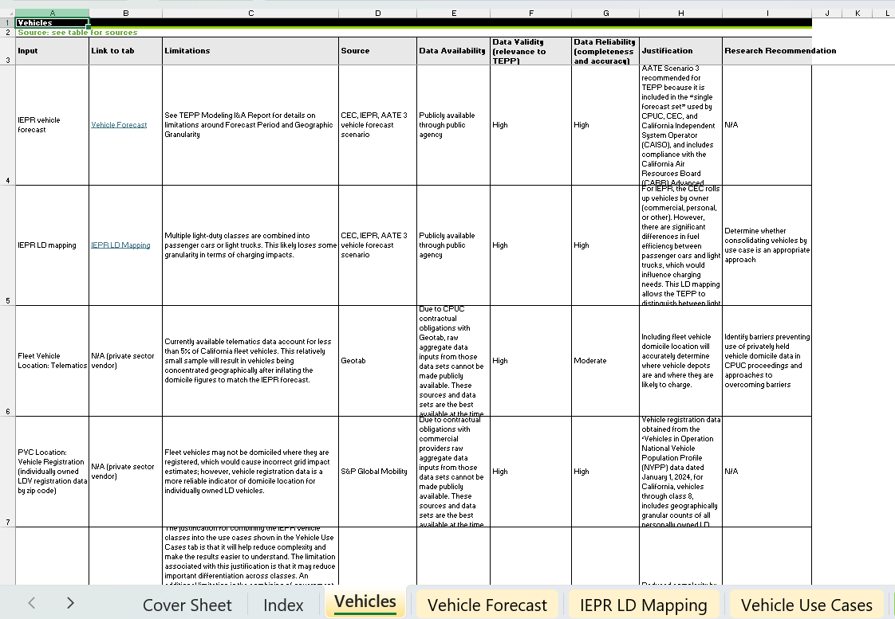
I&A Inputs Walkthrough
Takeaway: Vehicle disaggregation is an important extension of the IEPR forecast to allow bottom-up analyses
Vehicle input categories used in TEPP I&A
INPUTS
IEPR vehicle forecast
IEPR vehicle classes
APPROACH
IEPR provides BEV forecasts at the IOU-level
These are translated into vehicle use cases (e.g., long-haul, short-haul, and delivery trucks)
Guidehouse-proposed approach uses private sector data to disaggregate the BEV forecast down to vehicle domicile location at the ZCTA or census tract level
SOURCES
CEC (IEPR’s AATE 3 vehicle forecast scenario)
Private sector vendor
I&A Workbook

Slide 13
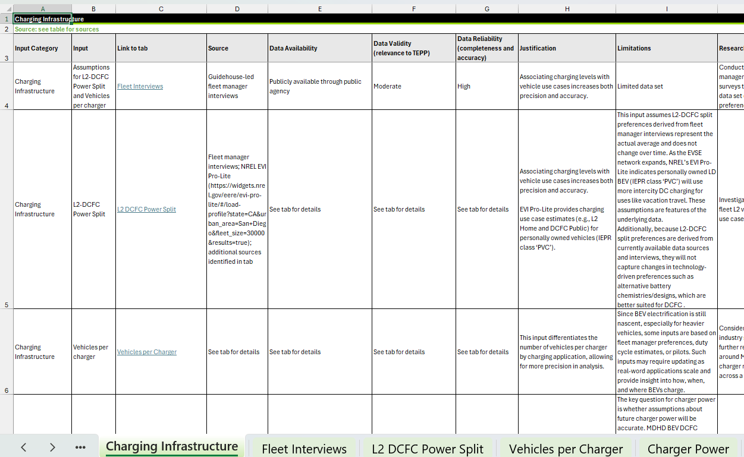
I&A Inputs Walkthrough
Takeaway: Using real-world EV fleet case studies enables more precise grid impacts estimation on a per-use case basis
Charging infrastructure input categories used in TEPP I&A
INPUTS
L2-DCFC split
Vehicles per port
Charger power
APPROACH
These inputs allow analysts to more precisely determine grid impacts which vary by vehicle use case
L2-DCFC split estimates whether vehicle use cases would use L2 or DCFC charging
Vehicles per port refers to the number of ports by power estimated to support identifying TE load at corridors
Charger power refers to rated kW by charging use case (e.g., public corridor or MD depot)
SOURCES
Public entities (e.g., AFDC, SFMTA)
Commercial entities (e.g., Amazon, ChargePoint)
Research entities (e.g., NREL, Run On Less/NACFE)
I&A Workbook

Slide 14
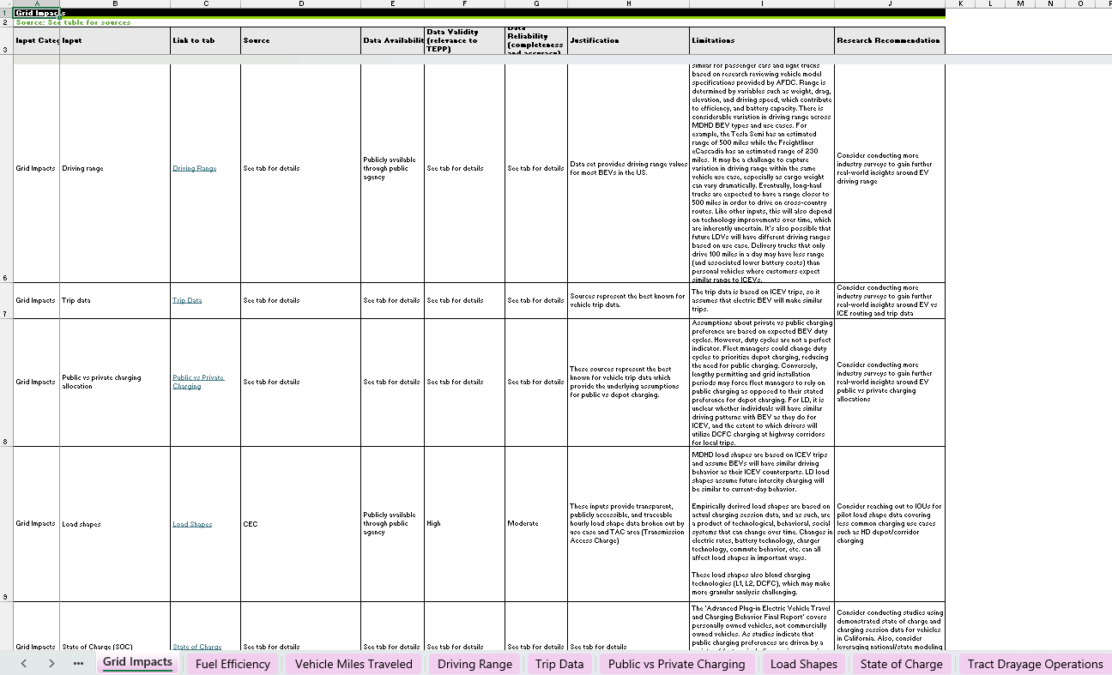
I&A Inputs Walkthrough
Takeaway: Most charging is expected to happen at private depots, and these inputs allow more accurate estimation of public charging impacts
Grid impacts input categories used in TEPP I&A
INPUTS
Vehicle fuel efficiency
Vehicle miles traveled (VMT)
Driving range
Trip data
Public vs private charging allocation
Load shapes
APPROACH
Energy impacts from charging derived from:
Vehicle energy impacts: Fuel efficiency x VMT
Percentage of charging away from depots (public vs. private charging allocation), determined from driving range and trip data
Load shapes take energy impacts from charging and estimate charging power demand by use case and hour of day
SOURCES
Public entities (e.g., DOE, EPA, AFDC, CARB, CA HVIP, ORNL, NREL, FHWA, DOT)
Commercial entities (e.g., ChargePoint)
Research entities (e.g., ICCT, The Fuels Institute)
Advocacy group (EDF)
Private sector vendor
I&A Workbook

Slide 15
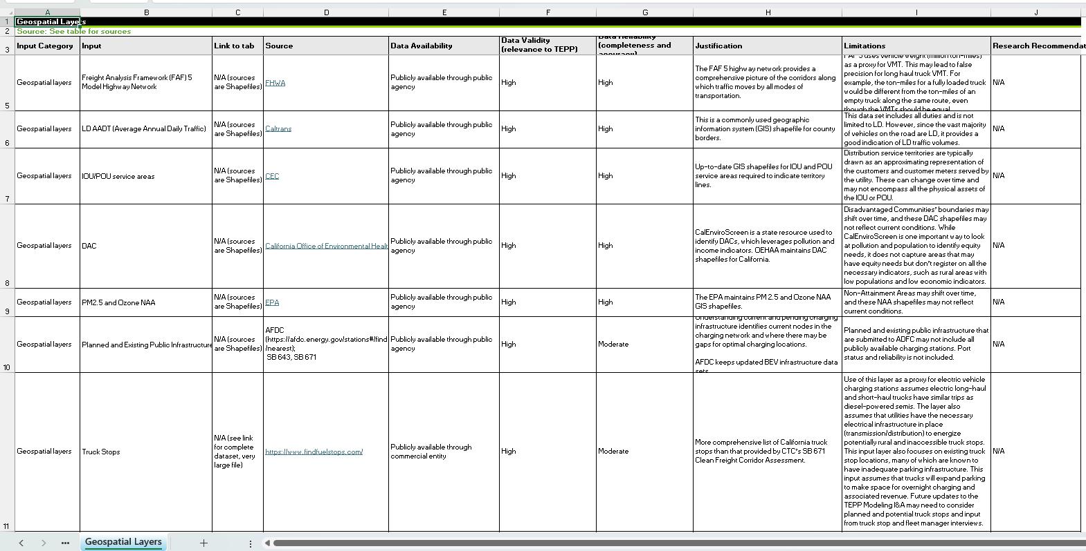
I&A Inputs Walkthrough
Takeaway: These layers can support planning by identifying potential grid impacts
Geospatial layers used in TEPP I&A
INPUTS
California Counties
Investor-Owned Utility (IOU) / Publicly Owned Utility (POU) Service Territories
Environmental and Social Justice (ESJ) / Disadvantaged Community (DAC)
PM2.5 and Ozone Nonattainment areas (NAA)
Planned & Existing Public Infrastructure
Truck Stops
SOURCES
Public agencies (Census.gov, FHWA, CEC, COEH, EPA, AFDC)
IOU data
Commercial (Find Fuel Stops)
I&A Workbook

Slide 16

Inputs and Assumptions
Q&A

Slide 17

Corridor Designation Methodology
Overview

Slide 18
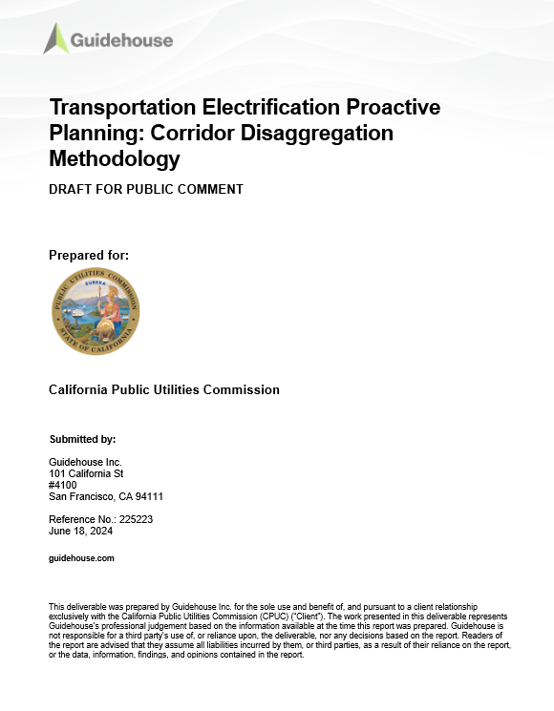
CDM Overview
Purpose of Corridor Designation Methodology (CDM)
Inform targeted grid planning by providing a methodology to estimate public charging demand for LD and MDHD BEVs, and depot charging demand for MDHD BEVs within one mile of major CA highway corridors*
Provide disaggregation of IEPR load that can inform existing planning processes
*CA highway corridors consist of 150 roads and highways that represent all major arterial and collector roads, interstate highways, collector/distributor lanes and controlled access highways across California identified in the FAF 5 data. The roads and highways are either 50 miles or more in length, included as part of the 34 priority corridors defined by CTC’s SB 671 Clean Freight Corridor Assessment, or included in the National Zero-Emission Freight Corridor Strategy that was released in March 2024.

Slide 19
CDM Overview
What is the TE load identification methodology for California highway corridors
Provides a bottom-up granular disaggregation methodology along California highways
Disaggregates to highway corridor segments using telematics data
Uses vehicle movement data to predict highway charging needs
Aligns with IEPR state-level load expectations
Disaggregates IEPR forecasts by providing a methodology to identify granular load expectation along corridors
Provides planners information for pro-active distribution planning

Slide 20
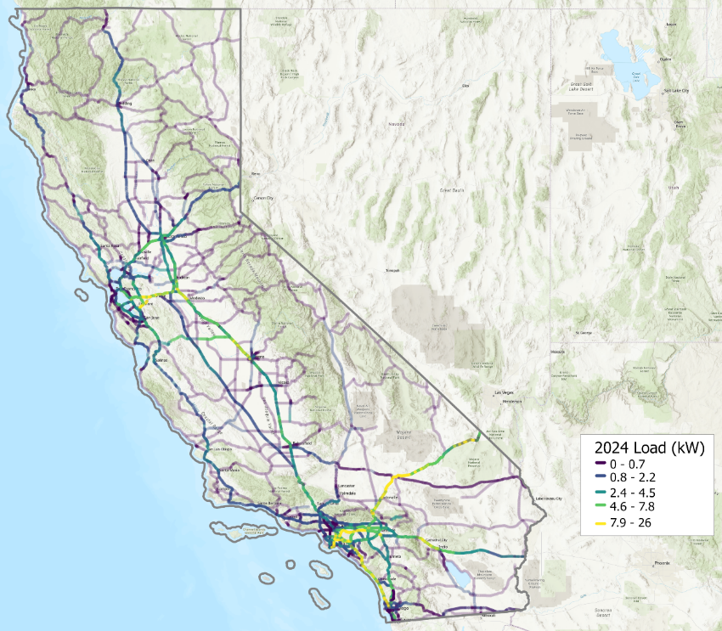
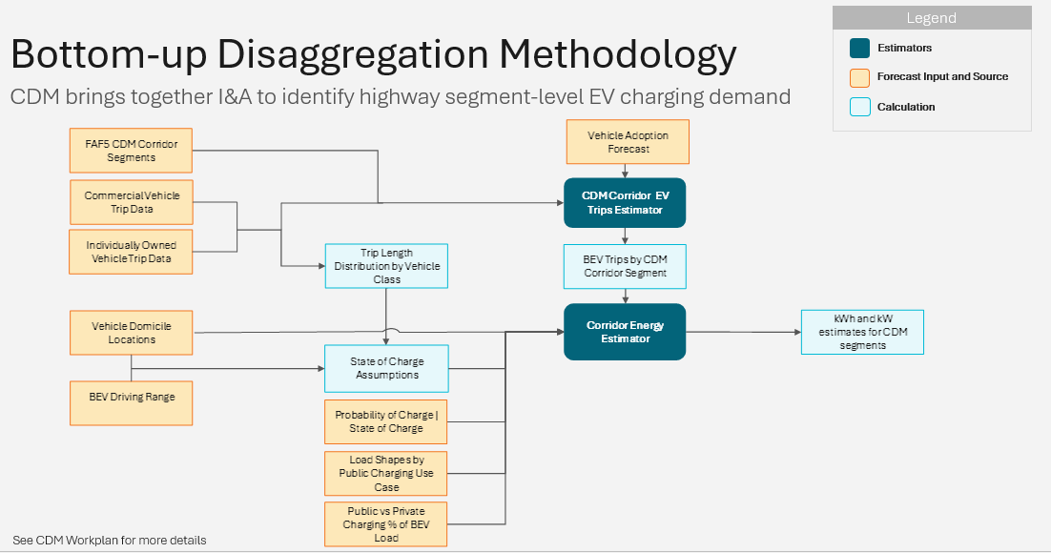
CDM Overview
How CDM will be used
Disaggregate load from IEPR energy demand forecast by bringing together I&A included in charging assumptions and geospatial input data for various corridors within California to identify demand for charging on a corridor segment* basis
* Corridor segment: section of a major arterial and collector road, interstate highway, collector/distributor lane or controlled access highway that varies in traffic volume from adjacent sections of the same major arterial and collector road, interstate highway, collector/distributor lane or controlled access highway and exists in a single utility territory.

Slide 21
Bottom-up Disaggregation Methodology
Legend
Estimators
Forecast Input and Source
CDM brings together I&A to identify highway segment-level EV charging demand
Calculation
See CDM Workplan for more details

Slide 22
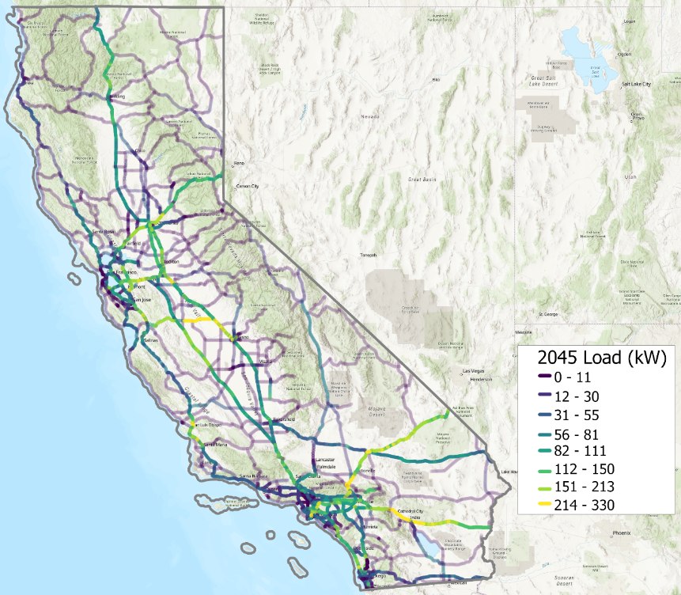
Projected TE Load for CA Corridors
Takeaway: Load is driven by a high traffic volume, and relatively lower states of charge for vehicles, leading to concentrations along major corridors that connect cities. I-5 and SR-99, connecting LA and San Diego to San Francisco and Sacramento, see the highest load, along with I-10 and I-15, connecting LA and San Diego with Nevada and Arizona
Example CDM outputs around SR-99, I-5, I-10 and I-15 using 2023 IEPR
2024 California Highway Corridors
2045 California Highway Corridors

Slide 23
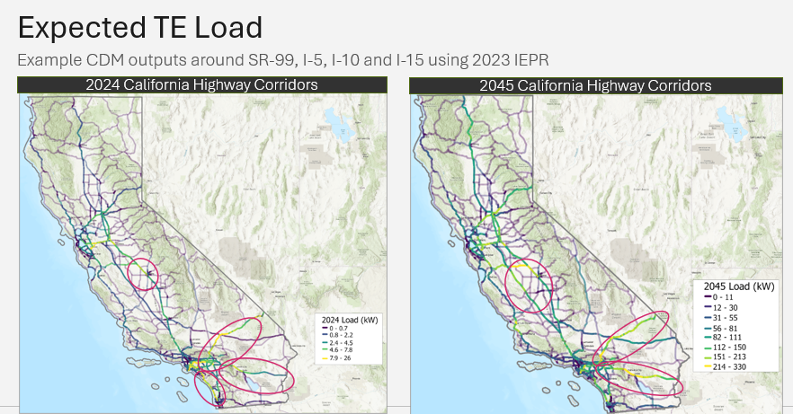
Key Takeaways
TEPP Modeling I&A provides foundational data to inform CDM’s bottom-up load disaggregation
The I&A leverages 2023* IEPR and real-world data, recent studies from national laboratories and government agencies, and geospatial layers to provide a granular dataset to calculate charging needs along public highway corridors
The CDM provides a methodology for identifying the probabilistic outcomes to identify public charging demand along public highway corridor segments
* The TEPP will use the most recent IEPR vintage available. This version of the TEPP includes 2023 IEPR report values adopted on February 14, 2024, for illustrative purposes only.

Slide 24
Corridor Designation Methodology
Q&A

Slide 25
Wrap Up and Next Steps

Slide 26
Wrap Up and Next Steps
Ruling Opening Comments are due on 11/14/2025, reply comments are due 12/5.
Please reach out to Emily.Clayton@cpuc.ca.gov and Emmanuelle.Truax@cpuc.ca.gov with any questions.

Slide 27
Appendix

Slide 28





Results Interpretation Example: Expected Load Value
CDM Segment Load Estimates: Given uncertainty in where future charging sites will be located, the CDM estimates an expected load value for each corridor segment to avoid false precision
Reality
2025 Max hourly projected demand: 40 kW
CDM Segment A
CDM Segment B
CDM Segment C
2025 Max hourly projected demand: 5 kW
2025 Max hourly projected demand: 15 kW
2025 Max hourly projected demand: 20 kW
CDM Segment A
CDM Segment B
CDM Segment C
Normalized Average
© 2025 Guidehouse Inc.
27

Slide 29
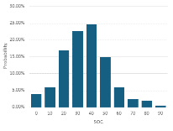
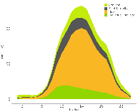
Energy Calculation: SOC, Journey Counts, Load shape
State of charge, driving behavior, and charging behavior influence vehicle demand for charging and load
BEV adoption
Journey Counts at segment
Estimate energy expended by vehicles along trips
Apply probability of charging distribution
Initial SOC for trips ending or passing through segment
Expected SOC at segment
Probability of charging
kWh, kW TE load
Average hourly load shape

Slide 30
CDM High Level Methodology Model
Takeaway: CDM identifies corridor segments, then integrates trip data & charging behavior
Overview
Integration of Trip Data and Cumulative EV Energy Requirement (Section 2.3)
Corridor Energy Requirement Calculation (Section 2.2)
Integration of Charging Behavior: Where (Section 2.4.1)
Corridor Segmentation and Characteristic Assignment (Section 2.1)
Integration of Charging Behavior: When (Section 2.4.2)

Slide 31
CDM Logic Model
Takeaway: CDM leverages all its inputs (both geospatial and non-geospatial) from the TEPP Modeling I&A
Overview

Slide 32
CDM Logic Model
Takeaway: Geospatial data informs key characteristics that will be used for designing priority corridor screening criteria
Corridor Segmentation and Characteristic Assignment (Section 2.1)

Slide 33
CDM Logic Model
Takeaway: Calculating energy vehicles expend while traversing a corridor segment is first step in identifying total charging load and port capacity for a corridor
Corridor Energy Requirement Calculation (Section 2.2)

Slide 34
CDM Logic Model
Takeaway: Trip data paired with corridor energy requirements informs EV energy charging needs during a trip through a corridor segment
Integration of Trip Data & Cumulative EV Energy Requirement (Section 2.3)

Slide 35
CDM Logic Model
Takeaway: Charging behavior establishes preferred locations and times of day of EV charging along corridors
Integration of Charging Behavior (Section 2.4)

Slide 36
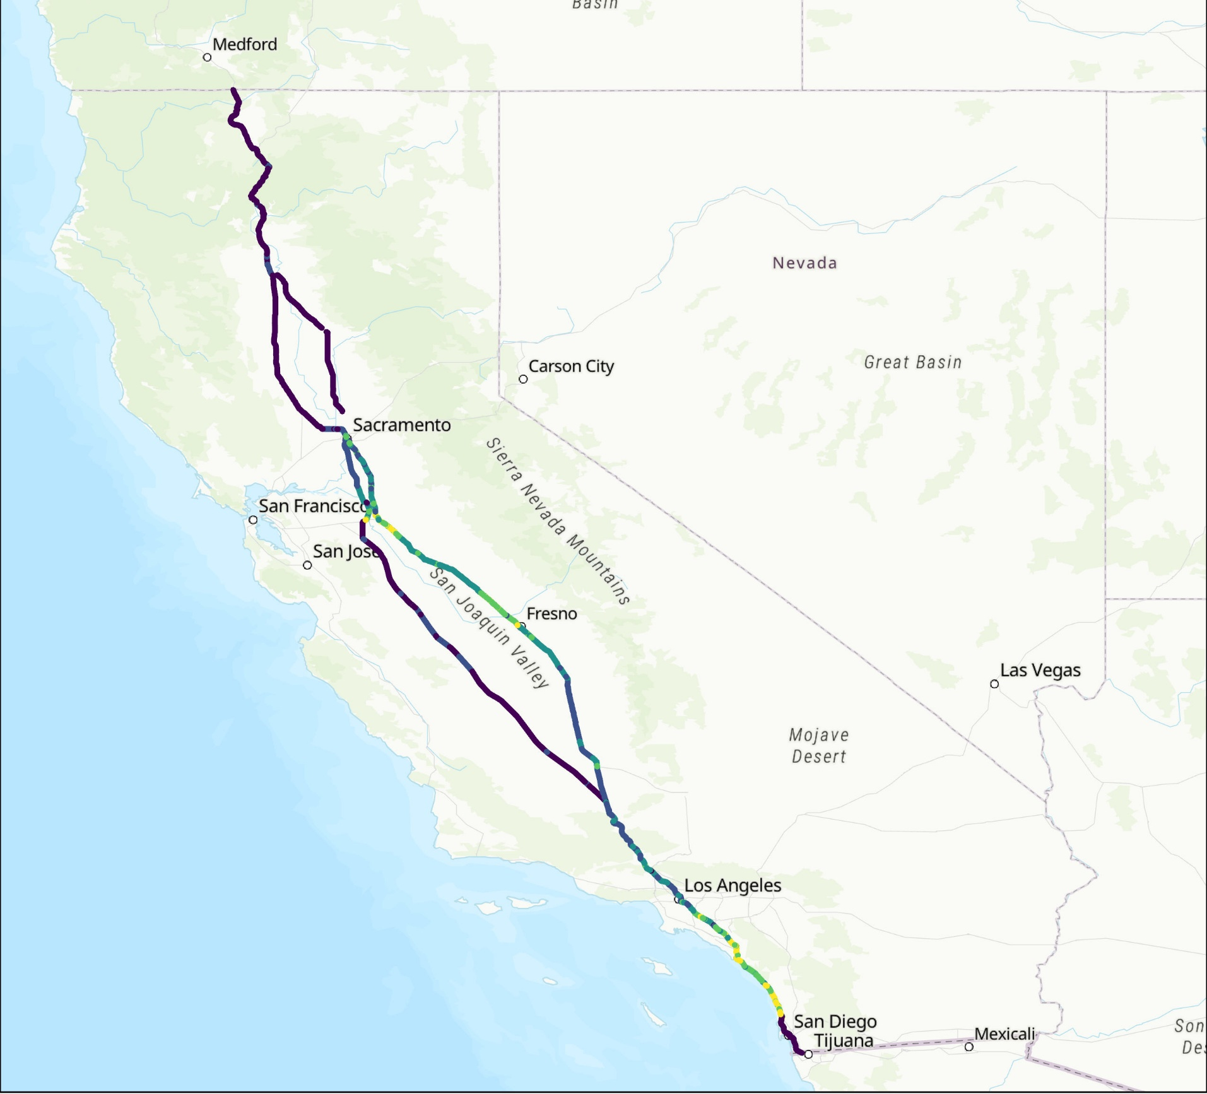
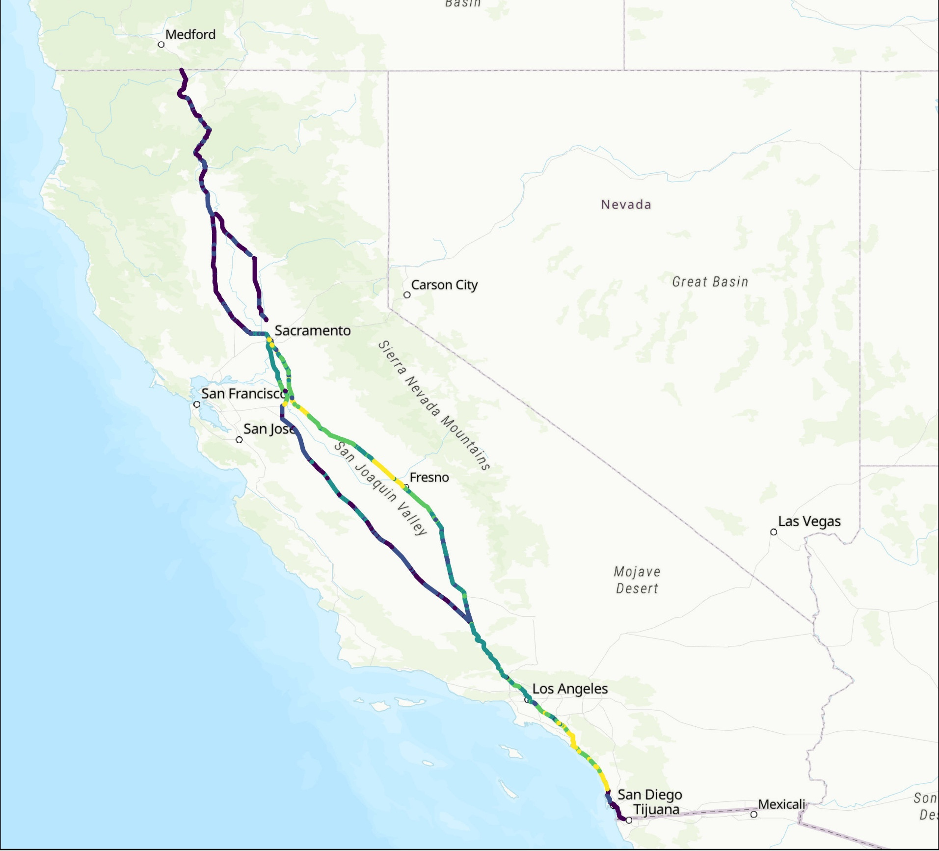
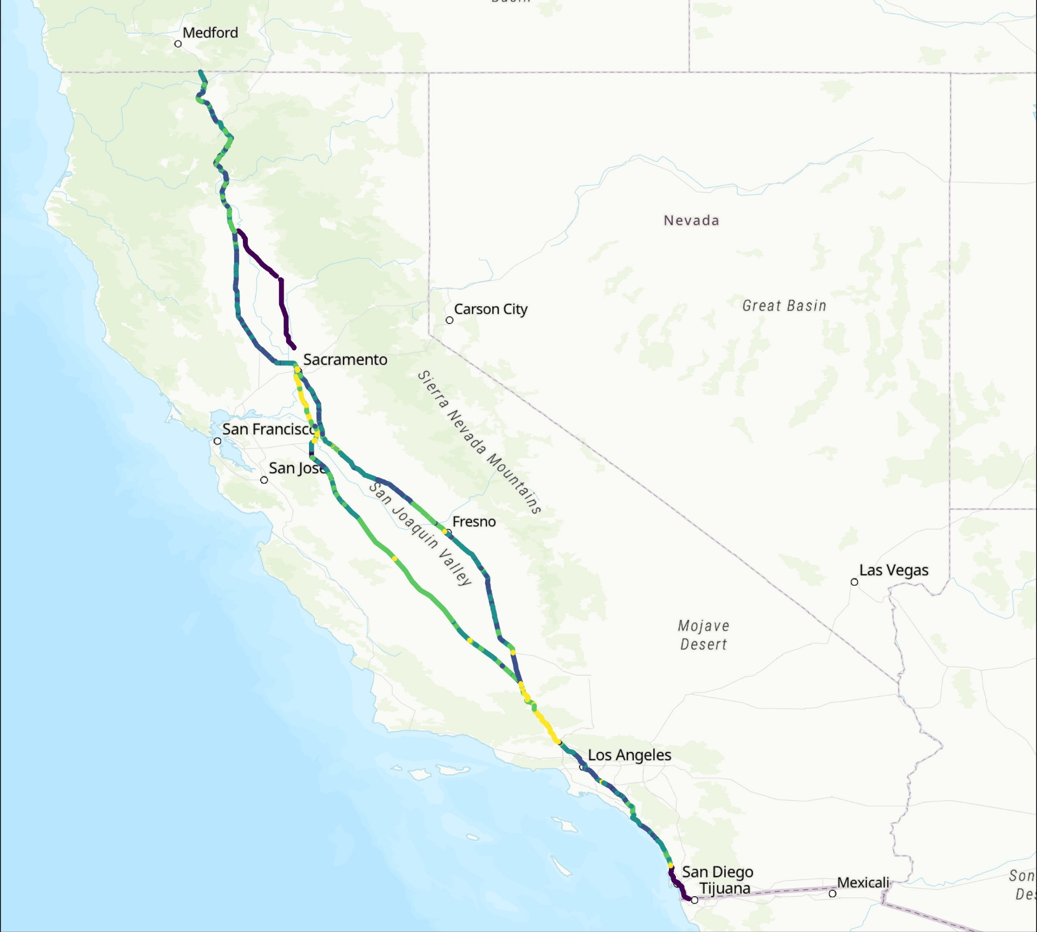
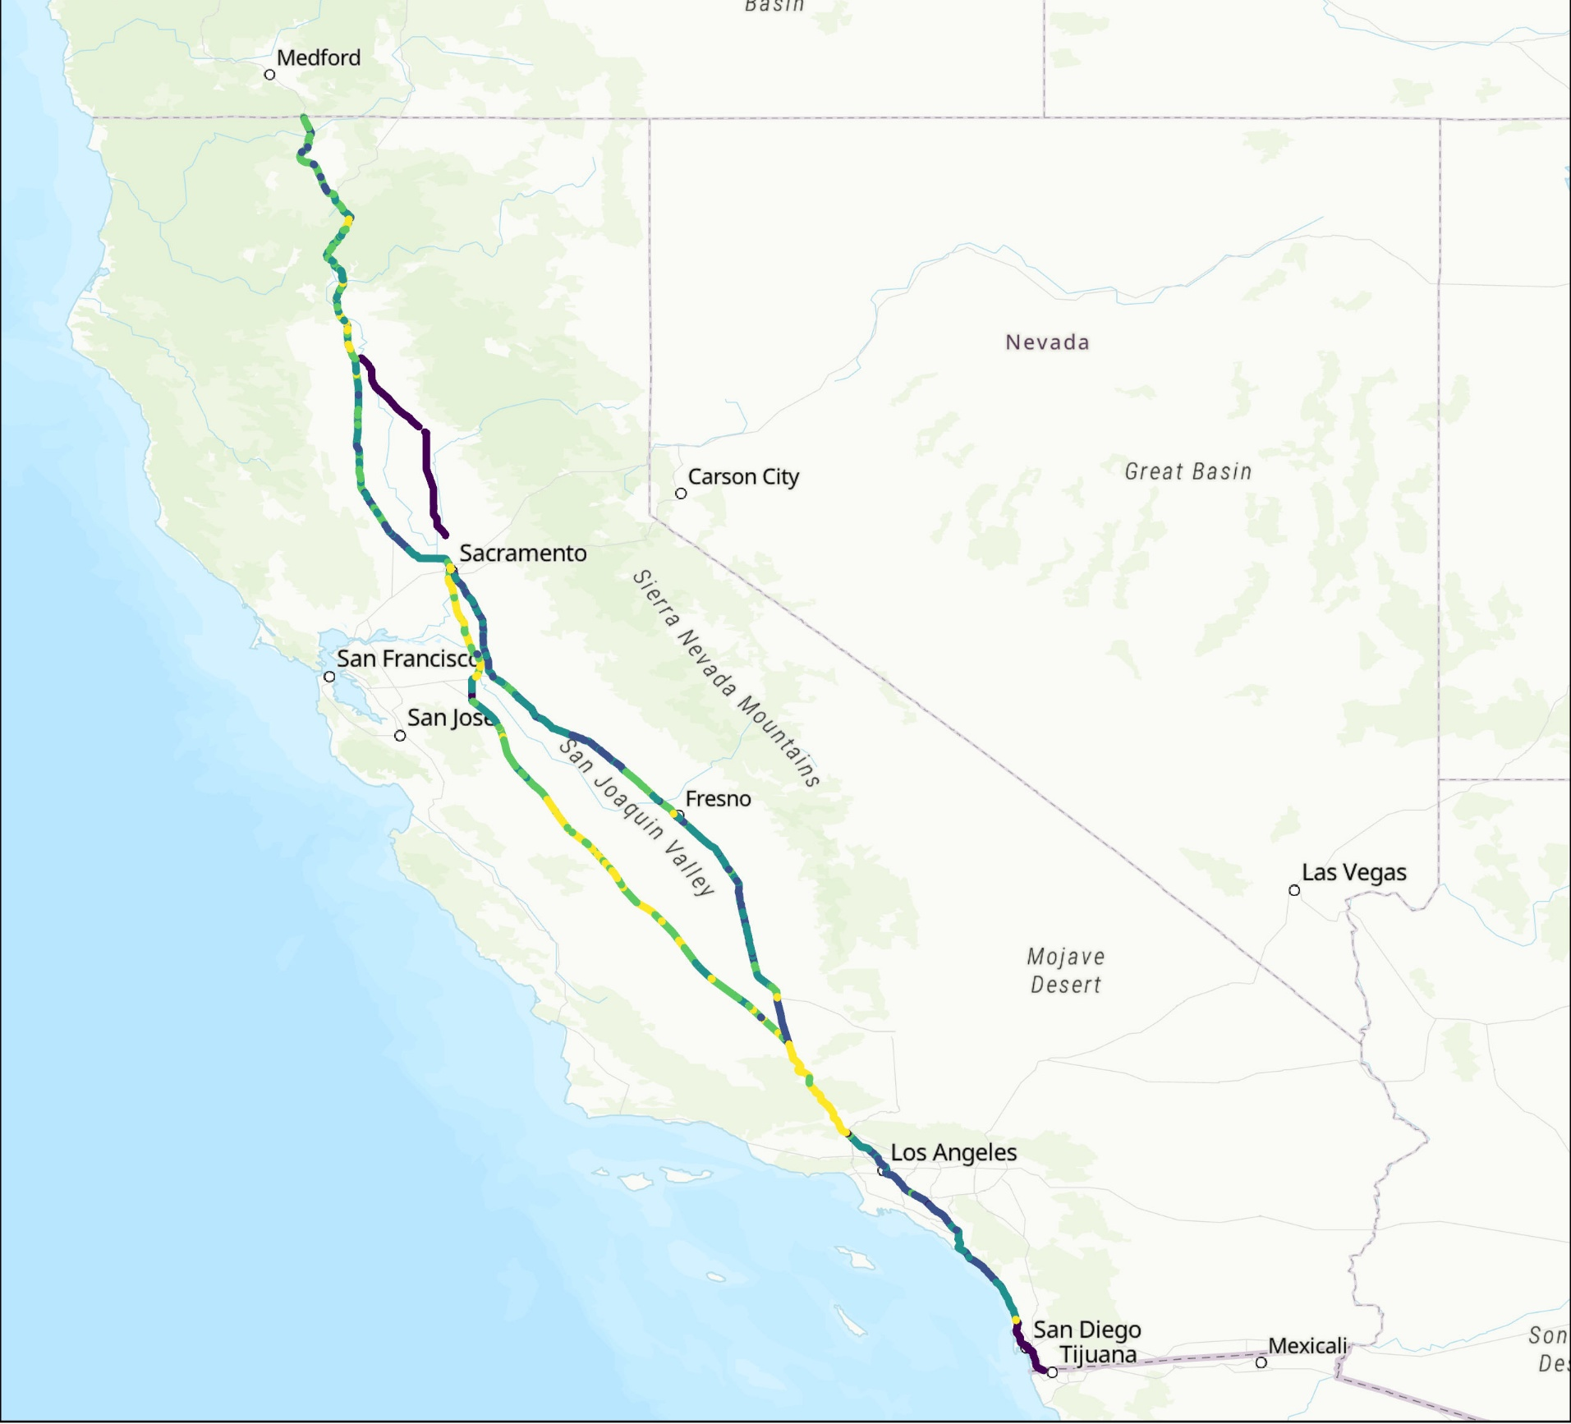
I-5 & SR 99
Example CDM outputs using 2023 IEPR
2025
2030
2035
2040
Average Daily Peak (kW)
Average Daily Peak (kW)
Average Daily Peak (kW)
Average Daily Peak (kW)
0 kW
30 kW
0 kW
100 kW
0 kW
250 kW
0 kW
400 kW

Slide 37
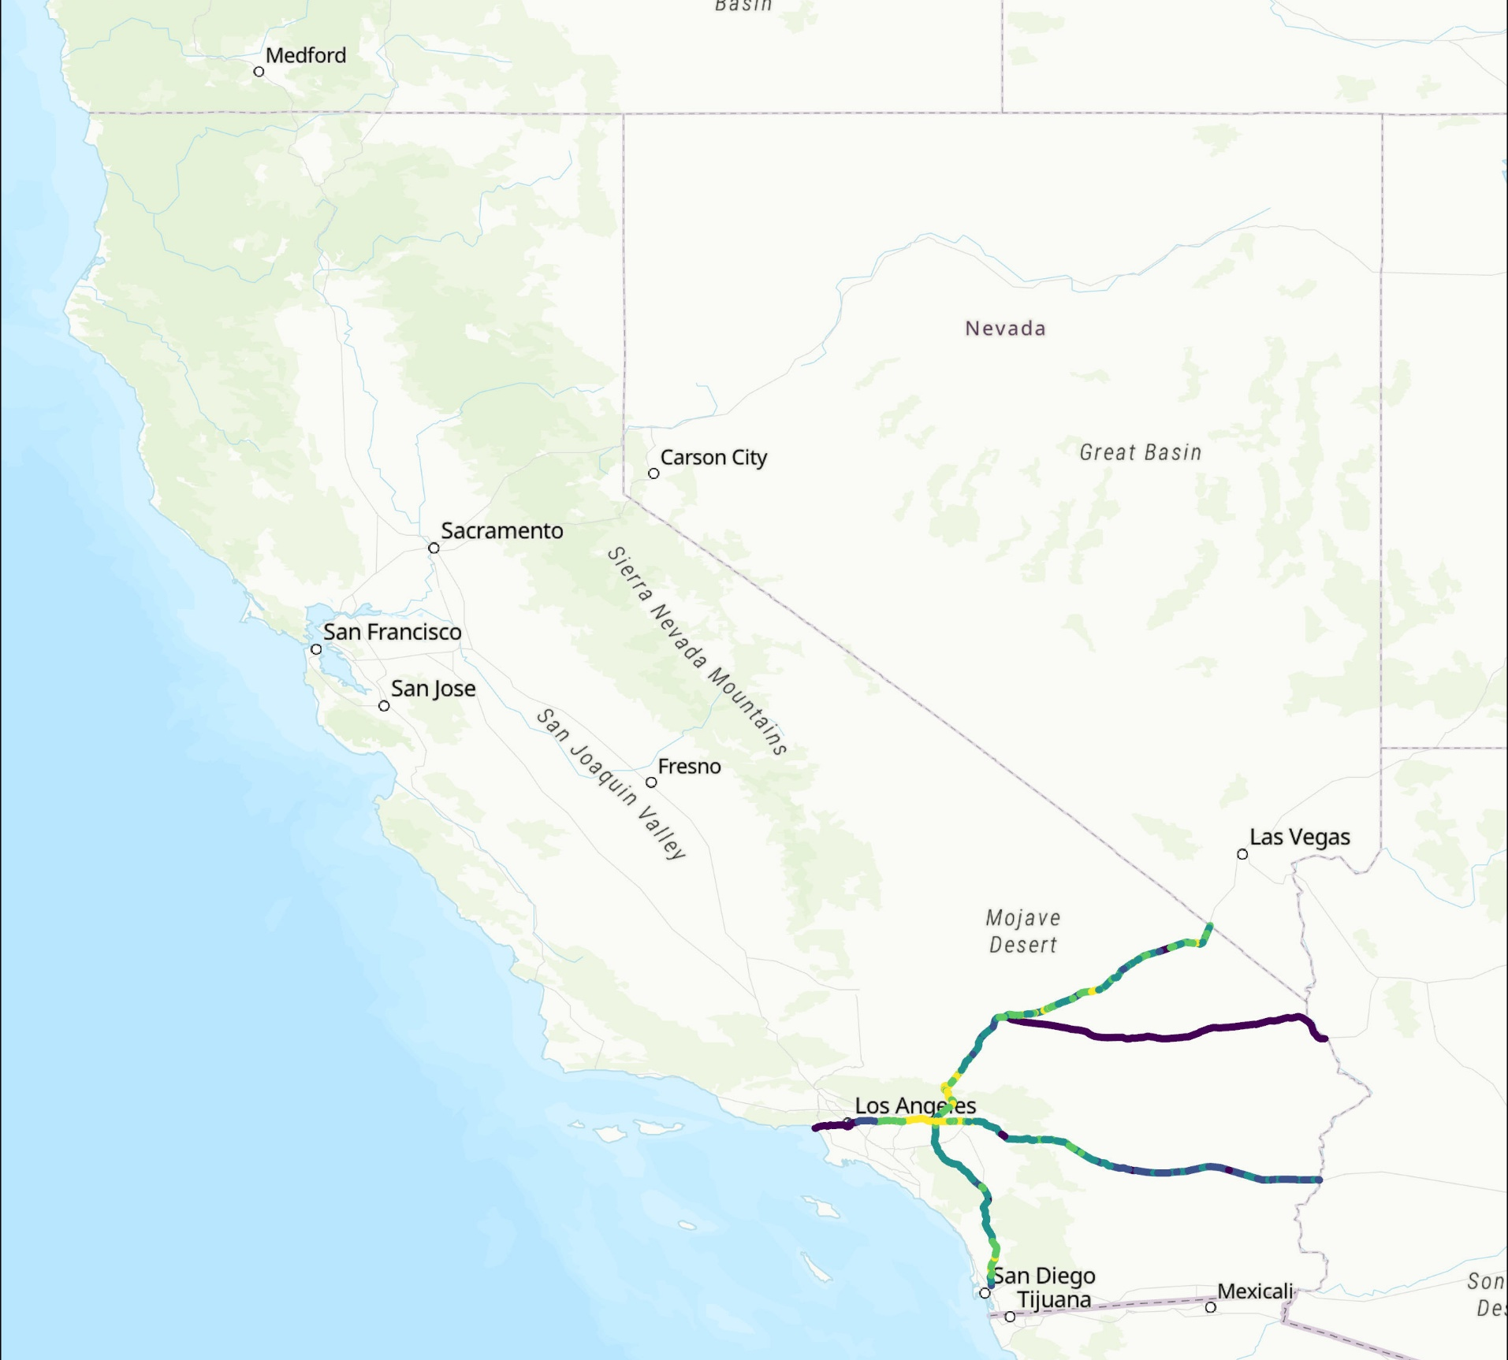
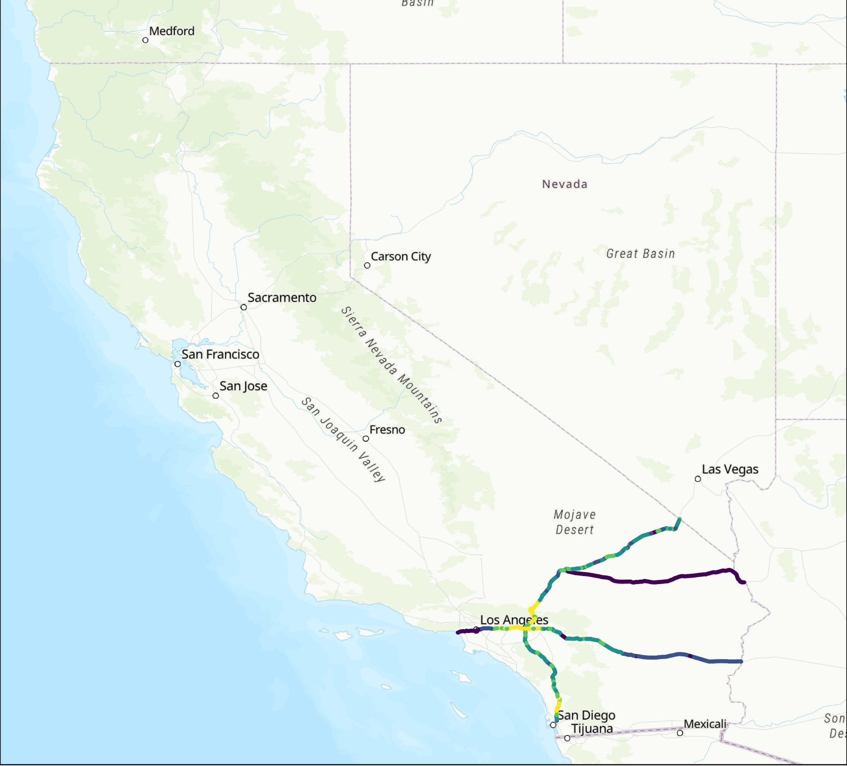


I-10, I-15, I-40
Example CDM outputs using 2023 IEPR
2025
2030
2035
2040
Average Daily Peak (kW)
Average Daily Peak (kW)
Average Daily Peak (kW)
Average Daily Peak (kW)
0 kW
20 kW
0 kW
65 kW
0 kW
400 kW
0 kW
700 kW

Slide 38
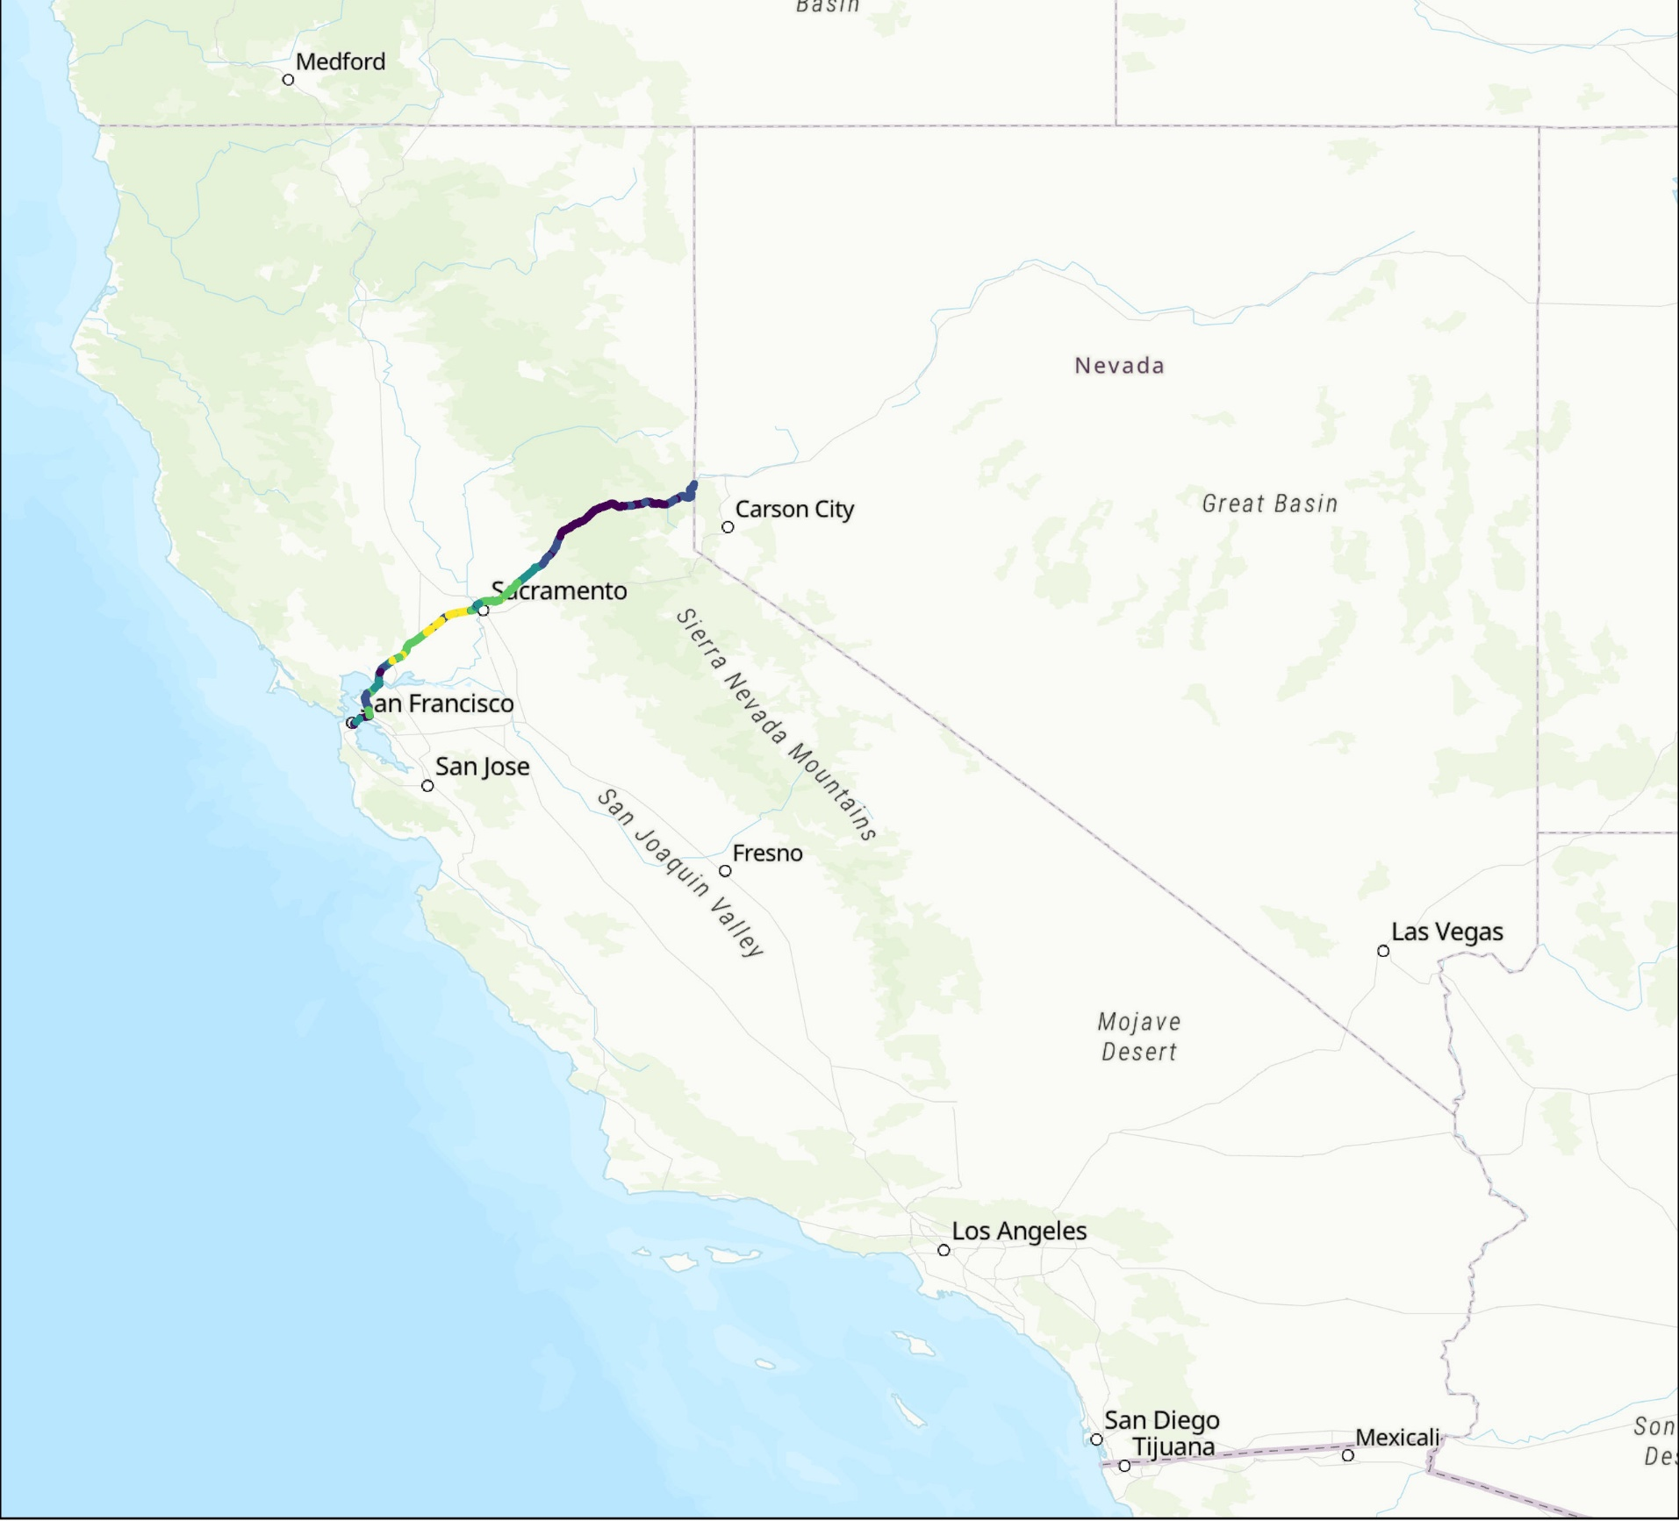

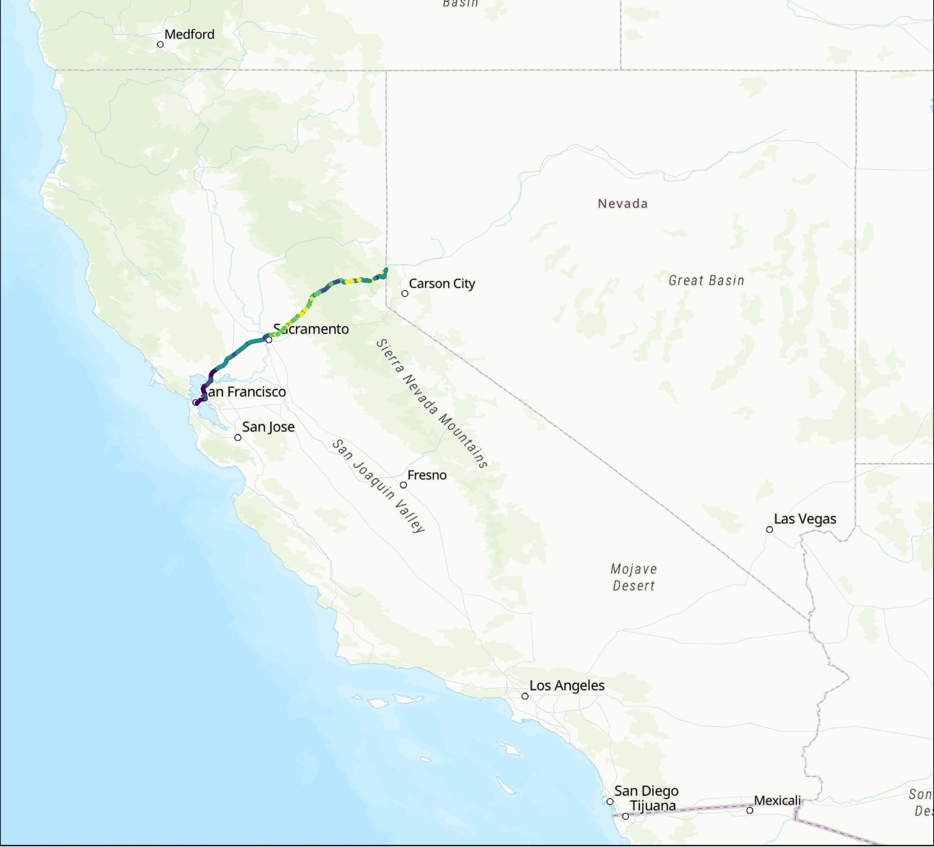

I-80
Example CDM outputs using 2023 IEPR
2025
2030
2035
2040
Average Daily Peak (kW)
Average Daily Peak (kW)
Average Daily Peak (kW)
Average Daily Peak (kW)
0 kW
15 kW
0 kW
50 kW
0 kW
350 kW
0 kW
600 kW

Slide 39
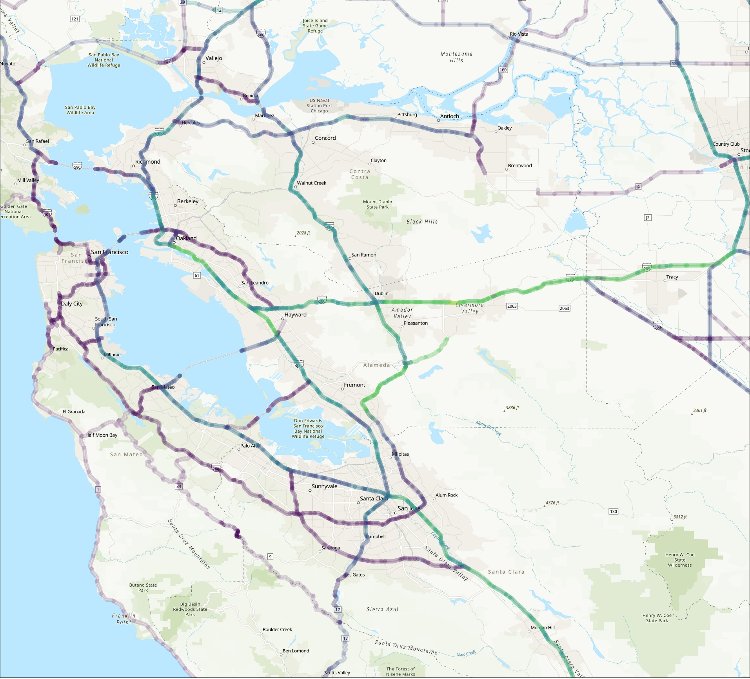

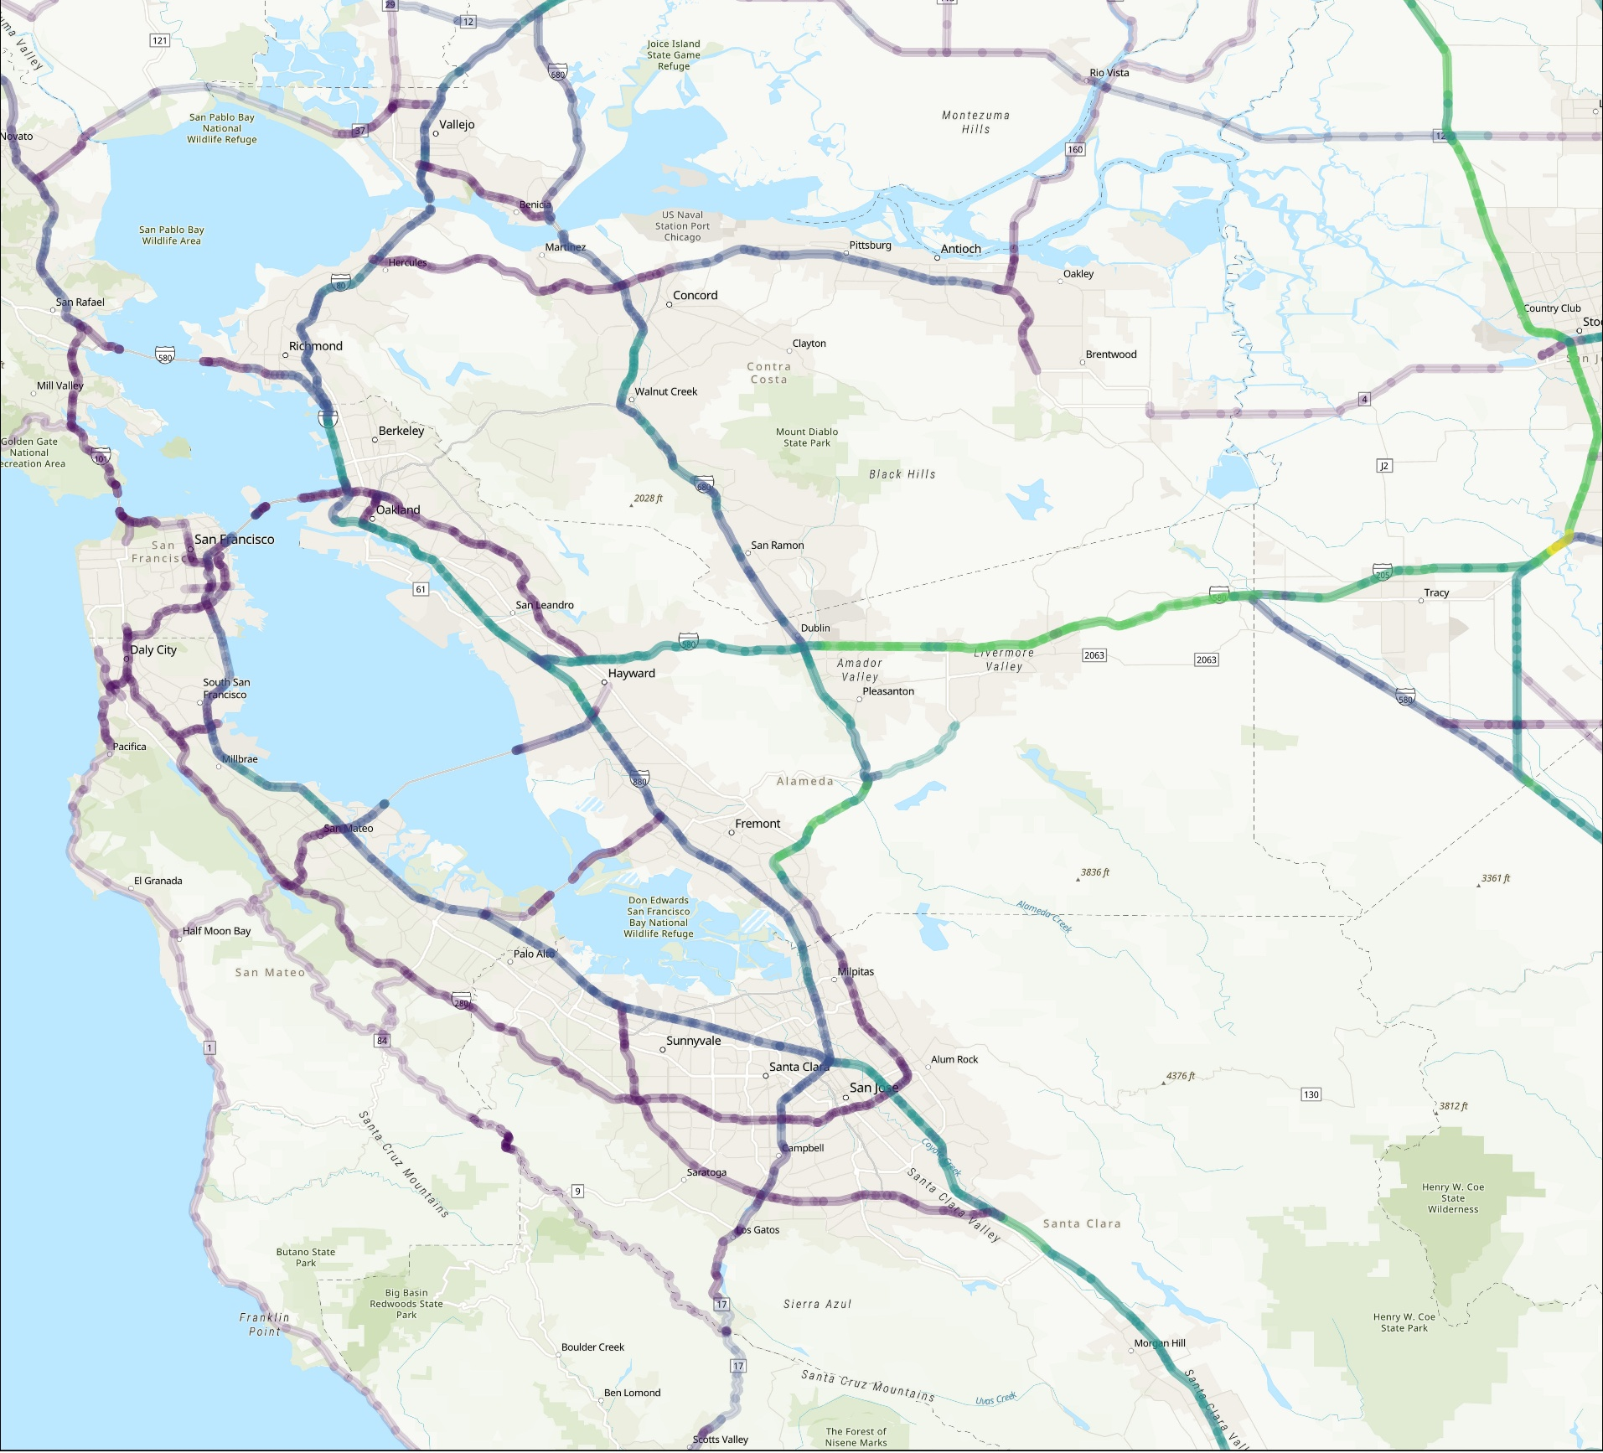

San Francisco Bay Area
Example CDM outputs using 2023 IEPR
2025
2030
2035
2040
Average Daily Peak (kW)
Average Daily Peak (kW)
Average Daily Peak (kW)
Average Daily Peak (kW)
0 kW
60 kW
0 kW
200 kW
0 kW
500 kW
0 kW
700 kW

Slide 40
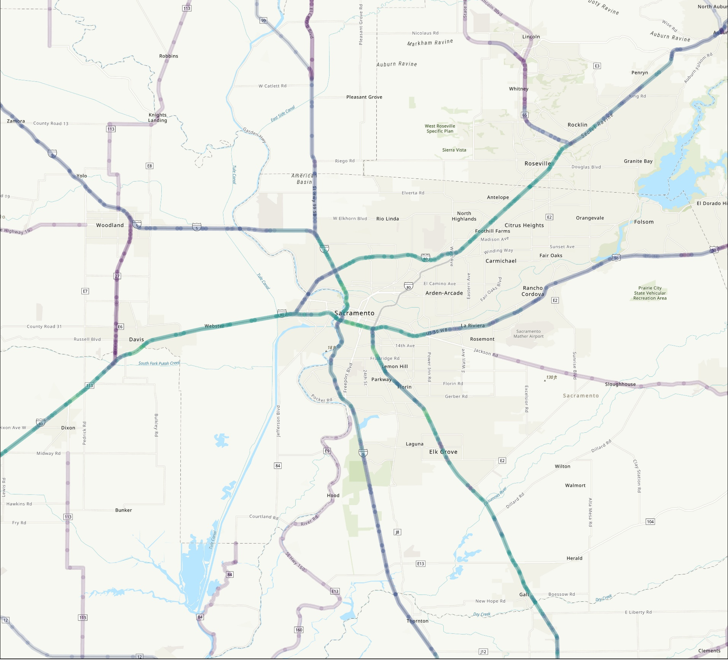
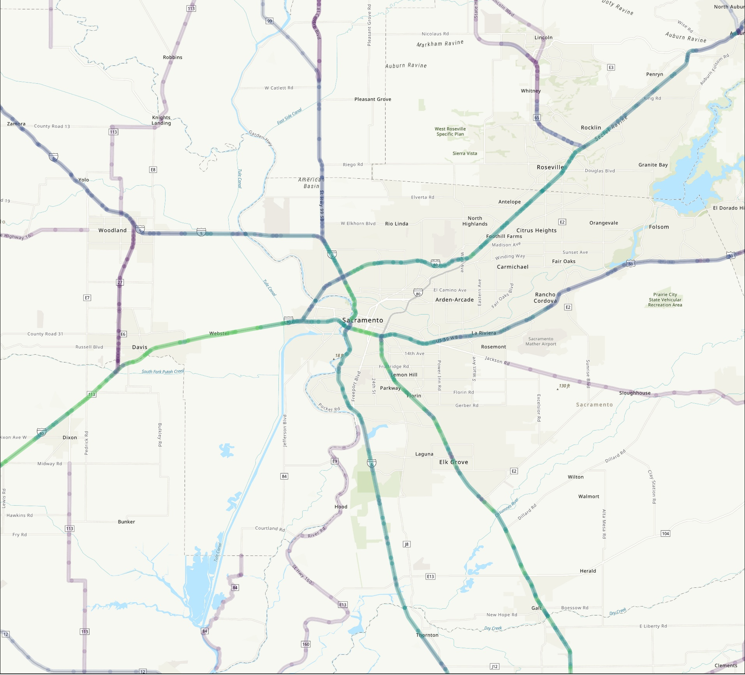
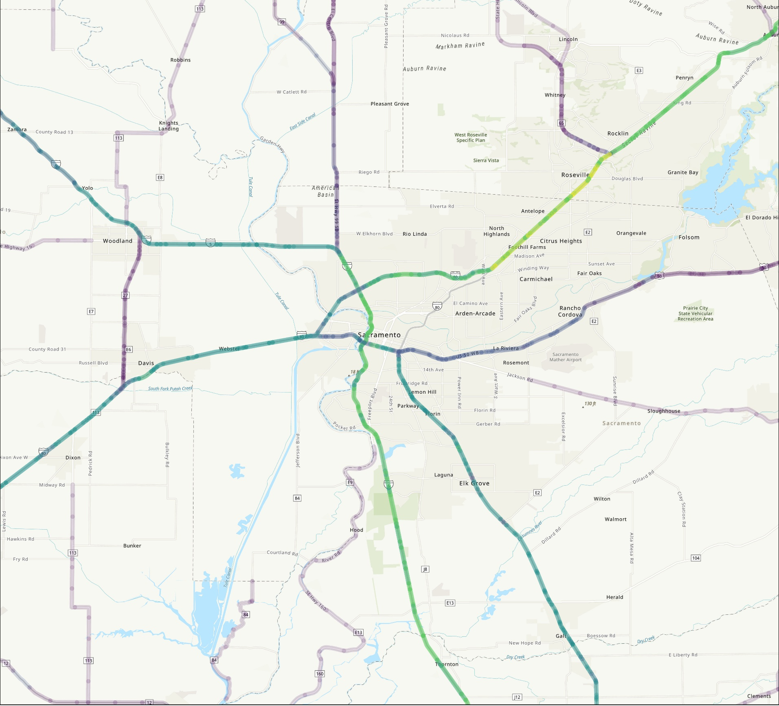

Sacramento
Example CDM outputs using 2023 IEPR
2025
2030
2035
2040
Average Daily Peak (kW)
Average Daily Peak (kW)
Average Daily Peak (kW)
Average Daily Peak (kW)
0 kW
60 kW
0 kW
200 kW
0 kW
500 kW
0 kW
700 kW

Slide 41
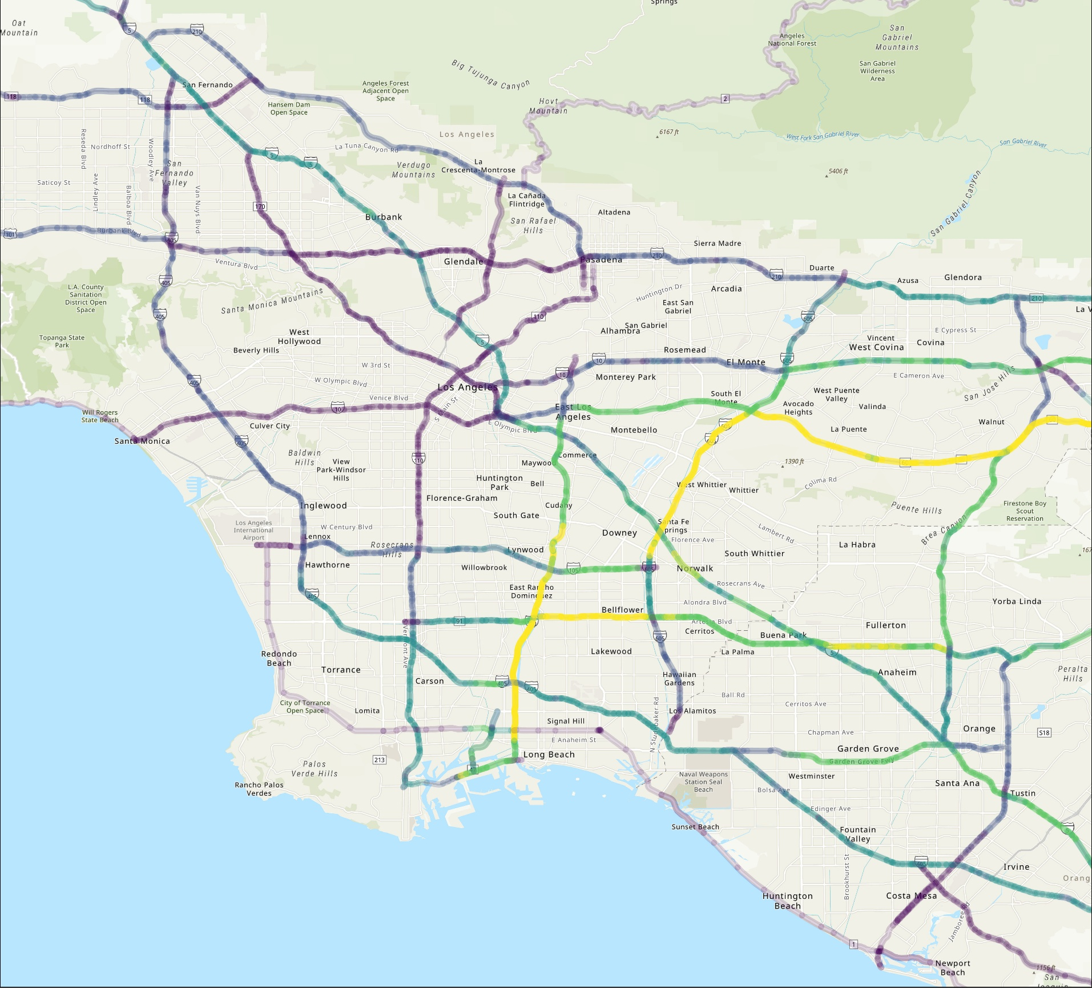

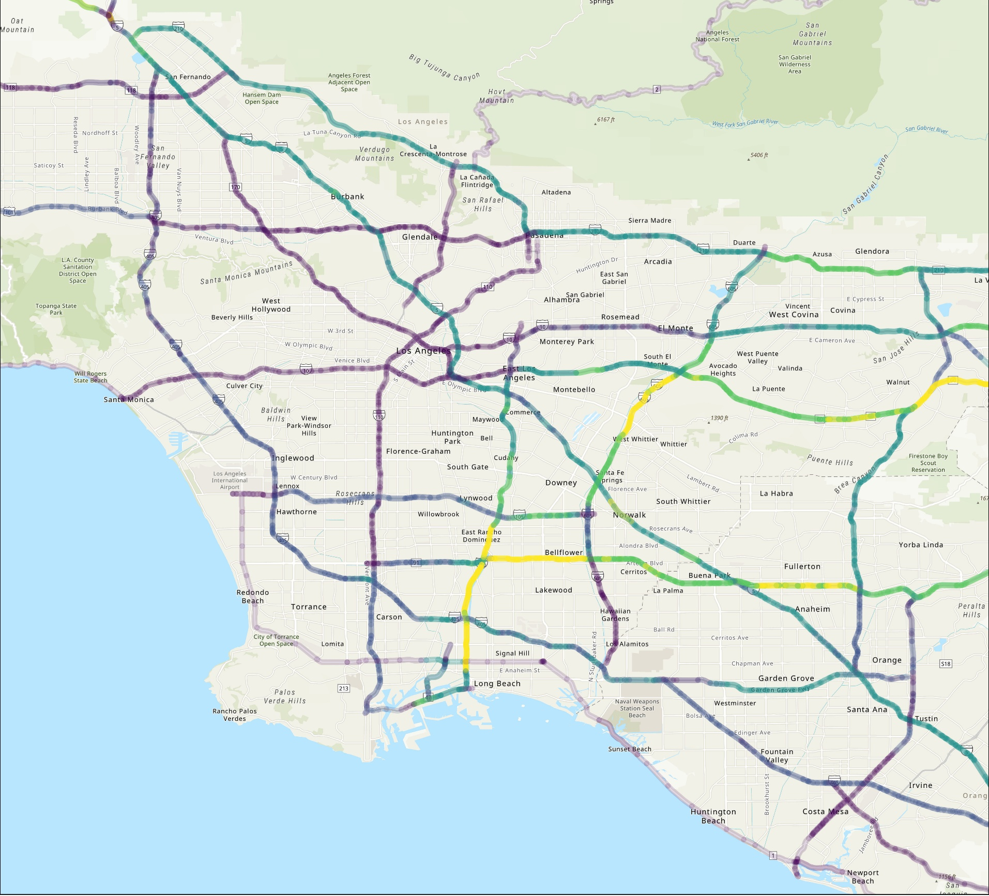
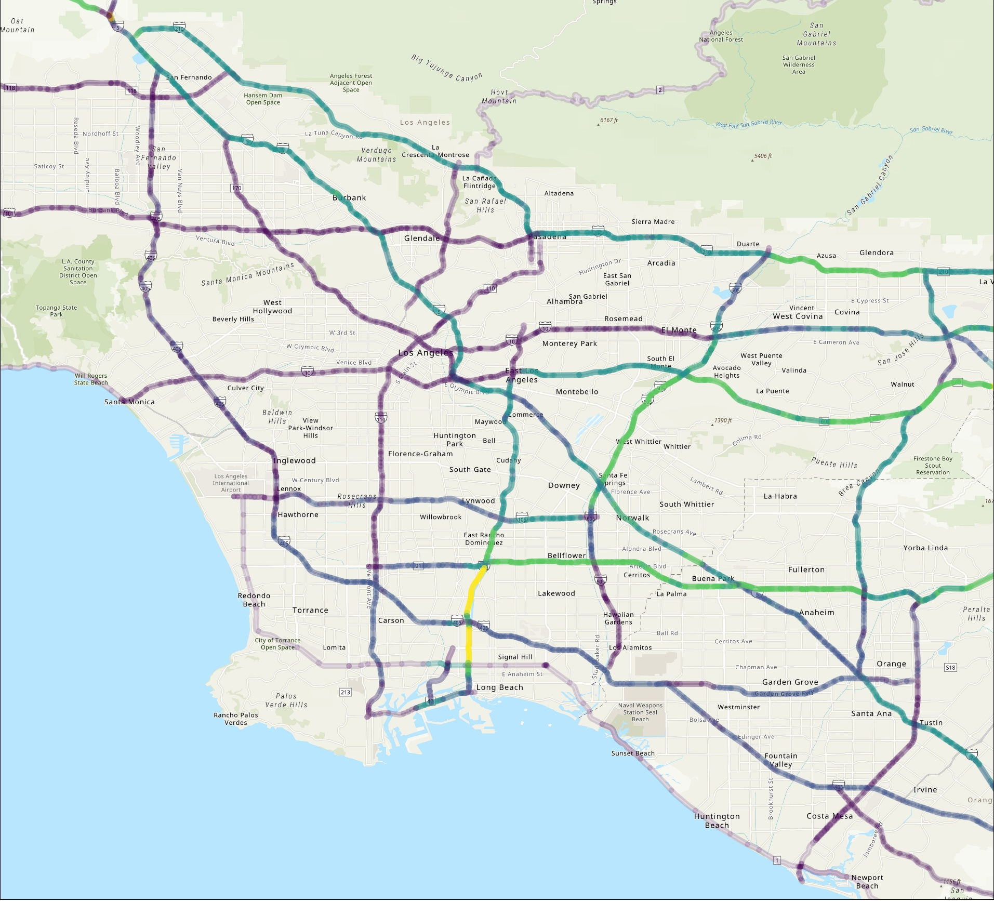
Los Angeles County
Example CDM outputs using 2023 IEPR
2025
2030
2035
2040
Average Daily Peak (kW)
Average Daily Peak (kW)
Average Daily Peak (kW)
Average Daily Peak (kW)
0 kW
60 kW
0 kW
200 kW
0 kW
500 kW
0 kW
700 kW

Slide 42
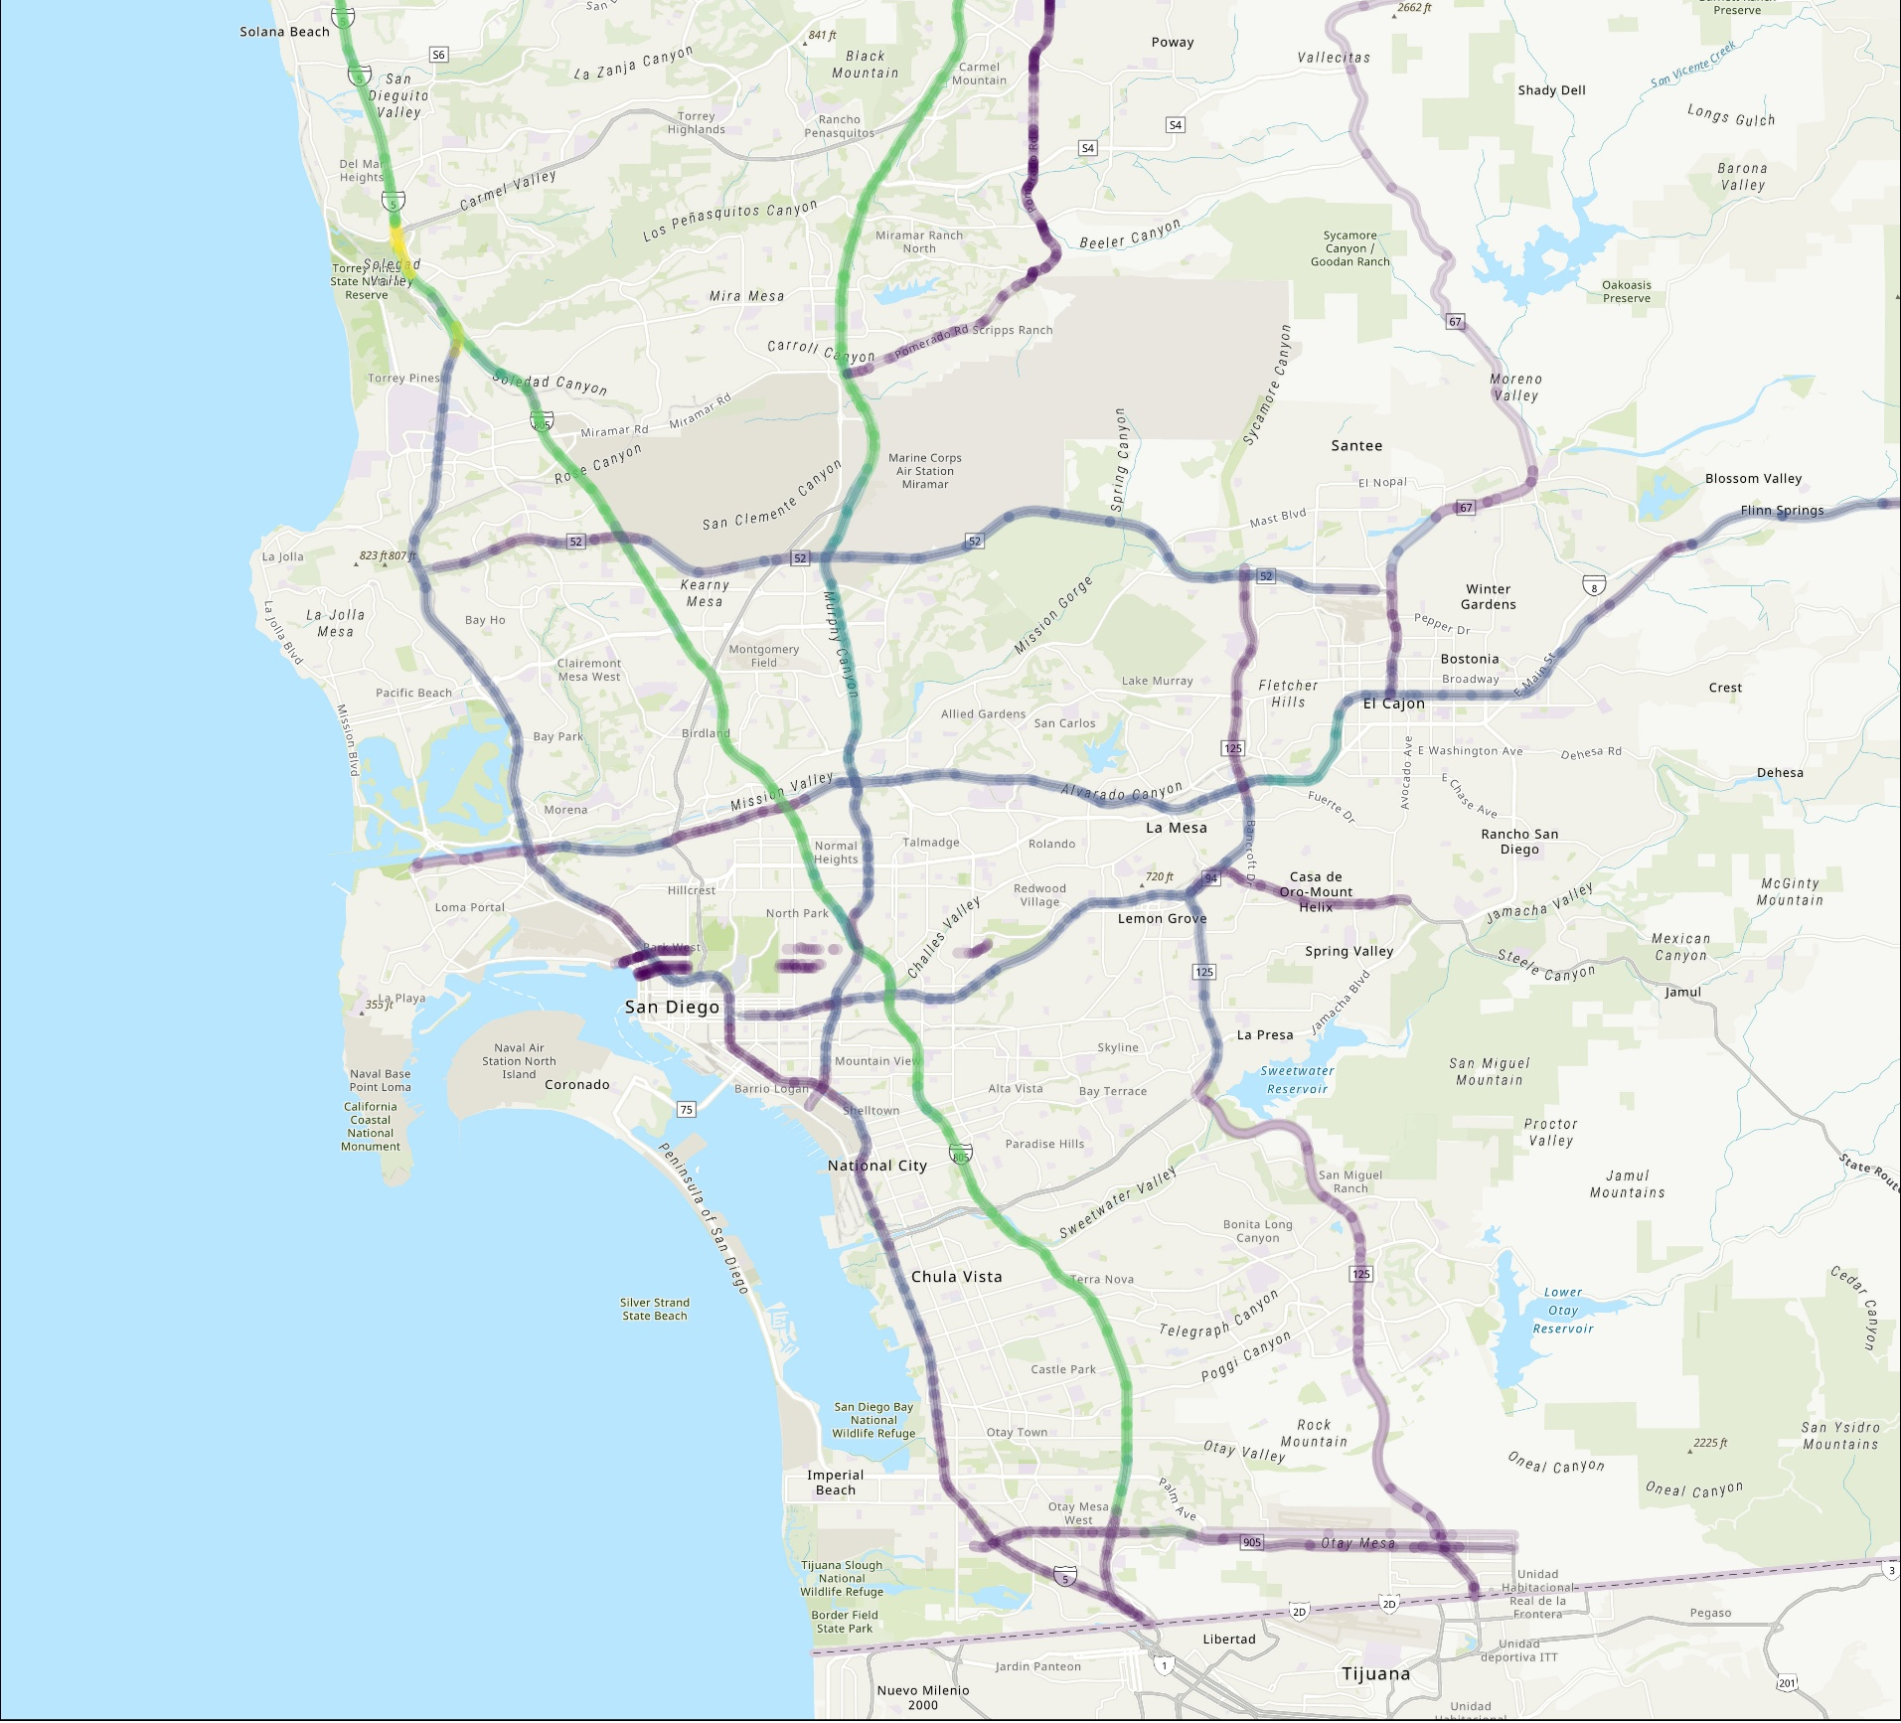



San Diego
Example CDM outputs using 2023 IEPR
2025
2030
2035
2040
Average Daily Peak (kW)
Average Daily Peak (kW)
Average Daily Peak (kW)
Average Daily Peak (kW)
0 kW
60 kW
0 kW
200 kW
0 kW
500 kW
0 kW
700 kW

Slide 43
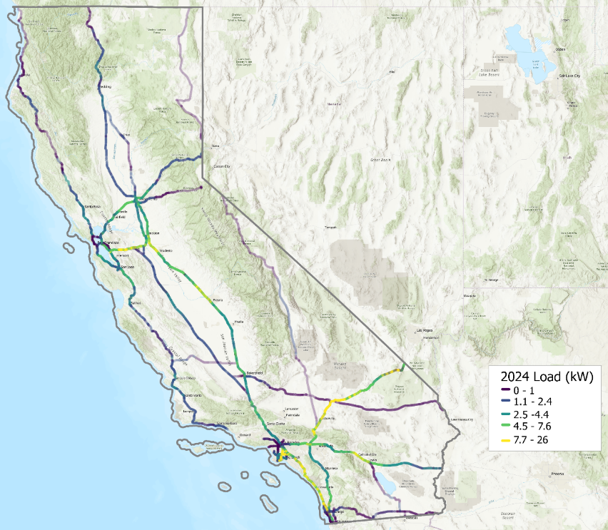
2024 Daily Peak Load
Load from Drayage vehicles concentrated in metro areas like LA and San Francisco. Transit Buses and LD vehicles contribute to load along routes connecting cities, such as SR-99, I-5, I-10 and I-15 into Las Vegas
Example CDM outputs using 2023 IEPR
California Highway Corridors
SB 671 Corridors

Slide 44
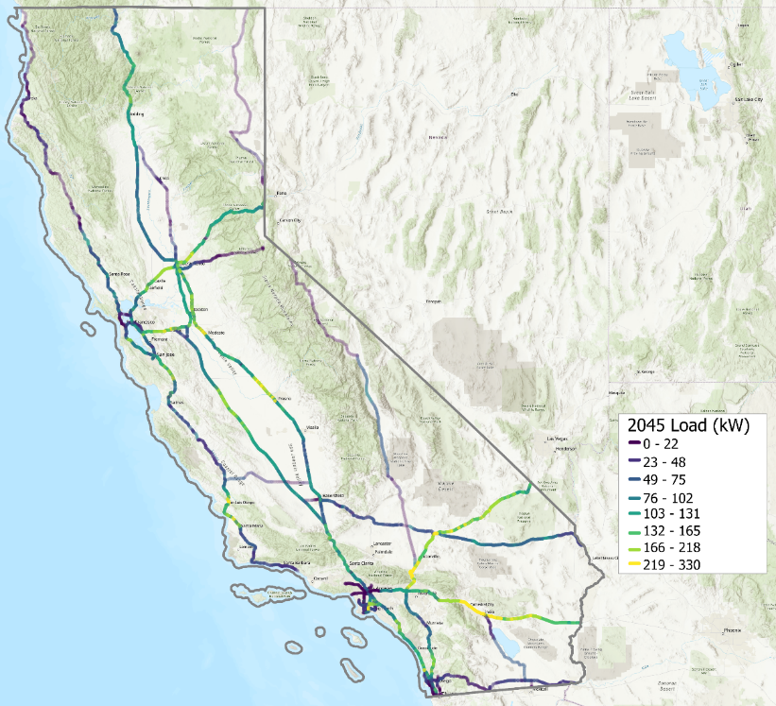
2045 Daily Peak Load
Load is driven by a high traffic volume, and relatively lower states of charge for vehicles, leading to concentrations along major corridors that connect cities. I-5 and SR-99, connecting LA and San Diego to San Francisco and Sacramento, see the highest load, along with I-10 and I-15, connecting LA and San Diego with Nevada and Arizona
Example CDM outputs using 2023 IEPR
California Highway Corridors
SB 671 Corridors

Slide 45


Thank You
Derek Jones
Director
derek.jones@guidehouse.com
Karen Maoz
Associate Director
karen.maoz@guidehouse.com
Tiina Aardemae
Associate Director
taardemae@guidehouse.com
Vivek Nath
Associate Director
vivek.nath@guidehouse.com
Gavin Aiello
Managing Consultant
gaiello.@guidehouse.com
Will Sierzchula
Managing Consultant
will.sierzchulda@guidehouse.com

