Slide 1
Public Safety Power Shutoff 2022 Pre-Season Briefing
Presented to the California Public Utilities Commission (CPUC)
July 15, 2022

Slide 2

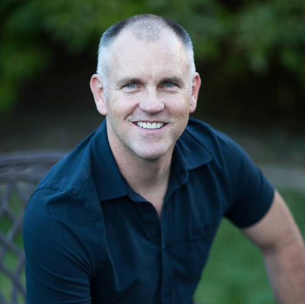
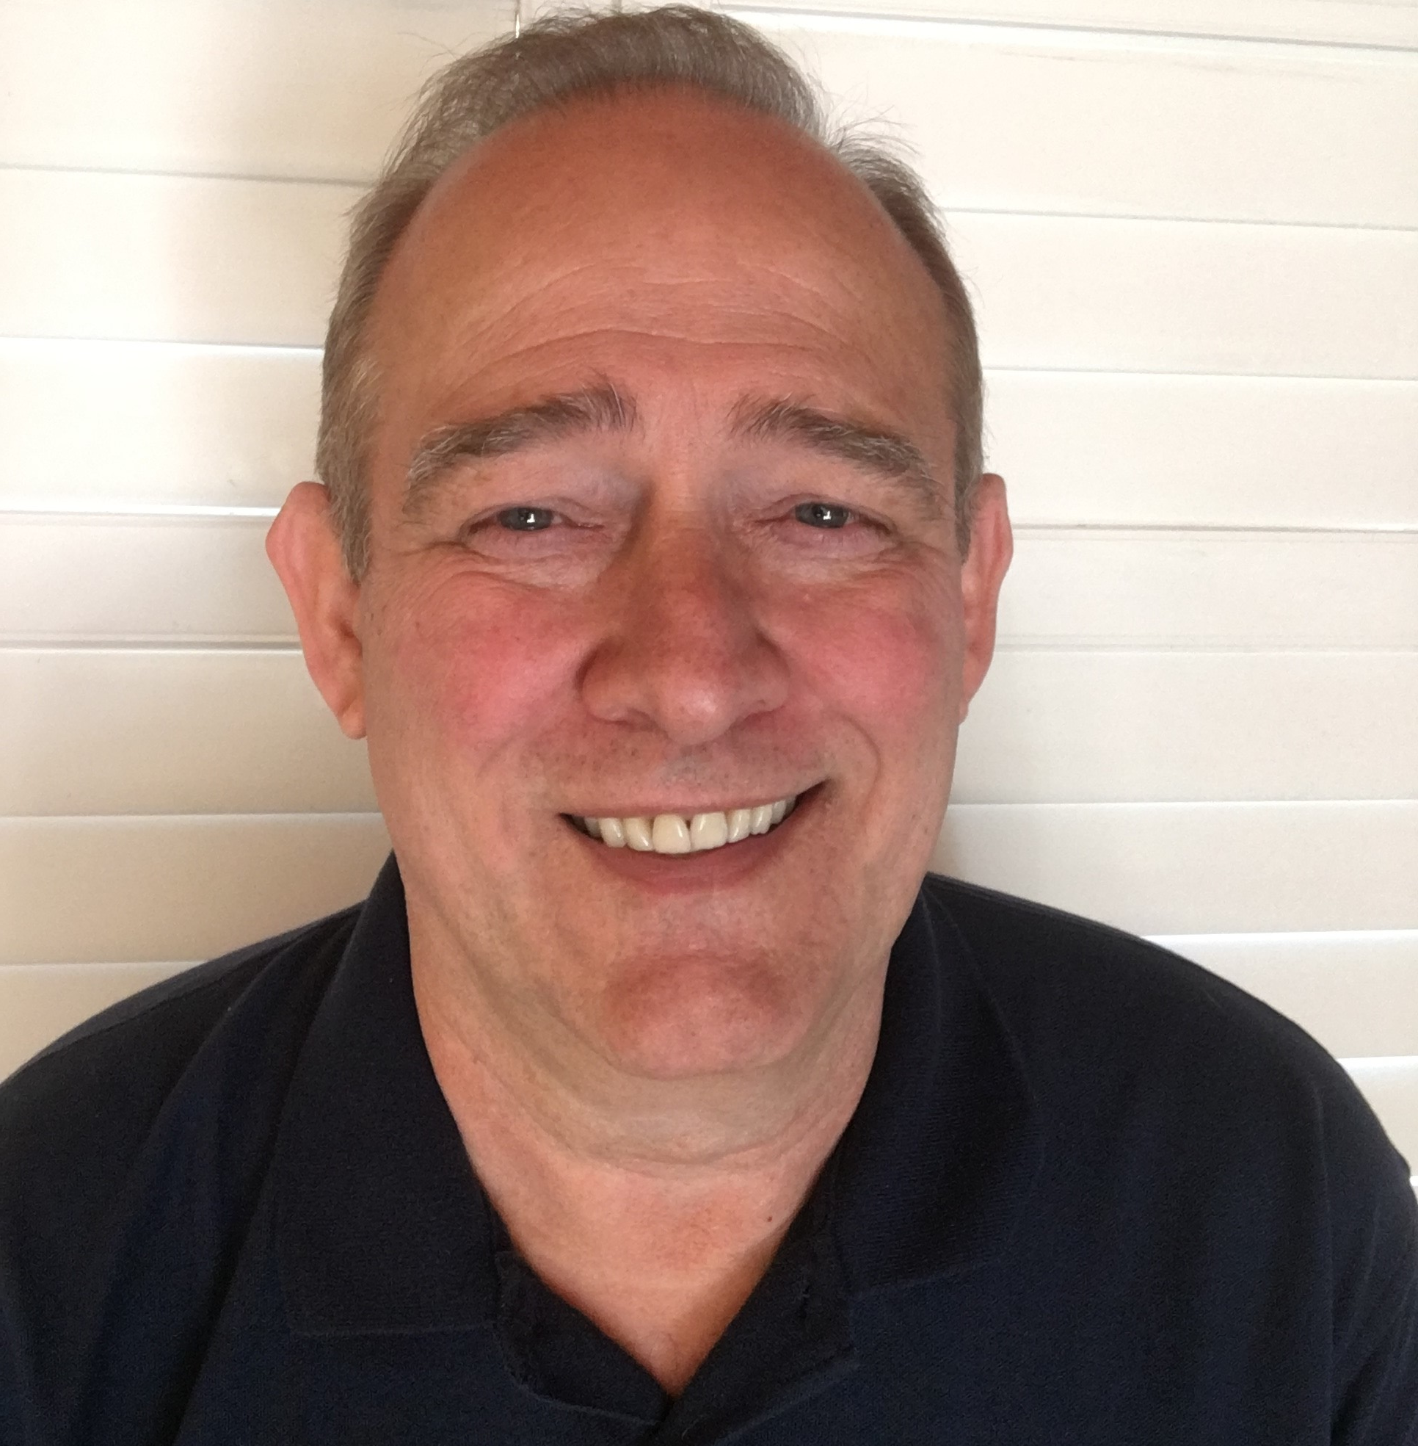
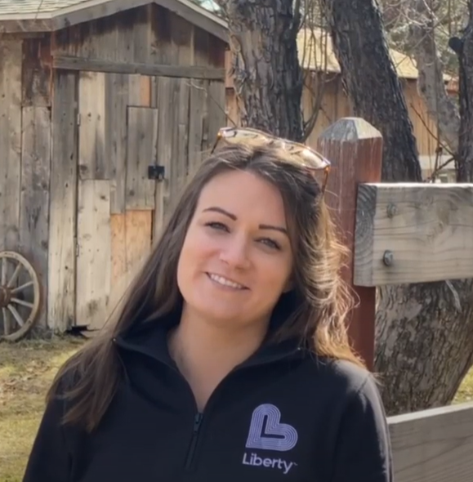
Liberty Team
Travis Johnson
Vice President, Operations
Eliot Jones
Senior Manager, Wildfire Prevention
Lee Kiolbasa
Manager, Emergency Management
Kate Marrone
Manager, Business and Community Development

Slide 3
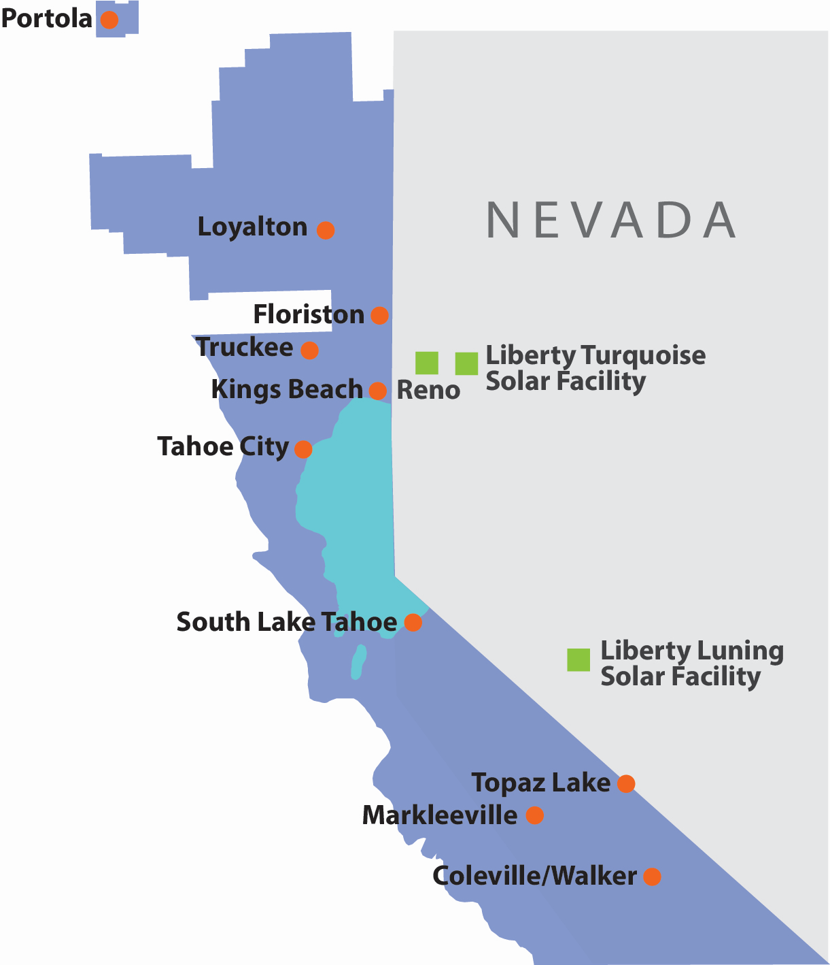
Liberty Utilities
~49,000 customers
~1,400 miles of overhead lines
~300 miles of underground lines
~23,000 utility poles
12 substations
Connected to Nevada Balancing Authority (not CAISO)
125 employees

Slide 4
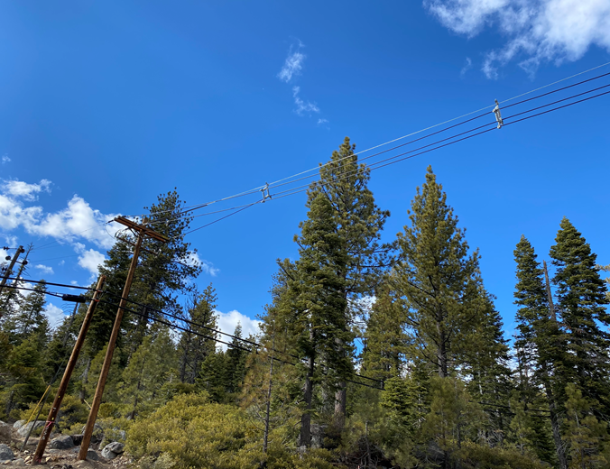
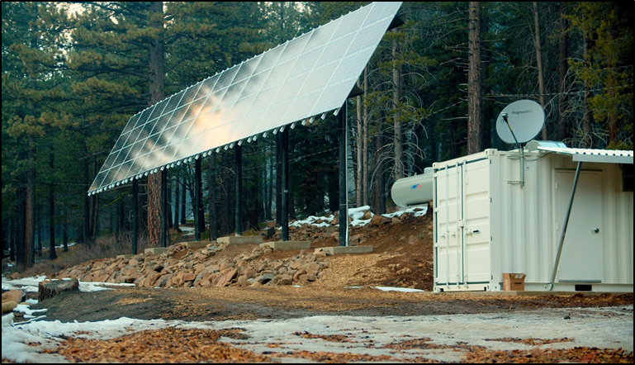
Grid Hardening
In 2022, Liberty plans the following system hardening:
  Complete 9.5 miles of covered conductor projects, including associated pole replacements
  Complete 231 G.O 165 Level 2 pole replacements
  Systematically replace equipment that creates ignition risk, such as expulsion fuses and tree attachments
  Improve substation infrastructure by installing substation animal guards and replacing oil circuit breakers
  Explore and pilot new technologies to improve system resiliency

Slide 5
PSPS Lessons Learned
Liberty has not initiated an actual PSPS event
Liberty updated its PSPS Playbook in advance of the 2022 PSPS season
Continue to build partnerships throughout service territory and expand CBO network
Liberty’s initial PSPS risk analysis includes estimating the frequency or likelihood of PSPS events given historic weather data gridded on Liberty’s overhead lines
Evaluating the use of fast trips with fault indicators as a tool to lower ignition possibility, mitigate PSPS impacts, and restore service more quickly

Slide 6
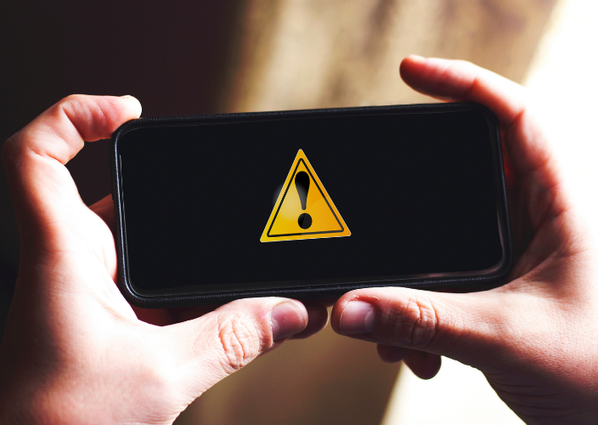
Notifications/Communications
Updated PSPS Playbook
Outreach
Multi-channel approach
PSPS portal
Liaisons for multiple customer categories
PSPS briefings

Slide 7
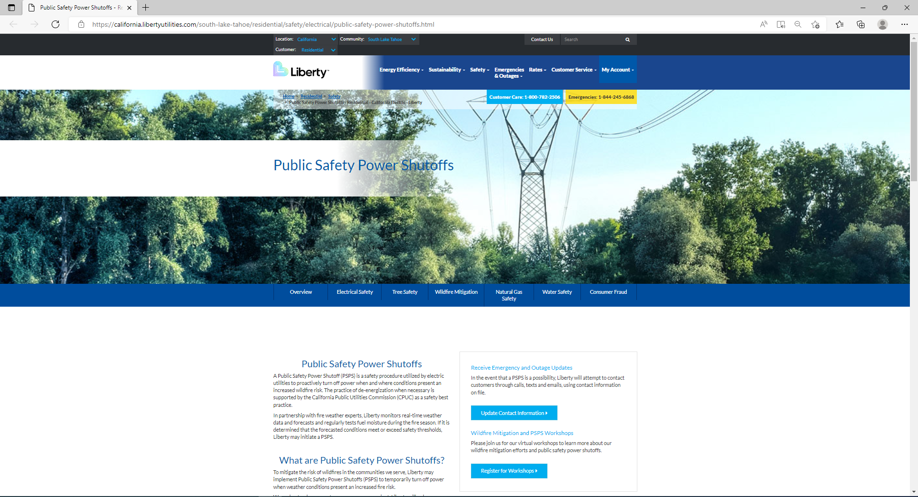
PSPS Website
PSPS Resource Page
  Helpful videos and tips
  PSPS fact sheets, preparedness, available programs
  211 resources
  AFN self-identification tool
  CRC resources
During Potential PSPS Event (Microsite)
  Customers directed only to PSPS information
  Available in English and Spanish
  Designed to handle web traffic

Slide 8
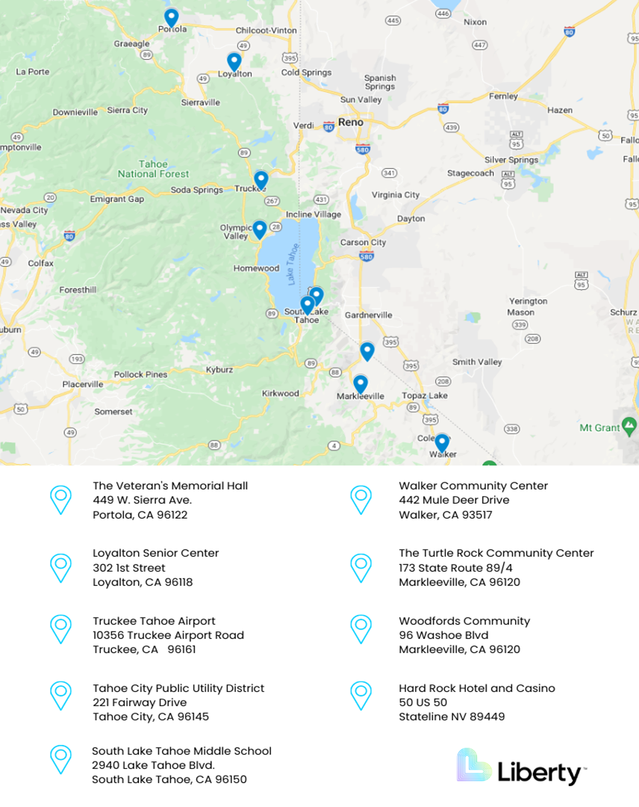
Community Resource Centers
Staffing & training
Site tours
Material additions
CRC site considerations
  Indoor venues compliant with fire codes and ADA requirements
  Back up generation
  Travel distance less than 30 miles for all customers
  Facility capacity and amenities

Slide 9
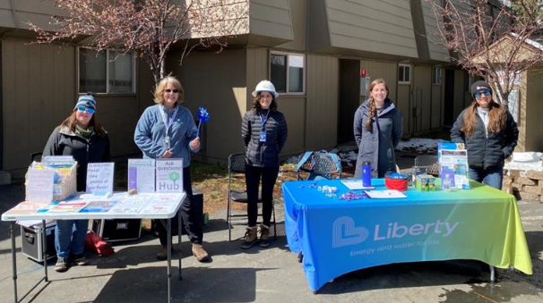
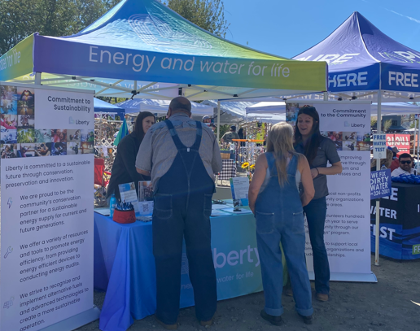
AFN and MBL Customers
CBO network expansion
Collaborative outreach
AFN data
Proposed Behind-the-Meter Battery Storage Program

Slide 10


Customer Resources
Community Based Organizations
211
Meals on Wheels Support
Community Resource Centers
Liberty Website

Slide 11
Preparedness Coordination
Coordination with Critical Infrastructure
  Public Safety Partner Support
    Mapping all Critical Infrastructure in the Liberty service area
    Updating the Liberty Utilities Public Safety Partner Portal
Coordination with Local/Tribal/County Emergency Response

Slide 12
PSPS Exercises and After Action Reports
Training on Incident Command and Conducting PSPS Exercises:
  ICS Training and PSPS Table Top Exercise—June 15, 2022
  PSPS Full Scale Exercise with Public Safety Partners—June 23, 2022
After Action Reports and Improvement Plans Completed
  Submitted with Pre-Season Report—July 1, 2022
  Lessons learned include:
    Two additional CRC locations
    Detailed staffing plan for CRCs
    Comprehensive training plan for CRCs
    Mapping of Critical Infrastructure and establishing a PSP portal
    Review of Incident Management Team staffing during a PSPS event
    Update of the Liberty PSPS Playbook

Slide 13
Appendix

Slide 14



PSPS Decision-Making Framework
ERC
Is Energy Release
Component >92%?
No
Yes
Do Wind Gusts Exceed 40mph?
No
No De-Energization
Yes
FFWI
Is The Fosberg Fire Weather Index >50?
No
Yes
Initiate Protocol for De-Energization

Slide 15
PSPS Decision-Making Framework
Do Wind Gusts Exceed 40mph?
No
Yes
BI
Is Burning Index >75?
No
No De-Energization
Yes
Initiate Protocol for De-Energization

