Slide 1
BVES Risk Based Decision Making Framework – Workshop Panel
February 22, 2018
Paul Marconi, Director

Slide 2
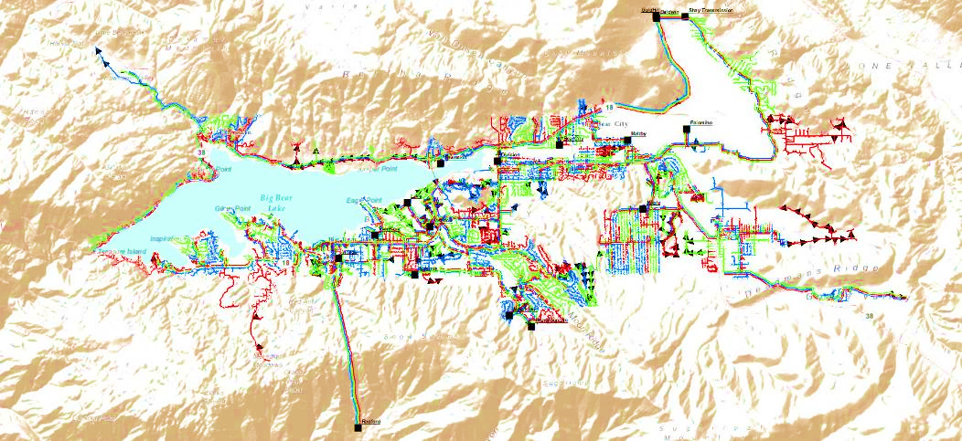
Overview
BVES’ approach to developing a Risk Based Decision Making Framework
Our process
Our challenges
What we produced

Slide 3
The Requirement (D.14-12-025)
“The small energy utilities, which consist of Bear Valley Electric Service, Liberty Utilities, PacifiCorp doing business as Pacific Power, and Southwest Gas Corporation, shall transition to including a risk-based decision-making framework into their General Rate Case application filings beginning three years from the effective date of this decision.”
“Due to the size of the small energy utilities, conducting a separate S-MAP and RAMP processes may not be practical or appropriate for these small energy utilities. However, the small energy utilities shall, in three years, begin the transition to include a risk-based decision-making framework into their future GRC application filings. That means the GRC presentations of these small energy utilities will have to address the safety risks that each utility faces in its system and operations, and to explain how it plans to manage, mitigate, and minimize those risks during the GRC cycle in the context of its GRC revenue requirement request.”

Slide 4
BVES’ Approach
We wanted a process that:
Used the same language as everyone else in this process – lexicon
Was grounded in a recognized risk management process – ISO 31000
Was conceptually along the lines of what other California Utilities and the CPUC were discussing
We worked with a consultant expert to get us to the point of having a program in place

Slide 5
Our Process
BVES | Cycla
Risk identification | Steps 1 and 2
Risk analysis:
Risk evaluation and scoring
Risk mitigation determination | Steps 3. 4, and 5
Risk informed project decision making | Steps 6, 7, 8 and 9
Risk monitoring | Step 10
Based on Cycla 10 process

Slide 6
Risk Heat Maps - Example

Slide 7
Risk Informed Decision Making

Slide 8
Our Challenges
Small stretched staff that is streamlined to handle day-to-day issues and business operations (not extra projects)
So we needed to convert this from an extra project to our way of doing business
Our goal is that all employees become “risk managers” who are encouraged to identify and ultimately help mitigate risks
Required paradigm shift
Lack of data to support modelling probability of an event occurring
First round was heavily reliant upon Subject Matter Experts
Getting staff to describe proposed operational actions in terms of risk mitigation and quantifying risk reduction
Keeping financial risk out of the operational risk discussion

Slide 9
Questions?
Powering The Mountain Since 1929

