Slide 1
STRAW PROPOSAL - 01
R.15-06-009
Proposed Rules for Electric Utility Distribution System Security Assessments

Slide 2
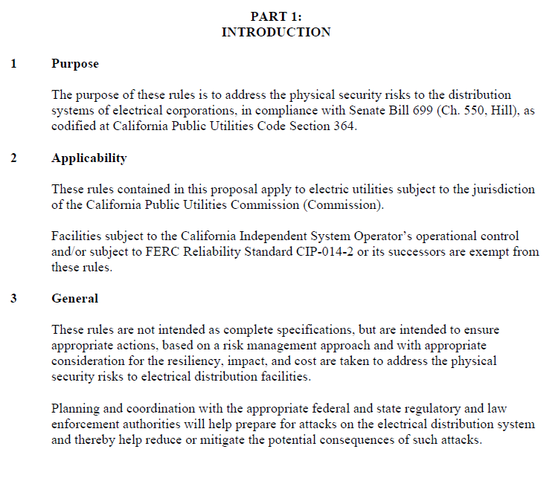
Part 1: Intro | Part 2: Definitions & Acronyms | Part 3: Dist. Substation & Control Center Security Programs | Part 4: Review | Part 5: Info Sharing

Slide 3

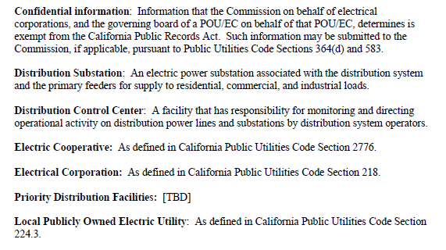
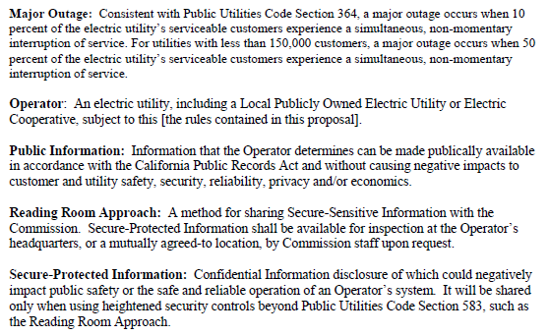
Part 1: Intro | Part 2: Definitions & Acronyms | Part 3: Dist. Substation & Control Center Security Programs | Part 4: Review | Part 5: Info Sharing

Slide 4

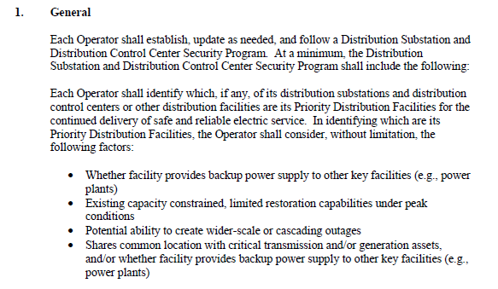
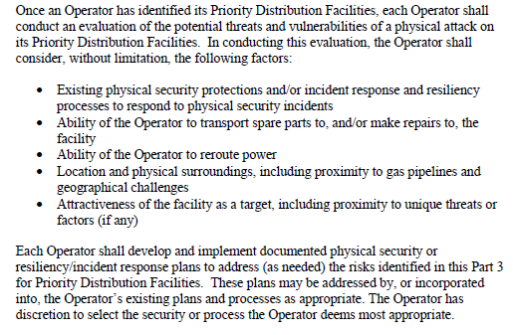
Part 1: Intro | Part 2: Definitions & Acronyms | Part 3: Dist. Substation & Control Center Security Programs | Part 4: Review | Part 5: Info Sharing

Slide 5
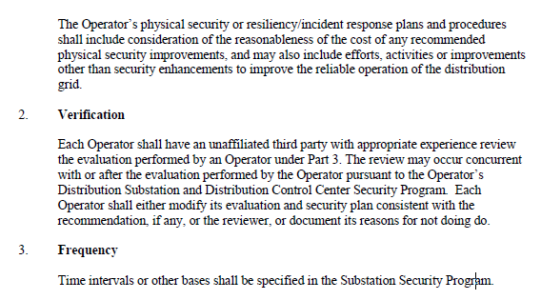
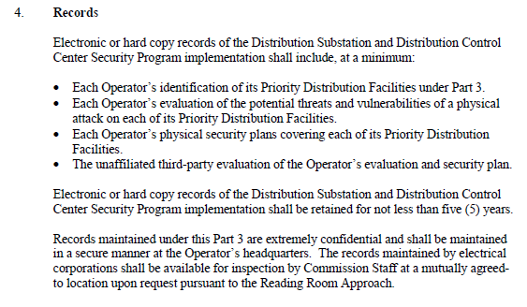
Part 1: Intro | Part 2: Definitions & Acronyms | Part 3: Dist. Substation & Control Center Security Programs | Part 4: Review | Part 5: Info Sharing

Slide 6
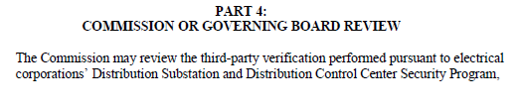
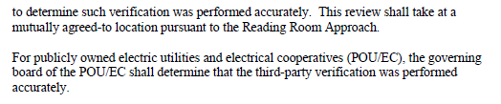
Part 1: Intro | Part 2: Definitions & Acronyms | Part 3: Dist. Substation & Control Center Security Programs | Part 4: Review | Part 5: Info Sharing

Slide 7
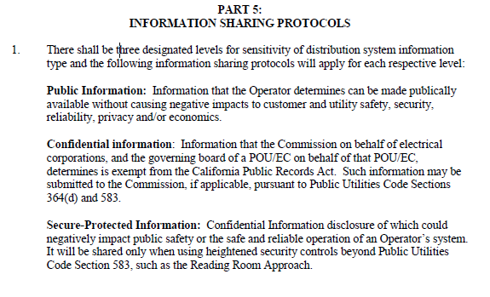
Part 1: Intro | Part 2: Definitions & Acronyms | Part 3: Dist. Substation & Control Center Security Programs | Part 4: Review | Part 5: Info Sharing

