Slide 1
  W-E Calculator 2.0 Workshop
  Experience Implementing the W-E Calculator
  Jill Kjellsson j6kh@pge.com
  Program Manager – Industrial, Ag and Water
  April 6, 2016

Slide 2
Agenda
Custom Approach
Deemed Approach
Next Steps

Slide 3
Custom Project
Customer submits application
Pre-Installation
Installation
Post-Installation
Paid
Customer submits application for a project that saves water
Pre-Installation
Installation
Post-Installation
Notes:
Very simplified process flow

Slide 4
Custom Project
Customer submits application
Pre-Installation
Installation
Post-Installation
Paid
Customer submits application for a project that saves water
Pre-Installation
Installation
Post-Installation
Project eligibility confirmed
Working on water saving eligibility
Energy baseline is determined
Working on a methodology to determine water baseline
Data is entered into internal databases
Configuring internal databases to accept embedded energy and water inputs
Projects selected for review
Potentially longer project review timelines
Technical review of installed energy use and energy savings calculations
Working on methodology to calculate post-installation water use
Project completion
Configuring internal databases to accept embedded energy and water inputs
Simplified calculator?
Training
File review
Notes:
These are the stages we run into hurdles –
Reduce time required for training and review and reduced opportunities for error

Slide 5
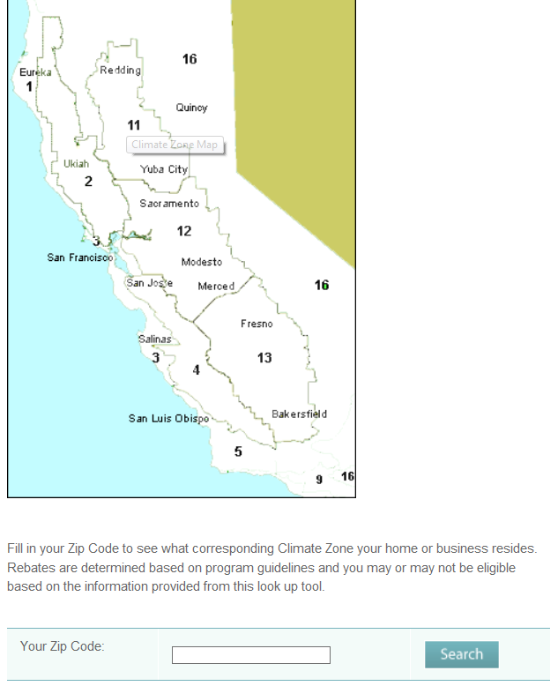
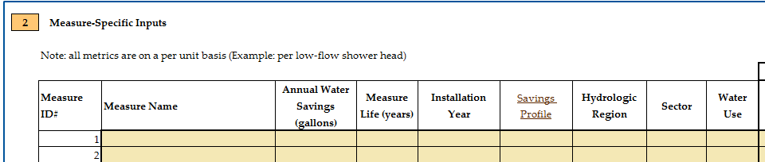
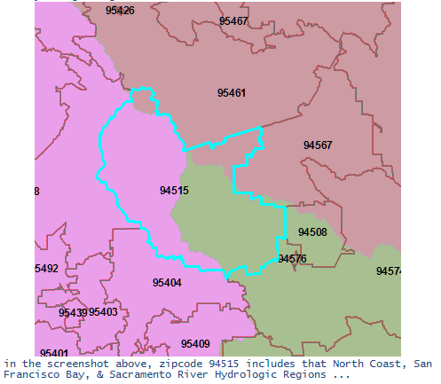
Hydrologic Region Look-up Tool based on Zip Code
PG&E climate zone look-up tool based on zip code
Notes:
We’d like to create a tool to determine which hydrologic region a project is in based on zip code. Alternatively, tool could be updated to have look-up tool embedded in a new sheet…how to deal with zip codes like 94515 that have 3 hydrologic zones.
Make point of lower right pic gis team made – not something available! Direction and agreement – statewide consistency

Slide 6
3rd Party Technical Review Feedback
Key findings:
Define zip codes for each region
Periodic parameter updates
Incremental measure costs, EUL, and other factors – DEER vs. water agency values
Fixed daily profile assumes water profile across all days – does not account for time-of-use or weekday vs. weekend
Less customizable tool or locked advanced tabs
Cost benefits are not of direct value to an incentive applicant
Notes:
PG&E submitted the calculator to one of our 3rd party technical reviewers for comments. Some items align with what PG&E have identified as hurdles, others are new and were not submitted in our comments to the CPUC before the workshop and we believe there is merit to them.

Slide 7
Custom: Outstanding Issues
Project eligibility
Determining eligibility requirements
Water use calculations
Creating pre- and post-installation water use calculation methodology
Submitting previously paid project to Ex-Ante Review team for feedback
Handling of new data types
Configuring our internal databases to handle water related data
Create custom measure for water savings
Hydrologic region look-up tool
Need statewide consensus on how to deal with unaligned boundaries and guidance from Energy Division and Ex-Ante Review team
Need to determine if functionality should be embedded in tool or separate
Water agency and DEER have different parameters for same measure (e.x. EUL)
Need guidance from Energy Division and Ex-Ante Review team on what numbers to use for embedded energy calculations
Potentially longer project review timelines
Simplified calculator?
Cost benefits are not of direct value to an incentive applicant
Fixed daily profile assumes water profile across all days – doesn’t account for time-of-use or weekday vs. weekend
Periodic parameter updates

Slide 8
Deemed Project
Work Paper Tool and DEER
Rebate Application
Processed/Input
Savings Tracked in Internal Databases
Paid
Customer submits application for a project that saves water
Pre-Installation
Post-Installation
Notes:
VERY simplified

Slide 9
Deemed Project
Work Paper Tool and DEER
Rebate Application
Processed/Input
Savings Tracked in Internal Databases
Paid
Customer submits application for a project that saves water
Pre-Installation
Post-Installation
Energy savings determined in work papers
Adding embedded energy savings in work papers
Deemed energy savings are determined by climate zone
Hydrologic regions span climate zones
Deemed measures establish averaged energy savings
Establish averaged water savings values for Deemed measures
Data entered into internal databases
Configuring internal databases to accept embedded energy and water inputs
System currently looks up Deemed savings based on zip code and climate zone
Further clarity and guidance on unaligned boundaries

Slide 10
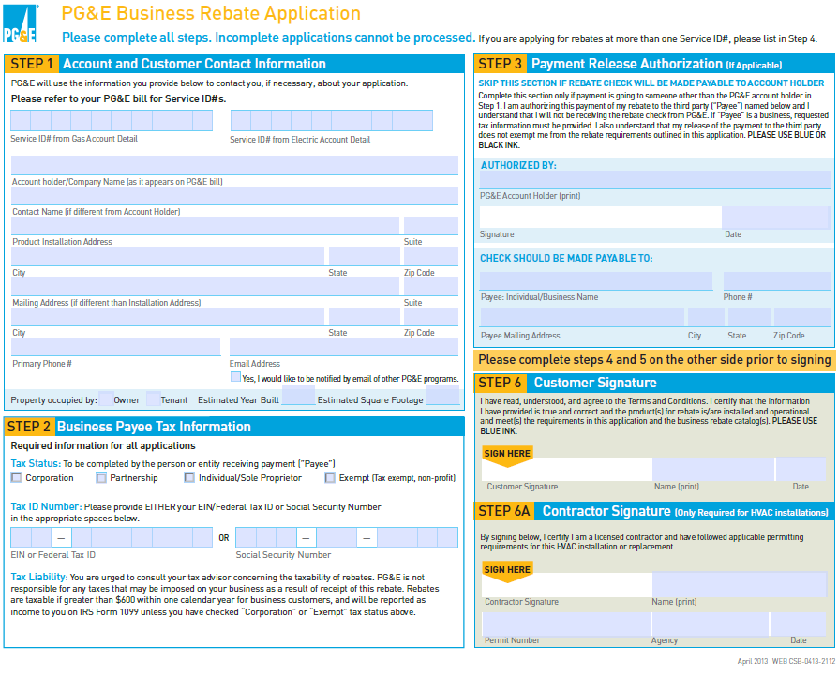
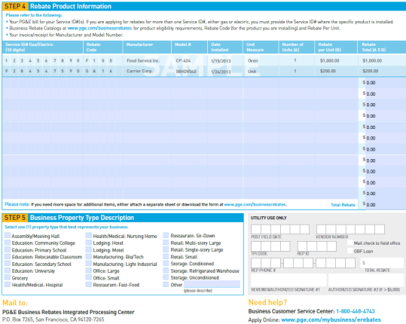
Data Linkages
Zip Code | Climate Zone
95467 | 2
95461 | 2
95403 | 2
95409 | 2
94515 | 2
… | …
Climate Zone | Energy Savings*
1 | 100
2 | 125
3 | 132
4 | 116
5 | 90
… | …
Zip Code | Hydrologic Region
95467 | NC
95461 | NC
95403 | SF
95409 | SF
94515 | ?
… | …
* Values do not represent actual market numbers, and are for illustrative purposes only

Slide 11
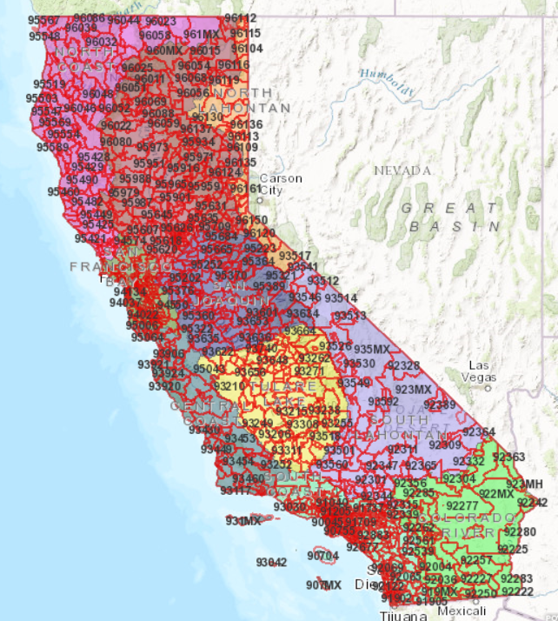
Unaligned Boundaries Complicate use of W-E Calculator
Hydrologic region and service territory boundary misalignment
With Deemed measures, time prohibitive to individually calculate embedded energy for each project
How to incorporate into work paper without increasing admin time
Notes:
Similar issues in deemed as we saw in custom – but the difference is with custom we are dealing with people and with deemed we’re dealing with a computer. We can train a person to look up the hydrologic region for each project. With deemed, we can’t perform call for each incentive applicant – we must automate in the computer. This means dealing with the same issue differently for custom and deemed.

Slide 12
Deemed: Outstanding Issues
Embedded energy savings not in work papers
Adding embedded energy savings in work papers or in “water savings” work paper
Submit work paper to Ex-Ante Review team for feedback
System currently looks up Deemed savings based on zip code and climate zone
In work paper, link embedded energy by climate zone or service territory
Further clarity and guidance on unaligned boundaries
Need guidance from Energy Division and Ex-Ante Review team
Internal databases not configured to accept embedded energy and water savings
Configuring internal databases to accept embedded energy and water inputs

Slide 13
Next Steps
Continue collaboration with IOUs
Need to get Ex-Ante Review team involved in the discussions, with Energy Division support
Custom:
Submit a completed, already paid project to Ex-Ante Review team
Deemed:
Work with IOUs and Ex-Ante Review team to establish appropriate water savings baseline values and sources
Create a work paper with water and embedded energy savings and submit for Ex-Ante Review
Notes:
want to expedite it and see value from it - Need Rory at table with ex-ante team – reinforce what this means to him and value to society

Slide 14
Q&A
Contact info:
Jill Kjellsson
j6kh@pge.com
Program Manager – Industrial, Ag and Water

