Slide 1
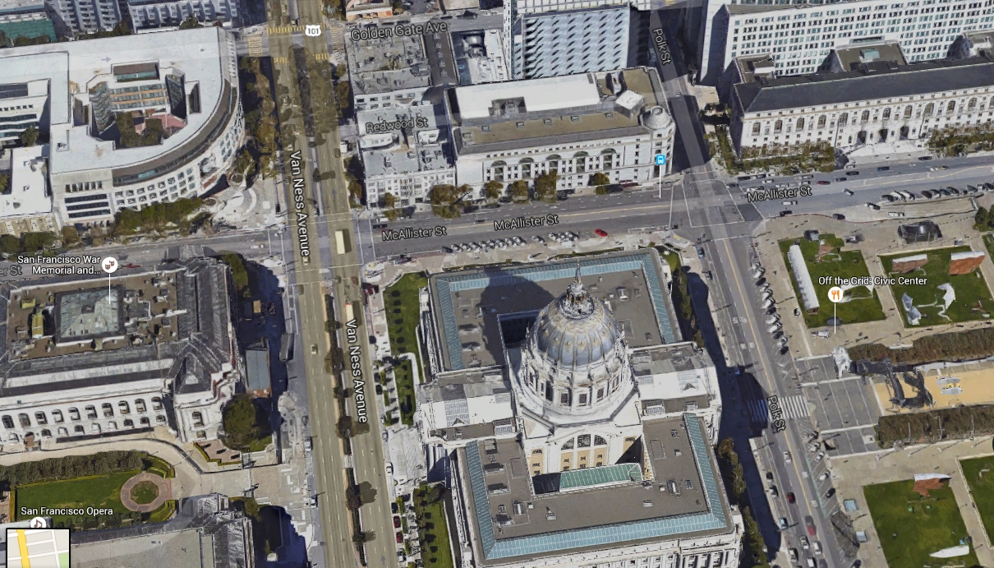



Evacuation Assembly Location
CPUC
State Supreme Court
SF Superior Court
Evacuation
Assembly
Area
City Hall
California
Public Utilities
Commission
Notes:
https://www.google.com/maps/@37.7758776,-122.4194558,507a,20y,41.59t/data=!3m1!1e3

Slide 2

2014 ESPI Ex-Post Workshop
California Public Utilities Commission
April 22, 2016

Slide 3
Overview of Workshop
10AM
10:30 AM
11:00 AM
Overview and Schedule
Database Components
Walkthroughs

Slide 4
What We Can Talk About Today
Overview
How to use the Data
Evaluation Methodologies

Slide 5



Purpose of Workshop
Overview
$
2014 ESPI Database
AL

Slide 6
Evaluation Results In March
Schedule
Draft Impact Reports Come out
S | M | T | W | Th | F | SA
March |  | 1 | 2 | 3 | 4 | 5
6 | 7 | 8 | 9 | 10 | 11 | 12
13 | 14 | 15 | 16 | 17 | 18 | 19
20 | 21 | 22 | 23 | 24 | 25 | 26
27 | 28 | 29 | 30 | 31
In-person Workshops
Comments Due

Slide 7
Get Familiar with Data In April
Schedule
S | M | T | W | Th | F | SA
April |  |  |  |  | 1 | 2
3 | 4 | 5 | 6 | 7 | 8 | 9
10 | 11 | 12 | 13 | 14 | 15 | 16
17 | 18 | 19 | 20 | 21 | 22 | 23
24 | 25 | 26 | 27 | 28 | 29 | 30
Final Reports come out;
1st draft of database released
In-person Workshop
2nd draft of database released (ETA)

Slide 8
Earnings Comes Out in June- Aug
Schedule
S | M | T | W | Th | F | SA
JUNE |  |  | 1 | 2 | 3 | 4
5 | 6 | 7 | 8 | 9 | 10 | 11
12 | 13 | 14 | 15 | 16 | 17 | 18
19 | 20 | 21 | 22 | 23 | 24 | 25
26 | 27 | 28 | 28 | 30
Draft Performance Statement Report
S | M | T | W | Th | F | SA
JULY |  |  |  |  | 1 | 2
3 | 4 | 5 | 6 | 7 | 8 | 9
10 | 11 | 12 | 13 | 14 | 15 | 16
17 | 18 | 19 | 20 | 21 | 22 | 23
24 | 25 | 26 | 27 | 28 | 29 | 30
31 | 1 | August
Performance Statement Report Workshop
2014 Audit Report comes out
Comments due
Final Performance Statement Report

Slide 9
Overview of Data
Goal: Combine all data/results into one database
  Review detailed claim level data
    Verify that claim level data roll up to various reports/memos
    Review which parameters were evaluated/updated
  Query/summarize data in various ways across portfolio

Slide 10
Overview of Data
Database includes:
  Final version of Claims data
    Nov. 2 Vintage (Last full submittal plus additional changes/corrections made provided during QC process)
  Ex-Ante Adjustments (Matching Payments)
  Ex-Post Results (Custom & Deemed)
  Categorical Fields (to ID ESPI records, etc)

Slide 11
Overview
PA Review
PA Review
$
2014 Database
AL
IESR Appendices
Audit Report

Slide 12
Detailed Data Discussion
What you can do with the data?
  ESPI
    ID claims paid under ExAnte Review Payments and determine what adjustments were applied
    …similar for ESPI ExPost
  Evaluation Results/Reports
    ID claims included in various Evaluation reports and review what parameters were updated
    Recreate the IESR Appendices*
    Query/summarize the results in different ways

Slide 13
Detailed Data Discussion: Fields
Categorical
Ex-Ante parameters and savings
ESPI Ex-Ante Review
  Original Adjusted Savings (EARAdj)
  Reconciled Adjusted Savings (EARRec)
Evaluator (Eval)
  Reporting
  Parameters and savings
ESPI Ex-Post savings (ESPIExPost)

Slide 14
Detailed Data Discussion: Queries
High level Ex-Ante
High level Ex-Post
Impact Evaluation Standardized Appendices*
ESPI
  Ex-Ante Review Savings and Payout
  Ex-Post Savings
  Ex-Post scenarios

Slide 15
Detailed Data Discussion: Caveats
Data contains only PY 2014 claimed savings
ESPI Ex-Ante review vs. Ex-Post reconciliation is ongoing
Codes and Standards Ex-Post savings is blank
Evaluation results not final
“Eval” field contents not always evaluated

Slide 16
Database Walkthrough
Detailed Data Discussion

Slide 17
Workbook Walkthrough
Workbook Discussion

Slide 18
Thanks!

