Slide 1

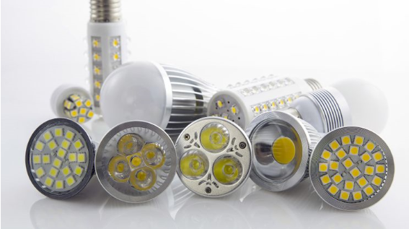
SCE To-Code Pilot Proposal
Devin Rauss
CPUC Existing Baseline Workshop

Slide 2
Outline
Preferred Resources Pilot Overview
Pilot Concept
  Region/Buildings
  Program Type
  End-use/measures
EM&V
Timeline

Slide 3
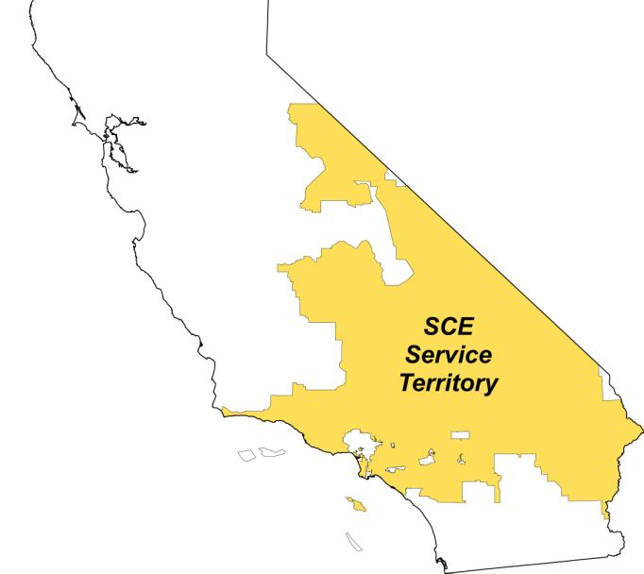
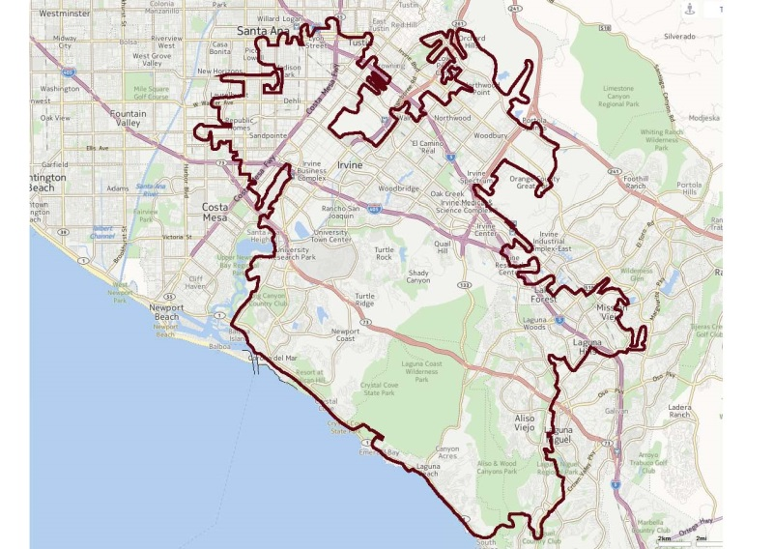
PRP Overview
The PRP seeks to:
Investigate and demonstrate how preferred resources may:
  offset growth in the pilot project region
  reduce or eliminate the need for additional natural gas power plants
Assess the capabilities of
preferred resources and inform
the development of the grid
of the future
Contribute toward
California’s environmental and renewable energy goals
PRP

Slide 4
Pilot Concept
Objective: Collect data on impact to adoption rate when below code savings are incentivized
Target commercial buildings in PRP region, given their significance in load
  Commercial offices are largest load
  Refrigeration significant end-use
End-uses/measures being considered:
  Lighting controls to influence overall system upgrade (offices)
  HVAC controls (offices)
  Refrigeration controls (refrigerated warehouse and supermarket)
Leverage existing 3rd party programs and core programs
  3rd parties target commercial offices
  Account managers target refrigeration

Slide 5
EM&V
Experimental design will be developed
  Utilizing Randomized Control Trial (RCT) methodology for experimental design
Third party evaluation
  Coordinating with impact evaluation team up front on pilot/experimental design
    Validate experimental assignment and present sampling plan
    Ex-post evaluation by third party evaluator
    Results validated by ED impact evaluator

Slide 6
Timeline
Targeting to file Advice Letter before the end of Q2
  Actively working RCT analysis
    Once complete, pilot design will be finalized
  Stakeholder outreach prior to filing
Approval Q3 of 2015
  Pilot will run for 1 full year after approval
Pending timing of Phase 3 and approval of AL, preliminary or final results will be leveraged to inform Phase 3

