Slide 1

Water Energy Nexus
CPUC Cost Allocation Workshop
Jarred Ross, Water Energy Nexus Program Manager
May 4, 2015

Slide 2
Question 1&2: How should we allocate W-E program costs and savings credit? What factors should be considered in determining cost allocations?
Program costs and savings credits should be allocated in proportion to the accrual of benefits to water and energy ratepayers.
The actual water capacity source per hydrologic region should be used to calculate avoided water capacity costs in order to ensure that budget allocations reflect actual avoided water capacity costs rather than default values.
Cross subsidies between the two sectors should be minimized or eliminated to the extent possible by aligning budget allocations to the amount of benefits realized by water and energy ratepayers.
The standard methodology (similar to what the IOU’s adopted) to allocate budgets for EE measures between electric and gas should apply.

Slide 3
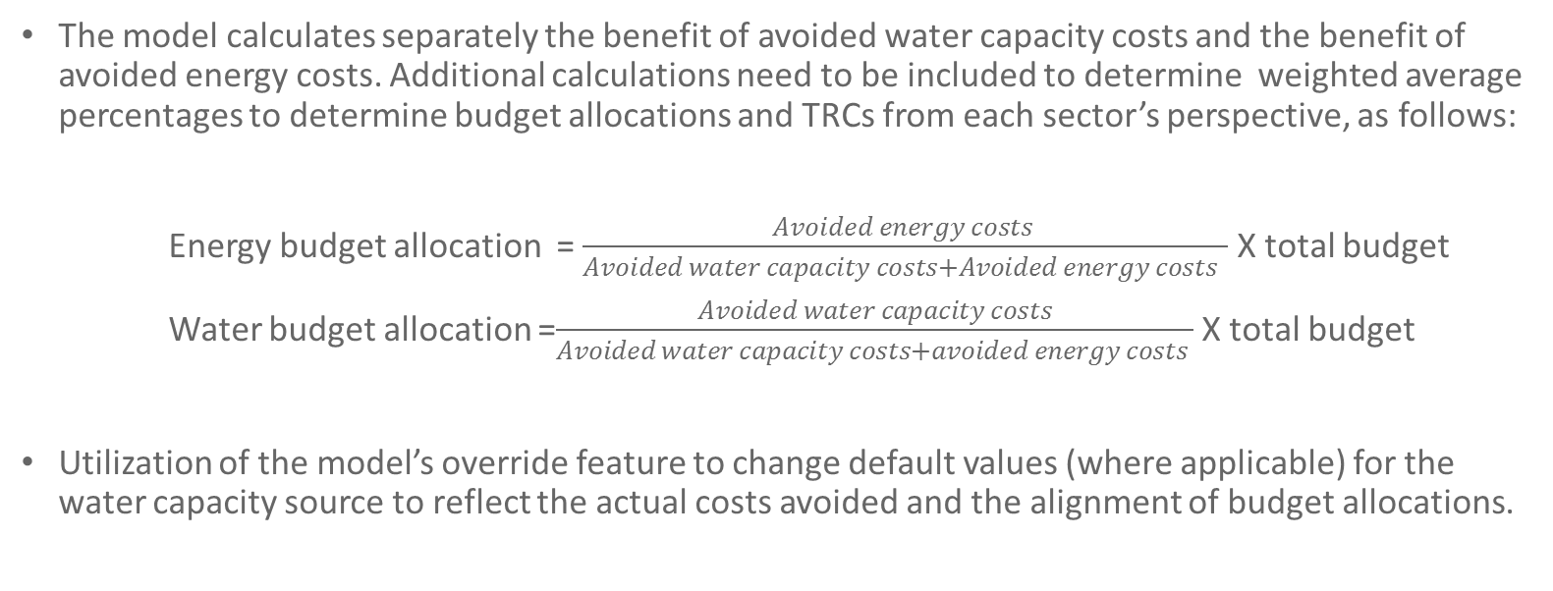
Question 3: Does the cost-effectiveness model provide sufficient information to support anticipated cost allocation processes?
The model calculates separately the benefit of avoided water capacity costs and the benefit of avoided energy costs. Additional calculations need to be included to determine weighted average percentages to determine budget allocations and TRCs from each sector’s perspective, as follows:
Energy budget allocation = $\frac{Avoided energy costs }{Avoided water capacity costs+Avoided energy costs }$ X total budget
Water budget allocation =$\frac{Avoided water capacity costs}{Avoided water capacity costs+avoided energy costs }$ X total budget
Utilization of the model’s override feature to change default values (where applicable) for the water capacity source to reflect the actual costs avoided and the alignment of budget allocations.

Slide 4
Example: SCE’s Water Leak Detection Pilot: E3 EE Model vs. W-E Cost Effectiveness Model (w/o allocation of budget costs)
City | Gross Measure Cost | kWh Savings | kW Savings | TRC
City 1 | $15,080.00 | 278.3 | 0.11 | 0.01
City 2 | $34,788.00 | 18349.7 | 6.40 | 0.28
City 3 | $20,221.00 | 6840.4 | 2.51 | 0.18
City 4 | $28,101.00 | 10027.3 | 3.36 | 0.19
City 5 | $27,834.00 | 914.2 | 0.30 | 0.02
TOTAL | $126,024.00 | 36,409.9 | 12.68
Water Loss Cost Effectiveness Using CPUC-Navigant Draft Calculator
Scenario | Gallons of Water Saved | Avoided IOU Electric Energy Cost (2014$) | Avoided Water Capacity Cost (2014$) | Combined Total Resource Cost Test
City 1 | 530,000 | $1,395.19 | $18,595.99 | 1.42
City 2 | 21,550,000 | $56,729.05 | $756,119.79 | 24.98
City 3 | 11,040,000 | $29,062.12 | $387,357.89 | 22.02
City 4 | 8,410,000 | $22,138.81 | $295,079.69 | 12.07
City 5 | 530,000 | $1,395.19 | $18,595.99 | 0.77
TOTAL | 42,060,000 | $110,720.36 | $1,475,749.35 | 13.46

Slide 5
Question 4: Does the ongoing drought impact cost allocations?
The current drought could impact the cost allocation if the following occur:
Cost of water commodity changes (recycled water cost reduction, not likely but it is possible)
Cost of avoided energy changes (rate increases, distributed generation implementation, fuel-switching, etc.)
Political considerations and impacts on efforts to save water.
High societal benefits might be considered in extreme drought conditions.
Potential of decreased emphasis on the use of economic theory to determine budget allocations due to drought conditions.

