Slide 1
Breakout Exercise: Mapping Use Cases to Network Architectures
Noel Crisostomo, Air Pollution Specialist, noel.crisostomo@energy.ca.gov
Vehicle-Grid Integration Communications Protocol Working Group
CA Energy Commission - Sacramento
February 12, 2017

Slide 2
Part a) Identify technical needs to complete Use Cases successfully, to assist formation of Network Architecture
Use Case
Network Architecture
Actions requested and actuated by the VGI resource to complete a(n) objective(s), subject to various constraints or situations
Categorized by 3 Binary Attributes in VGI Whitepaper & Roadmap:
Resource Quantity
One or Aggregated
Actors’ Objectives
Unified or Fragmented
Power Flow Direction
V1G or V2G
Comprised of multiple Actors providing Messages to each other to complete the objective
Senders
Recipients
Intermediaries
Both Senders & Recipients of messages

Slide 3
Part b) Assign value categories from grid services to use cases.
Grid Service
Value Categories
PEV ( – ) Charges
PEV ( + ) Discharges
PEV ( 0 ) Stops
[See E3 Storage Benefits Matrix]
Storage Service Recipient
Category
Planning/Procurement
Reliability
Capacity
Time Shift
Gen Ops
T&D Ops

Slide 4
We will answer: What Actors must be involved to complete Use Cases? Are there permutations?
Use Case
Network Architecture

Slide 5
Use Case Examples
Demand Charge Management of a Public Charging Array per a Commercial TOU Rate
CAISO Negative Pricing (Charge)
+ Congested Distribution Feeders (Discharge)
Across Many Facilities & Vehicle Types
Fleet Regulation Down per CAISO Automatic Generation Control
Manage Own Vehicle’s Charging per TOU

Slide 6
Demand Charge Management of a Public Charging Array per a Commercial TOU Rate
To facilitate understanding, sketch out diagrams to explain assertions.
kW original
kW shift
Coincident Peak High Price
t initial
t final

Slide 7
Examine from the perspective of the Subgroup Focus Areas
(c)
(b)
(d)
(a)
(d)

Slide 8
Subgroup Focus Area Questions
EVSE ←→ EV
Which VGI use cases require communications between the Electric Vehicle (EV) and EV Service Equipment (EVSE)?
Which existing communication protocols apply to these use cases?
For which VGI use cases are communications between the EV and EVSE optional?
(See also b, c, d within Workplan)

Slide 9
Answer Subgroup Focus Area Questions to Develop Requirements
(a)
Yes, DCM requires EVSE/EV signals
(i) The following communications protocols apply
ISO 15118, J2847, …
Because (list requirements):
EVSE_1 must send BEV_1 P_1(kW) for t_1(min) before t_depart
Sum of P_1 to P_10 + Building Load during t_initial to t_final is ≤ kW_shift

Slide 10
Demand Charge Management of a Public Charging Array per a Commercial TOU Rate
Amend diagrams to reflect requirements communicated/actuated
kW original
kW shift
Load Profile: Commercial Building + 10 BEV Charging Array
P_10
.
.
.
.
P_1
P_1*t_1
Coincident Peak High Price
t initial
t final
t depart

Slide 11
Demand Charge Management of a Public Charging Array per a Commercial TOU Rate
Assign Value Categories from Grid Services to Use Cases (E3) – Qualitative
kW original
kW shift
Load Profile: Commercial Building + 10 BEV Charging Array
Distribution Investment Deferral
System or Local Generation Capacity
Flexible Capacity
Reduced infrastructure rqeuirements
Reduced Procurement of A/S
…(non-exhaustive)
Demand Charge Reduction
TOU Energy Charge Reduction
Coincident Peak High Price
t initial
t final

Slide 12
Answer Subgroup Focus Area Questions to Develop Requirements
(a)
No, in DCM EVSE/EV is optional.
(ii) Communications between the EVSE/EV are optional for DCM
Because:
See Focus Area (b),(c),(d)

Slide 13
In the “No” cases where communications within a Subgroup Focus Area may be optional, examine the analogous questions elsewhere.
(c)
(b)
(d)
(a)
(d)

Slide 14
Demand Charge Management of a Public Charging Array per a Commercial TOU Rate
Closely examine “Y” or “N” answers for violations of requirements
kW original
kW shift
Load Profile: Commercial Building + 10 BEV Charging Array
Coincident Peak High Price
t initial
t final
t depart
Sum of P_1 to P_10 + Building Load + Fragmented BEV Charging during t_initial to t_final IS NOT ≤ kW_shift

Slide 15
Agency Staff will:
Observe breakouts and facilitate “stuck” conversations
Encourage diverse participation
Help ensure breakout activity is successful in:
Answering Deliverable 1 Questions
Which use cases require communications between the [Subgroup Focus Area]?
Which existing communication protocols apply to these use cases?
For which VGI use cases are communications between the [Subgroup Focus Area] optional?
Showing Work
Diagrams with use case requirements identified, potential violations identified
Listing Value Categories
Do not attempt to quantify or rank categories.

Slide 16
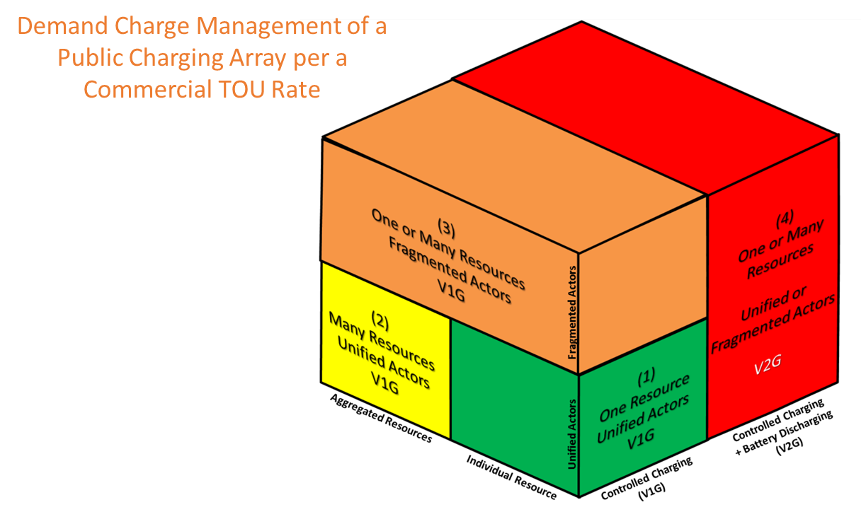
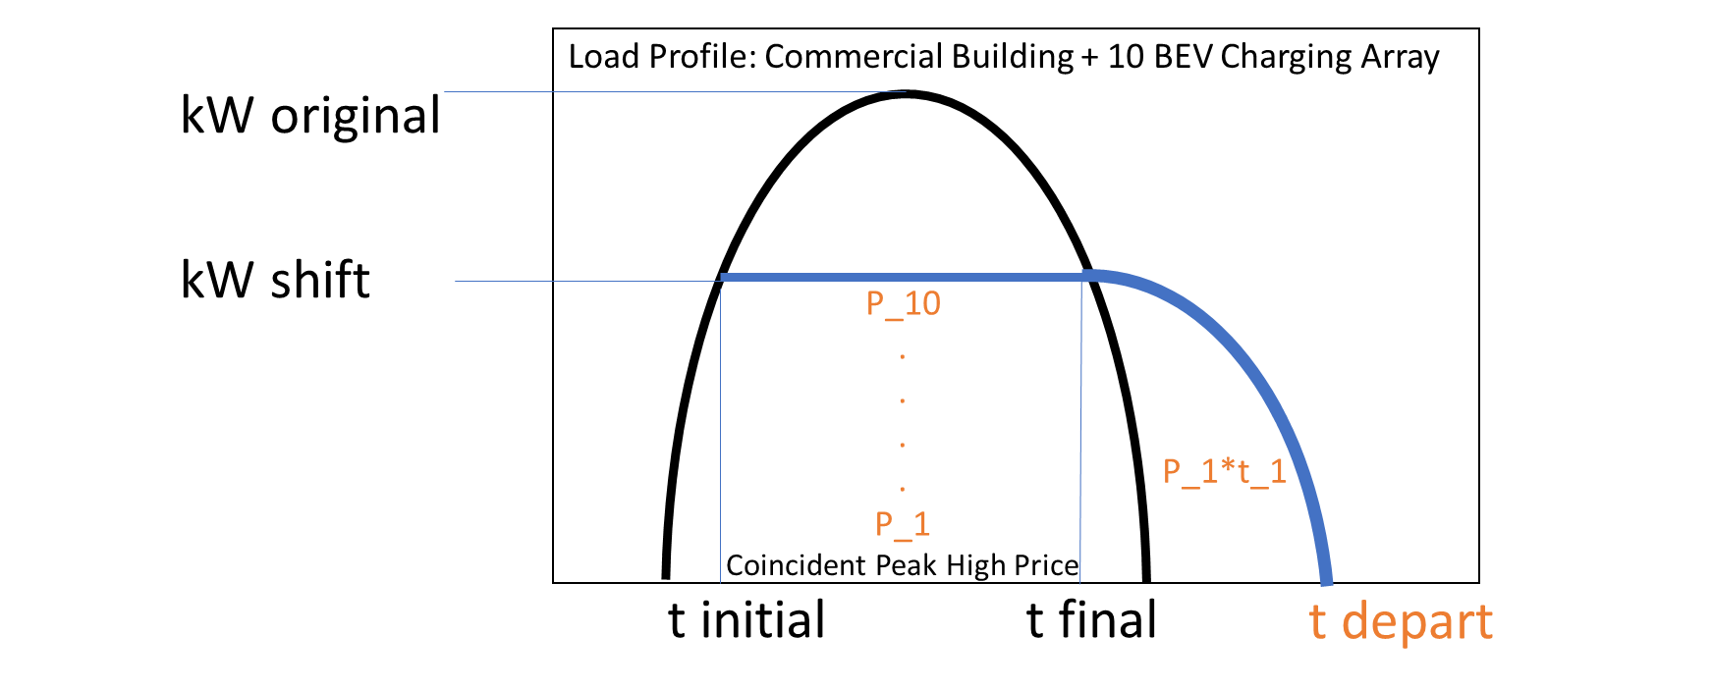
Subgroup Focus Area - Compiled Response
1. Focus Area Answers & Requirements
2. Use Case Diagram
(a)
(i)
Yes
Protocols
Requirements
(ii)
No
Alternative Focus Area
Potential Violations
3. List of Value Categories
Value a
Value b
Value c

Slide 17
After Breakouts, Reconvene and Report

Slide 18
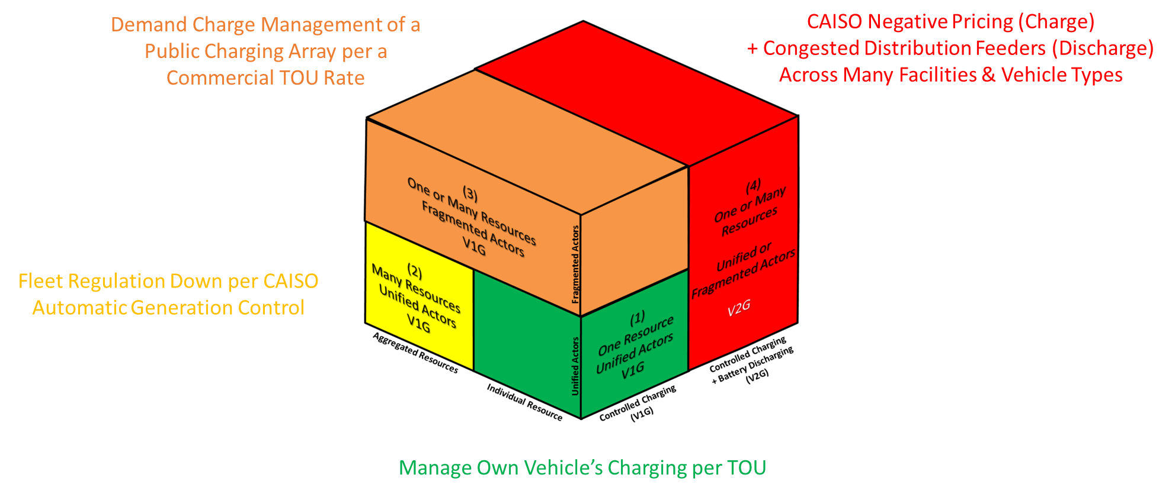
Subsequently, complete other Use Cases via Subgroup Focus Area Teams
VGI Category 1 | EV/EVSE | NSP/EVSE | NSP/EV | BEMS/EV or EVSE
Applicable Use Cases
(i) Applicable Protocols
Use Case Requirements
(ii) Optional – Alt. SFA
Potential Violations
Use Case Diagrams
Value Categories
VGI Category 2 | EV/EVSE | NSP/EVSE | NSP/EV | BEMS/EV or EVSE
Applicable Use Cases
(i) Applicable Protocols
Use Case Requirements
(ii) Optional – Alt. SFA
Potential Violations
Use Case Diagrams
Value Categories
VGI Category 3 | EV/EVSE | NSP/EVSE | NSP/EV | BEMS/EV or EVSE
Applicable Use Cases
(i) Applicable Protocols
Use Case Requirements
(ii) Optional – Alt. SFA
Potential Violations
Use Case Diagrams
Value Categories
VGI Category 4 | EV/EVSE | NSP/EVSE | NSP/EV | BEMS/EV or EVSE
Applicable Use Cases
(i) Applicable Protocols
Use Case Requirements
(ii) Optional – Alt. SFA
Potential Violations
Use Case Diagrams
Value Categories

Slide 19
Relevance of Breakout Activity
Mapping Use Cases will eventually yield Network Architectures
Assist parties and agencies in understanding “Technical capabilities and merits of different implementations or combinations of standards.”
Creates trackable methodology of where points of (dis)agreement lie.
Mapping exercise leads directly into Deliverable 2
Analyze stakeholder perspectives
Implication of standards
Characterize Value: costs and benefits
Questions?
Ask any agency staff for assistance.

