Slide 1
CAISO Local Capacity Requirement Overview and Load Shift Product
Eric Kim
Infrastructure and Regulatory Policy Specialist
February 15, 2018

Slide 2
Objectives
Provide an overview of the CAISO’s local capacity requirement study
Present high level description of three projects that the CAISO is recommending in its 2017-2018 transmission plan
Introduce the Load Shift Product that is being developed in ESDER 3

Slide 3
Local Capacity Requirement Overview
The CAISO performs an annual study to identify the minimum local resource capacity required in each local area to meet established reliability criteria.
The results are provided to the CPUC for consideration in their annual resource adequacy requirements program.
The annual study also assists in the allocation of the minimum required local capacity for each load serving entity.
Transmission projects identified through the CAISO annual transmission planning process can reduce the local capacity requirement.
http://www.caiso.com/informed/Pages/StakeholderProcesses/LocalCapacityRequirementsProcess.aspx

Slide 4
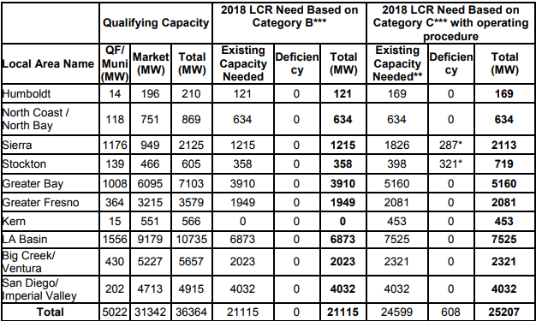
2018 Local Capacity Requirements
https://www.caiso.com/Documents/Final2018LocalCapacityTechnicalReport.pdf

Slide 5
Three Projects Recommended in the CAISO 2017-2018 Transmission Plan
Oakland Clean Energy Initiative
  In the Oakland sub-area, within the Greater Bay LCR area, the CAISO identified reliability needs without the aging generation in the area
  The CAISO is recommending the approval of the transmission regulated assets of the Oakland Clean Energy Initiative project that includes the substation upgrades and the installation of battery storage.
  The ISO is also recommending PG&E seek approval through the CPUC procurement process for additional identified preferred resources for the Oakland Clean Energy Initiative
http://www.caiso.com/planning/Pages/TransmissionPlanning/2017-2018TransmissionPlanningProcess.aspx

Slide 6
2017-2018 Transmission Plan Recommended Projects
(Continued)
2. South Bay / Moss Landing sub-area
  The South Bay / Moss Landing sub-area is a part of the Greater Bay Area LCR area.
  The ISO is recommending approval of reliability-driven and economically-driven projects that will reduce the sub-area LCR area requirements by 400 to 600 MW.
    Revised scope of previously approved South of San Mateo Capacity Increase project (Reliability)
    San Jose-Trimble 115 kV Limiting Facility Upgrade (Reliability)
    Moss Landing-Panoche 230 kV Path Upgrade (Economic)
    San Jose-Trimble 115 kV Series Reactor (Economic)

Slide 7
2017-2018 Transmission Plan Recommended Projects
(Continued)
Moorpark and Santa Clara Sub-areas
  Expected retirements of several gas-fired generating units due to OTC regulations and economic and age reasons, the Moorpark and Santa Clara local capacity sub-areas are expected experience local capacity deficiencies post 2020.
    The ISO is recommending the Moorpark-Pardee 230 kV No. 4 circuit project to address deficiencies in Moorpark LCR area.
    SCE has identified a 105 MW resiliency target in the Santa Barbara/Goleta area. New resources procured to address the Santa Barbara/Goleta resiliency objective will address Moorpark and Santa Clara LCR needs.

Slide 8
CAISO Load Shift Product
The ISO is developing a load shift product in ESDER Phase 3 policy initiative.
It will enhance the PDR model to allow for opportunities to provide additional grid services during oversupply conditions.
The product will only consider behind the meter storage due to the ability to directly meter and measure output.
Detailed product specifications are listed in the ESDER straw proposal.
http://www.caiso.com/informed/Pages/StakeholderProcesses/EnergyStorage_DistributedEnergyResources.aspx

Slide 9



Stay connected
THANK YOU
Download ISO Today
mobile app
Sign up for the
Daily Briefing at www.caiso.com
@California_ISO

