Slide 1
Targeting Demand Response to Benefit California’s
Disadvantaged Communities
Feb. 15, 2018
Workshop to Develop
Guidance for Pilots

Slide 2
Goals for Today’s Workshop
Set expectations for process
  Begin developing pilot designs <= we are here
  Final Proposal (March/April)
  Guidance Decision (mid-2018)
  IOU Pilots submitted for approval (later 2018)
  Implementation in 2019
Review and clarify straw proposal conceptual framework
Define what we know / need to know
  Geographic overlays – DACs/IOUs/LCAs
  IOU’s existing DR efforts related to DACs
  DAC advocates perspectives on DR
Brainstorming Session in afternoon
  Any areas of possible consensus for pilot designs?
  Additional data / analysis needed?

Slide 3
Goals for DAC-DR Pilots
Why DR Pilots for DACs?
  Harmonizes DR with other CPUC programs & Legislative intent
  Ensure DACs equitably realize pollution, energy, economic, and other benefits from DR
Pilot Goals
  Identify opportunities for targeting traditional or new forms of demand response to provide economic and environmental benefits to DACs

Slide 4
Economic Benefits of DR
Incentives
  Enrollment incentives
  Technology incentives
  Performance incentives (& penalties) for bill savings
Revenues (non-res?)
  Annual/monthly capacity payments?
  Energy revenues?
Bill Savings
  TOU rates
  ADR/EMT-enabled savings

Slide 5
Environmental Benefits of DR
Local Objective
Defer new gas plants or facilitate retirements in local capacity areas – transmission level planning objective
Supply side DR resources
  Contribute to capacity needed for reliability planning (Resource Adequacy) in Local Capacity Areas
  Traditional load shed programs (e.g. AC Cycling; Capacity Bidding Programs)
  ISO market integration requires aggregation within a single Sub-LAP and minimum size (100 kW for economic programs (PDR))
Load-Modifying DR resources
  Load impacts reduce load forecast – lower local capacity need
  Price responsive programs called on event days (e.g., PG&E SmartRate, SCE Save Power Days, Critical Peak Pricing for non-residential)

Slide 6
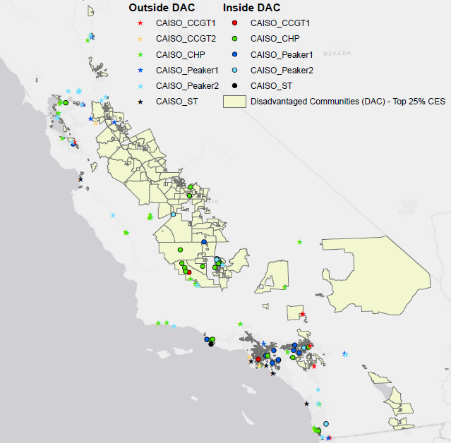
Natural gas power plant capacity is disproportionately located in DACs
Overview of Plant Locations in California. Source – Energy Division Staff. Higher resolution version of map produced in CPUC Energy Division Proposed System Reference Plan, Sept. 19, 2017, Appendix A (slide 154)

Slide 7
DACs in California IOU Territories
Correction to Footnote 10 - Source of IOU data are filings submitted in R.17-07-002 (NEM Successor Rulemaking) not IRP proceeding.

Slide 8
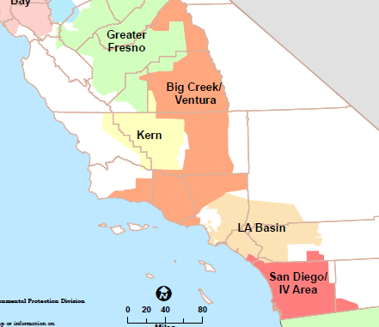
SCE LCAs
Big Creek/Ventura
LA Basin

Slide 9
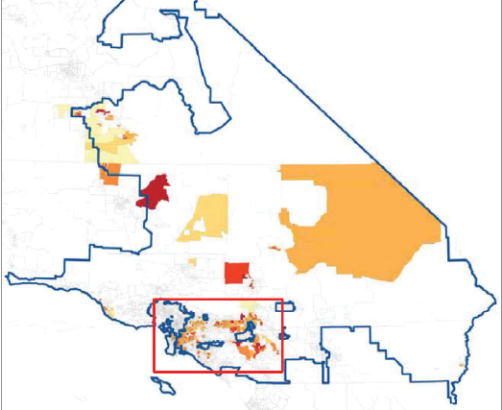
SCE Overlay of LCAs and DACs
Big Creek/Ventura
LA Basin

Slide 10
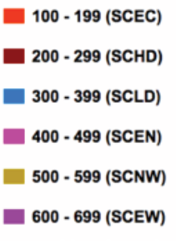
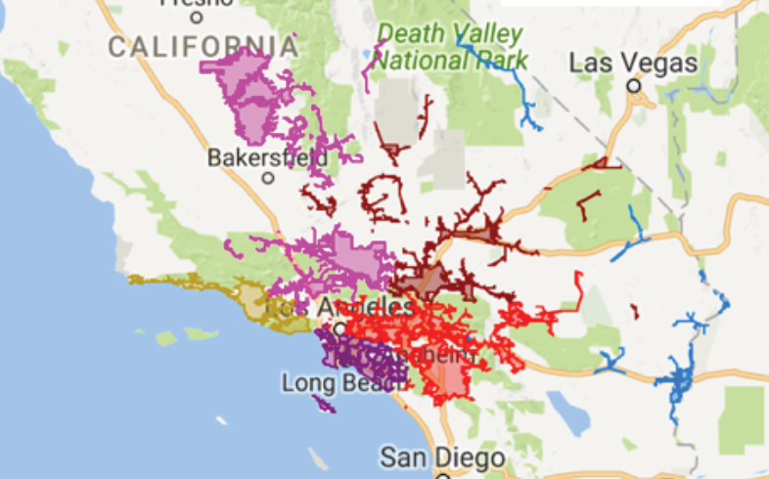
SCE Sub-LAPs
Source of map: DR Potential Study Addendum at 8

Slide 11
SCE Overlay of Sub-LAPs and DACs
Source of map: DR Potential Study Addendum at 8

Slide 12
SCE DAC Statistics
SCE Service Territory (Counties) | Total population in DACs in Service Territory | Number of Residential Electric Meters
Los Angeles | 2,431,207 | 638,196
San Bernardino | 813,342 | 221,057
Riverside | 334,548 | 95,399
Orange | 301,471 | 74,824
Kern | 48,187 | 12,439
Ventura | 36,915 | 8,977

Slide 13
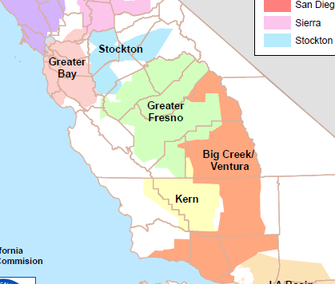
PG&E LCAs
LCAs
Stockton
Greater Fresno
Kern

Slide 14
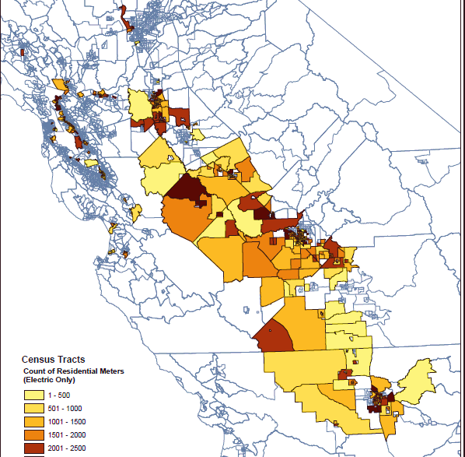
PG&E LCAs and DACs in
San Joaquin Valley
LCAs
Stockton
Greater Fresno
Kern
How do Sub-LAPS align with DACs?
Stockton PGST
Fresno PGF1
Kern PGKN

Slide 15
PG&E DAC Statistics
PG&E Service Territory (Counties) | Total population in DACs in Service Territory | Number of Residential Electric Meters
Fresno | 585,087 | 181,334
Kern | 353,481 | 111,199
San Joaquin | 342,160 | 106,865
Merced | 187,601 | 53,596
Alameda | 148,268 | 53,978
Contra Costa | 140,335 | 48,337
Santa Clara | 76,811 | 21,510
Stanislaus | 39,776 | 6,787

Slide 16
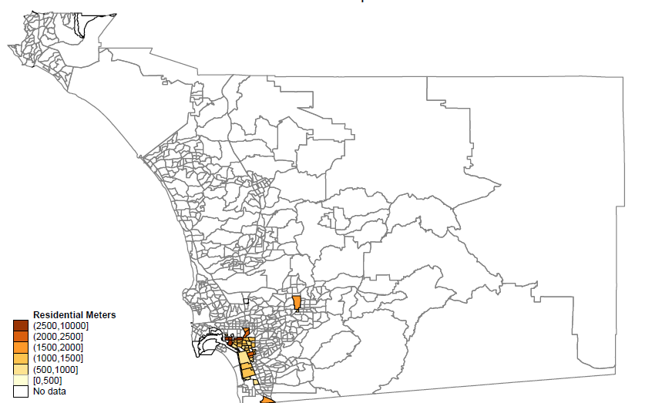
SDG&E DAC Statistics
SDG7&E Service Territory (Cities) | Total population in DACs in Service Territory | Number of Residential Electric Meters
San Diego | 108,131 | 36,188
National City | 30,855 | 8,264
Chula Vista | 15,752 | 4,154
El Cajon | 6,787 | 2,539
San Ysidro | 6,693 | 1,610
SDG&E territory is entirely in
one LCA and
one sub-LAP (SDG1)

Slide 17
Environmental Benefits of DR
System Objective
Reduce reliance on gas plants to meet operational needs (energy, ramping, ancillary services)
  TOU provides long-run reshaping of daily load (shape)
  CPP rates can shape load but event days are limited (e.g., PG&E SmartRate 9-15 events/year)
  New DR Programs envisioned in DR potential Study (shift)
  Can DR provide flexible RA?
Potential increases in cycling, starts/stops, running at partial load to integrate renewables may impact localized air pollutants

Slide 18
Summary Requirements for Pilots
Identify goals and describe benefits expected for DACs
    Economic
    Local or System Environmental Objective
    Describe how pilot is expected to yield actionable policy recommendations
Use adopted definition of “Disadvantaged Communities”
    Proposed definition - top 25th percentile of CalEnviroScreen + 22 additional census tracts
Identify target area/customer classes
    Justify selected area: DAC only/++, LCA/sub-Laps?
    Which customers (Residential, SMB, commercial/industrial, all)
Budget Details
    Propose pilot program costs including for evaluation
Describe pilot test objectives and proposed design

Slide 19
DR-DAC Pilots
Questions/Comments and Brainstorming Session

Slide 20
Setting the Scope:
A lot’s happening out there…
Distribution Level Planning
  Distribution Resources Plans
  Integrated Distributed Energy Resources
Time-of-Use Rates
  Default pilots for residential customers forthcoming
  SMB - some still defaulting to TOU?
  Proposals to align CPP (DR) hours with TOU hours?
Low Income Pilots
  ALs due 3/1 for ESA Pilots directed to high-usage CARE
AB 793 Offerings
  Smart Thermostats Smart Appliances
  Energy Marketplaces Mobile Apps
  Pay for Performance Pilots HAN
  Marketing to DACs, areas with high disconnection rates

Slide 21
Defining Scope:
Transmission Level Focus – Reliability or Operations
  not distribution planning goals
  can consider if distribution planning information informs locations to target DR in DACs for highest value (e.g. stacking)
Dispatchable / Event-based
  not TOU rates, not smart thermostats alone
  can consider if TOU/PCT can inform performance/cost-effectiveness of DR programs in light of expected TOU implementation
Marketing/Outreach Specific to DR
  not simply add DR offering in other program materials
  can consider targeted marketing/outreach with other programs designed to increase DR uptake/enrollments.
Notes:
Leveraging other brands (Energy Upgrade) or programs (EE/ESA) to market DR generally could be desirable but difficult to test and pinpoint beneficial DR messaging strategies.

Slide 22
Appendix

Slide 23
Questions
Which DR programs have most impact?
    For local objective? For system objective?
    By customer class? (Res, SMB, C/I)
    Variations by IOU, climate, end uses in area?
    Which are most cost-effective? Least C-E?
    Which have high(er) penetrations in DACs?
    Which are ripe for growth? Which have limitations on enrollment or are being phased out?
What data on customer usage is needed?
    Customer usage profiles (data analytics requirement)
    Building stock / market sectors / end uses
    Other resources?

Slide 24
Questions
What locations are of interest?
    What additional information is needed to identify appropriate geographic targets?
    How big/small of areas or populations to target?
    Opportunities for community focus / identify community needs
    Areas of grid need?
      DR Potential Study SubLAP analysis
      SCE needs in Moorpark
      CAISO presentation

Slide 25
Questions
What info from past pilots and studies could direct new pilots?
    SDG&E Locational DR Pilot tested targeted direct marketing techniques to residential and SMB
    SCE has targeted marketing and outreach for DR programs in response to SONGS and ALISO closures
    SCE research on small business barriers
    PG&E Demand Response T&E Pilot included targeted marketing to increase enrollment in AC cycling
    Other pilots?

Slide 26
Brainstorming Session
Potential Pilot Test Options
Increase customer enrollment vs. traditional M&O
    Cost/benefit of targeted messaging (geographic, by customer class e.g. to under-utilized customer segments)
    Cost/benefit of additional outreach strategies (web facilitated, door-to-door, telemarketing, highlighting environmental or community benefits)
    Test different enrollment or technology incentives
Improve customer responses
    Increase load drop per customer / event
    Increase customer participation / event
    Alternative notification methods, availability hours
    Cost/benefit of automated/enabling technologies
Test New Programs/Products
    Faster response times
    More frequent dispatch
    Demonstrate new or under-utilized technologies (DR Potential Study)
    Targeted for maximum potential by LCA/Sub-Lap (DR Potential Study Addendum)
    Alternative incentive structures

