Slide 1

R.14-10-010 Workshop on 2016 RA proposals
Energy Division Staff
Procurement Oversight and Resource Adequacy
California Public Utilities Commission
Thursday, February 18, 2016

Slide 2
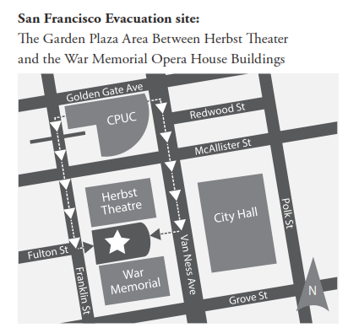
Evacuation Procedure
In the event of an emergency evacuation, please calmly proceed out the nearest exit.
Bathrooms are located in the lobby by the cafeteria and in the lobby by the auditorium.
Notes:
Basic Info
Bathrooms

Slide 3
Remote Access
Please place yourself on mute, and remain on mute unless you are asking a question
To mute / unmute press *6
PLEASE DO NOT PUT YOUR LINE ON HOLD!
Thursday February 18, 2016 10 am – 4:30 pm CPUC Auditorium | To join by phone: Call-in: (866) 811-4174 Participant: 4390072 WebEx information: Meeting Number: 745 135 759 Meeting Password: !Energy1 To start or join the online meeting: https://van.webex.com/van/j.php?MTID=m9b75f714cec33281340bfd0393fec437
Notes:
Meeting number:
745 135 759
Meeting password:
!Energy1
Join by phone
For those in room, please speak loudly and into or near telephone mics so people on telephone can hear
For everyone: Please announce your name and affiliation each time you speak
For those connecting remotely…
Unfortunately we cannot individually mute individual phone lines so if there is a problem we are going to have to silence all lines
We will try to take questions over the phone – just speak up and I will call on you, and I’ll also try and check in on the phone lines – or if we have to mute all the lines, then we will be taking comments via webex chat which we will be monitoring here

Slide 4
Suggested Etiquette for Today
Thank you all for your time and participation
We will have periodic stretch breaks and a lunch break during the course of the workshop
Come and go or stand up and stretch as needed, but please take all conversations and phone calls outside
I will stop for questions periodically – please wait until I ask for questions
For those on the phone – please send your question as a chat to WebEx, and I will read it aloud then answer it

Slide 5
Agenda for today
Introductions/Announcements
Establishment of RA Obligations and ELCC (ED staff)
Development of Coincidence Adjustment (CEC Staff)
Lunch
Demand Response Dispatch and Notification (ED staff/SCE/CAISO)
Load Impact Protocols (ED staff and Joint DR Parties)
Other Party Proposals (PG&E staff)

Slide 6
Summary - RA Obligations and ELCC
Current Status - revisions to inputs and methods since draft results (July 2015)
Establishment of RA obligations
Establishment of Average Solar ELCC and Average Wind ELCC
Locational and Technological Granularity
Monthly Shaping and Phase-in Schedule

Slide 7
Summary of Proposed Results
  ED proposes not to alter the PRM – Installed Capacity Requirement equal to month specific peak load plus 15%-17%
  ED proposes that capacity credit of solar resources should equal to monthly shaped average of 57.8% of installed capacity
  ED proposes that capacity credit of wind resources be equal to monthly shaped average of 12.6% of installed capacity

Slide 8
Current Status
Draft results published in July 2015
  Not official proposal; workshop in Aug 2015
Proposed results issued to R.14-10-010 service list Jan 15th, 2016
Energy Division proposes to set RA obligations and ELCC for wind and solar
Workshop Discussion
Comments and Reply Comments
Likely Revised Proposal March 11 with added results

Slide 9
Review - Sequential Process
Solar ELCC SoCal
Existing System – unknown reliability
Add/Subtract actual Capacity
Step 2A
Solar ELCC System
Step 3A
Solar ELCC NorCal
Step 0
0.1 Weighted Average LOLE Calibrated– RA requirements
Remove Solar/Wind, add Perfect Capacity until 0.1 Weighted Average LOLE
Step 1
Wind ELCC SoCal
Note - In these slides, 0.1 LOLE refers to probability weighted average 0.1 LOLE across all 165 study cases.
We are working on Step 3a and 3B right now
Wind ELCC system
Step 3B
Step 2B
Wind ELCC NorCal

Slide 10
Revisions to Study Inputs
Full conversion to TEPPC v1.5 – conformance and cleaning of generator list
Added new wind/solar that reached COD – totals reflected in proposal
Changed from import limits derived from 2024 CAISO study to import limits from RA import allocations
Scaled yearly load shapes to annual peak load AND total energy instead of just scaling to peak load – load stretching algorithm

Slide 11
Revisions to Import Limits
Max Avail Import (MW)
Import into CAISO areas | 24,291
Export from CAISO areas | 24,134
Draft PLEXOS values (MW)
Import into CAISO areas | 36,861
Export from CAISO areas | 38,163
Differences (MW)
Decreased import | 12,570
Decreased Export | 14,029
Revision to study assumptions to reflect historical flows instead of path ratings – resulted in decreased import and export transfers

Slide 12
Loads and Resources Calibrated – 2017
Effective Resource Breakdown – Base Case
Region | SDGE | PGE Bay | PGE Valley | SCE | CAISO
Annual Peak Load | 4,812 | 8,695 | 13,787 | 23,878 | 48,060
Total Nameplate Resources | 5,538 | 7,604 | 24,828 | 24,915 | 62,885
Total Effective Resources | 4,907 | 6,226 | 23,709 | 20,888 | 56,029
Nuclear Resources | 0 | 0 | 2,300 | 623 | 2,923
Fossil Resources | 3,227 | 4,388 | 9,052 | 11,337 | 28,004
Peaking Resources | 1,074 | 1,467 | 2,798 | 2,866 | 8,205
Run of River Hydro Resources | 0 | 0 | 374 | 132 | 505
Scheduled Hydro Resources | 0 | 0 | 5,586 | 972 | 6,558
Emergency Hydro Resources | 0 | 0 | 461 | 200 | 661
Pumped Storage Resources | 40 | 0 | 1,218 | 590 | 1,848
Demand Response Resources | 43 | 177 | 731 | 1,270 | 2,220
Renewable Resources | 798 | 201 | 1,208 | 2,898 | 5,105
Effective Capacity /Peak Load | 102.17% | 71.24% | 171.95% | 89.90% | 116.58%

Slide 13
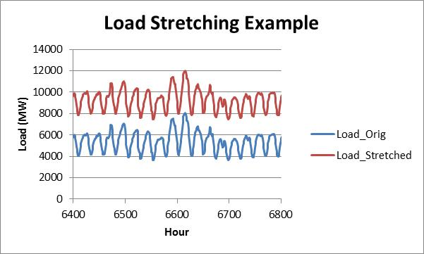

Scaling of Load Shapes
Draft results showed distortion of load shapes by simply scaling to peak load.
Want to preserve historical load shapes
At the same time, want to transform load shape to match forecast peak and average
Use linear transformation:
$$Y_{t}=aX_{t}+ b$$
Peak
Notes:
The parameters a and b of the linear transformation are a function of the peak and average of the historical load shape, along with the peak and average of the desired target forecast load shape. In this way, we preserve the overall shape of the historic load shape, while ensuring that it has the desired peak and average load of the target forecast year.

Slide 14
Establishment of RA Obligations
RA obligations currently start with CEC monthly peak load forecasts and add a static PRM (15% - 17%) to peak load each month
LOLE studies determine amount of Effective Capacity (EC) needed to maintain LOLE of 0.1 across year, given peak load and energy shapes for each study region – PRM is post processing step, not study result
PRM concept versus EC concept
Important difference in how RA obligation is conceptualized

Slide 15

Draft Results vs. Final Results – Calibrated Base Case
Draft Results from July 2015
Final Results from Jan 2016 – LOLE is spread out across months and larger in SDGE due to different resource portfolios/retirements. Load scaled differently - more extreme years produce more LOLE

Slide 16
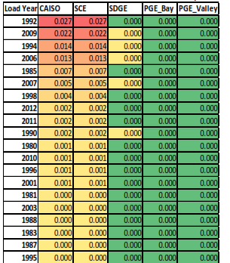
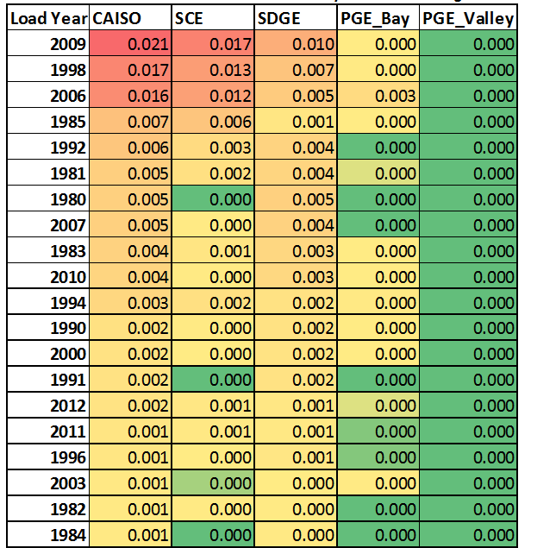
Load Shapes with Highest LOLE
Final Results – Scaled to Peak and Energy – LOLE more spread out across load shapes and less focused in most extreme years
Draft Results – Scaled to Peak

Slide 17
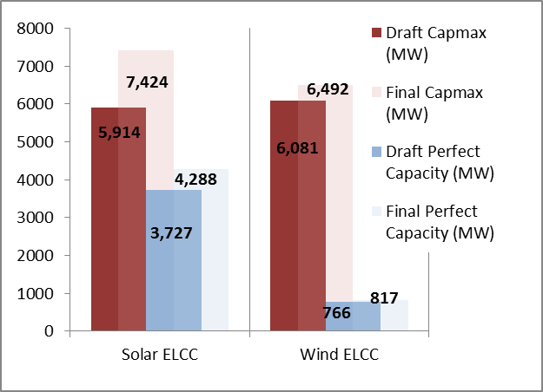
Draft Vs. Final ELCC Values
Increase in solar and wind capacity since draft results published – incremental increase in Perfect Capacity needed to return LOLE to 0.1.
Solar ELCC decreased from 63% to 57.8% and wind ELCC held steady at 12.6%

Slide 18
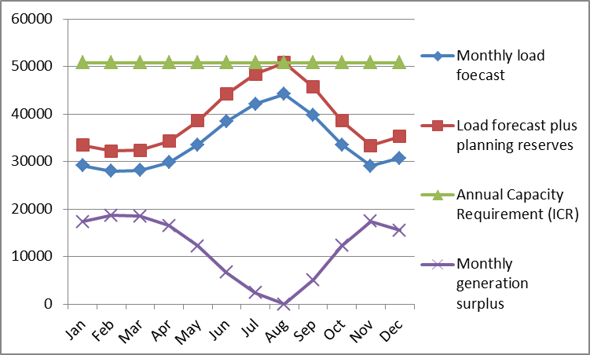
LOLE Studies Create Annual Values
Studies performed to test LOLE for capacity requirements hold capacity level relatively steady throughout the year – surplus of generation in offpeak months.
Sample of Annual LOLE generation to load comparison. Chart is illustrative and not actual values

Slide 19
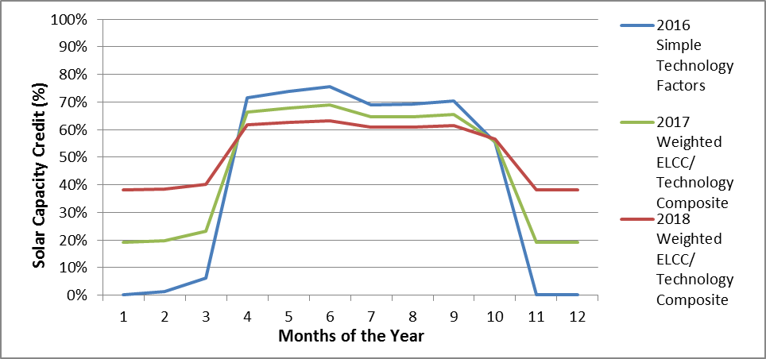
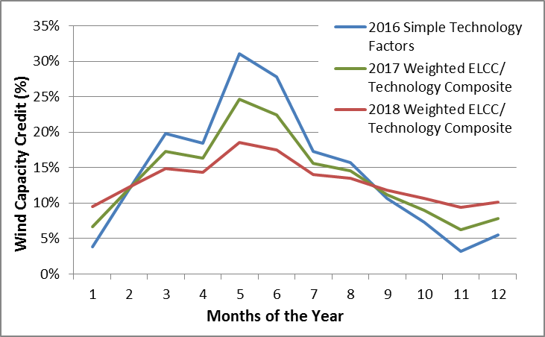
Shaping and Phasing In Monthly Values

Slide 20
Next Steps to March 11 Revised Proposal
ED staff will issue a final Inputs and Assumptions document incorporating the changes made in the January proposal
ED staff intends to develop complete the work of breaking the solar and wind ELCC values into locations (Northern and Southern CA for solar, Altamont, Tehachapi and San Gorgonio for wind)
More study will be ongoing, to be proposed for the 2018 RA compliance year

Slide 21
Implementation Proposal
Energy Division staff intend to review and revise ELCC values and the Effective Capacity Requirement at least every two years
Energy Division staff intends to propose adoption of assumptions and inputs via the RA proceeding whenever changes are proposed

Slide 22
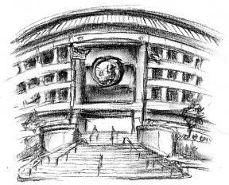
Thank you!
For Additional Information:
www.cpuc.ca.gov

Slide 23
Switch to CEC slide deck

