Slide 1
2016 SDG&E Summer Saver Load Impact Evaluation
DRMEC Spring 2017
Load Impacts Evaluation Workshop
May 8, 2017

Slide 2

Agenda
Summer Saver program overview
Ex post methodology
Ex post results
Ex ante methodology
  Enrollment forecast
Ex ante results
Ex post results for subgroups

Slide 3
Program Overview
Day-of demand response program offered by SDG&E to residential and small commercial customers
      Based on central air conditioning (CAC) load control, using direct load control (switches with 1-way paging communication)
  Events may be called on any non-holiday from May-October and run between 2 to 4 hours
      No more than three event days per week and no more than 60 event-hours per year
Participants have a choice of cycling strategy:
Participation is incented with an annual bill credit based on cycling strategy and tonnage of enrolled CAC unit(s)
      Residential - $11.50 per ton for 50% cycling, $30 per ton for 100% cycling
      Commercial - $ 9 per ton for 30% cycling, $15 per ton for 50% cycling
Customer Type | Cycling Strategy | % of CACs Enrolled | Number of Enrolled Customers
Residential | 50% | 60% | 12,733
 | 100% | 40% | 8,167
Commercial | 30% | 28% | 1,047
 | 50% | 72% | 3,522
Notes:
- The % of CACs enrolled in the table are relative to each customer type (e.g., 60% of residential CACs enrolled in the 50% cycling strategy)
- Overall, residential 50% cycling CACs accounted for 42% of total enrolled CACs in the 2016 Summer Saver Program

Slide 4
Ex Post Methodology
Nexant estimated reference loads using a randomized control trial (RCT) for the residential segment, and a matched control group for the small commercial segment
Matched control group was selected using a propensity score, which calculated the likelihood that a customer is a Summer Saver participant based on:
      Peak demand on hot, nonevent days; and
      Demand in the morning and afternoon prior to an event
  Ex post impacts were estimated for each hour of each event by taking the difference between the same-day adjusted average control group load and the average observed treatment group load

Slide 5
Ex Post Results
5 Summer Saver events in 2016
  All events occurred on weekdays from 3 PM to 7 PM
Residential impacts:
    Aggregate load impacts ranged from 4.1 MW to 12.9 MW across all events
    Average aggregate impact was 8.1 MW
Small Commercial impacts:
  Aggregate load impacts ranged from 0.4 MW to 1.7 MW across all events
  Average aggregate impact was 1.3 MW
Overall program:
  Largest load reduction of 14.6 MW on the July 22nd event across residential and small commercial
Hours of Availability | Hours of Actual Use | # of Available Dispatches | # of Actual Dispatches
60 | 20 | 15 | 5
Event Date | Day of Week | Event Times
6/20/2016 | Monday | 3 to 7 PM
7/22/2016 | Friday | 3 to 7 PM
8/15/2016 | Monday | 3 to 7 PM
9/26/2016 | Monday | 3 to 7 PM
9/27/2016 | Tuesday | 3 to 7 PM
Average* |  | 3 to 7 PM
* Reflects the average 2016 Summer Saver event

Slide 6
Ex Post Results
Residential
Date | Impact |  |  | Mean17 (°F)
 | Per CAC Unit (kW) | Per Premise (kW) | Aggregate (MW)
6/20/2016 | 0.27 | 0.32 | 6.20 | 82
7/22/2016 | 0.56 | 0.67 | 12.87 | 80
8/15/2016 | 0.45 | 0.54 | 10.39 | 80
9/26/2016 | 0.34 | 0.40 | 7.69 | 80
9/27/2016 | 0.18 | 0.21 | 4.06 | 84
Average* | 0.36 | 0.42 | 8.13 | 81
* Reflects the average 2016 Summer Saver event
Small Commercial
Date | Impact |  |  | Mean17 (°F)
 | Per CAC Unit (kW) | Per Premise (kW) | Aggregate (MW)
6/20/2016 | 0.16 | 0.39 | 1.72 | 80
7/22/2016 | 0.16 | 0.37 | 1.66 | 79
8/15/2016 | 0.13 | 0.31 | 1.38 | 79
9/26/2016 | 0.10 | 0.24 | 1.08 | 81
9/27/2016 | 0.04 | 0.10 | 0.45 | 84
Average* | 0.12 | 0.28 | 1.26 | 81
* Reflects the average 2016 Summer Saver event

Slide 7
Ex Post Results – Utility and System Peak Days
SDG&E peak corresponds to the HE 18 period on the September 26th event
Summer Saver was not dispatched on the CAISO peak that occurred on July 27th from 4 to 5 PM
SDG&E Peak: September 26th at 5:52 PM
Event Date | Hour Ending | Load Impact (MW)
 |  | Residential | Nonresidential
9/26/2016 | 16 | 6.18 | 2.23
 | 17 | 7.43 | 1.84
 | 18 | 8.44 | 0.81
 | 19 | 8.70 | -0.54

Slide 8
Ex Ante Methodology
2016 ex ante methodology differs from previous years’ evaluations and is driven by:
      Declining ex post impacts from 2010 to 2016 for both customer segments;
      Lower observed impacts later in the summer (September and October) for both customer segments; and
      Anticipated program changes that will significantly alter the composition of the residential Summer Saver population
  Ex post load impacts between 2 PM and 5 PM for all events in 2015 and 2016 were used to develop the ex ante model
      While prior years’ evaluations used a multiyear ex post impacts database starting in 2010, 2015 and 2016 impacts better reflect the current state of the Summer Saver Program
Notes:
Program changes include:
- Dropping the bottom 30% of residential users in 2017
- Restricting NEM customers from Summer Saver participation starting in 2018

Slide 9
Enrollment Forecast – Residential
Forecast Year | Forecast Month
 | January | February | March | April | May | June | July | August | September | October | November | December
2017 | 15,354 | 15,295 | 15,238 | 15,180 | 15,124 | 15,067 | 15,011 | 14,956 | 14,901 | 14,846 | 14,792 | 14,739
2018 | 13,160 | 13,113 | 13,066 | 13,020 | 12,974 | 12,929 | 12,884 | 12,839 | 12,795 | 12,751 | 12,707 | 12,664
2019 | 12,621 | 12,579 | 12,537 | 12,495 | 12,454 | 12,413 | 12,372 | 12,331 | 12,291 | 12,252 | 12,212 | 12,173
2020 | 12,134 | 12,096 | 12,058 | 12,020 | 11,983 | 11,945 | 11,909 | 11,872 | 11,836 | 11,800 | 11,764 | 11,729
2021 | 11,694 | 11,659 | 11,624 | 11,590 | 11,556 | 11,522 | 11,489 | 11,456 | 11,423 | 11,390 | 11,358 | 11,326
2022 | 11,294 | 11,263 | 11,231 | 11,200 | 11,170 | 11,139 | 11,109 | 11,079 | 11,049 | 11,019 | 10,990 | 10,961
2023 | 10,961 | 10,961 | 10,961 | 10,961 | 10,961 | 10,961 | 10,961 | 10,961 | 10,961 | 10,961 | 10,961 | 10,961
2024 | 10,961 | 10,961 | 10,961 | 10,961 | 10,961 | 10,961 | 10,961 | 10,961 | 10,961 | 10,961 | 10,961 | 10,961
2025 | 10,961 | 10,961 | 10,961 | 10,961 | 10,961 | 10,961 | 10,961 | 10,961 | 10,961 | 10,961 | 10,961 | 10,961
2026 | 10,961 | 10,961 | 10,961 | 10,961 | 10,961 | 10,961 | 10,961 | 10,961 | 10,961 | 10,961 | 10,961 | 10,961
2027 | 10,961 | 10,961 | 10,961 | 10,961 | 10,961 | 10,961 | 10,961 | 10,961 | 10,961 | 10,961 | 10,961 | 10,961
2017 – Drop customers in the bottom 3 usage deciles
2018 – Solar customers no longer allowed to participate in Summer Saver
Enrollment forecast also assumes:
  1% month-to-month decline
  Flat enrollment after the 2018-2022 funding cycle

Slide 10
Enrollment Forecast – Small Commercial
Forecast Year | Forecast Month
 | January | February | March | April | May | June | July | August | September | October | November | December
2017 | 3,682 | 3,675 | 3,668 | 3,661 | 3,654 | 3,648 | 3,641 | 3,635 | 3,628 | 3,622 | 3,615 | 3,609
2018 | 3,248 | 3,242 | 3,237 | 3,231 | 3,226 | 3,220 | 3,215 | 3,209 | 3,204 | 3,198 | 3,193 | 3,188
2019 | 3,183 | 3,177 | 3,172 | 3,167 | 3,162 | 3,157 | 3,152 | 3,147 | 3,142 | 3,137 | 3,132 | 3,127
2020 | 3,123 | 3,118 | 3,113 | 3,108 | 3,104 | 3,099 | 3,095 | 3,090 | 3,085 | 3,081 | 3,076 | 3,072
2021 | 3,068 | 3,063 | 3,059 | 3,055 | 3,050 | 3,046 | 3,042 | 3,038 | 3,034 | 3,030 | 3,025 | 3,021
2022 | 3,017 | 3,013 | 3,009 | 3,005 | 3,002 | 2,998 | 2,994 | 2,990 | 2,986 | 2,982 | 2,979 | 2,975
2023 | 2,975 | 2,975 | 2,975 | 2,975 | 2,975 | 2,975 | 2,975 | 2,975 | 2,975 | 2,975 | 2,975 | 2,975
2024 | 2,975 | 2,975 | 2,975 | 2,975 | 2,975 | 2,975 | 2,975 | 2,975 | 2,975 | 2,975 | 2,975 | 2,975
2025 | 2,975 | 2,975 | 2,975 | 2,975 | 2,975 | 2,975 | 2,975 | 2,975 | 2,975 | 2,975 | 2,975 | 2,975
2026 | 2,975 | 2,975 | 2,975 | 2,975 | 2,975 | 2,975 | 2,975 | 2,975 | 2,975 | 2,975 | 2,975 | 2,975
2027 | 2,975 | 2,975 | 2,975 | 2,975 | 2,975 | 2,975 | 2,975 | 2,975 | 2,975 | 2,975 | 2,975 | 2,975
Enrollment forecast assumes:
  1% month-to-month decline
  Flat enrollment after the 2018-2022 funding cycle

Slide 11
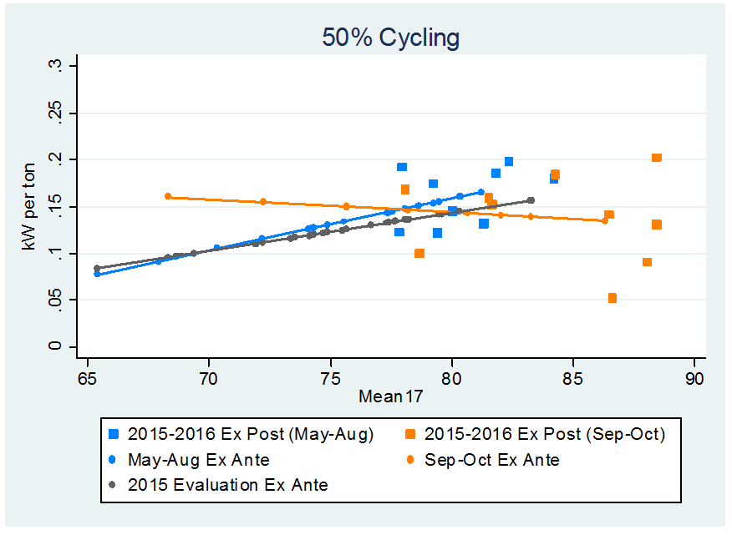
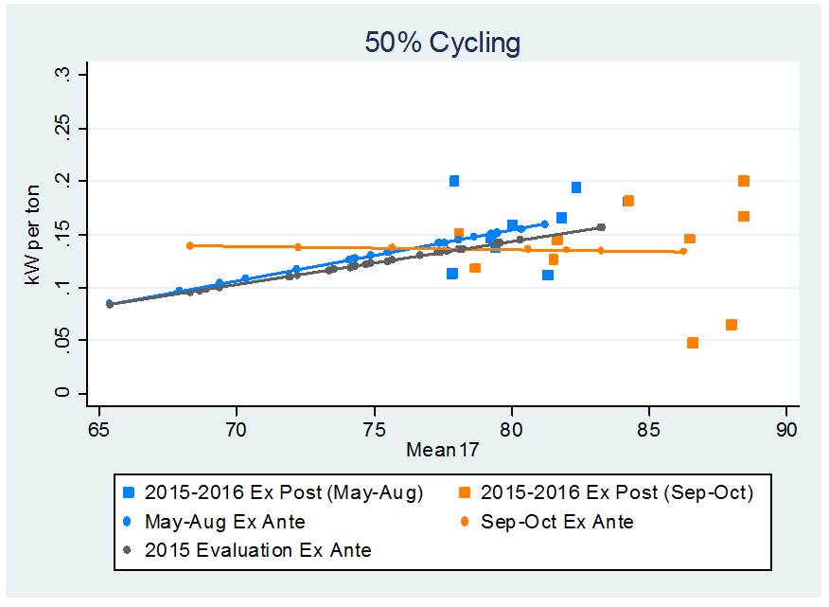
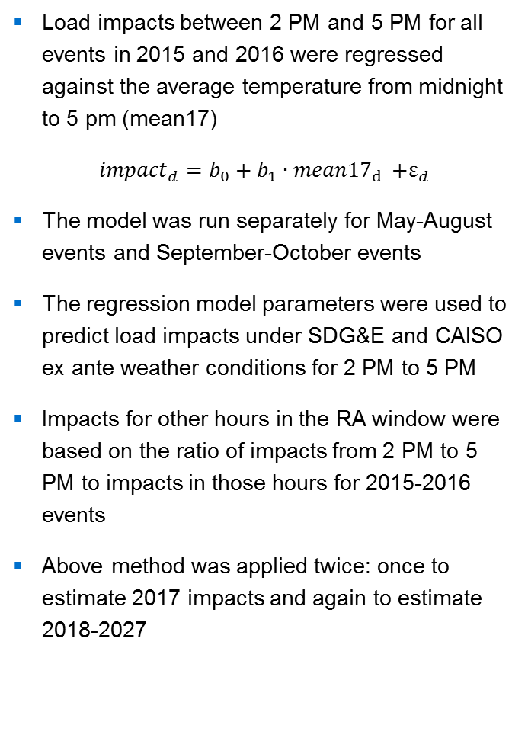
Ex Ante Methodology – Residential
Load impacts between 2 PM and 5 PM for all events in 2015 and 2016 were regressed against the average temperature from midnight to 5 pm (mean17)
$${impact}_{d}=b_{0}+b_{1}{∙mean17}_{d }+ε_{d}$$
The model was run separately for May-August events and September-October events
The regression model parameters were used to predict load impacts under SDG&E and CAISO ex ante weather conditions for 2 PM to 5 PM
Impacts for other hours in the RA window were based on the ratio of impacts from 2 PM to 5 PM to impacts in those hours for 2015-2016 events
Above method was applied twice: once to estimate 2017 impacts and again to estimate 2018-2027
Average 2 to 5 PM Ex Post Load Impacts and 2017 Ex Ante Predictions – Residential 50% Cycling
Average 2 to 5 PM Ex Post Load Impacts and 2018-2027 Ex Ante Predictions – Residential 50% Cycling

Slide 12
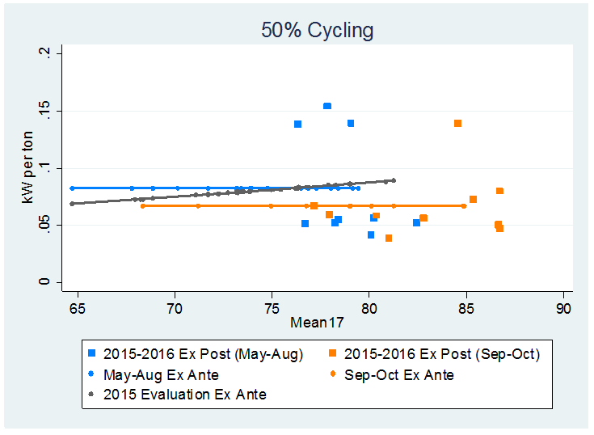
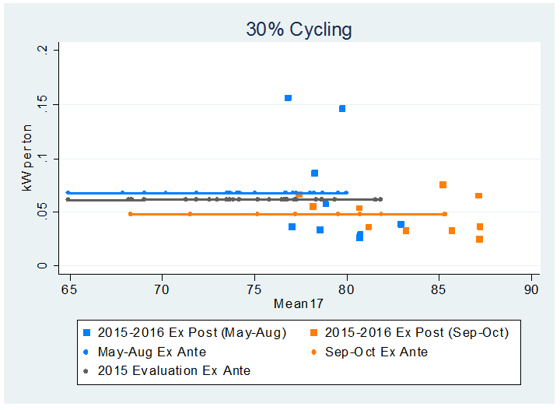
Ex Ante Methodology – Small Commercial
Impacts at the end of the summer (September and October) have been substantially smaller than impacts observed in May through August, even under similar and sometimes hotter temperatures
Small commercial ex post have been observed to be much less weather sensitive compared to residential impacts
Ex ante impacts are based on only the average 2 to 5 PM ex post impacts from May through August and from September through October
      Ex ante impacts for small commercial customers are not longer driven by weather conditions
Average 2 to 5 PM Ex Post Load Impacts and Nonweather Sensitive Ex Ante Predictions – Small Commercial 50% Cycling
Average 2 to 5 PM Ex Post Load Impacts and Nonweather Sensitive Ex Ante Predictions – Small Commercial 30% Cycling

Slide 13
Ex Ante Results – SDG&E 1-in-2 August Monthly Peak
Customer Type | Year | Per Premise Impact (kW) | Enrollment | Aggregate Impact (MW)
Residential | 2017 | 0.73 | 14,956 | 10.9
 | 2018 | 0.72 | 12,839 | 9.21
 | 2027 | 0.71 | 10,961 | 7.75
Nonresidential | 2017 | 0.59 | 3,634 | 2.16
 | 2018 | 0.59 | 3,209 | 1.91
 | 2027 | 0.59 | 2,975 | 1.79
Residential ex ante year-to-year differences are driven by:
  Program changes occurring in 2017 and 2018 affecting enrollment
  1% month-to-month enrollment decline
  Separate estimations for May-August events vs. September-October events
Small commercial ex ante year-to-year differences are driven only by changes to enrollment (1% month-to-month decline) and event month

Slide 14
Ex Ante Results – Comparison of 2016 to 2015
SDG&E August 1-in-2 Monthly System Peak Day
Evaluation Year | Customer Type | Forecast Year | Per Premise Impact (kW) | Enrollment | Aggregate Impact (MW)
2016 | Residential | 2017 | 0.73 | 14,956 | 10.9
 | Nonresidential |  | 0.59 | 3,634 | 2.16
2015 | Residential | 2017 | 0.48 | 21,671 | 10.5
 | Nonresidential |  | 0.65 | 4,674 | 3.02
Differences in estimated impacts arise because:
  Bottom 30% of residential users will be dropped from the program in 2017, increasing per premise impacts
    Residential aggregate impacts in 2016 larger relative to 2015 even though 2016 enrollment is substantially lower
  2016 small commercial estimates are only based on event month and not weather (slightly lower relative to 2015)
  Small commercial forecasted enrollment is lower relative to 2015 enrollment

Slide 15
Contact Us
Candice Potter
Managing Consultant, Utility Services
CPotter@nexant.com
(415) 640-2955

Slide 16
Ex Post Results by Program Subgroups
Date | Per CAC (kW) |  |  |  | Aggregate (MW)
 | Cycling Option |  |  |  | Cycling Option
 | Residential |  | Commercial |  | Residential |  | Commercial
 | 100 | 50 | 50 | 30 | 100 | 50 | 50 | 30
6/20/2016 | 0.42 | 0.17 | 0.19 | 0.10 | 4.0 | 2.2 | 1.4 | 0.3
7/22/2016 | 0.55 | 0.57 | 0.15 | 0.17 | 5.3 | 7.6 | 1.1 | 0.5
8/15/2016 | 0.56 | 0.38 | 0.17 | 0.05 | 5.4 | 5.0 | 1.2 | 0.1
9/26/2016 | 0.42 | 0.28 | 0.14 | 0.02 | 4.1 | 3.7 | 1.0 | 0.1
9/27/2016 | 0.27 | 0.11 | 0.03 | 0.06 | 2.6 | 1.5 | 0.3 | 0.2
Average* | 0.44 | 0.29 | 0.14 | 0.08 | 4.2 | 3.9 | 1.0 | 0.2
* Reflects the average 2016 Summer Saver event
Notes:
Residential comparison of 50 to 100: on the average event day, the reference loads for 50% cycling is almost 43% higher than those customers on 100% cycling (i.e., customers who use their CAC unites more are less likely to select the 100% cycling option)
Comparing 50 to 50: Over all 2016 SS events, average load impacts per CAC unit were more than 2x greater for residential 50% compared to nonresidential 50%
Difference in impacts is attributed to the relative behaviors of the reference loads during the event hours
Residential: reference loads are increasing during the average event window
Nonresidential: reference loads are decreasing during the average event window

