Slide 1

California Public Utilities Commission
RFP 17PS5017
For
Energy Efficiency Program Oversight and Evaluation of the Group B Sectors: Code & Standards Development and Adoption; Emerging Technologies Programs; Marketing, Education & Outreach; Workforce, Education, and Training; and Zero Net Energy
Bidders’ Conference
April 30, 2018

Slide 2
Safety and Emergency Information
In the event of an emergency, please proceed calmly out the exits.
The evacuation site is the Garden Plaza area between Herbst Theater and the War Memorial Opera House Buildings, on Van Ness
Exit the building at the Main Entrance at Van Ness and McAllister streets, cross McAllister Street, pass Herbst Theater and enter the plaza.

Slide 3
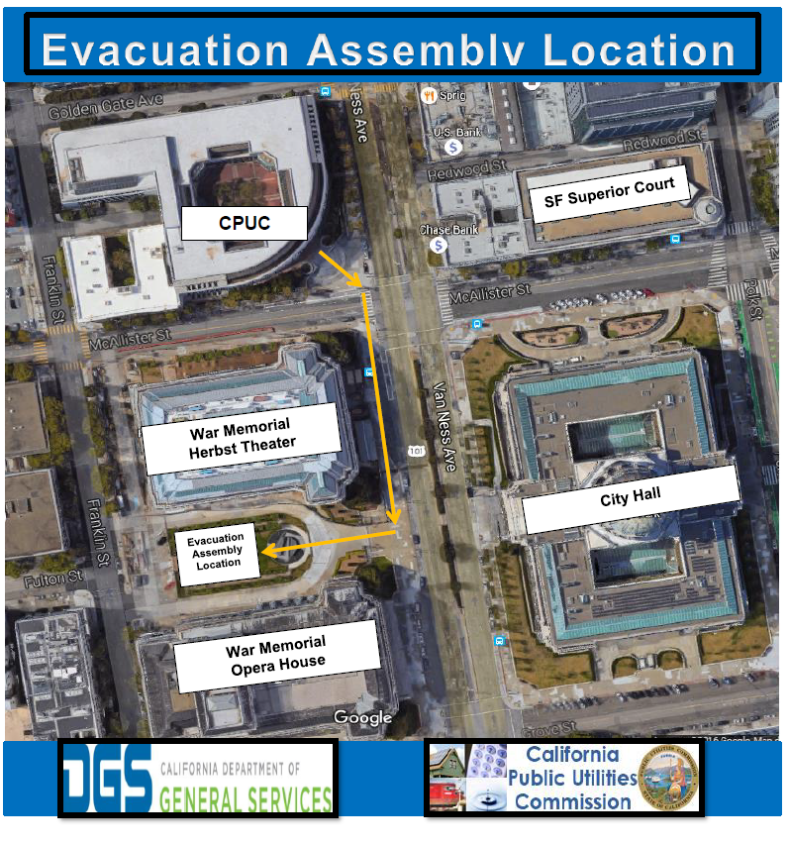

Slide 4
Agenda
10:00 – 10:15 Welcome + Housekeeping & EM&V Program Overview
Robert Hansen
Energy Efficiency Branch, California Public Utilities Commission
10:15 – 10:30 Procurement Overview & Minimum Qualifications
Michael Baltar, Contract Analyst
California Public Utilities Commission
10:30 – 11:15 Desirable Qualifications & Required Deliverables
Group B Sector Leads
Energy Efficiency Branch, California Public Utilities Commission
11:15 – 11:30 Deliverable Cost Sheet & Scoring Process
Michael Baltar, Contract Analyst
California Public Utilities Commission
11:30 – 12:00 Questions & Answers
All

Slide 5
Housekeeping
Presenter: Robert Hansen
Throughout the procurement process – from public comment until the contracts are awarded – the CPUC will work to ensure all potential proposers have a level playing field and that the CPUC operates in a manner that is accountable to the public.
The following protocols will be followed for the Question & Answers period:
  Out of respect for all participants, all questions will be held until the end of the conference in the time allotted for Q&A to ensure that we cover all components of the solicitation;
  Questions and comments received during this conference will be recorded;
  Preliminary responses may be provided to questions verbally during this conference. However, no responses will be considered final or binding until they have been posted in writing; and
  Vendors should follow up in writing with all questions asked at this conference – whether it was answered at the conference or not. Only questions submitted in writing are considered official submission and will receive a response in the official Q&A document.
For attendees on the conference call, please mute your phone line unless speaking during the Q&A period.
Signing-in and verbally identifying yourself on the call is optional. If you sign-in or identify yourself on the call, A list of those who participated in the conference will be public record.

Slide 6
Develop estimates for, and update the Commission’s DEER database; review and approve workpapers
Develop workplans and conduct market studies to inform programs, estimation and evaluation approaches
The EM&V Program Consists of the Following Key Elements:
Presenter: Robert Hansen
Measure and verify savings resulting from energy efficiency measures, programs and portfolios
Energy Savings Estimation
Seek and incorporate stakeholder feedback through public meetings, workshops and other Commission-approved processes
Market Research Studies
Impact Evaluations
Stakeholder Engagement

Slide 7
The Contract Group B RFP Seeks Evaluation of the Following Research Sectors:
Presenter: Robert Hansen
Codes and Standards
Local Government Partnerships, CCAs, and RENs
Emerging Technologies Programs
Marketing, Education & Outreach
Finance Programs
Workforce Education and Training
Zero Net Energy

Slide 8
The Contract Group B RFP Seeks Evaluation of the Following Research Sectors:
Presenter: Robert Hansen
Codes and Standards
Local Government Partnerships, CCAs, and RENs
Impact Evaluations
Supporting Research Activities
Emerging Technologies Programs
Marketing, Education & Outreach
Finance Programs
Workforce Education and Training
Zero Net Energy

Slide 9
The Contract Group B RFP Seeks Evaluation of the Following Research Sectors:
Presenter: Robert Hansen
Codes and Standards
Local Government Partnerships, CCAs, and RENs
Develop Emerging Technologies Database Requirements and Coordination
Evaluate Programs and Pilot
Emerging Technologies Programs
Marketing, Education & Outreach
Finance Programs
Workforce Education and Training
Zero Net Energy

Slide 10
The Contract Group B RFP Seeks Evaluation of the Following Research Sectors:
Presenter: Robert Hansen
Codes and Standards
Local Government Partnerships, CCAs, and RENs
Evaluate Residential EE Loan Pilot
Analyze data collected by CAEATFA
Evaluate additional Finance Pilots as they are launched
Emerging Technologies Programs
Marketing, Education & Outreach
Finance Programs
Workforce Education and Training
Zero Net Energy

Slide 11
The Contract Group B RFP Seeks Evaluation of the Following Research Sectors:
Presenter: Robert Hansen
Codes and Standards
Local Government Partnerships, CCAs, and RENs
Evaluate non-resource programs offered through LGPs, CCAs, and RENs
Provide recommendations to improve long-term program success
Emerging Technologies Programs
Marketing, Education & Outreach
Finance Programs
Workforce Education and Training
Zero Net Energy

Slide 12
The Contract Group B RFP Seeks Evaluation of the Following Research Sectors:
Presenter: Robert Hansen
Codes and Standards
Local Government Partnerships, CCAs, and RENs
Assess market effectiveness of ME&O programs
Evaluate and analyze ME&O metrics per Business Plans
Monitor and evaluate transition to Third Party Implementers
Emerging Technologies Programs
Marketing, Education & Outreach
Finance Programs
Workforce Education and Training
Zero Net Energy

Slide 13
The Contract Group B RFP Seeks Evaluation of the Following Research Sectors:
Presenter: Robert Hansen
Codes and Standards
Local Government Partnerships, CCAs, and RENs
Study correlation between WE&T programs and installation quality
Evaluate training partnerships
Conduct process evaluations of career connections and workforce readiness programs
Market study of workforce knowledge, skills, and abilities
Emerging Technologies Programs
Marketing, Education & Outreach
Finance Programs
Workforce Education and Training
Zero Net Energy

Slide 14
The Contract Group B RFP Seeks Evaluation of the Following Research Sectors:
Presenter: Robert Hansen
Codes and Standards
Local Government Partnerships, CCAs, and RENs
Emerging Technologies Programs
Marketing, Education & Outreach
Conduct Long-term case study
Perform planning for Commercial ZNE policy
Evaluate Cross-Cutting Programs
Evaluate ZNE real estate management
Analyze ZNE retrofit barriers
Finance Programs
Workforce Education and Training
Zero Net Energy

Slide 15
Agenda
10:00 – 10:15 Welcome + Housekeeping & EM&V Program Overview
Robert Hansen
Energy Efficiency Branch, California Public Utilities Commission
10:15 – 10:30 Procurement Overview & Minimum Qualifications
Michael Baltar, Contract Analyst
California Public Utilities Commission
10:30 – 11:15 Desirable Qualifications & Required Deliverables
Group B Sector Leads
Energy Efficiency Branch, California Public Utilities Commission
11:15 – 11:30 Deliverable Cost Sheet & Scoring Process
Michael Baltar, Contract Analyst
California Public Utilities Commission
11:30 – 12:00 Questions & Answers
All

Slide 16
Procurement key dates
Presenter: Michael Baltar
Key Action Dates | Date
Optional Bidders’ Conference (Tentative) Location: CPUC Courtyard Room | 04/30/2018 Time: 10 – 12 PM
Proposer’s Written Questions Submission Deadline (Tentative) | 05/04/2018 5:00 PM PT
CPUC Written Answers Posting Date (Tentative) | 05/11/2018
Intent to Bid Due Date (Tentative) | 05/14/2018 5:00 PM PT
Proposal Response Due Date (Tentative) | 05/21/2018 4:00 PM PT
Technical and Cost Evaluation (Tentative) | May 22 – May 30, 2018
Notice of Intent to Award (Tentative) | 06/04/2018
Deadline to submit Intent to Protest (Tentative) | 06/11/2018 5:00 PM PT
Deadline to submit Protest Letter (Tentative) | 06/15/2018 5:00 PM PT
Contract Award Date (Tentative) | 06/22/2018
Contract Execution Date (Tentative) | 7/02/2018

Slide 17
RFP questions and feedback must be submitted by 5 P.M.
Pacific Time on May 4, 2018
Presenter: Michael Baltar
Proposers may request clarification of the intent or content of this RFP or matters regarding the competitive solicitation process by submitting a question or requests for requirements change during this period.
Questions submitted during this period will be posted as an official Q&A document with the state’s official response.
CPUC will not be able to take personal meetings or respond to telephone inquiries regarding the solicitations in order to ensure a level playing field, full transparency, and the integrity of the solicitations.
All correspondence, questions, inquiries should be directed to Michael Baltar at Michael.Baltar@cpuc.ca.gov.
No answers provided by the Commission verbally shall be considered binding.

Slide 18
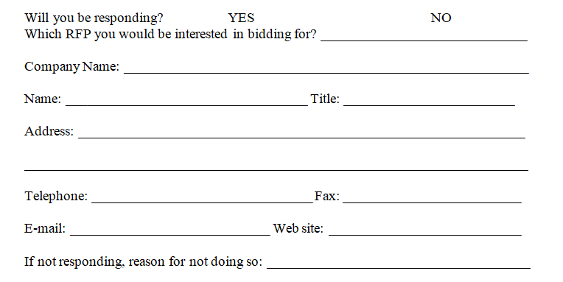
Prime Proposers must submit a Mandatory Notice of
Intent to Bid (Attachment 17) to be eligible to participate in the solicitation process
Presenter: Michael Baltar
Mandatory Notice of Intent to Bid
Key Notes
Prime Proposers must complete and return this form electronically to Michael Baltar at Michael.Baltar@cpuc.ca.gov by May 14, 2018 5 PM PT
Submission of the Intent to Bid is non-binding, however, Prime Proposers who do not return this form will not meet the minimum qualifications to submit a proposal.
Vendors who are not Prime Proposers, but wish to continue receive notifications for this RFP shall submit this form as a non-proposer.

Slide 19
Proposers must meet the following Minimum Qualifications to be eligible to bid:
Presenter: Michael Baltar
Read and understand the Conflict of Interest provisions pertaining to the RFP, and has certified and signed the Conflict of Interest Statement in Attachment 2;
Be registered as a private entity, non-profit organization, the University of California, California State University Foundation, or other governmental entities with the California Secretary of State or can provide an explanation as to why it is not necessary.
Proposer must identify all subcontractors proposed for participation in the contract, and the tasks or work areas that would be assigned to each subcontractor using Attachment 5: Bidder Declaration.
Certify and agree to the bidding and subcontracting limitations; A firm submitting a proposal as the Prime Contractor for Contract Group B may not be a subcontractor on any other proposing team for Contract Group B; A firm may submit proposals as the Prime Contractor for more than one contract group, but if a firm is awarded a contract as the Prime Contractor for one contract group, this precludes their eligibility as a Prime Contractor in any other contract groups under this set of Energy Efficiency Contracts; and A firm may be a subcontractor on multiple proposals for Contract Group B, so long as the firm is not participating as Prime Contractor on any of the Group B proposals.

Slide 20
Proposers must meet the following Minimum Qualifications to be eligible to bid:
Presenter: Michael Baltar
If awarded the contract, sign a Confidentiality/Nondisclosure Statement for the use of data.
Certify and agree to complete all deliverables in accordance to requirements described in the RFP and subject to the EDPM’s approval and any Commission requirements.
Certifies that they will adhere to the American Evaluation Association’s Guiding Principles for Evaluators.
Complete and return the Notice of Intent to Bid (Attachment 17). Vendors who do not return this form by the date specified in Section 2.4: Key Dates will be disqualified from further participation.

Slide 21
Agenda
10:00 – 10:15 Welcome + Housekeeping & EM&V Program Overview
Robert Hansen
Energy Efficiency Branch, California Public Utilities Commission
10:15 – 10:30 Procurement Overview & Minimum Qualifications
Michael Baltar, Contract Analyst
California Public Utilities Commission
10:30 – 11:15 Desirable Qualifications & Required Deliverables
Group B Sector Leads
Energy Efficiency Branch, California Public Utilities Commission
11:15 – 11:30 Deliverable Cost Sheet & Scoring Process
Michael Baltar, Contract Analyst
California Public Utilities Commission
11:30 – 12:00 Questions & Answers
All

Slide 22
Proposers will be evaluated on the following desired qualifications:
Presenter: Robert Hansen
General Qualifications Demonstrate experience in successfully managing complex projects involving multidisciplinary teams comprised of: Multiple subcontractors, At least one senior experienced overall project manager, At least one manager for each sector and measure group, and In-house staff. Demonstrate that they can and will effectively manage time and resources across multiple projects, setting work plan schedule, and workflow. Proposals should include resumes for senior team members for each sector, including pertinent experience. Demonstrate experience among the proposal team in successfully conducting a program evaluation study and producing a high-quality report for use by the public, policy-makers, and program administrators.
Stakeholder Communications Demonstrate experience in leading stakeholder workshops and engaging with stakeholders. Demonstrate experience working with stakeholders in a public regulatory process. Demonstrate experience in collecting and communicating data through various media, including graphs, charts, tables, and should demonstrate an understanding of the nature of data through quantitative analysis and qualitative interpretation.
Regulatory Experience Demonstrate knowledge and understanding of California energy efficiency policy, Commission processes, and Commission proceedings. Demonstrate understanding of the current Cost Effectiveness requirements and tests applicable to California energy efficiency programs, and should demonstrate the ability to perform Cost Effectiveness Tests for resource programs.

Slide 23
Proposers will be evaluated on the following desired qualifications:
Presenter: Robert Hansen
Evaluation Skills and Experience Demonstrate experience in the following energy programs evaluation related skills: Conducting in-depth program evaluation studies in a regulatory context; Designing and implementing sampling plans to inform statistically significant study results and findings. Developing and implementing complex study designs; Developing and conducting surveys through a variety of channels, e.g., telephone, internet, or physical surveys to address specific questions about a program; Designing and conducting Randomized Control Group studies to determine program influence and impacts; Collecting and organizing heterogeneous data from an array of sources; Conducting analysis of quantitative and qualitative energy program data (including energy savings estimates); Performing program evaluations and energy policy analysis that produces actionable recommendations for program decision-makers; Developing and providing specific feedback on energy efficiency methodologies for evaluation projects; Conducting energy and demand savings estimation; Measuring load/impact profiles, free ridership, measures effective and remaining useful life; and Developing net-to-gross values, gross realization rates, measures costs, estimation, and evaluation.
Research Experience Demonstrate experience in conducting research projects on a variety of energy program topics including expertise in the multi-disciplined research areas of engineering, econometrics, behavioral and market research related to energy programs.

Slide 24
Proposers will be evaluated on the following desired qualifications:
Presenter: Robert Hansen
Codes and Standards Related Experience Demonstrate familiarity with current industry building and appliance standards (Such as the California Title 20 and Title 24 standards), as well as current Federal appliance, equipment and lighting energy standards, and an understanding of the energy code development processes at the state and federal levels. Understand and be able to implement building certification methodologies.
Local Government Partnerships, Community Choice Aggregators, and Regional Energy Networks Related Experience Demonstrate experience in conducting research projects on a variety of energy program topics including expertise in the multi-disciplined research areas of engineering, econometrics, behavioral and market research related to energy programs.
Emerging Technologies Programs Related Experience Demonstrate knowledge of and experience working with current and emerging energy efficiency technologies, and demonstrate an ability to identify, evaluate, and commercial acceleration approaches and programs. Demonstrate knowledge of the industry standard process for inclusion of new technologies into the Energy Efficiency portfolio. Demonstrate knowledge of technology development processes, spanning early research and development to high levels of market penetration. Demonstrate experience, expertise, and knowledge working with energy-related market transformation approaches and programs.

Slide 25
Proposers will be evaluated on the following desired qualifications:
Presenter: Robert Hansen
Finance Related Experience Demonstrate experience in evaluating statewide finance programs, and familiarity working with complex finance program-related datasets.
Marketing, Education, and Outreach Related Experience Demonstrate familiarity with the strategies and goals of marketing, education, and outreach programs, and experience in evaluating marketing programs and campaigns.
Workforce Education and Training Related Experience Demonstrate an understanding of all aspects of workforce education and training programs, and an ability to evaluate program performance based on different program goals.
Zero Net Energy Related Experience Demonstrate knowledge of the concepts of Zero Net Energy and related terms and familiarity with current Zero Net Energy projects. Demonstrate experience in working with multiple stakeholders in developing strategic plans.

Slide 26
Proposers must follow the Evaluation Report Requirements
for all study and report components of each deliverable under this contract
Presenter: Robert Hansen
Evaluation Report Requirements
All studies and reports must clearly and thoroughly address each of the Key Research Questions as identified in the Deliverable description, and as defined in the final Research Sector Work Plans. Any draft and final documents will be submitted to the Commission for review, and to provide final edits and directions before finalizing and publishing the report. Both the draft and the final evaluation report will include the following components:
Title Page | Readability
Contacts Page | Copy-editing
Table of Contents | Graphic Design
Executive Summary | Review Process Peer Review Stakeholder Review Public Review Energy Division Management Approval Process
Approach and Methodology
Data Source
Table of Comments
Submission of a print-ready format and electronic PDF format

Slide 27
Deliverables – All Sectors (Page 1 of 2)
Presenter: Robert Hansen
Deliverables | Description
1. Research Sector Work plans | Create and establish research and evaluation workplans for each research sector describing all tasks and activities necessary to complete all deliverables under this contract.
2. Progress Reports and Updates | Submit interim progress reports and provide milestone updates on an as-needed basis.
3. Kickoff Meeting | Attend a 1-day kickoff meeting with the Commission upon award.
4. Standing Meetings | Participate in project coordination group meetings and progress meetings with the Commission for up to two meetings per month, per research sector.
5. Stakeholder Workshops & Webinars | Conduct up to 150 stakeholder engagement workshops or webinars.
6. Gaps and Emerging Issues Report | Submit a Gaps & Emerging Issues report by Nov 15th of each year for each sector.
7. Potentials and Goals Study Coordination | The contractor will cooperate with other prime contractors in collecting and analyzing data specific to the Contract Group B sectors, and coordinate with other Prime Contractors to update the Potentials and Goals report.
8. Data Collection, Transmission, and Storage Plan | Prepare a plan which clearly describes the approach and timeline for data collection throughout the life of the contract. Document any specifications and descriptions of the datasets throughout the life of this contract and provide all data collected to the contractors and to the Commission.
9. Program Analysis and Recommendations | Develop recommendations for program administrators to improve their energy efficiency programs, including the analysis of program management and current overview of current energy efficiency programs.

Slide 28
Deliverables – All Sectors (Page 2 of 2)
Presenter: Robert Hansen
Deliverables | Description
10. Subject Matter Expert Services | Advise Commission Staff as needed, on matters concerning the Energy Efficiency Evaluation efforts and EM&V Research Roadmaps.
11. Other Meetings and Briefings | Attend ad-hoc meetings with entities such as Commission Executives, Advisory Committee, and others, to provide updates, briefings, or participate in programmatic discussions.
12. Unanticipated Tasks | The State may add an additional amount in the contract for unanticipated tasks in the event that additional work must be performed that was wholly unanticipated, and which was identified in neither the State’s solicitation document nor the Vendor’s proposal, but which in the opinion of both parties is necessary to the successful accomplishment of the general scope of work. These tasks will be billed at a pre-approved proposed hourly rate, subject to the EDPM’s approval, and are not to exceed 10% of the total agreement amount awarded.

Slide 29
Deliverables – Codes and Standards Program (Page 1 of 1)
Presenter: Peter Biermayer
Deliverables | Description
13. Codes and Standards Impact Evaluation | Conduct impact evaluation of Codes and Standards programs, to ensure compliance with the Federal Standards and State building Standards per Title 20 and Title 24. In addition, the contractor shall complete the following analysis and assessment: Assessment of Overlapping Standards and To-Code Programs; Reasons for Non-compliance; Respond to Stakeholder Issues and Comments; Analyze Use of New Compliance Techniques; and Other additional reporting requirements.
14. Refine the Cost Effectiveness Calculations for Codes and Standards | Continue work begun in the Review of the Process for Codes and Standards Program Cost-effectiveness reporting to resolve gaps in the assessment.
15. Gross Savings Potential and Compliance Analysis Harmonization Project | Assess the need for, the possibility of, and the means for harmonizing the currently separate analyses for gross savings potential and code compliance. This analysis shall be conducted and completed within the first year of the evaluation cycle for codes and standards.

Slide 30
Deliverables – Emerging Technologies Programs (Page 1 of 1)
Presenter: Alexander Sasha Merigan
Deliverables | Description
16. Develop Emerging Technologies Database Requirements and Coordination | Facilitate the development and maintenance of the Emerging Technologies Program online database and its requirements. The Contractor will coordinate with the IOUs, the Data Contractor, and ED to facilitate decisions on website content and design to ensure the database provides data security and program transparency while being housed in a user-friendly modern website structure.
17. Emerging Technology to Portfolio Evaluation Study | Evaluate the market uptake and achieved savings of all technologies and approaches that have moved from ETP into the IOU EE Portfolio or directly into codes or standards, including evaluation of historical savings of ETP-originated energy efficiency measures in the Program Administrators’ portfolios and codes and standards going back to 2009.
18. Emerging Technologies Handoff Evaluation Study | Evaluate the existing processes for passing technologies, approaches, and projects between technology development actors (such as EPIC, CalSEED, CalPlug, the 4 CA technology clusters), ETP, the IOU ET Incentive Portfolio, and Codes and Standards.
19. Technology-focused Pilot Evaluation Study | Evaluate the Technology-Focused Pilots (TFP), which employs a roughly 2-year accelerated commercialization approach for high-priority high-potential technologies and approaches identified in the ETP Technology Priority Maps, and provide recommendations for program improvements.

Slide 31
Deliverables – Finance Programs (Page 1 of 1)
Presenter: Kevin Feizi
Deliverables | Description
20. Evaluation of Finance-Related Pilots | Conduct an evaluation study of the Residential Energy Efficiency Loan (REEL) at the end of two-year pilot period to measure the degree to which the program was successful in reaching its goals based on metrics adopted in Resolution E 4900. After future financing pilots are launched by the California Alternative Energy and Advanced Transportation Financing Authority (CAEATFA), the Contractor will also conduct evaluation studies of those pilots at the end of their two-year periods. The data collection and analysis should at include, at minimum: Data points collected by CAEATFA ; and Qualitative data generated through interviews with stakeholders including contractors, customers, and lenders.

Slide 32
Presenter: Robert Hansen and Nils Strindberg
Deliverables – Local Government Partnerships (LGP), Community Choice Aggregators (CCA), Regional Energy Networks (RENs) (Page 1 of 1)
Deliverables | Description
21. Assessment of Community Choice Aggregators | Support the Energy Division in tracking and analyzing of energy efficiency programs administered by current and any future Community Choice Aggregators (CCAs) Analyze benefits of non-resource programs, including reviewing and summarizing process evaluations, but any impact evaluation of resource programs will be evaluated under a separate Prime Contract.
22. Assessment of Local Government Partnerships and Regional Energy Networks | Support the Energy Division in tracking and analyzing the impacts and effectiveness of energy efficiency programs administered through local government partnerships (LGPs) and Regional Energy Networks (RENs). Analyze non-resource programs and how these programs provide benefits in terms of increased performance of contractors, greater customer awareness of programs and how to reduce energy consumption, etc., support non-resource programs provide to ongoing utility and REN resource programs and especially how they support program implementation and program delivery for resource programs.

Slide 33
Deliverables – Marketing, Education and Outreach Programs (Page 1 of 1)
Presenter: Rory Cox
Deliverables | Description
23. Cross-Cutting Marketing Effectiveness Study | Evaluate the energy efficiency Marketing, Education, and Outreach (ME&O) programs throughout the state, including Energy Upgrade California and the efforts of individual Program Administrators. The evaluation will focus on each program’s effectiveness in leading consumers to take specific actions, including the following components: Effectiveness Assessment; and Collaborative Process Assessment.
24. Marketing Education and Outreach Consensus | Conduct a study to determine whether a consensus opinion exists on benchmarks related to ME&O metrics and success criteria in the energy efficiency industry, and what that consensus is.
25. ME&O Program Transition from IOUs to Third Parties and CCAs | Evaluate how changes in the IOU Business Plans for ME&O will impact program delivery, and in particular how programs are marketed to residential and small businesses.

Slide 34
Deliverables – Workforce Education and Training (WE&T) Programs (Page 1 of 1)
Presenter: Reese Rogers
Deliverables | Description
26. WE&T and Installation Improvement Evaluation | Design and execute a study to understand whether and to what extent there is a causal link between IOU workforce training programs and improved installation practices.
27. Partnerships with Training Institutions Impact Evaluation | Design and execute a study to understand the functioning and impact of partnerships with WE&T training and job placement organizations, such as, but not limited to, community colleges, community-based organizations, workforce development boards, and apprenticeship programs.
28. WE&T Career Connections Process Evaluation | Conduct a process evaluation on the WE&T Career Connections Program to investigate the following items: Evaluability and adaptability of the program; Effectiveness toward program goals and cost-effectiveness; Workforce outcomes for program participants; and Alignment with the identified Strategic Plan goals.
29. Career & Workforce Readiness Process Evaluation | Conduct a process evaluation of the Career & Workforce Readiness program to investigate the following items: Evaluability and adaptability of the program; Effectiveness toward program goals and cost-effectiveness; Workforce outcomes for program participants; and Alignment with the identified Strategic Plan goals and best practices outlined in the Survey of Inclusion Workforce Landscape.
30. Knowledge, Skills, and Abilities Market Studies | Conduct a study to identify the knowledge, skills, and abilities (KSA) needed for implementers, contractors, technicians, and contractor laborers on energy efficiency concepts.

Slide 35
Deliverables – Zero Net Energy (ZNE) Programs (Page 1 of 1)
Presenter: Rory Cox
Deliverables | Description
31. A ZNE Community Case Study | Investigate study objectives in the context of the Newhall Ranch Development, including questions such as: How is the local utility planning for the unique attributes of this community on its grid?; and How is the developer defining “Net Zero?”
32. Planning for a Commercial ZNE Policy | Work with stakeholders to plan for the 2030 goals, developing plans and criteria to “mainstream” ZNE while taking into consideration ZNE buildings, communities, campuses, and portfolios.
33. IOU and CCA Cross-Cutting Program Evaluation | Track and evaluate the cost effectiveness and the quality of IOU-led cross-cutting programs such as the California Advanced Homes Partnership, Savings by Design, and Public Sector ZNE programs, and how they integrate with other EE programs. Investigate the strengths and weaknesses of Community Choice Aggregators, and examine how they can contribute to ZNE goals.
34. ZNE Commercial Real Estate Management | Evaluate the common property management setups and owner-tenant relationships, and how they impact ZNE implementation and performance.
35. ZNE Retrofit Timelines and Costs | Analyze the cost premiums associated with extending project timelines for retrofitting existing, occupied buildings, emphasizing commercial and industrial customers.

Slide 36
Agenda
10:00 – 10:15 Welcome + Housekeeping & EM&V Program Overview
Robert Hansen
Energy Efficiency Branch, California Public Utilities Commission
10:15 – 10:30 Procurement Overview & Minimum Qualifications
Michael Baltar, Contract Analyst
California Public Utilities Commission
10:30 – 11:15 Desirable Qualifications & Required Deliverables
Group B Sector Leads
Energy Efficiency Branch, California Public Utilities Commission
11:15 – 11:30 Deliverable Cost Sheet & Scoring Process
Michael Baltar, Contract Analyst
California Public Utilities Commission
11:30 – 12:00 Questions & Answers
All

Slide 37
Proposers shall carefully read and understand the following
cost evaluation topics before filling out the Deliverables Cost Sheet
Presenter: Michael Baltar
Topic | Key Notes
Cost Evaluation | For this RFP, the Proposers will be evaluated on the proposed “Total Evaluation Cost” to ensure fair competition and simplify comparisons among proposals. The awarded contractor will work with each of the Energy Division Project Managers upon contract execution to determine the final total contract cost and to identify a set of proposed Deliverable milestones as a part of contract management. Some Deliverables may trigger the need for progress payment.
Number of Units | The Commission will provide the number of units required for each Deliverable listed in this RFP, for planning and/or evaluation purposes. The actual number of units may vary upon contract execution based on program needs from year to year, and based on the Division Project Managers’ approval.
Sector-Specific Deliverables | Costs for the research sector-specific Deliverables shall only reflect costs for the base evaluation activities required in each item. Cost associated with these Deliverables shall be accounted for under that specific Deliverable. During the cost evaluation stage, the average of all approaches/cost options proposed under each Deliverable will be used to calculate the total evaluation cost under each Deliverable. This is calculated for evaluation purposes only, the final contract amount may be adjusted based on approach selected, but both the final contract amount and the total evaluation cost must not exceed the cap of $16,500,000.
Deliverable Milestone | Deliverable milestones under this contract can be defined as a periodic and/or progressive set of sub-Deliverable work products throughout the contract period. For example, a Deliverable milestone for Deliverable 02: Progress Reports and Updates could be one monthly report. Total cost per unit identified in this RFP cannot be modified throughout the contract period. However, milestone Deliverables can be added, removed, or modified by mutual agreement between the Contractor and the Energy Division Project Manager.
Calculation for Option Years | Upon contract award, total costs per unit submitted by the awarded contractor are fixed for the life of the contract. These rates will be adjusted using a Commission-defined CPI-based escalation rate to determine the total Deliverable costs for option year extension, if applicable. The Energy Division Project Manager for each research sector will determine the number of units required for each Deliverable for each option year. Not all Deliverables may be needed if an option year is exercised.

Slide 38
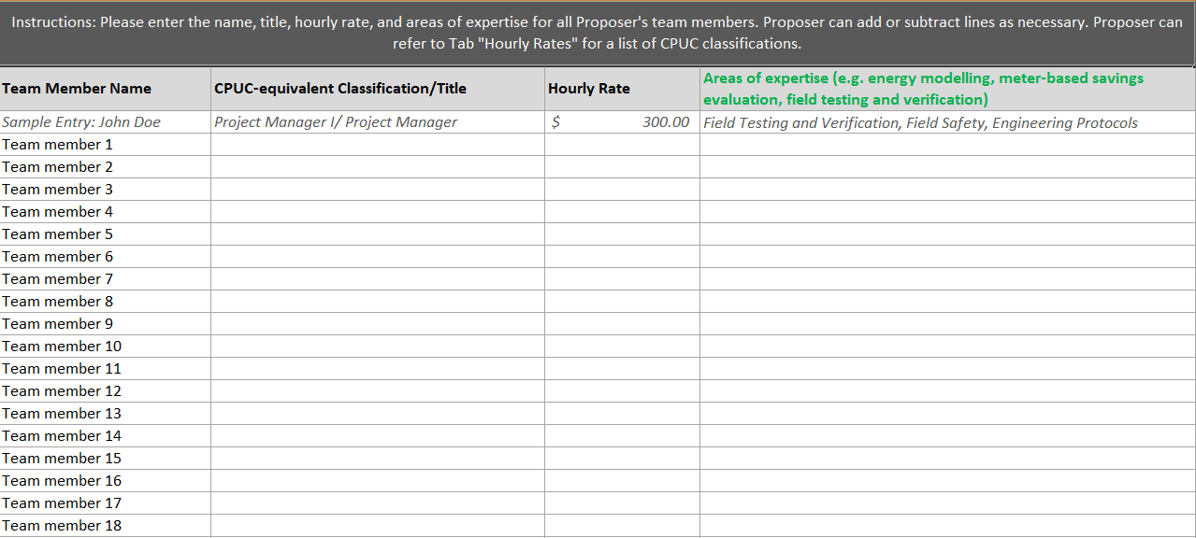
Proposers will fill out all tabs within the Deliverables Cost Sheet
in Attachment 10 to detail cost for each requested deliverable (Page 1 of 4)
Presenter: Michael Baltar
Team Members Tab
Description
Proposers will enter the name, title, hourly rate, and areas of expertise for all Proposer's key team members. Proposer can add or subtract lines as necessary. Proposer can refer to Tab "Hourly Rates" for a list of CPUC classifications.

Slide 39
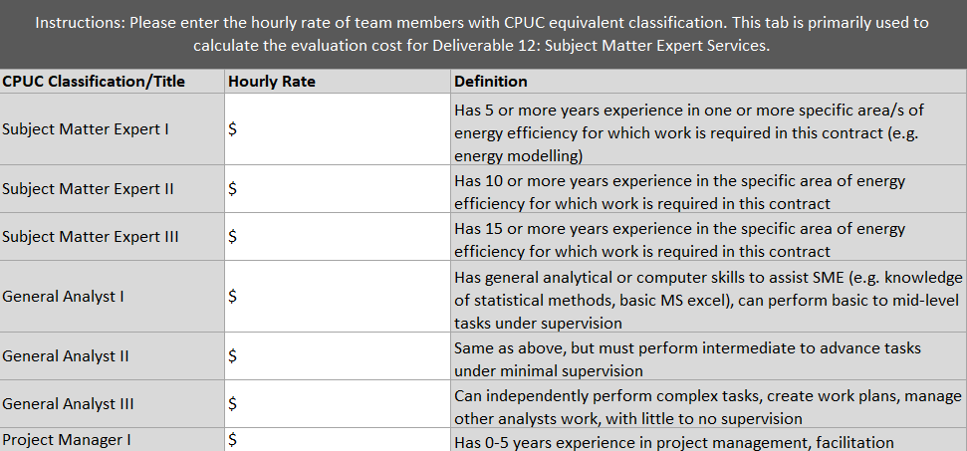
Proposers will fill out all tabs within the Deliverables Cost Sheet
in Attachment 10 to detail cost for each requested deliverable (Page 2 of 4)
Presenter: Michael Baltar
Hourly Rates Tab
Description
This is a list of positions equivalent to CPUC classifications. Proposers will enter the hourly rate of team members equivalent to the listed CPUC classification. This tab is primarily used to calculate the cost for Deliverable 18: Subject Matter Expert Services.

Slide 40
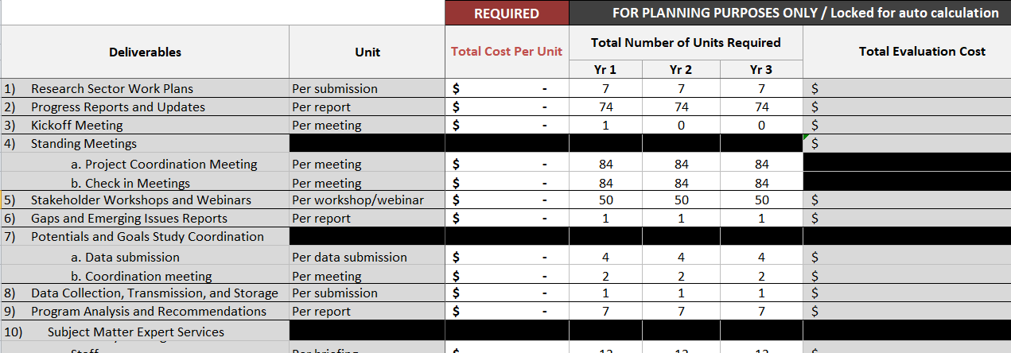
Proposers will fill out all tabs within the Deliverables Cost Sheet
in Attachment 10 to detail cost for each requested deliverable (Page 3 of 4)
Presenter: Michael Baltar
Deliverables Tab
Description
Proposer will fill out Column C – Column N to reflect the Total Cost Per Unit in order to calculate Evaluation Cost for all deliverables. The total evaluation cost is calculated for evaluation purposes only, the final contract amount may be adjusted based on level of rigor used and number of units required

Slide 41
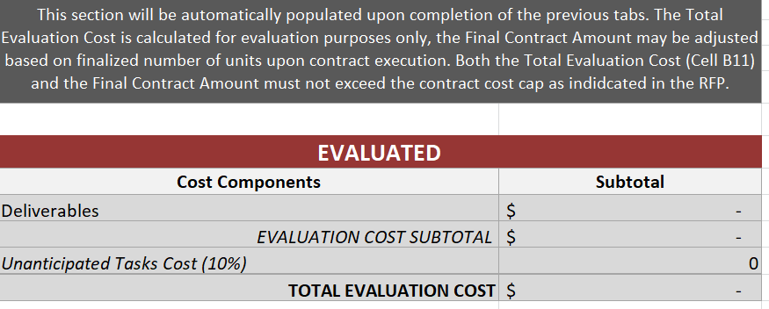
Proposers will fill out all tabs within the Deliverables Cost Sheet
in Attachment 10 to detail cost for each requested deliverable (Page 4 of 4)
Presenter: Michael Baltar
Total Evaluation Cost Tab
Description
This section will be automatically populated upon completion of the previous tabs. The total Evaluation Cost is calculated for evaluation purposes only, the final contract amount may be adjusted based on deliverable approach/rigor level upon contract execution. Both the Total Evaluation Cost and the Final Contract Amount must not exceed the contract cost cap of $16.5 million.

Slide 42
The contract will be awarded to the proposer whose proposal
received the highest score by the CPUC evaluation and selection team
Presenter: Michael Baltar
Stage | Scoring | Description
Stage 1: Technical Review | 710 Points | All proposals that pass the compliance check will begin Stage 1: Technical Review. The Review Panel will review all proposals to assess the Proposer’s ability to carry out the proposed work. The Review Panel will review each proposal individually and then score by consensus all aspects of the following requirements: Proposer’s Team Description and Experience (260 points); Organization Description; and Desired Qualifications. Approach and Workplan (450 points). Workplan Narrative; and Detailed Workplan. Proposers must obtain a minimum of 497 points in Stage 1 in order to advance to Stage 2.
Stage 2 : Reference Check | 40 Points | For proposals that passed Stage 1, all references will be contacted for this stage. CPUC will make reasonable attempts at contacting the references, and scores received from respondents will be averaged out for the final score of that element.
Stage 3 : Cost Evaluation | 322 Points | Each proposer’s total cost for all services will be ranked from low-to-high. The proposal with the lowest total cost will received a score of 322. The remaining proposals will receive an incrementally lower score as indicated in the sample calculation in the solicitation.
Stage 4: Adjustments for SB/DVBE Participation | N.A. | Scores will be adjusted to account for SB and/or DVBE participation.
Stage 5: Combining Scores | N.A. | CPUC will combine the points of each qualifying Proposer from Stage 1-4 to calculate the total score for each qualifying Proposer. The maximum point value for Stage 1-3 is 1072 points, prior to SB/DVBE adjustment.

Slide 43
Agenda
10:00 – 10:15 Welcome + Housekeeping & EM&V Program Overview
Robert Hansen
Energy Efficiency Branch, California Public Utilities Commission
10:15 – 10:30 Procurement Overview & Minimum Qualifications
Michael Baltar, Contract Analyst
California Public Utilities Commission
10:30 – 11:15 Desirable Qualifications & Required Deliverables
Group B Sector Leads
Energy Efficiency Branch, California Public Utilities Commission
11:15 – 11:30 Deliverable Cost Sheet & Scoring Process
Michael Baltar, Contract Analyst
California Public Utilities Commission
11:30 – 12:00 Questions & Answers
All

Slide 44
Questions & Answers
Presenter: Robert Hansen
  Questions and comments received during this conference will be recorded.
  Preliminary responses may be provided to questions verbally during this conference. However, no responses will be considered final or binding until they have been posted in writing.
  Vendors should follow up in writing with all questions asked at this conference – whether it was answered at the conference or not. Only questions submitted in writing are considered official submission and will receive a response in the official Q&A document.

Slide 45
Thank You for Participating!
  All Questions and comments shall be submitted to
  Michael Baltar
  at
  Michael.Baltar@cpuc.ca.gov

