Slide 1
Utility Role in Addressing PEV Infrastructure CPUC VGI and Financing Workshop Mark Duvall Director, Electric Transportation and Energy Storage December 4th, 2013

Slide 2
PEV Adoption Increasing Sharply in CA

Slide 3
Total Cost of Vehicle Ownership – PEVs Can Be Competitive, Today
Nissan Leaf Comparison
Recent price drops in some PEVs have caused TCO to improve—however pricing is regionally variable.

Slide 4
California has mandated 1.5 Million Zero Emission Vehicles by 2025 (3.3M including seven other states)
Plug-In Electric Vehicles
We Are Here
Fuel Cell Vehicles

Slide 5
From ‘Transportation Electrification – A Technology Overview’ in 2011
There are about five models for owning and operating charging equipment
Municipally owned and operated for public benefit, similar to traffic signals, street lights, etc. Supported through municipal budgets.
Utility owned and operated for public benefit. Supported in the utility rate base.
Employer owned and operated as an employee benefit
Privately owned primarily to enhance an unrelated business—retail shopping, hotels, restaurants, private parking facilities, etc.
Privately owned and operated for the sole purpose of providing charging services to PEV owners.
Source: EPRI Technical Report 1021334

Slide 6
Understanding and Planning Charging Infrastructure
Build Today’s Infrastructure Today
Infrastructure is expensive
~ $1500 home, $2500+ public
Focus on Residential
95% of vehicles end day at home
Costs can exceed $2200 - $2500
Cost and lead time minimization
Workplace
Fleet education and certainty of costs
Public Charging
Critical vs. convenience
Viable business models
Long-term sustaining of infrastructure
Public
Workplace
Residential

Slide 7
What Have We Learned to Date?
Residential issues
Multi-unit and tenant dwellings
Relatively high initial costs
High adoption of Level 1 at very low cost
Workplace
Potential has grown—see as driver of adoption
High installation costs, scaling issues
Public Charging
Clustering – need to build out networks
Long-term sustainability of infrastructure
Underestimated difficulties of locating infrastructure
Public
Workplace
Residential

Slide 8
Calculating the Type and Number of Public and Workplace EVSEs is Relatively Straightforward

Slide 9
Customer Expectations of Their Utility Survey results from Southern California
Expectations Of The Utility
Base: General Market (n=602)
Q. 40a How can your electric utility company best help you stay informed about plug-in hybrid electric vehicles?
Q.40b If you were planning on purchasing or leasing a plug-in hybrid electric vehicle, which of the following services would you want from your electric company?

Slide 10
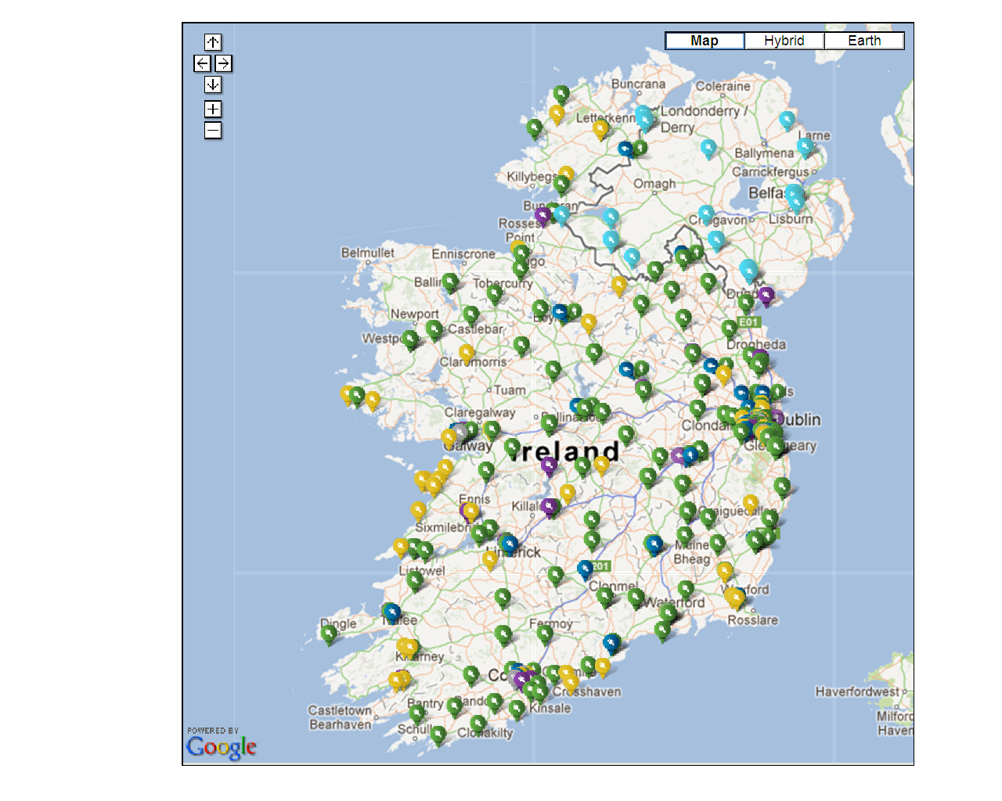
Ireland – eCar Ireland Project
Public chargers Ireland
All towns with population of 1500+
National Plan 1000 (654 to date)
Public Chargers Northern Ireland
320 in Northern Ireland (installed)
Fast Chargers every 60km on Key interurban routes
Original Plan 40
30 (Ire); 9 (NI)
Revised Plan
100 (Ire); 14 (NI)
Home/ Workplace
First 2000 installed free (IRL)
656 installed to date
Operated by ESB Networks
Source: ESB Networks
Notes:
10

Slide 11
San Antonio – CPS Energy Public EV Infrastructure Strategy
126 public chargers, most in banks of 4 for installation cost efficiency
Highly traveled, mixed-use sites
Own the infrastructure, but partnered with private property owners for optimal locations
Provided the stations and the network; split the cost of installation with the property owners
Installed separate meters where cost efficient; contracted to reimburse the property owner where behind the meter
Set the pricing and developed a monthly flat rate for public charging
Source: CPS Energy

Slide 12
Expectations of Two Utilities’ Customers for PEV Services
CenterPoint Energy
CPS Energy
Important
Somewhat Important
Not Important
Develop a public charging infrastructure
Offer charging station installation and maintenance
Provide information about Electric Vehicles
Provide for in-home display of on-going charging
Offer home audits
Notes:
Having respondents’ utility develop a public infrastructure is the most important to respondents in San Antonio and Houston. The second most important thing to respondents is for the utility to offer charging station installation and maintenance. These results indicate that San Antonio and Houston residents have substantial expectations regarding their electric utility’s role in supporting PEVs.
Date slide was prepared: 6/6/2012 – weighted
Sample Size: 1,072
Question Number: 1040
Question: Assume you will purchase or lease a Plug-In Hybrid Electric or Battery-Only Electric vehicle. In that case, how important would it be for your electric company to provide the following services?
Utility Version: CenterPoint

Slide 13
CA PEV Sales – 2013

Slide 14
CA PEV Sales – 2013 Existing Public EVSE

Slide 15
CA PEV Sales – 2013 Regional Networks

Slide 16
Together…Shaping the Future of Electricity

