Slide 1
CAISO’s proposed TOU periods to address grid needs with high numbers of renewables
Clyde Loutan, Sr. Advisor, Renewable Energy Integration, CAISO
John Goodin, Regulatory Policy Manager, CAISO
Delphine Hou, External Affairs Manager, CAISO
Jordan Pinjuv, Counsel, CAISO
February 26, 2016

Slide 2
Purpose of ISO TOU Analysis
OIR correctly states that “Time-of-use (TOU) pricing is the form of rate design that is most commonly used to communicate to the customer when system costs are high or low, or to create incentives for a customer to shift usage to times that are better for the overall electric system.”
The ISO analysis seeks to determine those time periods when customers should be incentivized to shift usage to benefit the overall electric system.
The ISO analysis does not:
  Quantify system impacts of TOU implementation;
  Analyze needed price differentials; or
  Analyze IOU or customer specific needs.

Slide 3
The ISO’s approach to analyzing TOU time-periods was developed to answer the following questions
Does the time of the CAISO’s coincident peak demand vary by season?
Does the time of the CAISO’s coincident peak coincide with the IOUs’ peak demand?
Is there a noticeable difference between weekdays and weekends/holidays?
Is there a need for IOU specific TOU time periods?
Can all three IOUs establish common TOU time periods based on the CAISO’s needs?
Should TOU time periods be grouped by months?

Slide 4
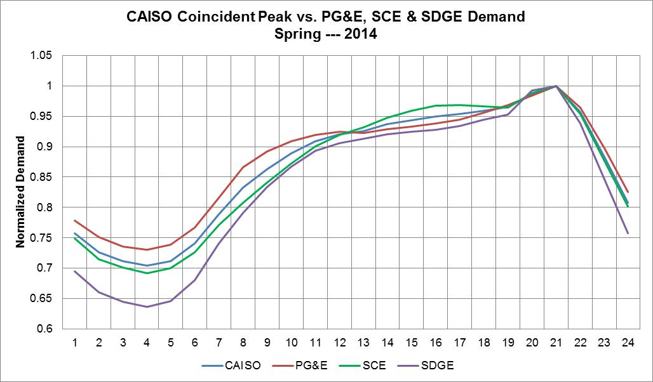
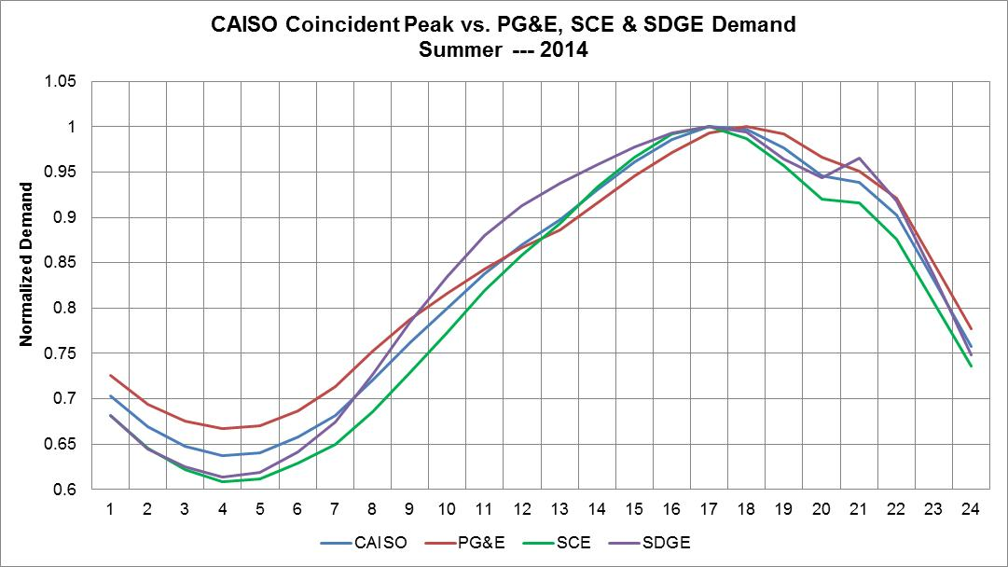
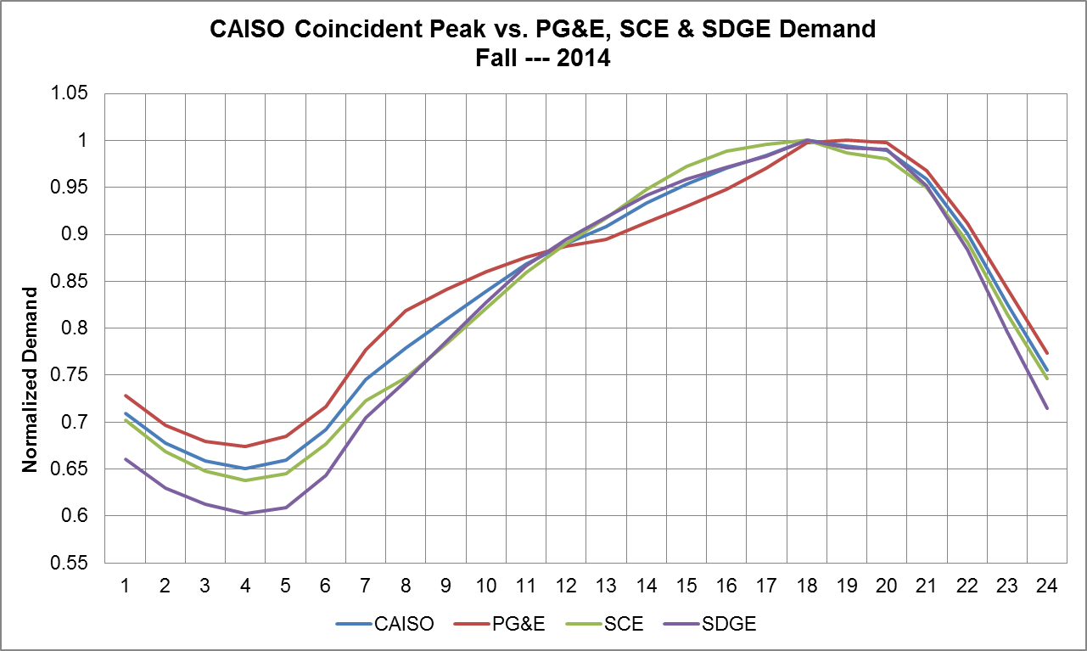
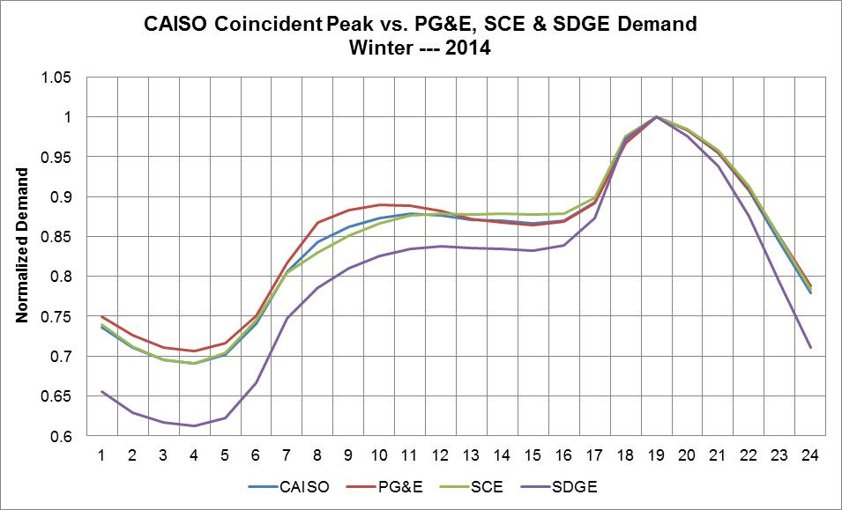
ISO’s coincident peak vs. PTO’s coincident peak
Spring: The ISO and three PTOs coincident peak occurs between 8 p.m. and 9 p.m.
Summer: The ISO, SCE & SDG&E coincident peak occurs between 4:00 p.m. and 5:00 p.m. PG&E is an hour later
Fall: ISO and three PTOs coincident peak occur between 7:00 p.m. and 8:00 p.m.
Winter: ISO and three PTOs coincident peak occur between 6:00 p.m. and 7:00 p.m.

Slide 5
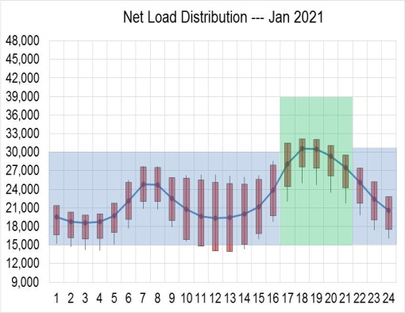
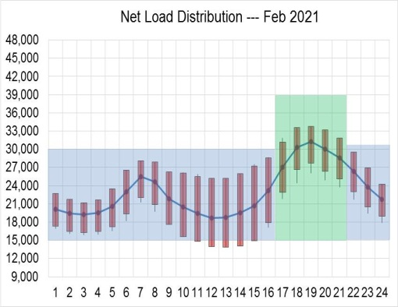
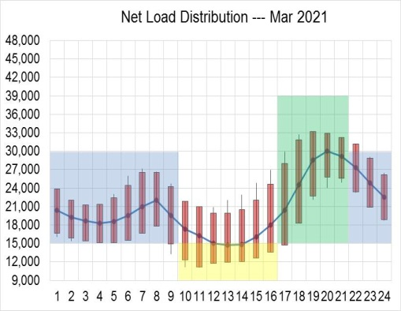
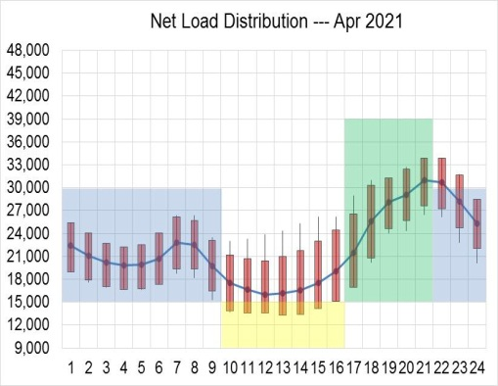
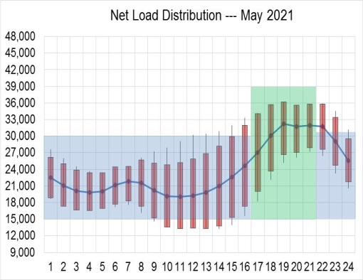
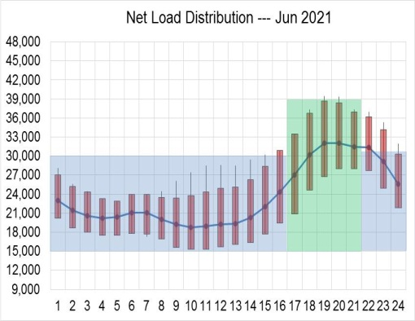
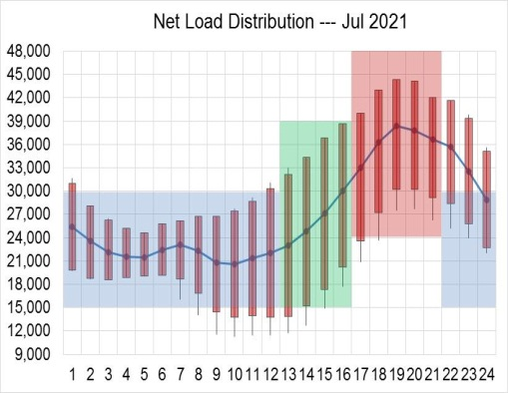
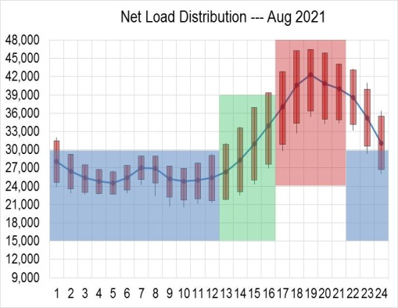
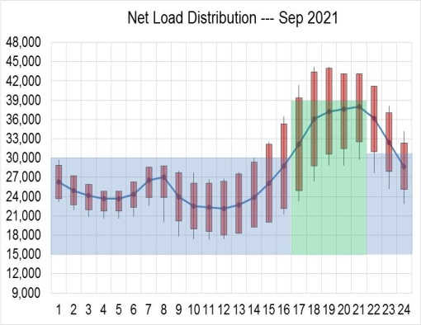
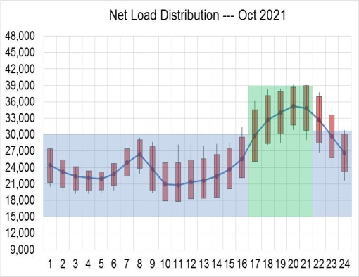
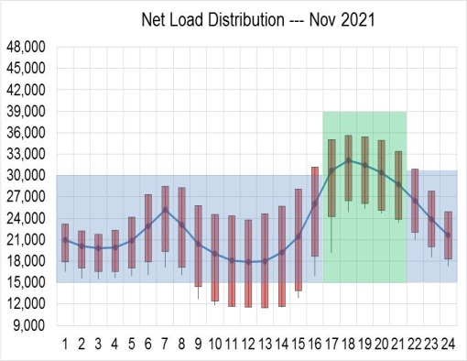
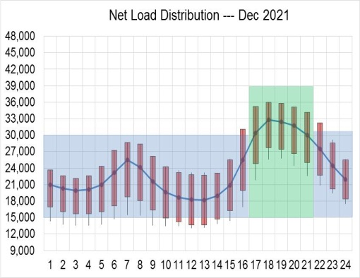
2021 Monthly Net Load Distribution --- Weekdays
Off-Peak
Peak
Super Off-Peak
Super Peak

Slide 6
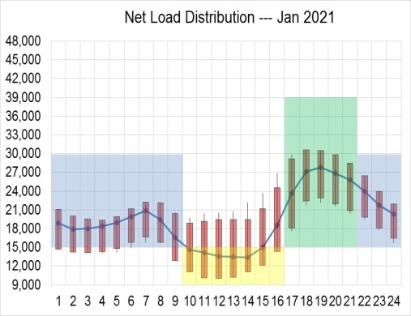
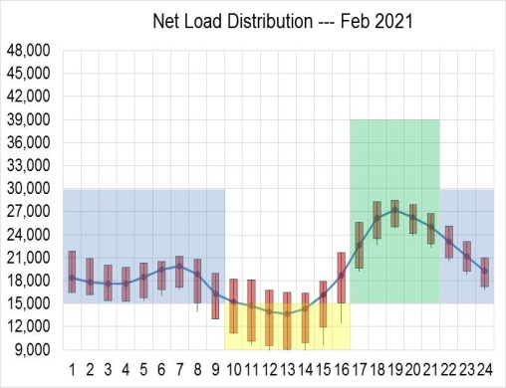
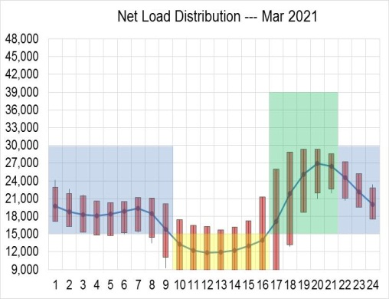
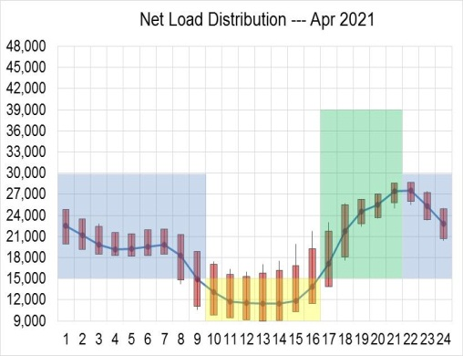
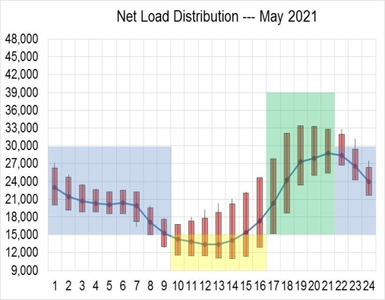
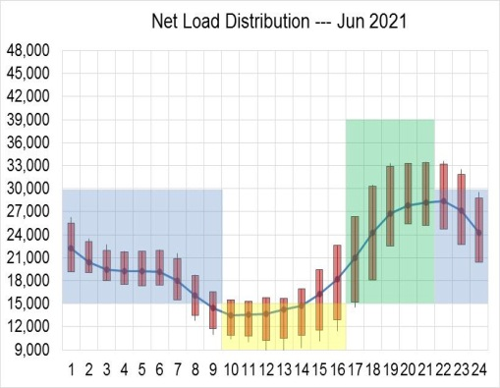
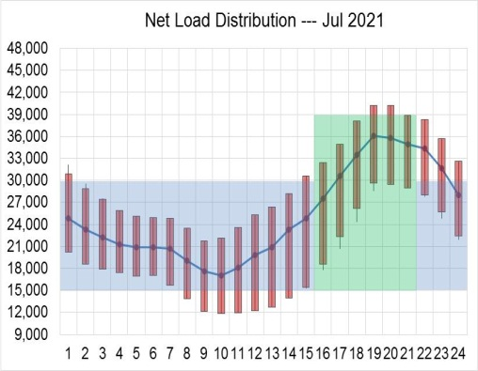
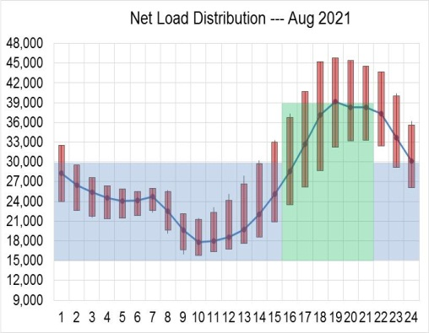
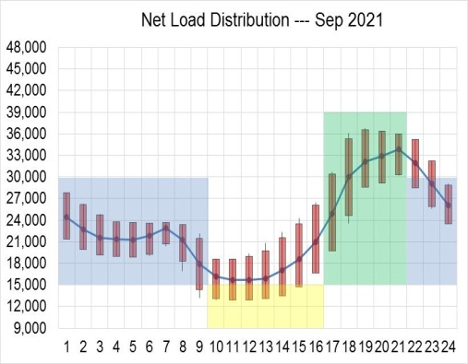
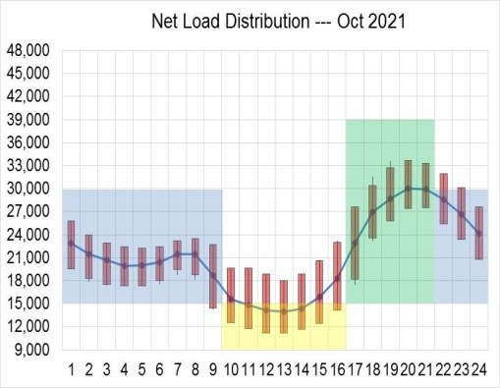
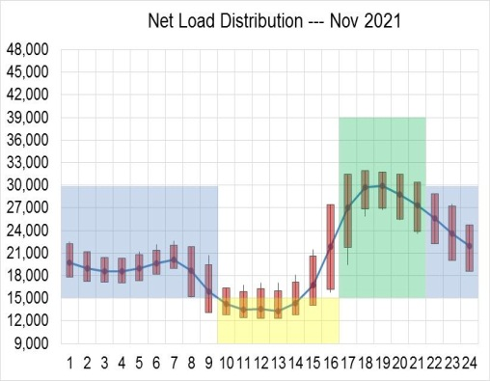
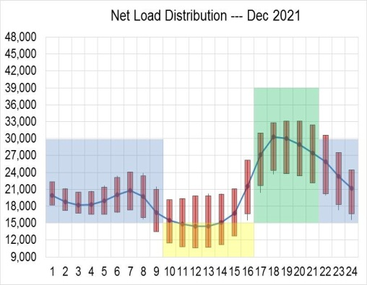
2021 Monthly Net Load Distribution --- Weekends
Off-Peak
Peak
Super Off-Peak

Slide 7
Proposed TOU Time Periods
Day-type | Months | Super Off-Peak | Off-Peak | Peak | Super Peak
Weekdays | Jan, Feb, May, Jun, Sep, Oct, Nov, Dec |  | Midnight – 4 PM 9 PM - Midnight | 4 PM – 9 PM
 | Mar & Apr | 10 AM – 4 PM | Midnight – 10 AM 9 PM - Midnight | 4 PM – 9 PM
 | Jul & Aug |  | Midnight – Noon 9 PM - Midnight | Noon – 4 PM | 4 PM – 9 PM
Weekends & Federal Holidays | Jan - Jun & Sep - Dec | 10 AM – 4 PM | Midnight – 10 AM 9 PM - Midnight | 4 PM – 9 PM
 | Jul & Aug |  | Midnight – 4 PM 9 PM - Midnight | 4 PM – 9 PM

Slide 8
Proposed Weekday and Weekend TOU Periods

Slide 9
Response to San Diego Gas & Electric Company comments in response to the ALJ’s ruling
Data on System Needs
  1-minute load, wind and solar data from the 2024 LTPP study were scaled back to calculate 2021 net load monthly profiles
  Behind-the meter demand response, electric vehicles or storage were not used in the analysis
  The solar data profiles were created by technology type (i.e. solar thermal, solar PV and distributed PV)
The solar and wind data used were in the LSEs’ portfolios, including out-of-state solar and firmed-and-shaped out-of-state wind
The analysis did not factor in out-of-state imports or exports….the analysis focused on the actual 2013 and 2014 ISO's load less the VERS production for 2013 and 2014 and expected net-load for 2021
The ISO analysis was based on 24-hour period of each day of each month (i.e. 8,760 hourly analysis, not only on over-generation or ramping needs)

Slide 10
Response to San Diego Gas & Electric Company comments in response to the ALJ’s ruling
Information on TOU Period Construction
The primary objective of the TOU periods was to develop minimal but meaningful TOU periods that reflect a shift from peak load to net load
The ISO used a net-load of 15,000 MW as a criteria to develop the super off-peak period
The super peak period was based on the hours the maximum net-load is likely to occur on average across an entire month
The super off-peak period was based on the projected hours over-generation is most likely to occur
The super off-peak period is contiguous to the peak period because the peak demand on the system is expected to occur just after the super off-peak period

Slide 11
Response to San Diego Gas & Electric Company comments in response to the ALJ’s Ruling
Information on IOU Differences
The ISO compared the monthly net load peaks during weekdays and weekends using historical data for 2013 and 2014 in addition to the expected monthly net load demand in 2021
The ISO did not look at hydro or nuclear generation in its analysis but instead focused on the expected impact of high levels of VERs production on the ISO’s net load in the 2021 timeframe
Although the peak load among IOUs could occur on different days or in different months, the ISO’s analysis focused on the overall ISO’s average hourly net load for each month broken out by weekdays and weekends because it is designed to reflect system needs, not individual IOU needs
The ISO did not focus on IOU DLAP prices in its analysis

Slide 12
Response to TURN comments in response to the ALJ’s Ruling
TURN identified two key areas it deems were omitted from the ISO’s analysis
Consideration of ongoing market modifications and the potential for an expanded regional Balancing Authority
  The ISO is continuing its efforts on market modifications and undergoing technical analysis on expanding the energy imbalance market (EIM).
  EIM will help mitigate some level of renewable curtailment. However, integrating higher levels of VERs into the existing resource mix requires multiple solutions including aligning TOU time-periods with the ISO’s operational needs.
CAISO analysis fails to provide any information about the greenhouse gas emissions intensity associated with the proposed TOU periods
  The proposed TOU time periods are aligned with the expected ISO operational needs. It did not focus on GHG reductions.

Slide 13
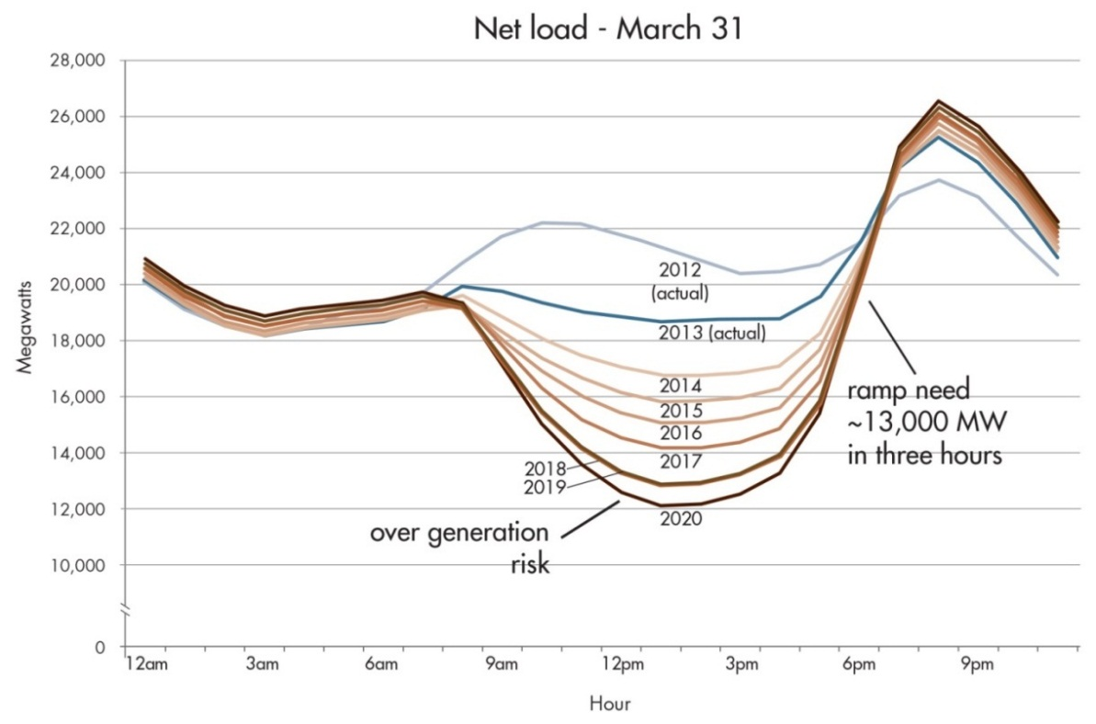
The proposed TOU periods are not expected to change under 33% RPS because additional VERS are primarily comprised of solar resources
Other factors that could accelerate the need for TOU time-periods
Rooftop Solar PV (ISO’s initial analysis assumed less than 5,000 MW, however the current estimate is in excess of 10,000 MW by 2021
Hydro conditions
Amount of based loaded and non-dispatchable generation
Dedicated imports such as LSEs’ contracted external VERs & jointly owned resources
The ISO’s ability to comply with all real-time control performance standards
VERs not being able to provide operational characteristics such as voltage support, frequency control and flexibility
  Need to mitigate steep intra-hour net demand ramps and multi-hour net demand ramps
Actual 3-hour ramp
10,892 MW on 2/1/2016
Net Load 13,003 MW on 2/21/2016

Slide 14
Actual 5-minute energy prices vs. net load for 2/21/2016
5-minute energy prices were less than zero for 31% of the day
Economically curtailed renewables from HE9 through HE17 (Max: 1,350 MW; total 2,701 MWh)

Slide 15
What we have learned...
TOU rate structures will be more complex in the future
  Properly designed rates could help manage RPS impacts; Poorly designed rates could exacerbate system conditions
The summer net-load coincident peak occurs later in the day
Over-generation will spur more frequent negative energy prices as more variable resources come on-line
  Negative real-time energy prices are occurring and are becoming more probable in the middle of the day, especially on weekends and holidays

Slide 16

Questions!

