Slide 1

TOU OIR Workshop
(R.15-12-012)
February 26, 2016

Slide 2
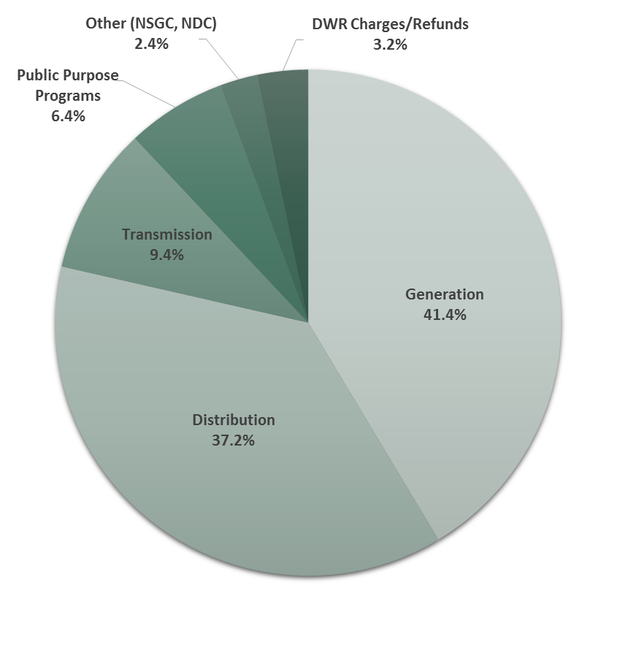
Cost Components of Utility Rate
  In general, about half of retail revenues fund variable cost generation-related activities.
  The remaining revenues fund more fixed non-generation services such as distribution and transmission system development and reliability, energy efficiency, demand response, and low income assistance programs.
  Non-generation costs are generally “fixed” in their nature.
    SCE intends to study the potential time-dependency of certain distribution marginal costs in its 2016 Rate Design Window Application
* Values reflect January 2016 Bundled System Average Rate Levels

Slide 3
Why Costs Matter
Understanding the relationship between load levels and corresponding marginal costs is important when determining Time of Use periods (See attached graph)
Historically, customer demand has been the primary driver of the “shape” and “peak” of the Utility’s “Typical or Gross” load curve
“Duck,” or Net Load, Curve: Due to the constraints of modelling intermittent supply from renewable resources, the CAISO has chosen to model renewable supply as an overlay on the utility’s “Typical or Gross” load curve
The passing of Senate Bill (SB) 350 and implementation of the 50% RPS requirement by 2030 requires that we look beyond 2020

Slide 4
Time Dependent Marginal Cost (MC) Overview
Marginal Costs
  Commission has used marginal costs to establish electric utility rates since the early 1980s
  Embedded costs are the basis of annual revenue recovery for IOU’s in California
Current scope of Functionalized Marginal Costs
  Time Dependent based on Time of Use (TOU) periods
    Marginal Generation Capacity Costs (MCC)
    Marginal Energy Costs (MEC)
  Non-Time Dependent Marginal Costs
    Marginal Distribution costs (EDF in concert with NCP)
    Marginal Customer Cost (MCC)
    Transmission costs addressed at FERC level on embedded cost basis
  NCP – Non coincident peak (kW) of a customer
  EDF – Effective Demand Factor - Ratio of customer demand (kW) at the time of circuit peak to the annual NCP

Slide 5
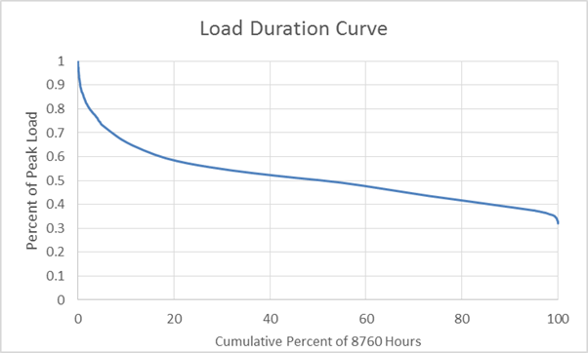
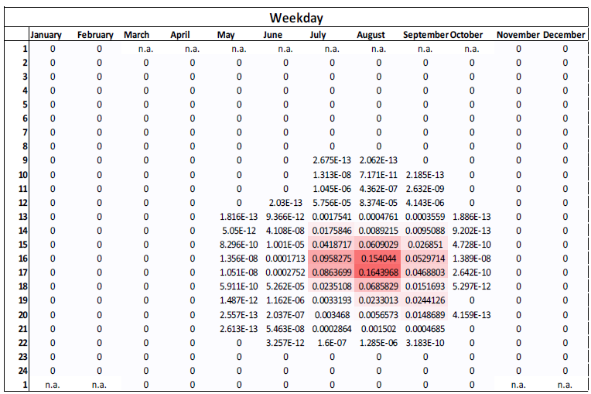
Why Costs Matter – Marginal Generation Capacity Costs (MCC)
Methods
  Least Cost of Capacity or Peaker – Annualized costs based on the least cost capacity option (typically a Peaker) net of energy rents – (Most prevalent method used by the IOUs)
  Differential Revenue Requirements – Present value of the difference in generation costs, with and without a load increment
  Linear programing model – A minimum cost model to meet demand given established constraints on the system
Valuation – Long run Combustion Turbine (CT) Proxy
  The “Duck” curve effects on ramp and peak capacity needs will affect the choice of the marginal resource (e.g., Frame 7 vs. aeroderivative vs. combined cycle), which in turn affects MCC
Allocation - MCCs and Time of Use Periods
  MCCs are allocated to time periods based on relative Loss of Load Expectation (LOLE) - the relative probability of an outage in an hour given an event (see attached graph)
  Capacity need is dependent on the shape and convexity of the load duration curve. The more convex the curve, the more concentrated the allocation of capacity need in those hours.
  MCCs are the biggest drivers of retail TOU price differentials
E3 Heat Map from DR Cost Effectiveness Workshop TBD

Slide 6
Why Costs Matter – Marginal Energy Costs (MEC)
Methods
  Least Cost Models – A simulation of plant dispatch and inter-pool exchanges to meet hourly demands
  Statistical methods – These methods relate market prices to observed factors, which can include both demand side and supply side variables
Valuation – Day Ahead Price forecast
  MECs are based on, or modeled to be similar to, the CAISO day ahead (DA) prices. They also include an energy premium for RPS costs
  MECs are established using a fundamental model that forecasts wholesale energy prices based on a supply and demand characteristics affected by the following constraints:
    Variable Costs such as Fuel and O&M
    Renewable energy is must-take and is not dispatchable
    Operational constraints
Allocation - MECs and Time of Use Periods
  MECs represent the closest proxy to wholesale energy prices that are paid by retail customers
  They are allocated based on the forecast of expected load by hour (kWh)
Concentration of Energy Costs
Concentration of Energy + Capacity Costs
Blue represents periods of lowest costs; red represents periods of highest costs

