Slide 1
TOU Periods Analysis Workshop
February 26, 2016

Slide 2
The Goal of TOU Rate Design is Two-Fold
Goal 1) Design Rates that are Just and Reasonable
Recover costs in proportion to how they are incurred
Goal 2) Incentivize a Helpful Behavioral Response
Send an actionable price signal that advances affordability, reliability, and GHG reduction
The emphasis in this proceeding is on Goal #2.

Slide 3
Key Question of the Proceeding
“what data, assumptions, and analytical methods should be used to determine the ‘target’ time periods during which it would be helpful to the California power grid for customers to modify their level of energy use.”
p.21-22 of the Draft OIR
Many parties have commented that net load analysis alone is insufficient for determining the periods where it is helpful for customers to modify usage.

Slide 4
CAISO’s Net Load Analysis Is Insufficient
May Not Fully Capture Generation Costs
Does not Consider Non-Generation Costs of Delivery
Does Not Account for Enhanced Regional Coordination

Slide 5
Additional Factors to Consider
Generation Capacity
Ramping Requirements
Distribution Peaks
Enhanced Regional Coordination

Slide 6
Additional Factors: Generation Capacity
Reducing load in the hours of greatest LOLE reduces the need for new generation capacity
Relative LOLE For SDG&E by Hour of Day During Summer – from GRC Phase 2

Slide 7
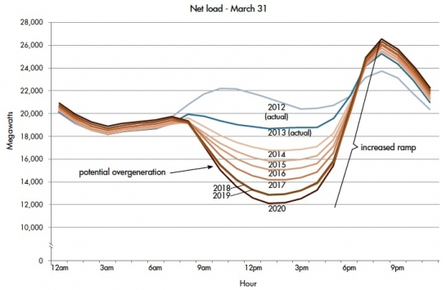
Additional Factors: Ramping Requirements
Up-ramps are more challenging to manage than down-ramps.
Reducing load in the hours of greatest ramping shortages reduces the need for flexible generation capacity.

Slide 8
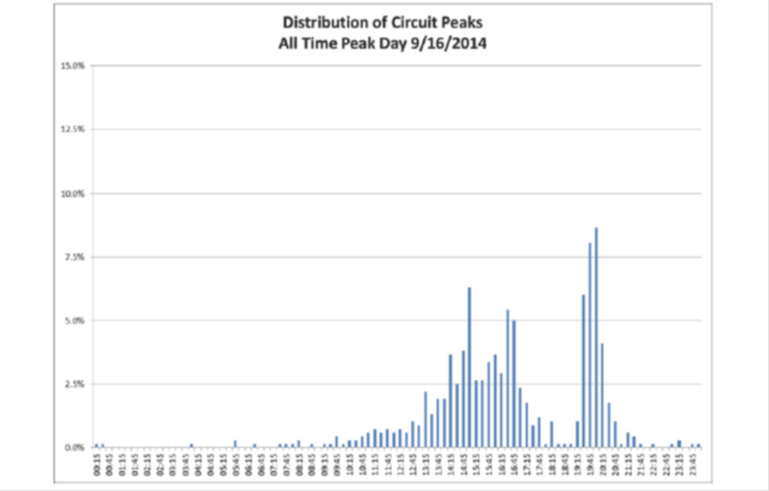
Additional Factors: Distribution Capacity
To the extent distribution peaks can be reduced, cost savings can be achieved through less investment in new infrastructure.
Given the diversity across circuits and substations, data on the timing of distribution peaks and costs of upgrades at the circuit level will allow parties to identify time periods when these costs can be reduced.

Slide 9
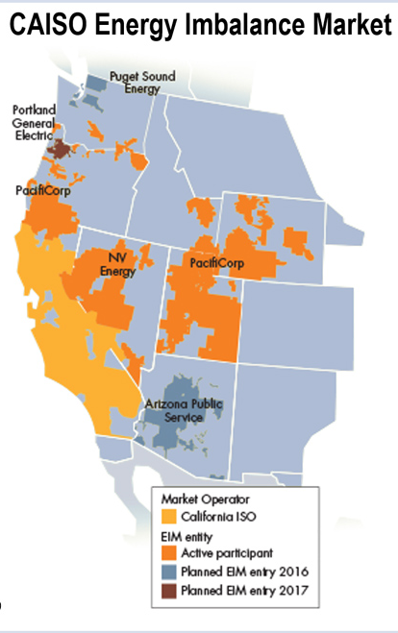
Additional Factors: Regional Coordination
EIM can help absorb excess supply.
Flexible resources outside of CA can help address ramping shortages.
Modeled system costs should take these capabilities into account.

