Slide 1
Future Proofing the EVSE: Enabling Secure Communications between the Grid and the EV
Proposal from VGI working group members Josh McDonald, George Bellino, Mike Bourton, Abigail Tinker, Lance Atkins, Rich Scholer, Dave McCready, Bill Boyce, Ralph Troute, Dean Taylor, Jim Tarchinski, Jordan Smith, Jeremy Whaling
Oct 18, 2017

Slide 2
Background
September 2016
Spring 2017
Present
ACR ruled that IOU electric vehicle infrastructure procurement applications must require support for ISO 15118 as an EVSE to EV communications protocol or justify why they wouldn’t require support
After much discussion due to divergent stakeholder viewpoints, the CPUC along with four other CA agencies created the VGI Working Group to evaluate communications protocols and recommend if none, one, or many should be required for IOU’s SB 350 TE behind-the-meter programs and investments
The VGI Working Group is assessing VGI requirements, EVSE-to-EV protocols that could enable those requirements (Deliverable 1), and the costs/benefits of adopting each potential protocol (Deliverable 2)* to enable end-to-end (grid to EV and back) solutions
*http://cpuc.ca.gov/vgi/

Slide 3
Proposal: Evaluate an Additional Option in Deliverable 2 on its Merits
Future-Proof
EV Infrastructure
Evaluate an EVSE capability that allows secure communications and the flexibility to allow VGI applications to develop, mature and expand
1
All non-level 1 AC EVSEs* deployed in IOU BTM programs must be capable of communicating VGI data back and forth between the EV and the grid (PFE/BMS) through an EVSE,** without having to translate applications
2
Does not exclude the use of alternative application protocols and paths of communications from the PFE/BMS to the EVSE or EV (e.g. telematics, EVSE control and management, EVSE metering, etc.)
Solution Also Allows for:
-Any “upper layer” application protocols for VGI communications
-Any physical media* (e.g. WiFi or cellular) to be used
*DC EVSEs may be the end point or may support this proposed function proposed here
**See appendix for details on protocol layers description of upper layers and physical media.

Slide 4
Concerns Regarding Selecting a VGI Communication Application Protocol
Sufficient empirical evidence does not exist today that supports the benefits of one VGI communication application protocol over another for EV adoption, customer ease of use, customer choice, market transformation, etc.
Most EVs do not currently support any high-level VGI communications for AC charging
Actual costs for stakeholder deployment of any application cannot be provided and are thus subjective and debatable
Well-known near-term grid applications and functionality (e.g., load management, cybersecurity, integration of distributed energy resources) must be supported by VGI communication applications. HOWEVER different applications and functionality will emerge and need to be deployed
Any VGI communication application mandate will not align with all stakeholders interests
Different market segments have different needs regarding VGI communications technologies and functionality
Communications from the building management system (BMS) or power flow entity (PFE)* supports Internet Protocol (IP) based communications which allows for VGI communication applications to be routed from remote sources to a destination and bridged between different physical media (Internet, Cellular, Wi-Fi, Ethernet, etc.)
*A PFE is an off-site entity or entities that is requesting or mandating VGI activities from other actors downstream. The PFE is broad term than may include the Aggregator, Utility, Site Host, EV Service Provider, Energy Service Company, Alternative Energy Supplier, Energy Portal, or Clearing House

Slide 5
Benefits of Future-Proofing EVSE Proposal
Enables Customer Choice
Allows the use of any VGI internet-based application if supported by PFE/BMS and the EV
Allows for alternative communication paths if EVSE bridging/routing not available or preferred (e.g. telematics).
Reduces vendor lock-in by standardizing the EVSE and allows users to swap service providers easily
Provides Flexibility
Allows for different VGI communication applications to be used for different deployment scenarios.
Does not predict what will be supported in the future (e.g., what occurred with ZigBee in smart meters)
Creates a fair & open ecosystem that allow many applications to flourish over time – like apps on a cell phone
Allows for upgrading of legacy EVSEs by adding interface cards supporting bridging/routing
Enables other communication pathways to the EV beyond PLC
Low-Cost Solution
Minimizes stranded asset risks by not requiring EVSE-centric VGI communication applications
Minimizes EVSE software deployment, support and upgrade costs
Removes cost and complexity of maintaining multiple VGI communication applications on the EVSE and their mapping to each other when either receives an update*
SECURE
Minimizes cyber security vulnerabilities by forwarding VGI communications between PFE/BMS and EV rather than de-encrypting and re-encrypting at the EVSE security
Does not require permission from an in-between point for VGI communications between grid and EV
*Because 2 different communication protocols are not needed to go end-to-end. Avoiding this mapping and update complexity eventually becomes. A significant burden when there are many different service providers that are required to update hundreds of thousands of EVSEs. See appendix for pictorial representation

Slide 6
Future Proofing the EVSE Reduces Complexity and Cost
The use of a single end to end application protocol that uses this EVSE capability allows for:
Less entities/costs required for updating application and gateway when revisions occur
A single certification process
A clear understanding (semantics) of what requests/data are intended to convey as the same application functionality/syntax is supported
Allows for simple firmware updates to bridge/router (can be done by user or locally)
The use of two VGI communication application protocols to go end-to-end:
Requires a third entity/costs that must maintain and update both VGI communication applications when revisions occur
Requires a gateway to translate between VGI applications
Must have agreement (mapping) of what one VGI applications request/data means for the other (semantics) and what parameters (syntax) is used
Must be updated whenever one of the VGI applications is updated
Functionality is not limited by one or the other VGI application
Must be standardized/certified globally

Slide 7
Cybersecurity Benefits Of the Future Proofing Proposal
End to End VGI communications allows application data to be encrypted between source and destination (e.g., PFE to EV) ensuring privacy and confidentiality
Only source and destination hold keys and able to unencrypt, utilize data
Personally Identifiable Information (PII) or data that can be used to calculate PII only held at source and destination, encrypted in transit
Authentication (you are who you say you are) and Authorization (you have permission to charge) occurs at the BMS/PFE
The EVSE does not say you are allowed to charge
As an analogy, a Home Access Point does not say you are allowed to use Facebook
When 2 separate VGI communication applications are used in series to go end-to-end, the EVSE must unencrypt data in order to map it to the other application via translation software
Separate keys maintained in EVSE/Home Access Point
Susceptible to man in the middle attacks- Interloper pretends to be source or destination
Can modify controls or other requests which may impact drivers, site hosts or grid or intercept PII or send malicious code

Slide 8
Technical Back-up Material

Slide 9
CPUC Mandate Proposal Suggestion
Should the Future Proofed EVSE proposal be approved, we propose that:
The CPUC requires that all non-level 1 AC EVSEs deployed in the IOU infrastructure programs be capable of routing/bridging external IP-based communications through the EVSE to the EV using Home Plug GreenPhy over the J1772 pilot.
And
The IOUs must coalesce on a single set of common requirements for bridging/routing
And
Other communications/applications may be used on the EVSE as deemed necessary per deployment.

Slide 10
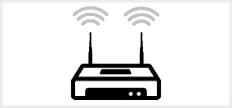
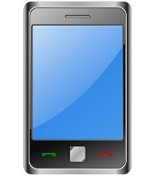
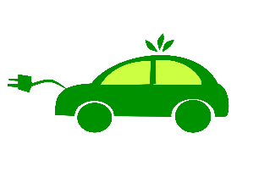
Future Proof EVSE Communications Analogy- EVSE and Home Access Point/Router
Server (e.g., PFE/BMS or App server) and end node (e.g., EV or Smart Phone) both support the application protocol (e.g., VGI App1 or Facebook in the picture)
EVSE/Home Access Point only looks at lower ‘Media’ layer information (e.g., source & destination addresses) to pass on the application data but cannot look at the application data (AppX and Facebook data passed through EVSE/Home Access Point)
Could add other apps to EV/Smart Phone if other functionalities are desired (e.g., Twitter, VGI App2, etc.)
Could remove EVSE as sole communication path
PFE/BMS Server with
VGI App1 Server
Demand Response Example:
App Server with
Facebook App Server
e.g., Internet
e.g., Internet
Equates to
=
App1 Data Example:
-LoadShed 10;
-Start 8;
-Duration 60;
//Understood by client & server
Facebook Data understood by client/server
Home Access Point (Physical Bridge/Router)
EVSE Bridge
e.g., Wi-Fi
e.g., Home Plug Green Phy
(over J1772 Pilot Wire)
Smart Phone
With Facebook
App
EV with VGI App1

Slide 11
When two different application protocols are used
EVSE/Home Access Point still bridges/routes data but must support both applications plus a translation software (aka Application Gateway)
How data is translated must be agreed to by Server and Client and be implemented the same way across all EVSE/Home Access Point vendors. This should require Standards Development Organization's development and maintenance, Testing, Certification (Who? Time?)
Both apps and translation software must be maintained by all EVSE/Home Access Point Vendors, especially when either application is updated breaking the existing translation. Requires above Standards Development Organization mapping update, Testing and maybe certification
PFE/BMS Server with
VGI App1 Server
Demand Response Example with translation:
App1 Data Sent:
LoadShed 10;
Start 8;
Duration 60;
App Server with
Twitter App Server
e.g., Internet
Equates to
=
e.g., Internet
EVSE Gateway (VGI App1 Client and VGI App2 and translation software)
EVSE gateway software converts App1 Data to App 2 Data:
LoadShed 10==CurtailPower 10;
Start 8 == Begin 480;
Duration 60 == Stop 540;*
Home Access Point (Physical Bridge/Router and has Facebook App and Twitter App and translation software)
e.g., Wi-Fi
e.g., Home Plug Green Phy
(over J1772 Pilot Wire)
*What if there is not a clear mapping because of lack of functionality (e.g., one app does not have support for load shed), or one app changes, or there are different apps used for different deployments, or data is encrypted?
App2 Data Received:
CurtailPower 10;
Begin 480;
Stop 540;
Smart Phone
With Facebook
App
EV with VGI App2
11

Slide 12
Primer on the OSI model
Open Systems Interconnection (OSI) Model describes communications between two computing systems by separating functionality into 7 layers.
Upper ‘Host’ layers deal with application data, authentication, authorization, connection, encryption/decryption
Lower ‘Media’ layers deal with moving upper layer data between networks and from source to destination
Networks operate on one basic principle: "pass it on"
Each layer takes care of a very specific job, and then passes the data onto the next layer

Slide 13
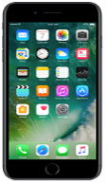
Analogy: How the Internet secures your apps so your transactions are safe
Bank
Banking App
Application Layer
Application Layer
Presentation Layer
Presentation Layer
Session Layer
Session Layer
Transport Layer
Bridge/Router
Transport Layer
Network Layer
Network Layer
Network Layer
Network Layer
Link Layer
Link Layer
Link Layer
Link Layer
Physical Layer
Physical Layer
Physical Layer
Physical Layer
E.g. Ethernet
E.g. WiFi
The information is carried in the Application Layer and is encrypted and the encryption keys are only known by the Server and Client.
Any device (E.g. Public WiFi Hotspot) between the Server and the Client uses the lower layers only to bridge, switch or route the packets.
This architecture complies with NISTIR 7628 Guidelines for Smart Grid Cyber Security

Slide 14
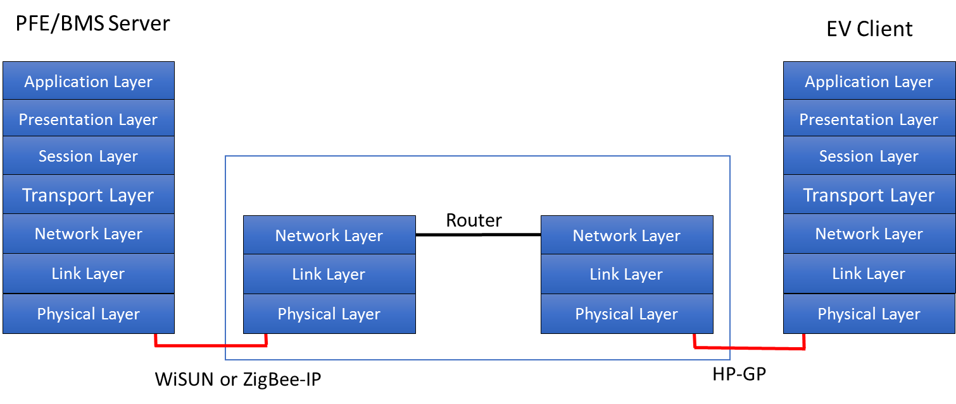
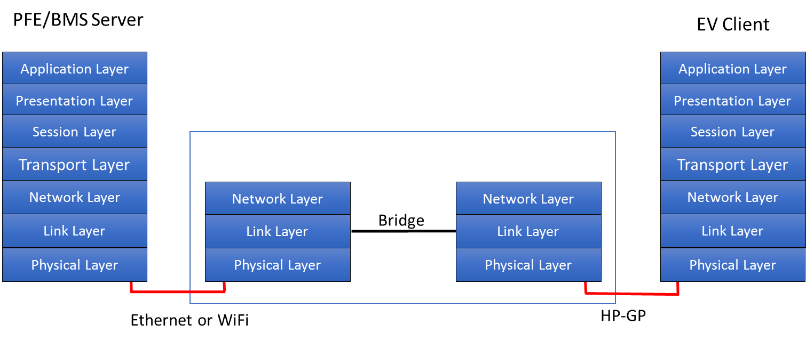
Whether to bridge or route?
Bridging may be used at the Link Layer if the Message Frame are the Same E.g. Ethernet (IEEE 802.11) is used by HomePlug and W-iFi.
Routing may be used when the Message Frames are not similar. E.g. ZigBee-IP to HP-GP.
Both methods will accomplish the same task and may be determined at Implementation
In this Router case, HP-GP is a different frame format at layer 2, WiSUN or ZigBee-IP uses 6LowPAN. At the Layer 3, they are both IP compatible.
In this Bridging case, Ethernet and Wi-Fi and HP-GP use the same frame at Layer 2 (IEEE 802.11) and therefore may be bridged at Layer 2. The packet is simply forwarded.

