Slide 1
Customer Specific Regression Overview
DRMEC Spring 2016 Evaluation and Enrollment Workshop – Session 3
Kelly Marrin, Director, Applied Energy Group

Slide 2
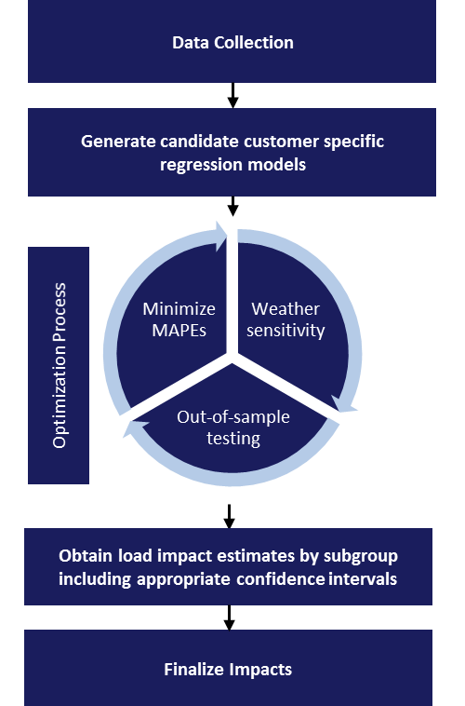
Agenda and Overview
Candidate model development
Optimization process
Obtain subgroup level results

Slide 3
Candidate Models
Building blocks of a customer-specific regression model
Variable Name | Variable Description
 | Baseline Variables
Weather_{i,d} | Weather related variables including average daily temperature, multiple cooling degree hour (CDH) terms with base values of 75, 70, and 65 depending on service territory, and lagged versions of various weather related variables
Month_{i,d} | A series of indicator variables for each month
DayOfWeek_{i,d} | A series of indicator variables for each day of the week
Year_{i,d} | An indicator for the year 2015
OtherEvt_{i,d} | Equals one on event days of other demand response programs in which the customer is enrolled
MornLoad_{i,d} | The average of each day’s load in hours 5 a.m. through 10 a.m.
 |  | Impact Variables
P_{t,d} | An indicator variable for aggregator program event days
P * Weather_{t,d} | An indicator variable for aggregator program event days interacted with weather terms
P * Year_{i,d} | An indicator variable for aggregator program event days interacted with the year 2015
P*NonTypEvent_{i,d} | An indicator variable for aggregator program event days interacted with an indicator for non-typical event windows (outside of HE 16-19)
Combinations of these variables were used to create approximately 35 different candidate models for the CBP and AMP participants
We created weather sensitive and non-weather sensitive models

Slide 4
Optimization Process
Selecting the “best” model for each customer
Identify event-like days to be used in the out-of-sample test
Remove out-of-sample days and fit all candidate models to the remaining data for each customer
Use the model results to predict (forecast) usage on the out-of-sample days and calculate the MAPE and MPE
Also calculate the MAPE and MPE on actual event days (in-sample days)
Select the candidate model for each customer with the minimum MAPE and MPE across both the out-of-sample and in-sample days
Goals:
(1) Accurately predict the actual participant load on event days, and, (2) Accurately predict the reference load in absence of an event.
Solution:
Typical forecasting approach minimizing MAPE and MPE with in- and out-of-sample testing

Slide 5
Ex Post and Ex Ante Results
Customer specific regression model aggregation
  Once the best model has been selected for each customer, we estimate the reference load and impact at the customer level as follows:
    Obtain the actual and predicted load on each hour and day
    Use the coefficients and the baseline portion of the model to predict each customer’s reference load
    Calculate the impact as the difference between the reference load (the estimate based on the baseline variables) and the predicted load (the estimate based on the baseline + impacts variables) on each event day.
  We estimate the aggregate impacts by summing individual impacts to any subgroup level including:
    LCA, Industry Type, Size category, Aggregator, or any other subgroup required by the utility
  Ex ante results leverage the same models, but use weather scenarios and enrollment forecasts as inputs rather than actual weather and enrollment

Slide 6
Load Impact Evaluation of
Aggregator Demand Response Programs
DRMEC Spring 2016 Evaluation and Enrollment Workshop – Session 3
Kelly Marrin, Analysis Director

Slide 7
Agenda
  Program Descriptions
  Ex Post Methodology
  Ex Post Impacts
  Ex Ante Methodology
  Enrollment Forecast
  Ex Ante Impacts
  Ex Post and Ex-Ante Comparison
  Key Findings

Slide 8
Program Description
Capacity Bidding Program (CBP)
  IOUs: PG&E, SCE, and SDG&E
  Program Basics:
    Statewide aggregator-managed DR program
    Operates May-Oct for PG&E and SDG&E and year-round for SCE
    Participants must meet eligibility requirements
    Participants receive monthly capacity payments based on nominated load + energy payments based on kWh reductions during events
    Capacity payment may be adjusted based on performance
    Participants receive monthly the capacity payment according to their nomination if no events called
    Dual enrollment in energy-only DR program with a different notification type is allowed
  Events:
    Triggered by IOU or CAISO market award
    Day-ahead (DA) and day-of (DO) notice options
    Event durations of 1-4 and 2-6 hours in 2015 and forecast
    Up to 30 event hours/month SCE and PG&E; 44 hours/month for SDG&E
    11 a.m. to 7 p.m. non-holiday weekdays

Slide 9
Program Description
Aggregator Managed Portfolio(AMP)
  IOUs: PG&E and SCE
  Program Basics:
    3rd party aggregators contract with IOUs
    Aggregators create own DR programs and contract with customers
    Operates May-Oct for PG&E and varies for SCE
    Customers must meet eligibility requirements
    PG&E: system and local products; local allows dispatch by Sub-LAP
    SCE: system and local dispatch pre-integration; dispatch by Sub-LAP post-integration
    Penalties for not delivering committed load reduction
    Customers may dually enroll in other DR programs (CPP, PDP, DBP, OBMC)
  Events:
    Triggered by IOU or CAISO market award
    Only DO notification contracts in 2015 and forecast
    Up to 80 event hours/year for PG&E; varies for SCE
    11 a.m. to 7 p.m. non-holiday weekdays for PG&E; varies for SCE

Slide 10
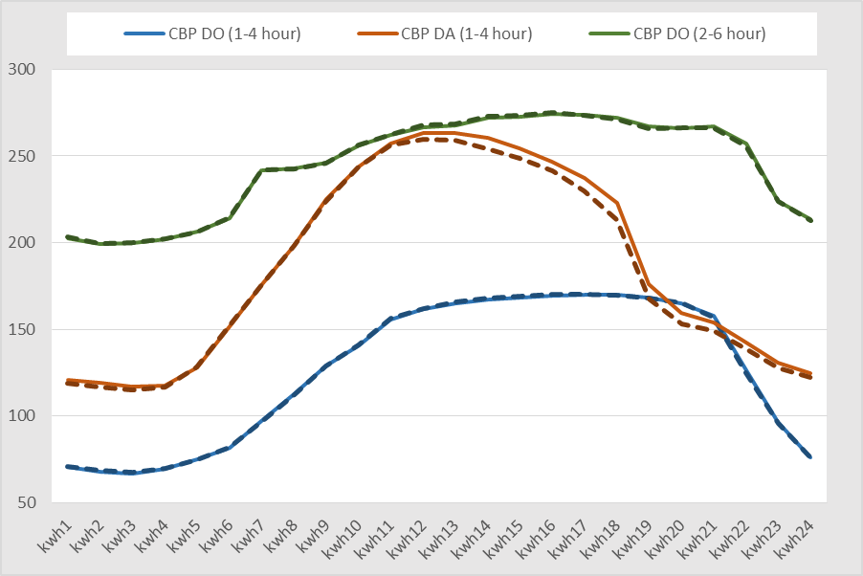
Ex Post Impacts
Methodology
  Customer-specific regression models
  Optimize the models for each customer through a process which includes the minimization of in-sample and out-of-sample MAPE and MPE
Example: SDG&E Actual & Predicted Loads on Event-Like Days

Slide 11
Ex Post Impacts
Program Dispatch and Event Summary
Represents a significant increase in hours called and number of events relative to 2014 (2014 events ranged from 7 – 15)
PG&E and SDG&E typical event hours are HE 16 - 19
SCE events ranged from 1 to 6 hours and HE 14-19
About half of SCE CBP events were called during the winter months
 |  | Day-Ahead |  |  | Day-Of
Program | IOU | Number of events | Hours of Availability | Actual Hours of Use | Number of events | Hours of Availability | Actual Hours of Use
CBP | PG&E | 16 | 150 | 72 | 18 | 150 | 63
 | SCE | 61 | 150 | 126 | 42 | 150 | 138
 | SDG&E | 42 | 220 | 168 | 24 | 220 | 96
AMP | PG&E | not applicable |  |  | 18 | 80 | 75
 | SCE | not applicable |  |  | 10 | 80 | 23

Slide 12
Ex Post Impacts
Average Event Hour
Overall, impacts generally fell short of nominated capacity (with the exception of SDG&E DA)
DO products have at least 2X more participants than the DA products
DO impacts are generally, but not always, higher than DA impacts
PG&E AMP has the highest impact with 97 MW and 1,417 participants
 |  | Day-Ahead |  |  | Day-Of
Program | IOU | Aggregate Impact (MW) | Nominated Capacity (MW) | Event Temp (˚F) | Aggregate Impact (MW) | Nominated Capacity (MW) | Event Temp (˚F)
CBP | PG&E | 15.9 | 23.7 | 90 | 20.0 | 23.9 | 90
 | SCE | 1.0 | 2.2 | 85 | 16.4 | 25.7 | 87
 | SDG&E | 7.8 | 7.6 | 80 | 5.7 | 6.8 | 82
AMP | PG&E | not applicable |  |  | 96.9 | 120.4 | 93
 | SCE | not applicable |  |  | Confidential
Results are average event-hour impacts for average summer (May-Oct) event day in 2015. Average event hours are HE 16 – 19 for all but SCE AMP, which is HE 14 – 15.

Slide 13
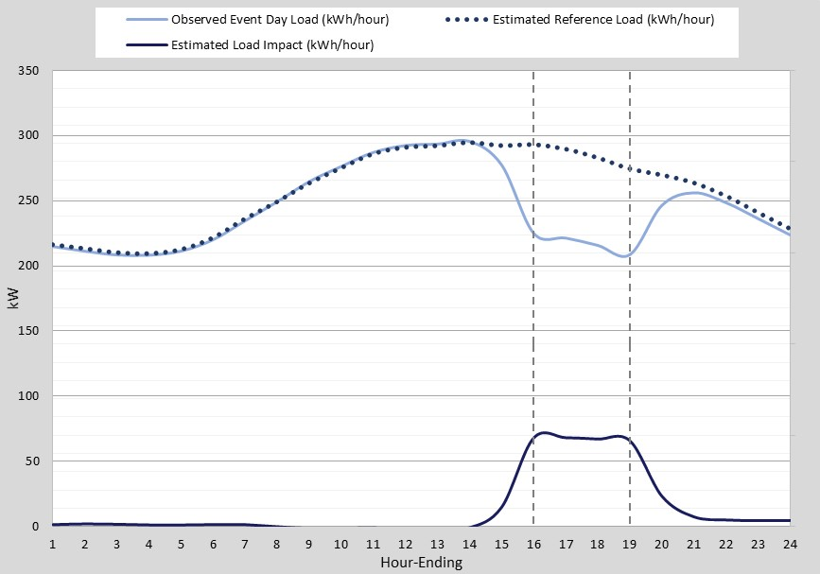
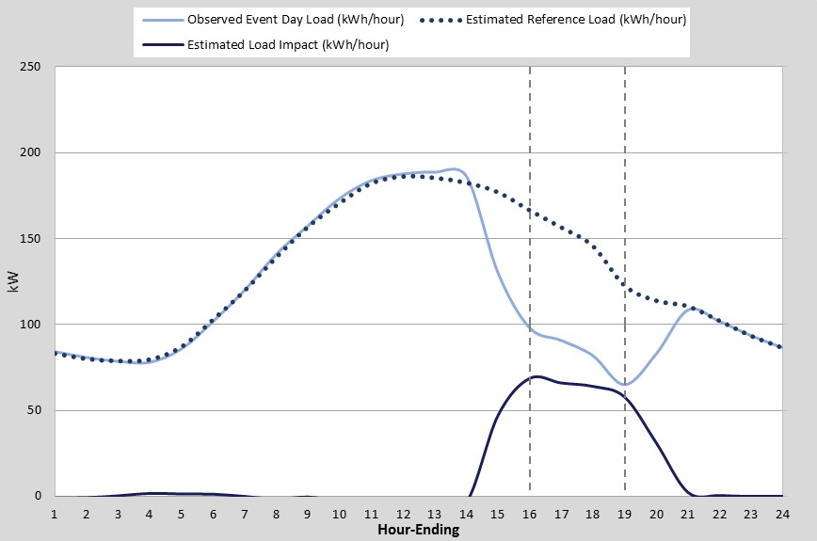
Ex Post Impacts
Example Load Profiles and Impacts
SDG&E CBP DA 1-4 Hours: Average Hourly Per-Customer Impact, Average Event Day
PG&E AMP DO: Average Hourly Per-Customer Impact, Average Event Day

Slide 14
Ex Post Impacts
Utility System Peak Hour
Program | IOU | Day-Ahead |  | Day-Of
 |  | Aggregate Impact (MW) | Event Temp (˚F) | Aggregate Impact (MW) | Event Temp (˚F)
CBP | PG&E | 13.4 | 94 | Confidential
 | SCE | no event called |  | Confidential
 | SDG&E | 7.9 | 96 | 6.9 | 93
AMP | PG&E | not applicable |  | 95.9 | 97
 | SCE | not applicable |  | Confidential
Results are for the 2015 utility system peak hour.
Weather across all three utilities is similar
PG&E’s AMP program has the highest impact at 96 MW
PG&E’s Peak: 6/30/2015 (HE 18); SCE’s Peak: 9/8/2015 (HE 17); SDG&E’s Peak: 9/9/2015 (HE 16)

Slide 15
Ex Post Impacts
Statewide System Peak Hour
 |  |  | Day-Ahead |  | Day-Of
Program | IOU |  | Aggregate Impact (MW) | Event Temp (˚F) | Aggregate Impact (MW) | Event Temp (˚F)
CBP | PG&E |  | 21.8 | 94 | 17.6 | 94
 | SCE |  | Confidential |  | 28.1 | 92
 | SDG&E |  | 7.3 | 93 | 6.9 | 92
AMP | PG&E |  | not applicable |  | 84.3 | 97
 | SCE |  | not applicable |  | Confidential
Results are for the 2015 statewide system peak hour.
Impacts range from 7 MW to 84 MW
PG&E’s AMP program has the highest impact at 84 MW
CAISO Peak 9/10/2015 (HE 17)

Slide 16
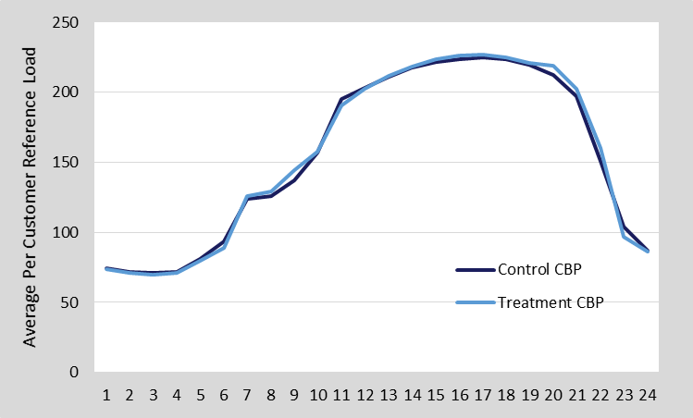
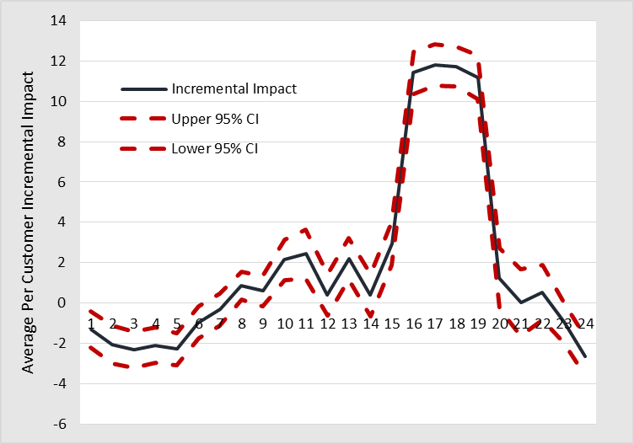
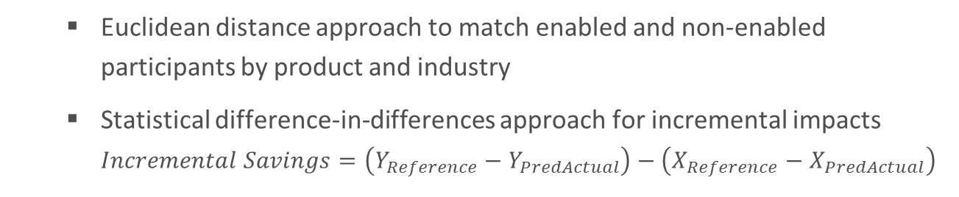
Incremental Impacts of TA/TI & Auto DR
Methodology
  Euclidean distance approach to match enabled and non-enabled participants by product and industry
  Statistical difference-in-differences approach for incremental impacts $Incremental Savings=\left(Y_{Reference}−Y_{PredActual}\right)−\left(X_{Reference}−X_{PredActual}\right)$
PG&E CBP Match – Reference Loads on an Event Day
PG&E CBP Impacts – Difference in Differences

Slide 17
Incremental Impacts of TA/TI & AutoDR
Ex post Incremental Impacts – Average Summer Event
On average, enabling technology allowed for an incremental ~25% (3.4MW) impact over similar non-enabled customers
Some caveats. . .
Impacts were not significant across all products at the product level
PG&E AMP control group was less well matched than the others, and showed positive impacts across all hours (including event hours)
Program | Product | IOU | Number of Enabled Customers | Incremental Impact |  | Significant
 |  |  |  | Per-Customer (kW) | Aggregate (MW)
CBP | All DA & DO | PG&E | 125 | 11.5 | 1.4 | Yes
 | DO 1-4 hour | SCE | 72 | 9.8 | 0.7 | Yes
 | All DA & DO | SDG&E | 97 | 6.2 | 0.6 | Yes
AMP* | All DO | PG&E | 68 | 10.2 | 0.7 | Yes
*Not enough SCE AMP events with similar durations to estimate statistically significant impacts.
Actual Ex Post impacts achieved by AutoDR and TA/TI participants were generally lower than the total kW load shed test results (SDG&E’s impacts were slightly higher)

Slide 18
Ex Ante Impacts
Methodology
  Use the customer-specific regression models from the in ex post analysis
  Predict per-customer weather-adjusted impacts for all subgroups
    Apply Utility and CAISO weather scenarios
    Because Aggregators strategically call on participants with a goal of meeting a specific MW nomination we assume the following:
      Assume no weather sensitivity in the impacts, therefore 1 in 2 is equal to 1 in 10
      Assume consistent response across months in accordance with a single monthly nomination value - applied impacts under July 1-in-2 to each month in forecast
  Use enrollment forecasts from IOUs to forecast aggregate impacts
    Enrollment was derived based on
      Per-customer impacts
      Contractual MW
      Historical performance

Slide 19
Ex Ante Impacts
Enrollment Forecast
 |  |  | Number of Service Accounts
Program | Utility | Notice | Avg. Summer Event 2015 | 2016-2017 (Each Year) | 2018-2026 (Each Year)
CBP | PG&E | DA | 200 | 175 | 175
 |  | DO | 569 | 609 | 609
 | SCE | DA | 55 | 30 | 30
 |  | DO | 670 | 814 | 1,264
 | SDG&E | DA | 122 | 122 | 122
 |  | DO | 223 | 220 | 220
AMP | PG&E | DO | 1,417 | 1,459 | 1,459
 | SCE | DO | Confidential
Drivers
  PG&E and SDG&E’s CBP and AMP enrollment forecasts stay relatively steady and are consistent with current enrollment
  SCE’s CBP and AMP programs are an exception, DO enrollment increases from 670 in 2015 to 1,264 in 2018 – driven by the assumption that AMP will discontinue after 2017

Slide 20
Ex Ante Impacts
Average Event Hour, August 2016/2017
 |  |  |  | Utility Peak 1-in-2
Program | Utility | Notice | Accounts | Per-Customer Impact (kW) | Aggregate Impact (MW)
CBP | PG&E | DA | 175 | 120.9 | 21.2
 |  | DO | 609 | 28.1 | 17.1
 | SCE | DA | 30 | 41.3 | 1.2
 |  | DO | 814 | 37.2 | 30.2
 | SDG&E | DA | 122 | 62.9 | 7.7
 |  | DO | 220 | 20.7 | 4.6
AMP | PG&E | DO | 1,459 | 55.1 | 80.4
 | SCE | DO | Confidential
Results are average event-hour impacts for August peak day in 2016 or 2017.
  As expected, ex ante impacts are similar to the 2015 ex post impacts
  Keep in mind that the aggregate impacts vary from the ex post based on the weather-adjusted per-customer impacts, the enrollment forecast, and embedded assumptions

Slide 21
Ex Ante Impacts
Comparison of current and previous forecast
 |  |  | Current Forecast |  | Previous Forecast
Program | Utility | Notice | Accounts | Aggregate Impact (MW) | Accounts | Aggregate Impact (MW)
CBP | PG&E | DA | 175 | 21.2 | 37 | 5.5
 |  | DO | 609 | 17.1 | 530 | 9.9
 | SCE | DA | 30 | 1.2 | 129 | 5.5
 |  | DO | 814 | 30.2 | 1,162 | 48.8
 | SDG&E | DA | 122 | 7.67 | 159 | 11.9
 |  | DO | 220 | 4.55 | 284 | 10.4
AMP | PG&E | DO | 1,459 | 80.4 | 1,511 | 102.0
 | SCE | DO | Confidential
Results are average event-hour impacts for August peak day in 2016 or 2017. Utility Peak 1-in-2 weather conditions.
  PG&E CBP increase - increased participation and nominated load during 2015
  SCE and SDG&E CBP decrease – decreased participation and nomination expected
  PG&E AMP decrease – aggregators lowered their commitment level for 2016 as part of their participation in the DR auction mechanism (DRAM)

Slide 22
Key Findings
  Ex Post
  Overall, impacts generally fell short of nominated capacity (with the exception of SDG&E CBP DA)
  Integration with the CAISO has resulted in a significant increase in program utilization
  DO products have at least 2X more participants than the DA products, and generally have higher impacts than DA
  Technology enabled customers show higher incremental impacts than their non-enabled counterparts, however, they still fall short of their load shed test results in most cases
  Ex Ante
  PG&E and SDG&E forecast impacts and enrollment that are consistent with 2015 impacts for CBP
  SCE forecasts a significant increase in enrollment and impacts for the CBP program when AMP enrollment drops to zero after 2017
  PG&E forecasts a drop in AMP impacts consistent with the aggregators’ reduction in nominated future MW
  While we see a fluctuation in per customer impacts across years, and across a single season, aggregate impacts are driven largely by nominated MW

Slide 23
Project Contributors
IOU Contributors
AEG Contributors
Gil Wong, PG&E Project Manager
Overall Project Manager
Gxwf@pge.com
Kathryn Smith and Lizzette Garcia-Rodriguez
SDG&E Project Managers
Lgarcia-rodriguez@semprautilities.com
ksmith2@semprautilities.com
Edward Lovelace
SCE Project Manager
Edward.Lovelace@sce.com
Kelly Marrin, Director
Analysis Director
kmarrin@appliedenergygroup.com
Abigail Nguyen, Principal Analyst
Analysis Lead
anguyen@appliedenergygroup.com
Kelly Parmenter, Principal Project Manager
Project Manager
kparmenter@appliedenergygroup.com
Craig Williamson, Managing Director
Overall Project Director
cwilliamson@appliedenergygroup.com

Slide 24
Appendix A
Detailed Ex Ante Slides

Slide 25
Ex Ante Impacts – Average Event Hour, Aug 2016/2017
Impacts Under Utility and CAISO Weather Conditions
 |  |  |  | Utility Peak 1-in-2 |  | CAISO Peak 1-in-2
Program | Utility | Notice | Accounts | Per-Customer Impact (kW) | Aggregate Impact (MW) | Per-Customer Impact (kW) | Aggregate Impact (MW)
CBP | PG&E | DA | 175 | 120.94 | 21.16 | 119.80 | 20.97
 |  | DO | 609 | 28.05 | 17.09 | 27.58 | 16.80
 | SCE | DA | 30 | 41.34 | 1.24 | 41.34 | 1.24
 |  | DO | 814 | 37.15 | 30.24 | 37.15 | 30.24
 | SDG&E | DA | 122 | 62.87 | 7.67 | 62.82 | 7.66
 |  | DO | 220 | 20.69 | 4.55 | 20.66 | 4.54
AMP | PG&E | DO | 1,459 | 55.07 | 80.38 | 55.88 | 81.55
 | SCE | DO | Confidential
Results are average event-hour impacts for August peak day in 2016 or 2017.

Slide 26
Ex Ante Impacts – Current and Previous Forecast for 2016/2017
Includes Comparison of Per-Customer Impacts
 |  |  | Current Forecast |  |  | Previous Forecast
Program | Utility | Notice | Accounts | Per-Customer Impact (kW) | Aggregate Impact (MW) | Accounts | Per-Customer Impact (kW) | Aggregate Impact (MW)
CBP | PG&E | DA | 175 | 120.9 | 21.2 | 37 | 147.4 | 5.5
 |  | DO | 609 | 28.1 | 17.1 | 530 | 18.8 | 9.9
 | SCE | DA | 30 | 41.3 | 1.2 | 129 | 42.6 | 5.5
 |  | DO | 814 | 37.2 | 30.2 | 1,162 | 42.0 | 48.8
 | SDG&E | DA | 122 | 62.87 | 7.67 | 159 | 74.8 | 11.9
 |  | DO | 220 | 20.69 | 4.55 | 284 | 36.6 | 10.4
AMP | PG&E | DO | 1,459 | 55.1 | 80.4 | 1,511 | 84.9 | 102.0
 | SCE | DO | Confidential
Results are average event-hour impacts for August peak day in 2016 or 2017. Utility Peak 1-in-2 weather conditions.

Slide 27
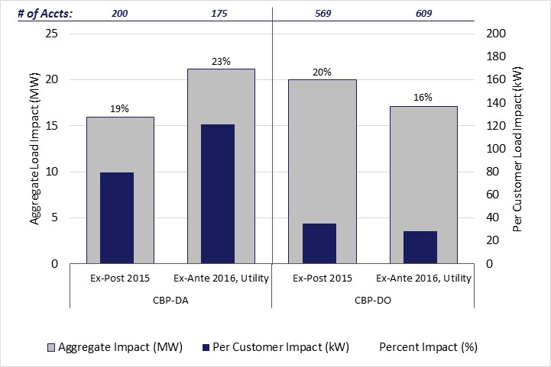
Ex Post and Ex Ante Comparison – PG&E CBP
PG&E CBP: Average Event-Hour Load Impacts, 2015 and 2016/2017

Slide 28
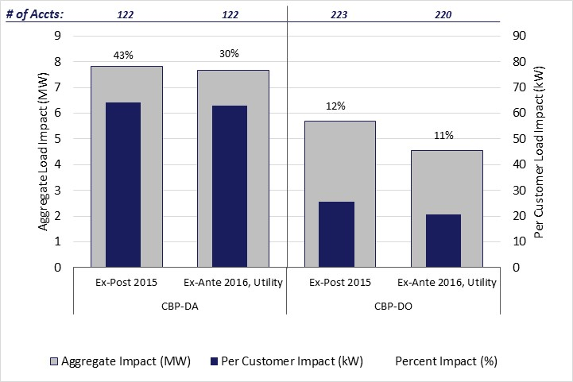
Ex Post and Ex Ante Comparison – SDG&E CBP
SDG&E CBP: Average Event-Hour Load Impacts, 2015 and 2016/2017

Slide 29
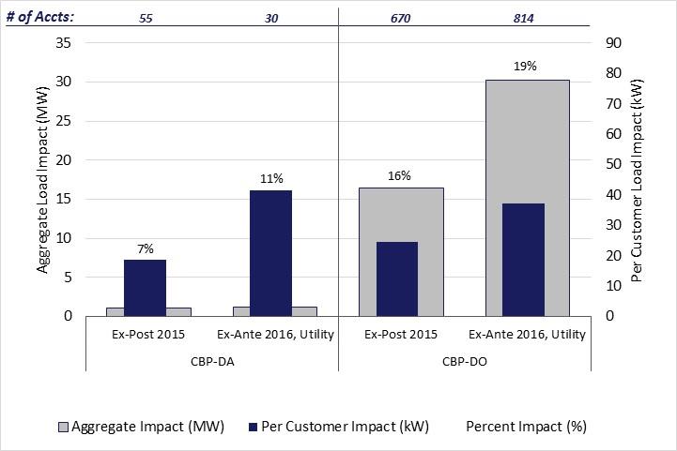
Ex Post and Ex Ante Comparison – SCE CBP
SCE CBP: Average Event-Hour Load Impacts, 2015 and 2016/2017

Slide 30
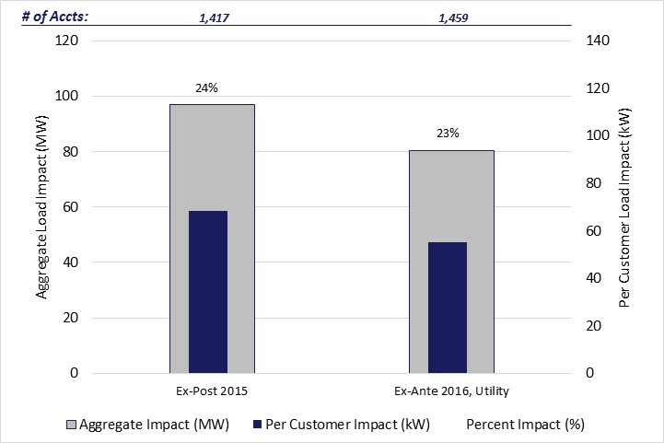
Ex Post and Ex Ante Comparison – PG&E AMP
PG&E AMP: Average Event-Hour Load Impacts, 2015 and 2016/2017

