Slide 1
TOU Periods Analysis Workshop
June 8, 2016

Slide 2
Marginal Cost Components and TOU
Marginal Cost Component | TOU Allocator | Explanation
Marginal Energy | CAISO hourly DLAP prices | DLAP prices include congestion and loss impacts on the CAISO system.
Generation Capacity | Allocator based on LOLP or contribution to peak net load or adjusted net load | Marginal generation is dispatched to meet net load or adjusted net load.
Transmission Capacity | Allocators such as PCAF measuring contribution to coincident system peak | Transmission system peak usage is typically coincident with system loads.
Sub-transmission | PCAFs based on A-Bank substation loads | Hourly profile of loads within 10% of peak load at each substation.
Distribution | PCAFs based on B-Bank substation loads | Hourly profile of loads within 10% of peak load at each substation.

Slide 3
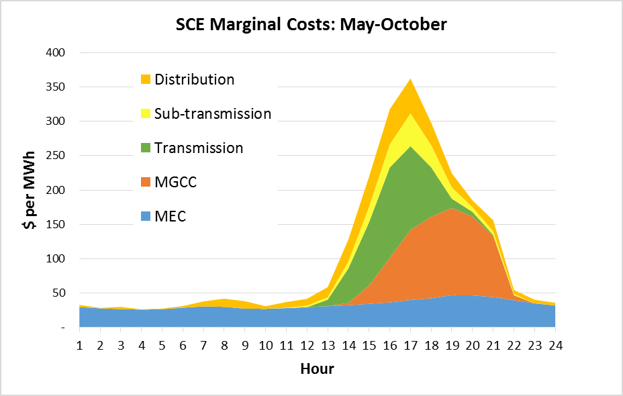
SEIA’S Recommended Methodology
Consider the time profile of all marginal cost elements

Slide 4
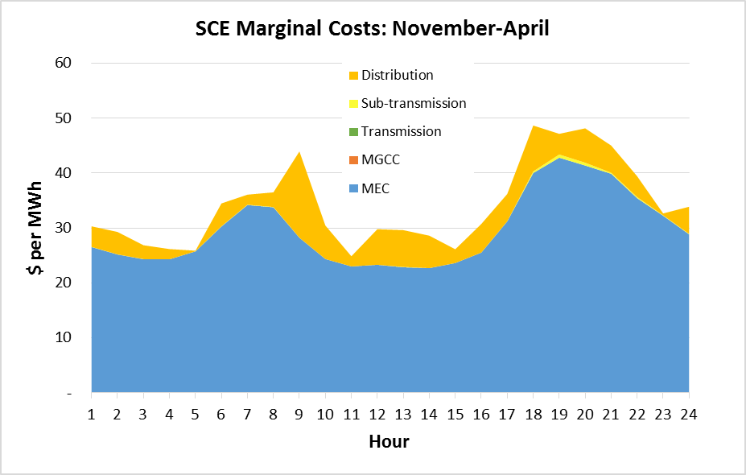
SEIA’S Recommended Methodology
Consider the time profile of all marginal cost elements

