Slide 1


Overview of the Matched Control Group Load Impact Estimation Methodology
Dan Hansen
Christensen Associates Energy Consulting
DRMEC Spring Workshop
May 10, 2016

Slide 2
Presentation Outline
What is a matched control group?
Why would you use it?
How do you do it?
What do you do after the matching is done?
Are there any potential problems with the method?
Summary

Slide 3
1. What is a matched control group?
It is a group of customers that is as similar as possible to the treatment customers being studied, but who are not subjected to the treatment (e.g., PG&E’s Residential SmartRate program)
The control group is not developed from an experimental design (e.g., a random draw of eligible customers where some are assigned the treatment and others are assigned to the control group)
Rather, it is based on a matching process using observable characteristics (e.g., load data, location, industry, CARE status), where the most similar eligible control customer is matched to each treatment customer

Slide 4
2. Why would you use a matched control group?
Matched control groups are useful when:
  An experimentally designed control group is unavailable (which is typically the case for non-pilot programs)
  There is a sizeable pool of eligible control customers (there are a lot of residential customers, but relatively few air products industrial customers)
  The treatment is not event-based (e.g., TOU pricing)
  The treatment is event based, but you are interested in potential non-event day treatment effects
  The treatment is event-based, but most or all of the hottest days are called as events

Slide 5
3. How do you make a matched control group?
There are two commonly used methods for developing a matched control group:
  Propensity score matching (PSM)
  Euclidean distance matching
Propensity score matching:
  Discrete choice regression model with one observation for each treatment and eligible control customer (regression can be segmented by characteristics)
    Dependent variable = 1 if treatment, 0 if eligible control
    Explanatory variables include observable characteristics (e.g., peak/off-peak usage ratio, other usage-based variables, LCA indicators, CARE status, industry group indicators)
  Model predicts each customer’s propensity score, which is the probability that the customer is a treatment customer given the characteristics included in the model
  Each treatment customer is matched to the eligible control customer with the closest propensity score (“nearest neighbor”)

Slide 6
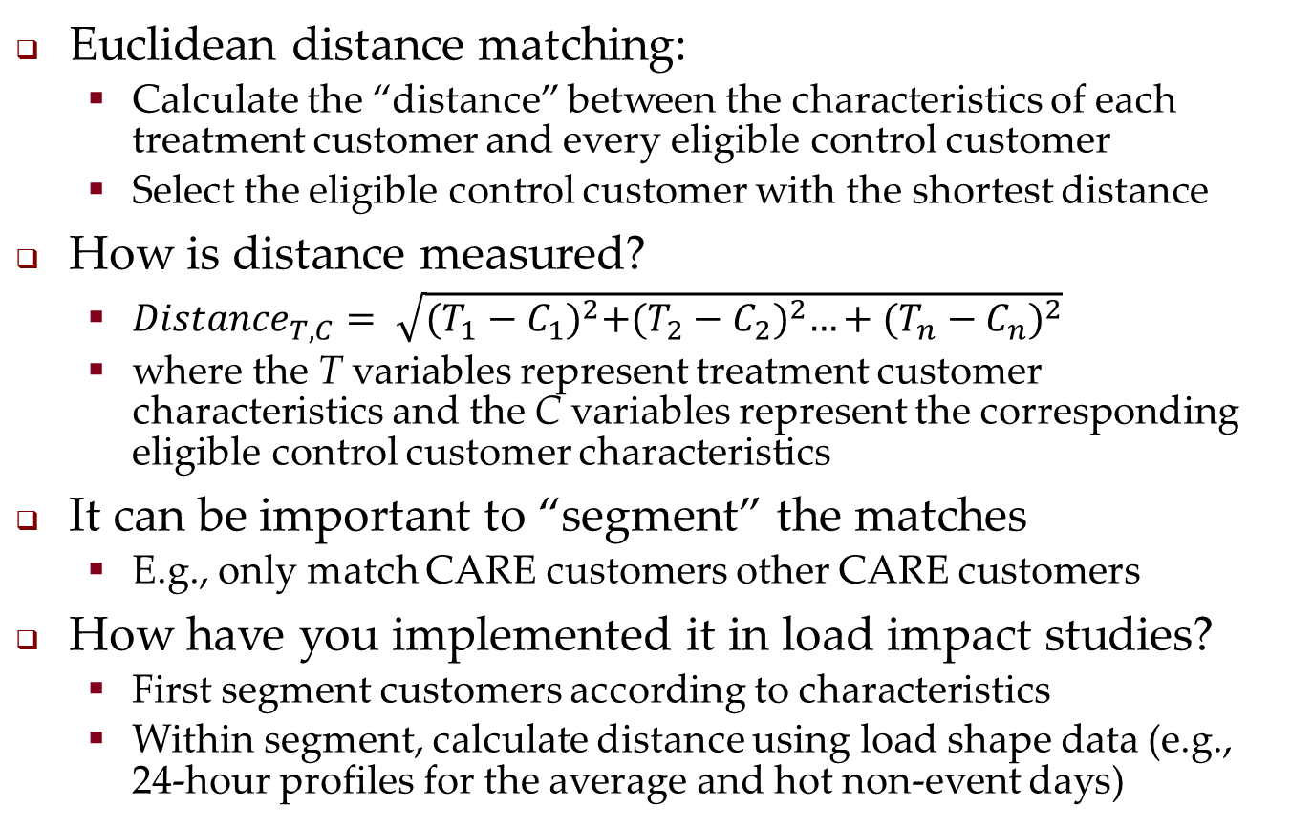
3. How do you make a matched control group? (2)
Euclidean distance matching:
  Calculate the “distance” between the characteristics of each treatment customer and every eligible control customer
  Select the eligible control customer with the shortest distance
How is distance measured?
  ${Distance}_{T,C}= \sqrt{{(T_{1}−C_{1})}^{2}+{(T_{2}−C_{2})}^{2}…+{(T_{n}−C_{n})}^{2}}$
  where the T variables represent treatment customer characteristics and the C variables represent the corresponding eligible control customer characteristics
It can be important to “segment” the matches
  E.g., only match CARE customers other CARE customers
How have you implemented it in load impact studies?
  First segment customers according to characteristics
  Within segment, calculate distance using load shape data (e.g., 24-hour profiles for the average and hot non-event days)

Slide 7
4. What do you do with the matched control group?
Once you have a matched control group, load impacts can be estimated using a difference-in-differences approach
Under this method, you compare treatment and control group usage on event days (or when customer faces TOU rates) and adjust that difference for the difference between the groups on non-event days (or before the customer faced TOU rates)
The simple calculation is:
  Load impact = (kWh_{T,1} – kWh_{C,1}) – (kWh_{T,0} – kWh_{C,0})
  In this equation, T = treatment customer and C = control customer; 1 = treatment period and 0 = non- or pre-treatment period
Can also estimate regressions that may or may not include other explanatory variables (e.g., weather)

Slide 8
4. Illustrating Difference-in-Differences Estimates
Match isn’t very good: C is 10% higher than T.

Slide 9
4. Illustrating Difference-in-Differences Estimates (2)
Incorrectly includes 5% exogenous increase from pre to post

Slide 10
5. Any potential problems with matched control groups?
Just because your match looks good doesn’t guarantee it will produce a good load impact estimate
For example, suppose:
  Pre-treatment loads used to match are from a mild weather year, the treatment period has hot weather, and the match doesn’t account for thermostat set points or the willingness to endure days without turning on AC;
  AND suppose the treatment group happens to contain a higher share of customers with a high thermostat set point or a high willingness to endure days without turning on AC (due to self selection into the program);
  THEN the load impact estimate will be biased upward (i.e., even with no program-related load response, treatment loads will be less than control loads in the treatment period – and even DinD won’t fix it)
In practice, this problem seems unlikely to occur
  Unobservable characteristics have to affect the change in loads (i.e., from pre-treatment to post-treatment or from non-events to events) differently for treatment and control groups
  Unobservable effects on load that are constant across time are differenced out (by D-in-D method) and therefore do no affect load impact estimates

Slide 11
6. Summary
Matched control groups are a way of mimicking an experimental design when one is not available
Its effectiveness depends on the availability of a “good” pool of eligible control customers (large enough sample, adequate range of observed characteristics, sufficiently similar to treatment customers except for treatment)
It is important to consider the potential effect of unobservable characteristics on the resulting estimates
  Difference-in-differences method can compensate for many but not all biases that could arise due to a failure to include unobserved characteristics

Slide 12
Questions?
Contact – Dan Hansen,
Christensen Associates Energy Consulting
Madison, Wisconsin
  dghansen@CAEnergy.com
  608-231-2266

