Slide 1
Comparison of Utility MGC* Data
TOU OIR Workshop (R.15-12-012)
May 5, 2016
Robert Levin – CPUC Energy Division
rl4@cpuc.ca.gov 415-703-1862
*Marginal generation cost
The content of this presentation reflects the presenter’s views only and does not necessarily reflect the positions of the CPUC or its Energy Division.

Slide 2
IOU MGC Data
On March 17, 2016, the large IOUs were asked to provide marginal generation cost forecasts for 2021, for use in the TOU OIR.
Below are some results of the IOU’s submittals, which were due on April 29, 2016.

Slide 3
Spring IOU MGC Data

Slide 4
Spring IOU MGC Data

Slide 5
Spring IOU MGC Data

Slide 6
Spring IOU MGC Data

Slide 7
Outer Summer IOU MGC Data

Slide 8
Inner Summer IOU MGC Data

Slide 9
Winter IOU MGC Data

Slide 10
Two TOU Seasons May Not Be Enough
(To reflect changes in load patterns and energy markets due to solar)
In 2015, CAISO proposed a four-season TOU period scheme to smooth and flatten the net load curve by season:
  Shifting peak load demand
  Incentivizing load to consume during low demand periods to minimize over-generation
  Reducing the need for flexible capacity resources, i.e. reduce the magnitude of upward and downward ramps through managed load response

Slide 11
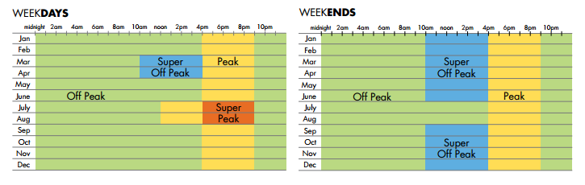
CAISO Proposed TOU Periods for Supplemental Analysis
Notes:
Based on the analysis, California ISO established a maximum of three time blocks per day tailored to seasons and the higher use patterns on weekdays versus weekends.
Furthermore, the TOU periods also reflect the system needs when generation is constrained during the late afternoon/early evening peak and plentiful at mid-day. The time periods were designed to reduce peak load or shift that demand to non-peak periods. Importantly, the rate periods were designed to incentivize load to consume during low demand periods to minimize over generation.
CPUC staff provided reasonably aggressive, revenue-neutral, rates for each time period designed to incent conservation or consumption, as appropriate.
CPUC staff’s conceptual scenario 5 & 6 TOU rates are revenue-neutral to a projected flat rate for each IOU, on an annual basis, but not revenue neutral by season.

Slide 12
MGC Data Averaged by CAISO TOU Period

Slide 13
MGC Data Averaged by CAISO TOU Period

Slide 14
MGC Data Averaged by CAISO TOU Period

Slide 15
MGC Data Averaged by CAISO TOU Period

Slide 16
Appendix (Extra Slides)

Slide 17
2021 Monthly Load vs. Net Load profiles --- weekdays

Slide 18
CAISO “Duck Curve”
(Spring Loads Net of Wind and Solar)

Slide 19
Spring --- Negative energy prices indicating over-generation appear in the middle of the day during high renewable production days
Increase in real-time negative prices shifting to the middle of the day

Slide 20
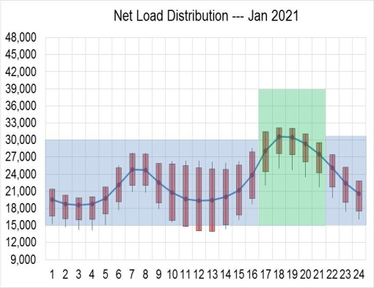
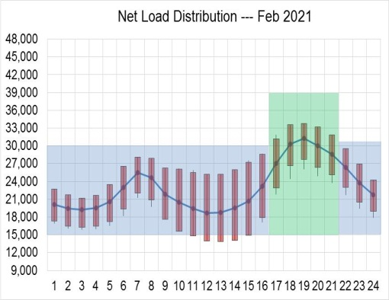
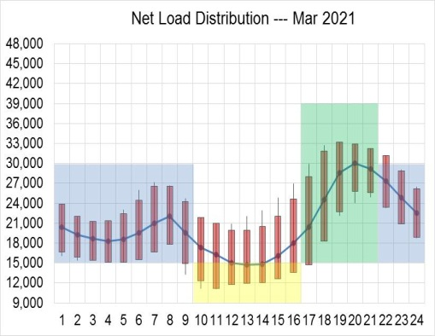
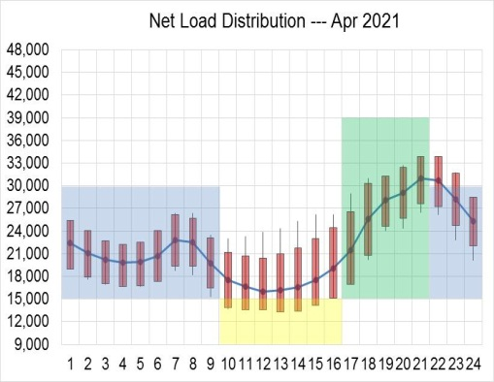
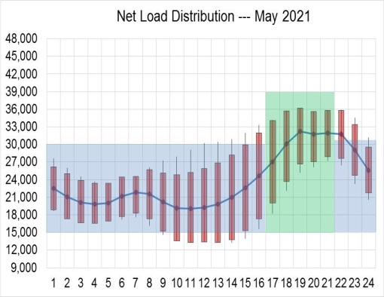
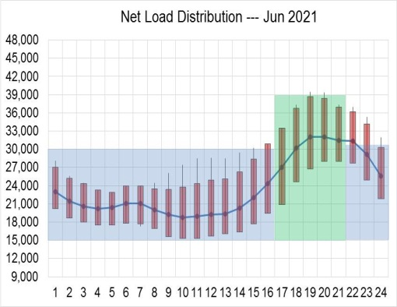
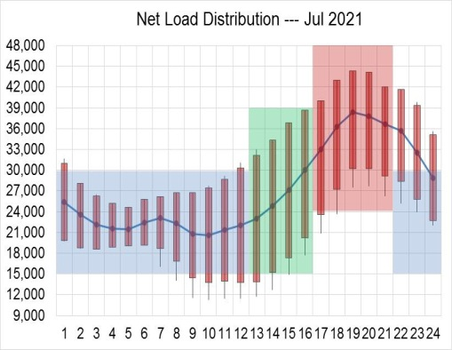
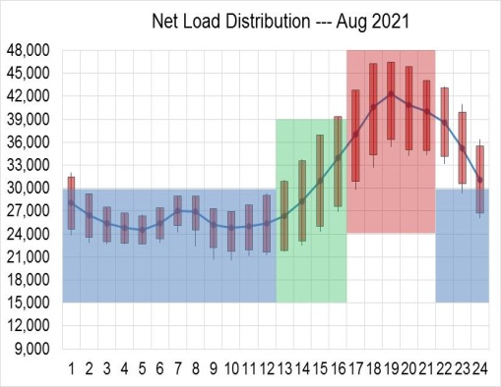
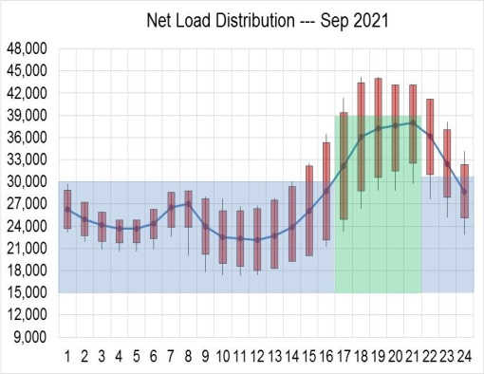
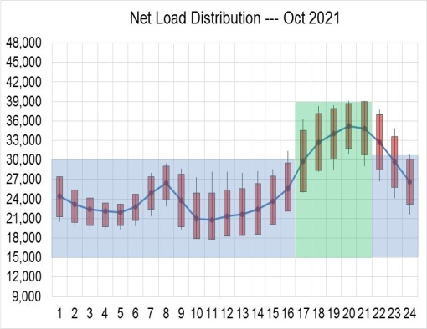
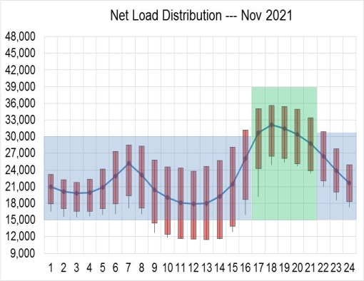
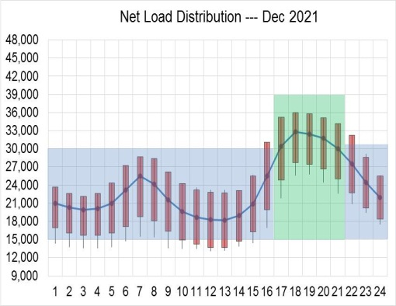
2021 Monthly Net Load Distribution --- Weekdays
Off-Peak
Peak
Super Off-Peak
Super Peak

Slide 21
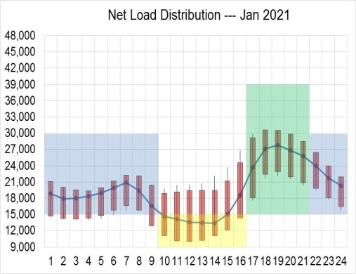
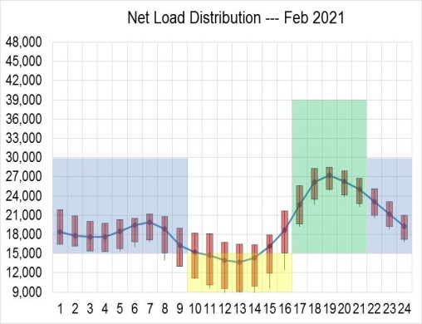
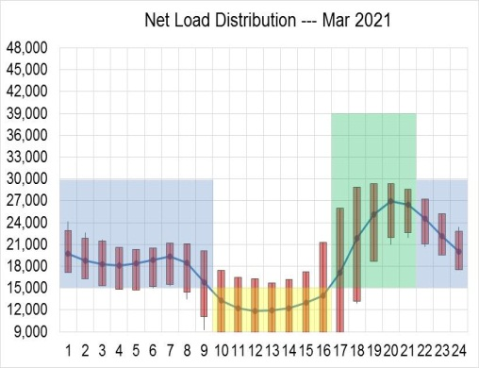
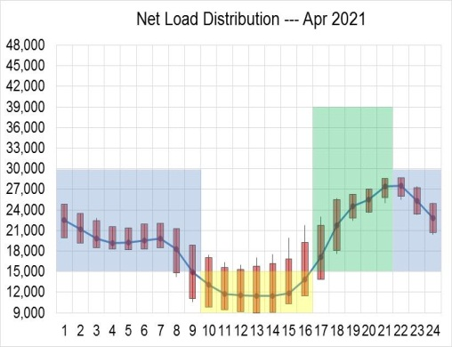
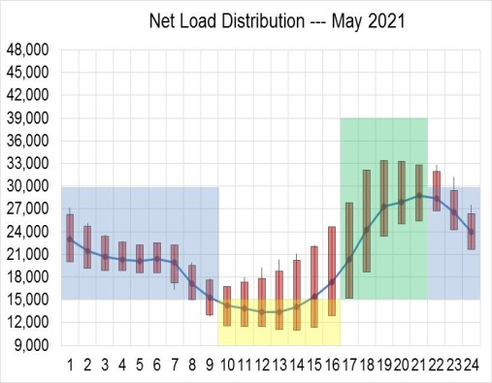
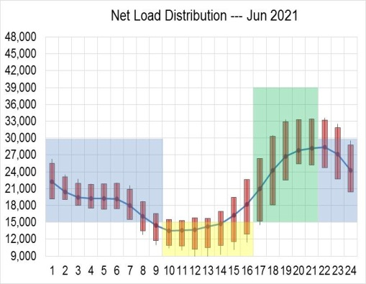
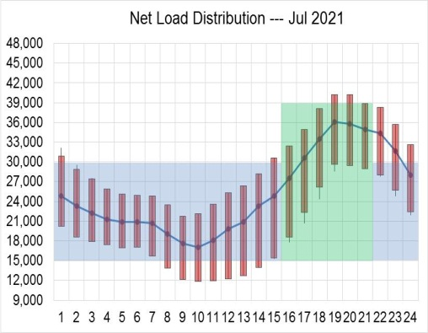
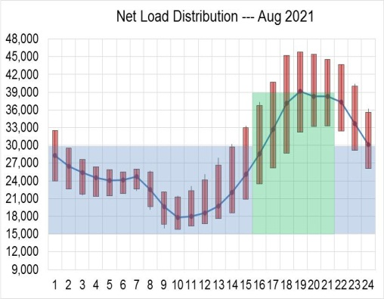
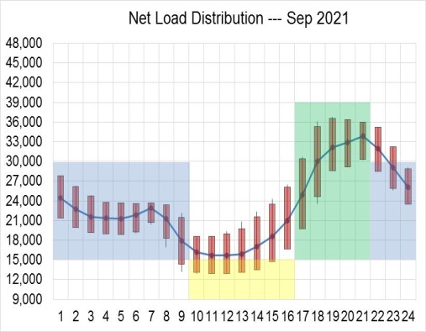
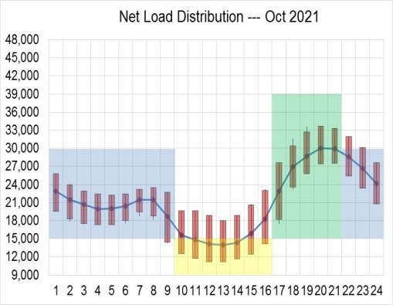
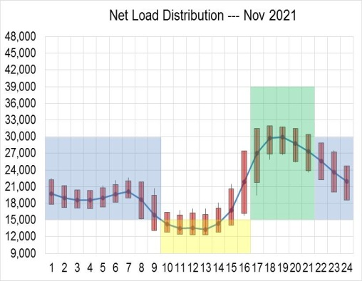
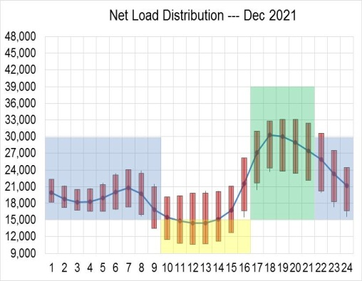
2021 Monthly Net Load Distribution --- Weekends
Off-Peak
Peak
Super Off-Peak

