Slide 1

TOU Period Cost Components
CPUC TOU Period Analysis Workshop
May 5, 2016
Reuben.Behlihomji@sce.com
Manager, Marginal Cost

Slide 2
Overview
Different cost components to be considered for TOU period analysis
  Marginal energy costs
  Marginal capacity costs (Peak and Flex)
  Distribution
Heat maps contained herein represent the 2024 modelled year
Notes:
Current TOU Period
On-Peak: 12 noon to 6 p.m. summer weekdays except holidays
Mid-Peak: 8 a.m. to 12 noon and 6 p.m. to 11 p.m. summer weekdays except holidays; 8:00 a.m. to 9:00 p.m. winter weekdays except holidays
Off-Peak: All other hours
New Potential TOU Period
On-Peak: 5 p.m. to 9/10 p.m.

Slide 3
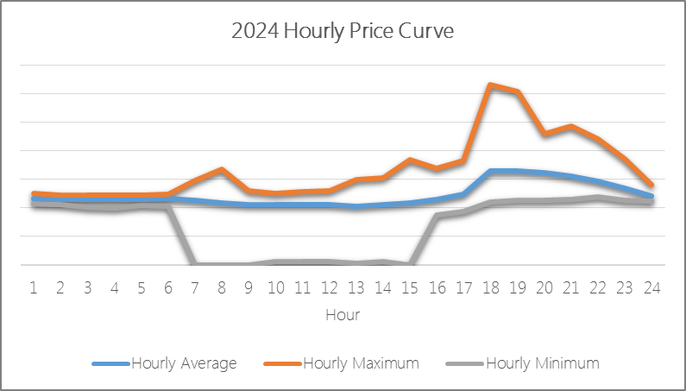
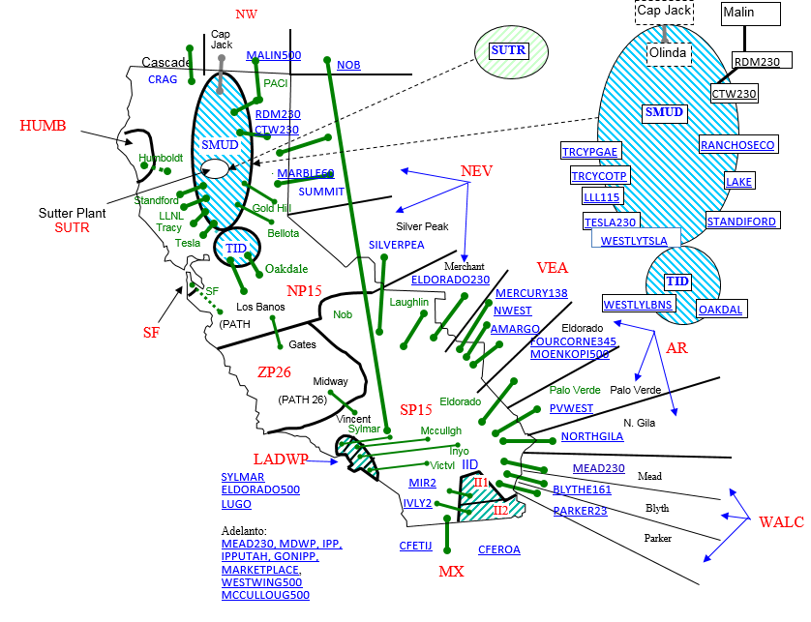
Marginal Energy Cost (MEC)
MEC’s are based on a PLEXOS fundamental price forecast
  RPS Resources – modelled as a must take
  Fundamental price forecast of dispatchable resources
Key Inputs:
  Gross load projections net of DERs (DG, EE and DR);
  Gas price forecasts for each “hub”;
  GHG compliance cost forecasts;
  Transmission line and interface limitations based on the CAISO Full Network Model;
  RPS trajectory for LSEs within the WECC;
  RPS Generation profiles for wind and solar resources;
  Variable operating costs (incremental fuel, variable O&M, emissions costs, startup costs, and no load fuel costs; and
  The energy price includes the costs related to congestion and losses.

Slide 4
MEC Heat Map
* Original CPUC template defined row to indicate "sums," SCE has modified it to reflect the average for each hour
** Spring: Mar. – May; Summer: Jun. – Sept.; Winter: Oct. – Feb.

Slide 5
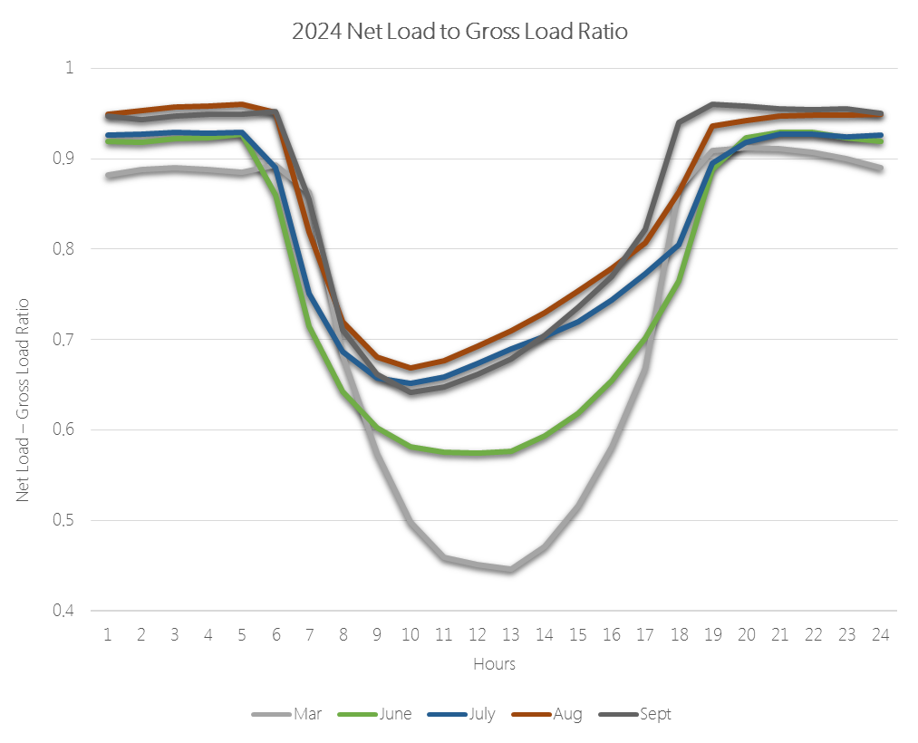
Loss of Load Expectation (LOLE)
Probabilistic approach for allocating annualized capacity value across hours in proportion to when the loss of load is likely to occur
Key Inputs:
  30-years historic weather to create 30 possible load shapes with an expected peak and energy equal to its model year load forecast.
  Daily wind and solar generation forecasts are then randomized against load, by month, to generate Net Load forecasts for each day in the model year.
  These daily net load forecasts are then sampled and compared to a distribution of non-intermittent resource availability, adjusted for expected maintenance and forced outages,
  This approach provides a reasonable estimate of the relative risk of being unable to serve some portion of system load in any given period.
Highest LOLE Hour(s)

Slide 6
LOLE Heat Map
* Original CPUC template defined row to indicate "sums," SCE has modified it to reflect the average for each hour
** Spring: Mar. – May; Summer: Jun. – Sept.; Winter: Oct. – Feb.

Slide 7
Flex Capacity
EFC Calculation based on CAISO FRAC-MOO
Categories of Flex
  Base Ramp
  Peak Ramp
  Super Peak Ramp
Method
  Daily max three hour upward ramp representing the amplitude of ramp in the hour that the ramp ends.
  Each value is then normalized by the sum of all of the daily maximum three hour upward ramps.
Purpose
  The end of the ramp is the targeted hour in which flex need is allocated, as it informs the period during which load should be reduced to lessen the three hour ramp.
Spring: Mar. – May; Summer: Jun. – Sept.; Winter: Oct. – Feb.

Slide 8
Flex Capacity Heat Map
*
*
* Spring: Mar. – May; Summer: Jun. – Sept.; Winter: Oct. – Feb.

Slide 9
Marginal Generation Capacity
- Combining Flex and Peak Needs (2024)
Planning for Capacity driven by both Peak and ramp Capacity needs on the system
Valuation of a proxy resource that meets both capacity needs requires apportionment of capacity “value” as a joint cost allocation problem
Method
  Resource adequacy – Annual Max Peak capacity needs
  ISO FRAC MOO criteria – Annual Max Ramp capacity needs
  Ratio of this planning criteria used as the determinant in apportioning value of capacity
Estimate of SCE Contribution
Year | CAISO Peak | CAISO FLEX | SCE | SCE Peak | SCE Ramp | Peak Cost | Flex Cost
2021 | 55,933 | 17,006 | 46.3% | 25,909 | 7,877 | 70% | 30%
2024 | 56,258 | 19,972 | 46.5% | 26,132 | 9,277 | 64% | 36%
2025 | 56,466 | 20,801 | 46.5% | 26,251 | 9,670 | 63% | 37%

Slide 10
Marginal Generation Capacity - LOLE & Flex Capacity
* Original CPUC template defined row to indicate "sums," SCE has modified it to reflect the average for each hour
** Spring: Mar. – May; Summer: Jun. – Sept.; Winter: Oct. – Feb.

Slide 11
Bringing it all Together
- Total Marginal Generation Costs (2024 Forecast with Flex Capacity & w/o RPS Adder)
* Original CPUC template defined row to indicate "sums," SCE has modified it to reflect the average for each hour
** Spring: Mar. – May; Summer: Jun. – Sept.; Winter: Oct. – Feb.

Slide 12
Distribution
Fixed versus Variable costs
  Allocation is relevant to the peak load variable component of distribution costs
Criteria
  Distribution Circuits – 73% of the average PLL of the aggregate circuits to a B-Bank
  Distribution B Banks – 90% of station PLL
Method
  Compare temperature normalized load to criteria
  Set all load points below criteria to zero
  For all load points above criteria, relative “peak load risk factor “is determined as the ratio of load above criteria in an hour to sum of all load above criteria for each hour of the year.

Slide 13
Distribution Heat Map
2014 Recorded Load
2024 Projected Load
NOTES:
- Analysis reflects sample circuits from Desert, Metro, North Coast, and Orange regions.
- The DG assumption is a 5kW system with 20% efficiency

Slide 14
Glossary of Acronyms
Acronym | Definition
CAISO | California Independent System Operator
DER | Distributed Energy Resources
DG | Distributed Generation
DR | Demand Response
EE | Energy Efficiency
EFC | Effective Flex Capacity
FRAC-MOO | Flexible Resource Adequacy Criteria – Must Offer Obligation
GHG | Greenhouse Gas
LSE | Load Serving Entities
MEC | Marginal Energy Cost
PLEXOS | Mixed Integer Programming model for marginal energy prices
PLL | Planned Loading Limit
RPS | Renewable Portfolio Standard
TOU | Time-of-Use
WECC | Western Electricity Coordinating Council

