Slide 1
CAISO’s proposed TOU periods to address grid needs with high numbers of renewables
Clyde Loutan, Sr. Advisor, Renewable Energy Integration, CAISO
John Goodin, Regulatory Policy Manager, CAISO
Delphine Hou, Manager of State Regulatory Affairs, CAISO
Jordan Pinjuv, Counsel, CAISO
May 5, 2016

Slide 2
ISO’s coincident peak vs. PTO’s coincident peak
Spring: The ISO and three PTOs coincident peak occurs between 8 p.m. and 9 p.m.
Summer: The ISO, SCE & SDG&E coincident peak occurs between 4:00 p.m. and 5:00 p.m. PG&E is an hour later
Fall: ISO and three PTOs coincident peak occur between 7:00 p.m. and 8:00 p.m.
Winter: ISO and three PTOs coincident peak occur between 6:00 p.m. and 7:00 p.m.

Slide 3
Thoughts on 2015 historical analysis
2015 net load shapes are similar to 2013 and 2014
Compared to 2014, the ramps are generally the same or steeper and the minimum net loads are generally lower
CAISO’s proposed time-of-use periods are applicable to 2015 data
  Period definitions continued to be driven by a combination of steep ramps and low net loads
  In other words, a period designation may be driven by the steep ramp later in the day as opposed to the absolute minimum net load

Slide 4
2015 Monthly Minimum Hourly Load & Minimum Hourly Net Load Distribution --- Weekdays
Load
Net Load

Slide 5
2015 Average Hourly Load & Average Hourly Net Load Distribution --- Weekdays
Load
Net Load

Slide 6
2015 Minimum Hourly Load & Minimum Hourly Net Load Distribution --- Weekends/Holidays
Load
Net Load

Slide 7
2015 Average Hourly Load & Net Load Distribution --- Weekends/Holidays
Load
Net Load

Slide 8
2015 Average Hourly Net-Load vs. Average Day-Ahead energy prices --- Weekdays
Off-Peak
Peak
Net Load
Super Off-Peak
Super Peak

Slide 9
2015 Average Hourly Net-Load vs. Average Day-Ahead energy prices --- March Weekdays
Off-Peak
Super Off-Peak
Peak
Super Peak

Slide 10
2015 Average Hourly Net-Load vs. Average Day-Ahead energy prices --- July Weekdays
Off-Peak
Super Off-Peak
Peak
Super Peak

Slide 11
2015 Average Hourly Net-Load vs. Average Day-Ahead energy prices --- Weekends/Holidays
Off-Peak
Peak
Net Load
Super Off-Peak
Super Peak

Slide 12
2015 Average Hourly Net-Load vs. Average Day-Ahead energy prices --- March Weekends/Holidays
Off-Peak
Super Off-Peak
Peak
Super Peak

Slide 13
2015 Average Hourly Net Load vs. 2021 Hourly Average Net Load Distribution --- Weekdays
Net Load 2021
Net Load 2015

Slide 14
2015 Average Hourly Net Load vs. 2021 Average Hourly Net Load --- Weekends/Holidays
Net Load 2021
Net Load 2015

Slide 15
Proposed TOU Time Periods
Day-type | Months | Super Off-Peak | Off-Peak | Peak | Super Peak
Weekdays | Jan, Feb, May, Jun, Sep, Oct, Nov, Dec |  | Midnight – 4 PM 9 PM - Midnight | 4 PM – 9 PM
 | Mar & Apr | 10 AM – 4 PM | Midnight – 10 AM 9 PM - Midnight | 4 PM – 9 PM
 | Jul & Aug |  | Midnight – Noon 9 PM - Midnight | Noon – 4 PM | 4 PM – 9 PM
Weekends & Federal Holidays | Jan - Jun & Sep - Dec | 10 AM – 4 PM | Midnight – 10 AM 9 PM - Midnight | 4 PM – 9 PM
 | Jul & Aug |  | Midnight – 4 PM 9 PM - Midnight | 4 PM – 9 PM

Slide 16
Proposed Weekday and Weekend TOU Periods

Slide 17
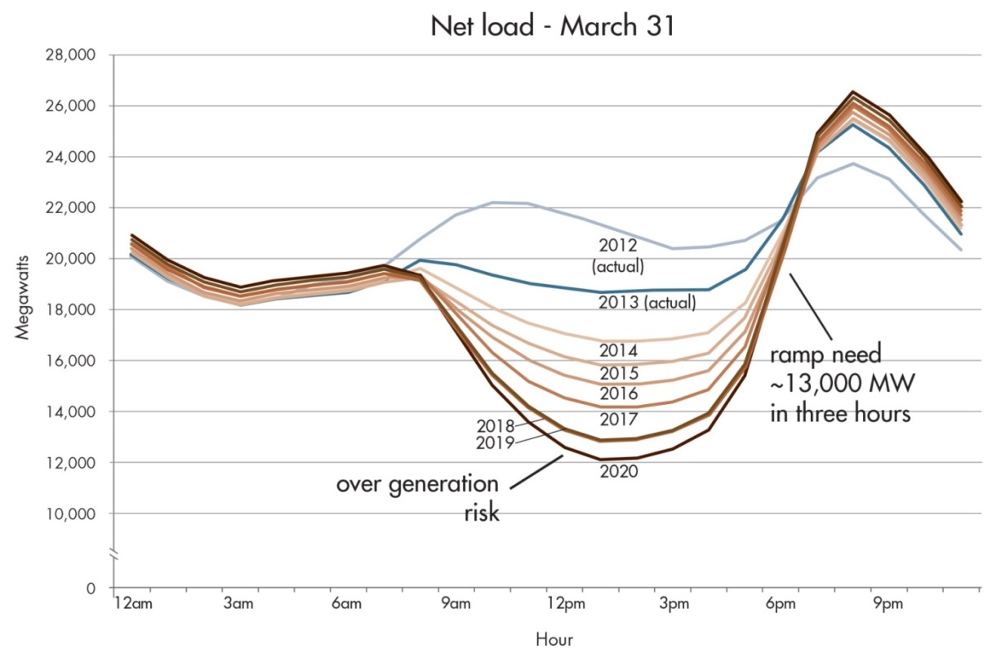
Original estimate of net-load as more renewables are integrated into the grid
Typical Spring Day
Actual 3-hour ramp 10,892 MW on February 1, 2016
Net Load 12,546 MW on April 24, 2016

Slide 18

Questions!

