Slide 1


Load Impact Evaluation: PG&E’s Residential SmartRate
Dan Hansen
Steve Braithwait
Dave Armstrong
Christensen Associates Energy Consulting
DRMEC Spring Workshop
May 10, 2016

Slide 2
Presentation Outline
Program Description
Ex Post Methodology
Ex Post Load Impacts
Ex Ante Methodology
Enrollment Forecast
Ex Ante Load Impacts
Additional Ex Post Results
Summary and Conclusions

Slide 3
1. Program Description
Voluntary Critical Peak Pricing (“CPP”) program for PG&E’s residential customers
Participants receive bill credits on non-event days from June 1 through September 30
On “SmartDays” (hereafter called “event days”), customers pay a 60 cents/kWh “High-Price Period Charge” from 2:00 to 7:00 p.m.
Target of 12 event days per summer (max of 15)
Bill protection is available through the first full season
SmartRate customers can also participate in SmartAC
28% dually enrolled

Slide 4
2. Ex Post Methodology
Primary results are based on a matched control group + difference-in-differences evaluation methodology
Matched on event-like non-event days using Euclidean Distance
Matches segmented by: SmartAC enrollment status, LCA, climate zone, CARE status, and (for dual only) CAC likelihood
Two 24-hour average load profiles used: core summer days and approximate school-year days
This method was chosen for two reasons:
A large pool of residential (non-SmartRate) customers available from which to select matches
Presence of the control group should improve load impact estimates by providing a proxy for event-day usage of similarly situated (but non-participating) customers
Individual regressions are used to examine the distribution of load impacts across enrolled customers

Slide 5
3. Ex Post Load Impacts: Events
Event Date | DOW | SmartRate Only |  | SmartRate + SmartAC
 |  | # Enrolled | Avg. Evt. Temp. (°F) | # Enrolled | Avg. Evt. Temp. (°F)
12-Jun-15 | Fri | 89,045 | 92 | 37,607 | 96
25-Jun-15 | Thu | 88,435 | 95 | 37,215 | 98
26-Jun-15 | Fri | 88,413 | 93 | 37,146 | 97
30-Jun-15 | Tue | 88,248 | 98 | 36,989 | 101
1-Jul-15 | Wed | 88,178 | 91 | 36,938 | 95
28-Jul-15 | Tue | 89,444 | 96 | 36,611 | 98
29-Jul-15 | Wed | 89,634 | 97 | 36,573 | 100
30-Jul-15 | Thu | 89,799 | 92 | 36,545 | 95
17-Aug-15 | Mon | 93,496 | 97 | 36,364 | 100
18-Aug-15 | Tue | 93,850 | 91 | 36,336 | 93
27-Aug-15 | Thu | 96,355 | 95 | 36,262 | 97
28-Aug-15 | Fri | 96,590 | 95 | 36,254 | 97
9-Sep-15 | Wed | 97,521 | 98 | 36,069 | 100
10-Sep-15 | Thu | 97,613 | 97 | 36,044 | 100
12-Jun-15 | Fri | 97,704 | 94 | 36,016 | 96
All events are from 2:00 to 7:00 p.m.
Notice that temperatures are higher for dually enrolled customers because of where they tend to be located (in hotter areas where the need for AC is higher).

Slide 6
3. Ex Post Load Impacts: Events (2)
Program | Hours of Availability | Hours of Actual Use | No. of Available Dispatches | No. of Actual Dispatches
SmartRate | 75 | 75 | Max = 15 days Min = 9 days | 15

Slide 7
3. Ex-Post Load Impacts: Summary – Key Event Hours
Result Type | Hour Type | SmartRate Only |  |  | SmartRate + SmartAC
 |  | Load Impact | # Custs | Temp. °F | Load Impact | # Custs | Temp. °F
Aggregate (MW) | Avg. Event Hour | 19.5 | 92,288 | 94.9 | 20.0 | 36,598 | 97.6
 | PG&E Peak Hour | 23.4 | 88,248 | 99.0 | 28.8 | 36,989 | 102.4
 | CAISO Peak Hour | 23.7 | 97,613 | 98.7 | 24.3 | 36,044 | 101.1
Per customer (kW) | Avg. Event Hour | 0.21 | 92,288 | 94.9 | 0.55 | 36,598 | 97.6
 | PG&E Peak Hour | 0.27 | 88,248 | 99.0 | 0.78 | 36,989 | 102.4
 | CAISO Peak Hour | 0.24 | 97,613 | 98.7 | 0.67 | 36,044 | 101.1
PG&E peak hour = June 30, 2015, HE 18 (5 to 6 p.m.)
CAISO peak hour = September 10, 2015, HE 17 (4 to 5 p.m.)

Slide 8
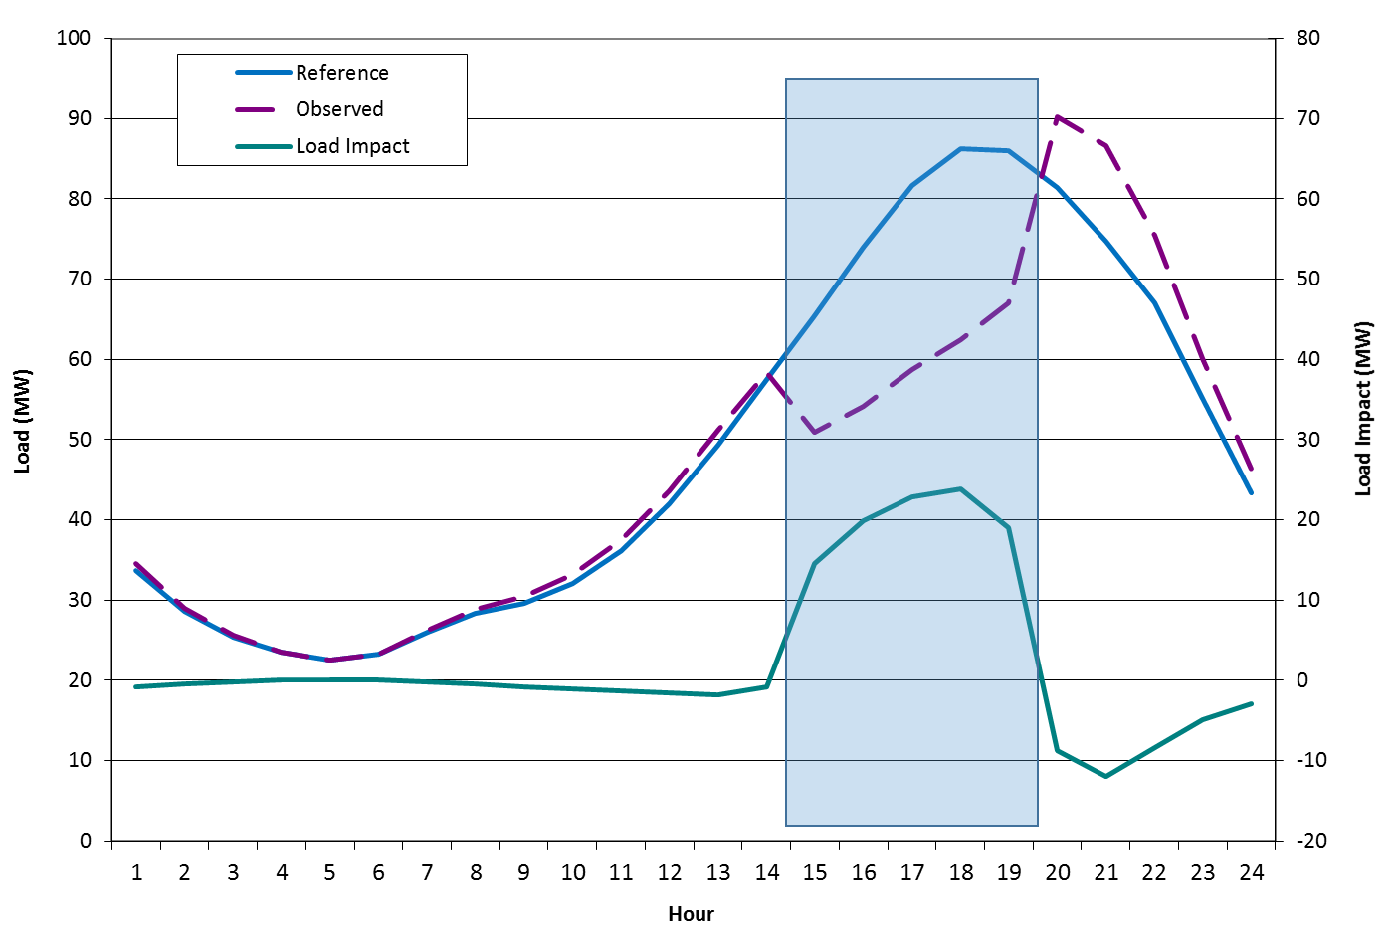
3. Ex Post Load Impacts: Avg. Event, SmartRate+SmartAC

Slide 9
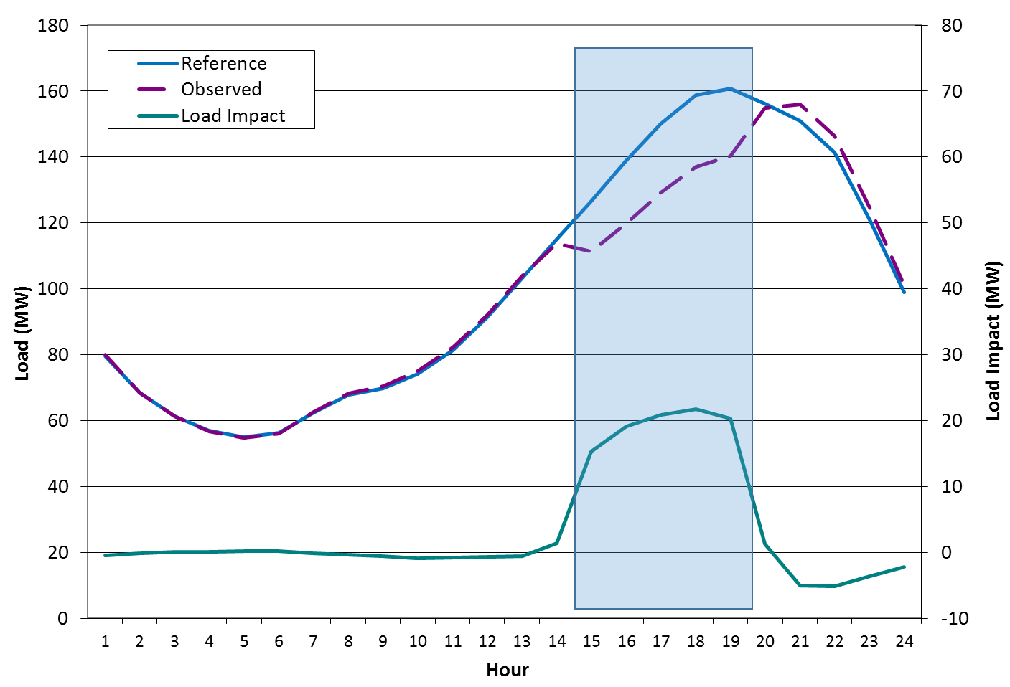
3. Ex Post Load Impacts: Avg. Event, SmartRate Only

Slide 10
3. Ex Post Load Impacts: By Event, SmartRate+SmartAC

Slide 11
3. Ex Post Load Impacts: By Event, SmartRate Only

Slide 12
4. Ex Ante Methodology
Ex-ante load impacts are developed using the ex-post load impacts from the 15 events of PY2015
Estimated the effect of weather conditions (CDD65) on per-customer load impacts
For each hour of the day (24)
For each LCA (8)
Separately for SmartRate-only and dually-enrolled customers (2)
24 x 8 x 2 = 384 estimated models
Combined estimates with the corresponding weather conditions (e.g., CAISO 1-in-2 weather conditions on an August peak day) to simulate the load impacts for every scenario / hour / customer type

Slide 13
4. Ex Ante Methodology (2)
Reference loads were developed for each month and LCA using:
Parameters obtained from regressions of per-customer hourly usage as a function of weather and load shape variables
Ex ante weather data and day-type characteristics (e.g., temperatures on a CAISO 1-in-2 June peak day)
Per-customer reference loads and load impacts are scaled using PG&E’s forecast enrollments (by month, year, and dual enrollment status)

Slide 14
4. Ex Ante Methodology (3) Non-summer load impacts
While we only observe summer load impacts, we are required to forecast non-summer load impacts as well (events may be called at any time of the year)
Because non-summer temperatures tend to be low relative to ex-post event temperatures, simulated load impacts are correspondingly low
They are defined by the constant term (a) in our estimated load impact equation (Load impact = a + b x CDD65 + e)

Slide 15
5. Enrollment Forecast
August enrollments are shown.
Enrollment is forecast to remain the same from 2017 through 2026.
Note that the share of dually enrolled customers is lower in the forecast period than in our ex-post analysis (~24 percent in ex ante vs. ~28 percent in ex post). This shift reduces the program-level load impact.

Slide 16
6. Ex Ante Load Impacts: Summary
Group | Result Type | Time Period | # Custs | Ref. Load | Event Load | Load Impact | % Load Impact | Avg. Temp.
SmartRate Only | Agg (MW) | RA Window (1-6 pm) | 110,200 | 149.1 | 130.8 | 18.3 | 12.3% | 93.9
 |  | Event Hours (2-7 pm) |  | 161 | 138.1 | 22.8 | 14.2% | 93.6
 | Per cust (kW) | RA Window (1-6 pm) |  | 1.35 | 1.19 | 0.17
 |  | Event Hours (2-7 pm) |  | 1.46 | 1.25 | 0.21
Dual Enrolled | Agg (MW) | RA Window (1-6 pm) | 34,800 | 59.9 | 44 | 16 | 26.7% | 98
 |  | Event Hours (2-7 pm) |  | 65.7 | 45.4 | 20.3 | 30.9% | 98
 | Per cust (kW) | RA Window (1-6 pm) |  | 1.72 | 1.26 | 0.46
 |  | Event Hours (2-7 pm) |  | 1.89 | 1.30 | 0.58
Table reflects PG&E 1in2 August peak day, 2017 to 2026. Enrollments (and therefore impacts) are constant from 2017 to 2026.
Note that the RA-window load impacts are lower than the event-hour load impacts because the RA-window impacts include one non-event hour (1 to 2 p.m.).

Slide 17
6. Ex Ante Load Impacts: SmartRate Only, Ex Post vs. Ex Ante
Ex Post / Ex Ante | Result Type | # SAIDs | Reference Load | Event Load | Load Impact | % Load Impact | Temp. (°F)
Ex Post | Aggregate (MW) | 92,288 | 147.1 | 127.6 | 19.5 | 13.2% | 94.9
Ex Ante | Aggregate (MW) | 110,200 | 161.0 | 138.1 | 22.8 | 14.2% | 93.6
Ex Post | Per SAID (kW) |  | 1.59 | 1.38 | 0.21
Ex Ante | Per SAID (kW) |  | 1.46 | 1.25 | 0.21
Ex post reflects the average event day.
Ex ante reflects PG&E 1in2 August peak day, 2017 to 2026.
Both results reflect event hours (2 to 7 p.m.) for comparability.

Slide 18
6. Ex Ante Load Impacts: Dual Enrolled, Ex Post vs. Ex Ante
Ex Post / Ex Ante | Result Type | # SAIDs | Reference Load | Event Load | Load Impact | % Load Impact | Temp. (°F)
Ex Post | Aggregate (MW) | 36,598 | 78.7 | 58.7 | 20.0 | 25.5% | 97.6
Ex Ante | Aggregate (MW) | 34,800 | 65.7 | 45.4 | 20.3 | 30.9% | 98.0
Ex Post | Per SAID (kW) |  | 2.15 | 1.60 | 0.55
Ex Ante | Per SAID (kW) |  | 1.89 | 1.30 | 0.58
Ex post reflects the average event day.
Ex ante reflects PG&E 1in2 August peak day, 2017 to 2026.
Both results reflect event hours (2 to 7 p.m.) for comparability.

Slide 19
6. Ex Ante Load Impacts: SR Only, Consistency of Ex Post vs. Ex Ante

Slide 20
6. Ex Ante Load Impacts: Dual Enroll, Consistency of Ex Post vs. Ex Ante

Slide 21
6. Ex Ante Load Impacts: SmartRate Only, Previous vs. Current Forecast
When Created | Result Type | # Custs | Reference Load | Event Load | Load Impact | % Load Impact | Temp. (°F)
Following PY2014 (Previous) | Agg (MW) | 93,800 | 145.3 | 126.9 | 18.4 | 12.7% | 90.7
Following PY2015 (Current) |  | 110,200 | 149.1 | 130.8 | 18.3 | 12.3% | 93.9
PY2014 | Per SAID (kW) |  | 1.55 | 1.35 | 0.20
PY2015 |  |  | 1.35 | 1.19 | 0.17
PG&E 1in2 scenario for August 2017 forecasts shown.
Results shown for the RA window (1 to 6 p.m.).

Slide 22
6. Ex Ante Load Impacts: Dual Enrolled, Previous vs. Current Forecast
When Created | Result Type | # Custs | Reference Load | Event Load | Load Impact | % Load Impact | Temp. (°F)
Following PY2014 (Previous) | Agg (MW) | 46,200 | 95.7 | 73.2 | 22.6 | 23.6% | 96.6
Following PY2015 (Current) |  | 34,800 | 59.9 | 44.0 | 16.0 | 26.7% | 98.0
PY2014 | Per SAID (kW) |  | 2.07 | 1.58 | 0.49
PY2015 |  |  | 1.72 | 1.26 | 0.46
PG&E 1in2 scenario for August 2017 forecasts shown.
Results shown for the RA window (1 to 6 p.m.).

Slide 23
6. Ex Ante Load Impacts: Comments
Current forecast of total SmartRate load impacts for August 2017 (PG&E 1in2 peak day) is lower than previous forecast
Current = 34.3 MW during RA window
Previous = 40.7 MW during RA window
Some of this difference can be attributed to a shift in enrollment
SmartRate-only customers are now a larger share of program enrollment
However, some the reduction reflects differences in the ex post load impacts
PY2015 ex post load impacts are lower than those of PY2014

Slide 24
6. Ex Ante Load Impacts: Comparison of PY2014 and PY2015
We conducted a comparison of PY2014 and PY2015 ex post load impacts
Regressions (by dual enrollment status) of average event-hour load impact as a function of factors we believed could affect demand response:
Weather (CDD65)
Whether the prior day was also an event day (“Consecutive Event”)
Whether the date is when school is in session (before mid-June or later than mid-August)
Whether the date is in 2014 or 2015

Slide 25
6. Ex Ante Load Impacts: Comparison of PY2014 and PY2015 (2)
Variable | SmartRate Only | SmartRate + SmartAC
CDD65 | 0.013 (0.000) | 0.041 (0.000)
Consecutive Event | 0.009 (0.356) | 0.017 (0.471)
School | -0.026 (0.009) | -0.054 (0.026)
PY2015 Event | -0.061 (0.001) | -0.105 (0.002)
Constant | 0.064 (0.047) | -0.110 (0.246)
Notes:
p-values in parentheses.
Weather affects the load impact (not surprising).
Consecutive events don’t matter.
Load impacts are lower when school is in session.
Controlling for the above variables, PY2015 ex post load impacts are lower than PY2014.

Slide 26
6. Ex Ante Load Impacts: Comparison of PY2014 and PY2015 (3)
Why were load impacts lower in PY2015? We’re not entirely sure.
Things that are NOT the (entire) cause of the reduction:
Any variable included in the meta-analysis (weather, number of consecutive event days, number of days during school year)
Increasing share of SmartRate-only customers
Changes in methodology (probably) – estimates appear robust to methodological changes
New customers being less responsive than customers who remained in the program (there is churn in addition to the change in the overall number of enrolled customers)
Possible (untested) explanation:
Customers are setting their thermostat set points higher

Slide 27
7. Additional Ex Post Results: By CARE Status
 |  |  | Aggregate |  | Per-Customer
Program | CARE Status | Enrolled | Ref. Load (MW) | Load Impact (MW) | Ref. Load (kW) | Load Impact (kW) | % Load Impact | Ave. Event Temp.
SR-only | Non-CARE | 66,465 | 97.8 | 16.4 | 1.47 | 0.25 | 17% | 93
 | CARE | 25,824 | 49.3 | 3.1 | 1.91 | 0.12 | 6% | 98
Dually enrolled | Non-CARE | 27,389 | 56.3 | 15.6 | 2.06 | 0.57 | 28% | 97
 | CARE | 9,209 | 22.4 | 4.4 | 2.43 | 0.48 | 20% | 99
CARE customers are less responsive in both program sub-groups.

Slide 28
8. Summary and Conclusions
SmartRate load impacts continue to have a strong relationship with temperatures
Particularly true for customers dually enrolled in SmartAC
SmartRate + SmartAC customers have both higher load impacts than SmartRate-only customers and higher post-event load increases
Per-customer load impacts appear to be declining over time for reasons that are not entirely clear
Perhaps caused by higher thermostat set points over time?
Interesting area for further research, perhaps including surveys

Slide 29
Questions?
Contact – Dan Hansen, Christensen Associates Energy Consulting Madison, Wisconsin
dghansen@CAEnergy.com
608-231-2266

