Slide 1

Randomized Control Trials
2016 DRMEC Workshop
Jonathan Cook
May 11, 2016

Slide 2
What is Impact Evaluation and Why is it Needed?
Impact evaluation is all about measuring causal relationships
    X happened. How much of a change in Y was caused by X? How much of a change in Y would be caused by X in the future?
Goals of DR impact evaluations for event-based programs
    Produce quantitative measurements of the load impacts that occurred during the most recent event season (ex post)
    To the extent possible, understand the mechanisms that underlie the causal relationship
    Use impact estimates to develop forecasts of future load impacts under standardized weather and event conditions that can be used for planning (ex ante)
Why do we need it?
    Measurement of program performance
    Informs grid planning and allocation of resources
    Gives us insight into how customers use electricity and how much additional DR resource may be available

Slide 3
The Problem of the Counterfactual
  Fundamental problem of impact evaluation - What would have happened to program participants in the absence of the program/event?
    You never actually observe this, you can only estimate it
    Every method for impact evaluation has a way of estimating the counterfactual
    Different methods are judged based on how convincing and reasonable the estimated counterfactual is
    This is a key concept in econometrics and is the primary question that needs to be answered in order to establish causal relationships

Slide 4
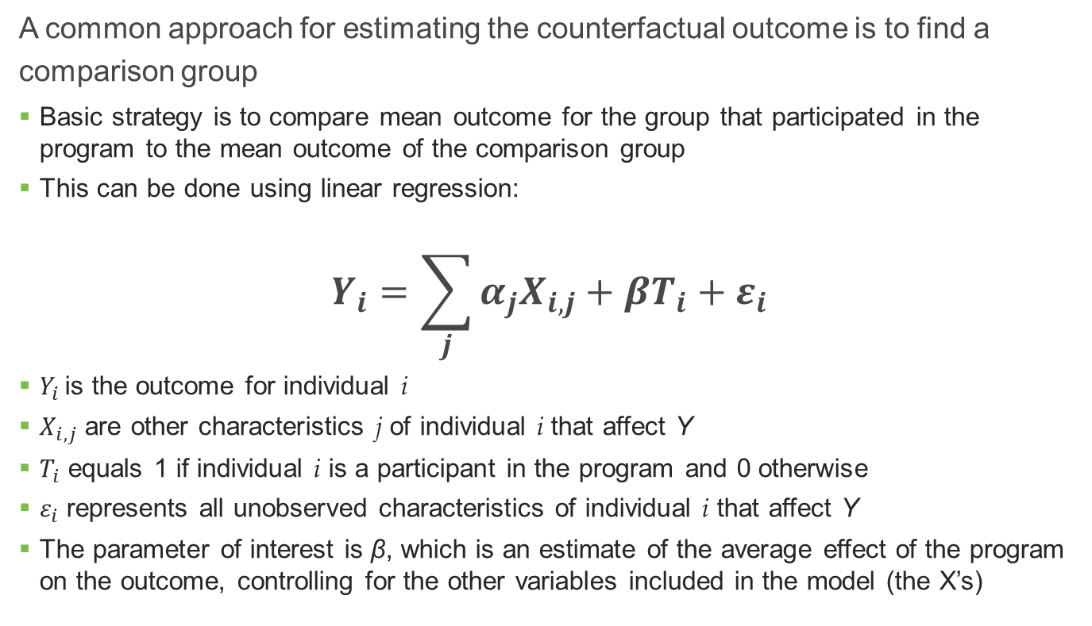
Motivating an RCT Using a Simple Example
  A common approach for estimating the counterfactual outcome is to find a comparison group
    Basic strategy is to compare mean outcome for the group that participated in the program to the mean outcome of the comparison group
    This can be done using linear regression:
  $$Y_{i}=\sum_{j}{α_{j}X_{i,j}}+βT_{i}+ε_{i}$$
    $Y_{i}$ is the outcome for individual i
    $X_{i,j}$ are other characteristics j of individual i that affect Y
    $T_{i}$ equals 1 if individual i is a participant in the program and 0 otherwise
    $ε_{i}$ represents all unobserved characteristics of individual i that affect Y
    The parameter of interest is β, which is an estimate of the average effect of the program on the outcome, controlling for the other variables included in the model (the X’s)

Slide 5
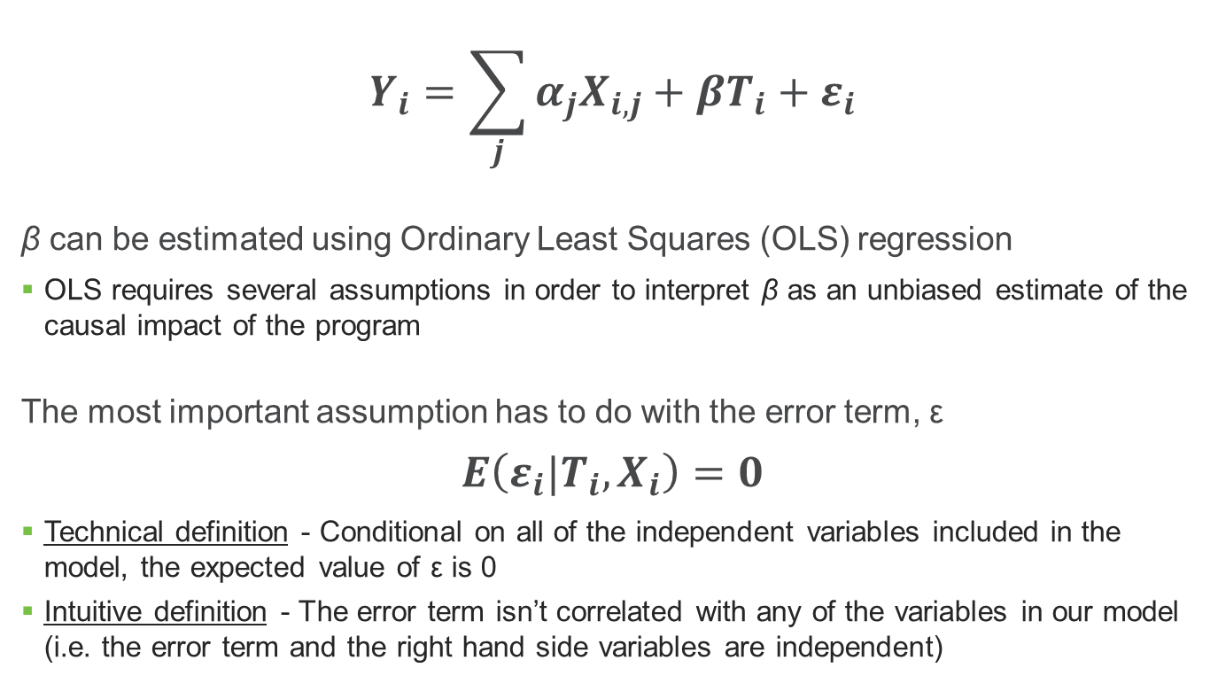
Review of Linear Regression
  $$Y_{i}=\sum_{j}{α_{j}X_{i,j}}+βT_{i}+ε_{i}$$
  β can be estimated using Ordinary Least Squares (OLS) regression
    OLS requires several assumptions in order to interpret β as an unbiased estimate of the causal impact of the program
  The most important assumption has to do with the error term, ε
  $$E\left(ε_{i}|T_{i},X_{i}\right)=0$$
    Technical definition - Conditional on all of the independent variables included in the model, the expected value of ε is 0
    Intuitive definition - The error term isn’t correlated with any of the variables in our model (i.e. the error term and the right hand side variables are independent)

Slide 6
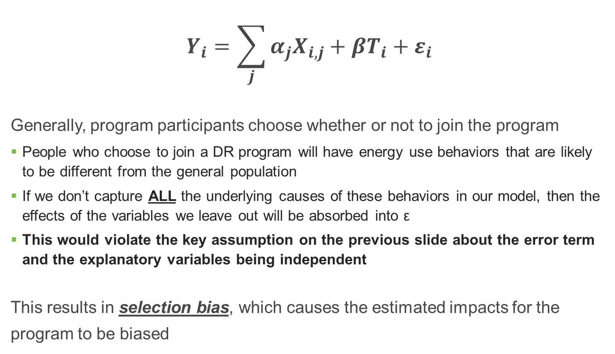
Selection Bias is the Enemy
  $$Y_{i}=\sum_{j}{α_{j}X_{i,j}}+βT_{i}+ε_{i}$$
  Generally, program participants choose whether or not to join the program
    People who choose to join a DR program will have energy use behaviors that are likely to be different from the general population
    If we don’t capture ALL the underlying causes of these behaviors in our model, then the effects of the variables we leave out will be absorbed into ε
    This would violate the key assumption on the previous slide about the error term and the explanatory variables being independent
  This results in selection bias, which causes the estimated impacts for the program to be biased

Slide 7
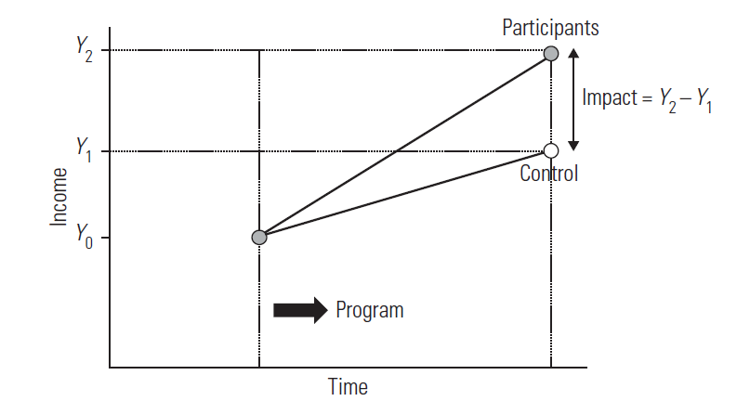
What’s so Great About Randomized Experiments?
  One way to eliminate selection bias is to determine program/event participation randomly by splitting population into treatment and control groups
    Treatment group participates, control group does not
  Because the groups are determined randomly, participation is guaranteed to be independent of everything else that affects usage by definition as long as we have large enough sample sizes
    This means that a simple comparison of means will provide an unbiased impact estimate

Slide 8
What does an experiment look like in the context of A/C load control?

Slide 9
Event Day

Slide 10
“Cascading” Events

Slide 11

Questions and Discussion
  Contact Info:
  Jonathan Cook
  jonathancook@nexant.com
  202-974-0615

