Slide 1
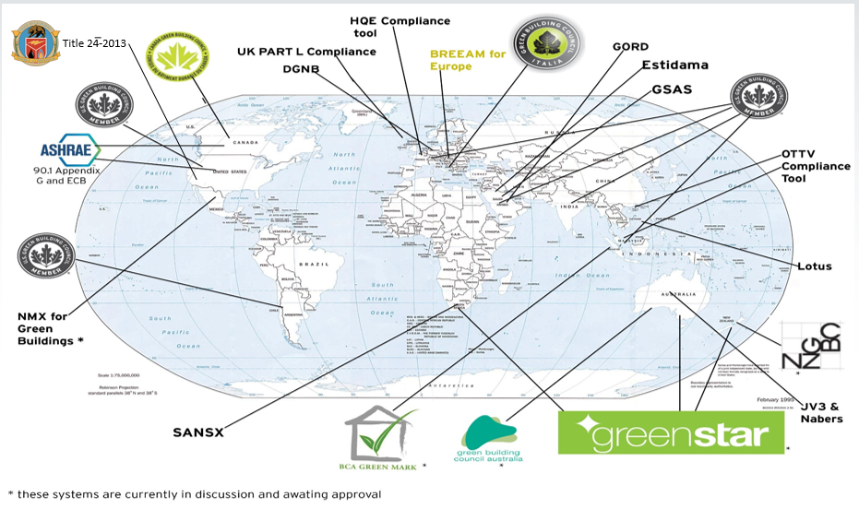
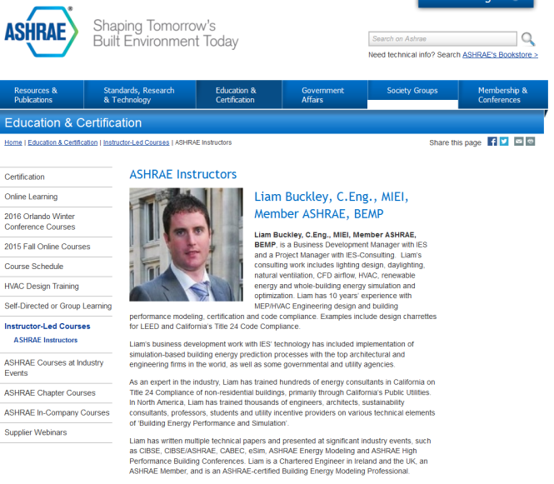
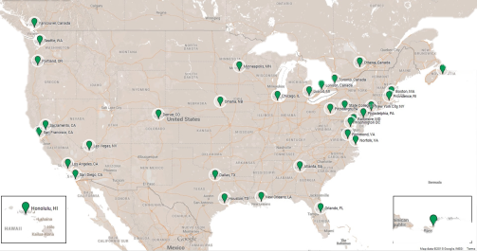
Reflections from Building Modeling Experts: Liam
About IES: - largest and most popular worldwide energy modeling software.
Software Used in 140 Countries.
Tens of Thousands technical support queries/year.
Very popular in California, for design and Title 24.
About Liam: - IES representative in California
Works with leading AEC firms in North America.
ASHRAE Certified Energy Modeling Professional.
IBPSA-San Francisco board member.
Leading a team for ASHRAE ZNE Model Challenge.

Slide 2
Reflections from Building Modeling Experts: Liam
Topics for Discussion:
How do modeling experts validate models?
Are there some tool features that facilitate understanding of underlying calculation methods, inputs, and outputs?
How do experts and non-experts understand whether an output is reasonable?
How do people who aren’t building modeling experts understand what is accurate?
What can be done to account for user error, if anything?

Slide 3
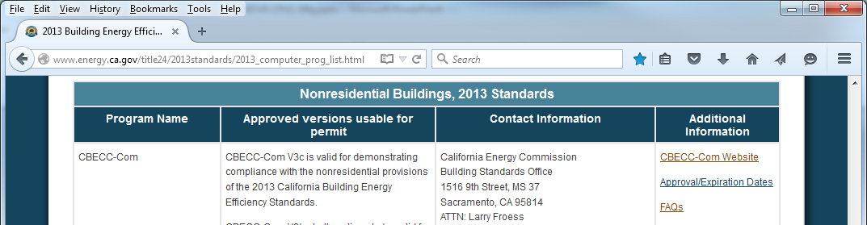
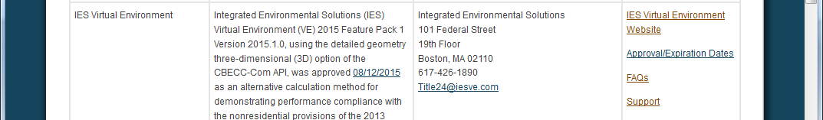
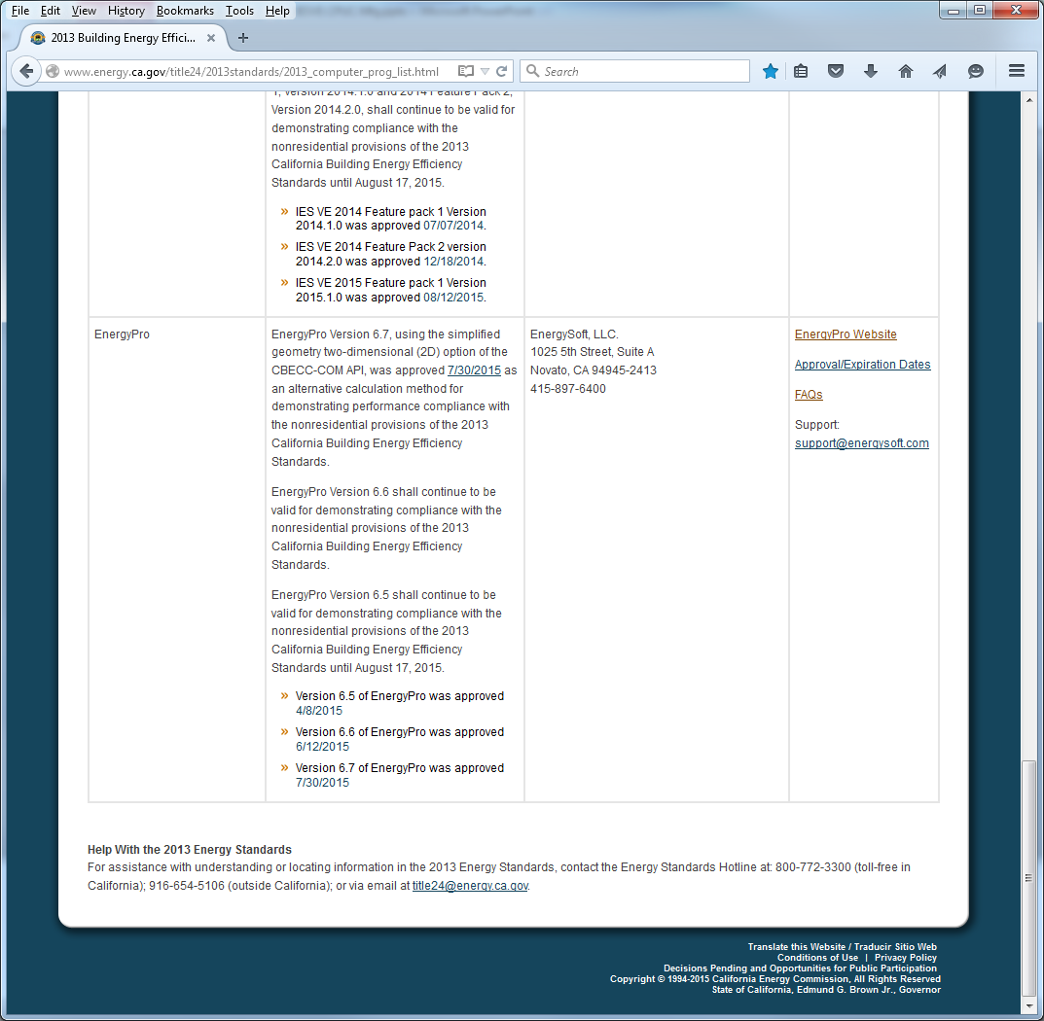
How do modeling experts validate models?
Validating The Modeling Software:
First: are you permitted use the software for the task as hand?
  www.energy.ca.gov/title24/2013standards/2013_computer_prog_list.html
Second: can the software output be trusted?
  ASHRAE 140 Validation
  United States Department of Energy to qualify for tax deductions (Internal Revenue Code 179D.
  www.energy.gov/sites/prod/files/2014/02/f7/qs_iesve_v2013_20140127.pdf
Third: can the software model the systems?
  Natural Ventilation, Displacement Ventilation, Active Chilled Beams, VRF and DOAS, Radiant Systems, Evaporative Cooling (IDEC), Energy Recovery (air & water), Custom Controls, etc.
  Or, the “workarounds”

Slide 4
How do modeling experts validate models?
Validating The Modeler:
I have trained 2,000+ energy modelers over the last 7 years.
  The best energy analysts are architects or engineers who have a deep understanding of building physics and or building systems.
  Next, very good energy analysts have a deep understanding of building code or rating systems. Energy Modeling ≠ Compliance Modeling.
Certification of the energy modeler
  ASHRAE BEMP (Requires minimum 2 years experience in BEM + a bachelors degree in AEC )
    www.ashrae.org/education--certification/certification/government-recognition
  CABEC CEA (Requires 50 points from previous education & training)
    For Compliance Modeling, not energy modeling.
    www.cabec.org/index.php?option=com_content&view=article&id=242:faqs-about-2013-cea-certification&catid=38:about-cea&Itemid=57
Otherwise, it’s GIGO!

Slide 5
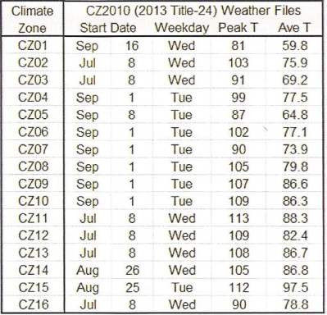
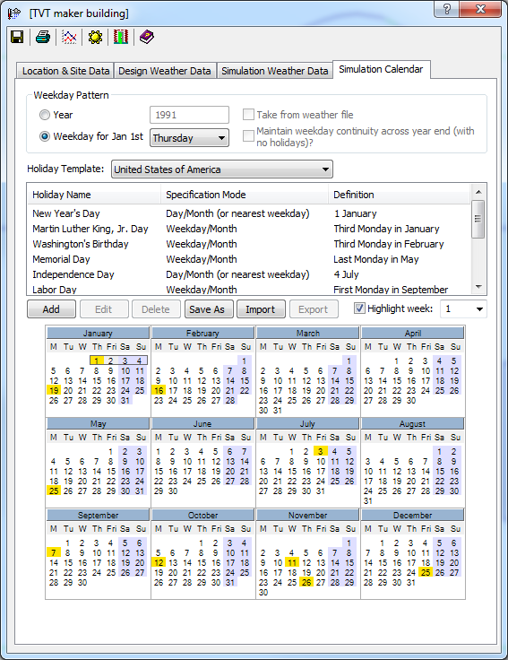
How do modeling experts validate models?
Validating the Model:
Check the output report matches the model output correctly.
Unmet Load Hours.
  If met, all HVAC systems are sized sufficiently. (cheating is less likely)
  If unmet, is there a separate natural ventilation / thermal comfort study?
Check individual items, depending on where savings are being claimed.
  Weather files, weather year 1991, Geometry, DEER Peaks, schedules, VLTs, displacement ventilation zoning, radiant systems zoning, u-values, SHGCs, R-values, openable window areas, solar shading geometry, solar shading controls, internal gains, plugs loads & ventilation against the baseline, LPDs against the baseline, daylight harvesting strategies, target illuminance levels, loads sizing methodology, fan curves, static pressures, HVAC system efficiencies & controls, renewable energies, etc

Slide 6
Are there some tool features that facilitate understanding of underlying calculation methods, inputs, and outputs?
The Model Methods:
HVAC Sizing
  ASHRAE Prescribed Heat Balance Method
  RTS Method, CLTD Method, Simple Spreadsheets, Oversizing Factors
Energy Simulation
  8,760 hours/year
  ApacheSim, DOE2, EnergyPlus
  Integration (airflow simulation, daylight simulation, solar simulation, etc.)
Daylight Simulation
  Necessary now in Title 24 Part 6 2014, and ASHRAE 90.1-2010
  Required a 3D Model
  Radiance Engine

Slide 7
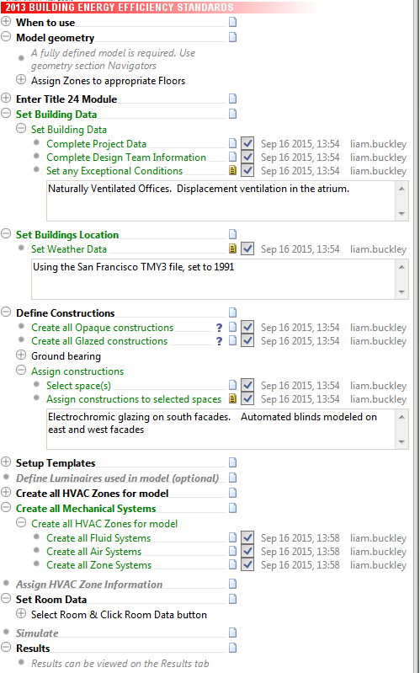

Are there some tool features that facilitate understanding of underlying calculation methods, inputs, and outputs?
The Model Inputs (Navigator Narrative):
Natively details necessary inputs

Slide 8
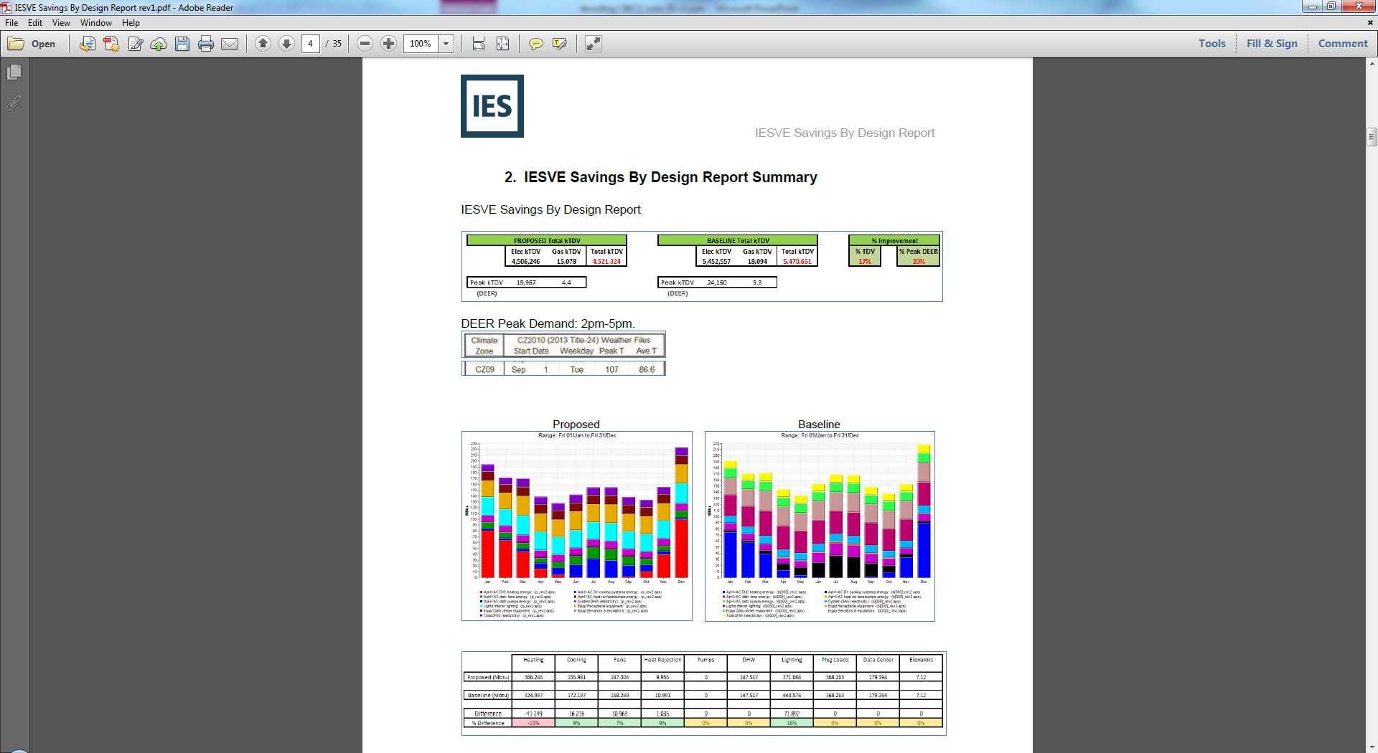
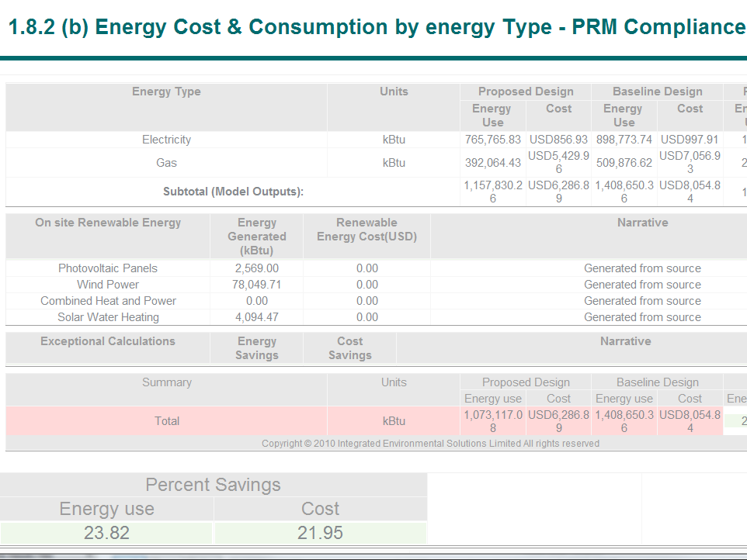
Are there some tool features that facilitate understanding of underlying calculation methods, inputs, and outputs?
The Model Outputs (Reports):
Demonstrates the savings being claimed
  Automated Reports
  User-compiled Custom Reports (Input & Output)

Slide 9
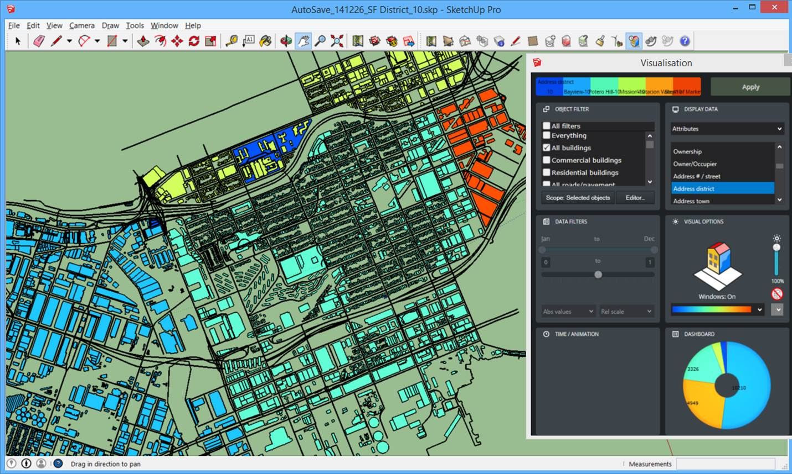
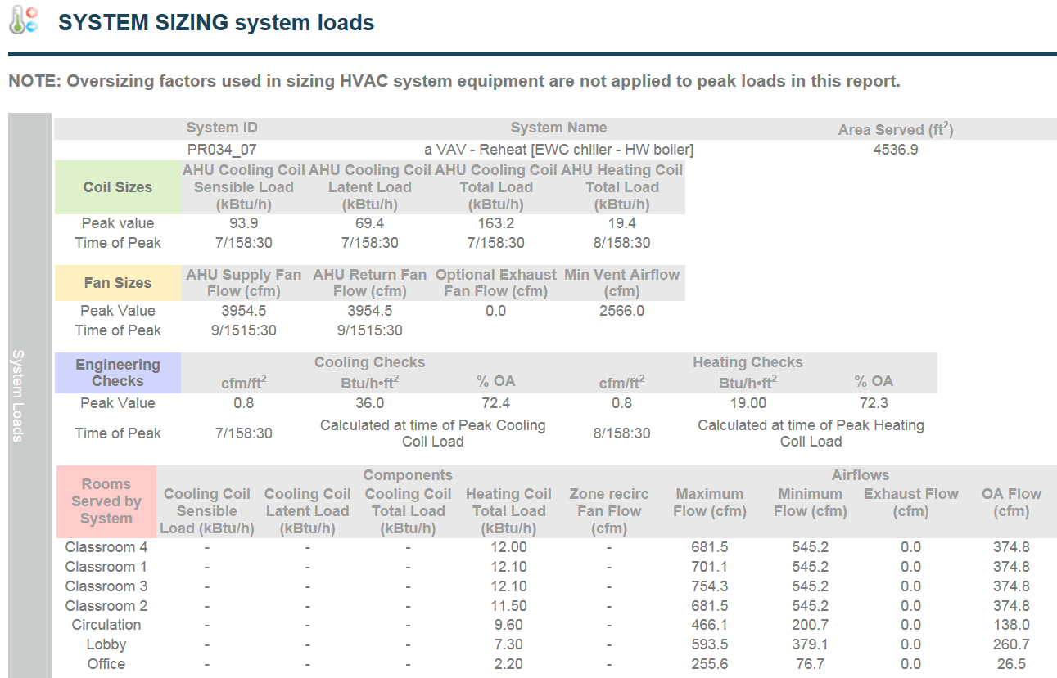
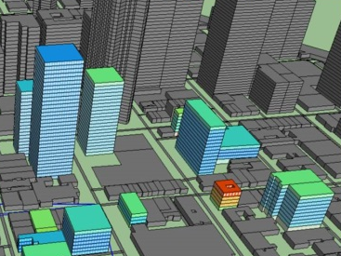
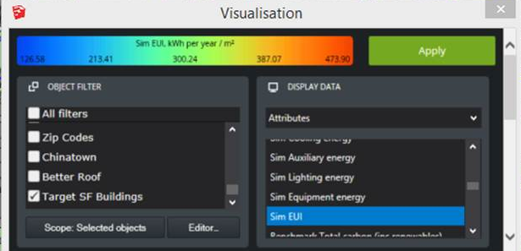
How do experts and non-experts understand whether an output is reasonable?
Non-experts:
Reports with Engineering checks (EUI-kBtu/sf/year, cfm/sf, Btu/h/sf)
Previous project outcomes
Public Benchmarking (E.g. City of SF)

Slide 10
How do experts and non-experts understand whether an output is reasonable?
Experts:
Most experts have received formal training on the software and its outputs.
ARCHITECTS
Gensler, CBT Architects, Perkins+Will, NBBJ,
ZGF, Steffian Bradley, RNL,
ARCH. & ENG.
AECOM, HOK, RTKL, SOM,
US Army Corps of Engineers,
Burns & McDonald, Stantec, Tetra Tech, Clark Nexsen
DLR Group, Ballinger, etc.
ENGINEERS
Integral Group, Taylor Engineering,
WSP Group, Buro Happold,
ARUP, Interface Engineering,
Syska Hennessy, Kohler Ronan,
Guttmann & Blaevoet, Jacobs,
Mazzetti Nash Lipsey Burch, SSR Inc.,
P2S Engineering, ME Group,
SmithGroupJJR, MCW Consultants,
PAE Engineers, Dialog Engineering,
Affiliated Engineers Inc., LPA Inc.,
exp, TLC Engineering for Architecture,
Alfa Tech, M-E Engineers, Henderson Engineers, 350 Engineering, etc.
ENERGY CONSULTANTS
Gabel Associates,
Green Dinosaur,
Atelier Ten, EnerNOC,
Ambient Energy, EBS,
Cyclone Energy Group,
Steven Winter Associates,
CONTRACTORS
DPR Construction, ACCO,
Southland Ind., Swinerton
CA UTILITIES
SMUD, SCE, LADWP, ______

Slide 11
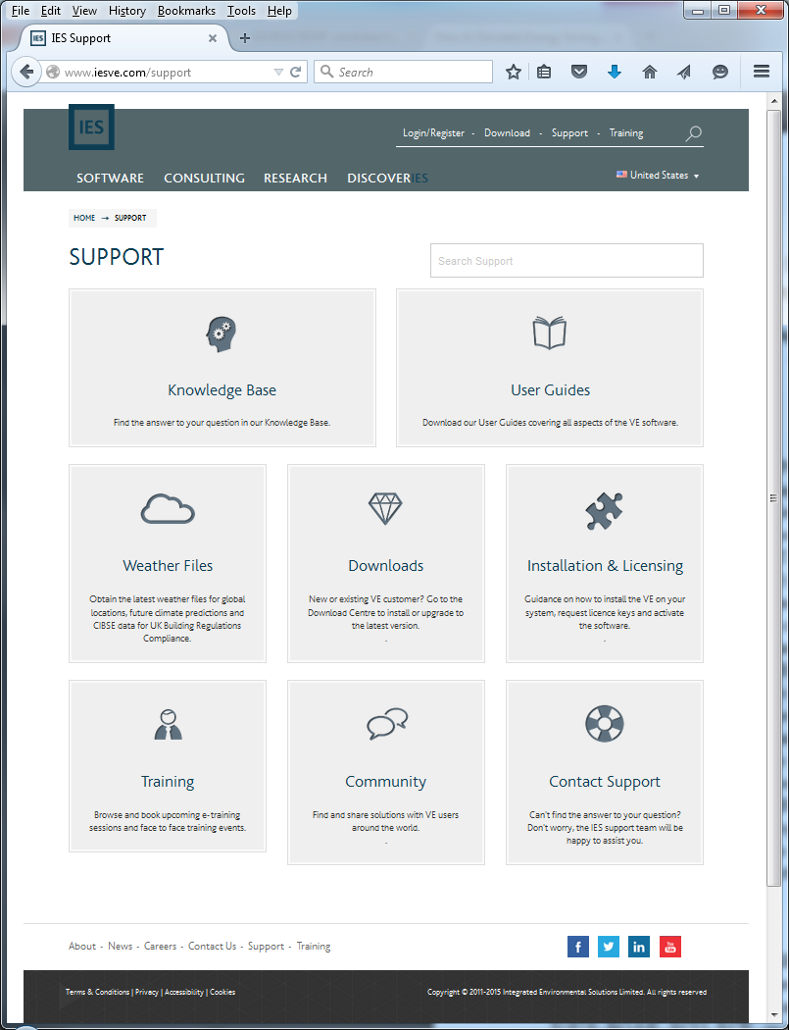
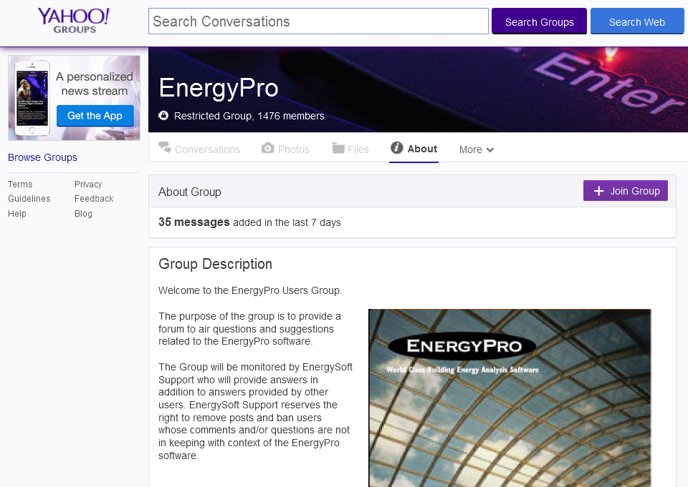
How do experts and non-experts understand whether an output is reasonable?
Experts:
Pick up the phone and ask if it’s reasonable; access to online technical support.

Slide 12
How do people who aren’t building modeling experts understand what is accurate?
Trust the model software validation
Trust the capabilities of the software
Trust the modeler certification
Request an independent third party review
  By the software vendors who yield the best understanding of the process
  In Canada, this is a pre-requisite for any LEED EAc1 project; i.e. a third-party review.
    Approved “Experiences Modeller List” www.cagbc.org/cagbcdocs/CaGBCs_Experienced_Modellers_List-EN.pdf

Slide 13
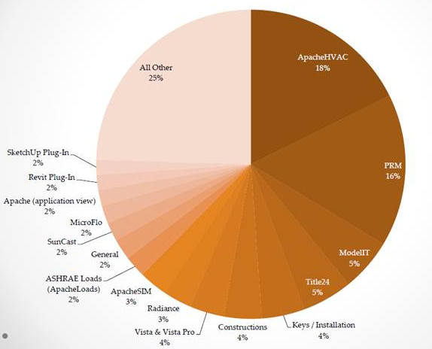
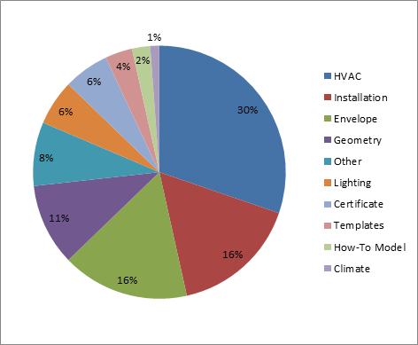
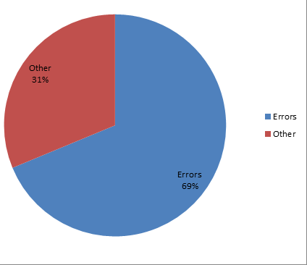
What can be done to account for user error, if anything?
Ask the software developers to remedy common user errors
Title 24 Only:
Notes:
About 70% of the support queries we receive, related to T24, are sent to us because the user received an error they needed our help with:
When users had errors, they most often spanned multiple categories, but I picked the predominant one in each query for the above. It’s no surprise that HVAC tops the list as it’s the most tedious of the inputs (at least on a project bigger than 10 rooms). Installation was a big surprise to me. Customers were super confused by v2b, v3, v3a, etc. What version of CBECC do I need? CEC approved CBECC version doesn’t match approved IES version of CBECC. How does FP2 relate to this madness? If they knew what to ask, they were confused. Usually though, customers got an error because they were running the wrong version of CBECC relative to the VE.
Envelope & Geometry are also near the top of the list almost always because (1) you have to use T24 materials and (2) convex surfaces issue.

Slide 14
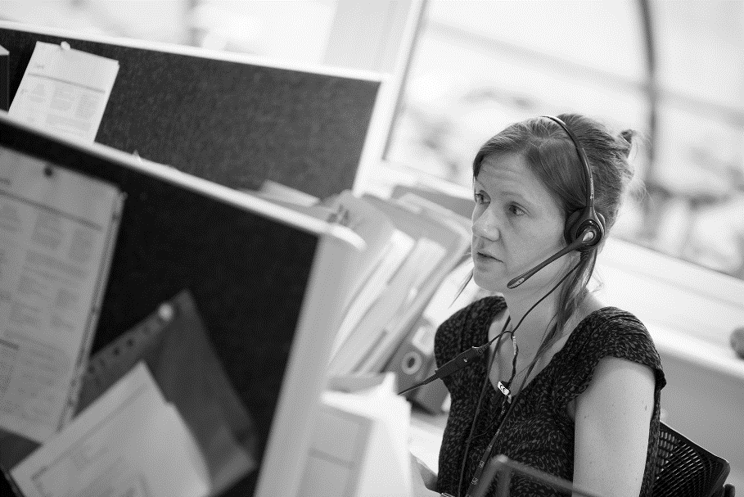
What can be done to account for user error, if anything?
Training Courses & Masterclasses about the Energy Modeling Software
  By the software companies
Training Courses about the Codes, Standards & Incentive Programs
  By the reviewers
Software Technical Support
  www.iesve.com/support
  24/7 IES support
  Telephone access to IESVE problem solvers
  Community: Forum, LinkedIn, YouTube etc
  Online bank of Tutorials and User Guides
  Email: support@iesve.com
  Pick up the Phone: +1 (404) 806 2018

