Slide 1
Selective Overview of
R&D to Improve Energy Simulation
Philip Haves
LBNL
CPUC Workshop: Energy Modeling Tools and their Applications in Energy Efficiency
September 18, 2015

Slide 2
Goal
Improve the Reliability of Energy Simulation in Use:
Practitioners: design and operation
Policy and program support – e.g. DEER
Requires:
Accurate, explicit modeling of low energy and conventional buildings and systems
Characterizing and estimating the effects of uncertainty → manage risk of investing in energy efficiency

Slide 3
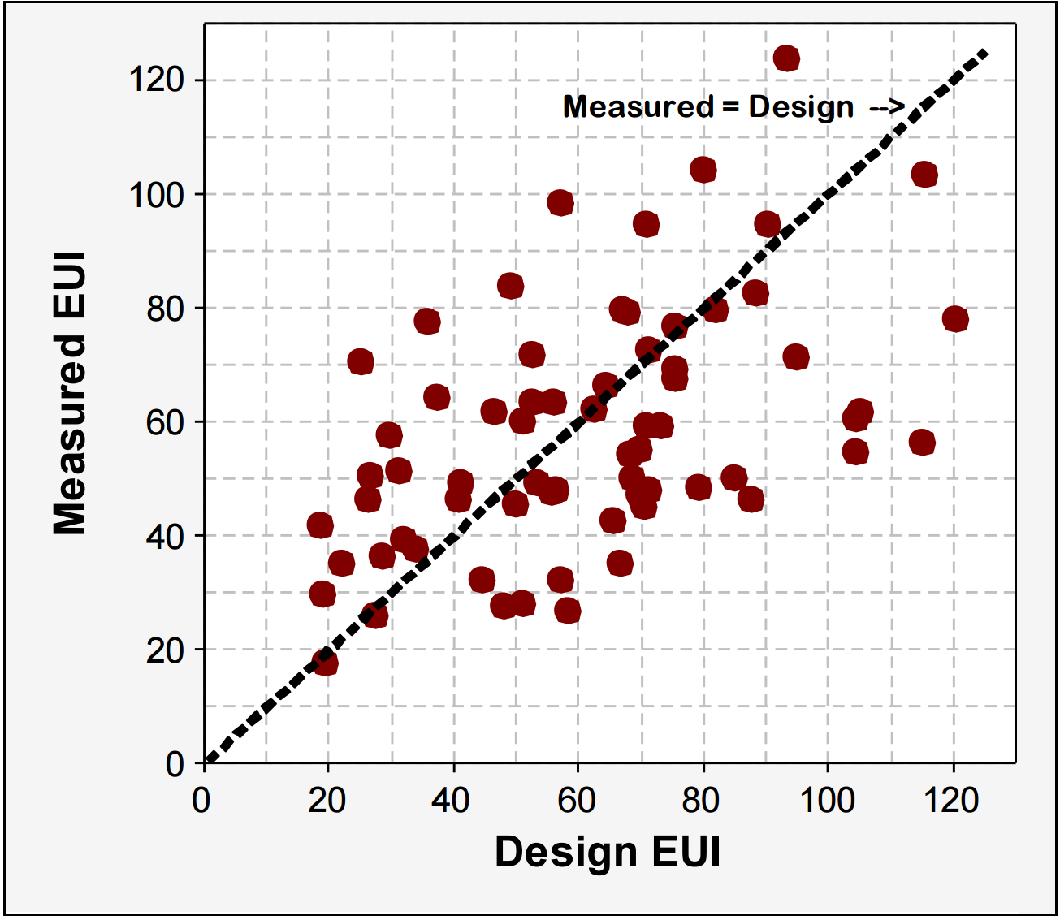
Challenge
Sources of differences:
Uncertainty:
  model algorithms
  input parameters
  modeler decisions
Variability:
  weather
  occupancy
  operation – controls, O&M
Minimize, then quantify
as-built vs. as-designed issue
for low-energy buildings
Source: Energy performance of LEED-NC buildings, NBI, 2008

Slide 4
Goals of Current Research
Validation:
Enable substantial improvements in the energy performance of new construction and major retrofits by increasing the accuracy and credibility of all energy simulation tools.
Uncertainty:
Facilitate the management of risk associated with the procurement of high performance buildings by characterizing the uncertainty of energy performance predictions.

Slide 5
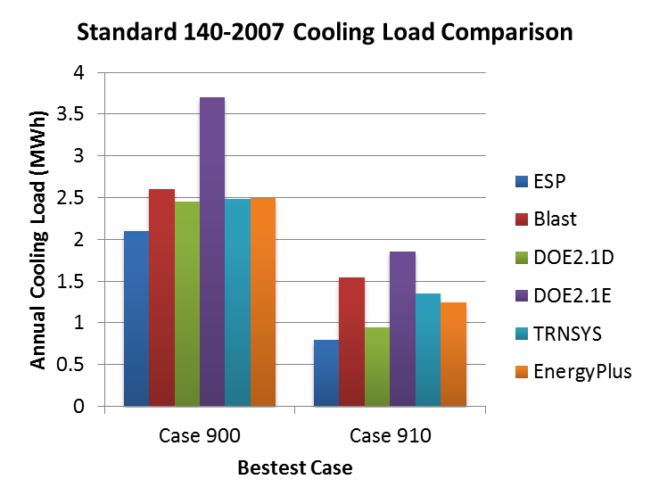
Doesn’t BESTEST Validate Energy Calculations?
ASHRAE Standard 140 Method of Test for Evaluation of Building Energy Analysis Computer Programs is based on IEA BESTEST procedures:
Standard 140 tests & partially validates energy calculations
  Analytical tests – idealized cases → partial validation
  Comparative tests - no ‘ground truth’
The Standard 140 framework
accommodates empirical tests
but does not (yet) include any
We now have facilities to
make cost-effective empirical
testing possible:
  LBNL FLEXLAB
  ORNL FRP
  NREL HVAC

Slide 6
Model algorithm validation – new DOE project
Generate sets of measured data for simulation model validation:
  Set priorities based on Validation Roadmap and input from TAG
  Conventional systems (↔ existing Standard 140 cases)
  Low energy systems
  Control of multi-zone systems
  HVAC performance maps
  EnergyPlus and commercial programs

Slide 7
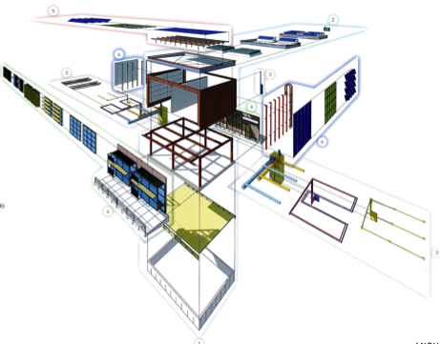
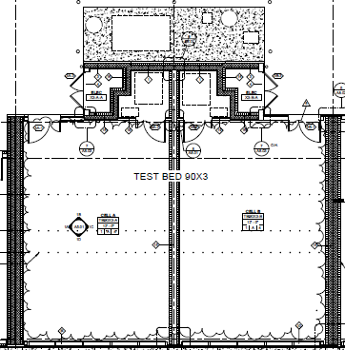
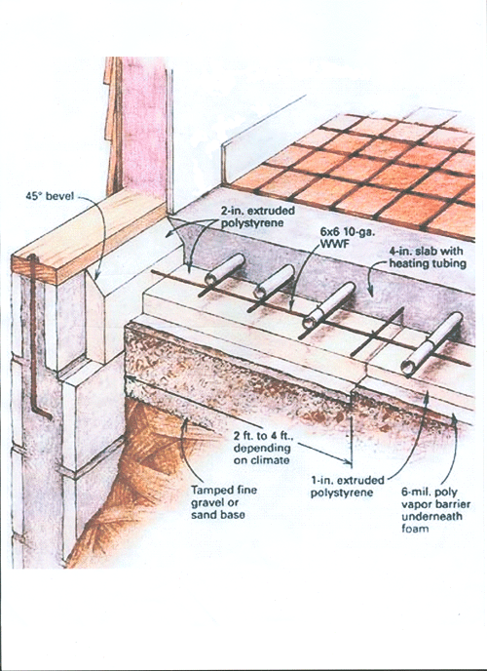
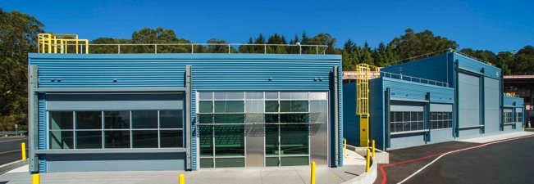
Experimental Facilities - LBNL
LBNL: FLEXLAB
4 matched pairs of 20’x30’ test cells
1 pair of cells rotates
Reconfigurable south façade
Radiant slab and panels

Slide 8
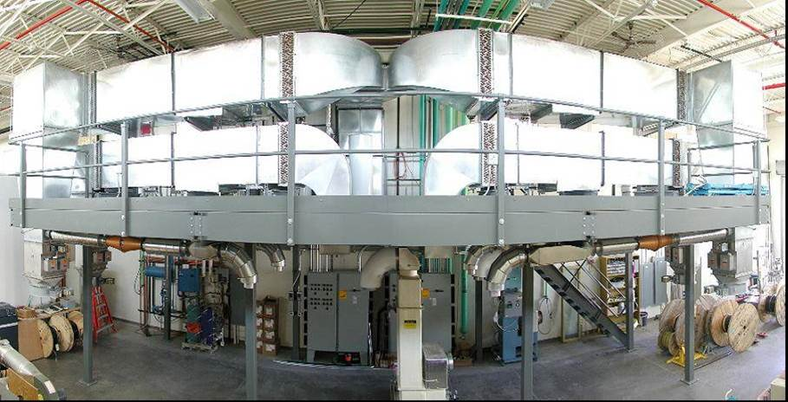
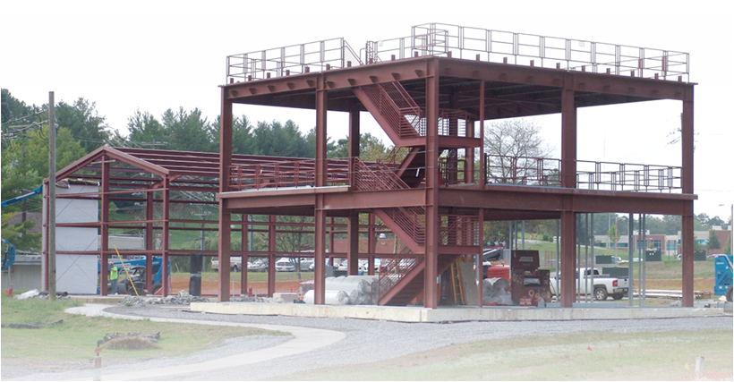
Experimental Facilities – NREL and ORNL
NREL: HVAC test facility
Performance maps of HVAC components ≤ 10 tons
Uncertainty < 5%
ORNL: Flexible Research Platforms (FRP)
Two buildings:
  Two story, 5 zones per floor
  Single story, large zone

Slide 9
Uncertainty characterization – DOE
Implement a framework for estimating the uncertainty of simulation results:
Georgia Tech – funded by NSF: probability distributions for 75 common/important input parameters:
  Insulation R-value per inch
  Luminaire power
  …
Develop a representation of ‘model form’ uncertainty driven by validation data
Extend the implementation of the input parameter uncertainty framework in OpenStudio
→ Simulation results: X±Y

Slide 10
User Variability
Experiment on 12 practicing eQuest modelers:
Each given identical plans and schedules for relatively conventional middle school – 3 hours
Input differences: internal gains, HVAC – need for more explicit modeling protocols(?)
Source: Pam Berkeley, Philip Haves and Erik Kolderup. Proc. SimBuild 2014, ASHRAE/IBPSA-USA

Slide 11
New project: Accuracy of HVAC Load Predictions -Validation of EnergyPlus and DOE-2 using FLEXLAB
    Characterize differences between EnergyPlus and DOE-2.1e and DOE-2.2
  Use FLEXLAB to adjudicate between EnergyPlus and DOE-2
  Start with ASHRAE Standard 140 Tests:
    thermal Mass
    night-set-up/setback
    night ventilation …
  Report problems with DOE-2
  Fix and document any problems with EnergyPlus

Slide 12
Conclusions
Need for ongoing development – validated models and procedures for:
  High performance new construction
  Deep retrofits
  Building operations
  Policy and program data
Impact of validation and uncertainty characterization:
  Designer confidence: direct energy savings from greater user of advanced low-energy systems and improved integrated design
  Investor confidence: management of risk → scaling up of high performance building projects

