Slide 1
EEDR Integration through TOU-friendly Energy Management Technologies
Karen Herter, Ph.D.
June 26, 2017

Slide 2
Q: Why EEDR? A1: Reduce energy use and flatten loads
Notes:
Goals:
reduce electricity demand when market prices are high to put downward pressure on system costs and customer rates
reduce the angle of the ramp

Slide 3
Q: Why EEDR? A2: Heal programmatic separation anxiety
Silos can lead to…
Inconsistency
Inefficiency
Ineffectiveness
(Insert your favorite I word here)
Is there a logical difference?
EE = kWh per daily-hour = average kW
TOU = kWh per peak-hour = average kW
DR = kWh per event-hour = average kW

Slide 4
EEDR via Pricing TOU and CPP are extremely cost-effective for homes
Note: Values would almost certainly be higher for:
TOU-CPP combo
Automation (EMTs)
Both
Estimated 10-year costs and benefits
Res Rate | Utility |  |  | Participant
 | Avoided Capacity | Avoided Energy | Benefit-Cost Ratio | Avg Monthly Bill Savings
CPP default | $ 92M | $ 2M | 55 | $4.50
TOU default | $ 42M | $ 7M | 23 | $2.00
CPP opt-in | $ 44M | $ 1M | 8 | $6.50
TOU opt-in | $ 27M | $ 5M | (1) | $2.80
Source: Energy Institute at Haas, UC Berkeley, based on SMUD pilot data

Slide 5
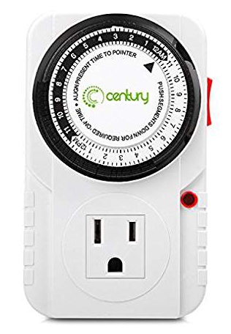
Residential EEDR Proposal Overview
Current Status
Voluntary TOU (limited participation)
Separate/siloed EE & DR funding, programs, and measures
Utilities control DR, customers control EE and TOU
Proposal: EEDR via Pricing + EMTs
Given: Default TOU coming in January 2019
Encourage customers to purchase and program EMTs
Automate TOU response
EE optimization
DR participation potential (for connected devices)
Offer low-cost TOU-friendly EMTs to low-income customers
Merge EE, TOU, and DR funding for more holistic programs
110V: $10

Slide 6
Long term vision
“California electricity consumers will have the opportunity and capability to adjust their electricity usage in response to time-varying signals reflecting economic, reliability or environmental conditions.”
- CPUC, CEC, CAISO 2008
EMTs with or without communications helpful
TOU
Default res rate in 1.5 years
EMTs with communications desired
CPP
Optional add-on with potential for default if system needs warrant
EMTs necessary
RTP
Option for those who have communicating EMTs to respond

Slide 7
Recommendations

Slide 8
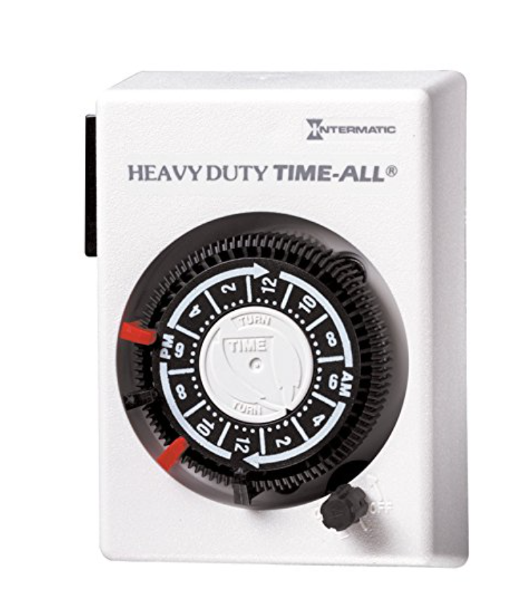
1. Integrate EE and DR into TOU education
Use customer-friendly terminology
Use site visits to look for customer opportunities (15 min)
e.g. Low-income weatherization or thermostat installation visits
Look for: electric water heating, ceiling insulation, pool, spa, EV
Lowering TOU bills is as easy as A-B-C
Act: Behavioral changes
Buy: Efficient appliances, weatherization, EMTs
Control: Automation to avoid peak use
Teach customers how to precool and peak… coast? float? slide? glide?
Teach customers to take control of their pool pump and EV schedules
Are there EMTs for scheduling electric water heaters and hot tubs?
If not, how do we make this happen?
Other ideas?
220V: $20

Slide 9
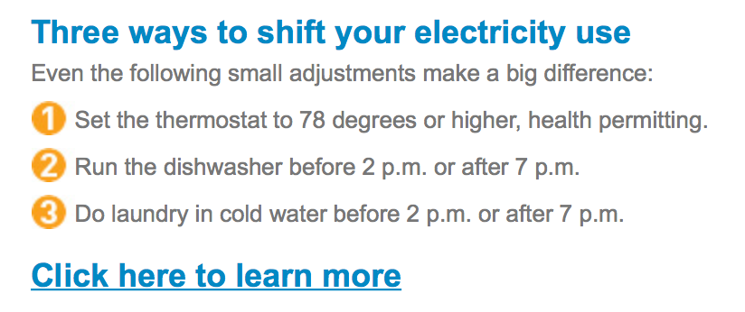
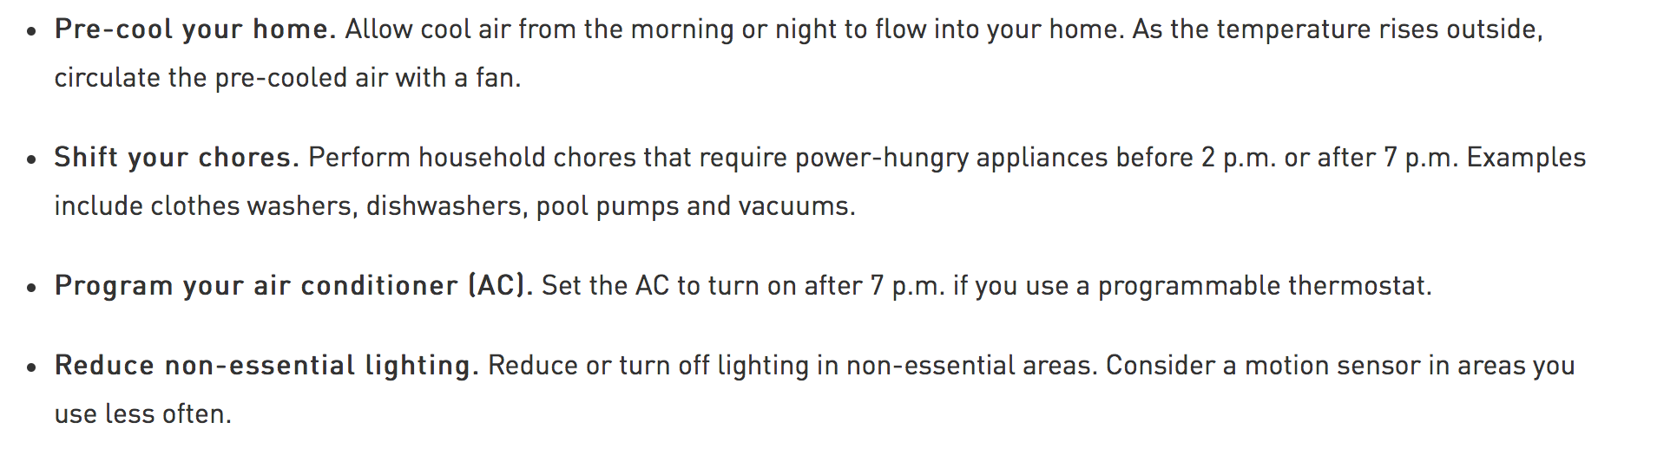
PG&E SmartRate Education – a good start
Act
Act
Act
Act
Act
Control
Act
Scoreboard
Act 6
Buy 0
Control 1
Also encourage customers to BUY
Efficient and TOU-friendly appliances
EMTs they can use to schedule loads.
Perhaps include a plug for PG&E Marketplace?

Slide 10
2. Post electricity prices (e.g. OpenADR)
Allows automation of TOU and CPP price response
OpenADR infrastructure is already in place at utilities
72 OpenADR 2.0 compliant thermostats ready for IOU programs (CEC)
Can EMTs for other loads be ready by 2019?
Electric water heaters, pool pumps, hot tubs, electric vehicles
Rumors that OpenADR thermostat programs are coming…
If true, what is the plan and schedule at each IOU?

Slide 11
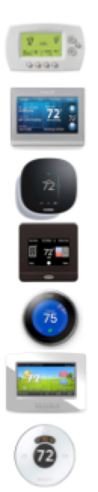
OpenADR 2.0 Thermostats (WiFi)
Q: What are the standards for default settings – and why?
Vendor | Product | Cost | $/
Honeywell | Wi-Fi 6000 | $83 | $19
Honeywell | Wi-Fi 9000 | $154 | $35
ecobee | ecobee3 | $160 | $36
Carrier | Cor | $150 | $42
Nest | 3rd Generation | $240 | $44
Venstar | Color Touch | $175 | $52
Honeywell | Lyric round | $180 | $53
$57 without WiFi
Source: California Energy Commission Title 24 OCST list, Amazon.com

Slide 12
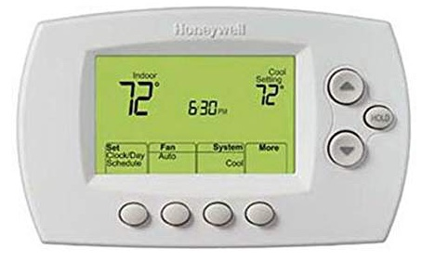
3. Encourage user-friendly EMTs
EMT = Energy Mgmt Technology ≠ Connected
Required features – communications not needed
Industry-standard terminology and default scheduling (Title 24)
Default schedules to avoid TOU peak rates
Default precooling or preheating (as appropriate)
Simple delay mechanisms for dishwashers, laundry, etc.
Usability score of at least 50%
Optional features – communications needed
Fully automated TOU and CPP price response
OpenADR compliant
Utility or 3rd party controlled DR
Whole-house energy data display
→ 3x greater TOU impacts
No WiFi: $57
WiFi: $83

Slide 13
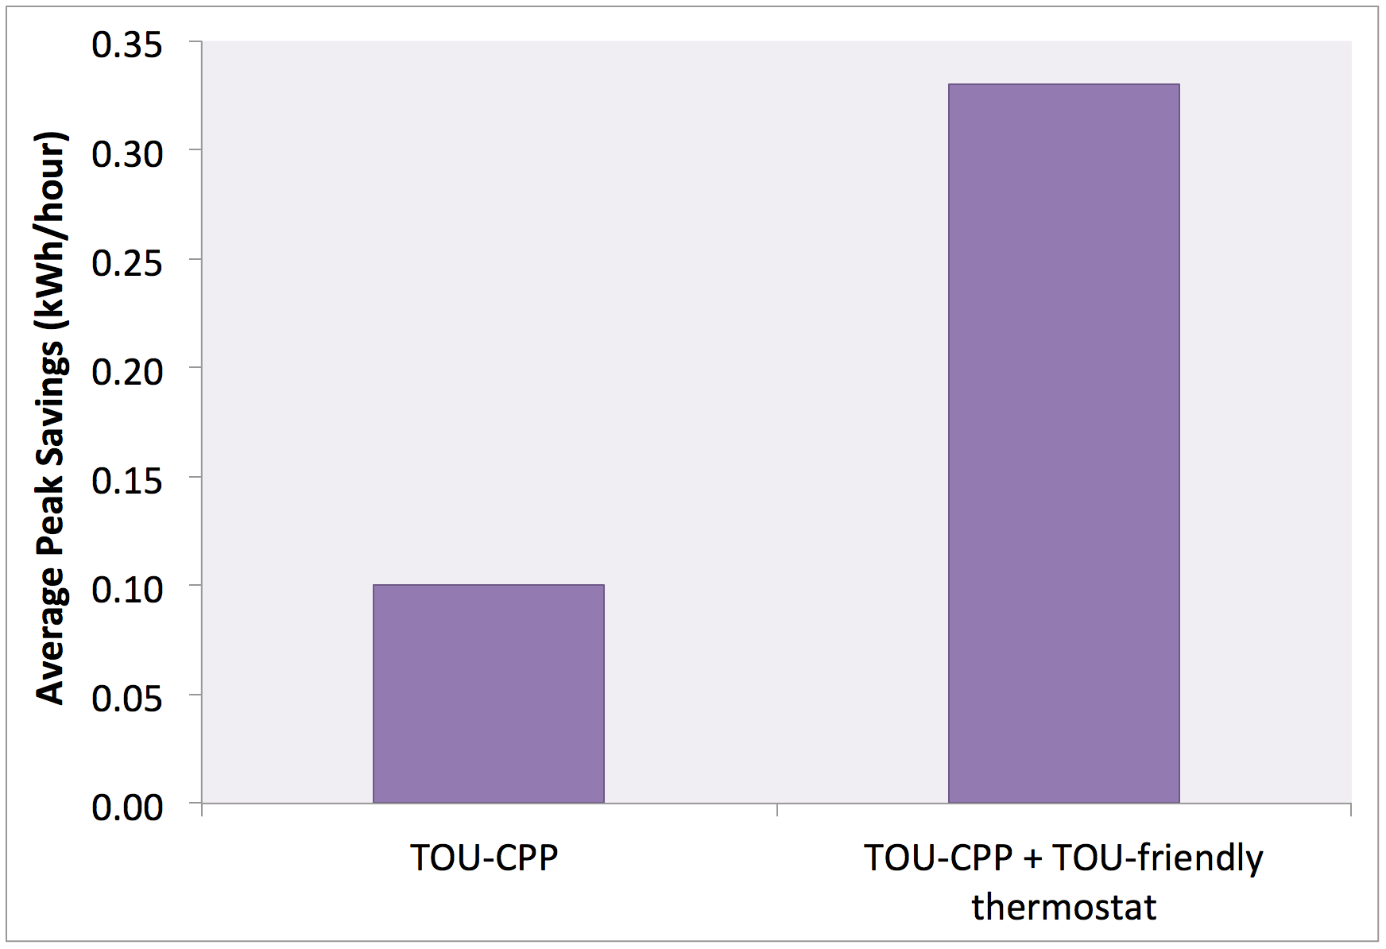
Automation → 3x greater TOU impacts
SMUD
Thermostat default preset to avoid TOU peak price
Thermostat settings not changed
Source: SMUD Multifamily Summer Solutions Study

Slide 14
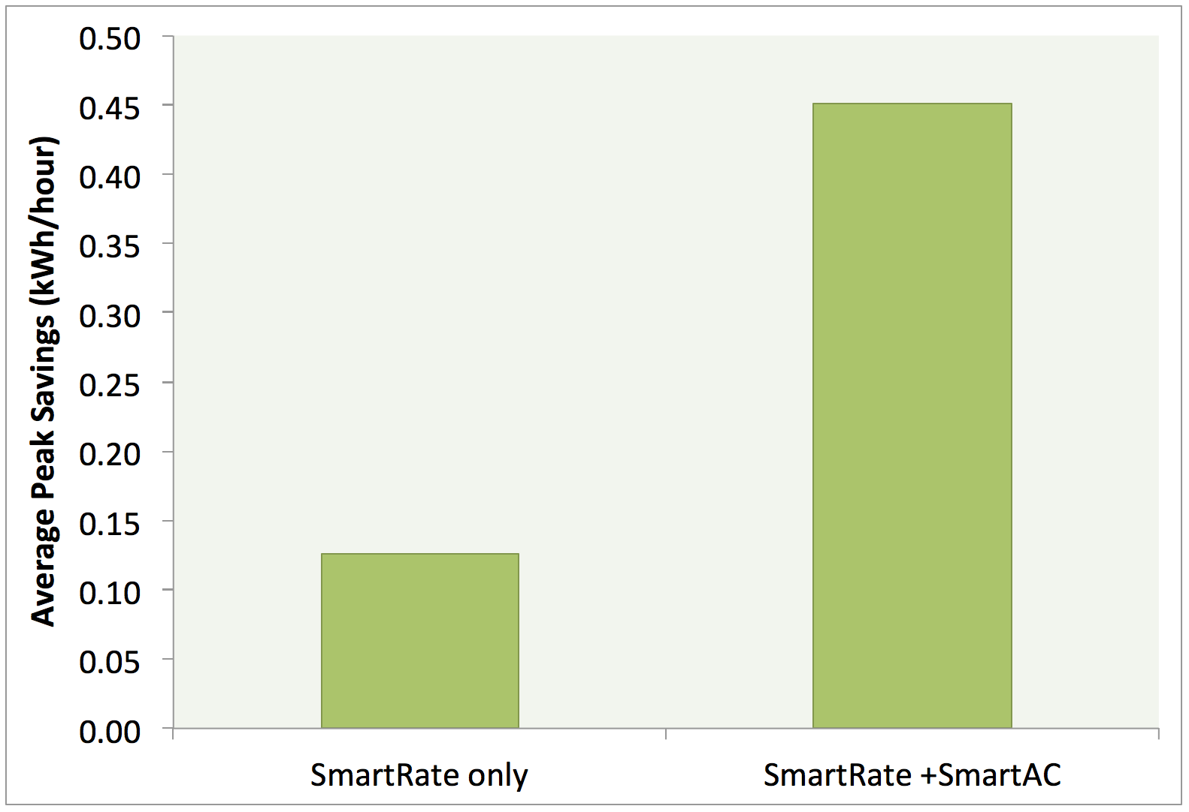
Automation → 3x greater DR impacts
PG&E
Communi-cating thermostat installed for control by PG&E
(24%)
Automation participation likely to double once Title 24 Occupant Controlled Smart Thermostats with OpenADR are offered
Thermostat not changed
(76%)
Note: SmartRate includes both CPP and TOU-CPP participants

Slide 15
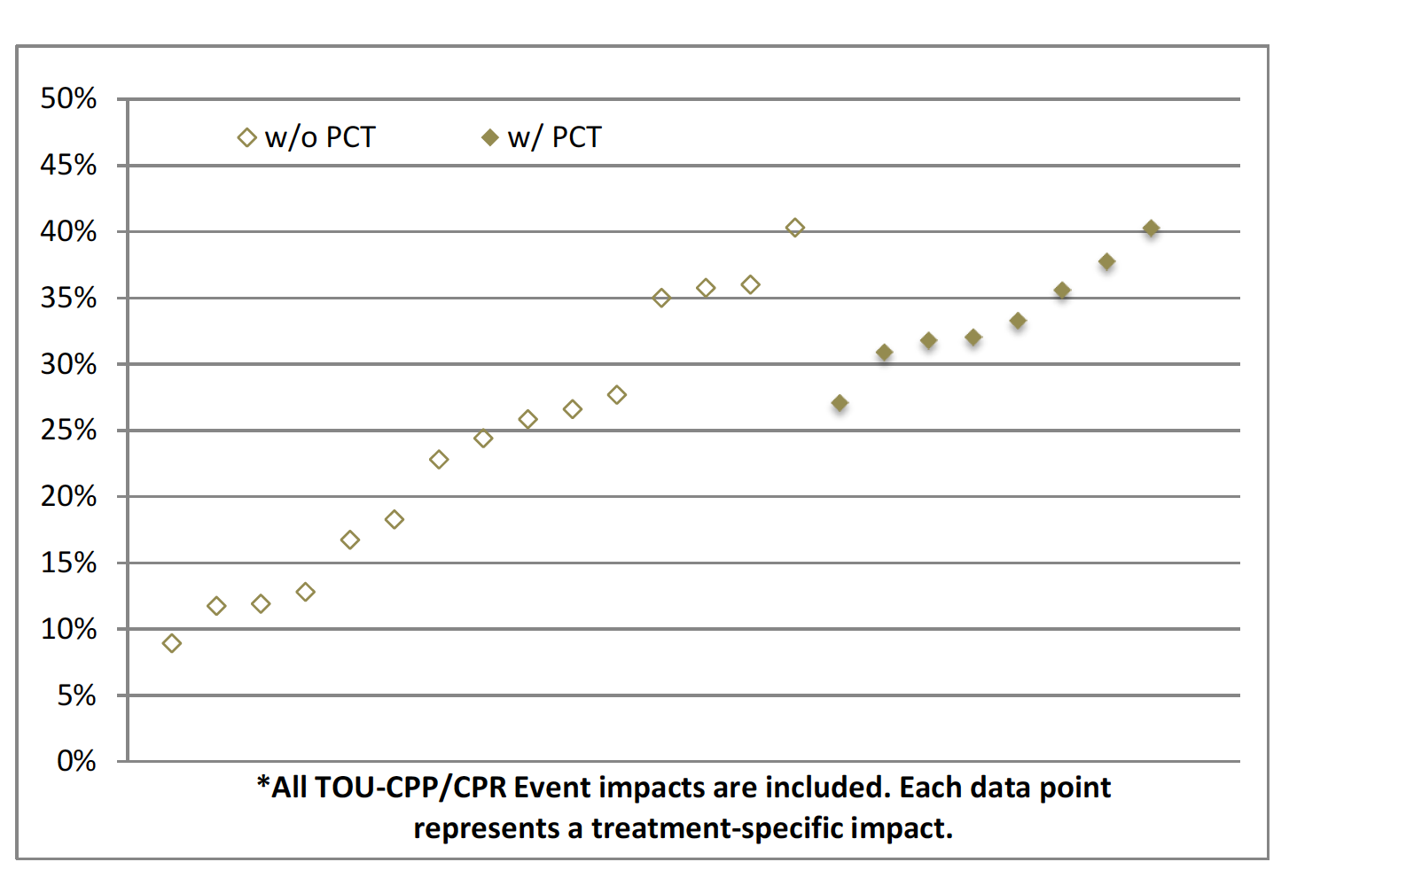
Automation → Greater DR impacts nationwide
Average event reduction values in U.S. Smart Grid Pricing studies
With automation
Without automation
Source: U.S. DOE Consumer Behavior Studies

Slide 16
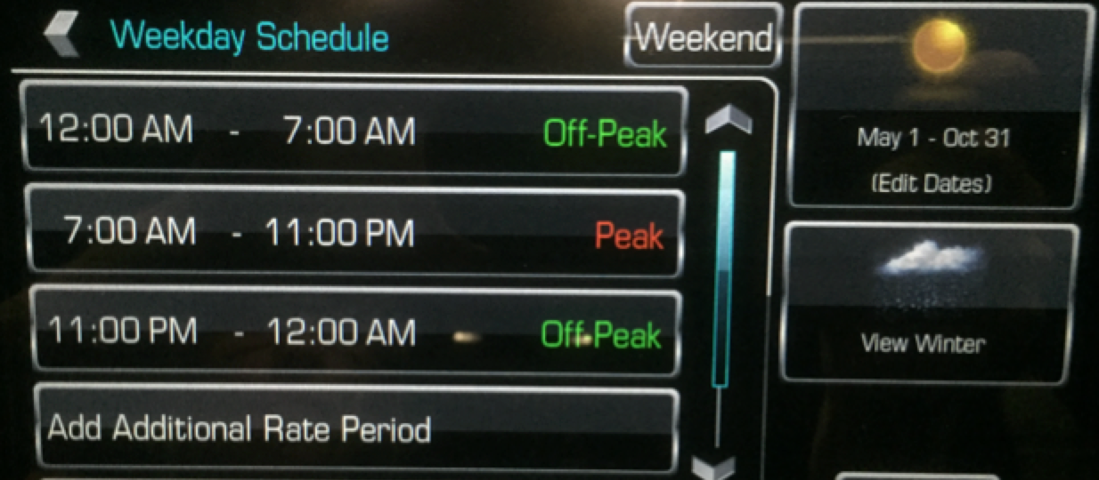
4. Standards for EE-TOU-DR scheduling
TOU-friendly rate scheduling example: Chevrolet Volt

Slide 17
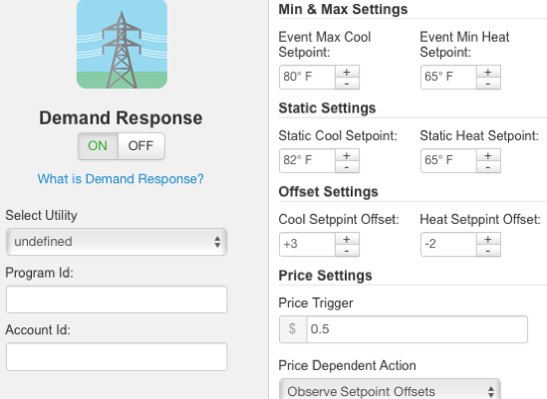
4. Standards for EE-TOU-DR scheduling
DR-friendly rate scheduling example: Venstar Color Touch
Online Settings

Slide 18
EEDR Standards - To Do List
Encourage programming features like these in more devices
Ensure that the default settings are appropriate for system needs
Work towards usability and consistency in programming so customers can easily modify defaults if desired

Slide 19
5. Address the TOU needs of low-income and other at-risk customers
TOU-friendly EMTs for low-income customers
AB793 → EMTs included in weatherization programs
Research: Nest thermostats increased low-income bills at SMUD
Recommendation: Cheap, TOU-friendly EMTs
Non-communicating TOU-friendly thermostats + precooling + insulation
…or just reprogram the old thermostat?
Plug load timers and advanced power strips?
What can we do about electric water heaters with 5-10 kW loads?
Usability is especially important here
Shoot for SUS scores of at least 60%
→ 3x greater TOU impacts

Slide 20
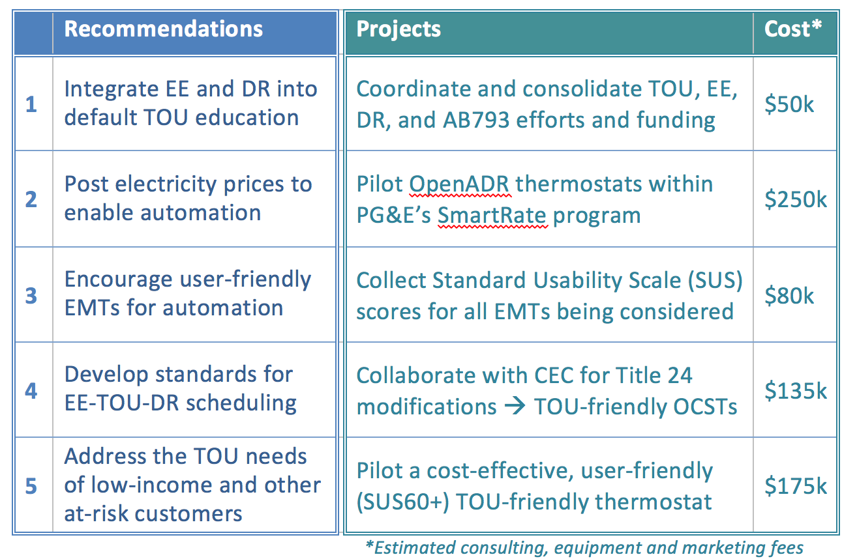
Recommendations

Slide 21
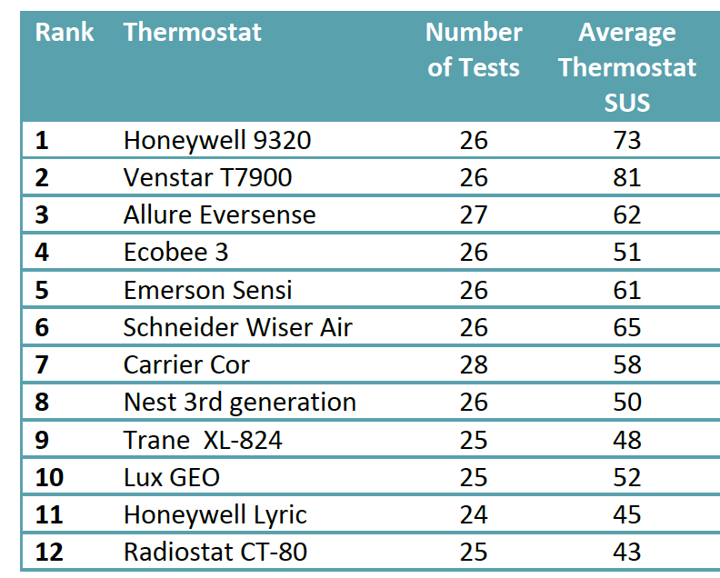
Average SUS scores for smart thermostats

Slide 22
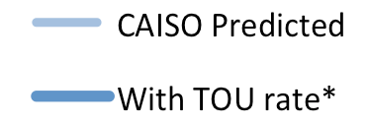
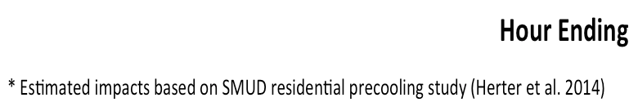
Happily Ever After: How a TOU rate might effect system loads (based on a true story*)
CAISO System Loads - August 2021
Average 2°F Precool to 76
Average 2°F Precool to 76
Average 2°F Offset to 80
Average 2°F Offset to 80
5-11 pm
Peak Rates
(decrease load)
5-11 pm
Peak Rates
(decrease load)
Discounted Rates
(increase load)
Discounted Rates
(increase load)

Slide 23
Thank you for your time
For more information:
info@HerterEnergy.com

Slide 24
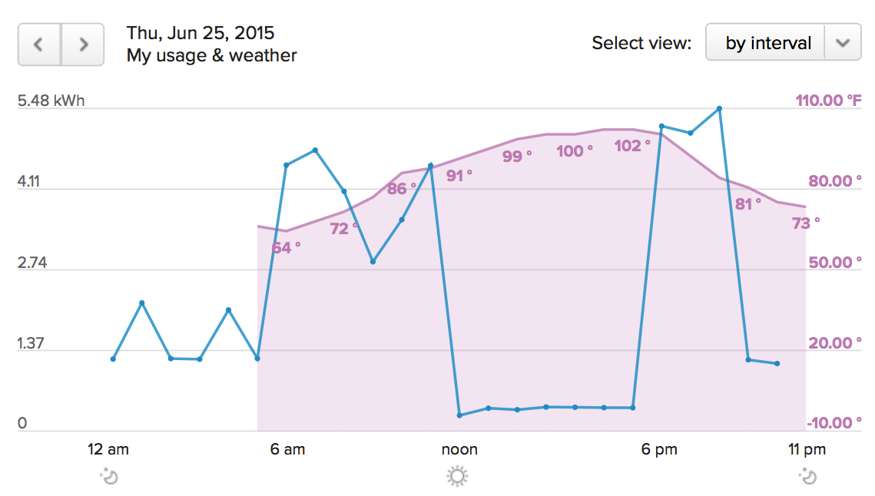
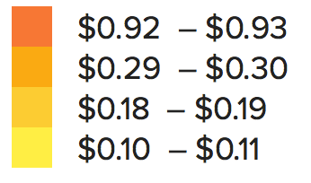
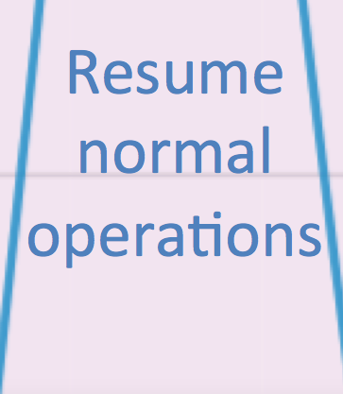
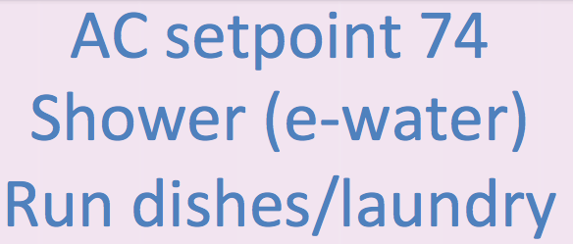

Example:
A single-family home responds to a TOU-CPP event (SmartRate)
High Price
PG&E SmartRate 2015
Colors show hourly retail rates
Actual loads at Karen’s house – Thursday June 25, 2015
AC setpoint 80
Hot tub off
Plug loads off
Efficient appliances
Good insulation
Electric vehicle
Battery charging
Notes:
Evaluation work from the Sacramento Municipal Utility District’s pricing pilot shows that more than 80 percent of customers took discrete actions to reduce loads during high cost periods, including turning off lights and electronics, deferring laundry and dishwashing, and adjusting thermostats.
Note that pricing works in similar ways in the commercial and industrial sectors

Slide 25
Dear PG&E,
Please post SmartRate prices on your OpenADR server so my VenStar can respond automatically. Thank you. - Karen

