Slide 1
Role of Codes and Standards and Energy Procurement Planning in Determining Baseline
Chris Kavalec, Demand Analysis Office
Martha Brook, Efficiency Division
California Energy Commission

Slide 2
Building Energy Efficiency Standards (BEES)
April 28, 2015
Martha Brook, P.E.
Existing Buildings
Energy Efficiency Division
mbrook@energy.ca.gov / 916-654-4086

Slide 3
Standards for Existing Buildings vs.
Standards for New Construction
Cost effectiveness analyses completed separately
Different technology costs used - retrofit product availability/cost is often different than new construction product availability/cost

Slide 4
BEES for Existing Buildings
Existing building upgrades trigger code requirements
  Building additions
  Building alterations
  Equipment replacements
  Equipment additions
Only the INCREMENTAL costs of meeting efficiency standards are used in LCCA

Slide 5
BEES Life Cycle Cost Analysis
The Warren-Alquist Act, requires the Energy Commission to develop and maintain energy efficiency standards that are “… cost effective, when taken in their entirety, and when amortized over the economic life of the structure when compared with historic practice”.
Warren Alquist Act, Public Resources Code Section 25402.

Slide 6
BEES Life Cycle Cost Analysis Assumptions – for New Construction & Existing Buildings
Net Present Value (NPV)
Residential – 30 year life used for all measures
Commercial – 30 year life for envelope measures; 15 year life used for lighting & mechanical equipment
3% real (inflation adjusted) discount rate
Energy cost metric is Time Dependent Valuation (TDV)

Slide 7
TDV metric consistent with setting Standards based on the costs/benefits to the consumer
Electricity costs:
  Transmission & Distribution
  Capacity
  Emissions
  Ancillary Services
  Losses
  Energy
  Retail Adjustment
Natural Gas costs:
  Transmission & Distribution
  Emissions
  Commodity Cost
  Retail Adjustment

Slide 8
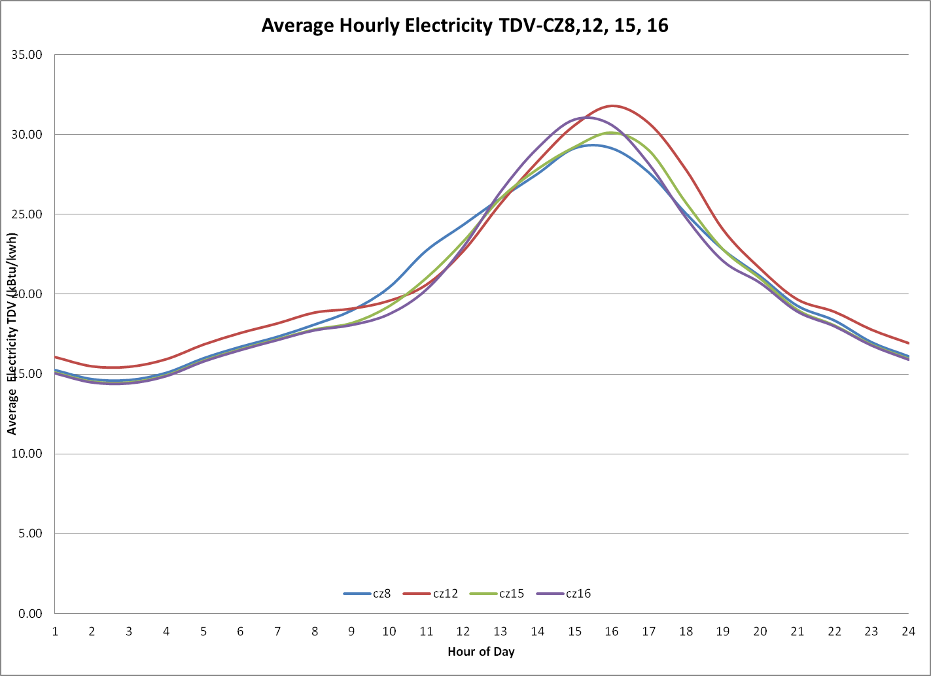
TDV values on-peak savings > off-peak savings

Slide 9
Issues to explore for EE Standards in Existing Buildings
Two separate market failures concern us:
Upgrade decision makers in the marketplace use shorter cost recovery terms than CEC uses in LCCA
  Results in upgrades being deferred
    Market actions diverge from CEC & CPUC assumptions about USEFUL LIFE
When upgrades occur, code requirements are not met
  CEC and C&S ACE program working to correct this

Slide 10
EE Standards for Existing Buildings
Another market reality in CA: BEES does not always represent the efficiency “floor”
BEES updates occur every 3 years
BEES updates do not depend on a long history of voluntary market uptake prior to code adoption
More and more often, BEES updates drive market change

Slide 11
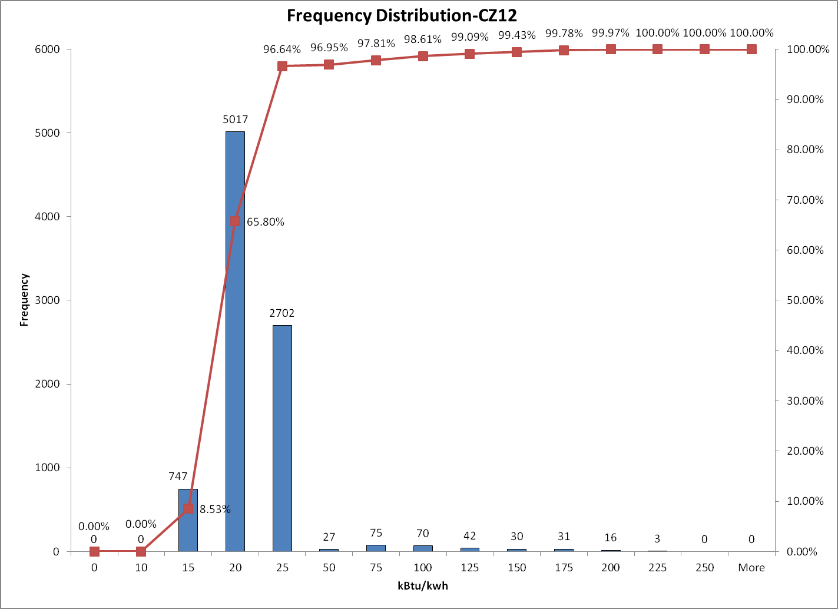
Appendix: Frequency of hourly TDV multipliers

Slide 12
Building and Appliance Standards in Energy Commission Forecasts
April 28, 2015
Chris Kavalec
Demand Analysis Office
Energy Assessments Division
Chris.Kavalec@energy.ca.gov / 916-654-5184

Slide 13
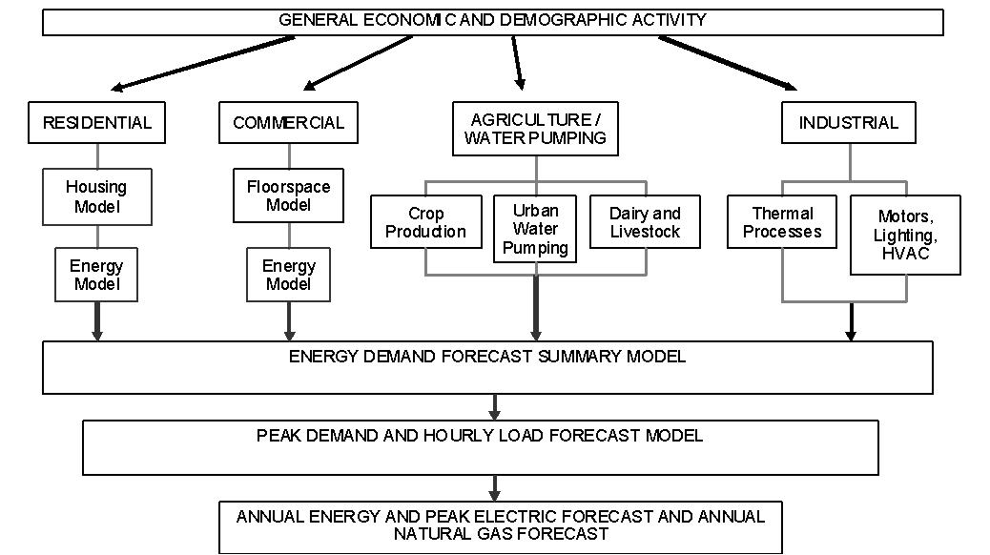
Forecast Structure

Slide 14
Residential End Use Model
3 housing types, 20 electricity end uses, and 8 natural gas end uses
Consumptione,t = HOUSESt * ASATe,t * UECe,t (e=end use, t=time)
End use and house turnover tracked within model using decay functions
These functions determine new appliances and homes in each year

Slide 15
Commercial End Use Model
12 building types, 10 electricity end uses, and 6 natural gas end uses
Energy use in forecast year "T" for a particular fuel, end use, and building type of vintage year "t" = End Use Efficiency (U_{Tt}) * Utilization * (% Floor Space Using End Use) * (New Floorspace + Floor Space Stock remaining in T) *%Occupied
End use and floor space turnover tracked in model using decay functions

Slide 16
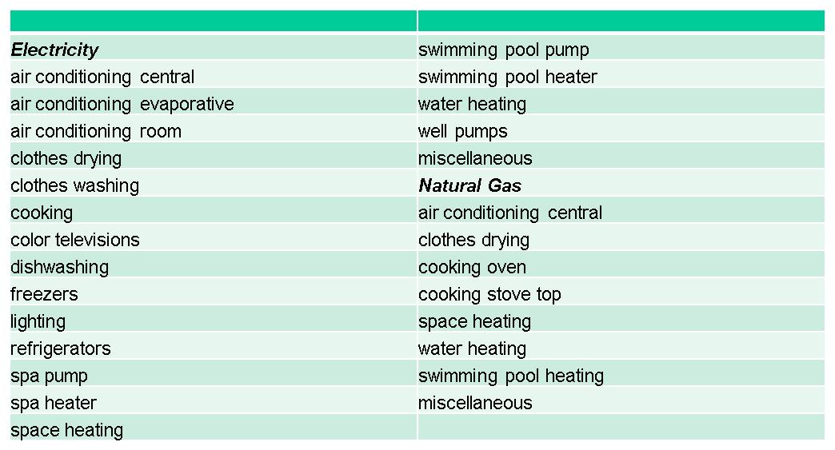
Residential End Uses

Slide 17
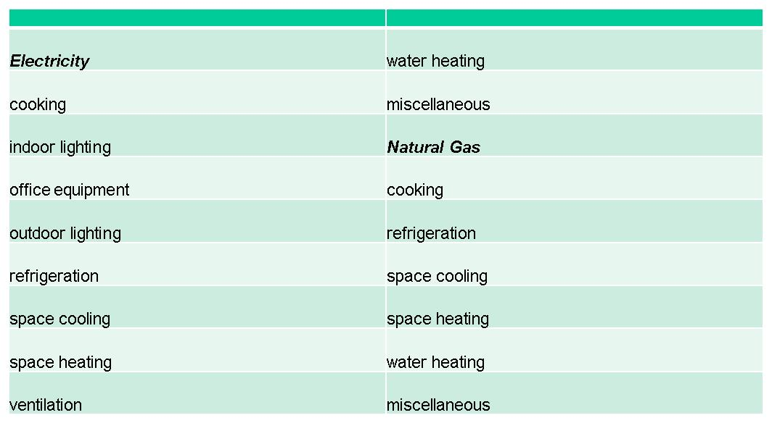
Commercial End Uses

Slide 18
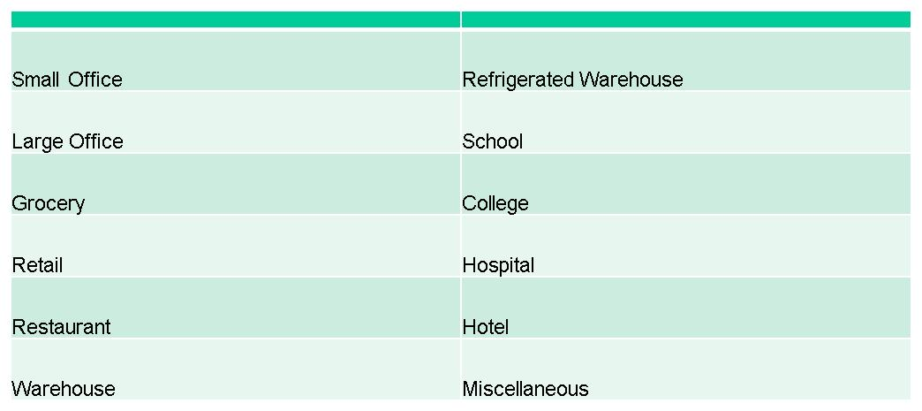
Commercial Building Types

Slide 19
Incorporating Standards
Efficiency Division provides savings by measure for building standards climate zones
Savings are mapped to forecasting climate zones and converted to percentage savings relative to a baseline by end use
Percentages are applied to UECs in the residential sector and use per square foot in the commercial
New and existing buildings

Slide 20
Incorporating Standards
Savings percentages may require adjustment
  Usage assumptions may differ
  Baseline assumptions not always available
  Not all building types represented in impact studies

Slide 21
Demand Forecast Baseline Issues
Compliance rates for existing building standards
Frequency or lack thereof of saturation surveys
Naturally occurring savings
Assumptions for appliance and building turnover
Calibration

