Slide 1
Understanding Value of Short-Duration Resources
CPUC RA Workshop
March 5, 2016

Slide 2
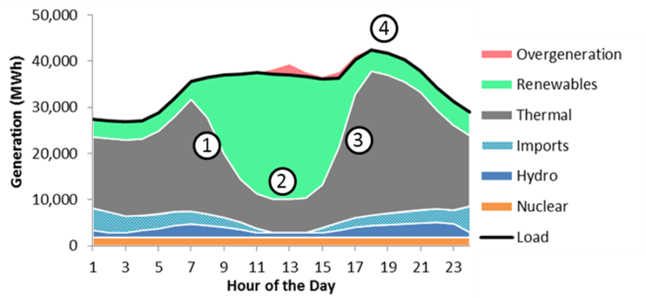
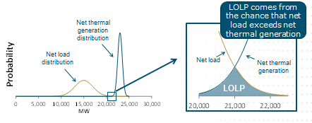
Capacity & Flexibility
The potential value of instituting resource adequacy value for short-duration resources should be considered separately for capacity & flexibility
Capacity
Can short-duration (use-limited resources) provide a reliability benefit, and if so, how can it be quantified?
Flexibility
Is there evidence to support the need for a shorter-duration ramping product to ensure flexibility adequacy?

Slide 3
Short-Duration Capacity Resources

Slide 4
Measuring Capacity Value with ELCC
Effective Load Carrying Capability (ELCC) measures the contribution of a resource to system reliability based on its ability to generate during periods of system stress (LOLP)
Unlike heuristics or rules of thumb, calculating ELCC requires technical modeling tools and is data intensive
However, ELCC is a flexible metric that can be used to measure the value of any type of resource
LOLP comes from the chance that net load exceeds net available generation
Net thermal generation distribution
Net load distribution
Net load
Net thermal generation
LOLP

Slide 5
ELCC and Demand Response Resources
Many factors impact the efficacy of demand response as a capacity resource
  DR programs are commonly available only certain months, hours, and day-types (weekend/weekday)
  DR programs are also subject to additional uncertainty
  Forecast error, uncertainty availability, variable response rate
ELCC for demand response calculated as the product of “A factor” and “D factor”
  Availability – The ability to be called in any hour. This should reflect the hours when a capacity shortage could occur (0-100%)
  Dispatchability – The number of times, duration, and frequency that may occur based on the program design (0-100%)

Slide 6

Dispatchability Table
The dispatchability table shows the effectiveness of a limited number of demand response calls with limited duration relative to an unlimited demand response resource
For example, 15 DR calls with a duration of 7 hours each is an equivalent capacity resource to an unlimited number of DR calls with unlimited duration
Duration of Call (hrs)
 | 1 | 2 | 3 | 4 | 5 | 6 | 7 | 8 | 9 | 10
1 | 9% | 17% | 20% | 21% | 22% | 22% | 22% | 22% | 22% | 22%
2 | 16% | 28% | 34% | 38% | 39% | 39% | 39% | 39% | 39% | 39%
3 | 23% | 39% | 48% | 52% | 53% | 54% | 54% | 54% | 54% | 54%
4 | 26% | 46% | 58% | 64% | 66% | 66% | 66% | 67% | 67% | 67%
5 | 30% | 52% | 64% | 70% | 72% | 73% | 73% | 73% | 73% | 73%
6 | 33% | 58% | 72% | 79% | 81% | 81% | 82% | 82% | 82% | 82%
7 | 36% | 64% | 78% | 85% | 87% | 88% | 88% | 88% | 88% | 88%
8 | 37% | 65% | 80% | 87% | 89% | 90% | 90% | 90% | 90% | 90%
9 | 39% | 67% | 83% | 91% | 92% | 94% | 94% | 94% | 94% | 94%
10 | 39% | 69% | 86% | 93% | 96% | 97% | 97% | 97% | 97% | 97%
11 | 41% | 71% | 87% | 95% | 96% | 98% | 98% | 98% | 98% | 98%
12 | 41% | 72% | 88% | 96% | 98% | 99% | 99% | 99% | 99% | 99%
13 | 41% | 72% | 88% | 96% | 98% | 99% | 99% | 99% | 99% | 99%
14 | 41% | 73% | 88% | 96% | 98% | 99% | 99% | 99% | 99% | 99%
15 | 42% | 73% | 88% | 96% | 98% | 99% | 100% | 100% | 100% | 100%
16 | 42% | 73% | 88% | 96% | 98% | 99% | 100% | 100% | 100% | 100%
17 | 42% | 73% | 88% | 96% | 98% | 99% | 100% | 100% | 100% | 100%
18 | 42% | 73% | 88% | 96% | 98% | 99% | 100% | 100% | 100% | 100%
19 | 42% | 73% | 88% | 96% | 98% | 99% | 100% | 100% | 100% | 100%
20 | 42% | 73% | 88% | 96% | 98% | 99% | 100% | 100% | 100% | 100%
Number of Calls per Year
Dispatchability table derived for DR programs using RECAP model

Slide 7
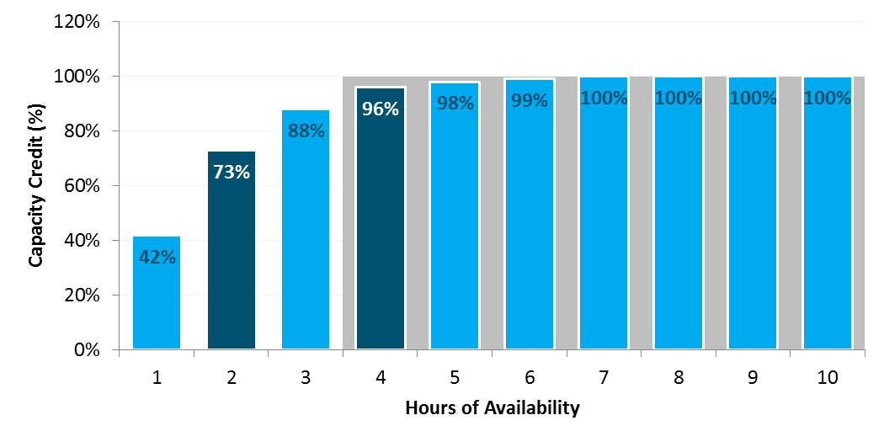
Value of Shorter Duration Capacity Products
A two-hour capacity product would provide a significant share of the capacity value provided by the current capacity product
Capacity value is not limited to discrete intervals; the value provided by resources with short durations of availability can be measured through ELCC techniques
Two hour product provides 73% of the value of a perfectly reliable resource
Four hour product provides 96% of the value of a perfectly reliable resource

Slide 8
SHOrt-Duration RESOurces & Flexibility

Slide 9
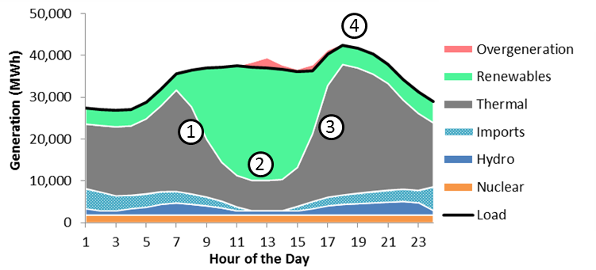
Flexibility Planning Challenges
1. Downward ramping capability
  Thermal resources operating to serve loads at night must be ramped downward and potentially shut down to make room for a significant influx of solar energy after the sun rises.
2. Minimum generation flexibility
  Overgeneration may occur during hours with high renewable production even if thermal resources and imports are reduced to their minimum levels. A system with more flexibility to reduce thermal generation will incur less overgeneration.
3. Upward ramping capability
  Thermal resources must ramp up quickly and new units may be required to start up to meet a high net peak demand that occurs shortly after sundown.
4. Peaking capability
  The system will need enough resources to meet the highest peak loads with sufficient reliability.
5. Sub-hourly flexibility (not shown in chart)
  Flexible capacity needed to meet sub-hourly ramping needs.
There are a number of potential flexibility constraints that can become binding at various times and on various systems.

Slide 10
Many Resource Characteristics Can Be Important for Flexibility
Characteristic | How it helps with system flexibility
Upward ramping capability on multiple time scales: 1 minute, 5 minutes, 20 minutes, 1 hour, 3 hours, 5 hours | Helps meet upward ramping demands
Downward ramping capability on multiple time scales: 1 minute, 5 minutes, 20 minutes, 1 hour, 3 hours, 5 hours | Helps meet downward ramping demands
Minimum generation levels | Lower minimum generation levels can help meet upward ramping needs while avoiding overgeneration
Start time | Faster start times help meet upward ramping demands
Shut-down time | Faster shut-down times help avoid overgeneration
Minimum run times | Shorter minimum run times help avoid overgeneration
Minimum down times | Shorter minimum down times can help meet upward ramping needs
Number of starts | If starts are limited under air permits, units are less available to meet ramping needs

Slide 11
Lessons Learned from Flexibility Modeling
Unlike in resource adequacy, there is no single metric that can be used to measure the adequacy of the flexibility of an electric system
  Too many “flavors” of flexibility
  Flexibility is a matter of economics—not reliability
Modeling results have not indicated that upward ramping capability across multiple hours is not a binding constraint for the California system
  Primary challenge for California system is how much energy can be absorbed in the middle of the day
“Must offer obligation” is a key part of the FRAC-MOO program

Slide 12
Thank You!
Energy and Environmental Economics, Inc. (E3)
101 Montgomery Street, Suite 1600
San Francisco, CA 94104
Tel 415-391-5100
Web http://www.ethree.com
Nick Schlag, Managing Consultant (nick@ethree.com)

