Slide 1
SCE Plug-In Electric Vehicle (PEV) Workplace Charging DR Pilot (WPC) Status
DRMEC Meeting
May 10-11, 2016

Slide 2
PEV Workplace Charging Pilot Background
Approved by the California Public Utilities Commission and funded by ratepayers as part the SCE 2012-2014 Demand Response (DR) Application (A.11-03-003).
Pilot Timeframe: January 2013 – December 2015.
Pilot Objectives:
Gain a better understanding of consumer behavior related to fee-based charging and DR events.
Evaluate technologies that support non-proprietary charging options and an open communications standard (OpenADR 2.0b).
Measure system and building load impacts related to plug-in electric vehicle charging.
Better quantify DR potential of EV charging in the workplace.
Help determine the balance between DR and customers’ needs for EV charging at the workplace.
Advise business customers regarding the costs, benefits, and impacts of workplace charging to inform future installation plans at customer properties.

Slide 3
PEV Workplace Charging DR Pilot Schedule
August 2009 | CPUC directed utilities to consider alternative-fuel vehicle tariffs, infrastructure and policies to support CA GHG emissions reductions goals (R.09-08-009).
March 2011 | SCE proposed the PEV Workplace Charging Pilot in its 2012-2014 DR Application (Tariffs Programs & Services).
June 2012 | SCE filed AL-2746-E pursuant to OP80 of D.12-04-045, which outlined 9-point pilot plan.
December 2012 | SCE filed AL-2746-E-A to supplement its 9-point pilot plan as required by the CPUC.
January 2013 | CPUC approved the SCE Workplace Charging pilot. SCE Transportation Electrification (TE) assumed project management lead role.
September 2013 | 2nd EV User Survey was conducted with SCE/EIX employees and used as the basis for installation site selection.
October 2013 | Competitive solicitation completed and bidder selected.
December 2013 | SCE New Product Development & Launch assumed project management lead role. Site selection and installation plan completed; Design & engineering activities started.
June 2014 | New construction activities started; Technical Requirements finalized; Purchase Order issued.
September 2014 | Construction and Installation Activities Completed.
October 2014 | EV Chargers Operational and Baseline Data Gathering Phase Launched: Complimentary Charging.
December 2014 | Baseline Data Gathering Phase Completed.
January 2015 | Pilot Execution Phase Launched: Fee-based EV Charging started.
May 2015 | DR Testing Phase Launched: DR Events started.
August 2015 | Space Management Testing Phase Launched: Non-Charging Occupancy Fee started.
December 2015 | Pilot Completion Date: 12/31/2015
Q1-Q2 2016 | Transition 80 EV chargers to outsourced operation and management while continuing enabled functionality.
May 2016 | Present SCE PEV Workplace Charging DR Pilot status update at the DRMEC Meeting.
Q3 2016 | File SCE PEV Workplace Charging DR Pilot final report with the CPUC.

Slide 4
PEV Workplace Charging Pilot Activities
Installed 80 EV charging stations (EVSEs) at 9 SCE facilities to evaluate workplace charging.
Curtailed charging during 20 DR events from May - December 2015 to measure:
  consumer response to demand response events
  DR potential from EV chargers
Tested innovative communication processes and open standards (OpenADR 2.0b).
Tested non-proprietary payment options.
Tested multiple pricing strategies to measure consumer response to fee-based charging.
Tested space management control using a non-charging occupancy fee.

Slide 5
Preliminary 2015 Workplace Charging Pilot Data
75% of drivers opted to charge at Level 2 (208V) when charging in the workplace.
  Pilot realized almost 10,500 Level 2 sessions vs. 3,400 Level 1 sessions.
65% of drivers complete charging within 3 hours.
Nearly 58,500 kg (130,000 lbs) of GHG Emissions Reductions were achieved by SCE employees and visitors during 2015.
  Approximately 11,500 kWh of energy was consumed per month to achieve the reduction.
  84% of GHG emissions reductions resulted from Level 2 (208V) charging.
EV drivers saved almost 25,000 gallons of gasoline (e.g., gallons per kWh).
The 80 Pilot charging stations served 584 unique drivers during 2015.
On average, over 1,100 sessions per month were authorized under varying Level 1 and Level 2 pricing strategies.
86% of drivers disconnected within 30 min. of completed charging due to real-time notifications and space management controls (e.g., non-charging occupancy fee).
The large majority of charging sessions occurred during off-peak pricing hours (e.g., 12:00 AM-noon; 6:00 PM to 11:59 PM).
  81% of sessions occurred during off-peak pricing hours vs. 19% during on-peak hours.

Slide 6
WPC Pilot Statistics and Preliminary Findings
Data Timeframe: January – December 2015
Per Session kWh Consumption | Energy consumption ranges from 2.74 kWh – 19.42 kWh per session for 85% of sessions executed during 2015. | Energy Consumed dependent upon Charging Level Selected and Battery Size
Per Session Revenue (Transaction fees of 2.9%+$0.30 deducted from revenue amount.) | During 2015: Revenue per session normally ranged from $0.35 to $18.28 | Revenue dependent upon Charging Level Selected, Rate in Effect, Penalties Applied, and Charging Duration.
Charging Time | Majority complete within 3 hours. 2 hours: 28% 3 hours: 37% 4 hours: 17% | Charging Time dependent upon Connection Time, Rate in Effect, Battery Size, and Charge Status
Charging Level Selected | Level 1: 25% of total sessions Level 2: 75% of total sessions
GHG Savings Achieved by Charging Level Selected | Level 1: 16% of total GHG savings Level 2: 84% of total GHG savings

Slide 7
Preliminary 2015 Pilot Demand Response Data
  20 DR events were dispatched during 2015, which resulted in total energy curtailment of almost 900 kWh.
  All events were dispatched for 1 hour.
  50% of the events were dispatched between 7:30 AM and 10:00 AM
  50% of the events were dispatched between 1:00 PM and 2:00 PM
80% of DR load curtailment was provided by Level 2 (208V) charging.
76% of sessions participating in the DR events occurred during AM hours.
  Aligns with the preliminary finding that the majority of workplace charging occurs between 5:00 AM – 12:00 PM.
  The average amount of energy curtailed during AM events was 67 kWh
  The average amount of energy curtailed during PM events was 21 kWh
  The time of DR event dispatch did not significantly impact driver participation.
  76% of drivers participated in DR events dispatch between 7:30 – 10:00 AM
  72% of drivers participated in DR events dispatch between 1:00 – 2:00 PM.

Slide 8
Appendix

Slide 9
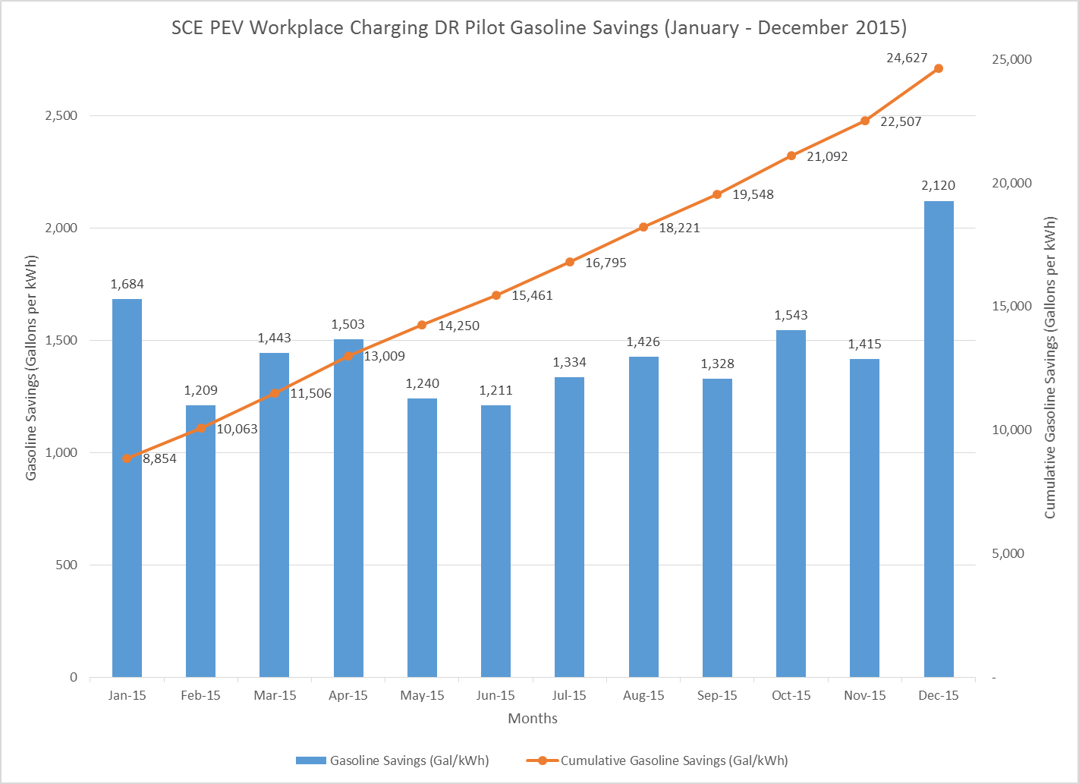
Preliminary 2015 Gasoline Savings

Slide 10
Preliminary WPC Pilot Behavioral Findings
Commute distance and convenience impact the charging decision for most drivers.
33% of 2015 survey respondents noted HOV access as the primary reason for buying/leasing a PEV, with an equal number noting high gas prices.
EV ownership among SCE employees increased almost 500% from 2012 to 2016 (i.e., 58 to 342) based on 2016 survey responses.
BEV drivers are more tolerant of fee-based charging than hybrid EV drivers.
Gasoline prices impact the charging decision for hybrid PEV drivers.
Availability of EV charging in the workplace influences employee EV buy/lease decisions.
The large majority of drivers chose Level 2 (208V) charging in the workplace.
The large majority of drivers opted to charge during AM hours.
The time of DR event dispatch did not significantly impact driver participation.

Slide 11
2016 Employee Survey: Significant Findings
EV Ownership
  Own BEV: 131 employees (4.1% of respondents)
  Own PHEV: 167 employees (5.3% of respondents)
  Own Both BEV and PHEV: 22 employees (<1% of respondents)
Workplace Arrival & Departure Time
  Employees with >50 mile commute more frequently arrive before 7:00 a.m. and depart before 4:00 p.m.
EV Driving and Charging Behaviors
  Probability that an EV owner would drive their EV to work directly correlates to commute distance.
    84% of EV owners drive their EV to work daily (4-5 days a week)
  Probability that an EV owner would charge more days at work directly correlates to commute distance.
    EV owners with >30 mile commute are more likely to charge at work 4-5 days per week vs drivers with shorter commute
    33% of EV owners charge their EV at work daily
    25% of EV owners never charge at work due to lack of employee-accessible charging stations
    77% of EV owners would plan to charge more often if more stations were available while 60% would plan to charge every day
      Finding does not consider fee-based vs free charging.

