Slide 1
SCE Summer Discount Plan
2015 Ex Post and Ex Ante Impact Estimates
Prepared by:
Aimee Savage
May, 2016

Slide 2
Program Description
The SCE Summer Discount Plan (SDP) uses direct load control of central air conditioning to curtail residential and commercial usage on DR event days.
    Participants earn a bill credit throughout the summer months based on which cycling option they select.
    Events are called within load control groups where DR is needed – not all customers are called for every event.
The residential program has over 305,000 participants and offers two cycling strategies.
    30 residential SDP events were called in 2015
The commercial program has over 11,000 participants and offers three cycling strategies.
    16 commercial SDP events were called in 2015
Cycling Strategy | Number of Customers | % of Customers | AC Tonnage | % of AC Tonnage
100% | 270,890 | 89% | 1,145,437 | 89%
50% | 34,821 | 11% | 144,911 | 11%
All | 305,711 | 100% | 1,290,348 | 100%
Cycling Strategy | Number of Customers | % of Customers | AC Tonnage | % of AC Tonnage
30% | 949 | 8% | 35,173 | 8%
50% | 2,770 | 24% | 118,798 | 27%
100% | 7,749 | 68% | 287,961 | 65%
All | 11,468 | 100% | 441,933 | 100%

Slide 3
Program Description
Hours of Availability | 2015 Hours of Actual Use | Available for Dispatch | No. of Actual Dispatches
180 hours annually | 35 | Reliability Events = Year Round 24/7 Economic Events = All Non-SCE Holiday Weekdays, up to 4 hours, no more than 3 consecutive days | 30

Slide 4
Ex Post Methodology
Impact estimates were developed using a matched control group
    Two different control groups were assembled: one for the commercial SDP population and one for the residential SDP population.
    The control groups were selected using a propensity score match to find customers who had load shapes most similar to SDP customers on hot, non-event weekdays.
    Matching was performed within specific customer segments (weather station, industry, etc.).
    A difference-in-differences approach was used by subtracting the difference between the control and treatment customers on the hot non-event days from the difference between the groups on event days.

Slide 5
Ex Post Impacts
During the SCE system peak, September 8 from 4 to 5 PM, residential customers provided 347 MW and commercial customers provided 74 MW
    The temperature reached over 98 degrees Fahrenheit during this hour
    SDP events are dispatched locally and not all customers were called on this day
There were no SDP events during the CAISO peak on September 10

Slide 6
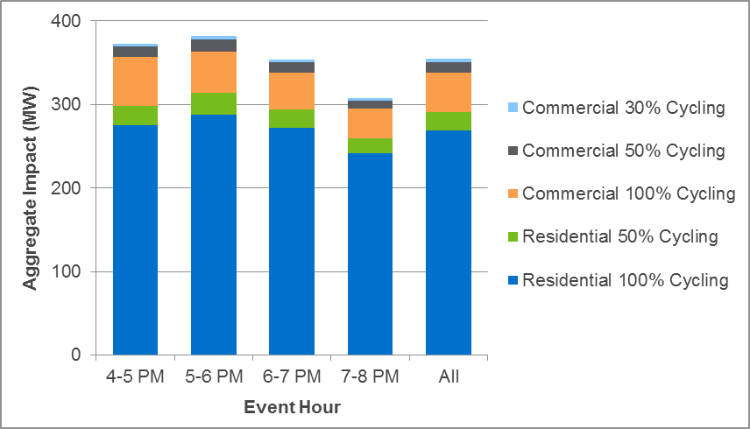
Ex Post Impacts
On September 9, 2015, SCE called all residential and commercial customers on SDP from 4 to 8 pm
From 5 to 6 PM, the entire SDP program delivered a 382 MW load reduction
Most of the load impacts came from residential SDP customers with the 100% cycling option

Slide 7
Ex Post Impacts (Residential)
September 9 was a territory-wide residential SDP event.
Approximately 296,700 participants provided an aggregate impact of 291.5 MW.
The average customer reduced demand by 0.98 kW during event period (4 to 8 PM).

Slide 8
Ex Post Impacts (Commercial)
September 9 was a territory-wide commercial SDP event.
Approximately 11,500 participants provided an aggregate impact of 63.1 MW.
The average customer reduced demand by 5.51 kW during event period (4 to 8 PM).

Slide 9
Ex Ante Methodology
At a high level, ex ante impact estimates for SDP were developed using the following multi-step process:
    First, ex post estimates were developed for SDP customers for 2015 using the matched control group methodology
    Second, regression models were estimated that relate ex post load impacts in each hour from 4 to 8 pm to average temperatures from midnight to the hour of interest (referred to as mean17, mean18, and so on) on the event day. Separate models were estimated for each AC cycling strategy, hour, and demand category (for commercial customers).
    Third, ex ante weather conditions were used as input to the regression models to predict impacts for each hour for monthly system peak days from January through December and for the typical event day.
    A similar method was used to estimate reference loads.
    Finally, ex ante impact estimates were adjusted to apply to the RA window from 1 to 6 pm for the summer and 4 to 9 pm for the winter.

Slide 10
Ex Ante Methodology
There were slight differences between the ex ante methodology for residential and control customers (customer segmentation, for example)
The scatterplot below illustrates the ex ante model for residential customers (ex post impacts vs. Mean17)

Slide 11
Enrollment Forecast
Enrollment in the residential and commercial SDP programs are expected to decline somewhat sharply between 2016 and 2026
Residential enrollments are expected to fall from 275k to about 65k from 2016 to 2026
Commercial enrollments are expected to fall from 11.6k to 4.2k from 2016 to 2026

Slide 12
Ex Ante Impacts (1-in-2 SCE Weather)
Per-customer impacts are assumed to remain the same from year to year
Aggregate impacts will decrease sharply from 2017 to 2026 due to decrease in enrollment
Expected impacts are similar under CAISO weather conditions, and slightly higher under 1-in-10 weather year conditions
Group | Program Year | Enrollment | kW Impact per Customer | Aggregate MW Impact
Commercial | 2015 Ex Post | 11,473 | 5.48 | 62.9
 | 2017 | 10,662 | 4.58 | 48.9
 | 2026 | 4,267 | 4.58 | 19.6
Residential | 2015 Ex Post | 296739 | 0.97 | 287.8
 | 2017 | 242,268 | 0.86 | 207.2
 | 2026 | 65,578 | 0.86 | 56.1

Slide 13
Ex Ante Impacts (Residential)
Residential ex ante impacts range from 0.00 kW per customer in the winter months to 1.00 kW per customer in August of a 1-in-10 weather year under SCE conditions.

Slide 14
Ex Ante Impacts (Commercial)
Commercial ex ante impacts range from 0.00 kW per customer in January and December to 6.20 kW per customer in September of a 1-in-10 SCE weather year.

Slide 15
Recommendations and Conclusion
SCE called SDP for 30 residential events and 16 commercial events in 2015 from June 30 to October 9. Many of these events were called for specific load control groups that delivered load reductions in a specific area of need on a given day.
All of these events occurred between 4 pm and 8 pm. However, the summer hours for which ex ante impacts are estimated range from 1 to 6 pm.
Given that SDP is a large resource that has flexible event hours, can be dispatched locally and meets the increasing need for system resources during the late afternoon/early evening hours, the ex ante estimates from 1 to 6 pm may not reflect the overall value of the program.
Therefore, Nexant recommends that stakeholders consider the flexibility of this resource to meet the evolving needs of SCE and the system operator (CAISO) when assessing the overall value of this program.

Slide 16
For comments or questions, contact:
Aimee Savage
Consultant
asavage@nexant.com
Josh Schellenberg
Vice President
jschellenberg@nexant.com
Nexant, Inc.
101 2nd St., 10th Floor
San Francisco, CA 94105
415-369-1000

