Slide 1

2015 SDG&E PTR/SCTD Evaluation
DRMEC Spring 2016 Load Impact Workshop
George Jiang
May 11th, 2016
Customer Category | Mean Active Participants | Mean Reference Load (kW) | Mean Observed Load (kW) | Mean Impact (kW) | % Load Reduction | Aggregate Load Reduction (MW) | Mean °F
All | 74,433 | 1.54 | 1.45 | 0.08 | 5.4% | 6.07 | 91.2
Large | 32,166 | 2.35 | 2.21 | 0.14 | 6.0% | 4.51 | 91.9
Medium | 26,115 | 1.13 | 1.08 | 0.05 | 4.1% | 1.19 | 91.0
Small | 16,150 | 0.52 | 0.50 | 0.03 | 5.6% | 0.46 | 90.1
Coastal | 38,381 | 1.29 | 1.23 | 0.06 | 4.5% | 2.16 | 88.8
Inland | 36,050 | 1.80 | 1.69 | 0.11 | 6.0% | 3.84 | 93.7
No SCTD | 69,976 | 1.52 | 1.44 | 0.08 | 5.5% | 5.72 | 91.1
No Load Control (SCTD or Summer Saver) | 65,797 | 1.49 | 1.43 | 0.07 | 4.5% | 4.31 | 90.9
Low Income* | 23,117 | 1.32 | 1.27 | 0.05 | 3.6% | 1.08 | 91.0
Non-Low Income* | 36,161 | 1.60 | 1.51 | 0.09 | 6.1% | 3.40 | 90.9
Enroll. Year – 2012* | 20,871 | 1.52 | 1.49 | 0.03 | 2.4% | 0.72 | 91.0
Enroll. Year – 2013* | 6,641 | 1.53 | 1.51 | 0.01 | 1.0% | 0.09 | 91.1
Enroll. Year – 2014* | 26,473 | 1.48 | 1.38 | 0.10 | 6.9% | 2.71 | 90.9
Enroll. Year – 2015* | 11,812 | 1.43 | 1.36 | 0.07 | 4.8% | 0.81 | 90.9
Notification – Email Only* | 43,573 | 1.49 | 1.43 | 0.06 | 4.3% | 2.74 | 90.9
Notification – Text Only* | 11,277 | 1.43 | 1.39 | 0.05 | 3.3% | 0.52 | 91.0
Notification – Both* | 9,592 | 1.56 | 1.45 | 0.11 | 7.3% | 1.08 | 91.1
Net Energy Metered | 7,331 | 0.90 | 0.64 | 0.26 | -38.7% | 1.91 | 92.2
Electric Vehicles | 1,637 | 2.21 | 1.96 | 0.25 | 11.3% | 0.41 | 90.4
Customer Category | Mean Active Participants | Mean Reference Load (kW) | Mean Observed Load (kW) | Mean Impact (kW) | % Load Reduction | Aggregate Load Reduction (MW) | Mean °F
All | 4,179 | 1.84 | 1.57 | 0.27 | 14.7% | 1.13 | 92.5
Summer Saver – 50% Cycling | 1,487 | 2.09 | 2.10 | -0.01 | -0.4% | -0.01 | 92.9
Summer Saver – 100% Cycling | 2,690 | 1.69 | 1.27 | 0.42 | 24.8% | 1.12 | 92.3
Customer Category | Mean Active Participants | Mean Reference Load (kW) | Mean Observed Load (kW) | Mean Impact (kW) | % Load Reduction | Aggregate Load Reduction (MW) | Mean °F
All | 6,602 | 2.45 | 1.93 | 0.52 | 21.4% | 3.44 | 92.1
4 Degree Setback | 3,511 | 2.51 | 1.92 | 0.59 | 23.5% | 2.05 | 92.0
50% Cycling | 3,002 | 2.38 | 1.94 | 0.43 | 18.4% | 1.30 | 92.1
PTR | 3,899 | 2.46 | 1.82 | 0.63 | 25.9% | 2.47 | 92.1
PTR – 4 Deg. Setback | 2,085 | 2.52 | 1.82 | 0.70 | 28.0% | 1.46 | 92.0
PTR – 50% Cycling | 1,746 | 2.39 | 1.84 | 0.54 | 22.9% | 0.95 | 92.2
SCTD Only | 2,703 | 2.45 | 2.08 | 0.37 | 15.1% | 0.99 | 92.0
SCTD Only – 4 Degree Setback | 1,426 | 2.50 | 2.08 | 0.42 | 17.0% | 0.60 | 92.1
SCTD Only – 50% Cycling | 1,256 | 2.37 | 2.08 | 0.29 | 12.4% | 0.36 | 92.0

Slide 2
Introduction
Program Overviews
Methods
Ex-post Results
Ex-Ante Estimates
Notes:
3) Including some supplementary analyses of interest,

Slide 3
Peak Time Rebate (Reduce Your Use) Program
Notification on a day-ahead basis for events
  11 a.m. – 6 p.m.
Two-level incentive program
  Basic ($0.75/kWh)
  Premium ($1.25/kWh)
Bill credit based on reduction in electric usage below customer reference level (CRL)
Hours of Availability | Hours of Actual Use | No. of Available Dispatches | No. of Actual Dispatches
No Maximum | 28 hours | No Maximum | 4 times
Notes:
Premium Incentive to customers that reduce energy use through automated demand response (DR) enabling technologies
CRL: the average of the 11 a.m. to 6 p.m. usage for the highest three out of the past five non-event, non-holiday weekdays

Slide 4
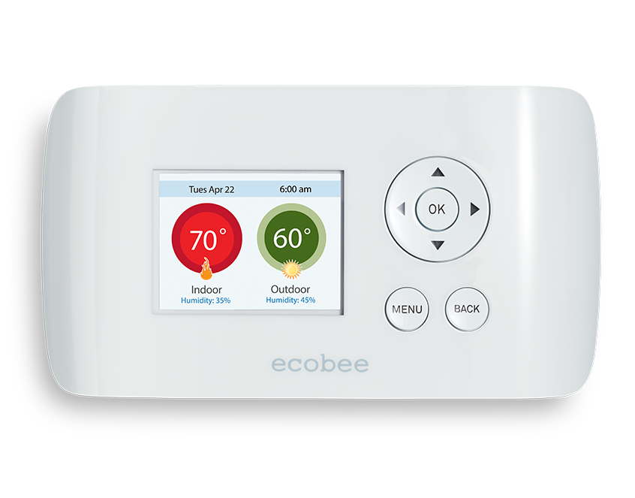
Small Customer Technology Deployment (SCTD) Program
Free programmable communicating thermostats (PCTs) with DR-enabling technology
Two DR methods – randomly assigned
  50% air conditioning cycling
  4 degree thermostat setback
2 p.m. – 6 p.m.
Hours of Availability | Hours of Actual Use | No. of Available Dispatches | No. of Actual Dispatches
Maximum Event Length of 4 Hours | 16 hours | No Maximum | 4 times

Slide 5
Ex Post Methodology
Control groups selected via Stratified Propensity Score Matching
  Logistic regression model to estimate probability of participation
  Few events on hottest days
  Small average impacts relative to overall size of average participant load during events
  Large population from which to develop matched control group
Two stages of Propensity Score Matching
  Stage I – Billing Data, 5-to-1 matches
  Stage II – Interval Data, 1-to-1 matches
Regression-based models using a difference-in-differences format
  Final model specifications included variables for hour, day of the week, month, cooling degree hours (CDH65), event indicators, and opt-in status
Notes:
First stage: monthly kWh usage, correlation between monthly CDD65 and kWh usage for summer and winter months, ratio of average monthly usage between summer and winter months, dummy variable for Low Income customers, EE program participation, others.
The second stage of matching saw the inclusion of hourly kWh usage during the event hours for summer and hot days, as well as monthly event hour kWh usage.

Slide 6
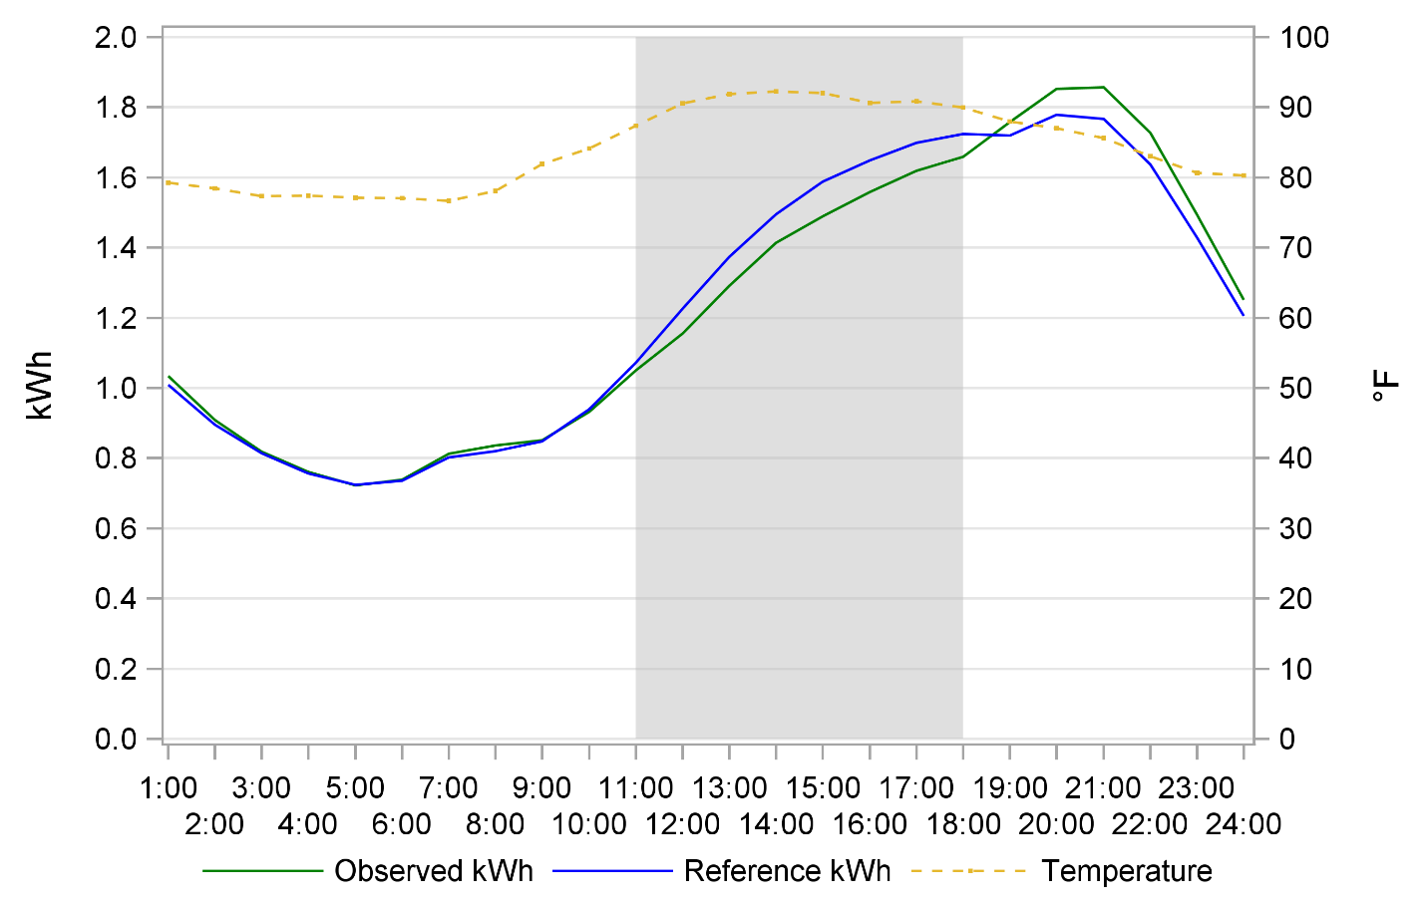
Ex Post Results - PTR
Four Events in 2015 – August 28th, September 9th, 10th, 11th
Average Participant Event Hour Load Reduction : 0.08 kW
Average Aggregate Event Load Reduction : 6.07 MW (5.4%)
Average Temperature : 91.2°F; Average Active Participants : 74,433

Slide 7
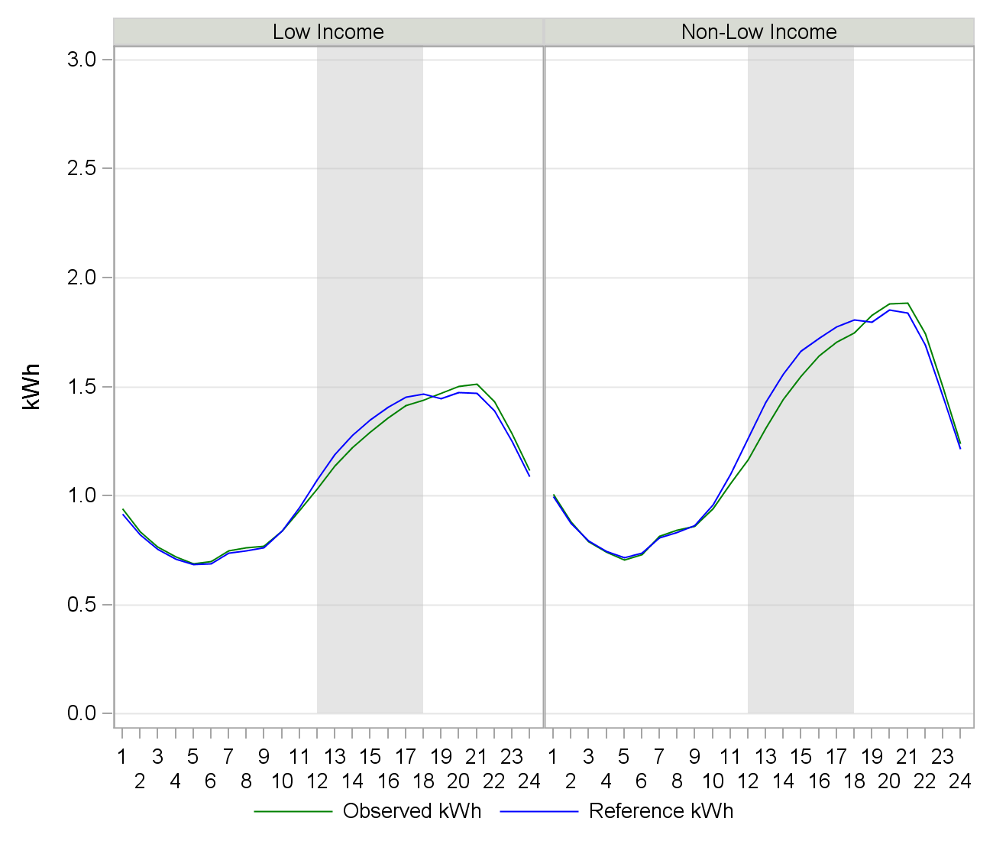
Ex Post Results – PTR – Low Income
Average Participant Event Hour Usage
  Non-L.I. : 1.51 kW
  L.I. : 1.27 kW
Average Participant Event Hour Load Reduction
  Non-L.I. : 0.09 kW (6.1%)
  L.I. : 0.05 kW (3.6%)
Average Active Participants
  Non-L.I. : 42,680
  L.I. : 23,117
Notes:
PTR with no Load Control

Slide 8
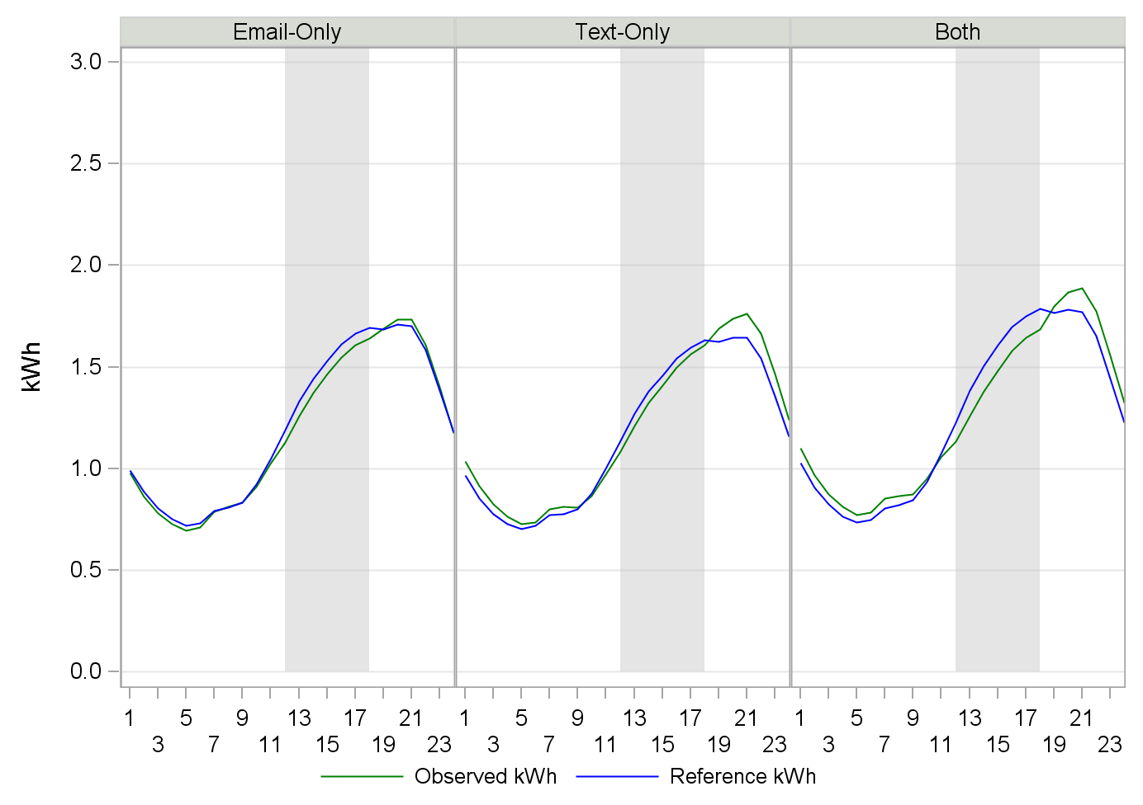
Ex Post Results – PTR – Notification Type
Average Participant Event Hour Load Reduction
  Email-Only: 0.06 kW (4.3%)
  Text-Only: 0.05 kW (3.3%)
  Both: 0.11 kW (7.3%)
Average Aggregate Event Hour Load Reduction
  Email-Only: 2.74 MW
  Text-Only: 0.52 MW
  Both: 1.08 MW
Average Active Participants
  Email-Only: 43,573
  Text-Only: 11,277
  Both: 9,592
Notes:
There were 3 types of notification for PTR events – email, text, and phone call. Only 7% of participants opted for Phone notification, and only 2% opted for phone-only, so the analysis focused on the email and text notifications.

Slide 9
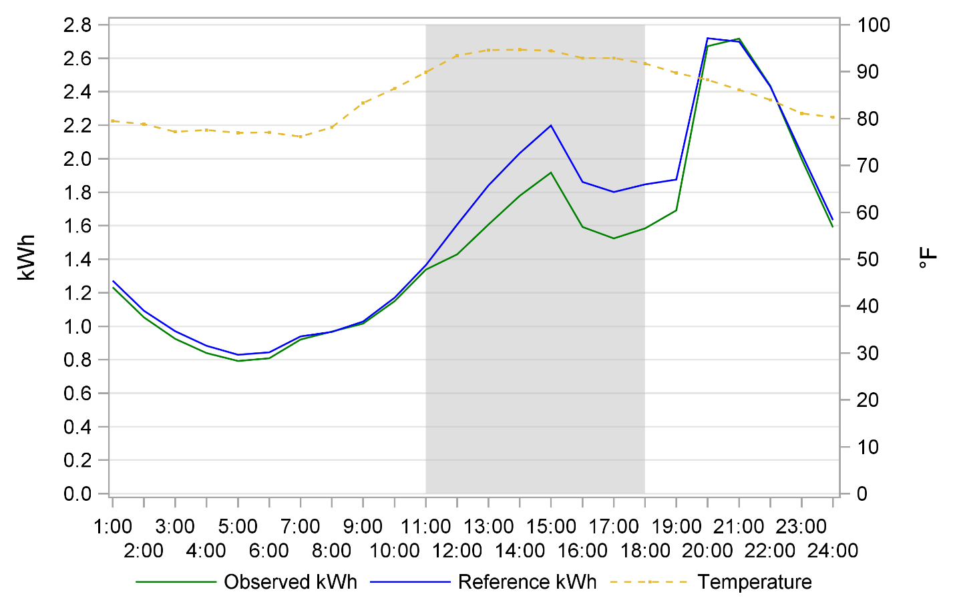
Ex Post Results – PTR Dually Enrolled in Summer Saver
AC Cycling (50% or 100%), from 3 p.m. to 7 p.m.
Average Participant Event Hour Load Reduction : 0.25 kW
Average Aggregate Event Hour Load Reduction : 1.05 MW (13.3%)
Average Temperature : 93.5°F; Average Active Participants : 4,179
Notes:
All PTR events were also Summer Saver Events

Slide 10
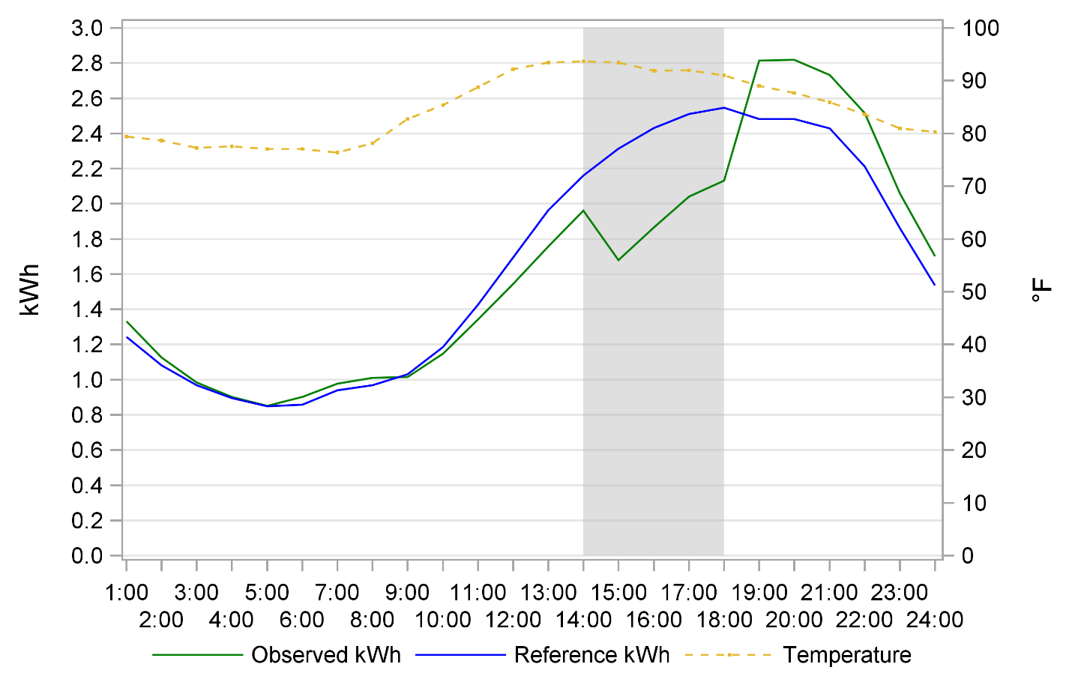
Ex Post Results - SCTD
Four Events in 2015 – August 28th, September 9th, 10th, 11th
Average Participant Event Hour Load Reduction : 0.52 kW
Average Aggregate Event Hour Load Reduction : 3.44 MW (21.4%)
Average Active Participants : 6,602
Notes:
All SCTD, including dually enrolled with PTR (majority) and SCTD-only.
SCTD-only participants had similar results, with a slightly lower average load reduction of 0.55 kW, 19.8%.

Slide 11
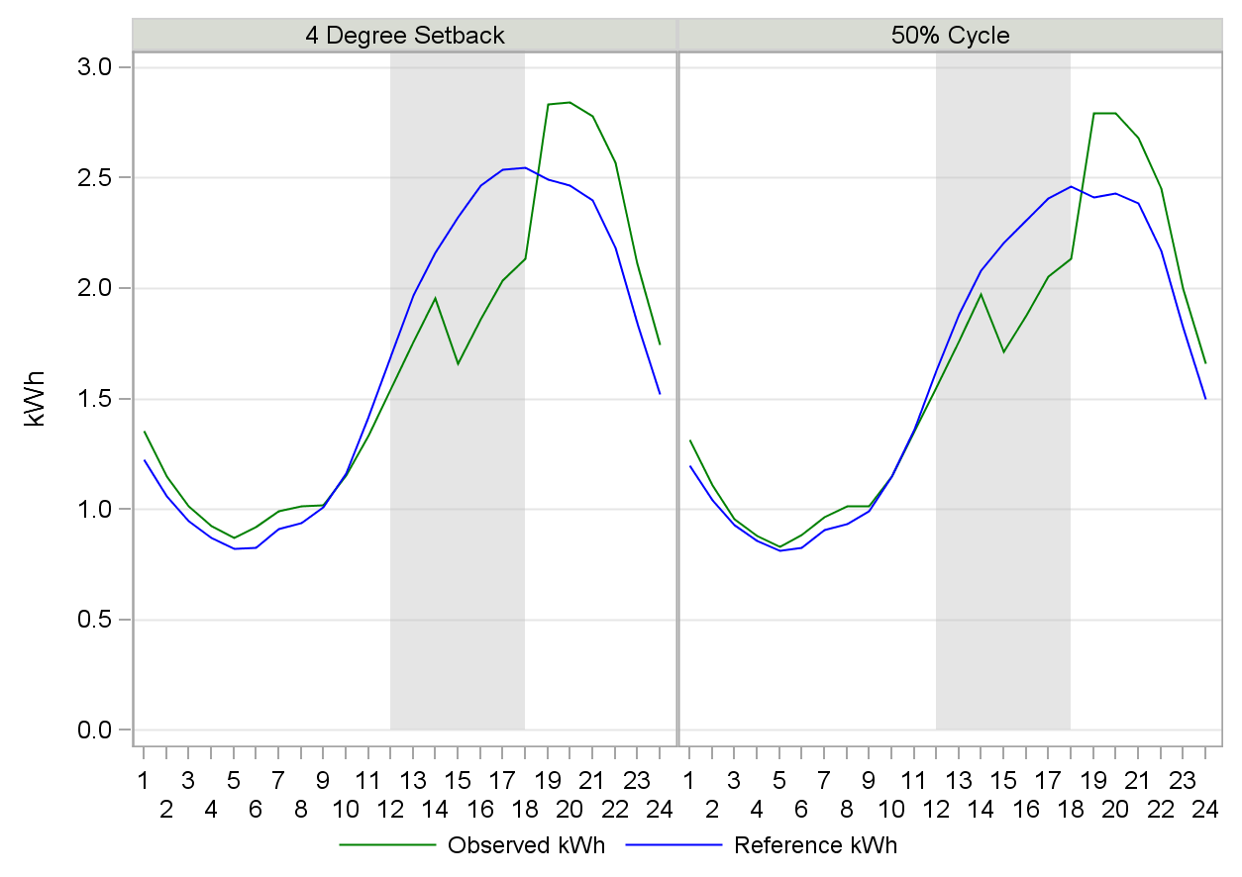
Ex Post Results – SCTD – Cycling Strategy
Average Participant Event Hour Load Reduction
  4 degree : 0.59 kW
  50% cycling: 0.43 kW
Average Aggregate Event Hour Load Reduction
  4 degree : 2.05 MW (23.5%)
  50% cycling: 1.30 MW (18.4%)
Average Active Participants
  4 degree : 3,511
  50% cycling : 3,002

Slide 12
SCTD – Energy Savings
Energy conservation effects estimated using panel time-series regression analysis
Separate matching groups – Thermostat vs. No Thermostat
Electric – Daily and Hourly Models
  Daily: average 0.16 kWh per weekday (0.9%)
  Hourly: average 0.27 kW
Gas– Daily Model
  Average -0.002 Therms per weekday (-0.37%)
Notes:
Energy savings of the program are estimated by using both a dummy variable (ActiveParticipant=1 * Post = 1) and this same dummy variable interacted with CDD to allow for linear changes in energy savings as temperatures vary

Slide 13
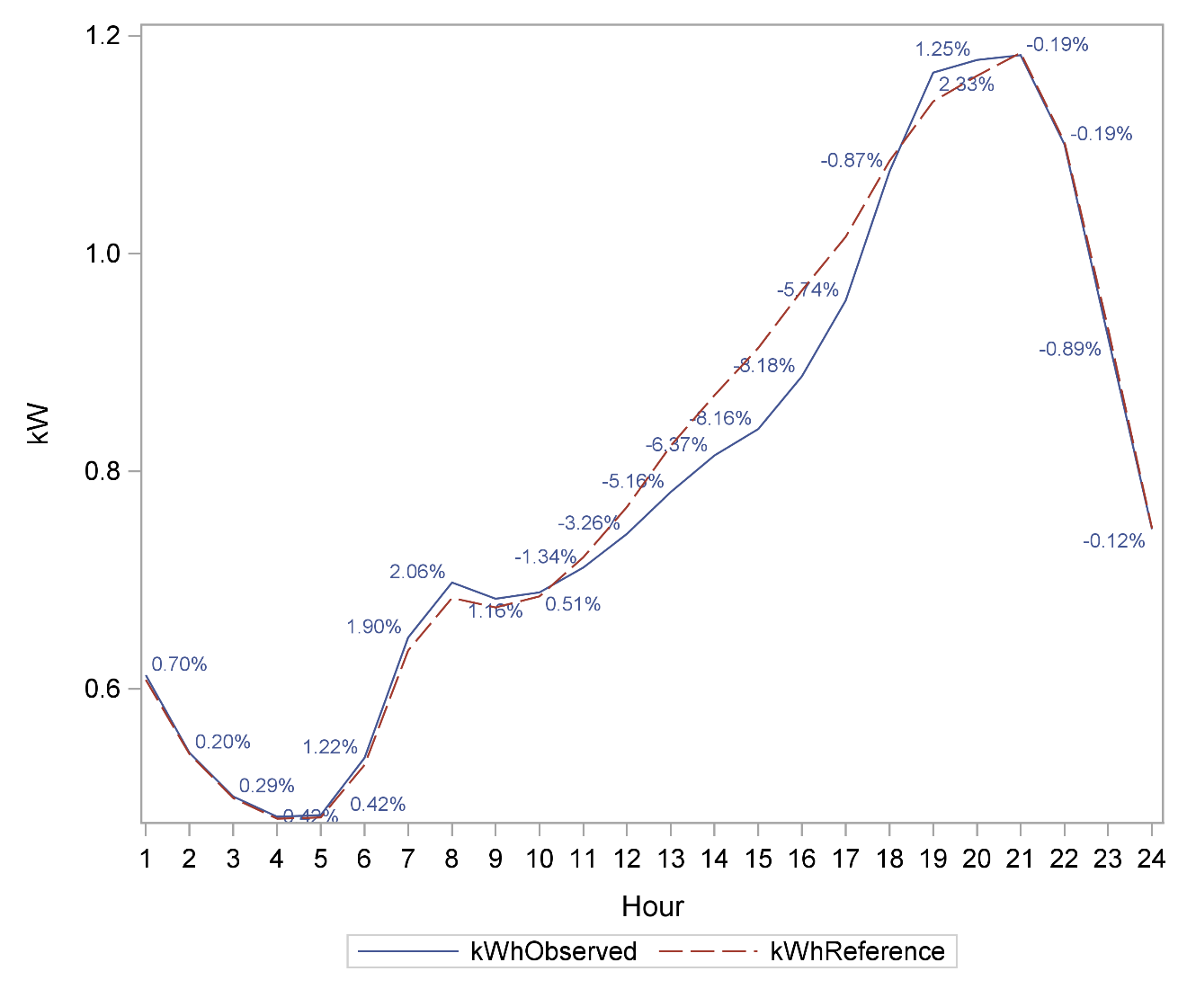
SCTD – Energy Savings – Weekday Hours
Notes:
observed kWh and reference kWh ranged from 0.48 kW at about 4 am to 1.18 kW at about 9 pm. highest impact happened at 4 pm, about 0.08 kW

Slide 14
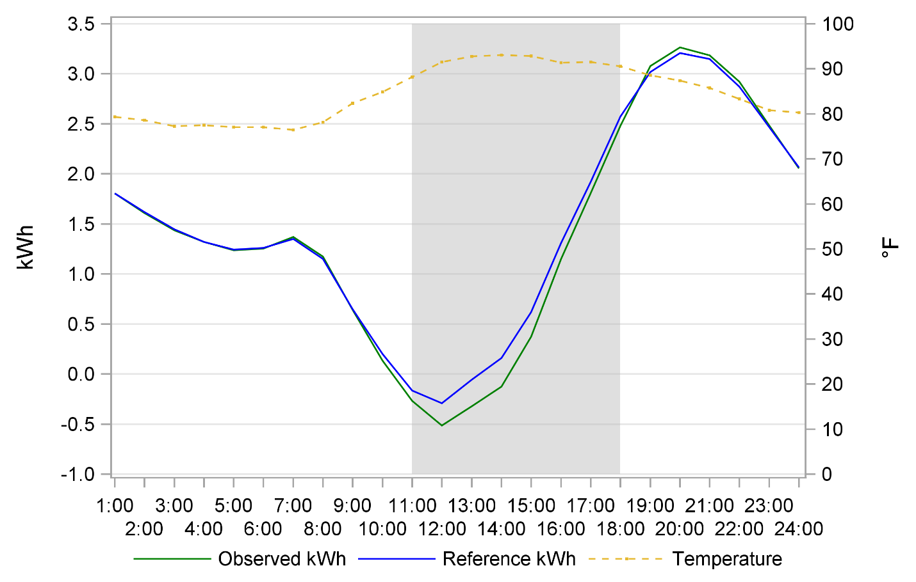
Ex Post Results – Net Energy Metering
Average Participant Event Hour Load Reduction : 0.26 kW
Average Aggregate Event Hour Load Reduction : 1.91 MW (-38.7%)
Average Active Participants : 7,331
Notes:
PTR participants with photovoltaic (PV) generation, Able to export excess PV energy back to grid
PSM matching done on both import and export channels of interval data
Ex-post results based on net impact of NEM customers’ consumption minus exported PV delivered to the grid

Slide 15
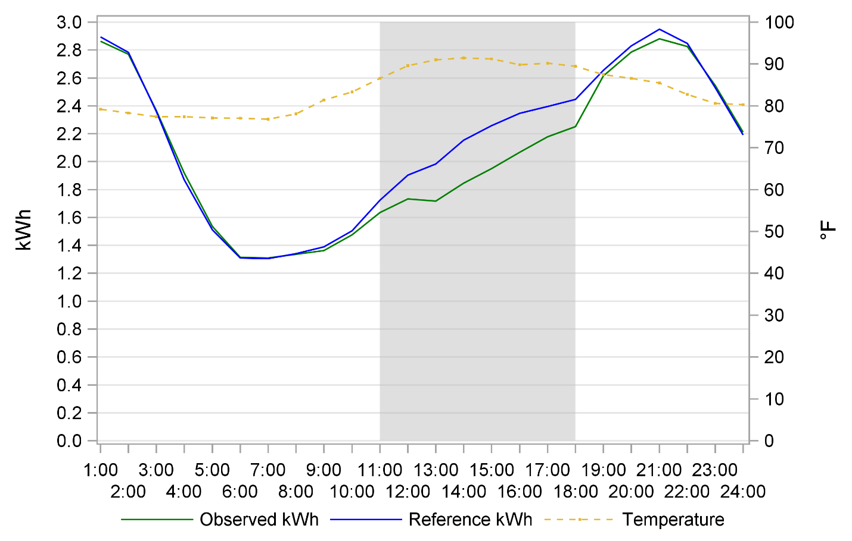
Ex Post Results – Electric Vehicles
Average Participant Event Hour Load Reduction : 0.25 kW
Average Aggregate Event Hour Load Reduction : 0.41 MW (11.3%)
Average Active Participants : 1,637
Notes:
significant jump in consumption in the hour after midnight, EV time-of-use rate schedule, which has a “Super Off-Peak” rate between the hours of 12 a.m. and 5 a.m.

Slide 16
Ex Ante Methodology
Four participant segments
  Opt-in PTR-Only
  PTR Dually Enrolled in Summer Saver
  PTR Dually Enrolled in SCTD
  SCTD-Only
Data sources
  2015 ex post regression model results
  10-year enrollment forecast
  SDG&E and CAISO weather scenarios
Calculate per participant average reference loads, observed loads, and load impacts
Combine results for the different weather scenarios with forecast of enrolled participants to generate the total program impacts
Notes:
Taking the model parameters from the ex post regression model and combining them with the weather scenarios to calculate per participant average reference loads, observed loads, and load impacts.
Combine estimated per-participant impacts for the different weather scenarios and multiply them by the forecast of enrolled participants to generate the total program impacts.

Slide 17
Ex Ante Enrollment Forecast
Year | Month | RYU Only | Growth Rate (RYU only) | Summer Saver Enrolled in RYU | SCTD enrolled in RYU | SCTD not enrolled in RYU | TOTAL SCTD | SCTD Goal
2016 | 1 | 66,026 | 3% | 4,369 | 4,485 | 3,176 | 7,661 | 5000 Thermostats (approx. 4167 accounts)
2016 | 2 | 66,206 |  | 4,369 | 4,707 | 3,333 | 8,040
2016 | 3 | 66,386 |  | 4,369 | 4,929 | 3,490 | 8,419
2016 | 4 | 66,566 |  | 4,369 | 5,151 | 3,647 | 8,797
2016 | 5 | 66,746 |  | 4,369 | 5,372 | 3,804 | 9,176
2016 | 6 | 66,926 |  | 4,369 | 5,594 | 3,961 | 9,555
2016 | 7 | 67,106 |  | 4,369 | 5,816 | 4,118 | 9,934
2016 | 8 | 67,286 |  | 4,369 | 6,038 | 4,275 | 10,313
2016 | 9 | 67,467 |  | 4,369 | 6,260 | 4,432 | 10,691
2016 | 10 | 67,647 |  | 4,369 | 6,481 | 4,589 | 11,070
2016 | 11 | 67,827 |  | 4,369 | 6,703 | 4,746 | 11,449
2016 | 12 | 68,007 |  | 4,369 | 6,925 | 4,903 | 11,828
2017 | 1 | 68,177 | 3% | 4,369 | 7,108 | 5,032 | 12,140 | 4500 Thermostats (approx. 3750 accounts)
2017 | 2 | 68,347 |  | 4,369 | 7,291 | 5,162 | 12,453
2017 | 3 | 68,518 |  | 4,369 | 7,474 | 5,291 | 12,765
2017 | 4 | 68,689 |  | 4,369 | 7,657 | 5,421 | 13,078
2017 | 5 | 68,861 |  | 4,369 | 7,840 | 5,551 | 13,390
2017 | 6 | 69,033 |  | 4,369 | 8,023 | 5,680 | 13,703
2017 | 7 | 69,206 |  | 4,369 | 8,206 | 5,810 | 14,015
2017 | 8 | 69,379 |  | 4,369 | 8,389 | 5,939 | 14,328
2017 | 9 | 69,552 |  | 4,369 | 8,571 | 6,069 | 14,640
2017 | 10 | 69,726 |  | 4,369 | 8,754 | 6,198 | 14,953
2017 | 11 | 69,901 |  | 4,369 | 8,937 | 6,328 | 15,265
2017 | 12 | 70,075 |  | 4,369 | 9,120 | 6,457 | 15,578

Slide 18
Ex Ante Load Impacts – PTR Only
Day / Type | Month | 1-in-2
 |  | Avg. Hourly Reference Load (kWh) | Avg. Hourly Observed Load (kWh) | Avg. Hourly Impact (kWh) | Percent Load Reduction | Enrollment Forecast | Avg. Total Hourly Impact (MWh)
Typical Event Day | Aug 2017 | 1.17 | 1.13 | 0.04 | 3.3% | 67,286 | 2.67
Typical Event Day | Aug 2026 | 1.17 | 1.13 | 0.04 | 3.3% | 70,075 | 2.73

Slide 19
Ex Ante Load Impacts –SCTD Only
Control Strategy | Day / Type | Month | 1-in-2
 |  |  | Avg. Hourly Reference Load (kWh) | Avg. Hourly Observed Load (kWh) | Avg. Hourly Impact (kWh) | Percent Load Reduction | Enrollment Forecast | Avg. Total Hourly Impact (MWh)
4 Degree Setback | Typical Event Day | Aug 2017 | 1.62 | 1.36 | 0.25 | 15.6% | 3,093 | 0.78
 |  | Aug 2026 | 1.62 | 1.36 | 0.25 | 15.6% | 3,363 | 0.85
50% Cycle | Typical Event Day | Aug 2017 | 1.53 | 1.36 | 0.17 | 11.1% | 2,805 | 0.48
 |  | Aug 2026 | 1.53 | 1.36 | 0.17 | 11.1% | 3,049 | 0.52
All | Typical Event Day | Aug 2017 | 1.58 | 1.36 | 0.22 | 13.7% | 5,939 | 1.28
 |  | Aug 2026 | 1.58 | 1.36 | 0.22 | 13.7% | 6,457 | 1.39

Slide 20
Ex Ante Load Impacts – PTR Dually Enrolled in SCTD
Control Strategy | Day / Type | Month | 1-in-2
 |  |  | Avg. Hourly Reference Load (kWh) | Avg. Hourly Observed Load (kWh) | Avg. Hourly Impact (kWh) | Percent Load Reduction | Enrollment Forecast | Avg. Total Hourly Impact (MWh)
4 Degree Setback | Typical Event Day | Aug 2017 | 1.59 | 1.18 | 0.40 | 25.4% | 4,470 | 1.81
 |  | Aug 2026 | 1.59 | 1.18 | 0.40 | 25.4% | 4,860 | 1.96
50% Cycle | Typical Event Day | Aug 2017 | 1.51 | 1.20 | 0.31 | 20.5% | 3,762 | 1.17
 |  | Aug 2026 | 1.51 | 1.20 | 0.31 | 20.5% | 4,090 | 1.27
All | Typical Event Day | Aug 2017 | 1.55 | 1.19 | 0.36 | 23.4% | 8,389 | 3.05
 |  | Aug 2026 | 1.55 | 1.19 | 0.36 | 23.4% | 9,120 | 3.32

Slide 21
Ex Ante/Ex Post Comparison – PTR Only
Participant Segment | Weather Year | Day / Type | Average Hourly Reference Load (kW) | Average Hourly Observed Load (kW) | Average Hourly Impact (kW) | Percent Load Reduction | Average °F
PTR Only | 1-In-2 | August System Peak Day | 1.20 | 1.16 | 0.04 | 3.4% | 81.37
 | Ex Post | Ex Post Average Event Day | 1.59 | 1.52 | 0.06 | 4.0% | 90.94

Slide 22
Ex Ante/Ex Post Comparison – SCTD Only
Participant Segment | Control Strategy | Weather Year | Day / Type | Average Hourly Reference Load (kW) | Average Hourly Observed Load (kW) | Average Hourly Impact (kW) | Percent Load Reduction | Average °F
SCTD Only | 4 Degree Setback | 1-In-2 | August System Peak Day | 1.65 | 1.39 | 0.26 | 15.8% | 82.12
 |  | Ex Post | Ex Post Average Event Day | 2.42 | 2.08 | 0.34 | 14.0% | 92.38
 | 50% Cycle | 1-In-2 | August System Peak Day | 1.56 | 1.39 | 0.18 | 11.2% | 82.13
 |  | Ex Post | Ex Post Average Event Day | 2.29 | 2.08 | 0.20 | 8.9% | 92.27
 | ALL | 1-In-2 | August System Peak Day | 1.61 | 1.39 | 0.22 | 13.9% | 82.13
 |  | Ex Post | Ex Post Average Event Day | 2.36 | 2.08 | 0.28 | 11.9% | 92.34

Slide 23
Ex Ante/Ex Post Comparison – PTR Dually Enrolled in SCTD
Participant Segment | Control Strategy | Weather Year | Day / Type | Average Hourly Reference Load (kW) | Average Hourly Observed Load (kW) | Average Hourly Impact (kW) | Percent Load Reduction | Average °F
PTR/SCTD | 4 Degree Setback | 1-In-2 | August System Peak Day | 1.62 | 1.21 | 0.42 | 25.7% | 82.06
 |  | Ex Post | Ex Post Average Event Day | 2.40 | 1.82 | 0.58 | 24.0% | 92.34
 | 50% Cycle | 1-In-2 | August System Peak Day | 1.54 | 1.22 | 0.32 | 20.7% | 82.1
 |  | Ex Post | Ex Post Average Event Day | 2.29 | 1.85 | 0.44 | 19.2% | 92.49
 | ALL | 1-In-2 | August System Peak Day | 1.59 | 1.21 | 0.38 | 23.6% | 82.07
 |  | Ex Post | Ex Post Average Event Day | 2.35 | 1.83 | 0.52 | 22.0% | 92.4

Slide 24
Ex Ante Comparison – Current and Previous
Participant Segment | Weather Year | Day / Type | Current |  |  |  | Previous
 |  |  | Average Hourly Reference Load | Average Hourly Observed Load | Average Hourly Impact | Percent Load Reduction | Average Hourly Reference Load | Average Hourly Observed Load | Average Hourly Impact | Percent Load Reduction
PTR Only | 1-in-2 | August System Peak Day | 1.20 | 1.16 | 0.04 | 3.4% | 1.39 | 1.32 | 0.07 | 5.0%
PTR/SCTD | 1-in-2 | August System Peak Day | 1.59 | 1.21 | 0.38 | 23.6% | 2.09 | 1.64 | 0.45 | 21.5%
SCTD Only | 1-in-2 | August System Peak Day | 1.61 | 1.39 | 0.22 | 13.9% | 2.19 | 1.84 | 0.35 | 15.8%

Slide 25

Questions?
Email: george.jiang@itron.com

