Slide 1
2015 SDG&E Summer Saver Load Impact Evaluation
DRMEC Spring 2016 Load Impacts Evaluation Workshop
San Francisco, California
May 10, 2016

Slide 2
Agenda
Summer Saver program overview
Ex post methodology
Ex post results
Ex ante methodology
Enrollment forecast
Ex ante results
Ex post results for subgroups

Slide 3
Summer Saver Program Overview
Day-of demand response program offered by SDG&E to residential and small commercial customers
Based on central air conditioning (CAC) load control, using direct load control (switches with 1-way paging communication)
Events may be called on any non-holiday from May-October and run between 2 to 4 hours
No more than three event days per week
Participants have a choice of cycling strategy:
Participation is incented with an annual bill credit based on cycling strategy and tonnage of enrolled CAC unit(s)
Residential - $11.50 per ton for 50% cycling, $30 per ton for 100% cycling
Commercial - $ 9 per ton for 30% cycling, $15 per ton for 50% cycling
Customer Type | Cycling Strategy | % of CACs Enrolled
Residential | 50% | 57%
 | 100% | 43%
Commercial | 30% | 24%
 | 50% | 76%

Slide 4
Ex Post Methodology
Nexant estimated reference loads using a randomized control trial (RCT) for the residential segment, and a matched control group for the small commercial segment
Ex post impacts were estimated for each hour of each event by taking the difference between the same-day adjusted average control group load and the average observed treatment group load
Same day adjustment is based on the ration of usage between the treatment and control groups for the hour prior to the event start
Hourly impact estimates for the residential and nonresidential Summer Saver population were calculated by taking a weighted average of the impact estimates for each cycling option, with weights determined by the number of tons enrolled on each cycling option.

Slide 5
Ex Post Results
15 Summer Saver events called in 2015
2015 was the first year since 2012 that weekend events were called
Residential impacts:
Aggregate load impacts ranged from 7.6 MW to 17.8 MW
On average, weekend load impacts were almost 10% higher than weekday impacts
Small commercial impacts:
Aggregate load impacts ranged from 0.4 MW to 2.5 MW
Date | Day of Week | Start Time | End Time
8/13/2015 | Thursday | 3:00 PM | 7:00 PM
8/14/2015 | Friday | 4:00 PM | 8:00 PM
8/16/2015 | Sunday | 3:00 PM | 7:00 PM
8/26/2015 | Wednesday | 4:00 PM | 8:00 PM
8/27/2015 | Thursday | 3:00 PM | 7:00 PM
8/28/2015 | Friday | 3:00 PM | 7:00 PM
9/9/2015 | Wednesday | 3:00 PM | 7:00 PM
9/10/2015 | Thursday | 3:00 PM | 7:00 PM
9/11/2015 | Friday | 3:00 PM | 7:00 PM
9/20/2015* | Sunday | 2:00 PM | 4:00 PM
9/24/2015 | Thursday | 2:00 PM | 6:00 PM
9/25/2015 | Friday | 2:00 PM | 6:00 PM
10/9/2015 | Friday | 3:00 PM | 7:00 PM
10/10/2015 | Saturday | 3:00 PM | 7:00 PM
10/13/2015 | Tuesday | 4:00 PM | 8:00 PM
Hours of Availability | Hours of Actual Use | # of Available Dispatches* | # of Actual Dispatches
60 | 58 | 15 | 15
* Emergency event called from 1:35 PM to 3:35 PM

Slide 6
Ex Post Results – Residential
Date | Event Time | Impact |  | Mean17 (°F)
 |  | Per CAC Unit (kW) | Aggregate (MW)
8/13/2015 | 3 to 7 PM | 0.42 | 10.5 | 78
8/14/2015 | 4 to 8 PM | 0.36 | 9.0 | 79
8/16/2015 | 3 to 7 PM | 0.70 | 17.8 | 82
8/26/2015 | 4 to 8 PM | 0.35 | 9.0 | 80
8/27/2015 | 3 to 7 PM | 0.54 | 13.7 | 82
8/28/2015 | 3 to 7 PM | 0.59 | 14.9 | 84
9/9/2015 | 3 to 7 PM | 0.68 | 17.2 | 88
9/10/2015 | 3 to 7 PM | 0.45 | 11.4 | 86
9/11/2015 | 3 to 7 PM | 0.51 | 13.0 | 84
9/20/2015* | 2 to 4 PM | 0.34 | 8.7 | 84
9/24/2015 | 2 to 6 PM | 0.48 | 12.2 | 78
9/25/2015 | 2 to 6 PM | 0.40 | 10.1 | 79
10/9/2015 | 3 to 7 PM | 0.43 | 10.8 | 81
10/10/2015 | 3 to 7 PM | 0.45 | 11.4 | 88
10/13/2015 | 4 to 8 PM | 0.30 | 7.6 | 82
Average** | 3 to 7 PM | 0.53 | 13.3 | 83
*Reflects the emergency event called from 1:35 PM to 3:35 PM
**Reflects the average 4-hour weekday event from 3PM to 7 PM

Slide 7
Ex Post Results – Nonresidential
Date | Event Time | Impact |  | Mean17 (°F)
 |  | Per CAC Unit (kW) | Aggregate (MW)
8/13/2015 | 3 to 7 PM | 0.12 | 1.3 | 77
8/14/2015 | 4 to 8 PM | 0.08 | 0.8 | 78
8/16/2015 | 3 to 7 PM | 0.12 | 1.3 | 80
8/26/2015 | 4 to 8 PM | 0.09 | 1.0 | 79
8/27/2015 | 3 to 7 PM | 0.12 | 1.3 | 80
8/28/2015 | 3 to 7 PM | 0.10 | 1.1 | 83
9/9/2015 | 3 to 7 PM | 0.11 | 1.2 | 87
9/10/2015 | 3 to 7 PM | 0.15 | 1.7 | 85
9/11/2015 | 3 to 7 PM | 0.14 | 1.6 | 83
9/20/2015* | 2 to 4 PM | 0.06 | 0.6 | 83
9/24/2015 | 2 to 6 PM | 0.23 | 2.5 | 77
9/25/2015 | 2 to 6 PM | 0.20 | 2.1 | 78
10/9/2015 | 3 to 7 PM | 0.14 | 1.6 | 80
10/10/2015 | 3 to 7 PM | 0.15 | 1.6 | 87
10/13/2015 | 4 to 8 PM | 0.04 | 0.4 | 81
Average** | 3 to 7 PM | 0.13 | 1.4 | 82
*Reflects the emergency event called from 1:35 PM to 3:35 PM
**Reflects the average 4-hour weekday event from 3PM to 7 PM

Slide 8
Ex Post Results – Utility and System Peak Days
SDG&E Peak: 9/9/2015 at 3:43 PM
CAISO Peak: 9/10/2015 at 4:43 PM
Event Date | Hour Ending | Load Impact (MW)
 |  | Residential | Nonresidential
9/9/2015 | 16 | 14.5 | 2.13
 | 17 | 18.3 | 1.42
 | 18 | 17.7 | 1.19
 | 19 | 18.4 | -0.07
Event Date | Hour Ending | Load Impact (MW)
 |  | Residential | Nonresidential
9/10/2015 | 16 | 10.3 | 2.73
 | 17 | 13.3 | 2.33
 | 18 | 11.7 | 1.12
 | 19 | 10.3 | 0.44
SDG&E peak corresponds to the HE 16 period on the 9/9/2015 event
CAISO peak corresponds to the HE 17 period on the 9/10/2015 event

Slide 9
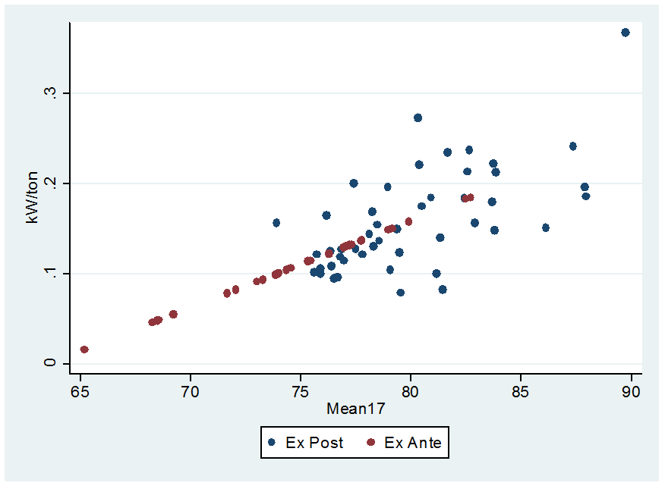
Ex Ante Methodology
Load impacts between 3 and 5 PM for all events in 2010 through 2015 were regressed against the average temperature from midnight to 5 pm (mean17)
$${impact}_{d}=b_{0}+b_{1}{∙mean17}_{d }+ε_{d}$$
The regression model parameters were used to predict load impacts under ex ante weather conditions for 3 to 5 PM
Load impacts are estimated for a set of SDG&E-peaking weather conditions as well as for a set of CAISO-peaking weather conditions
Impacts for other hours were based on the ratio of impacts from 3 to 5 PM to impacts in those hours for 2015 events
Average Ex Post Load Impacts and Ex Ante Predictions from 3 to 5 PM for Residential 100% Cycling Participants

Slide 10
Enrollment Forecast
Source | Nonresidential
 | 30% |  |  | 50%
 | Tons | Customers | Devices | Tons | Customers | Devices
2015 Analysis Dataset | 12,600 | 1,138 | 3,254 | 29,886 | 3,530 | 7,563
2015 SDG&E Forecast | 12,544.5 | 1,134 | 3,243 | 29,866.7 | 3,540 | 7,791
Very little difference between ex ante and SDG&E program forecasts
SDG&E enrollment forecast is flat from 2015 – 2026
Source | Residential
 | 50% |  |  | 100%
 | Tons | Customers | Devices | Tons | Customers | Devices
2015 Analysis Dataset | 51,186.7 | 12,510 | 13,940 | 41,569.8 | 9,255 | 11,388
2015 SDG&E Forecast | 51,547 | 12,598 | 14,702 | 40,741.3 | 9,073 | 11,210

Slide 11
Ex Ante Results – August Monthly Peak under SDG&E 1-in-2 Weather Conditions
Customer Type | Year | Per Premise Impact (kW) | Enrollment | Aggregate Impact (MW)
Residential | 2017 | 0.48 | 21,671 | 10.5
 | 2026 | 0.48 | 21,671 | 10.5
Nonresidential | 2017 | 0.65 | 4,674 | 3.0
 | 2026 | 0.65 | 4,674 | 3.0
Same estimates for 2017 and 2026 by customer type because SDG&E enrollment forecast is flat from 2015 – 2026

Slide 12
Ex Ante Results – Compare August 2017 1-in-2 Ex Ante Forecast to 2015 Ex Post
Customer Type | Estimate Type | Date | Per Premise Impact (kW) | Aggregate Impact (MW) | Mean17
Residential | Ex Post | 9/24/2015 (2-6 PM) | 0.58 | 12.2 | 78
 | Ex Ante | August 2017 (2-6 PM) | 0.50 | 10.9 | 75
Nonresidential | Ex Post | 9/24/2015 (2-6 PM) | 0.54 | 2.45 | 77
 | Ex Ante | August 2017 (2-6 PM) | 0.64 | 3.0 | 75

Slide 13
Ex Ante Results – Comparison of 2015 to 2014
Analysis Year | Customer Type | Forecast Year | Per Premise Impact (kW) | Enrollment | Aggregate Impact (MW)
2014 | Residential | 2017 | .48 | 23,026 | 11.2
 | Nonresidential |  | .66 | 4,789 | 3.15
2015 | Residential | 2017 | 0.48 | 21,671 | 10.5
 | Nonresidential |  | 0.65 | 4,674 | 3.0
Differences in estimated impacts arise because:
Residential forecasted enrollment was larger in 2014
Nonresidential per premise impact slightly larger in 2014 and the forecasted enrollment was larger

Slide 14
Contact Us
Candice Churchwell Senior Consultant, Utility Services CChurchwell@nexant.com
(415) 369-1194

Slide 15
Ex Post Results by Program Subgroups
Date | Per CAC (kW) |  |  |  | Aggregate (MW)
 | Cycling Option |  |  |  | Cycling Option
 | Residential |  | Commercial |  | Residential |  | Commercial
 | 100 | 50 | 50 | 30 | 100 | 50 | 50 | 30
8/13/2015 | 0.52 | 0.34 | 0.11 | 0.13 | 5.88 | 4.75 | 0.83 | 0.44
8/14/2015 | 0.43 | 0.29 | 0.08 | 0.07 | 4.93 | 4.02 | 0.62 | 0.23
8/16/2015 | 0.88 | 0.55 | 0.15 | 0.06 | 10.02 | 7.70 | 1.11 | 0.19
8/26/2015 | 0.39 | 0.32 | 0.06 | 0.15 | 4.41 | 4.48 | 0.48 | 0.48
8/27/2015 | 0.54 | 0.53 | 0.15 | 0.06 | 6.19 | 7.44 | 1.14 | 0.20
8/28/2015 | 0.73 | 0.47 | 0.08 | 0.16 | 8.33 | 6.58 | 0.61 | 0.52
9/9/2015 | 0.77 | 0.61 | 0.12 | 0.08 | 8.74 | 8.45 | 0.91 | 0.25
9/10/2015 | 0.62 | 0.31 | 0.20 | 0.04 | 7.03 | 4.37 | 1.49 | 0.15
9/11/2015 | 0.52 | 0.51 | 0.14 | 0.15 | 5.87 | 7.08 | 1.08 | 0.48
9/20/2015 | 0.52 | 0.21 | 0.06 | 0.04 | 5.88 | 2.88 | 0.48 | 0.13
9/24/2015 | 0.45 | 0.51 | 0.22 | 0.23 | 5.09 | 7.14 | 1.70 | 0.76
9/25/2015 | 0.57 | 0.26 | 0.19 | 0.21 | 6.51 | 3.67 | 1.46 | 0.67
10/9/2015 | 0.39 | 0.46 | 0.14 | 0.16 | 4.41 | 6.43 | 1.04 | 0.52
10/10/2015 | 0.64 | 0.29 | 0.17 | 0.09 | 7.30 | 4.10 | 1.29 | 0.29
10/13/2015 | 0.26 | 0.33 | 0.01 | 0.10 | 3.02 | 4.58 | 0.07 | 0.32
Average* | 0.58 | 0.46 | 0.13 | 0.11 | 6.64 | 6.45 | 1.01 | 0.37
*Reflects the average weekday 3-7 PM 2015 Summer Saver event
Notes:
Residential comparison of 50 to 100: 9 events with common hours of 3-7 PM show the reference loads for 50% cycling is 42% higher than those customers on 100% cycling (i.e., customers who use their CAC unites more are less likely to select the 100% cycling option)
Commercial comparison of 30 to 50: No self selection is apparent when comparing the impacts for the nine events with common hours
Comparing 50 to 50: Over all 2015 SS events, average load impacts per CAC unit were more than 3x greater for residential 50% compared to nonresidential 50%
Difference in impacts is attributed to the relative behaviors of the reference loads during the event hours
Residential: reference loads are increasing during the average event window
Nonresidential: reference loads are decreasing during the average event window

