Slide 1
2015 California Statewide Critical Peak Pricing Evaluation
DRMEC Spring 2016
Load Impact Evaluation Workshop
San Francisco, California
Prepared by:
Eric Bell
Marshall Blundell
May, 2016

Slide 2
Program Description
Critical Peak Pricing (CPP) is an electric rate in which a utility charges a higher price for consumption of electricity during peak hours on selected days, referred to as critical peak days or event days
  Typically, CPP hours coincide with the utility’s peak demand—SDG&E’s events last from 11 AM to 6 PM while PG&E’s and SCE’s last from 2 to 6 PM
  The higher price during peak hours on critical event days is designed to encourage reductions in demand and reflects the fact that electric demand during those hours drives a substantial portion of electric infrastructure costs
  Each utility typically calls event days 5 to 15 times a year based on their system conditions when demand is high and supply is short
  System load patterns across utilities are not always coincidental, particularly between Northern and Southern California
  Comparisons of impacts between the utilities should be made with caution
  September 9 and September 10 events were common to all utilities

Slide 3
Program Description
CPP is the default rate for large customers, and is offered to small and medium customers on a voluntary basis
  PG&E began defaulting small and medium business (SMB) customers onto CPP in 2014—defaulting will continue in large batches each November through 2016
  SDG&E will begin to default their SMB customers onto CPP in 2016, and SCE will begin to default their SMB customers onto CPP starting in 2018
CPP enrollment¹ by utility and customer size
Hours of Availability and Actual Use
Utility | Large >200 kW | Medium 20 kW to 199 kW | Small <20 kW
PG&E | 1,835 | 23,541 | 136,843
SCE | 2,587 | 529 | 532
SDG&E | 826 | 358 | 23
Utility | Hours of Availability | Hours of Actual Use | No. of Available Dispatches | No. of Actual Dispatches
PG&E | 60 | 60 | 15 | 15
SCE | 60 | 48 | 15 | 12
SDG&E | 126 | 35 | 18 | 5
¹ Enrollment from average event day in 2015.

Slide 4
Hours of Availability and Actual Use
Utility | Hours of Availability | Hours of Actual Use | No. of Available Dispatches | No. of Actual Dispatches
PG&E | 60 | 60 | 15 | 15
SCE | 60 | 48 | 15 | 12
SDG&E | 126 | 35 | 18 | 5

Slide 5
Ex Post Methodology

Slide 6
Methodology for large default customers consistent across utilities
Large C&I Customers:
  Used matched control groups with difference-in-differences panel regressions
  Yields unbiased results for average event
  Matches evaluated using out-of-sample testing
  Load impacts for customers that are large or idiosyncratic for which matching was not successful were estimated using individual customer regressions (very few)
Default SMB Customers (PG&E only)
  Methodology same as above but all customers successfully matched
  Homogeneous population and availability of large control group facilitated finding similar control group counterparts for all customers
  SCE and SDG&E do not yet have default SMB customers

Slide 7
PG&E Ex Post Results
Large C&I Customers

Slide 8
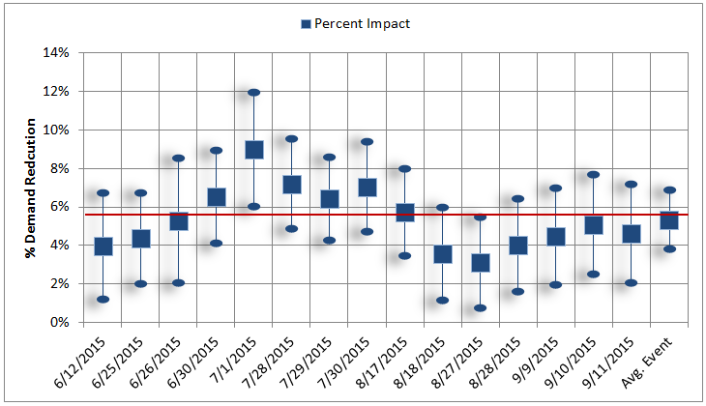
PG&E’s average load reduction for large C&I customers was 5.3%, or 30 MW across the 15 event days in June-September 2015

Slide 9
Event Summary
PDP was called for 15 events in 2015, compared to 10 in 2014
Most events were clustered into groups of sequential event days
Significant differences between 2014 and 2015
  2014: 7 out of the 10 events were in July
  2015: events were distributed more evenly from June through September

Slide 10
2014 vs 2015 Comparison: Persistent Customers
Year over year impacts similar for persistent customers in first 9 events of 2015
Later season events show smaller impacts, significantly lowering the average event impact
2015 impacts: 29.8 MW, 14.24 kW per customer (5.3%)
  Persistent Customers (1,500 Accounts): 27.6 MW, 18.4 kW per customer (7%)
  Non-Persistent Customers (593 Accounts): 2.2 MW, 3.7 kW per customer (1.6%)
2014 impacts: 41 MW, 23.2 kW per customer (8.1%)

Slide 11
PG&E detailed event load impacts- Large C&I
Event Date | Day of Week | Accounts | Avg. Customer Reference Load | Avg. Customer Load w/ DR | Impact | Aggregate Impact | % Reduction | Avg. Event Temp. | Daily Max. Temp.
 |  |  | (kW) | (kW) | (kW) | (MW) | (%) | (°F) | (°F)
6/12/2015 | Fri | 2,107 | 248.4 | 238.6 | 9.8 | 20.7 | 3.9% | 88.2 | 101.8
6/25/2015 | Thu | 2,103 | 256.2 | 245.0 | 11.1 | 23.4 | 4.4% | 91.3 | 105.0
6/26/2015 | Fri | 2,105 | 250.3 | 237.0 | 13.3 | 27.9 | 5.3% | 88.5 | 107.0
6/30/2015 | Tue | 2,106 | 266.0 | 248.6 | 17.3 | 36.5 | 6.5% | 93.9 | 106.5
7/1/2015 | Wed | 2,106 | 262.7 | 239.1 | 23.6 | 49.7 | 9.0% | 87.9 | 102.0
7/28/2015 | Tue | 2,091 | 264.3 | 245.3 | 19.0 | 39.8 | 7.2% | 93.1 | 102.0
7/29/2015 | Wed | 2,092 | 262.7 | 245.8 | 16.9 | 35.3 | 6.4% | 92.3 | 107.5
7/30/2015 | Thu | 2,091 | 258.3 | 240.1 | 18.2 | 38.0 | 7.0% | 87.7 | 103.0
8/17/2015 | Mon | 2,089 | 277.5 | 261.7 | 15.8 | 33.1 | 5.7% | 93.0 | 108.0
8/18/2015 | Tue | 2,089 | 264.3 | 254.9 | 9.4 | 19.6 | 3.6% | 86.9 | 104.0
8/27/2015 | Thu | 2,083 | 272.3 | 263.8 | 8.5 | 17.7 | 3.1% | 92.8 | 103.5
8/28/2015 | Fri | 2,082 | 275.9 | 264.9 | 11.0 | 23.0 | 4.0% | 93.5 | 106.0
9/9/2015 | Wed | 2,083 | 283.9 | 271.3 | 12.7 | 26.4 | 4.5% | 96.1 | 104.0
9/10/2015 | Thu | 2,084 | 283.6 | 269.2 | 14.4 | 30.0 | 5.1% | 94.6 | 105.0
9/11/2015 | Fri | 2,084 | 271.7 | 259.2 | 12.5 | 26.1 | 4.6% | 91.2 | 101.0
Avg. Event |  | 2,093 | 266.5 | 252.2 | 14.2 | 29.8 | 5.3% | 91.4 | 103.7
Utility System Peak Hr. |  | 2,084 | 277.3 | 263.4 | 13.9 | 34.0 | 5.0% | 94.8 | 105.0
Statewide System Peak Hr. |  | 2,106 | 248.9 | 232.7 | 16.1 | 29.0 | 6.5% | 94.0 | 106.5
Utility system peak hour: 34 MW (June 30, HE18)
Statewide system peak hour: 29 MW (September 10, HE17)
Average event hour: 29.8 MW

Slide 12
PG&E Ex Post Results
SMB Customers

Slide 13
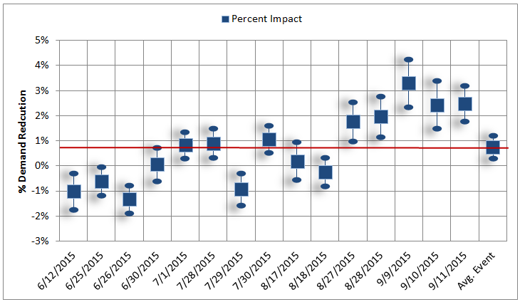
PG&E’s average load reduction for SMB customers was 0.8%, or 5.8 MW across the 15 event days in June-September 2015
Notes:
Inconsistent event performance, generally improving over time.

Slide 14
PG&E detailed event load impacts- SMB Customers
Event Date | Day of Week | Accounts | Avg. Customer Reference Load | Avg. Customer Load w/ DR | Impact | Aggregate Impact | % Reduction | Avg. Event Temp. | Daily Max. Temp.
 |  |  | (kW) | (kW) | (kW) | (MW) | (%) | (°F) | (°F)
6/12/2015 | Fri | 152,399 | 4.7 | 4.8 | 0.0 | -7.4 | -1.0% | 90.1 | 90.8
6/25/2015 | Thu | 150,899 | 5.0 | 5.1 | 0.0 | -4.7 | -0.6% | 92.5 | 92.9
6/26/2015 | Fri | 150,817 | 4.8 | 4.9 | -0.1 | -9.7 | -1.3% | 90.1 | 90.8
6/30/2015 | Tue | 150,687 | 5.2 | 5.2 | 0.0 | 0.5 | 0.1% | 95.4 | 96.0
7/1/2015 | Wed | 150,540 | 5.0 | 4.9 | 0.0 | 6.2 | 0.8% | 89.3 | 89.7
7/28/2015 | Tue | 148,998 | 5.1 | 5.1 | 0.0 | 6.8 | 0.9% | 94.4 | 94.9
7/29/2015 | Wed | 148,921 | 5.2 | 5.2 | 0.0 | -7.2 | -0.9% | 94.1 | 94.6
7/30/2015 | Thu | 148,851 | 5.0 | 4.9 | 0.1 | 7.9 | 1.1% | 89.2 | 89.8
8/17/2015 | Mon | 147,883 | 5.2 | 5.2 | 0.0 | 1.4 | 0.2% | 94.4 | 95.2
8/18/2015 | Tue | 147,812 | 5.0 | 5.0 | 0.0 | -1.7 | -0.2% | 87.5 | 88.1
8/27/2015 | Thu | 147,436 | 5.3 | 5.2 | 0.1 | 13.7 | 1.8% | 93.5 | 94.5
8/28/2015 | Fri | 147,358 | 5.3 | 5.2 | 0.1 | 15.2 | 2.0% | 94.0 | 95.6
9/9/2015 | Wed | 146,489 | 5.5 | 5.3 | 0.2 | 26.5 | 3.3% | 96.9 | 97.6
9/10/2015 | Thu | 146,373 | 5.5 | 5.3 | 0.1 | 19.5 | 2.4% | 95.7 | 96.2
9/11/2015 | Fri | 146,280 | 5.1 | 5.0 | 0.1 | 18.6 | 2.5% | 92.2 | 93.2
Avg. Event |  | 148,782 | 5.1 | 5.1 | 0.0 | 5.8 | 0.8% | 92.6 | 93.2
Utility System Peak Hr. |  | 146,373 | 5.4 | 5.3 | 0.1 | -0.9 | 2.5% | 96.0 | 96.2
Statewide System Peak Hr. |  | 150,687 | 4.7 | 4.7 | 0.0 | 20.2 | -0.1% | 95.7 | 96.0
Utility system peak hour: -0.9 MW (June 30, HE18)
Statewide system peak hour: 20.2 MW (September 10, HE17)
Average event hour: 5.8 MW

Slide 15
PG&E Ex Post Results
All Customers

Slide 16
PG&E detailed event load impacts- All Customers
Event Date | Day of Week | Accounts | Avg. Customer Reference Load | Avg. Customer Load w/ DR | Impact | Aggregate Impact | % Reduction | Avg. Event Temp. | Daily Max. Temp.
 |  |  | (kW) | (kW) | (kW) | (MW) | (%) | (°F) | (°F)
6/12/2015 | Fri | 165,800 | 7.8 | 7.7 | 0.1 | 16.3 | 1.3% | 89.9 | 101.8
6/25/2015 | Thu | 164,244 | 8.2 | 8.1 | 0.1 | 22.8 | 1.7% | 92.2 | 105.0
6/26/2015 | Fri | 164,161 | 8.0 | 7.8 | 0.1 | 21.3 | 1.6% | 89.9 | 107.0
6/30/2015 | Tue | 164,028 | 8.6 | 8.3 | 0.3 | 41.7 | 3.0% | 95.2 | 106.5
7/1/2015 | Wed | 163,884 | 8.3 | 7.9 | 0.4 | 59.3 | 4.4% | 89.1 | 102.0
7/28/2015 | Tue | 162,426 | 8.4 | 8.1 | 0.3 | 49.9 | 3.6% | 94.3 | 102.0
7/29/2015 | Wed | 162,349 | 8.5 | 8.3 | 0.2 | 31.0 | 2.2% | 93.9 | 107.5
7/30/2015 | Thu | 162,282 | 8.3 | 8.0 | 0.3 | 49.3 | 3.7% | 89.0 | 103.0
8/17/2015 | Mon | 161,351 | 8.8 | 8.5 | 0.2 | 37.5 | 2.6% | 94.2 | 108.0
8/18/2015 | Tue | 161,278 | 8.3 | 8.2 | 0.1 | 20.6 | 1.5% | 87.2 | 104.0
8/27/2015 | Thu | 160,926 | 8.7 | 8.5 | 0.2 | 34.0 | 2.4% | 93.3 | 103.5
8/28/2015 | Fri | 160,860 | 8.8 | 8.5 | 0.3 | 40.9 | 2.9% | 93.9 | 106.0
9/9/2015 | Wed | 160,032 | 9.1 | 8.8 | 0.4 | 56.1 | 3.8% | 96.8 | 104.0
9/10/2015 | Thu | 159,918 | 9.1 | 8.8 | 0.3 | 52.4 | 3.6% | 95.5 | 105.0
9/11/2015 | Fri | 159,829 | 8.6 | 8.3 | 0.3 | 46.9 | 3.4% | 92.1 | 101.0
Avg. Event |  | 162,224 | 8.5 | 8.3 | 0.2 | 38.7 | 2.8% | 92.4 | 103.7
Utility System Peak Hr. |  | 159,918 | 9.0 | 8.7 | 0.3 | 36.8 | 3.6% | 95.8 | 105.0
Statewide System Peak Hr. |  | 164,028 | 7.8 | 7.6 | 0.2 | 51.9 | 2.9% | 95.5 | 106.5
Utility system peak hour: 36.8 MW (June 30, HE18)
Statewide system peak hour: 51.9 MW (September 10, HE17)
Average event hour: 38.7 MW

Slide 17
SCE Ex Post Results
Large C&I Customers

Slide 18
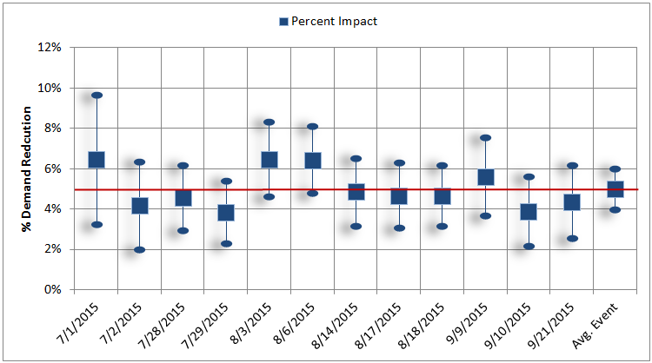
SCE’s average load reduction was 5.0%, or 29 MW across the 12 event days in July-September 2015
Notes:
Much more consistent performance, similar to prior years

Slide 19
SCE detailed event load impacts- Large C&I
Event Date | Day of Week | Accounts | Avg. Customer Reference Load | Avg. Customer Load w/ DR | Impact | Aggregate Impact | % Reduction | Avg. Event Temp. | Daily Max. Temp.
 |  |  | (kW) | (kW) | (kW) | (MW) | (%) | (°F) | (°F)
7/1/2015 | Wed. | 2,690 | 208.8 | 195.4 | 13.5 | 36.3 | 6.5% | 82.8 | 98.4
7/2/2015 | Thu. | 2,692 | 202.5 | 194.1 | 8.4 | 22.7 | 4.2% | 84.8 | 100.1
7/28/2015 | Tue. | 2,679 | 208.8 | 199.2 | 9.5 | 25.5 | 4.6% | 85.3 | 97.0
7/29/2015 | Wed. | 2,676 | 212.8 | 204.6 | 8.2 | 21.8 | 3.8% | 85.8 | 104.5
8/3/2015 | Mon. | 2,667 | 214.6 | 200.7 | 13.9 | 37.0 | 6.5% | 85.0 | 93.1
8/6/2015 | Thu. | 2,667 | 212.2 | 198.6 | 13.6 | 36.4 | 6.4% | 83.3 | 91.2
8/14/2015 | Fri. | 2,669 | 216.2 | 205.7 | 10.5 | 28.0 | 4.8% | 94.7 | 102.9
8/17/2015 | Mon. | 2,669 | 219.9 | 209.6 | 10.3 | 27.4 | 4.7% | 85.1 | 105.4
8/18/2015 | Tue. | 2,667 | 216.4 | 206.3 | 10.1 | 26.8 | 4.7% | 83.7 | 100.4
9/9/2015 | Wed. | 2,684 | 236.5 | 223.2 | 13.3 | 35.6 | 5.6% | 93.0 | 102.5
9/10/2015 | Thu. | 2,684 | 240.0 | 230.7 | 9.3 | 25.0 | 3.9% | 93.4 | 102.0
9/21/2015 | Mon. | 2,682 | 218.2 | 208.7 | 9.5 | 25.4 | 4.3% | 80.7 | 99.9
Avg. Event |  | 2,677 | 217.2 | 206.4 | 10.8 | 29.0 | 5.0% | 86.5 | 98.1
Utility System Peak Hr. |  | - | - | - | - | - | - | - | -
Statewide System Peak Hr. |  | 2,684 | 233.0 | 224.2 | 8.8 | 23.6 | 3.8% | 93.6 | 102.0
Utility system peak hour: 0 MW (No event called)
Statewide system peak hour: 23.6 MW (September 10, HE17)
Average event hour: 29 MW

Slide 20
SDG&E Ex Post Results
Large C&I Customers

Slide 21
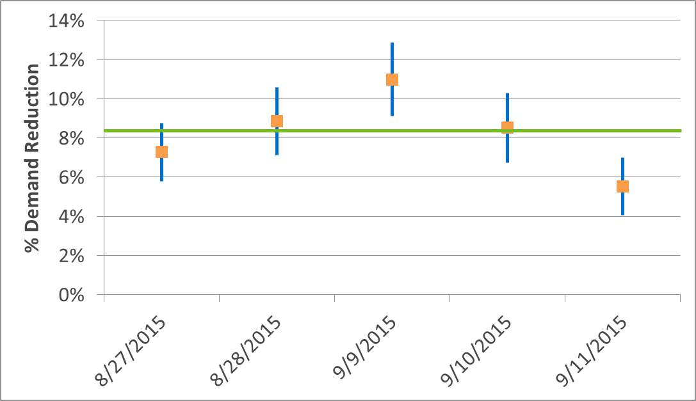
SDG&E’s average load reduction was 8.3%, or 25 MW across the 5 event days in August-September 2015

Slide 22
SDG&E detailed event load impacts- Large C&I
Event Date | Day of Week | Accounts | Avg. Customer Reference Load | Avg. Customer Load w/ DR | Average Customer | Aggregate Impact | % Reduction | Avg. Event Temp. | Daily Maximum Temp.
 |  |  |  |  | Impact
 |  |  | (kW) | (kW) | (kW) | (MW) | % | °F | °F
8/27/2015 | Thu | 1,207 | 240.6 | 223.1 | 17.5 | 21.1 | 7.3% | 88.5 | 93.1
8/28/2015 | Fri | 1,206 | 240.8 | 219.5 | 21.3 | 25.7 | 8.8% | 91.2 | 94.3
9/9/2015 | Wed | 1,209 | 270.7 | 241.0 | 29.7 | 35.9 | 11.0% | 94.6 | 103.0
9/10/2015 | Thu | 1,209 | 267.4 | 244.6 | 22.8 | 27.5 | 8.5% | 92.6 | 98.0
9/11/2015 | Fri | 1,208 | 245.8 | 232.2 | 13.5 | 16.4 | 5.5% | 87.3 | 95.0
Avg. Event |  | 1,207 | 253.1 | 232.1 | 21.0 | 25.3 | 8.3% | 90.8 | 97.3
Utility System Peak Hr. |  | 1,209 | 265.2 | 235.5 | 29.7 | 35.9 | 11.2% | 92.6 | 103.0
Statewide System Peak Hr. |  | 1,209 | 251.8 | 230.1 | 21.7 | 26.3 | 8.6% | 91.6 | 98.0
Utility system peak hour: 35.9 MW (September 9, HE16)
Statewide system peak hour: 26.3 MW (September 10, HE17)
Average event hour: 25.3 MW

Slide 23
Ex Ante Methodology

Slide 24
Ex ante estimates relied on available historical data
The steps involved in the analysis are as follows:
  Calculate Percent Impacts
    Large Default Customers- Use 2015 ex post results for large default customers to calculate percent impacts for each hour on the average event day;
      SCE and SDG&E also used 2014 results for large default customers enrolled in the program for both years;
      Segmented by geographic area (LCA/Transmission Planning Area)
    PG&E SMB Customers- Calculate percent reductions across the ex post event hours for the average event;
      PG&E SMB results used for projected SMB impacts at SCE and SDG&E;
  Model reference load as a function of temperature, by geographic area;
  Apply reference load model to ex ante weather conditions;
  Combine percent impacts and reference load for each set of ex ante conditions to get kW impacts for the average customer; and
  Multiply average customer impacts by ex ante enrollment.
Notes:
SCE SMB used the hourly % impacts; SDG&E used the average hourly impact.

Slide 25
PG&E Ex Ante Results

Slide 26
PG&E Enrollment Projections by Size,
Forecast Year and Month
Size | Year | Jan. | Feb. | Mar. | Apr. | May | Jun. | Jul. | Aug. | Sep. | Oct. | Nov. | Dec.
Large: Greater than 200 kW | 2015 | 1,826 | 1,826 | 1,826 | 1,826 | 1,826 | 1,826 | 1,826 | 1,826 | 1,826 | 1,826 | 1,826 | 1,826
 | 2016 | 2,123 | 2,123 | 2,483 | 2,483 | 2,483 | 2,483 | 2,483 | 2,483 | 2,483 | 2,483 | 2,776 | 2,776
 | 2017 | 2,776 | 2,776 | 3,011 | 3,011 | 3,011 | 3,011 | 3,011 | 3,011 | 3,011 | 3,011 | 3,109 | 3,109
 | 2026 | 3,150 | 3,150 | 3,154 | 3,154 | 3,154 | 3,154 | 3,154 | 3,154 | 3,154 | 3,154 | 3,155 | 3,155
Medium: 20 kW to 199.99 kW | 2015 | 21,347 | 21,347 | 21,347 | 21,347 | 21,347 | 21,347 | 21,347 | 21,347 | 21,347 | 21,347 | 33,118 | 33,118
 | 2016 | 33,118 | 33,118 | 33,118 | 33,118 | 33,118 | 33,118 | 33,118 | 33,118 | 33,118 | 33,118 | 58,283 | 58,283
 | 2017 | 58,283 | 58,283 | 58,283 | 58,283 | 58,283 | 58,283 | 58,283 | 58,283 | 58,283 | 58,283 | 64,334 | 64,334
 | 2026 | 69,474 | 69,474 | 69,474 | 69,474 | 69,474 | 69,474 | 69,474 | 69,474 | 69,474 | 69,474 | 69,960 | 69,960
Small: Less than 20 kW | 2015 | 125,191 | 125,191 | 125,191 | 125,191 | 125,191 | 125,191 | 125,191 | 125,191 | 125,191 | 125,191 | 184,027 | 184,027
 | 2016 | 184,027 | 184,027 | 184,027 | 184,027 | 184,027 | 184,027 | 184,027 | 184,027 | 184,027 | 184,027 | 234,332 | 234,332
 | 2017 | 234,332 | 234,332 | 234,332 | 234,332 | 234,332 | 234,332 | 234,332 | 234,332 | 234,332 | 234,332 | 260,751 | 260,751
 | 2026 | 287,981 | 287,981 | 287,981 | 287,981 | 287,981 | 287,981 | 287,981 | 287,981 | 287,981 | 287,981 | 289,952 | 289,952
All Customers | 2015 | 148,364 | 148,364 | 148,364 | 148,364 | 148,364 | 148,364 | 148,364 | 148,364 | 148,364 | 148,364 | 219,268 | 219,268
 | 2016 | 219,268 | 219,268 | 219,628 | 219,628 | 219,628 | 219,628 | 219,628 | 219,628 | 219,628 | 219,628 | 295,391 | 295,391
 | 2017 | 295,391 | 295,391 | 295,627 | 295,627 | 295,627 | 295,627 | 295,627 | 295,627 | 295,627 | 295,627 | 328,194 | 328,194
 | 2026 | 360,605 | 360,605 | 360,609 | 360,609 | 360,609 | 360,609 | 360,609 | 360,609 | 360,609 | 360,609 | 363,067 | 363,067
Due to additional large customers that are scheduled to be defaulted onto CPP, PG&E projects that large C&I CPP enrollment will grow to 3,109 by November 2017 and will then remain essentially flat
For medium and small customers, customers with at least 24 months of experience on TOU will be defaulted in November 2016 and 2017
Notes:
For large customers, program enrollment expected to grow by approximately 70% in the next 2 years, then level off.
For SMB customers, 2 more waves of default in 2016 and 2017.

Slide 27
PG&E Ex Ante Impacts: August 1-in-2 PG&E Weather
Demand Size | Year | Enrollment Forecast | Avg. Load Impact (kW) | Aggregate Load Impact (MW) | Percent Impact (%)
Greater than 200 kW | 2017 | 2,910 | 14.2 | 41.3 | 5.00%
 | 2026 | 3,053 | 14.1 | 43.1 | 4.96%
Medium: 20 kW to 199.99 kW | 2017 | 58,259 | 0.2 | 10.8 | 0.73%
 | 2026 | 69,450 | 0.2 | 13.0 | 0.73%
Small: Less than 20 kW | 2017 | 234,320 | 0.0 | 2.0 | 0.39%
 | 2026 | 287,968 | 0.0 | 2.4 | 0.39%
All Customers | 2017 | 295,489 | 0.2 | 54.2 | 1.92%
 | 2026 | 360,471 | 0.2 | 58.5 | 1.80%
Ex ante impacts use RA window of 1-6 PM, yielding slightly lower impacts and percent reductions than program operating hours
On the average ex post event day, all customers yielded:
  Avg. load impact of 0.2 kW, similar to ex ante impact of 0.2 kW
  Aggregate load impact of 39 MW, smaller than ex ante 2017 impact of 54 MW, with difference due to higher future enrollment

Slide 28
Comparison of 2015 PG&E ex ante year estimates to prior year estimates
Demand Size | Weather Year | Year | Accounts |  | Reference Loads (MW) |  | Percent Reductions |  | Aggregate Impacts (MW)
 |  |  | 2014 Estimates | 2015 Estimates | 2014 Estimates | 2015 Estimates | 2014 Estimates | 2015 Estimates | 2014 Load Impact (MW) | 2015 Load Impact (MW)
Large: Greater than 200kW | 1-in-10 | 2017 | 2,624 | 3,011 | 71.8 | 45.2 | 8.1% | 5.0% | 71.8 | 45.2
 | 1-in-2 | 2017 | 2,624 | 3,011 | 64.8 | 43.9 | 7.7% | 5.0% | 64.8 | 43.9
Medium: 20 kW to 199.99 kW | 1-in-10 | 2017 | 37,579 | 58,283 | 14.0 | 11.6 | 1.2% | 0.7% | 14.0 | 11.6
 | 1-in-2 | 2017 | 37,579 | 58,283 | 13.1 | 10.9 | 1.2% | 0.7% | 13.1 | 10.9
Small: Less than 20kW | 1-in-10 | 2017 | 203,973 | 234,332 | 10.5 | 2.2 | 1.6% | 0.4% | 10.5 | 2.2
 | 1-in-2 | 2017 | 203,973 | 234,332 | 9.5 | 2.0 | 1.6% | 0.4% | 9.5 | 2.0
All Customers | 1-in-10 | 2017 | 244,176 | 295,627 | 96.2 | 59.0 | 3.5% | 1.9% | 96.2 | 59.0
 | 1-in-2 | 2017 | 244,176 | 295,627 | 87.4 | 56.8 | 3.4% | 2.0% | 87.4 | 56.8
Large:
  Percent reductions lower in 2015, reflecting ex post performance
  Enrollment slightly higher
SMB:
  Realized percent reductions are lower than previously assumed¹
  Enrollment is higher in 2015
Net effect is 35% reduction for August 2017
¹ Prior assumptions were based off the PG&E Early Enrollment Pilot percentage load impacts, and scaled down by approximately two-thirds to account for customer self selection bias. Customer self selection appears to strongly influence event performance.

Slide 29
SCE Ex Ante Results

Slide 30
SCE enrollment projections by size, forecast year and month
Size | Year | Jan. | Feb. | Mar. | Apr. | May | Jun. | Jul. | Aug. | Sep. | Oct. | Nov. | Dec.
Large: Greater than 200 kW | 2015 | 2,677 | 2,677 | 2,677 | 2,677 | 2,677 | 2,677 | 2,677 | 2,677 | 2,677 | 2,677 | 2,677 | 2,677
 | 2016 | 2,718 | 2,718 | 2,718 | 2,718 | 2,718 | 2,718 | 2,718 | 2,718 | 2,718 | 2,718 | 2,718 | 2,718
 | 2017 | 2,738 | 2,738 | 2,738 | 2,738 | 2,738 | 2,738 | 2,738 | 2,738 | 2,738 | 2,738 | 2,738 | 2,738
 | 2026 | 2,813 | 2,813 | 2,813 | 2,813 | 2,813 | 2,813 | 2,813 | 2,813 | 2,813 | 2,813 | 2,813 | 2,813
Medium: 20 kW to 199.99 kW | 2015 | 0 | 0 | 0 | 0 | 0 | 0 | 0 | 0 | 0 | 0 | 0 | 0
 | 2016 | 0 | 0 | 0 | 0 | 0 | 0 | 0 | 0 | 0 | 0 | 0 | 0
 | 2017 | 0 | 0 | 0 | 0 | 0 | 0 | 0 | 0 | 0 | 0 | 0 | 0
 | 2026 | 13,918 | 13,918 | 13,918 | 13,918 | 13,918 | 13,918 | 13,918 | 13,918 | 13,918 | 13,918 | 13,918 | 13,918
Small: Less than 20 kW | 2015 | 0 | 0 | 0 | 0 | 0 | 0 | 0 | 0 | 0 | 0 | 0 | 0
 | 2016 | 0 | 0 | 0 | 0 | 0 | 0 | 0 | 0 | 0 | 0 | 0 | 0
 | 2017 | 0 | 0 | 0 | 0 | 0 | 0 | 0 | 0 | 0 | 0 | 0 | 0
 | 2026 | 86,082 | 86,082 | 86,082 | 86,082 | 86,082 | 86,082 | 86,082 | 86,082 | 86,082 | 86,082 | 86,082 | 86,082
All Customers | 2015 | 2,677 | 2,677 | 2,677 | 2,677 | 2,677 | 2,677 | 2,677 | 2,677 | 2,677 | 2,677 | 2,677 | 2,677
 | 2016 | 2,718 | 2,718 | 2,718 | 2,718 | 2,718 | 2,718 | 2,718 | 2,718 | 2,718 | 2,718 | 2,718 | 2,718
 | 2017 | 2,738 | 2,738 | 2,738 | 2,738 | 2,738 | 2,738 | 2,738 | 2,738 | 2,738 | 2,738 | 2,738 | 2,738
 | 2026 | 102,813 | 102,813 | 102,813 | 102,813 | 102,813 | 102,813 | 102,813 | 102,813 | 102,813 | 102,813 | 102,813 | 102,813
SCE projects that large C&I CPP enrollment will grow by 0.73% per year to approximately 2,813 customers by December 2026.
SMB customers on a TOU rate will be defaulted onto CPP in April 2018.

Slide 31
SCE ex ante impacts: August 1-in-2 SCE weather
Demand Size | Year | Enrollment Forecast | Avg. Load Impact (kW) | Aggregate Load Impact (MW) | Percent Impact (%)
Greater than 200 kW | 2017 | 2,738 | 10.2 | 27.9 | 4.44%
 | 2026 | 2,813 | 10.2 | 28.6 | 4.44%
Medium: 20 kW to 199.99 kW | 2017 | 0 | - | - | -
 | 2026 | 13,918 | 0.2 | 3.3 | 0.73%
Small: Less than 20 kW | 2017 | 0 | - | - | -
 | 2026 | 86,082 | 0.0 | 0.8 | 0.39%
All Customers | 2017 | 2,738 | 10.2 | 27.9 | 4.44%
 | 2026 | 102,813 | 0.3 | 32.7 | 2.53%
Ex ante impacts use RA window of 1-6 PM, yielding slightly lower impacts and percent reductions than program operating hours.
On average, ex post event day, large customers yielded:
  Avg. load impact of 10.8 kW, similar to ex ante impact of 10.2 kW in 2017
  Aggregate load impact of 29 MW, similar to ex ante impact of 28 MW in 2017

Slide 32
Comparison of 2015 SCE ex ante year estimates to prior year estimates
Demand Size | Weather Year | Year | Accounts |  | Reference Loads (MW) |  | Percent Reductions |  | Aggregate Impacts (MW)
 |  |  | 2014 Estimates | 2015 Estimates | 2014 Estimates | 2015 Estimates | 2014 Estimates | 2015 Estimates | 2014 Load Impact (MW) | 2015 Load Impact (MW)
Large: Greater than 200kW | 1-in-10 | 2017 | 2,657 | 2,738 | 642.5 | 642.4 | 3.3% | 4.4% | 21.1 | 28.5
 | 1-in-2 | 2017 | 2,657 | 2,738 | 624.8 | 628.3 | 3.5% | 4.4% | 22.1 | 27.9
Medium: 20 kW to 199.99 kW | 1-in-10 | 2017 | 34,795 | 0 | 1,143.3 | - | 1.2% | - | 13.6 | -
 | 1-in-2 | 2017 | 34,795 | 0 | 1,095.3 | - | 1.2% | - | 13.0 | -
Small: Less than 20kW | 1-in-10 | 2017 | 215,205 | 0 | 511.6 | - | 1.6% | - | 8.1 | -
 | 1-in-2 | 2017 | 215,205 | 0 | 482.8 | - | 1.6% | - | 7.6 | -
All Customers | 1-in-10 | 2017 | 252,657 | 2,738 | 2,297.4 | 642.4 | 1.9% | 4.4% | 42.8 | 28.5
 | 1-in-2 | 2017 | 252,657 | 2,738 | 2,202.9 | 628.3 | 1.9% | 4.4% | 42.8 | 27.9
Large C&I:
  Percent reductions in 2015 are 30% higher: 2014 estimates exhibited a negative relationship with temperature, and so percent impacts under ex ante conditions were relatively low
  2015 enrollment forecast is about 6% higher than in 2014
  Net effect in 2016 year forecast:
    38% higher than last year’s forecast for 1-in-10 weather conditions
    29% higher than last year’s forecast for 1-in-2 weather conditions
SMB default was delayed a year from 2017 to 2018

Slide 33
SDG&E Ex Ante Results

Slide 34
SDG&E enrollment projections by size, forecast year and month
Size | Year | Jan. | Feb. | Mar. | Apr. | May | Jun. | Jul. | Aug. | Sep. | Oct. | Nov. | Dec.
Large: Greater than 200 kW | 2015 | 1,207 | 1,207 | 1,207 | 1,207 | 1,207 | 1,207 | 1,207 | 1,207 | 1,207 | 1,207 | 1,207 | 1,207
 | 2016 | 1,263 | 1,264 | 1,265 | 1,266 | 1,267 | 1,268 | 1,270 | 1,271 | 1,272 | 1,273 | 1,274 | 1,275
 | 2017 | 1,276 | 1,277 | 1,278 | 1,278 | 1,279 | 1,280 | 1,281 | 1,282 | 1,283 | 1,283 | 1,284 | 1,285
 | 2026 | 1,410 | 1,411 | 1,413 | 1,414 | 1,415 | 1,417 | 1,418 | 1,419 | 1,421 | 1,422 | 1,424 | 1,425
Medium: 20 kW to 199.99 kW | 2015 | 0 | 0 | 0 | 0 | 0 | 0 | 0 | 0 | 0 | 0 | 0 | 0
 | 2016 | 19,308 | 19,308 | 19,308 | 19,308 | 19,308 | 19,308 | 19,308 | 19,308 | 19,308 | 19,308 | 19,308 | 19,308
 | 2017 | 17,276 | 17,276 | 17,276 | 17,276 | 17,276 | 17,276 | 17,276 | 17,276 | 17,276 | 17,276 | 17,276 | 17,276
 | 2026 | 16,260 | 16,260 | 16,260 | 16,260 | 16,260 | 16,260 | 16,260 | 16,260 | 16,260 | 16,260 | 16,260 | 16,260
Small: Less than 20 kW | 2015 | - | - | - | - | - | - | - | - | - | - | - | -
 | 2016 | - | - | - | - | - | - | - | - | - | - | - | -
 | 2017 | - | - | - | - | - | - | - | - | - | - | - | -
 | 2026 | - | - | - | - | - | - | - | - | - | - | - | -
All Customers | 2015 | 1,207 | 1,207 | 1,207 | 1,207 | 1,207 | 1,207 | 1,207 | 1,207 | 1,207 | 1,207 | 1,207 | 1,207
 | 2016 | 20,571 | 20,572 | 20,573 | 20,574 | 20,575 | 20,576 | 20,578 | 20,579 | 20,580 | 20,581 | 20,582 | 20,583
 | 2017 | 18,552 | 18,553 | 18,554 | 18,554 | 18,555 | 18,556 | 18,557 | 18,558 | 18,559 | 18,559 | 18,560 | 18,561
 | 2026 | 17,670 | 17,671 | 17,673 | 17,674 | 17,675 | 17,677 | 17,678 | 17,679 | 17,681 | 17,682 | 17,684 | 17,685
Large C&I forecast simply reflects the expected growth of SDG&E large customer population
In March 2016, medium C&I customers with at least 24 months of experience on TOU rate will be defaulted onto CPP

Slide 35
SDG&E ex ante impacts: August 1-in-2 SDG&E weather
Demand Size | Year | Enrollment Forecast | Avg. Load Impact (kW) | Aggregate Load Impact (MW) | Percent Impact (%)
Greater than 200 kW | 2017 | 1,282 | 17.4 | 22.3 | 7.71%
 | 2026 | 1,419 | 17.4 | 24.6 | 7.69%
Medium: 20 kW to 199.99 kW | 2017 | 17,276 | 0.3 | 5.2 | 0.92%
 | 2026 | 16,260 | 0.3 | 4.9 | 0.92%
Small: Less than 20 kW | 2017 | - | - | - | -
 | 2026 | - | - | - | -
All Customers | 2017 | 18,558 | 1.5 | 27.5 | 3.22%
 | 2026 | 17,679 | 1.7 | 29.5 | 3.47%
Ex ante impacts use RA window of 1-6 PM, which is shorter than SDG&E’s CPP program window of 11AM – 6PM
On average, the ex post event day, large customers yielded:
  Avg. load impact of 21 kW, higher than ex ante impact of 17.4 kW in 2017
  Aggregate load impact of 25 MW, higher than ex ante aggregate impact of 22 MW in 2017
  Smaller ex ante impacts due to higher ex post temperatures (avg. event day mean17 was 83.2, while mean17 for 1-in-2 event day SDG&E weather was 72.5)—this is a very significant difference in temperature that strongly influences the results
Notes:
Low temperatures for ex ante weather conditions compared to hot ex post temperatures drive the lower ex ante results.

Slide 36
Comparison of 2015 SDG&E ex ante year estimates to prior year estimates
Demand Size | Weather Year | Year | Accounts |  | Reference Loads (MW) |  | Percent Reductions |  | Aggregate Impacts (MW)
 |  |  | 2014 Estimates | 2015 Estimates | 2014 Estimates | 2015 Estimates | 2014 Estimates | 2015 Estimates | 2014 Load Impact (MW) | 2015 Load Impact (MW)
Large: Greater than 200kW | 1-in-10 | 2017 | 1,283 | 1,282 | 326.6 | 304.6 | 8.4% | 8.3% | 27.5 | 25.3
 | 1-in-2 | 2017 | 1,283 | 1,282 | 312.3 | 289.3 | 7.9% | 7.7% | 24.8 | 22.3
Medium: 20 kW to 199.99 kW | 1-in-10 | 2017 | 8,050 | 17,276 | 458.0 | 605.0 | 2.0% | 0.9% | 9.2 | 5.6
 | 1-in-2 | 2017 | 8,050 | 17,276 | 431.0 | 565.1 | 2.0% | 0.9% | 8.6 | 5.2
Small: Less than 20kW | 1-in-10 | 2017 | - | - | - | - | - | - | - | -
 | 1-in-2 | 2017 | - | - | - | - | - | - | - | -
All Customers | 1-in-10 | 2017 | 9,333 | 18,558 | 785 | 910 | 4.7% | 3.4% | 36.6 | 30.9
 | 1-in-2 | 2017 | 9,333 | 18,558 | 743 | 854 | 4.5% | 3.2% | 33.4 | 27.5
Large:
  Accounts, percent reductions similar across years
  Reference loads lower in 2015 so impacts are slightly lower.
SMB:
  Realized percent reductions are lower than previously assumed
  Enrollment is higher in 2015
Net effect is 18% reduction in load impacts for August 2017 1-in-2 year weather
Notes:
Slight (~2MW) decrease in overall impact due to the drop in reference loads for large customers, larger decrease (~3-4 MW) due to smaller SMB impacts based on PG&E results.

Slide 37
Conclusions and Recommendations
Ex post and ex ante impacts for SCE and SDG&E were generally comparable to prior years for large existing customers
PG&E experienced significant changes in the population of customers, and in the number and timing of events
  First wave of default SMB customers at PG&E, influx of additional large default customers
  PG&E also increased the number of events from 10 in 2014 to 15 in 2015
  Lower performance in later events is possibly due to a combination of seasonality for certain industries, and event fatigue
Recommendations
  Compare the performance of the newly defaulted SMB customers in 2016 to customers defaulted in 2015 to determine if the inconsistent early event performance was seasonal, industry related, or perhaps related to learning or awareness
  Consider developing an experimental design to vary the number and timing of event dispatches across customers for the 2016 event season to learn more about the effects of seasonality and possible event fatigue

Slide 38
For comments or questions, contact:
Eric Bell
Managing Consultant
ebell@nexant.com
Marshall Blundell
Consultant
mblundell@nexant.com
Nexant, Inc.
101 Montgomery St., 15th Floor
San Francisco, CA 94104
415-777-0707

