Slide 1
2015 Load Impact Evaluation of Southern California Edison’s Peak Time Rebate Program
Prepared by:
Eric Bell
Jenny Gai
May 11, 2016

Slide 2
Presentation overview
Program Overview
Ex Post Methodology
Ex Post Results
Ex Ante Methodology
Enrollment Forecast
Ex Ante Results
Ex Post Results for Program Subgroups
Recommendations and Conclusion

Slide 3
Program Overview

Slide 4
SCE Save Power Days (SPD) program overview
SCE may call PTR events on a day-ahead basis year-round on non-holiday weekdays.
Customers signed up for notification receive phone, text message or email alerts that PTR credits are in effect from 2 to 6 PM the following day
Most customers earn a rebate of $0.75 per kWh reduced
Customers with approved enabling technology, such as programmable communicating thermostats (PCT), are eligible to earn an additional $0.50 per kWh reduced, for a total incentive of $1.25 per kWh
Bill credit is calculated based on 2 to 6 PM load reduction below customer-specific reference level (CSRL)
  The CSRL is defined as the average 2:00 PM through 6:00 PM usage for the highest three (3) of five (5) previous weekdays, excluding PTR event days and holidays. Customers with event period usage below their CSRL receive PTR credits.
8 Events in 2015
  7/1, 7/29, 7/30, 8/17, 8/26, 8/27, 9/9, 9/10
Notes:
Voiceover note: What SCE has traditionally called PCTs for this program are actually smart thermostats with many advanced features beyond a basic PCT.

Slide 5
SCE Save Power Days (SPD) program overview
The 2015 SCE PTR load impact evaluation focused on the following three customer segments:
  Opt-in alert PTR customers (Opt-in): Customers that voluntarily enrolled in PTR event notification by phone, text message, or email (approximately 380,000 customers);
  Customers with in-home displays (IHD): Customers who received IHDs as part of pilot program (approximately 750 customers); and
  Third-party PCT customers: Customers that have a programmable communicating thermostat (PCT) and who participated in the third-party PCT study, which enabled demand response during 2015 PTR events (approximately 3,800 customers).

Slide 6
Ex Post Methodology

Slide 7
Overview of ex post analysis methodology
Reference loads for the PTR impact estimates were calculated using a matched control group drawn from the non-participant population
Control group was selected using propensity score matching to find non-participant customers who had similar load shapes to PTR customers on proxy event days (within the same weather station area and average daily energy use quartile)
  Probit model matching variables: Average Daily kWh, Hourly kWh: 11 AM to 9 PM
  The analysis included the entire population of PTR customers (Not based on a sample)
  A sample of SCE’s residential non-participant population was used as a pool for matching (approximately 1.8M customers)
Load impact estimates were based on a difference-in-difference analysis
  Difference in loads for the participant and control group customers on the event day minus the difference in load between the two groups on similar, nonevent days

Slide 8
Ex Post Results

Slide 9
Average event ex post load impact estimates (2-6 PM)
Participant Group | Number of Customers | Avg. Reference Load (kW) | Avg. Load w/ DR (kW) | Avg. Load Impact (kW) | % Load Impact | Aggregate Load Impact (MW) | Heat Buildup (Avg. °F, 12 AM to 5 PM)
Opt-in PTR | 324,681 | 1.86 | 1.79 | 0.08 | 4.1% | 24.5 | 80.4
IHD | 634 | 2.19 | 2.12 | 0.07 | 3.5% | 0.05 | 81.3
PCT | 2,682 | 2.31 | 1.53 | 0.78 | 34.2% | 2.08 | 80.4
Opt-in PTR load impacts were similar to the 2014 impacts
PCT average load impacts per customer increased by 30% compared to 2014
  Reference loads increased by approximately 3% in 2015 compared to 2014
  Average heat buildup 80.4 °F in 2015 compared to 77.8 °F in 2014
  Significant customer turnover between years (46% of 2014 PCT customers left the program before 2015, 44% of customers in 2015 were new to the program)
  Resolved NEM customer missing data issue from prior years (NEM 16% of PCT population)
Note: For each event day, if a PTR participant was also activated for SDP – SCE’s AC cycling program – that participant was removed from the ex post load impact estimates for PTR in order to avoid overestimating PTR impacts
^{[1]} Average population across all events for the season. SDP customers are excluded from the count on SDP event days, lowering the overall average across all events.

Slide 10
Aggregate impacts for statewide system peak day
Event Date | Hour Ending | Load Impact (MW)
 |  | Opt-in PTR | IHD | PCT
9/10/2015 | 15 | 30.1 | 0.2 | 3.5
 | 16 | 34.3 | 0.1 | 3.7
 | 17 | 34.9 | 0.1 | 3.4
 | 18 | 31.5 | 0.1 | 2.9
  CAISO System Peak: September 10, 2015 at 4:53 PM (corresponding to the HE 17 period)
  SCE’s peak occurred September 8, 2015 at HE 17 (no event was called)

Slide 11
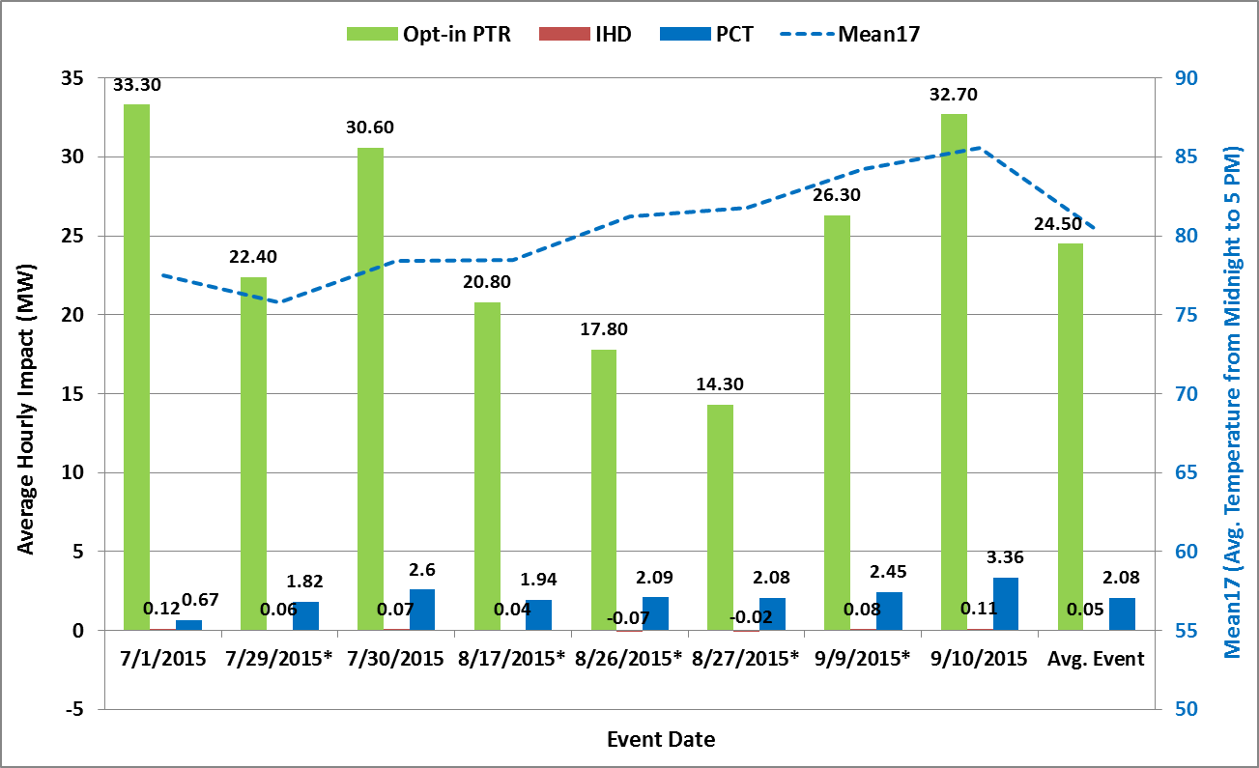
Aggregate load reductions (MW) by event day and group
* Indicates PTR events that overlap with SDP events
11

Slide 12
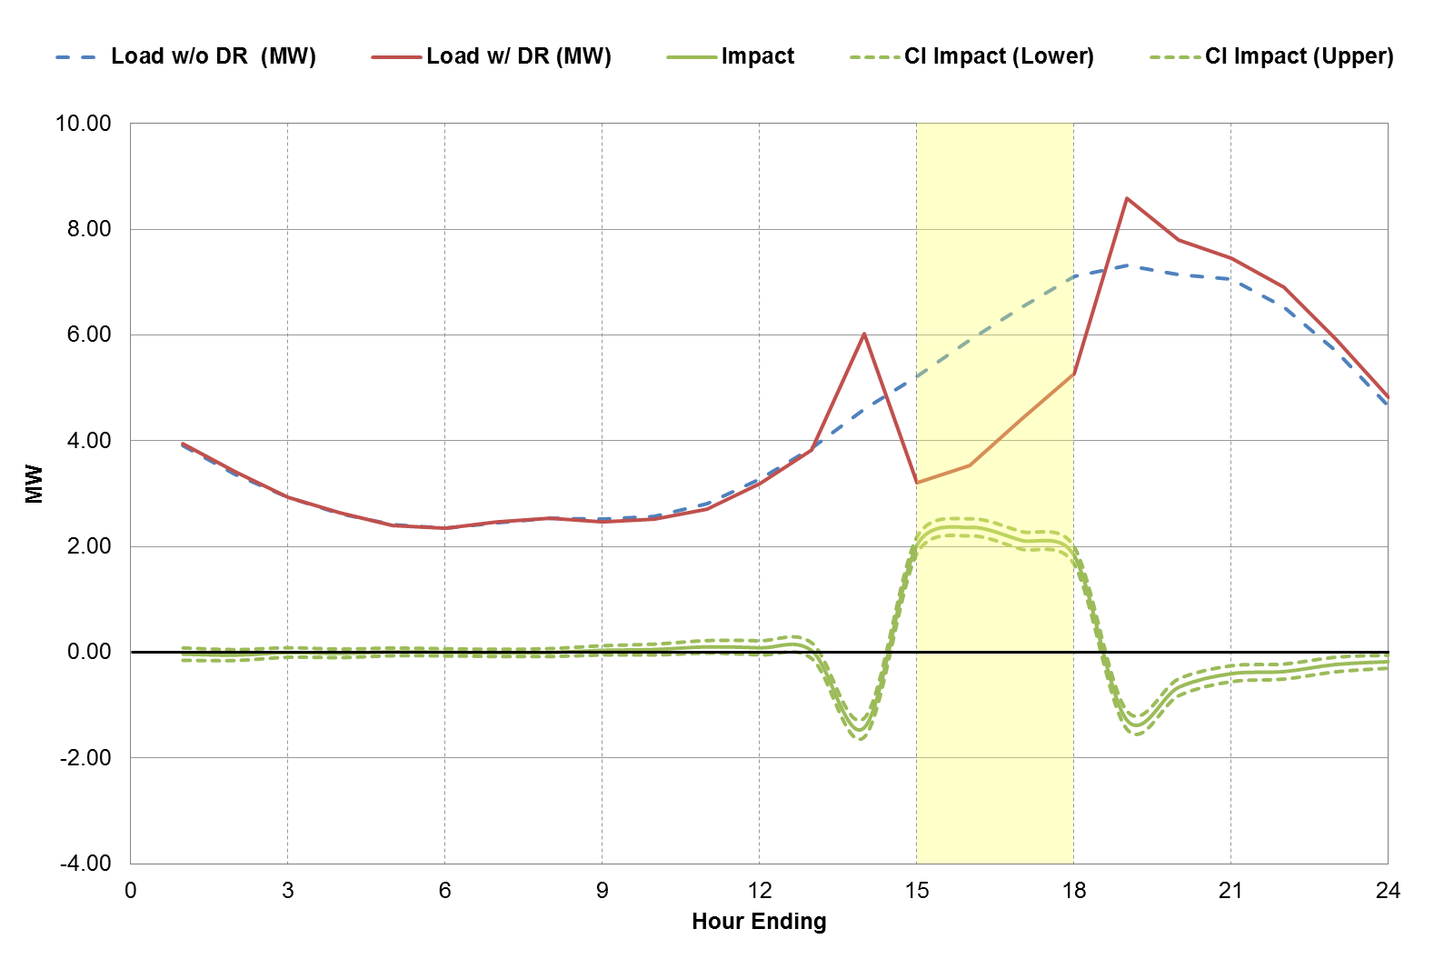
Average event aggregate ex post results for PCT customers
PCTs delivered substantial pre-cooling before the event period
In the hour before the event, the load impact was negative 31% (-1.42 MW) (i.e., there was a large increase in cooling load before the event began, intended to mitigate discomfort during the event period)
Similarly, the load impact was negative 17% (-1.27 MW) during the first hour after the event to make up for the increase in temperature during the event period
Overall energy use throughout the day was 3.8% lower
Avg. Load Reduction for Event Window (MW): 2.08
% Load Reduction for Event Window: 33.7%
12
Notes:
The event start time of 2 PM results in the precooling occurring during the hour starting at 1 PM, which is inside the Resource Adequacy (RA) window of 1 PM to 6 PM

Slide 13
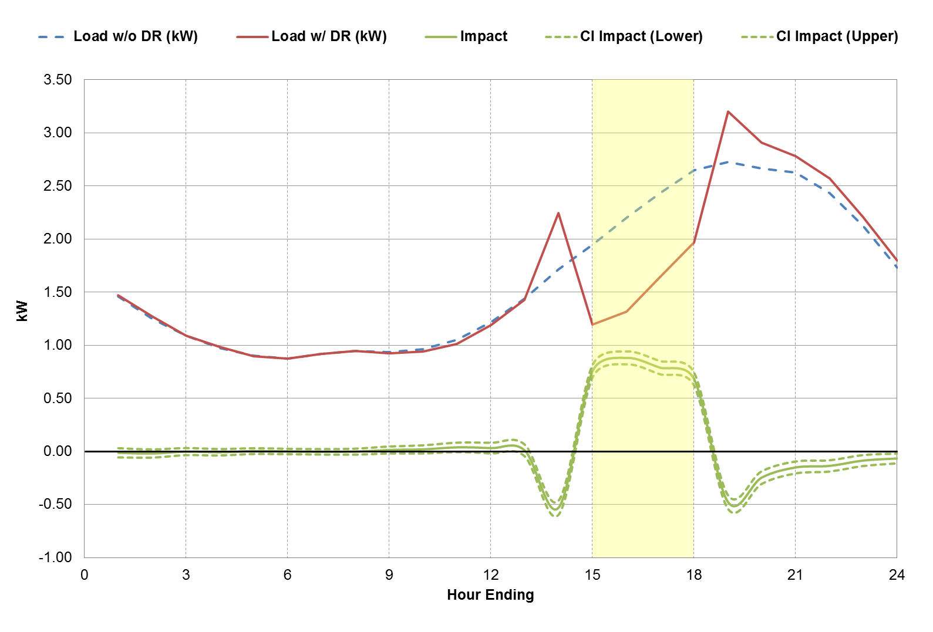
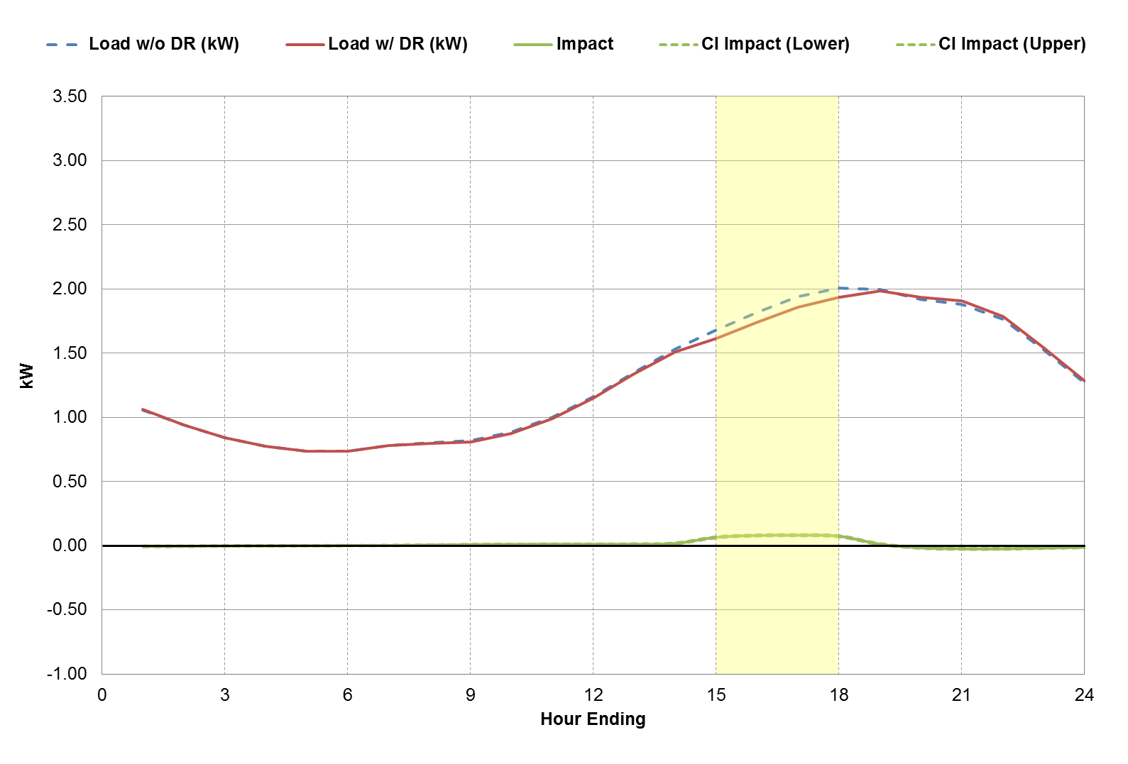
Comparing PCT vs Opt-in PTR load impacts
PCT | Opt-in PTR
Avg. Load Reduction for Event Window (kW): 0.78 % Load Reduction for Event Window: 33.7% | Avg. Load Reduction for Event Window (kW): 0.08 % Load Reduction for Event Window: 4.1%
0.72 kW
There is a significant difference between PCT and Opt-in PTR customers
  PCT customers exhibit a 0.72 kW higher on-peak reference load

Slide 14
Ex Ante Methodology

Slide 15
Overview of ex ante methodology
Ex ante load impacts calculated for PCT customers only
  IHD customers not included because it is a pilot study and not expected to become a full scale program
  Opt-in PTR customers not included because the portion of the program without technology (i.e., PCTs) was expected to be decommissioned in 2016— after filing the load impacts it was determined the program will likely remain in operation for one additional year due to the Aliso Canyon gas leak
Ex ante impact estimates are based on:
Ex post estimates calculated by LCA (Only impacts from 2015 were used to estimate the ex ante model)
Regression model developed to explain hourly ex post impacts as a function of temperature
The model was then used to predict hourly impacts based on the set of ex ante weather conditions
Each step was performed separately for PCT-only customers and for customers dually-enrolled in SDP
Hourly whole-house reference loads were also predicted for each set of ex ante weather conditions based on 2015 observed loads

Slide 16
Enrollment Forecast

Slide 17
Enrollment forecast for PCT customers
SCE expects significant growth in the PCT customer segment over the planning horizon as customer adoption of PCT (smart thermostat) technology is expected to increase significantly in coming years
  By the end of year 2026, SCE expects to have approximately 106,000 PCT customers on the program.
2015 year-ending enrollment: 4,238
The difference between 2015 year-end and 2016 year-beginning enrollments is driven by targeted marketing efforts as the PTR program focuses on PCT-enabled customers
Year | Year-Beginning Enrollment | Net Incremental Enrollment | Year-Ending Enrollment
2016 | 4,710 | 12,035 | 16,745
2017 | 16,745 | 8,279 | 25,024
2018 | 25,024 | 13,945 | 38,969
2019 | 38,969 | 8,409 | 47,378
2020 | 47,378 | 8,409 | 55,787
2021 | 55,787 | 8,409 | 64,196
2022 | 64,196 | 8,409 | 72,605
2023 | 72,605 | 8,409 | 81,014
2024 | 81,014 | 8,409 | 89,423
2025 | 89,423 | 8,409 | 97,832
2026 | 97,832 | 8,409 | 106,241

Slide 18
Ex Ante Results

Slide 19
PCT ex ante load impact estimates for August (2017 & 2026)
Weather Year | Program Year | Average per Customer (kW) | Aggregate PCT-only (MW) | Aggregate Dually-enrolled (MW) | Total Aggregate (MW) | Total Enrollment
SCE 1-in-2 | 2017 | 0.52 | 9.2 | 3.1 | 12.3 | 23,644
 | 2026 |  | 40.8 | 13.9 | 54.7 | 104,839
CAISO 1-in-2 | 2017 | 0.51 | 9.0 | 3.0 | 12.1 | 23,644
 | 2026 |  | 40.1 | 13.5 | 53.6 | 104,839
In 2014, the ex ante estimates for August 2017 under SCE 1-in-2 weather conditions were:
  Average per customer: 0.41 kW
  Aggregate: 5.7 MW
The difference is driven by:
  The higher average ex post load impacts for 2015 relative to 2014
  The forecasted enrollment used in the 2015 analysis represents an increase of almost 9,700 customers compared to the enrollment used in 2014
Notes:
Talking point- difference between SCE-specific and CAISO specific impacts are negligible

Slide 20
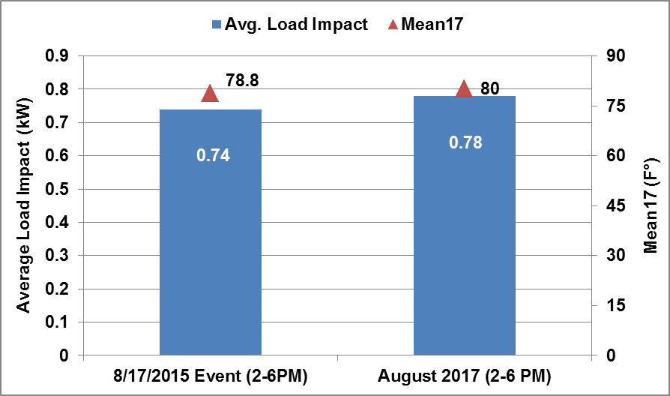
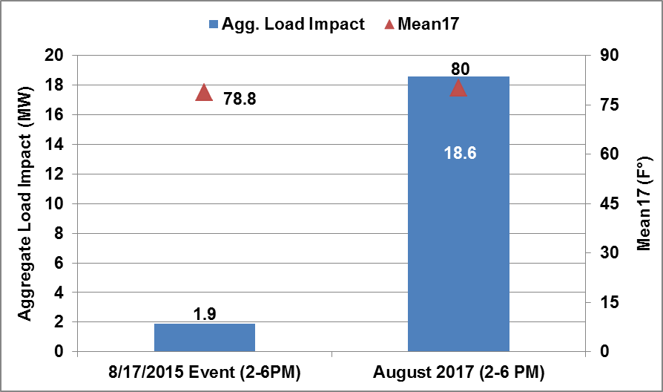
Comparison of PCT ex post and August 2017 ex ante estimates under SCE 1-in-2 weather conditions
Average Load Impact
Aggregate Load Impact
August 2017 temperatures under 1-in-2 conditions are most similar to the temperatures for the August 17, 2015 event
  As expected, the average 2-6 PM impacts are very similar, with the event ex post impacts slightly smaller due to the slightly cooler temperature
When scaled by the number of participants, the August 2017 estimated aggregate load impacts are much larger due to the 23,644 forecasted participants compared to the 2,619 customers participating on the August 17, 2015 event day
Notes:
If you scale the August 17, 2015 average load impact (.74 kW) by the August 2017 enrollment forecast (23,644), the expected aggregate load impact would be 17.5 MW

Slide 21
Ex Post Results for Program Subgroups

Slide 22
Opt-in PTR ex post load impact estimates by customer category for the average event (2-6 PM)
Customer Category | Number of Customers | Avg. Reference Load (kW) | Avg. Load w/ DR (kW) | Avg. Load Impact (kW) | % Load Impact | % of Aggregate Load Impact | Heat Buildup (Avg. °F, 12 AM to 5 PM)
LCA - LA Basin | 269,026 | 1.84 | 1.77 | 0.07 | 3.8% | 78% | 80.5
LCA - Outside LA Basin | 23,837 | 2.08 | 1.97 | 0.11 | 5.1% | 10% | 81.3
LCA - Ventura | 31,818 | 1.87 | 1.78 | 0.09 | 4.9% | 12% | 78.7
Region - South of Lugo | 95,244 | 2.15 | 2.08 | 0.07 | 3.3% | 28% | 82.8
Region - South Orange County | 37,545 | 1.35 | 1.31 | 0.05 | 3.3% | 7% | 77.3
Region - Neither | 191,892 | 1.82 | 1.73 | 0.08 | 4.6% | 65% | 79.8
Non-SDP | 290,935 | 1.81 | 1.74 | 0.07 | 3.7% | 79% | 80.2
SDP | 89,991 | 2.26 | 2.10 | 0.16 | 7.2% | 60% | 81.3
Non-CARE | 214,177 | 1.94 | 1.87 | 0.07 | 3.7% | 62% | 80.0
CARE | 110,504 | 1.71 | 1.63 | 0.08 | 5.0% | 38% | 81.0
Avg. kW Less than 1 kW | 231,361 | 1.32 | 1.25 | 0.07 | 5.2% | 65% | 79.8
Avg. kW More than 1 kW | 93,320 | 3.25 | 3.16 | 0.09 | 2.8% | 35% | 81.7
Alert Type - Text Only | 71,533 | 1.97 | 1.86 | 0.11 | 5.6% | 32% | 80.7
Alert Type - Phone Only | 29,834 | 1.69 | 1.57 | 0.13 | 7.5% | 15% | 80.1
Alert Type - Email Only | 223,314 | 1.85 | 1.79 | 0.06 | 3.1% | 52% | 80.3
Non-NEM | 307,469 | 1.88 | 1.80 | 0.07 | 3.9% | 93% | 80.3
NEM | 17,212 | 1.47 | 1.36 | 0.10 | 7.1% | 7% | 81.6
Non-SDP Non-NEM | 276,556 | 1.82 | 1.76 | 0.06 | 3.5% | 73% | 80.2
Non-SDP NEM | 14,379 | 1.45 | 1.35 | 0.10 | 6.9% | 6% | 81.5
SDP Non-NEM | 82,437 | 2.31 | 2.15 | 0.17 | 7.2% | 56% | 81.3
SDP NEM | 7,554 | 1.57 | 1.46 | 0.12 | 7.3% | 4% | 81.7
All Customers | 324,681 | 1.86 | 1.79 | 0.08 | 4.1% | 100% | 80.4
Notes:
The number of customers reflects the average event results. The average event is comprised of a combination of PTR events with and without a concurrent SDP event. With concurrent SDP events, the SDP customers are not included as participants for the PTR event. Based off this situation, the number of customers for the aggregate level results for the average event day will not reflect the total population of each of the sub-groups of enrolled customers.

Slide 23
Recommendations and Conclusions

Slide 24
Recommendations and Conclusions
PTR program is dispatched from 2-6 PM, whereas the resource adequacy (RA) hours are from 1-6 PM
PCTs precool during the hour before the program event, resulting in a significant negative load impact during the first hour of the RA window calculation
  Difference in the average hourly load impact between the program event window and the RA window is 0.26 kW
  This difference results in a nearly 33% lower average hourly impact for the RA window directly attributable to the timing of the program event hours relative to the RA hours
Given that SCE plans to only include PCT-enabled customers moving forward with the PTR program, Nexant recommends SCE take this issue into consideration for any future changes in program design

Slide 25
For comments or questions, contact:
Dr. Eric Bell
Managing Consultant
EBell@nexant.com
Nexant, Inc.
101 Second St., Ste 1000
San Francisco, CA 94105
(415) 369-1197

Slide 26
Appendix

Slide 27
Brief history of SPD (PTR) program eligibility
Program Overview
In 2012 and 2013, PTR was the default rate option for residential customers with a smart meter (nearly everyone was eligible for a rebate)
Additionally, SCE encouraged residential customers to directly enroll in notifications of PTR events by email, text message and/or phone
My Account customers were defaulted onto email PTR notifications
Default notification customers were ultimately contacted and asked if they would like to opt-in for PTR notifications, dropping non-responsive and declining customers from the program
Starting in 2014, SCE required that residential customers directly enroll in the SPD program to receive notification in order to receive PTR credits

Slide 28
Evaluation objectives
Evaluation Objectives
Ex post
  Estimate hourly load reductions on the eight 2015 PTR event days (aggregate and per-customer level)
  Estimate load reductions for each SCE local capacity area (LCA) and for areas affected by the SONGS closure (South of Lugo and Southern Orange County)
Ex ante
  Forecast 2016–2025 PTR hourly ex ante load impacts for a 1-in-2 and 1-in-10 weather year by month, coincident with SCE and CAISO monthly system peak conditions (aggregate and per-customer level)
  Estimate ex ante load reductions for each LCA and for areas affected by the SONGS closure
Customer Segment | Ex Post | Ex Ante
Opt-in PTR | ✓
IHD | ✓
PCT | ✓ | ✓

Slide 29
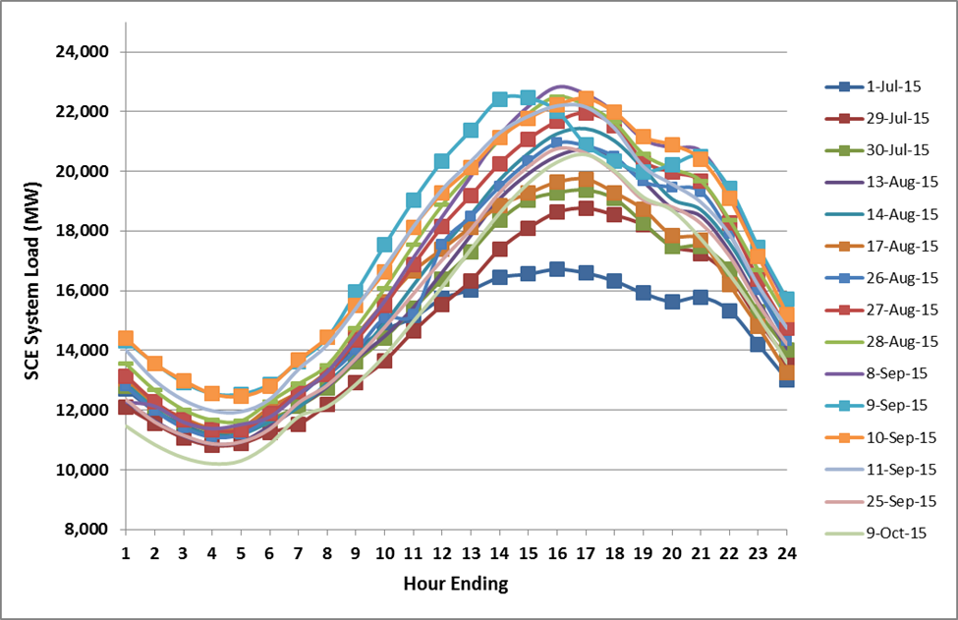
Matched control group
Ex Post Methodology
There were many non-event weekdays with similar load as event days, which is ideal for developing a matched control group
*PTR event days are marked by squares

Slide 30
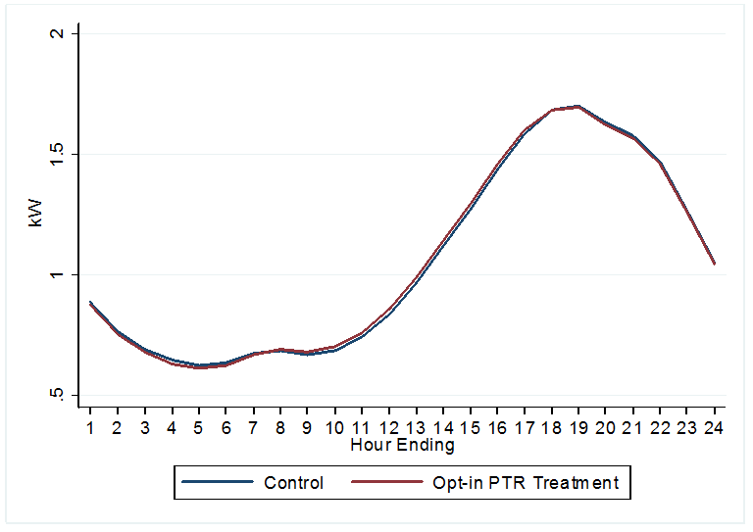
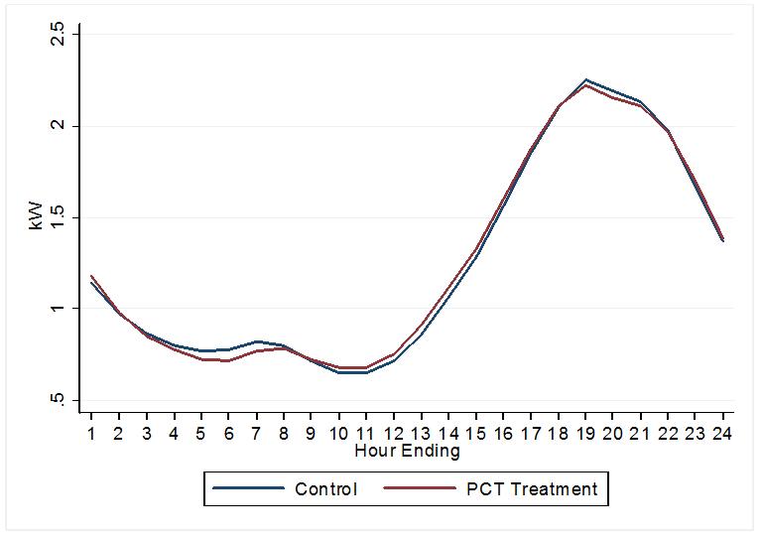
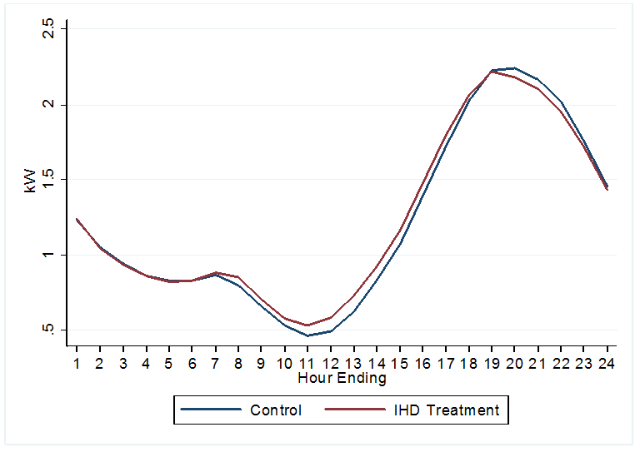
Matching results
Ex Post Methodology
Report includes many validations to show that the model produced accurate estimates
Difference-in-differences was used to calculate impacts, but the magnitude of the adjustment was small
30

Slide 31
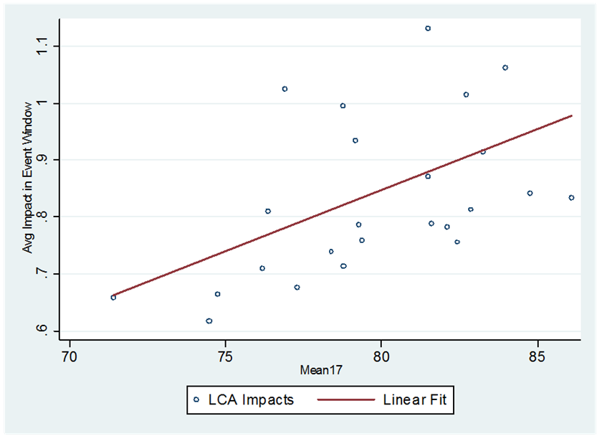
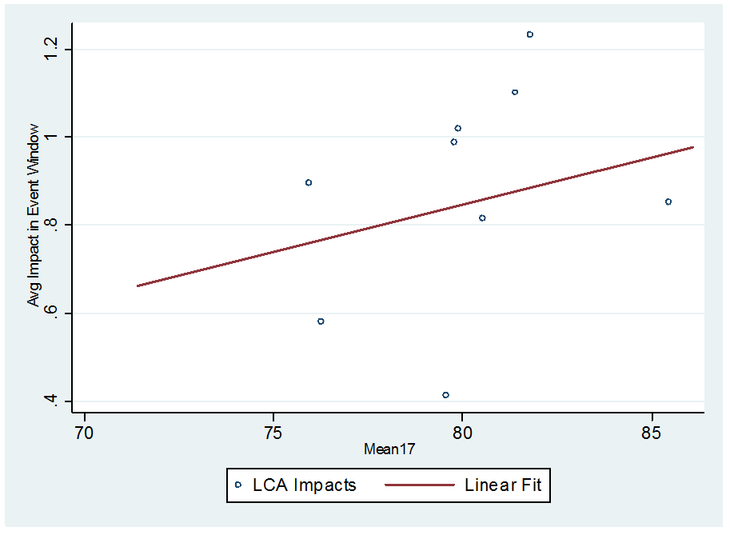
Ex post impacts versus Mean17 for PCT customers
Ex Ante Methodology
Population Weighted Ex Post Impacts versus Mean17 for PCT-Only Customers
Population Weighted Ex Post Impacts versus Mean17 for Customers Dually Enrolled with SDP

Slide 32
Relationship between ex post and ex ante estimates
(PCT-only plus dually enrolled with SDP)
Ex Ante Results
Factor | Aggregate Load Impact (MW) | Explanation
Ex-Post Impact | 2.08 | Combined PCT-only & dually enrolled with SDP
Ex-Post Impact with Ex-Ante Enrollment* | 13.1 | 2016 enrollment is projected to increase considerably compared to 2015
Ex Ante Model Ex Post Event Window* | 14.1 | Only impacts from 2014 were used to estimate the ex ante model due to program changes
Ex Ante Model RA Event Window* | 9.5 | The event window includes an hour that is not in the RA window – reduces impacts by 33%
CAISO 1-in-2 | 8.3 | Ex post mean17 = 80.4 CAISO mean 17 = 79
SCE 1-in-2 | 7.68 | Ex post mean17 = 80.4 SCE mean 17 = 76
CAISO 1-in-10 | 9.66 | Ex post mean17 = 80.4 CAISO mean 17 = 84
SCE 1-in-10 | 9.5 | Ex post mean17 = 80.4 SCE mean 17 = 83
* Assuming 2015 average event day under SCE specific 1-in-10 conditions

