Slide 1
SCE Smart Energy Program:
2018 Load Impact Evaluation
DRMEC Workshop on the 2019 Load Impact Protocol (LIP) Report Annual Filing
April 26, 2019

Slide 2

Agenda
Smart Energy Program overview
Ex post methodology
Ex post results
Ex ante methodology
Ex ante results
Conclusions and recommendations

Slide 3
Smart Energy Program (SEP) Description
Load impacts are achieved through SCE-approved but customer-installed programmable communicating thermostats (PCTs)
SEP events are called by SCE and dispatched by the PCT manufacturers by remotely raising participants’ cooling setpoints
  Event length: 1-4 hours in duration between 11:00 AM and 8:00 PM
  Availability: Non-holiday weekdays, year-round
  Restrictions: No more than four hours of load control per day
  Notification: PCT manufacturers are now given 20 minutes day-of notice, rather than day-ahead – precooling no longer feasible
  Dual-enrollment: Customers are no longer permitted to dually enroll with SDP
Customers receive sign-up and capacity payments as incentives to participate
  Incentives are paid as bill credits on June through September bills
  Energy payments are eliminated in 2019 but were in place through 2018
Notes:
Prior availability was 2:00 PM – 6:00 PM
Signup payment: $75
Capacity payment: Up to $40 per year, or $0.3275 per summer season enrolled day
Bundled customers are eligible to participate

Slide 4
Summary of 2018 SEP Events
Date | Day of Week | Dispatch Protocol | Event Start | Event Stop | Event Duration | Average Event Temp. (°F) | Heat Buildup Avg. 12 AM to 5 PM (°F) | Number of Customers
6/8/2018 | Friday | M&E/Test | 2:00 PM | 4:00 PM | 2:00 | 71.8 | 70.9 | 44,848
8/7/2018 | Tuesday | Economic | 2:00 PM | 6:00 PM | 4:00 | 83.5 | 82.9 | 48,748
9/13/2018 | Thursday | Economic | 2:00 PM | 6:00 PM | 4:00 | 74.2 | 73.2 | 51,288
9/14/2018 | Friday | Economic | 2:00 PM | 6:00 PM | 4:00 | 76.5 | 76.0 | 51,344
9/20/2018 | Thursday | Economic | 2:00 PM | 6:00 PM | 4:00 | 71.1 | 71.2 | 51,565
10/2/2018 | Tuesday | Economic | 2:00 PM | 6:00 PM | 4:00 | 73.3 | 74.4 | 52,498

Slide 5
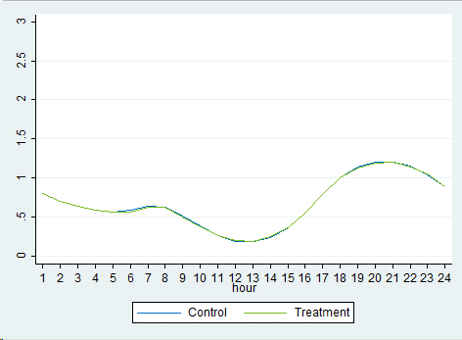
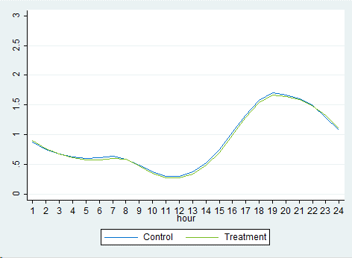
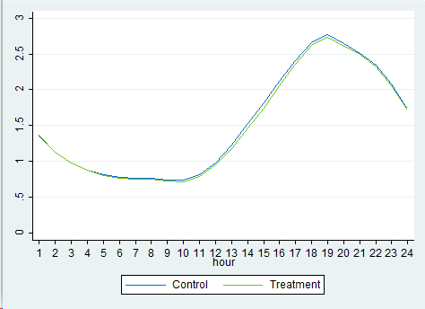
Ex Post Methodology
Matched control group selected based on 15 proxy days close in temperature to actual event days
  Each customer was matched for hot, moderate, and cold event days
Propensity score matching was performed to select control groups
Each participant was matched to a non-participant in the same Abank and with the same CARE status
Used difference-in-differences fixed effects regression model to estimate impacts
Cool
Moderate
High
Notes:
-Matched over Abank and care status
-cold matched on kw1-kw3 kw7 kw15-kw18 kw22-kw23
-mod matched on kw8-kw21 total_kwh nem status
-hot matched on kw6-kw7 kw12 kw17-kw20 kw23
Control and treatment customers were matched by load shape to ensure that any observed impacts on load are due to program effects
Since program events were called across a wide range of temperatures, we compared behavior on cold, moderate and hot days

Slide 6
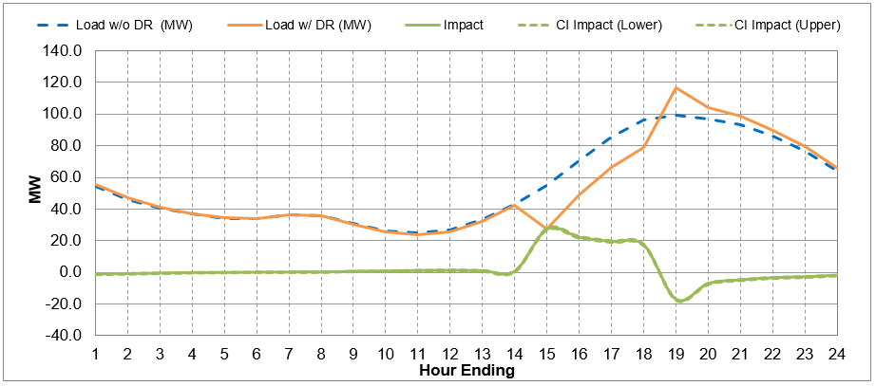
2018 Ex Post Impacts
Event Date | Number of Customers | Heat Buildup Avg. 12 AM to 5 PM (°F) | Avg. Reference Load (kW) | Avg. Load w/ DR (kW) | Avg. Load Impact (kW) | % Load Impact | Snapback (kW) | Aggregate Load Impact (MW)
*6/8/2018 | 44,848 | 70.9 | 0.58 | 0.53 | 0.06 | 9.6% | -0.03 | 2.5
9/20/2018 | 51,565 | 71.2 | 1.13 | 0.80 | 0.34 | 29.7% | -0.09 | 17.3
9/13/2018 | 51,288 | 73.2 | 1.32 | 0.92 | 0.40 | 30.1% | -0.13 | 20.3
10/2/2018 | 52,498 | 74.4 | 1.04 | 0.77 | 0.27 | 26.1% | -0.10 | 14.2
9/14/2018 | 51,344 | 76.0 | 1.56 | 1.18 | 0.37 | 24.0% | -0.11 | 19.2
8/7/2018 | 48,748 | 82.9 | 2.54 | 1.80 | 0.74 | 29.3% | -0.19 | 36.3
Average Event | 51,089 | 75.4 | 1.50 | 1.08 | 0.42 | 27.9% | -0.12 | 21.5
Average Event Day
*6/8 TEST EVENT NOT INCLUDED IN AVERAGE EVENT CALCULATON

Slide 7
2018 vs. 2017 Ex Post Impacts
2018 Ex Post Summary
Event Date | Number of Customers | Heat Buildup Avg. 12 AM to 5 PM (°F) | Avg. Reference Load (kW) | Avg. Load w/ DR (kW) | Avg. Load Impact (kW) | % Load Impact | Snapback (kW) | Aggregate Load Impact (MW)
*6/8/2018 | 44,848 | 70.9 | 0.58 | 0.53 | 0.06 | 9.6% | -0.03 | 2.5
9/20/2018 | 51,565 | 71.2 | 1.13 | 0.80 | 0.34 | 29.7% | -0.09 | 17.3
9/13/2018 | 51,288 | 73.2 | 1.32 | 0.92 | 0.40 | 30.1% | -0.13 | 20.3
10/2/2018 | 52,498 | 74.4 | 1.04 | 0.77 | 0.27 | 26.1% | -0.10 | 14.2
9/14/2018 | 51,344 | 76.0 | 1.56 | 1.18 | 0.37 | 24.0% | -0.11 | 19.2
8/7/2018 | 48,748 | 82.9 | 2.54 | 1.80 | 0.74 | 29.3% | -0.19 | 36.3
Average Event | 51,089 | 75.4 | 1.50 | 1.08 | 0.42 | 27.9% | -0.12 | 21.5
*6/8 EVENT NOT INCLUDED IN AVERAGE EVENT CALCULATON
SEP performed nearly identically in 2018 vs. 2017…
  Same % load reduction
  Same MW
… However, that is despite a large increase in the number of enrolled customers
2018 SEP events were much cooler on average than 2017
  Mean17 of 75.4 vs 81.4 (°F)
Cooler temperatures lead to lower reference loads and lower load impacts
  Ref. load 1.50 kW vs. 2.31 kW
  Load imp. 0.42 kW vs. 0.64 kW
2017 Ex Post Summary
Event Date | Number of Customers | Heat Buildup Avg. 12 AM to 5 PM (°F) | Avg. Reference Load (kW) | Avg. Load w/ DR (kW) | Avg. Load Impact (kW) | % Load Impact | Snapback (kW) | Aggregate Load Impact (MW)
7/31/2017 | 36,066 | 76.5 | 1.83 | 1.26 | 0.57 | 31.1% | -0.15 | 20.6
6/19/2017 | 31,036 | 76.9 | 1.86 | 1.23 | 0.63 | 33.7% | -0.16 | 19.4
6/21/2017 | 25,965 | 77.5 | 1.94 | 1.33 | 0.60 | 31.1% | -0.13 | 15.6
9/5/2017 | 39,141 | 77.7 | 1.90 | 1.32 | 0.58 | 30.4% | -0.16 | 22.7
6/20/2017 | 31,231 | 78.4 | 2.02 | 1.39 | 0.64 | 31.5% | -0.19 | 19.9
7/6/2017 | 32,792 | 79.3 | 2.07 | 1.40 | 0.67 | 32.3% | -0.13 | 21.9
8/1/2017 | 30,333 | 79.7 | 2.18 | 1.49 | 0.69 | 31.8% | -0.19 | 21.0
8/28/2017 | 32,515 | 80.3 | 2.46 | 1.78 | 0.68 | 27.6% | -0.13 | 22.1
8/2/2017 | 35,408 | 82.2 | 2.08 | 1.64 | 0.44 | 21.0% | -0.21 | 15.4
8/3/2017 | 36,460 | 83.1 | 2.33 | 1.63 | 0.70 | 30.0% | -0.28 | 25.5
8/29/2017 | 38,953 | 83.7 | 2.71 | 1.98 | 0.73 | 26.8% | -0.29 | 28.3
7/7/2017 | 32,916 | 84.1 | 2.53 | 1.85 | 0.68 | 26.7% | -0.27 | 22.2
8/30/2017 | 39,031 | 85.1 | 2.77 | 2.04 | 0.73 | 26.3% | -0.24 | 28.4
8/31/2017 | 37,160 | 86.2 | 2.76 | 2.09 | 0.67 | 24.2% | -0.18 | 24.8
9/1/2017 | 32,799 | 87.8 | 2.94 | 2.31 | 0.63 | 21.4% | -0.20 | 20.7
Avg. 2017 Event | 34,120 | 81.4 | 2.31 | 1.66 | 0.64 | 27.8% | -0.21 | 21.9

Slide 8
Ex Ante Assumptions
Enrollment expected to increase from 52,795 in October 2018 to 192,970 in 2029
The evaluation specifically projects load impacts expected to be observed during the resource adequacy (RA) window
  The summer RA window has shifted from 1-6 PM to 4-9 PM
  The winter RA window is remains unchanged at 4-9 PM
RA Window | Hour Ending
 | 14 | 15 | 16 | 17 | 18 | 19 | 20 | 21
Previous RA Window (Apr - Oct)
Previous RA Window (Nov - Mar)
Current RA Window

Slide 9
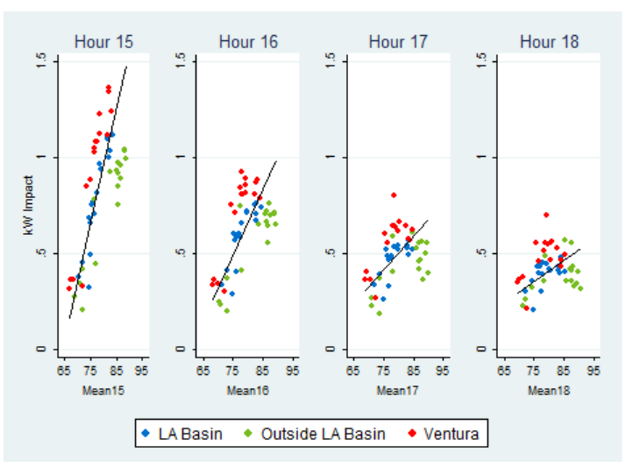
Ex Post Load Impacts vs. Weather
We estimate ex ante load impacts for each hour as a function of heat buildup
We note a behavioral component unique to SEP that we don’t see in SCE’s direct load control program (SDP):
  Downward trend in magnitude across the four event hours
  Downward trend in weather responsiveness across the four event hours
Event fatigue, potentially occupancy? SDP does not show this strong an effect and they would be likely be subject to the same occupancy patterns.

Slide 10
Per customer load impacts – SCE 1-in-2 and 1-in-10 Weather Conditions (kW)
SCE Weather Year | Month
 | May | June | July | August | September | October
1-in-2 | 0.45 | 0.50 | 0.53 | 0.66 | 0.60 | 0.59
1-in-10 | 0.69 | 0.64 | 0.66 | 0.73 | 0.79 | 0.65
Aggregate load impacts – SCE 1-in-2 and 1-in-10 Weather Conditions (MW) – 2019 Enrollment
SCE Weather Year | Month
 | May | June | July | August | September | October
1-in-2 | 28.54 | 31.58 | 33.94 | 42.13 | 37.81 | 37.21
1-in-10 | 43.63 | 40.55 | 42.15 | 46.42 | 50.22 | 41.38

Slide 11
Typical Event Day Aggregate Impacts for SCE 1-in-10 Weather Conditions (MW)

Slide 12
Comparison to PY 2017 ex ante load impacts
– per customer impacts for SCE 1-in-10 Weather Conditions (kW)
The PY 2017 evaluation estimated SEP as capable of delivering 163 MW on a SCE 1-in-10 September peak day
The PY 2018 evaluation estimated 153 MW for the same scenario
The difference reflects the net effect of three changes:
  RA window change
  Enrollment forecast
  New PY 2018 ex post data

Slide 13
RA Window Change
By moving the summer RA window later in the day, there’s more load to shed (example here is SCE 1-in-10) :
Hour | Avg. Customer kW Impact
 | Previous RA Window | Current RA Window
14 | 0.8
15 | 1.0
16 | 0.7
17 | 0.5 | 1.3
18 | 0.4 | 0.9
19 |  | 0.6
20 |  | 0.4
21 |  | 0.4
Avg. Hour in RA Window | 0.70 | 0.73

Slide 14
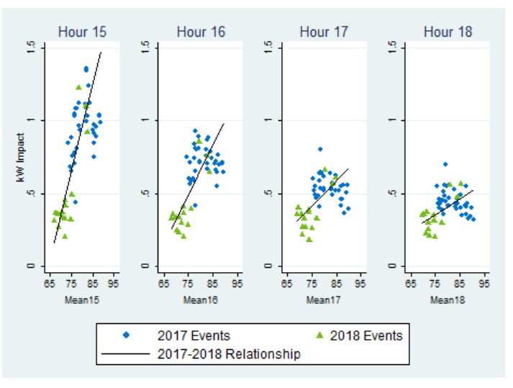
Enrollment and New Information Changes
The PY 2017 evaluation projected 229,000 enrolled customers in 2028; the PY 2018 evaluation projects 192,970 enrolled customers in 2029.
The PY 2018 events added impacts to the ex ante estimation dataset that were much cooler than the PY 2017 events – the new relationship was steeper (lower impacts at cooler temperatures and higher impacts at hotter temperatures)

Slide 15
Recommendations and Conclusions
SCE should conduct market research to understand the characteristics, sentiments, and behaviors of new SEP customers:
  How are the characteristics, sentiments and behaviors of SEP participants changing over time?
Call events under varying circumstances:
  Variety of time periods: help establish relationship between load impacts and time of day, particularly during the new RA window.
  Variety of weather conditions: calling events on cooler summer days will provide valuable data points for ex ante estimation
Vendors should provide override information:
  Help identify conditions under which customers opt out of events

Slide 16
Contact Us
Candice Potter
Principal, Utility Services
CPotter@nexant.com
(415) 640-2955

